Slide 1
Advancing Energy efficiency Through AM: A Collaborative Approach by Nikon SLM,
PRO CONTROL and Valland
CONFERENCE
ORGANIZERS

Slide 2
Advancing Energy Efficiency Through AM: A Collaborative Approach by Nikon SLM,
PRO CONTROL and Valland
Fabrizio Ragusa | Global Business Development Director Energy, Nikon SLM Solutions
Co Author :
Manuela Marion | Business Development Manager, PRO CONTROL

Slide 3

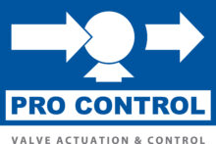
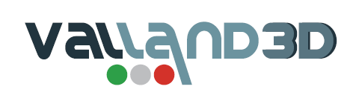
Agenda
Introduction of the companies
  Nikon SLM Solutions
  PRO CONTROL
  Valland
Why DfAM brings benefits to valve applications
How this applied to PRO CONTROL component
Conclusions

Slide 4
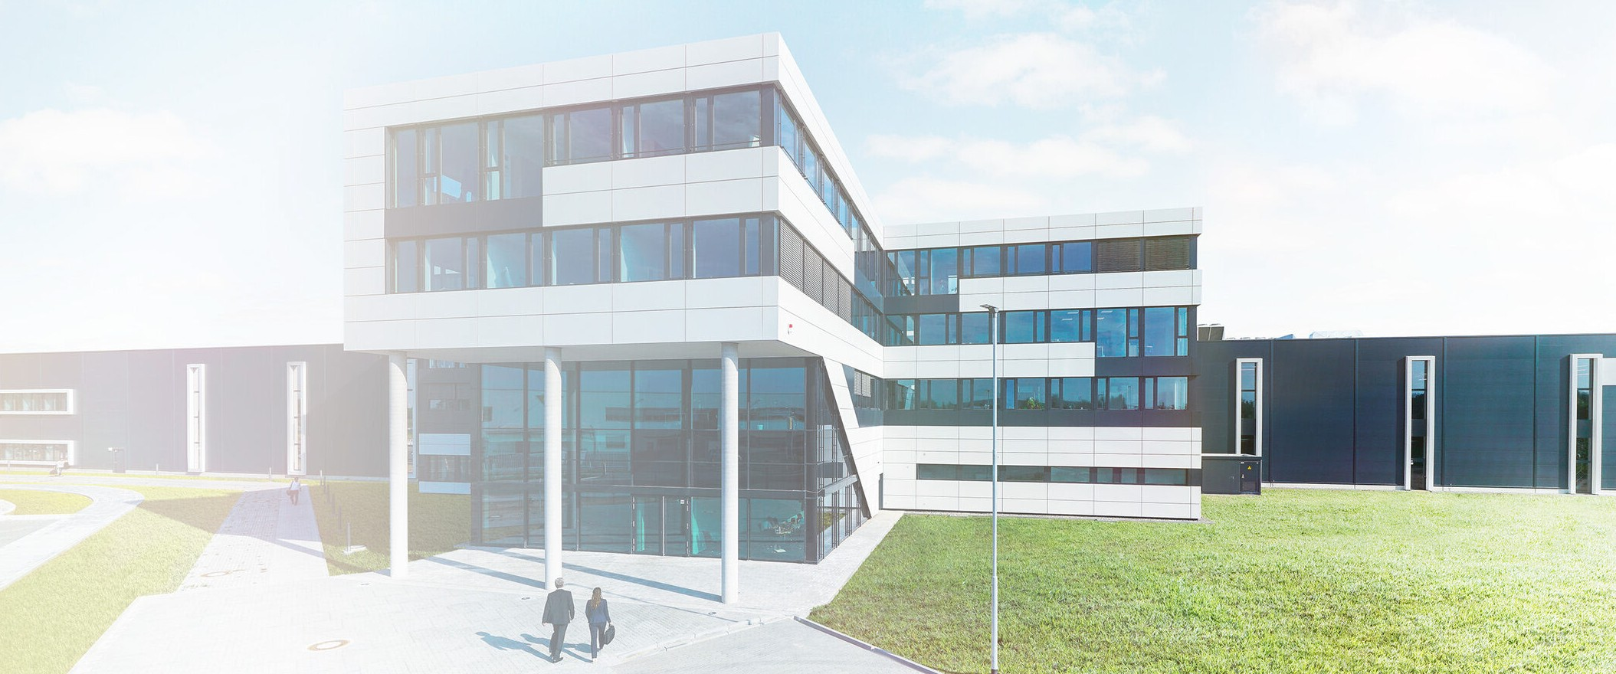
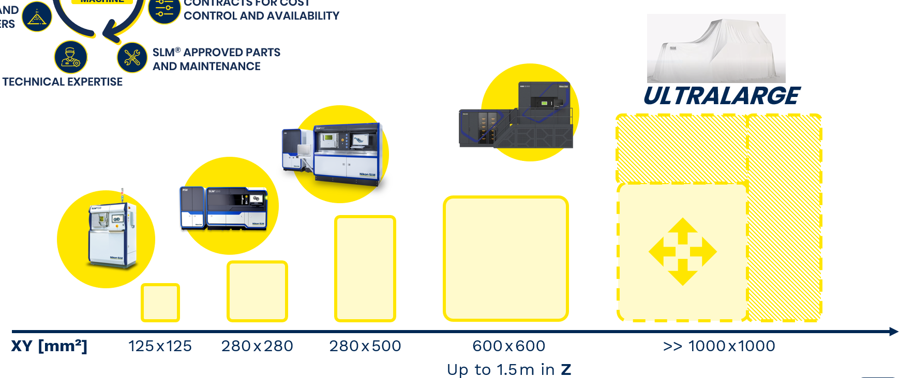
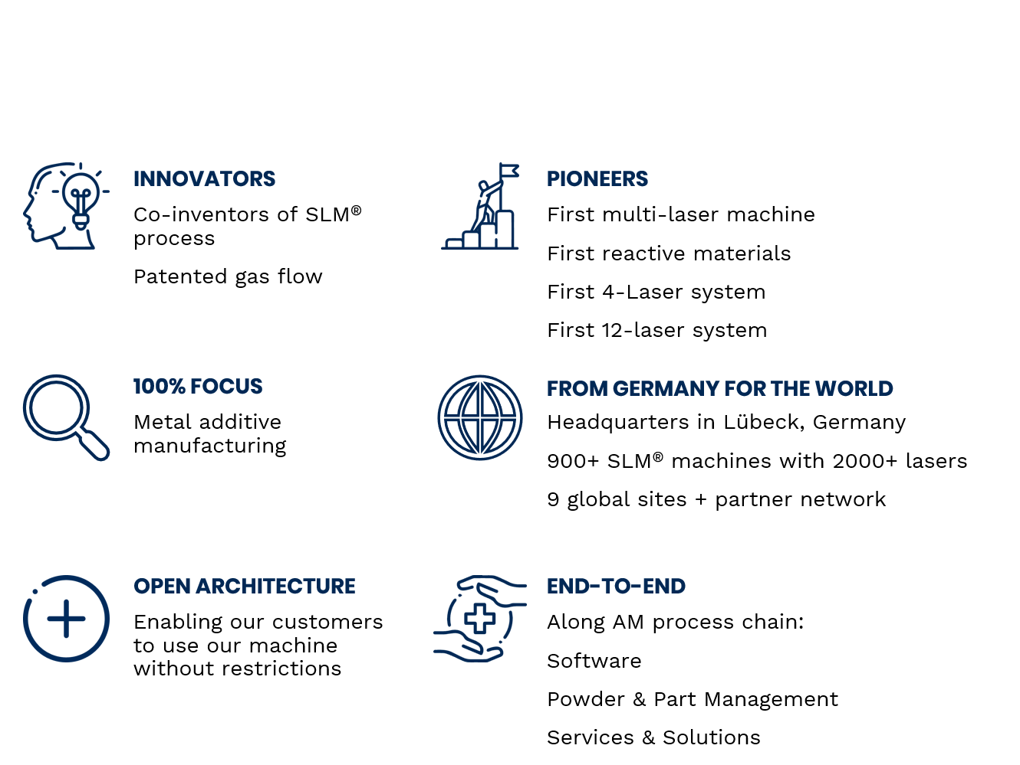




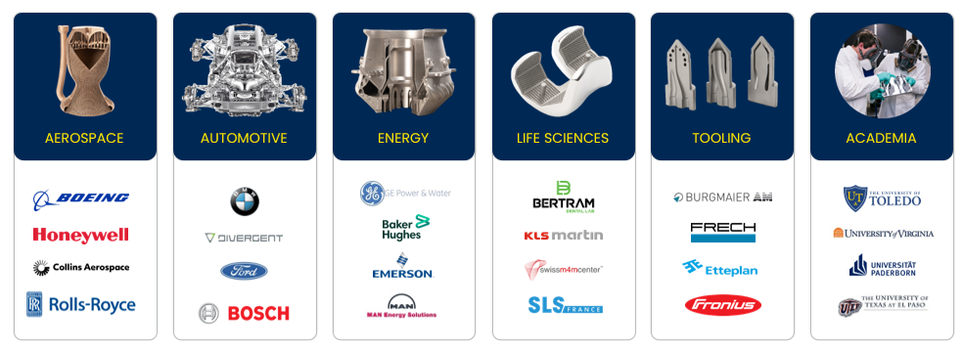

Slide 5
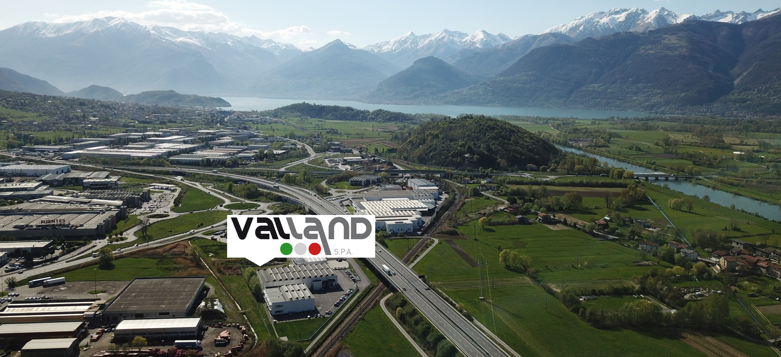
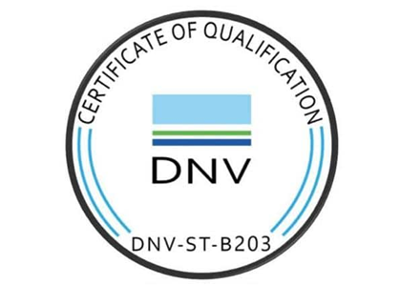
Valland S.p.A: AM for Energy Excellence
Valland3D is the Advanced Manufacturing Department of Valland S.p.A, an Italian manufacturer of high quality and tailor-made Ball, Gate and Check Valves
Timeline:
2016 → First AM tests
2020 → First polymeric 3D printer
2022 → Valland3D
Competences:
Material Science
Additive Manufacturing
Oil&Gas -> Offshore, Subsea, Severe Service
Hydrogen
Product LCA according to ISO 14044 – Carbon Footprint

Slide 6
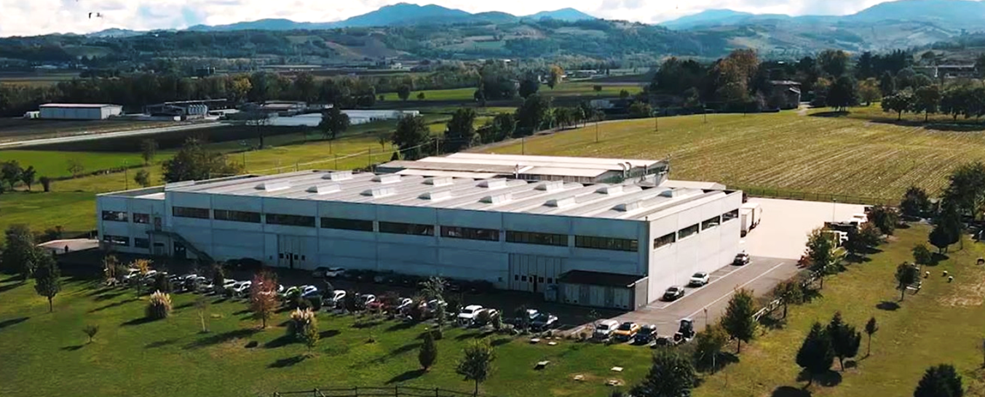

PRO CONTROL S.r.L.: Advanced
SOLUTIONS for valve operation in the
harshest applications and environments
Headquartered in Italy 2 hours far from Milano Malpensa Airport, PRO CONTROL has over 20 years experience in manufacturing complete overall solutions for valve actuation and control requirements and HIPPS systems integration for Production, Transportation and Process applications for the Energy Industries. The PRO CONTROL name signifies advanced forward-looking solutions, sustainable valve operation technologies and progressive design worldwide. At PRO CONTROL, we are always looking for the perfect match, transforming complex goals into simplified solutions to achieve maximum efficiency which means first understanding what really matters and what’s really needed, it is important to be accountable for our clients: today and tomorrow.
Meet our experts today Booth 138 Hall A

Slide 7
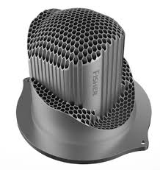
Design for AM benefits for valves
Cost is neutral with investment casting manufacturing
The big advantage is the performance improvement, better design with hydrodynamic noise reduced and at the same time higher flow capacity. Or reduce the size and keep the same flow capacity
Reduced assembly manufactured in one piece
Better design brings more sales of parts
Increase of volume –> 30K Euro 10-inch value, a customer can pay reduce 20% size valve at 30% lower cost, maintaining same performance - > customers buy more parts, approx. double
20K Euro x 200/ y – 30K Euro x 100 / y = add 1MEuro revenue!
Lead time improvement -> for titanium body valve casting 30 weeks to 12 weeks by AM, fully machined, more competitive to get the order, advantage in volume of revenue
Year 1 Revenues | Year 2 Revenues | Year 3 Revenues
100 / y -> 1M Eu | 150 /y -> 2M Eu | 200/y -> 3M Eu

Slide 8
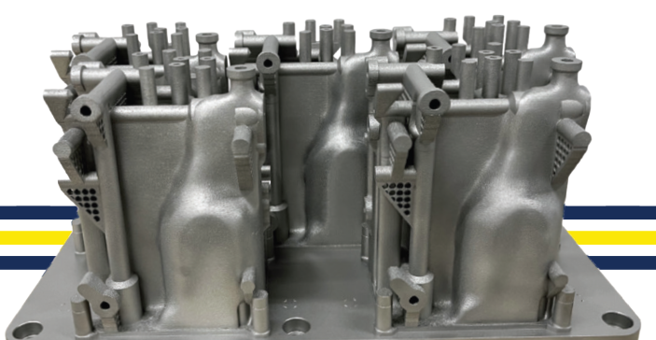
3D Hydraulic HP compact control manifold for actuators used in O&G offshore
PRO CONTROL’s 3D Hydraulic High Pressure compact control manifold has been produced by AM instead of milling.
The traditional methods posed challenges in achieving internal connections. Nikon SLM Solutions, together with Valland3D and PRO CONTROL engineering department, embarked on redesigning the manifold component.
The objectives were:
  maximize stiffness,
  reduce weight,
  optimize topology,
  cut down on production lead time,
  ensure component customization.

Slide 9
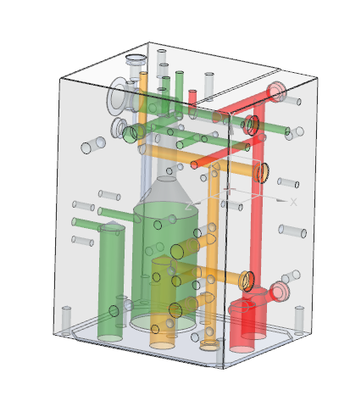
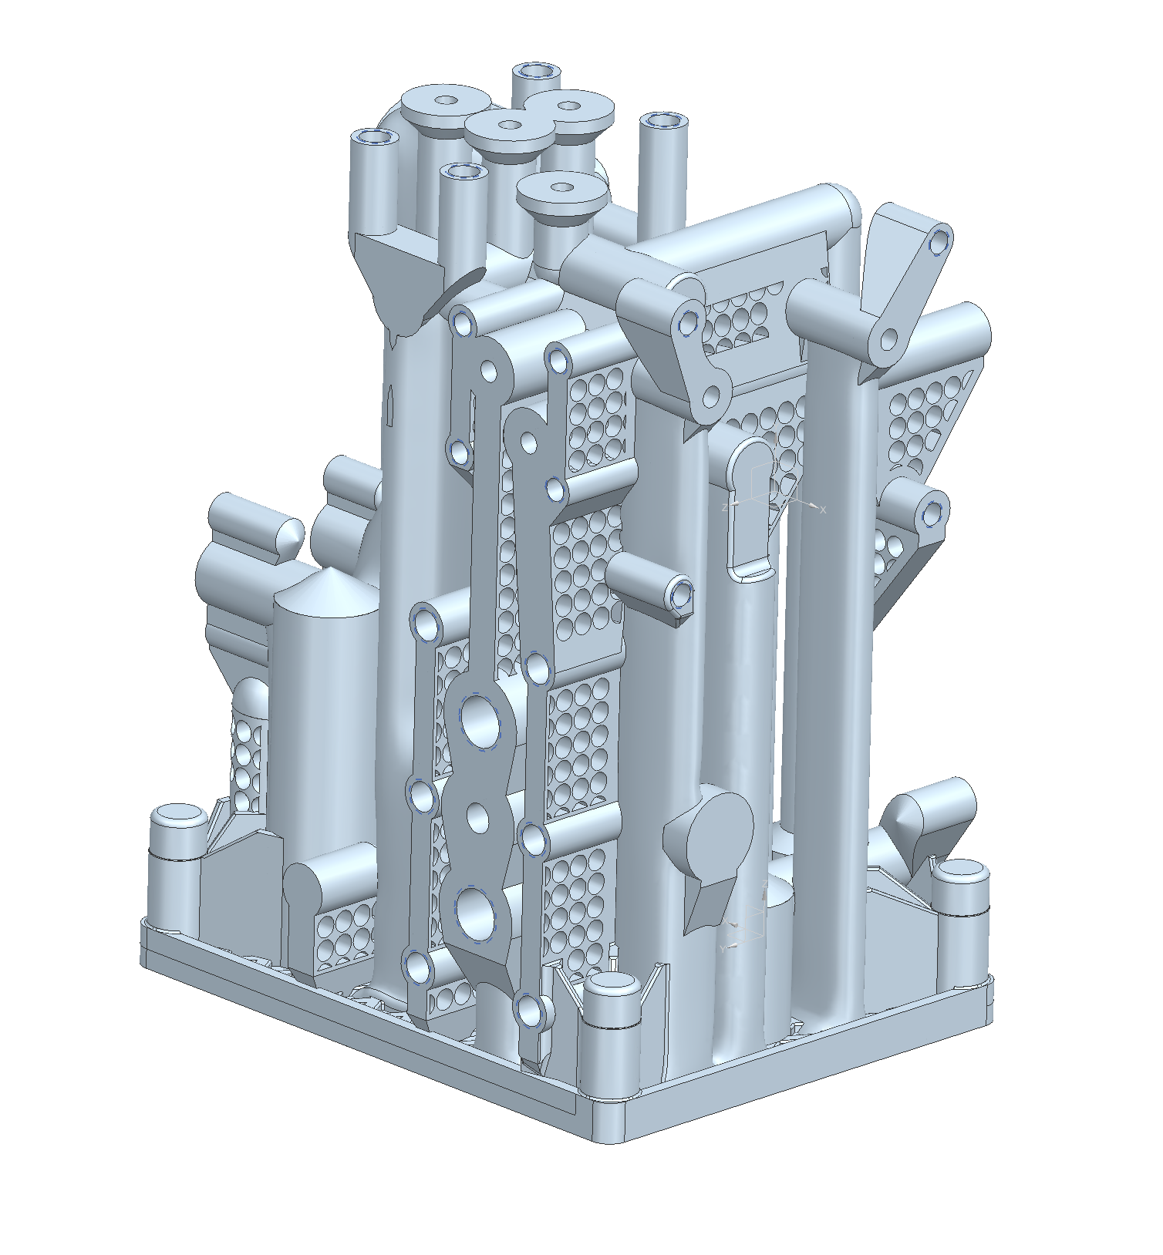

3D Hydraulic HP compact control manifold: DfAM
Maximizing stiffness, reducing weight and optimizing productivity
SLM® technology provided the tools and flexibility needed.
The freedom of design granted by AM enabled Valland to customize the component and achieve topological optimization
Environmental impact improvements in the entire lifecycle due to weight/material reduction, improved efficiency, spare part inventory reduction

Slide 10
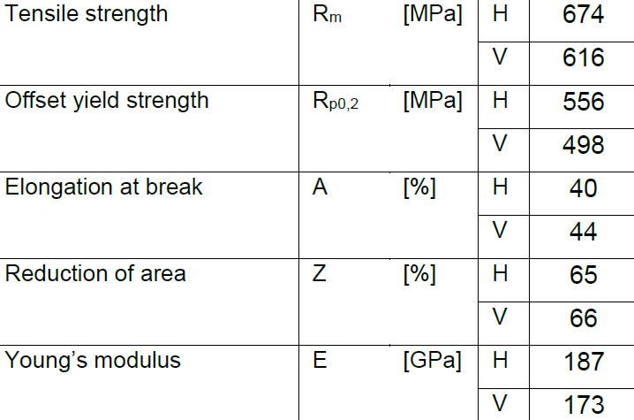
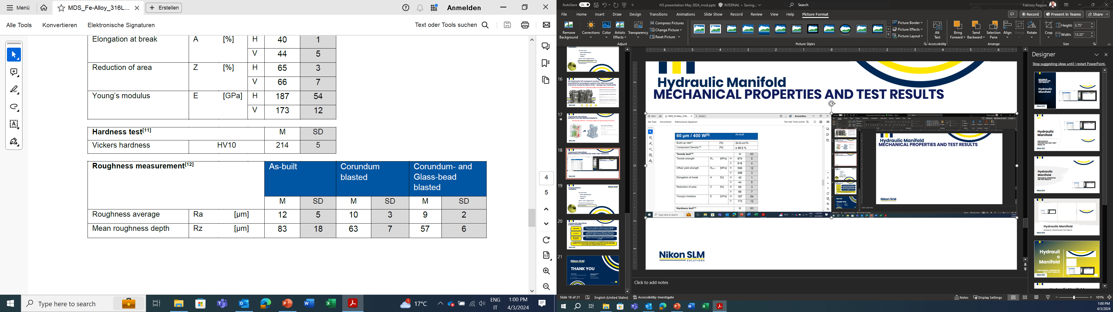
3D Hydraulic HP compact control manifold
Testing and Mechanical Properties
As built characteristics with current parameters, additional HT further improves the condition of the parts
Density > 99.5% consistent
Tensile tests results excellent
Hardness test results excellent
Roughness Ra 12 as built

Slide 11
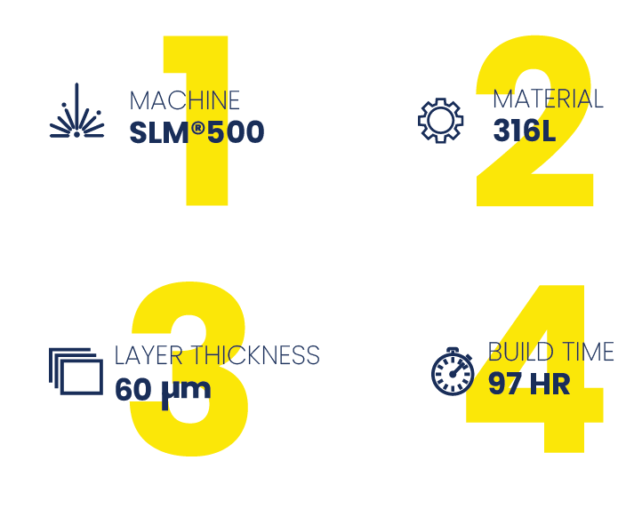
3D Hydraulic HP compact control manifold
Achievements
Part improvement through AM
60% lighter part
Maximum stress lower than 60% of material’s yield strength
Production Lead time Reduction
Lead time from 2-3 months down to 3 weeks due to high productivity process

Slide 12
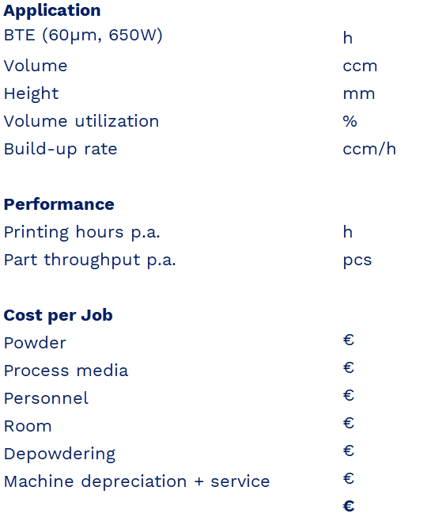
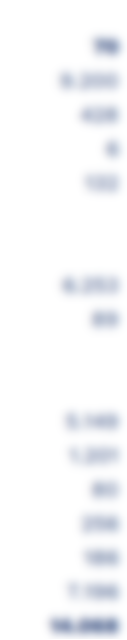
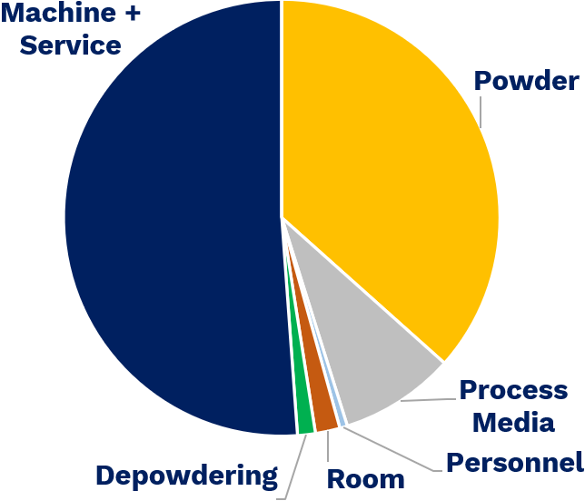
High volume production
Cost optimization
Cost reduction through build plate saturation
Cost reduction through printer saturation (more Parts-Per-Year)
Production Optimization
Reduced high-power printing time = cost efficient
Reduced idle times = higher printing rate
Parallelizing depowdering = higher part output
Customization: Modify the design according to requirements without increasing the costs

Slide 13
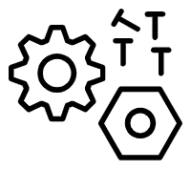
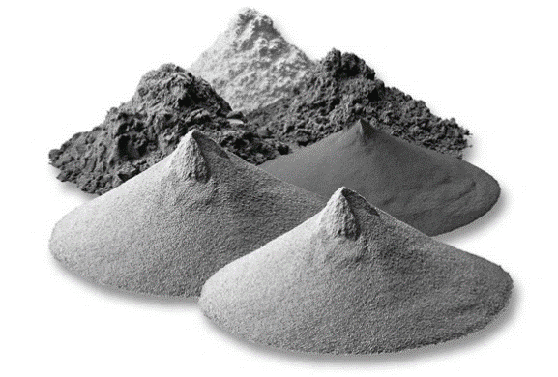
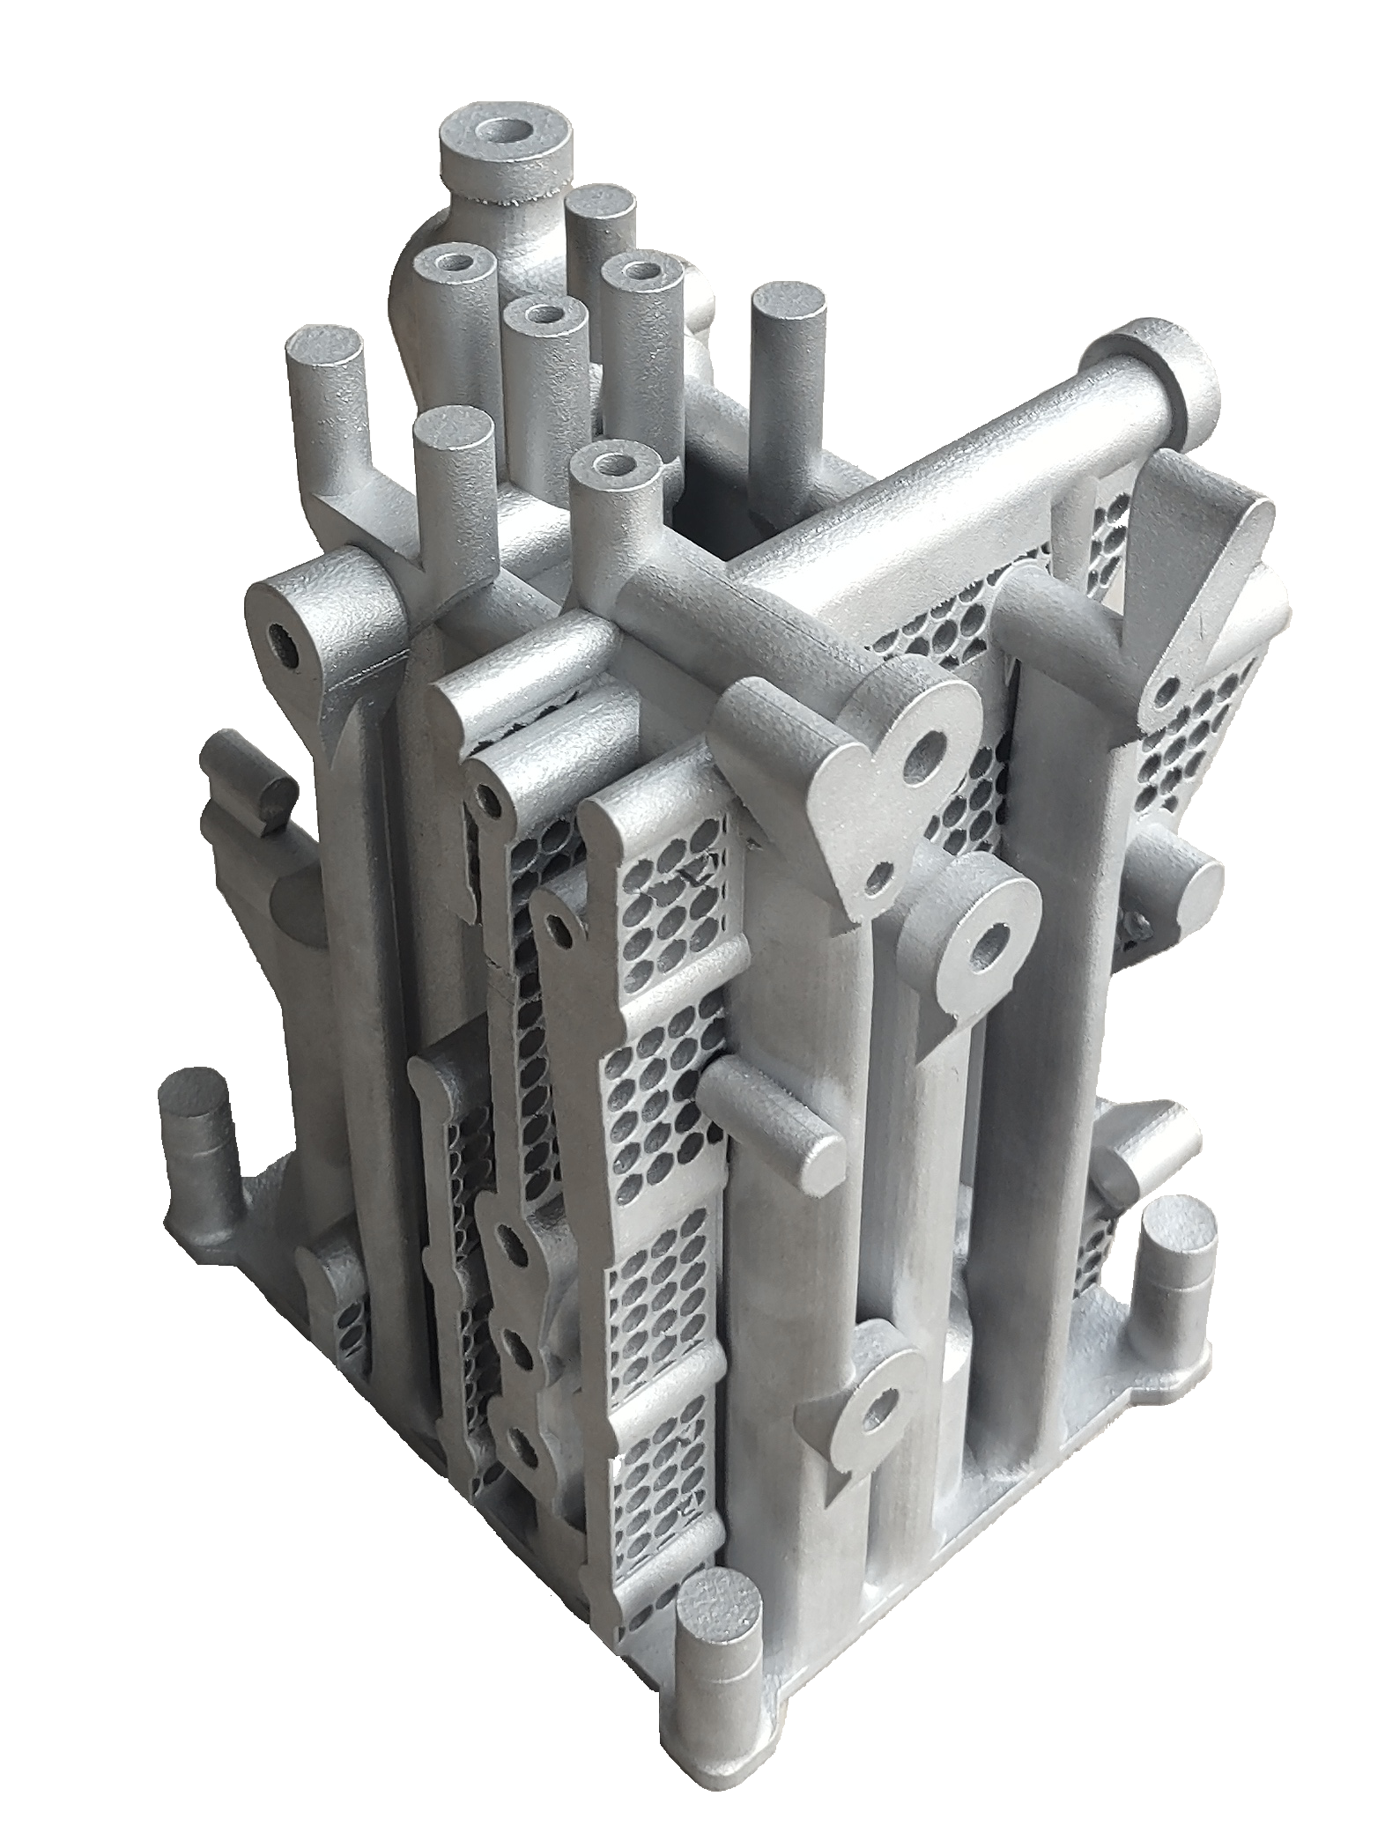

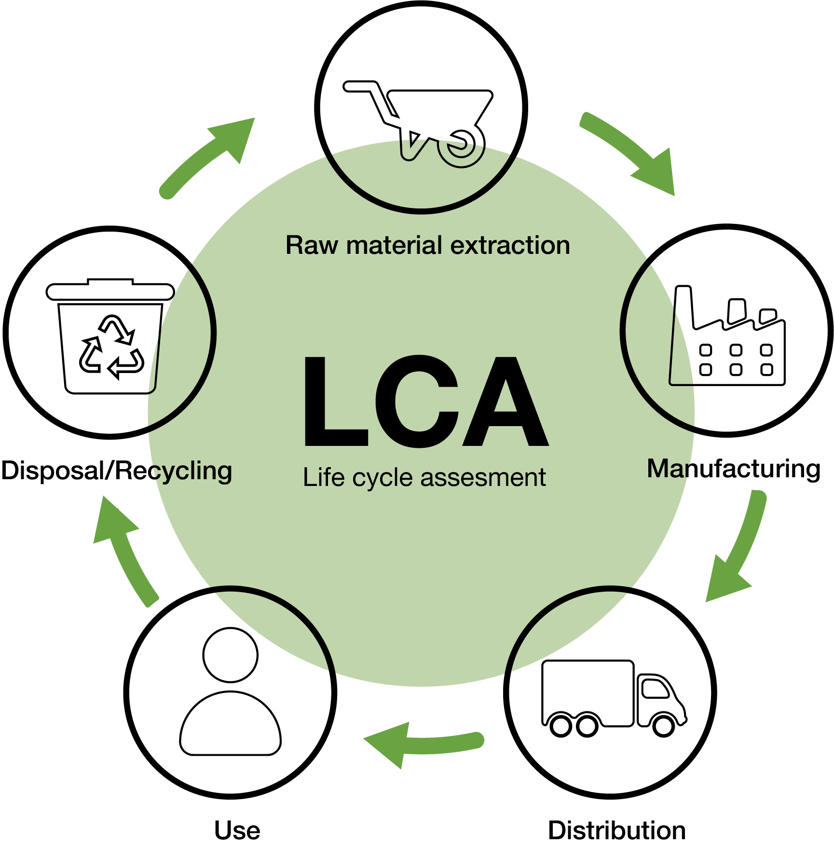

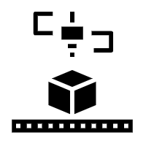
3D Hydraulic HP compact control manifold
The purpose of this design was to reduce & exclude a huge amount of fittings thus potential hydraulic leak points in the field. So we decided to try and go another step further with AM in order to bring additional added value to our products, and we started to investigate how we could reduce further the dimensions and further reduce the weight of our manifold build from 25 to 9,8 Kilos.
3D Printed manifold Weight = 9.8 Kg
(More than 60% reduction)
Fast high quality printing
Metal Scrap
Metal Powder
3D Printed Parts
Meet our experts today Booth 138 Hall A

Slide 14
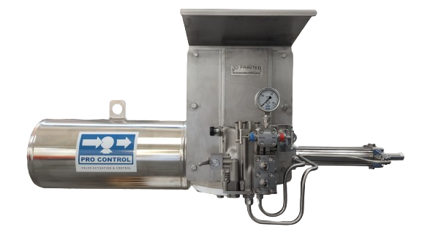
3D Hydraulic HP compact control manifold
The sustainability of ADDITIVE MANUFACTURING involves a collaborative effort across the entire value chain to maximize its environmental, economic, and social benefits. End users play a role in driving demand for customized, locally produced goods that are sustainably manufactured, influencing how industries adopt these technologies. But, we all play a part in this, and our focus should shift from initial purchase price to the full life cycle costs of products.
Meet our experts today Booth 138 Hall A

Slide 15
Hydraulic manifold
Conclusions
Lightweight
AM part mass of 9,8 kg. Traditional part was 25,6 kg, it has been possible to reduce the weight by 61,7%.
Lead time
Traditional lead time of 2-3 months to receive and machine the forged material. AM produce 5 parts in 4 days plus 2 weeks for the post-processing, 3 weeks
Mechanical Proprieties
Maximum stress lower than 60% of material’s yield strength
Cooperation between design / part producer and OEM and a SLM technology provider. It is very imperative that OEMs participate more actively and provide more components suggestions like this case

Slide 16
Fabrizio Ragusa
Global Business Development Director Energy
Nikon SLM Solutions AG
Estlandring 4
23560 Lübeck
Germany
Phone +49 451 4060-0000
Mobile +39 342 1066789
Mail fabrizio.ragusa@nikon-slm-solutions.com
Internet www.nikon-slm-solutions.com

Slide 17
Thanks
ORGANIZING SECRETARIAT
Ph. +39 035 3230904
e-mail info@industrialvalvesummit.com
CONFERENCE ORGANIZERS
Ph. +39 3474908420
e-mail segreteria@valvecampus.com
www.industrialvalvesummit.com
www.valvecampus.com

