Slide 1
2024 Updates for all Fugitive Emission Test Standards for Valves and Seals
CONFERENCE
ORGANIZERS

Slide 2
2024 Updates for all Fugitive Emission Test Standards for Valves and Seals
Matthew Wasielewski, PE | General Manager | Yarmouth Research and Technology, LLC

Slide 3
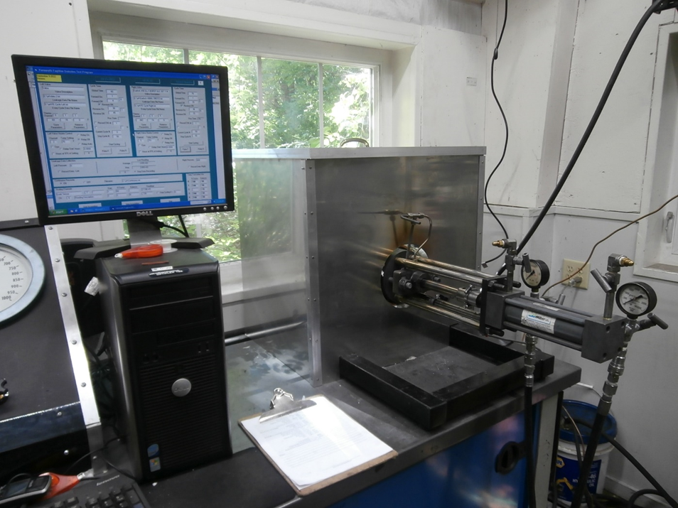
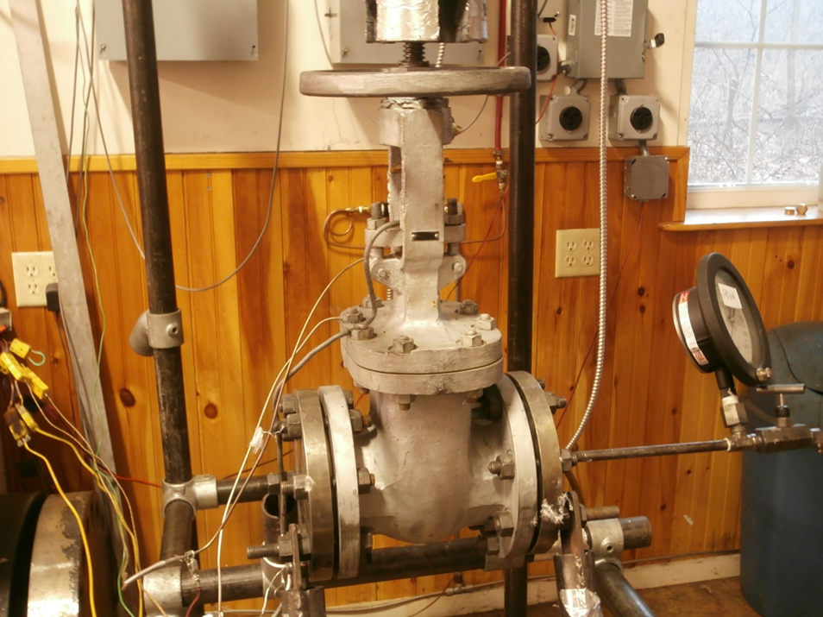
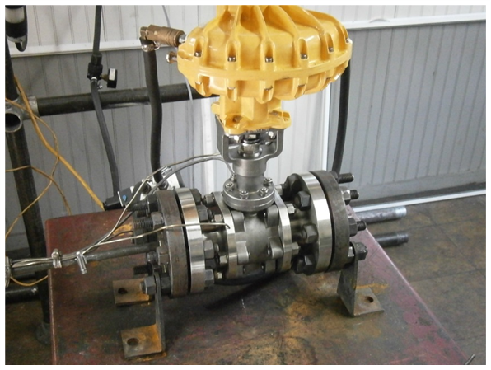
API Downstream Test Standards
API 622
API 624
API 641
Type Testing of Process Valve Packing for Fugitive Emissions
3rd Edition/Addendum
March 2022
Type Testing of Rising Stem Valves Equipped with Graphite Packing for Fugitive Emissions
2nd Edition / Errata
Feb/May 2023
Type Testing of Quarter-turn Valves for Fugitive Emissions
2nd Edition
May 2023

Slide 4
Connected API Downstream Standards
Valve Design Standards
API 600, 602, 603, 609 etc.
Valve Test Standards
API 624
API 641
Packing Test Standard
API 622

Slide 5
API 622 – 3rd Edition
Released 2018 with Addendum 2022
Full Test includes:
Fugitive Emissions: 5 Thermal Cycles, 1510 Mechanical Cycles to 260c, 600 psig Methane
Materials Tests – Wt Loss, Density, Lubricant Content (PTFE) and Leachables (chloride, fluoride)
Corrosion Test – Ambient and 149C, 35 days

Slide 6
API 622
Addendum 1 included the addition of Annex C and some minor changes to the base document was released in March 2022
Minor changes include some dimensional corrections to fixtures and an additional 24 hour -1100F weight loss test
Committee just started to revise for next edition – Comments?

Slide 7
API 622 – Annex C – High Temperature Test
Can be performed on new packing set or as continuation after 500F test
3 Thermal Cycles to 750F
12 hour min. time at temp.
Gas changed out to He for high temp
Pressure – 600 psig for leak reading,
    200 psig at high temp.
100 PPMv max. allowable
1 packing nut adjustment allowed
Figure C.1—Testing Cycles

Slide 8
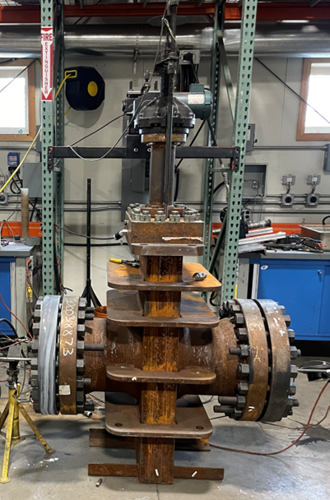
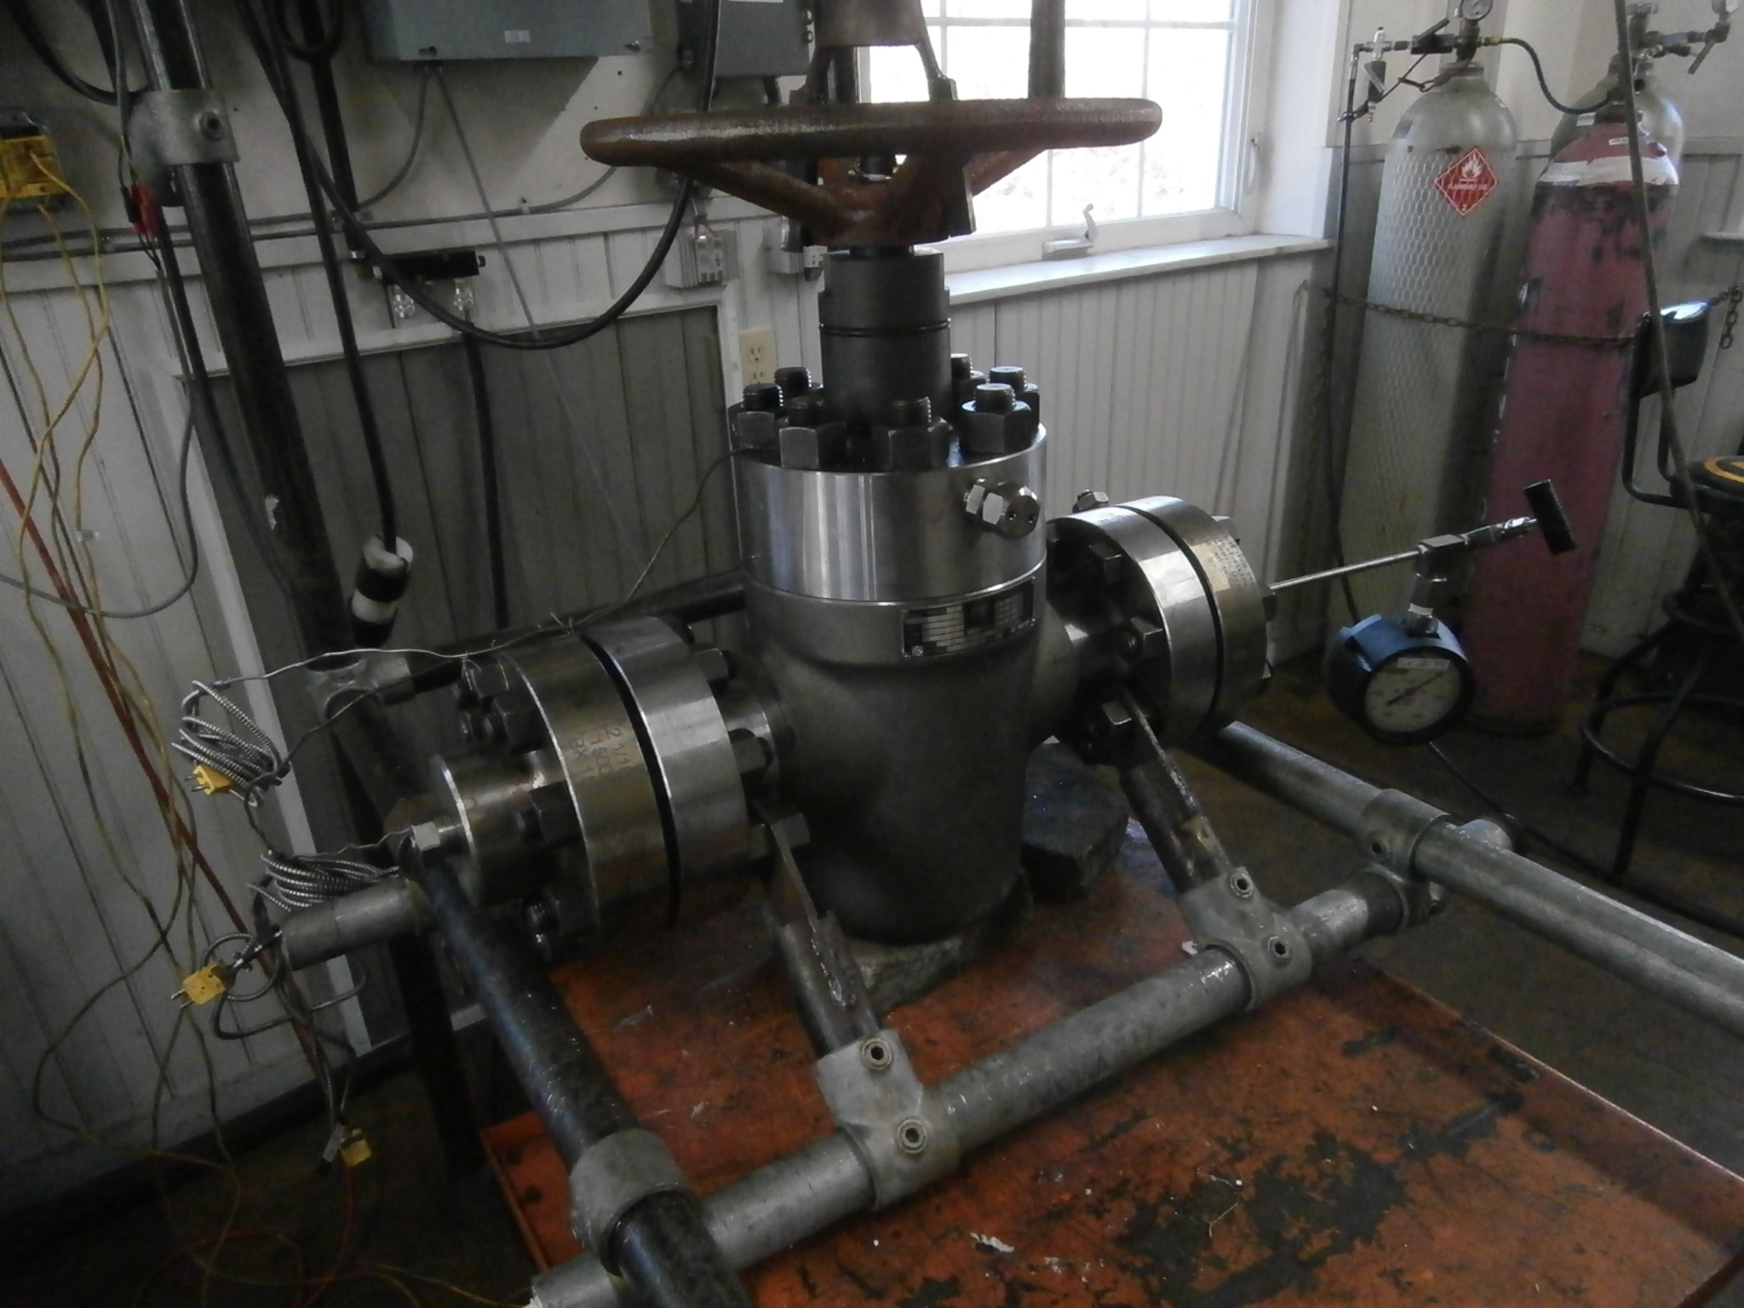
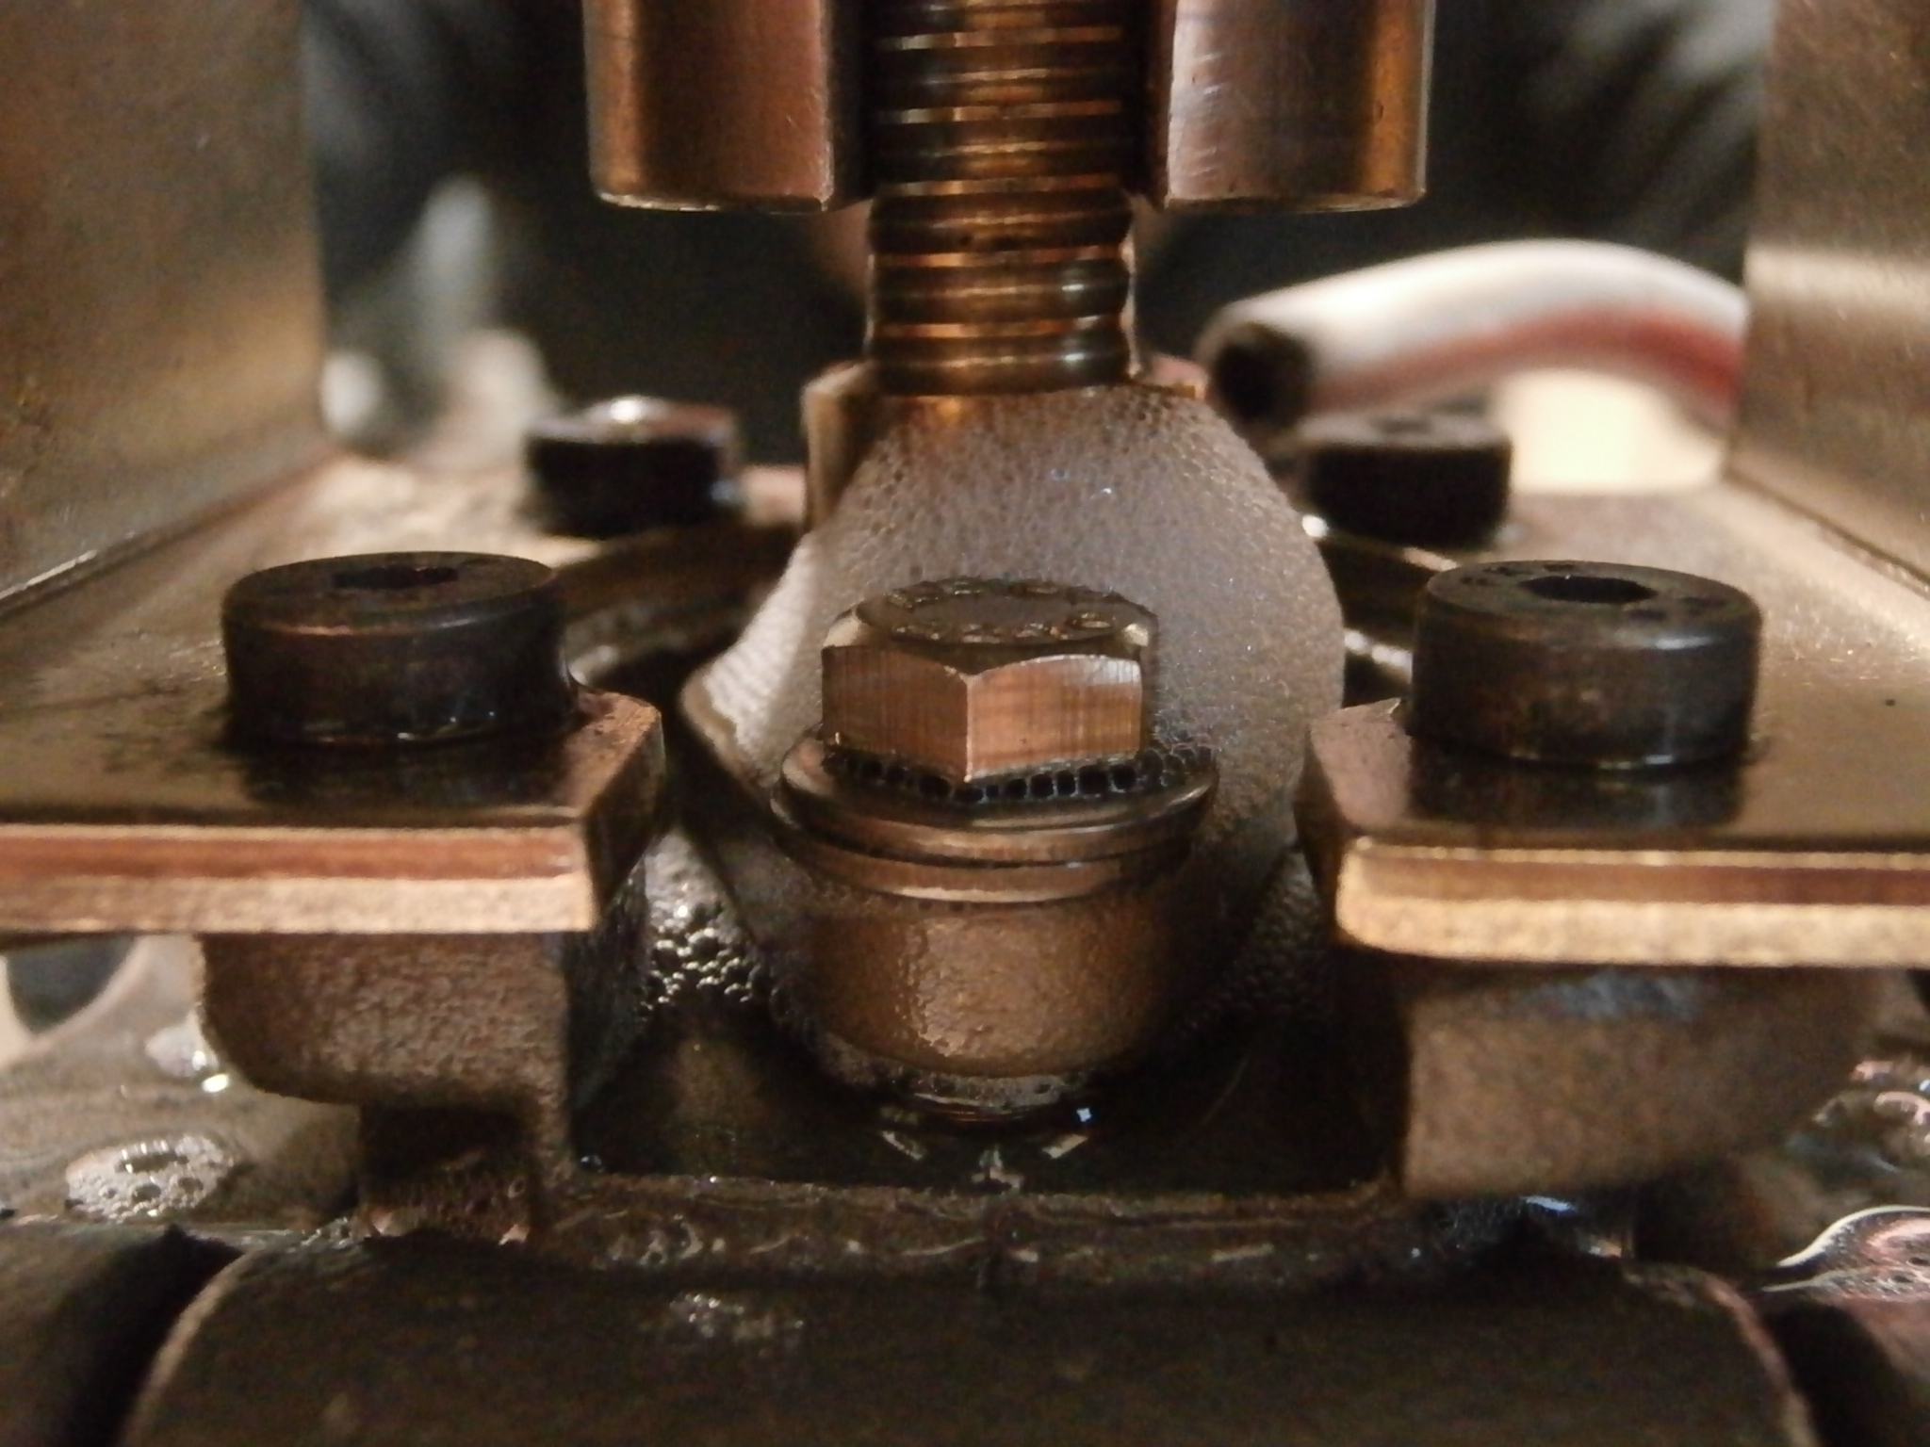
API 624 – Parameters
Mechanical Cycles | # of Thermal Cycles | High Temperature | Test Pressure
310 | 3 | 260C | 41.4 barg

Slide 9
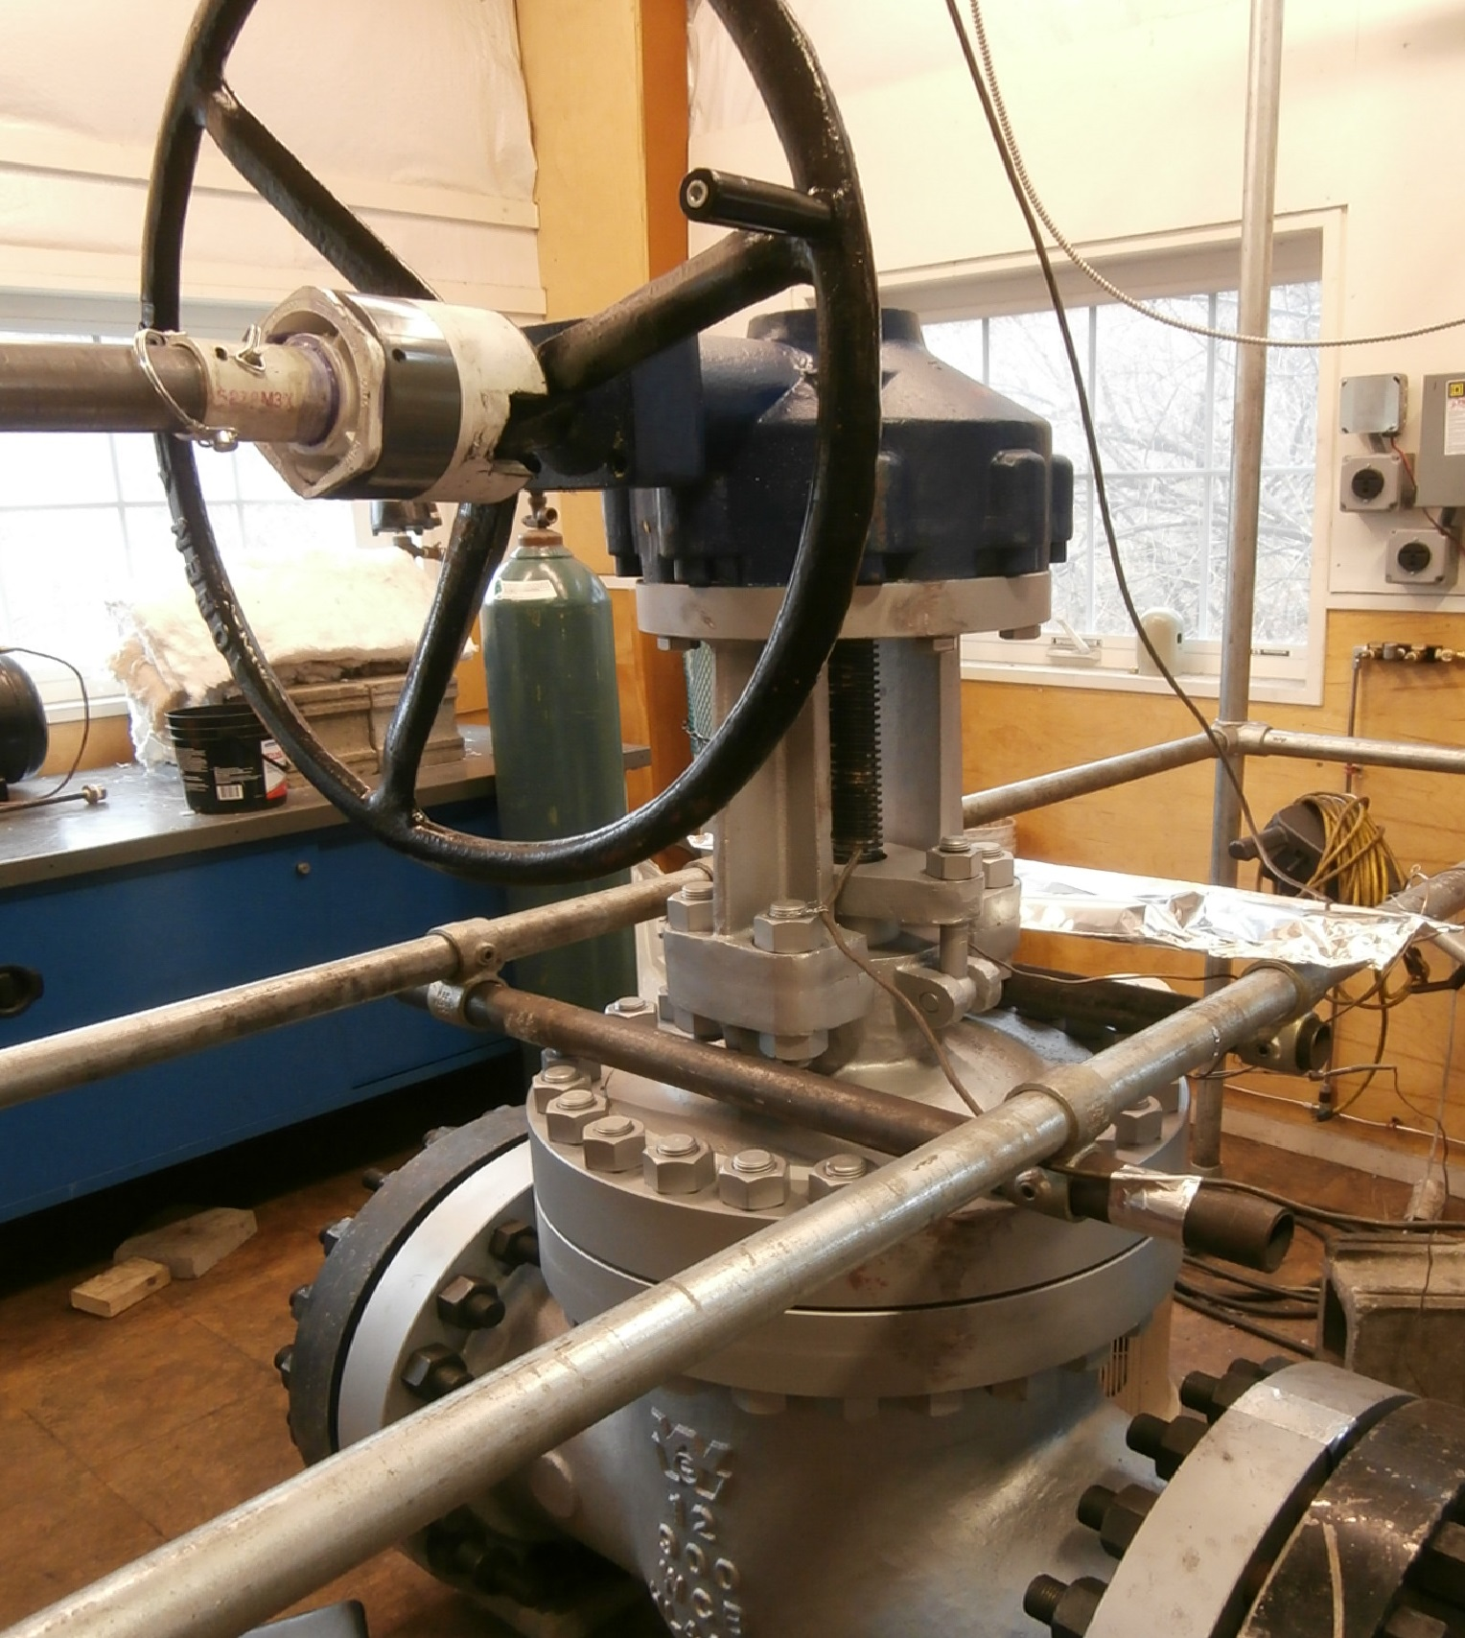
API 624 – 2nd Edition
2nd Edition released Feb. 2023 with Errata 1, May 2023
Revised and enhanced qualification section
Defines 622 packing size to valve size (<=3/16 packing in valve qualified by 1/8” 622)
No retests
              Live-loading added
              No need to test to 2nd edition is packing complies with API 622 3rd.
              20 inch and larger tested with stem orientation change
Partial retest
  Change of packing of API 622 HT
  Change of gasket design (no mech cycles)
  2 valves need to be tested per Annex C
Annex D – High Temperature Test

Slide 10
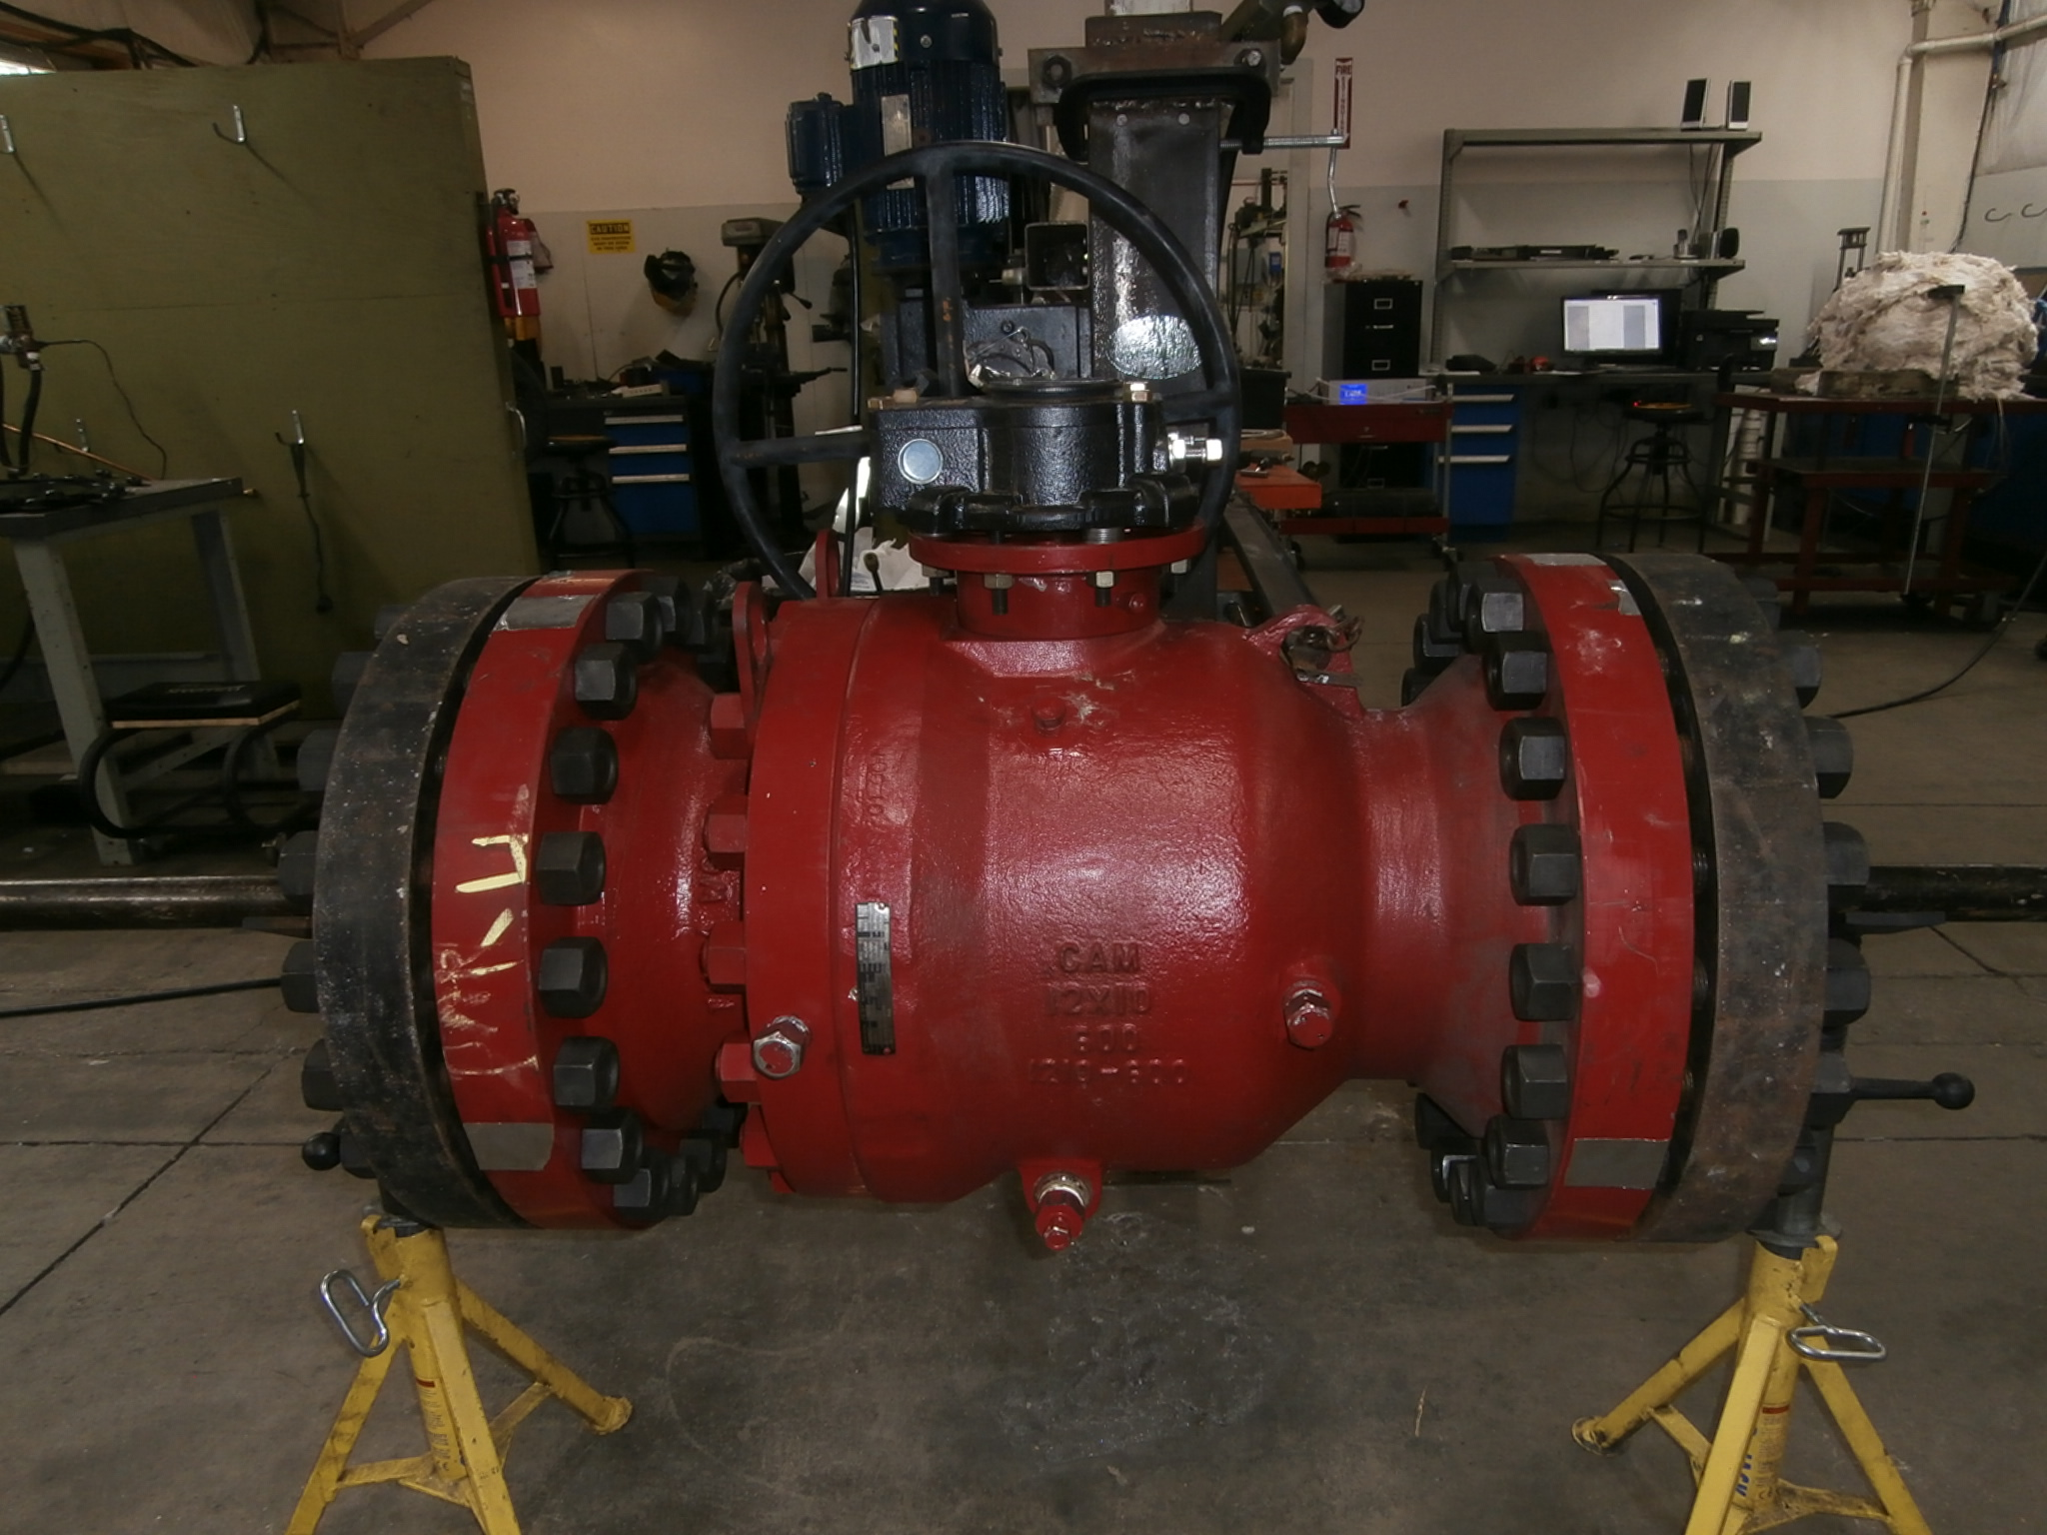
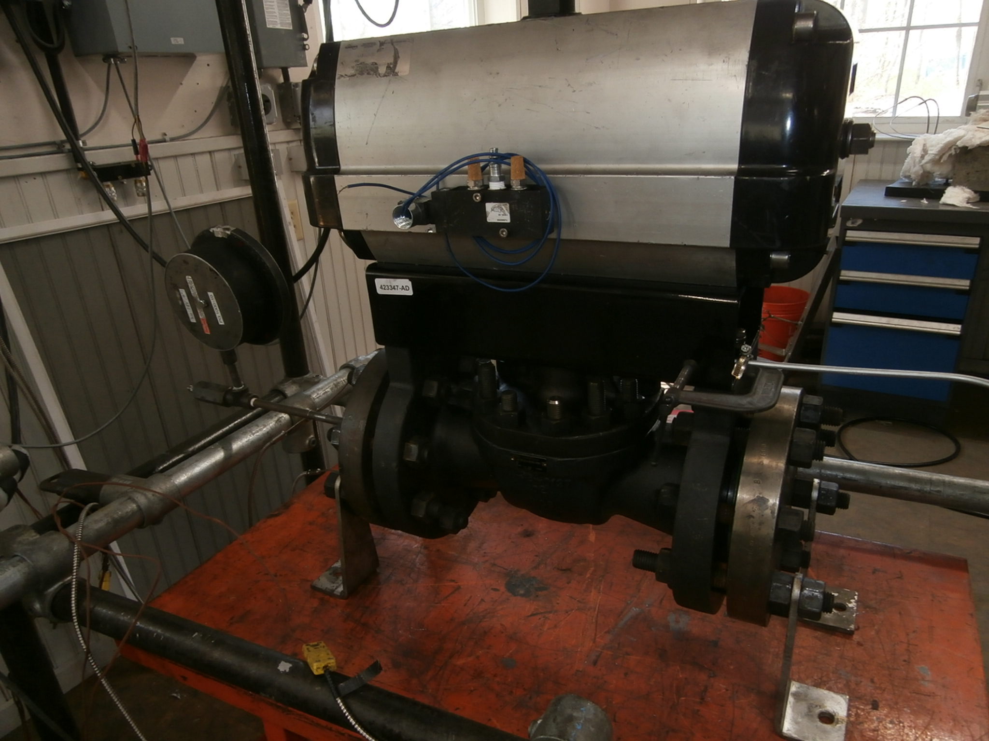
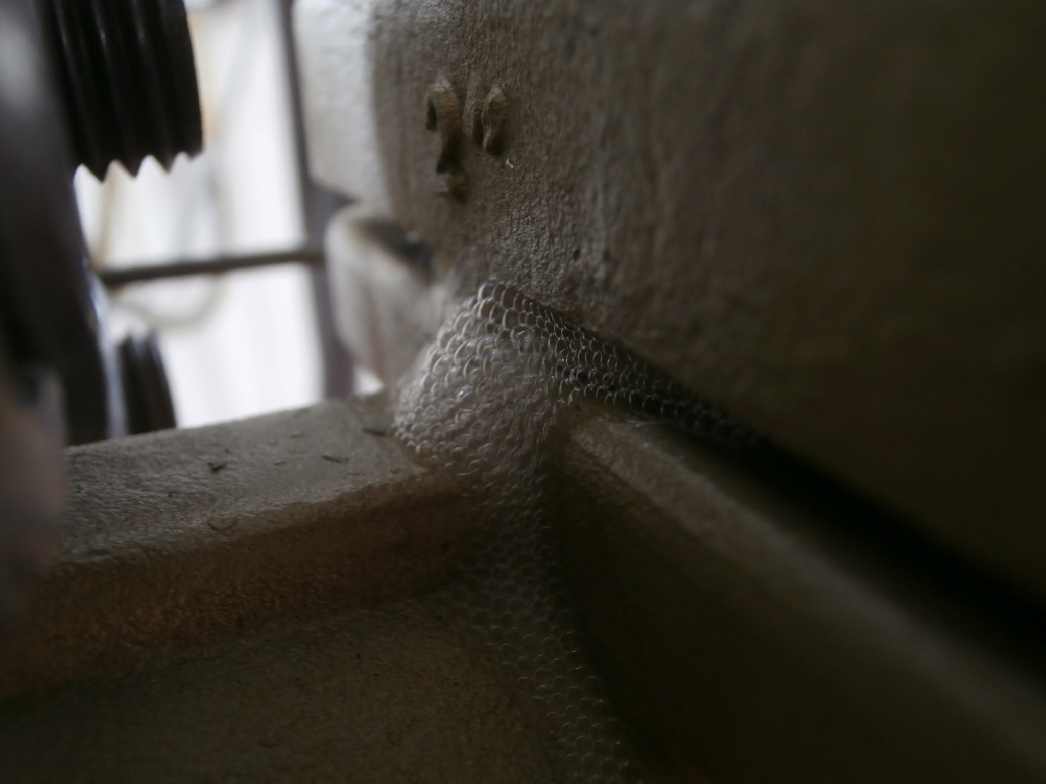
API 641 2nd Edition
2nd Edition released October 2023
Type 1 – Te>500F with Pe>100 psig
Type 2 – Te< 500F or <500F with Pe<100 psig
Test pressure – 75% of rated pressure
Revised and enhanced qualification section
  No retests
    No need to test to 2nd edition is packing complies with API 622 3rd.
    Previously qualified Class 150-600’s. (test pressure)
  Partial retest
    Change of elastomer seal material manufacturer
    Change of graphite material (non-primary seal)
    Single median stem size valve.
Annex C – High Temperature Test

Slide 11
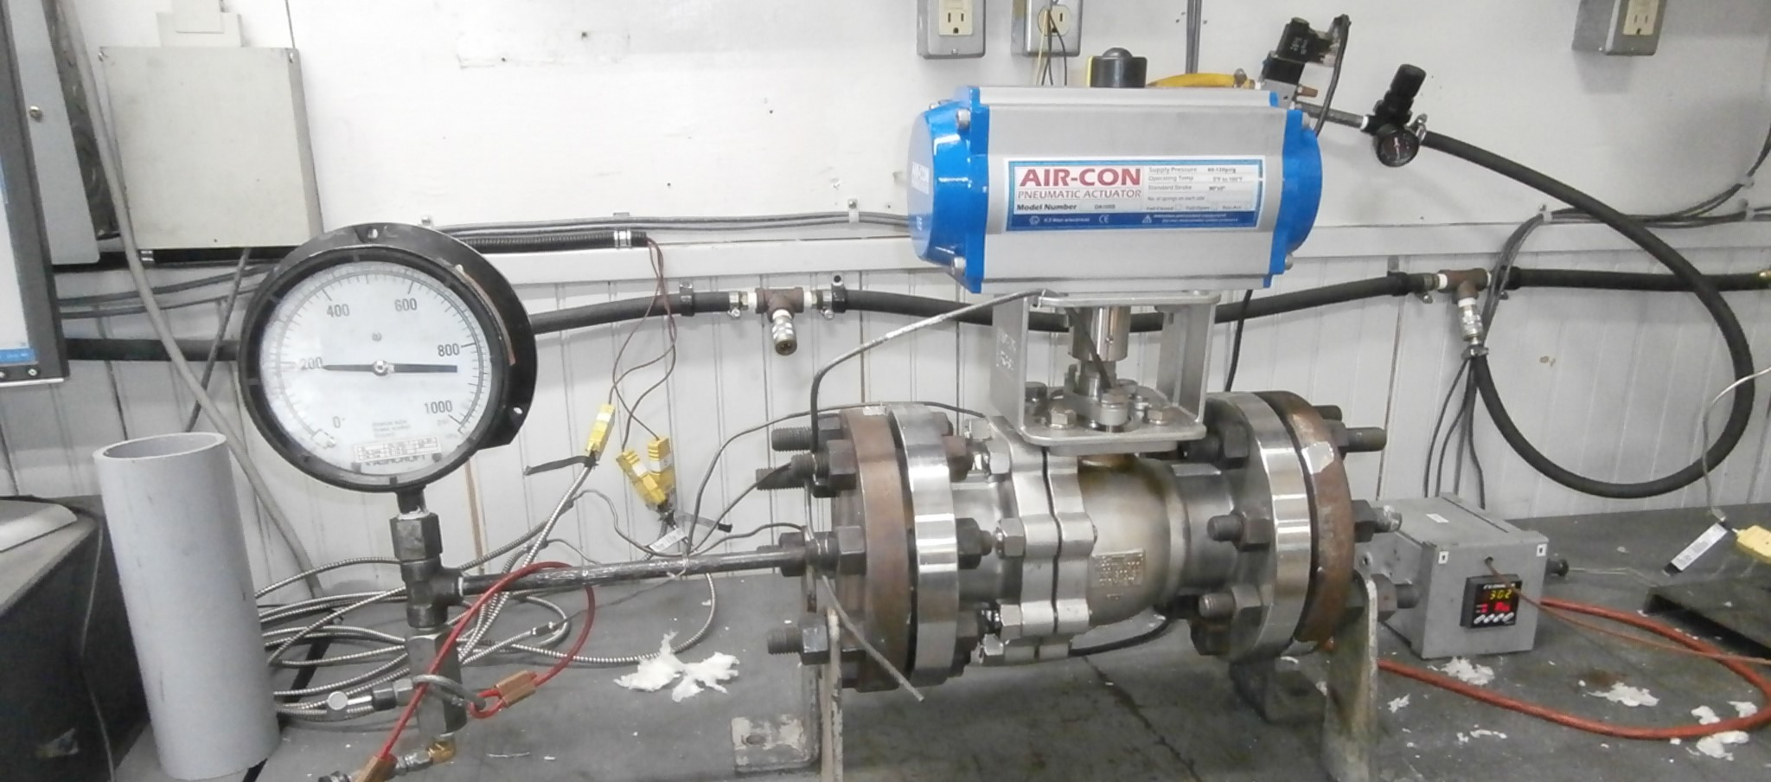
API 624 and 641 High Temp Parameters
  Packing complies with API 622 HT
  1 Thermal cycle to 750F
  20 hour hold
  5 and 5 mechanical cycles
  Performed as continuation or on new valve
  Leakage tests performed at room temp.
  1 packing nut adjustment allowed

Slide 12

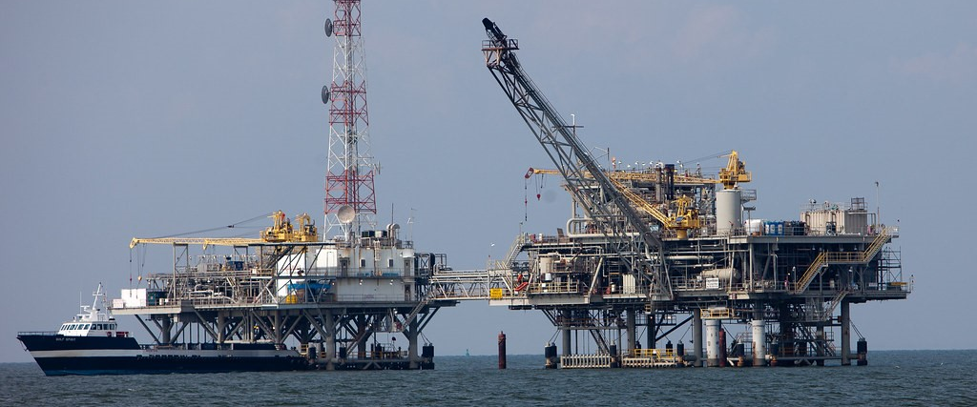
API Upstream Fugitive Emission Specification – API 6Y
Scope
This standard identifies the requirements for testing of valves where fugitive emission of methane at pressures up to 20,000 psi is a consideration. Factors affecting fugitive emissions performance that are considered by this standard include temperature, pressure, and thermal and mechanical cycling. Through bore valve leakage is outside the scope of this document.
High pressure – 6A, 6D valves
Last committee draft – Feb 2024. Release 6-12 months?

Slide 13
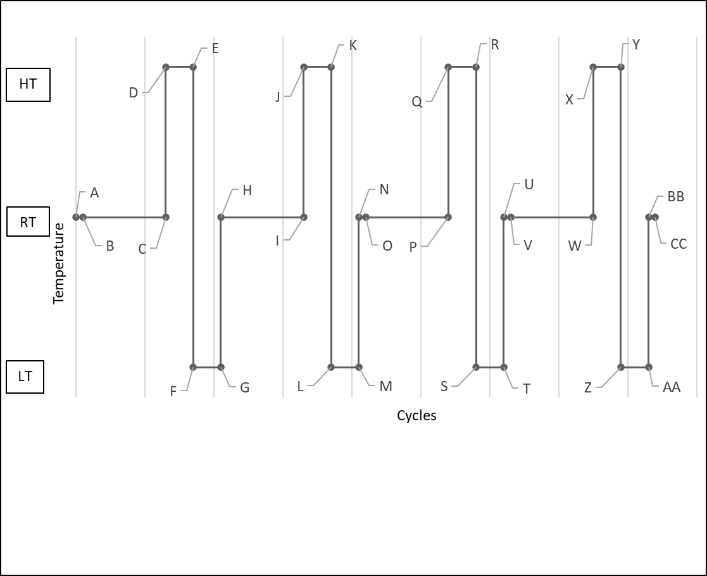
API 6Y - Parameters
Multiple gas options
  Helium, methane, argon, 10% He or CH4
  Leakage limit study – U of OK
High and Low temperatures in same test – similar to 6A categories, -321F to +752F
Endurance Classes
Valve Type | On-Off | Chokes | Control
Mech Cycles | 205-1005 | 205-2505 | 20K – 100K
Endurance Class 1
Endurance Class 2
Endurance Class 3

Slide 14
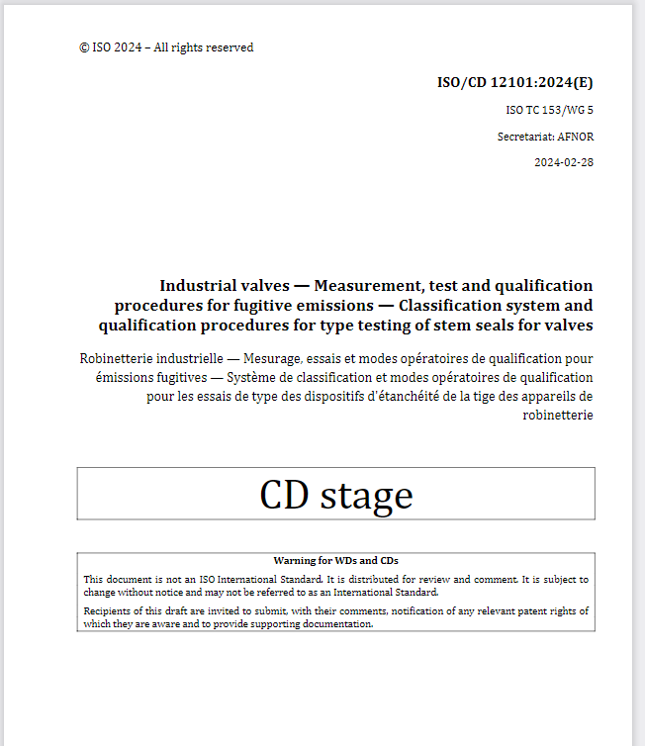
ISO 12101
In progress by ISO TC 153 / WG5
Combination of API 622 and ISO 15848-1
Any seal types or materials – compression, non-adjustable, spring and pressure energized, polymers, graphitic and elastomers.
Standard fixtures or in valves
Helium or methane
Allowable leakages and mechanical cycles same as ISO 15848-1

Slide 15
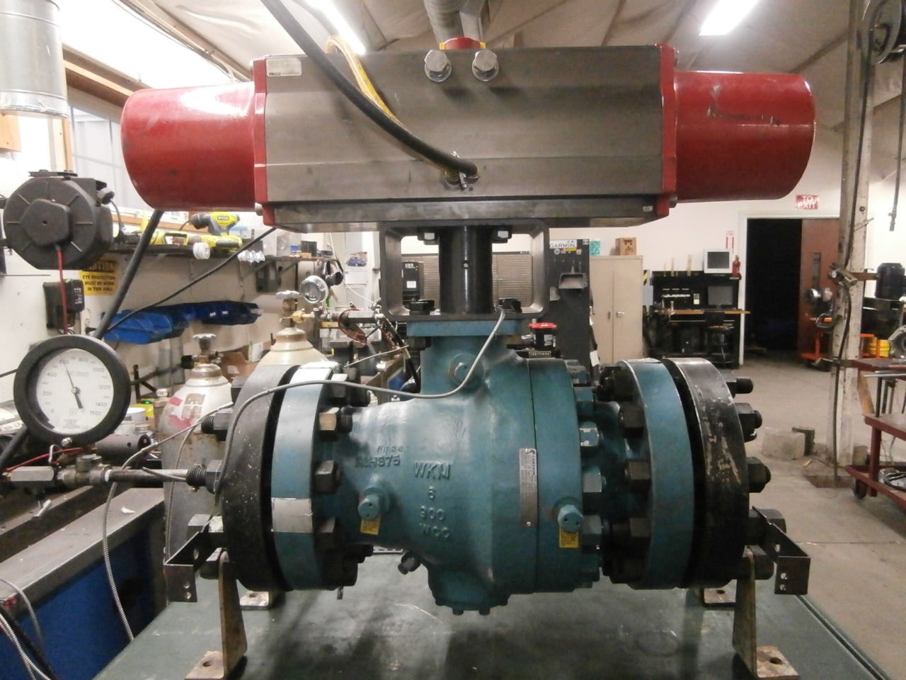
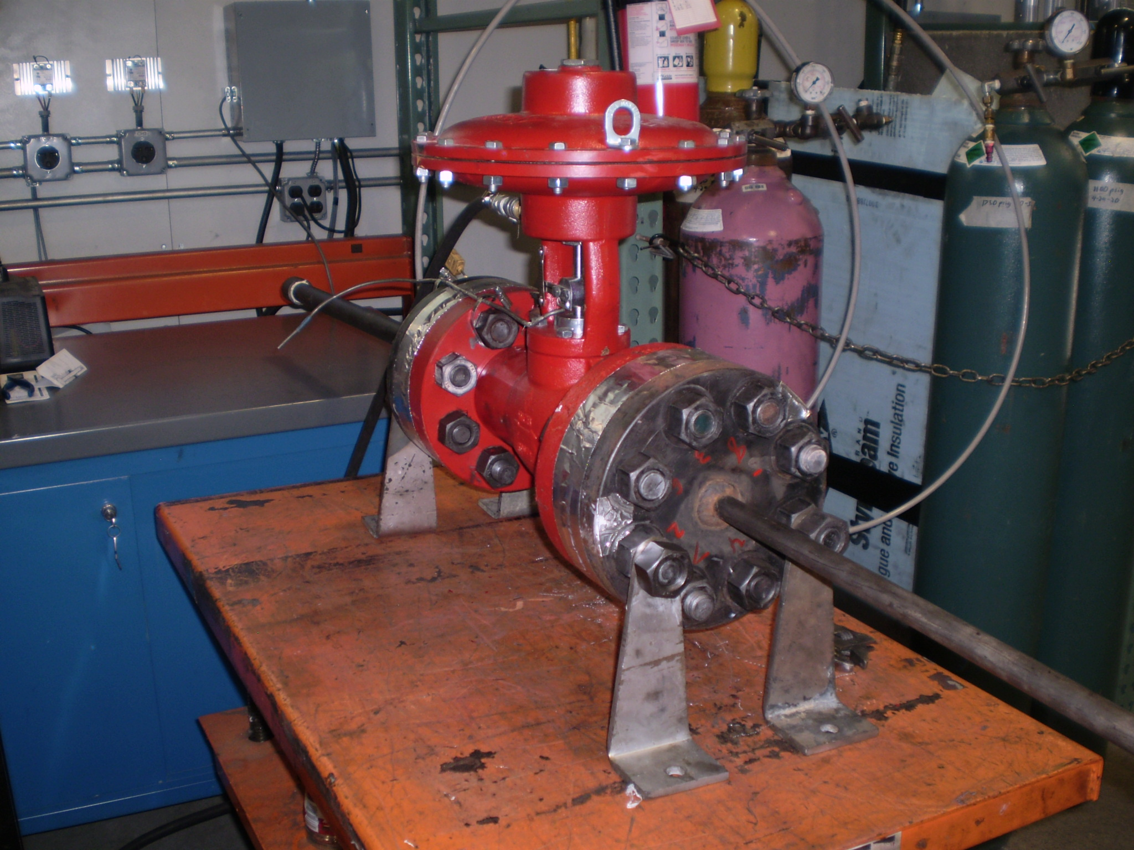
ISO 15848-1 2nd Edition, 2015
Valve Types | On/Off | Control
Number of Mechanical Cycles | 205, 1500, 2500 | 20,000, 60,000, 100,00
Number of Thermal Cycles | 2-3-4
Test Temperature –C | -196, -46, -29, RT, 200, 400
Test Pressure | Rated Pressure
Allowable Leakage-Methane | 50, 100 or 500 PPMv (AM, BM, CM)
Allowable Leakage-Helium | 1.78 e-7, 1.78 e-6, 1.78 e-4 mbar-l/sec per mm of stem diameter (AH, BH, CH)
Allowable Packing Adjustments | 1 per each qualification stage

Slide 16
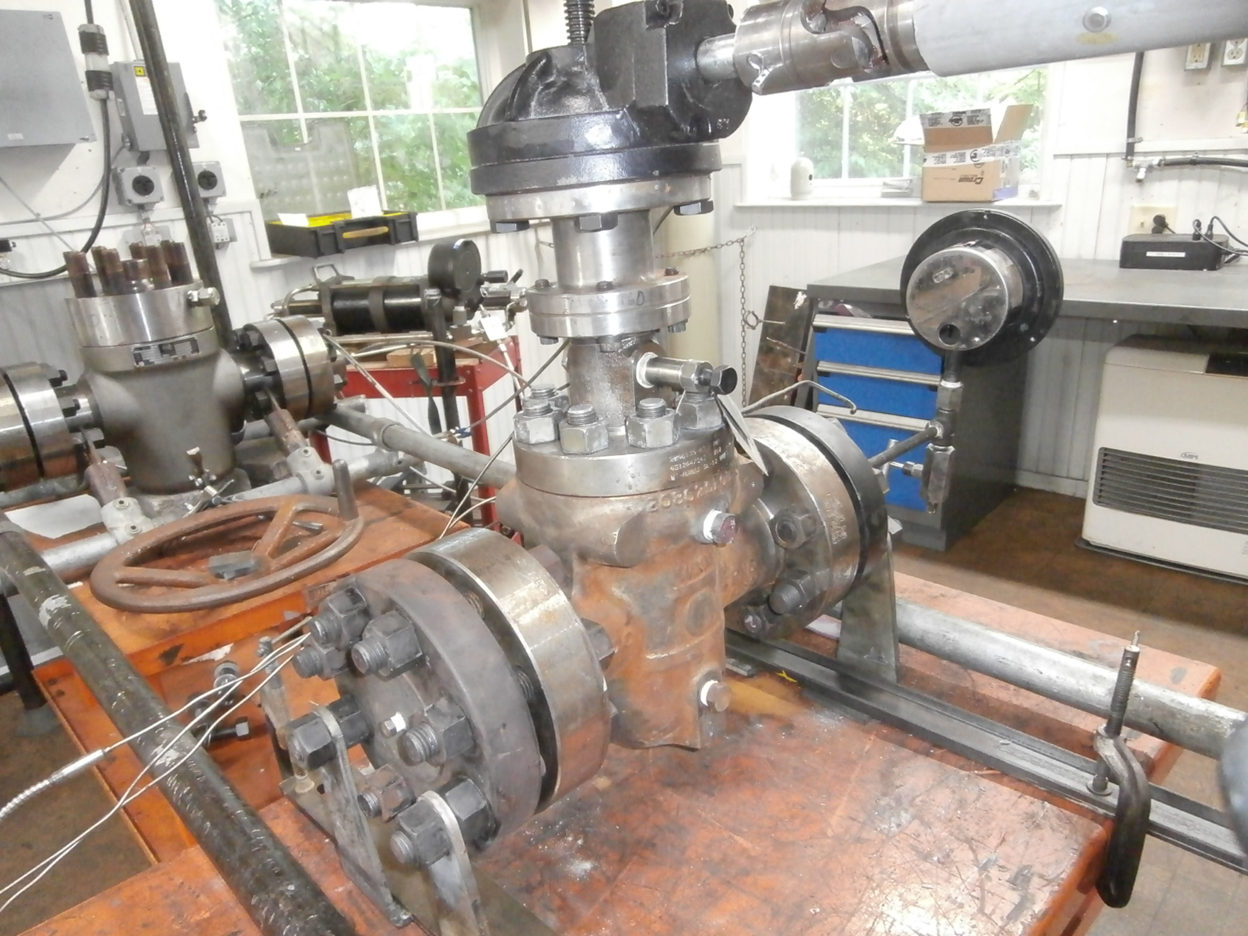
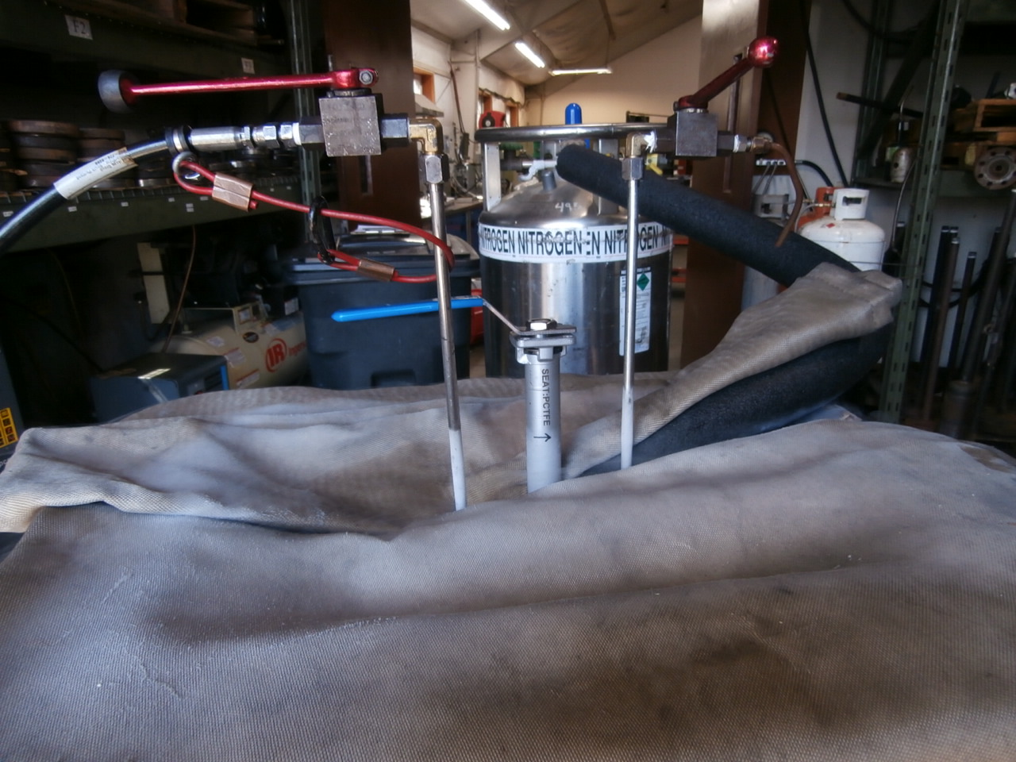
ISO 15848-1 (and -2)
Committee to be started by ISO TC 153 / WG5 for next revision late 2024/2025
Changes may include
    More accurate “sniffing” method
    Relocation of dominant temperature probe
    Addition of hydrogen or argon as test gas
    Static seal only test – No dynamic cycles
          Send me other suggestions.

Slide 17



A strong partnership for the sealing and valve industry
Matthew Wasielewski, PE
matt@yarmouthresearch.com
maw@amtec-services.com

Slide 18
Thanks
ORGANIZING SECRETARIAT
Ph. +39 035 3230904
e-mail info@industrialvalvesummit.com
CONFERENCE ORGANIZERS
Ph. +39 3474908420
e-mail segreteria@valvecampus.com
www.industrialvalvesummit.com
www.valvecampus.com

