Slide 1
Assessment of Pipeline Buried Valves
CONFERENCE
ORGANIZERS

Slide 2
Assessment of Pipelines Buried Valves
Mohanned Tarabzouni | Aramco

Slide 3
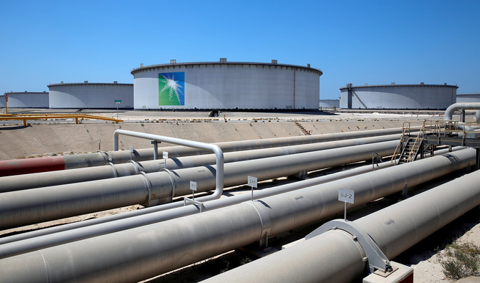
Background
Aramco Pipeline System Network
Services, Temperaure And Pressure
Inspection and Maintenance
+30,000 KM in length
Size range from 8-60 inches
Sour/Sweet, NGL, Crude, Gas and refined products
Complex geometry and elevation changes
40-60 yrs in service
Inline inspection + pigging
10,000+ valves

Slide 4
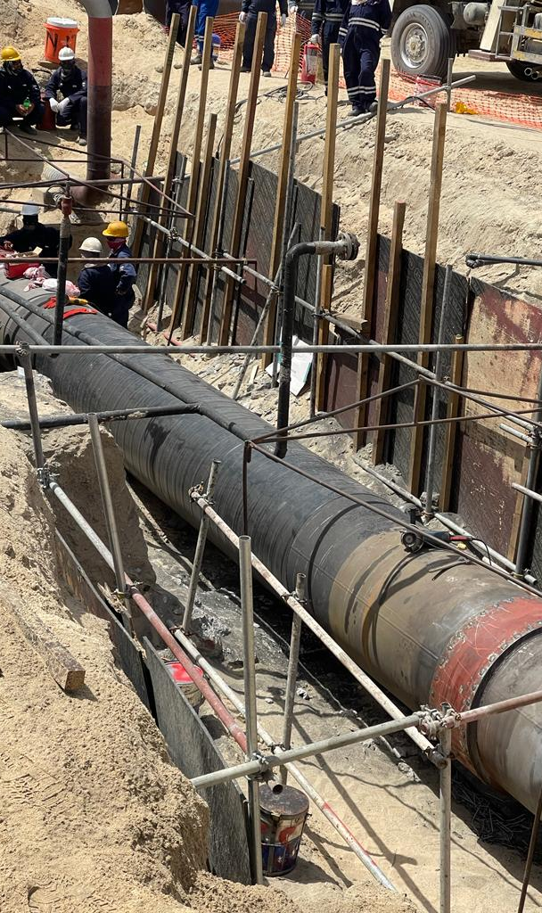
Design Specs
Multiple buried pipelines
FBE Coated
Tape Wrapped
Buried valves with same coating
30+ years of service
Multiple soil, weather and environment changes
Not commonly inspected

Slide 5
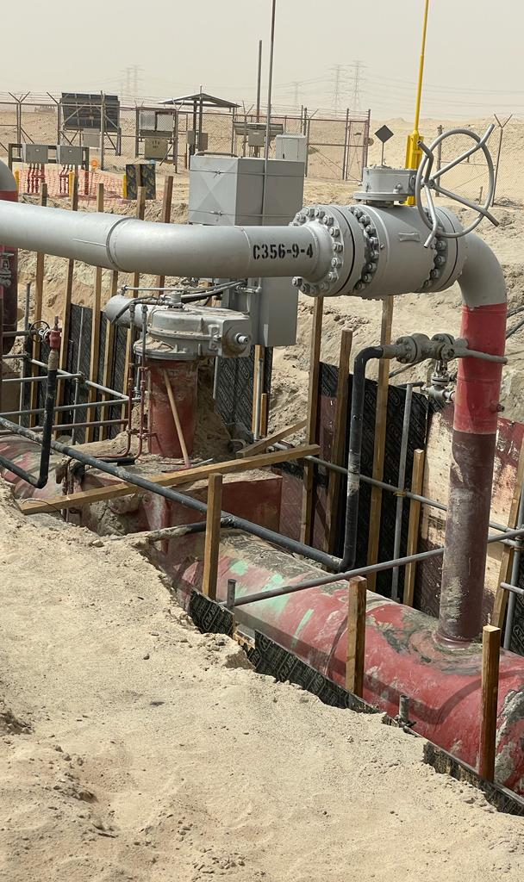
Challenges
Coating condition and design life
Cathodic protection continuity and effectivness
Valve body material and coating selection
Difficulties to periodic inspection

Slide 6
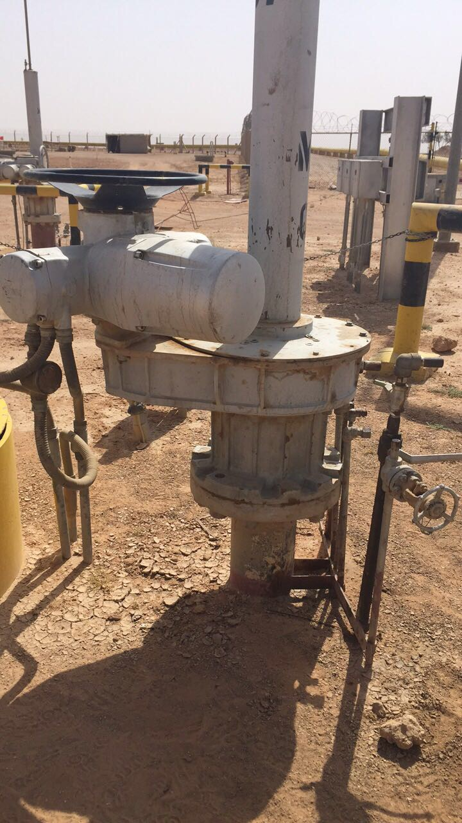
Challenges
Coating condition and design life
Cathodic protection continuity and effectivness
Valve body material and coating selection
Difficulties to periodic inspection

Slide 7
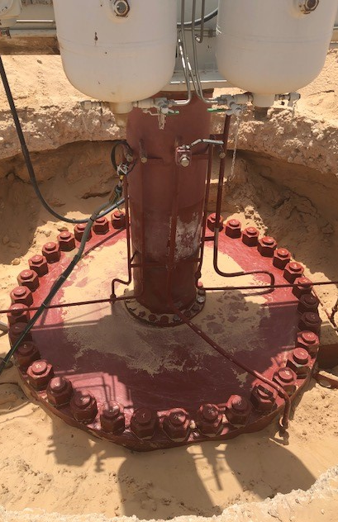
Case Study 1
56 inch top entry ball valve
Fully buried
FBE coated
Gas over oil operated
Minor gas release due to loose bonnet bolts

Slide 8
Analysis
Improperly torqued bonnet bolts
Difficult (not feasilbe) to be removed since its welded to pipeline
Possible bonnet gasket/seal damage

Slide 9

Recommendations
Includes coating, cathodic protection, material selection and environmental assessment/impact
Proper inspection program based on severity, location and other factors impacting the valve’s performance

Slide 10
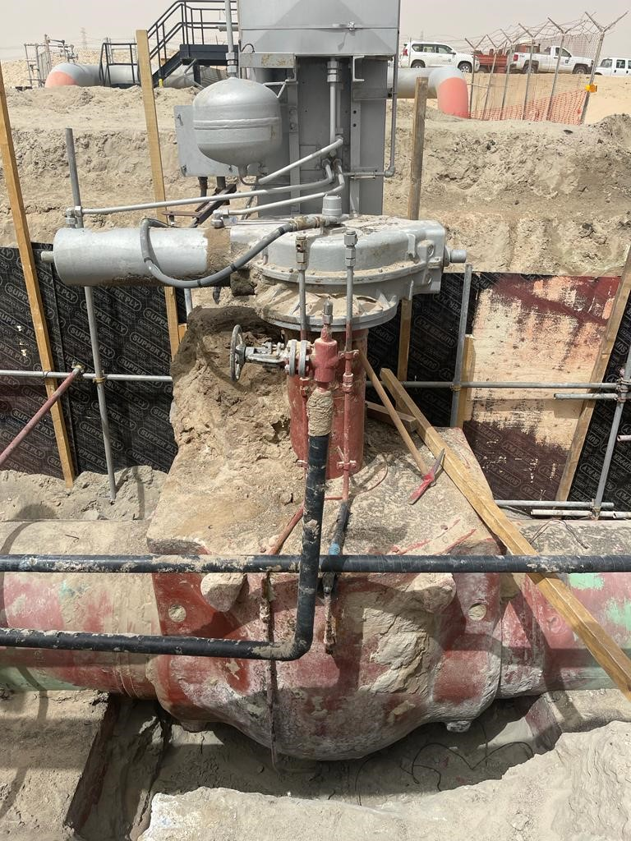
Case Study 2
40 inch top entry ball valve
FBE coated
Fully buried
Axuliaries failure

Slide 11
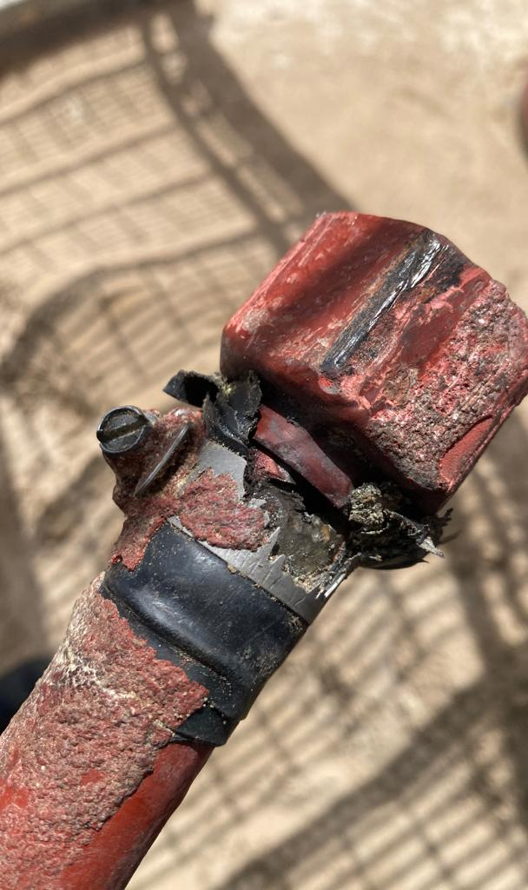

Analysis
Potential external corrosion failure
Shield cathodic protection due to multiple connections/joints (union, elbows, coupling)
Coating application condition and procedure not verified
Carbon steel material selected
Threaded without sealwelding
CONFERENCE ORGANIZERS

Slide 12
Recommendations
Inspect coating condition and develop action plan (Condition vs. Method)
Verify cathodic protection continuity and efficiency along valve an auxiliaries
Includes coating, cathodic protection, material selection and environmental assessment/impact
Proper inspection program based on severity, location and other factors impacting the valve’s performance

Slide 13
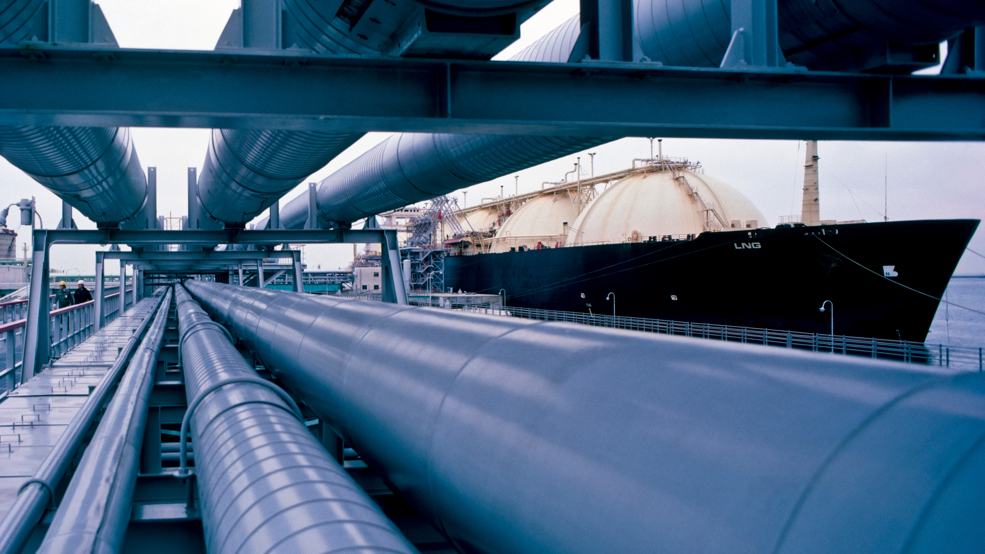

Take Away Notes
Thorough review is required to ensure all protection methods
Includes coating, cathodic protection, material selection and environmental assessment/impact
Proper inspection program based on severity, location and other factors impacting the valve’s performance
Corrosion protection/mitigation methods suitable for pipeline valves in addition to associated auxilaries
ORGANIZERS
CONFERENCE ORGANIZERS

Slide 14
Thank You
Mohanned.Tarabzouni@aramco.com

Slide 15
Thanks
ORGANIZING SECRETARIAT
Ph. +39 035 3230904
e-mail info@industrialvalvesummit.com
CONFERENCE ORGANIZERS
Ph. +39 3474908420
e-mail segreteria@valvecampus.com
www.industrialvalvesummit.com
www.valvecampus.com

