Slide 1
Is ‘Smart LDAR’ correctly applied in Europe?
Take a look at the differences between CWP and AWP LDAR following the EN 17628:2022, EN 15446:2008 and dutch guideline NTA 8399:2015
CONFERENCE
ORGANIZERS

Slide 2
Is ‘Smart LDAR’ correctly applied in Europe?
Take a look at the differences between CWP and AWP LDAR following the EN 17628:2022, EN 15446:2008 and dutch guideline NTA 8399:2015
Paolo Corsini | Division Manager

Slide 3
There are two standards governing what is commonly referred to as 'Smart LDAR’:
EN 15446:2008
EN 17628:2022
‘Fugitive and diffuse emissions of common concern to industry sectors - Measurement of fugitive emission of vapours generating from equipment and piping leaks’
‘Fugitive and diffuse emissions of common concern to industry sectors - Standard method to determine diffuse emissions of volatile organic compounds into the atmosphere’

Slide 4
Topic-to-norm association
Fugitive Emissions
Norm EN 15446:2008
LDAR
Smart LDAR
Norm EN 17628:2022
Previously was: ‘Guideline NTA 8399:2015’
Diffuse Emissions

Slide 5
OGI Monitoring
OGI systems work in a sub-region of the infrared (IR) spectrum where molecules that comprise hydrocarbon emission plumes absorb and emit energy in the form of IR photons. The most widely used OGI camera is the FLIR GF320, which operates in the 3.2 to 3.4 μm region.
The OGI camera operator looks at a scene containing the LDAR component under inspection and observes the IR photons emitted from objects in the background, the component, and by the gas itself (if emitted). If a fugitive or vented gas emission is present above detection limit, the molecules in the plume can net absorb IR radiation (or net emit if the gas is hotter than the scene), producing a discernable contrast in the image that makes the normally invisible plume visible.
The emitted gas must have IR spectral features detectable by the OGI camera utilized to be observed.

Slide 6
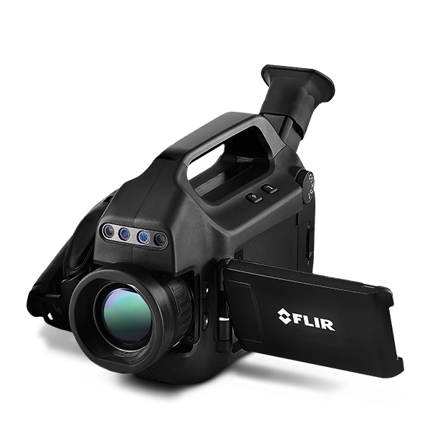
OGI Camera
OGI uses an infrared thermal imaging camera, fitted with optical filter, which is sensitive to IR absorption by certain VOCs. The camera enables plumes of VOCs to be visualized, appearing as clouds of vapour on the camera. OGI is used to visualize and identify the location of some leaks/emissions.
It does not directly allow quantification of emission rates of leaks/emissions

Slide 7
OGI Camera (source: EN 17628:2022)
Detection
This method is used to detect and locate certain hydrocarbon leaks/emissions by viewing them on a video screen. Preventive maintenance of fluid circulation installations: pumps, valves, flanges, line ends, plugs, etc. It can be used to validate repairs made to the faulty component by providing the operator with a means of direct inspection of the effectiveness of said maintenance.
OGI can be used as part of a LDAR (leak detection and repair) programme, to visualize diffuse VOC emissions of storage tanks, to visualize diffuse VOC emissions that are released while loading operations, to visualize VOC emissions from sources not included in the SOW (Statement of work) of an LDAR program, or for a qualitative inspection after a turn-around

Slide 8
OGI Camera (source: EN 17628:2022)
Compound Determined
Some VOCs under certain conditions (but the list of undetectable products and mixtures has yet to be produced).
The instrument does not respond in the same way for every compound (depending on its optical absorption properties in the IR), and the response factor can vary by a factor of 10 or more from one compound to another. For example, the detection limit for light aromatics is higher than for alkanes. Mixtures are detected with a sensitivity proportional to the mass concentration of the individual components in the mixture.

Slide 9
OGI Camera (source: EN 17628:2022)
Accuracy of the location of emission sources (ref. to scale)
Optical gas imaging is able to locate precisely certain emission sources, however for small leaks (close to the detection limit) several viewing angles can be required to find an appropriate background against which to visualize the source
Detection limits (emission rate and/or concentration)
The detection limit of the OGI depends on the nature of the substance(s) to be detected. For aliphatic hydrocarbons and benzene, the lower limit of detection of an emission is typically around 10 g/h

Slide 10
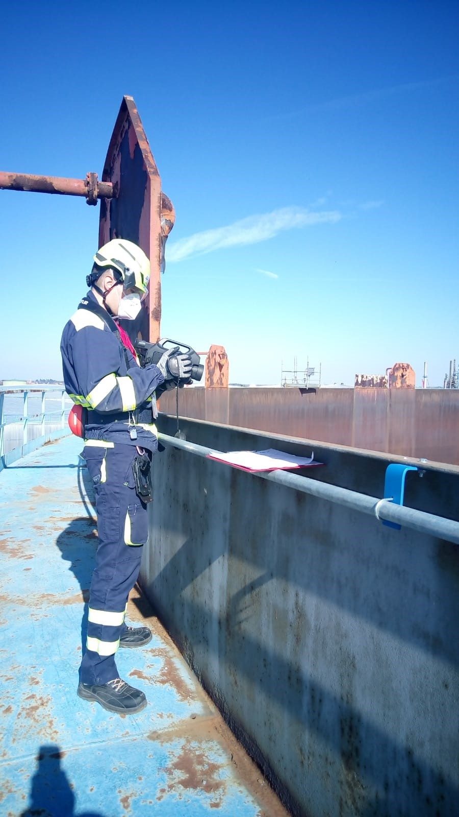
Smart LDAR
Measurement of leaks helps to categorize severity and prioritize repairs, significant impact to total emissions/recovery. The available approaches are:
Direct measurement (Hi-Flow Sampler). It is the most accurate method for leak flow rates
PPM Concentration (Method 21-EN 15446:2008). This methodology is the most widely employed because the FID-PID is a flexible and capable instrument
OGI leak rate estimation can be nearly as accurate as quantification when done by an experienced technician
QOGI –software to estimate leak rates can be effective in prime conditions but less so in field settings and it takes considerable time to get readings

Slide 11
OGI Pitfall
Corrections
Inexperienced with camera use and the concepts of OGI
Not using multiple camera angles
Constantly moving the camera from scene to scene without pausing in each view to look for gas leaks
Area where questionable thermal background is present that may reduce the detection capabilities of the camera
Scanning too fast and missing components/areas
Poor data management
Technicians follow a detailed and prescriptive inspection protocols
Maintain a high degree of Quality Control
Follow protocols that contain technical procedures, training requirements, and individual and team performance audits
Ensure that all processes and equipment are scanned
Continuously performing a qualitative analysis of the thermal properties of the background to ensure that adequate thermal background is present (multiple performance tests)
Ensure that all source data is consistently recorded
Database Management Systems

Slide 12
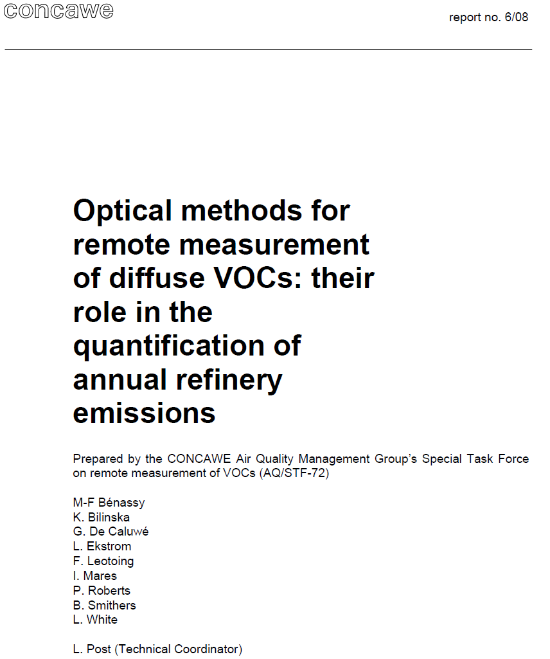
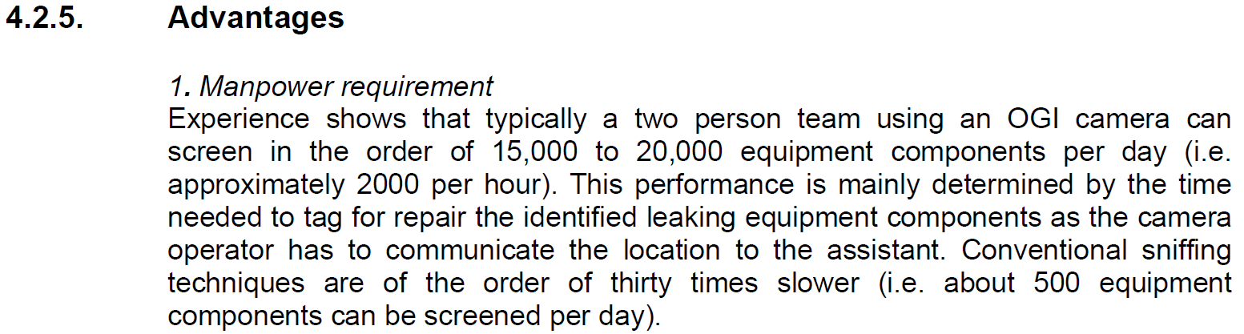
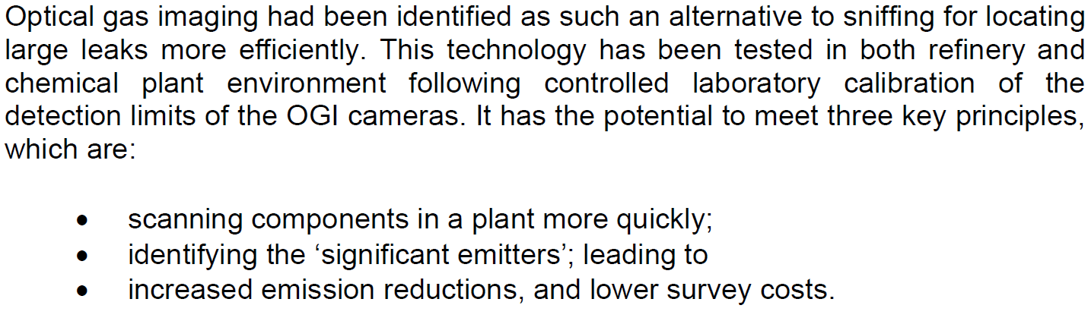
6.1.2

Slide 13
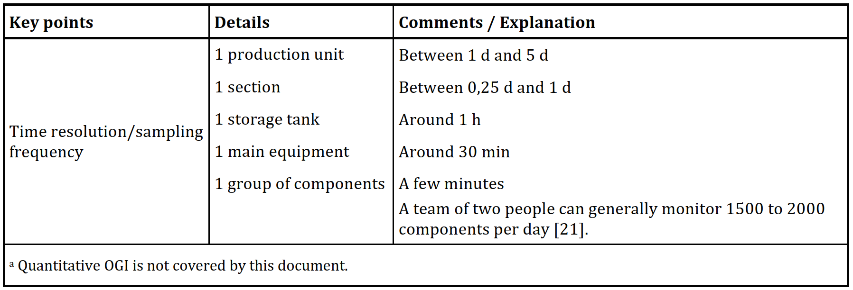
Timing – Table 5 EN 17628:2022

Slide 14
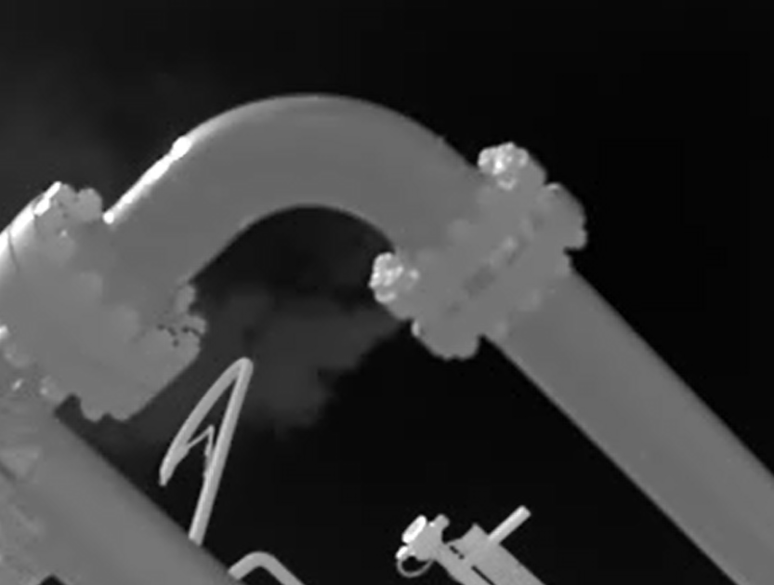
Smart LDAR examples
Some examples of OGI inspections during ‘Smart LDAR’ campaigns

Slide 15
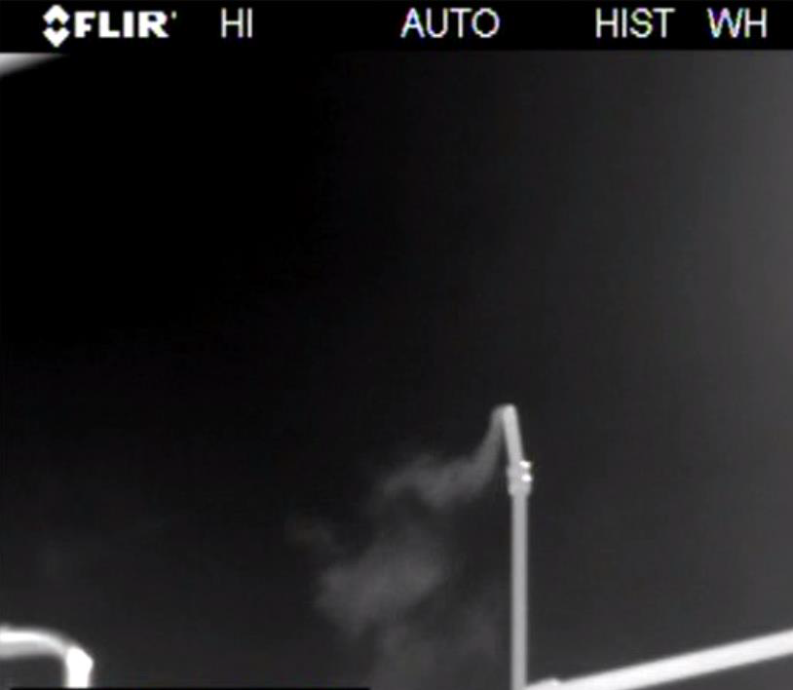
Smart LDAR examples

Slide 16
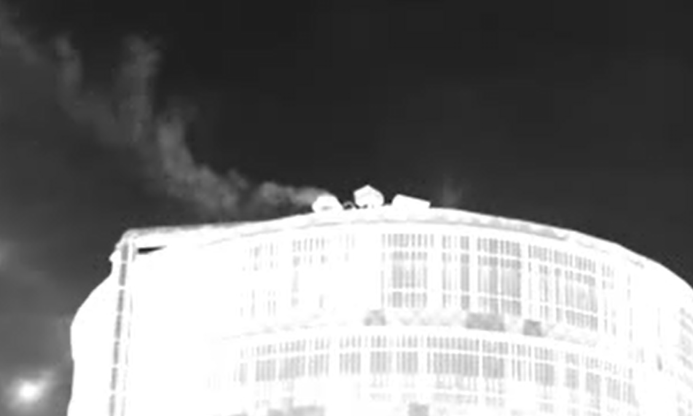
Smart LDAR examples

Slide 17
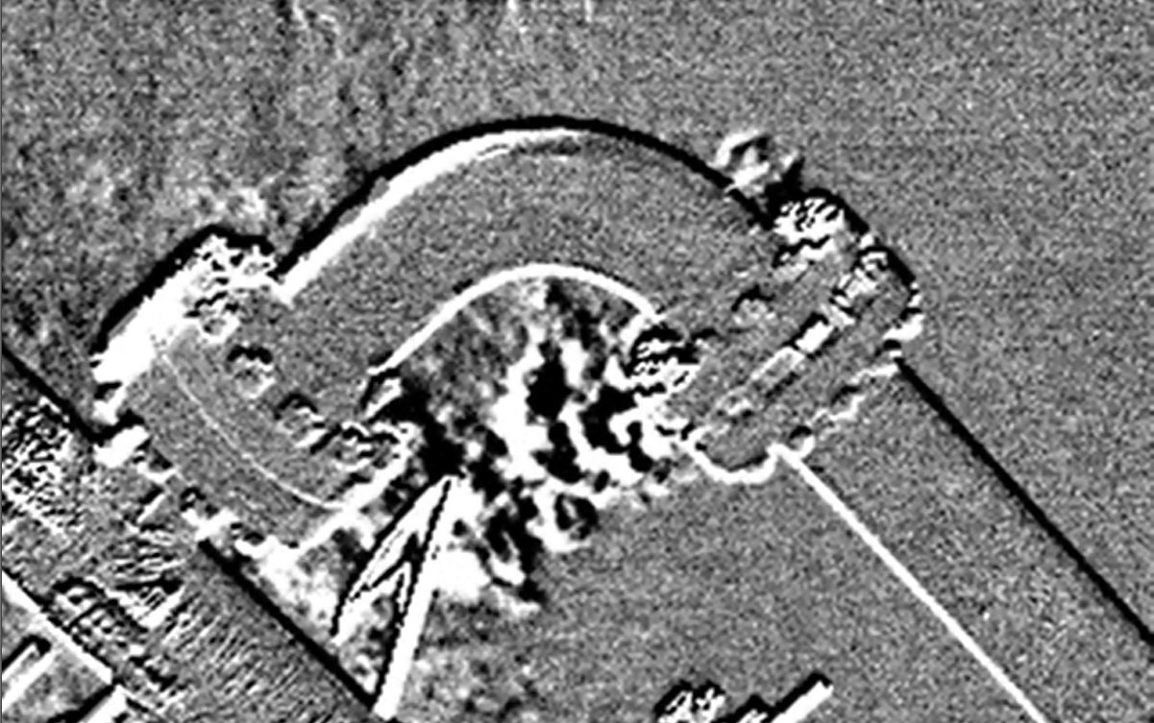
Smart LDAR examples

Slide 18
Thanks
ORGANIZING SECRETARIAT
Ph. +39 035 3230904
e-mail info@industrialvalvesummit.com
CONFERENCE ORGANIZERS
Ph. +39 3474908420
e-mail segreteria@valvecampus.com
www.industrialvalvesummit.com
www.valvecampus.com

