Slide 1
What exactly is a Severe Service Valve?
CONFERENCE
ORGANIZERS

Slide 2
What exactly is a Severe Service Valve?
David Bayreuther | Valmet Flow Control Inc.

Slide 3

Introduction
Over 40 years experience in valve and actuator design
Chairman of committee for ASME B16.34
Member of API subcommittee for piping and valves (SCOPV)
Board of Directors for Manufactuers Standardization Society (MSS)
Member of US TAG to ISO TC153, Valves

Slide 4
Many manufacturer’s advertise they make severe service valves
Our Diverse Selection of Severe Service Valves
Every system has different needs, and you need a severe service valve that matches them
Severe Service Valve
Severe service valves are used in the most difficult installations in your process plant
Severe Service Valve
We manufacture a unique line of severe service valves. The most challenging aspect of severe service valves is defining the scope that falls into this category
Severe Service Valves
We specialize in high performance valves for demanding applications

Slide 5

Severe service valve market analysis reports are available

Slide 6
Users of the term generally define severe service for valves as....
Commonly include cavitating, erosive, corrosive, noisy, high pressure, high temperature, high pressure drop, or high velocity media.
A severe service valve must withstand extreme conditions such as high pressures, corrosive environments, or fluctuating temperatures.
Designed for large mass flow rates and high differential pressures.
One area where no standards currently exist is for defining severe service valves.

Slide 7
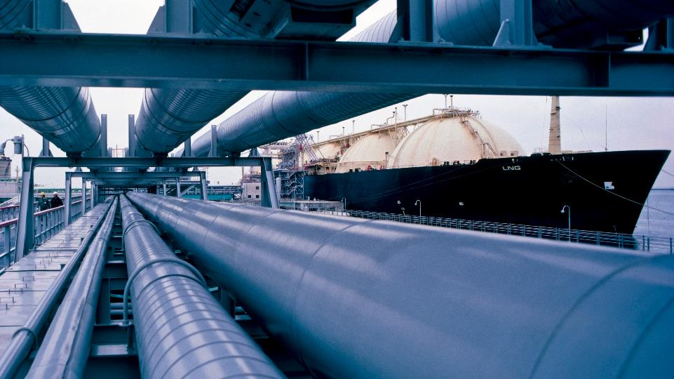
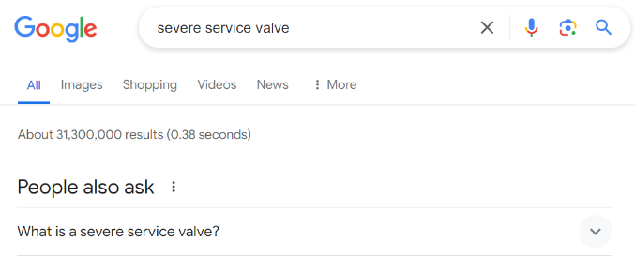


Internet search to learn the definition
ORGANIZERS
CONFERENCE ORGANIZERS

Slide 8
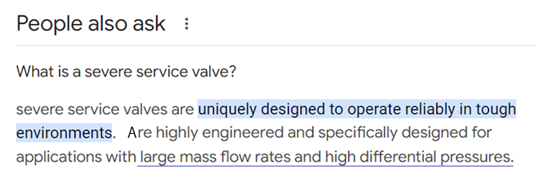
Internet search for the definition
ORGANIZERS
CONFERENCE ORGANIZERS

Slide 9
Typical definition for severe service
Is this list complete?
High temperature
High pressure / drop
Abrasive slurries
Corrosive media
Large flow rate
ORGANIZERS
CONFERENCE ORGANIZERS

Slide 10
Magnitude of the parameters are not defined
What constitutes an abrasive slurry?
What classifies a corrosive media?
What is considered a high pressure, high temperature, high flow rate?
Are there any other service conditions affect valve type selection and design?

Slide 11

Manufacturers Standardization Society (MSS) defines severe service valve

Slide 12

MSS introduction
Manufacturers Standardization Society develops standards for the valve and fittings industry
Celebrating 100 years
Over 115 member companies
12 technical committees responsible 90+ standards
Manages US TAG participation in ISO TC153, Valves
Technical voice of the industry
CONFERENCE ORGANIZERS

Slide 13
Are there other service conditions that affect selection of valve type and design?
ORGANIZERS
CONFERENCE ORGANIZERS

Slide 14
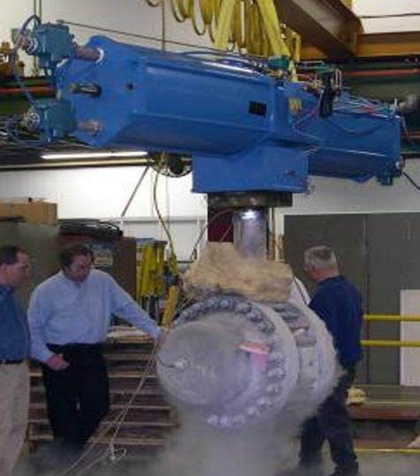
Speed of operation
NPS 24 Class 600 cryogenic butterfly valve
Closing in less than ½ sec.

Slide 15
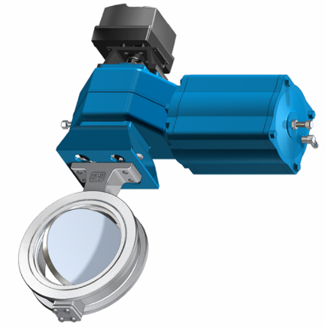
Frequency of operation
NPS 24 Class 150 butterfly valve opening and closing in less than ½ sec.
1,5 million times per year
5 years before servicing
CONFERENCE ORGANIZERS

Slide 16
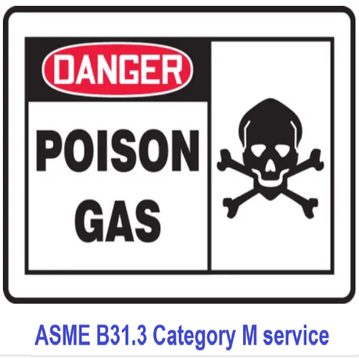
Lethal service (toxic media)
Chlorine
Phosgene
Hydrogen cyanide
Methyl isocyanate

Slide 17
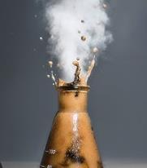
Highly reactive fluid
Decomposition of >50% concentration Hydrogen Peroxide

Slide 18
Other conditions of concern
Flow velocity - gas, liquid, slurries
Scaling media (calcium and magnesium salt)
Slurries – how much and how abrasive?
Flammability (e.g., diesel vs hydrogen)
Multi-phase flow (single, two, and three-phase)
Combinations of such conditions?
CONFERENCE ORGANIZERS

Slide 19
How was the MSS criteria developed?
MSS formed a group of experts to develop list of severe service conditions for valves
Experts assigned a numerical score for each condition
Challenging applications were scored by multiple experts to define a ranking scale
Shop air valve – 6 pts
Chlorine valve – 25 pts
Oxygen gas valve – 28 pts
H₂ PSA switch valve – 23 pts
Distallation tower furnace isolation valve – 48 pts
HF acid rapid evac valve – 52 pts
CCR reactor isolation valve – 59 pts
FCCU catalyst withdrawl valve – 69 pts

Slide 20
Three categories in new MSS standard
General purpose
Fit-for-purpose
Severe service
Typically produced in large quantities
Comply with one or more common industry standards
Sometimes referred to as commodity valves
Regularly available in Distributor stock
General purpose valve modified with one or more alterations:
- part dimensions
- materials of construction
- factory cleaning
- surface preparations
- extra testing (leak, NDT, etc.)
- packaging
Specifically engineered for an application which is beyond the capabilities of general purpose and fit-for-purpose valves
Design features that enhance service life and overall performance to that required by the specific service conditions

Slide 21
Category identification and guidelines
General purpose
Fit-for-purpose
Severe service
< 20 pts
20 to 50 pts
> 50 pts
Requests for additional testing and inspections beyond those required by the applicable product standard are generally unnecessary
Additional inspection and testing beyond those required by the applicable product standard may be appropriate to ensure the valve is prepared and suitable for the service conditions
Consultation with the manufacturer may be required
Valves that are specifically engineered for the application
Consultation with the manufacturer is recommended

Slide 22
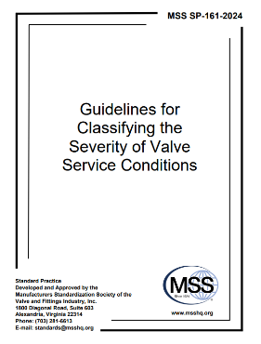
Why is this standard important?
Capitol cost
Plant reliability
Safety
Environment
ORGANIZERS
CONFERENCE ORGANIZERS

Slide 23
Thank you
ORGANIZING SECRETARIAT
Ph. +39 035 3230904
e-mail info@industrialvalvesummit.com
CONFERENCE ORGANIZERS
Ph. +39 3474908420
e-mail segreteria@valvecampus.com
www.industrialvalvesummit.com
www.valvecampus.com

