Slide 1
Combined multistage trims for managing of very severe cavitation applications
CONFERENCE
ORGANIZERS

Slide 2
Combined multistage trims for managing of very severe cavitation applications
Filippo Carlo Bossi | Senior Design Engineer, Ph.D.

Slide 3

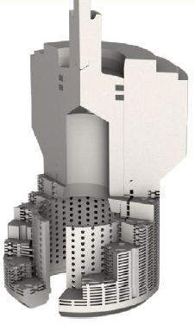
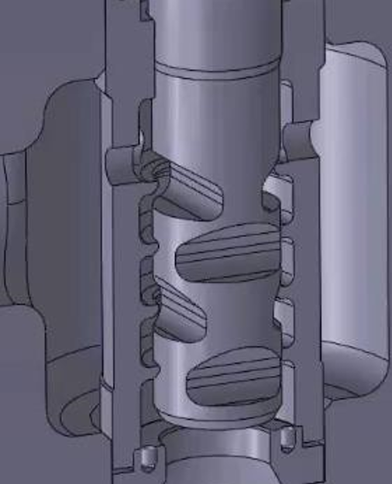
Introduction
When working with high pressure liquid a common valve solution is to use multistage trims to subdived the pressure drop and to contain the flow speed.
Common proposed trim types are:
Multi-path, multi-stage.
Single-path, multi-stage.

Slide 4
Introduction
Both of them has its own benefits and limits:
Multi-path, multi-stage:
has high number of stages that develop radially but it is limited by the internal diameter of the body
has a single plug that control the flowing area partializing and opening le labyrith sections one by one
the plug need a small gap between the plug and the labyrith stack
Single-path, multi-stage:
the stages develop axially, this limit the stage max number to around 8
all the stages move together giving a continous control of the flow

Slide 5
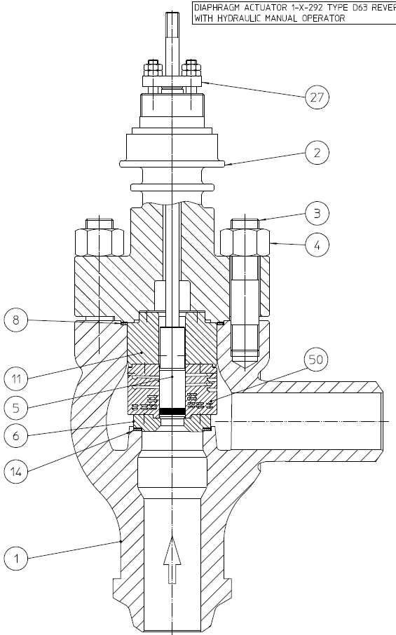
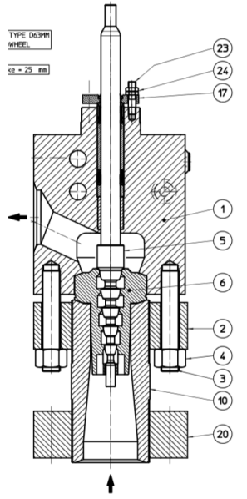
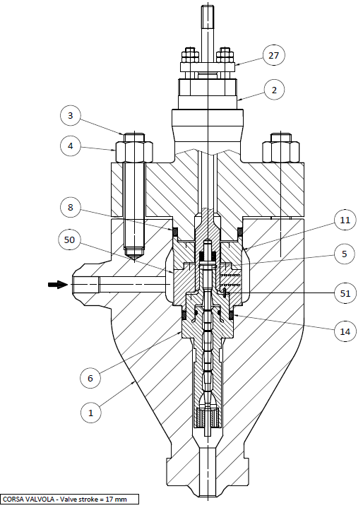
Introduction
Taking the best of both types
Single-Path
Multi-Stage
Hybrid-Path
Multi-Stage
Multi-Path
Multi-Stage
Expanding
Cascade
Trim
Tandem
Plug
Limiphon
Additive
Manufacturing

Slide 6
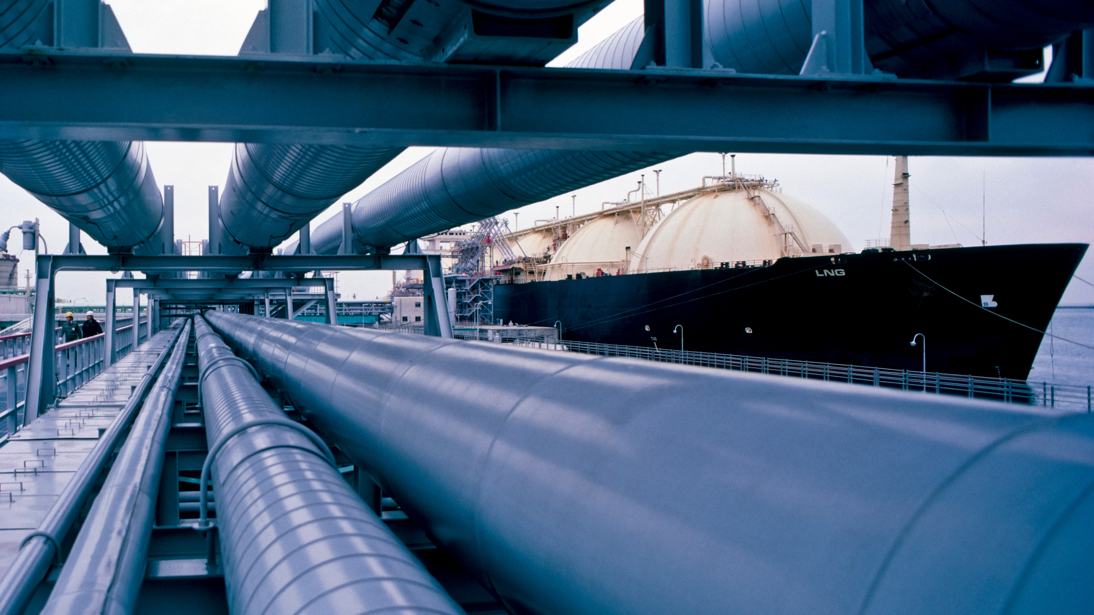


1) Risks associated with high Pressure Drop / High Speed:
- Examples, Criteria and International standard
2) Case Studies and Previous Experiences:
- Analysis and Experiments
3) Current Project:
- Modeling of Tandem Plug
ORGANIZERS
CONFERENCE ORGANIZERS

Slide 7
1) Risks associated with high Pressure Drop / High Speed:
- Examples, Criteria and International standard
2) Case Studies and Previous Experiences:
- Analysis and Experiments
3) Current Project:
- Modeling of Tandem Plug
ORGANIZERS
CONFERENCE ORGANIZERS

Slide 8
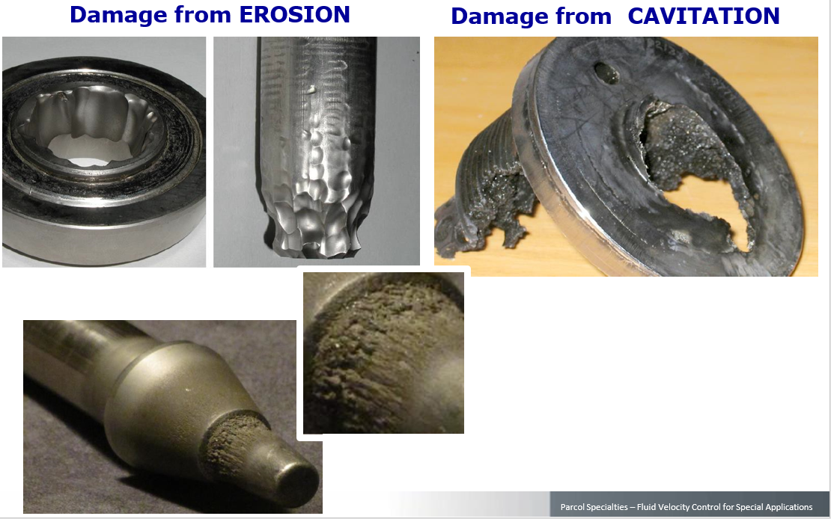
Examples
Typical cavitation and high speed associated damages

Slide 9
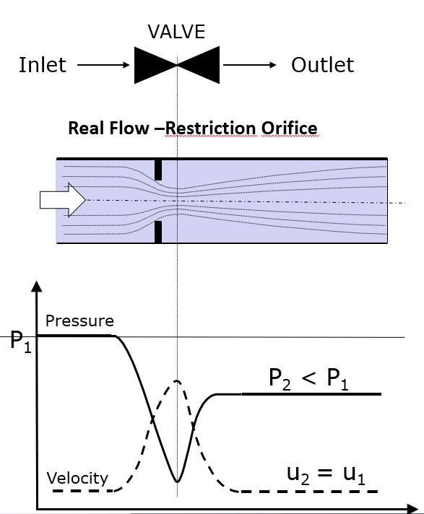
Physics behind
To reduce the pressure, a valve need to dissipate energy.
Energy dissipation is usually obtained by restriction, expansion and change of direction
The simplest example is the orifice

Slide 10
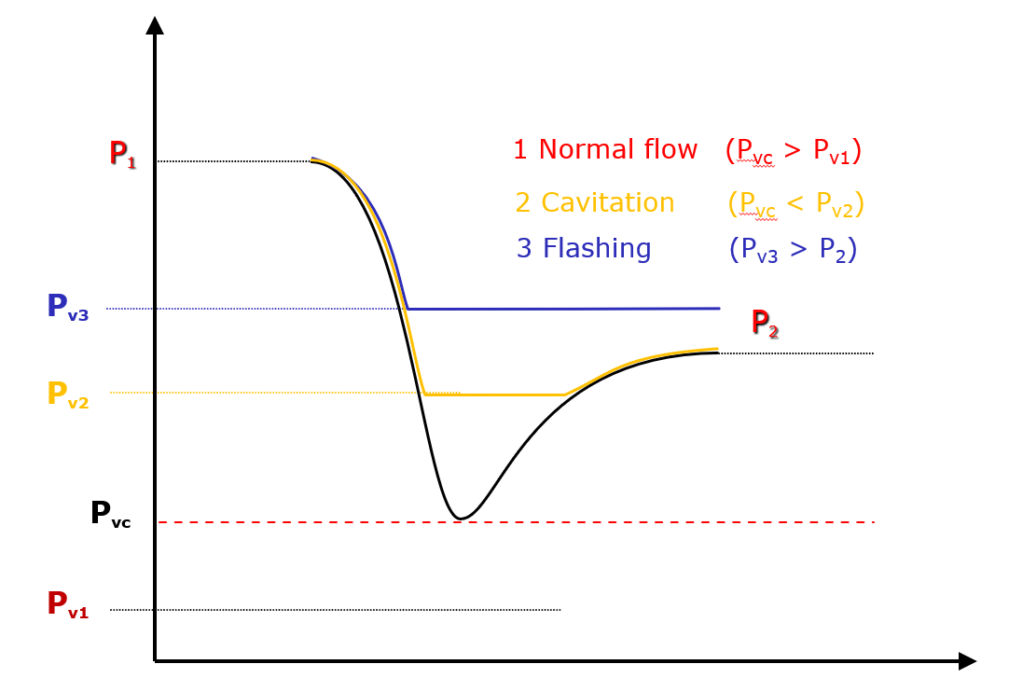
Physics behind
Cavitation is a phenomenon correleted with the fluid vapor pressure
When the local pressure goes below the P_vap, gases are released from the liquid phase
The gas bubbles then collapse as the pressure increase

Slide 11
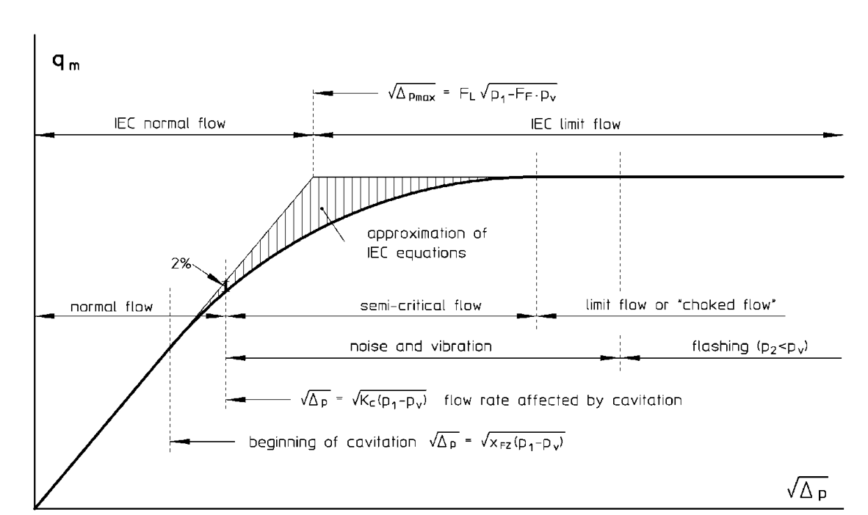

IEC 60534 approach to cavitation
$$X_{F}=\frac{∆_{P}}{P_{1}−P_{v}}$$
The IEC criterion need to determine all the required parameters (Xfz, Kc, Fl)
It’s precise, but focus only on cavitation (also on caviation noise…)

Slide 12
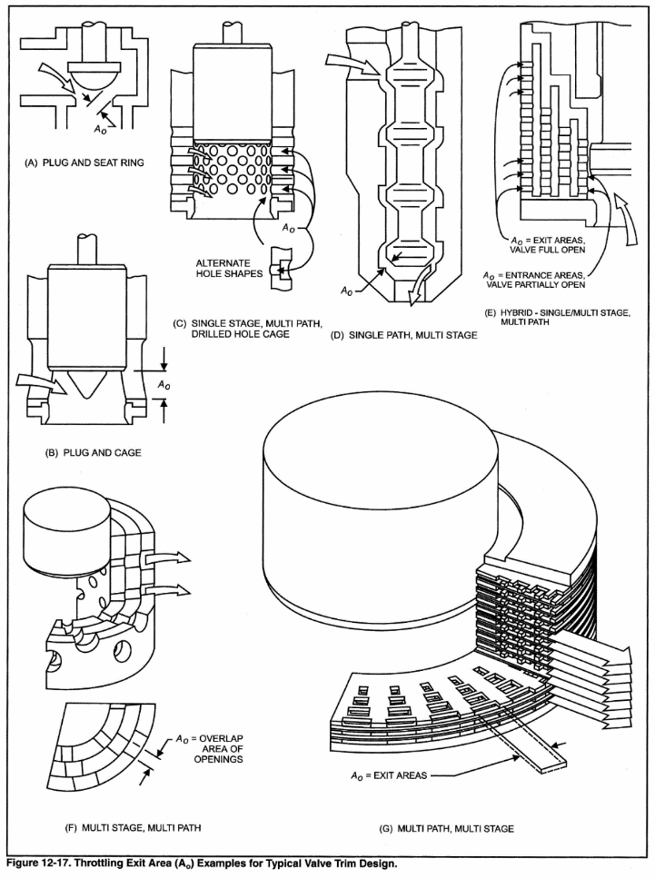
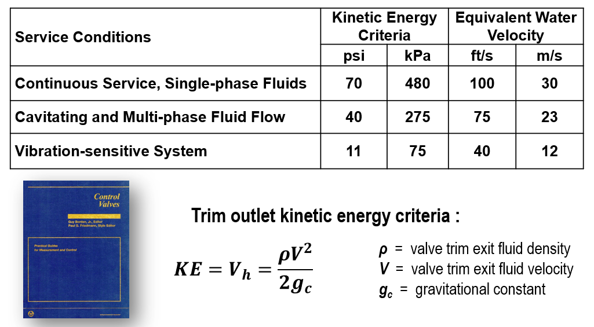
ISA approach to flow speed

Slide 13
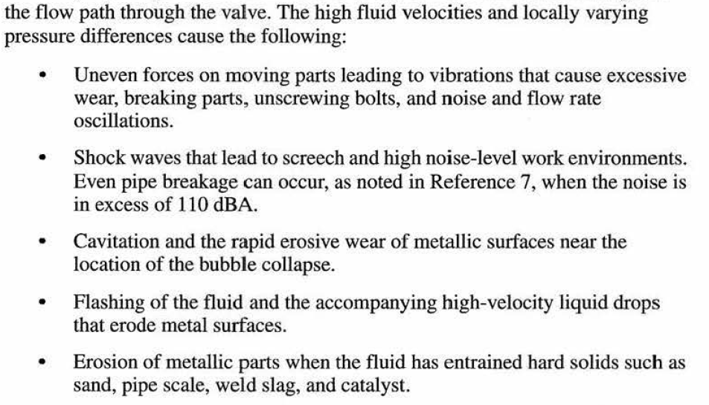
ISA approach to flow speed
Extraction from ISA Control Valve book
The ISA criterion trays to answer with a single parameter (K.E.) a variety of problems (see extraction beside)
It is useful and of simple application, but may not be so accurate
<<…
…>>

Slide 14

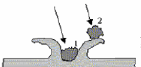

Other approaches to erosion
Abrasion
When solids are entrained into the flow, erosion is much faster then by clean fluid
Different formulations can be found in literature (Reye, Petry, etc..)
Erosion mechanisms are different mainly based on the angle of attack
Small angle of impact
Direct impact
Plastic deformation / fusion
∆P > 1000 bar
Water Jet
V > 450 m/s
Parcol has his own formulation for erosion index (I.E.)
$$I.E.=f(ρ, V,HB)$$

Slide 15
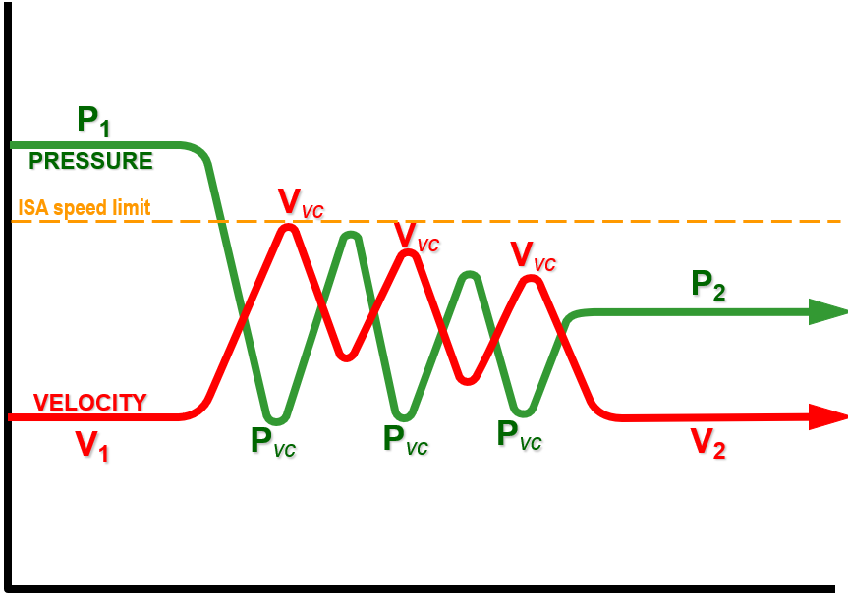
Best practice solution
The best way to manage all the problems above mentioned is the use of Multi-Stage trims
Subdiving the total pressure drop in smallest ones allows to reduce the speed and the cavitation potetial
The number of stages depends on the established criteria (IEC, ISA, etc…)
P_vap

Slide 16
1) Risks associated with high Pressure Drop / High Speed:
- Examples, Criteria and International standard
2) Case Studies and Previous Experiences:
- Analysis and Experiments
3) Current Project:
- Modeling of Tandem Plug
ORGANIZERS
CONFERENCE ORGANIZERS

Slide 17
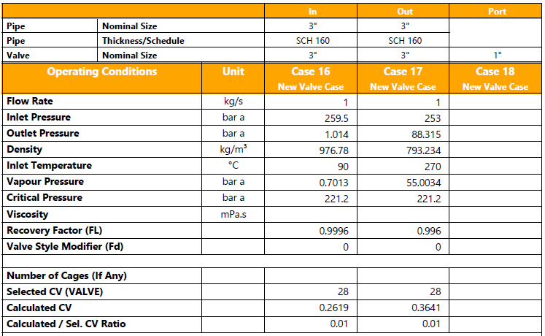
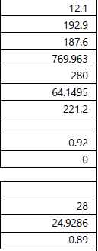
Case Study: OTC application
Service conditions:
∆P_max = 258.5 bar
X_{F}_max = 0.9988
Cv_max = 24.9
Cv_min = 0.262
Rangeability = 95
Intermediate cases with:
∆P_ref = 100 bar
X_{F}_ref = 0.65
During start-up, the conditions are extreme!
Frequent start-up and shut down
Case Min
Start-UP
Case Max
Run

Slide 18
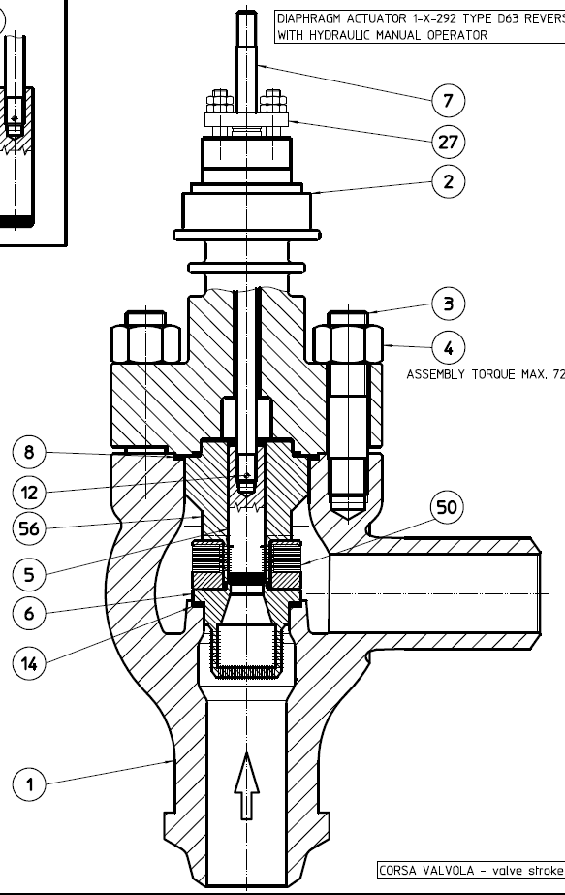
Case Study: trim selection
56 – CAGE
Material : F6NM nitrided
Hardness : 1000 HV (on the surface only)
5 – PLUG
Material : F6NM nitrided
Hardness : 1000 HV (on the surface only)
Standard Limiphon trim
(Multi-Path, Multi-Stages)
50 – LIMIPHON DISC STACK
Material : 1.4913
Limiphon disc stack’s with expansion ratio (increasing of flow passage between inlet and outlet)
6 – SEAT
Material : AISI 316 stellited
Hardness : 44 HRC in the contact surface area
1 – FLOW TO OPEN
Flow to open design is used to maximize valve’s Cv, since the flow path area of the limiphon disc stack increases with increasing of the diameter of the disc stack itself.

Slide 19
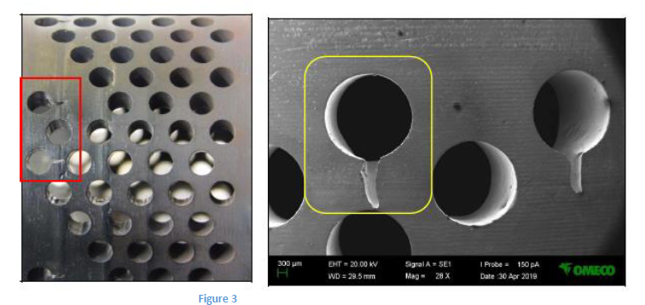
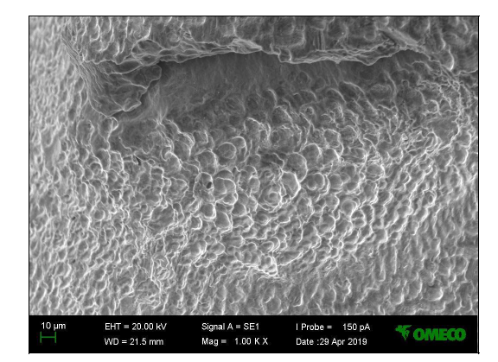
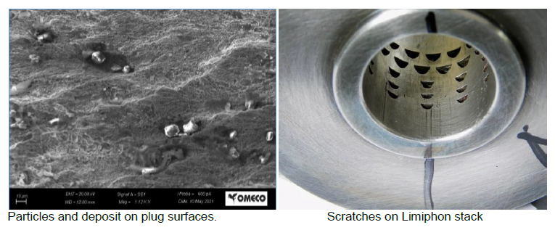
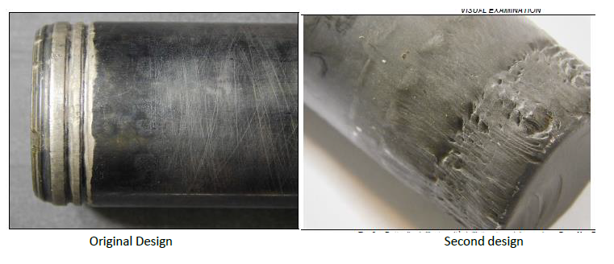
Case Study: first field feedback
Trim got damaged in 3 months
The damage extension was so strong that was impossible to control the minimum flow required
Plug tip and cage holes (closer to the seat - firstly opened at lower travels) where strongly eroded
After laboratory analysis, the cause was mainly identified as cavitation and secondarily by hard particles found in the metal surface (impact erosion)

Slide 20
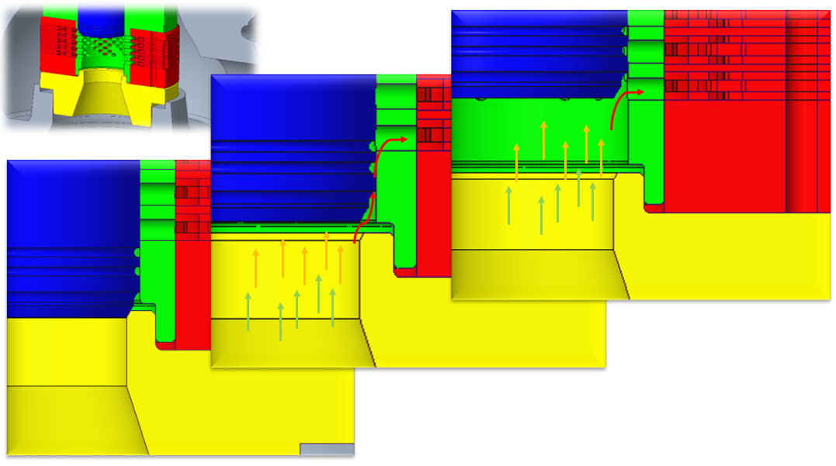
Case Study: first design analysis
Since the highest damaged parts where found to be at the first openings, the design analysis was firstly focused on the clearance flow between plug and cage
First row fully open
Valve working in the clearance flow
Valve close

Slide 21
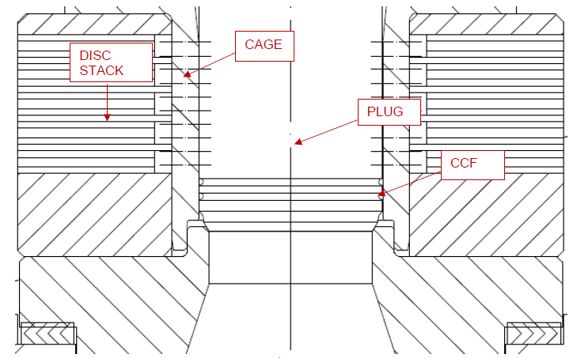
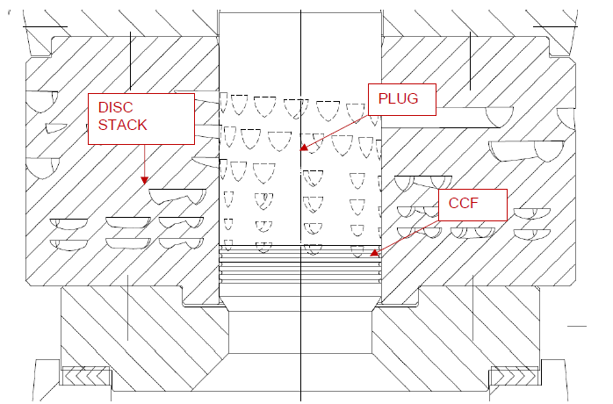
Case Study: first design analysis
Design Upgrade:
Elimination of cage -> single piece additive manufacturing limiphon stack
Adding more CCF to increase pressure loss
Change of materials:
from F6NM nitrided to INCONEL 718 44 HRC for DISK STACK
from F6NM nitrided to full TCC for PLUG
INCONEL has high Yield Strength and is very though and Age hardening allow the same properties for the whole thickness
TCC is known to be very hard and very high rupture (unfortunately is fragile…)

Slide 22
Case Study: second field feedback and design analysis
Trim got damaged in 1 month
TCC plug lost almost 1 mm on the external diameter
No significant damages on the limiphon stack (scratches)

Slide 23
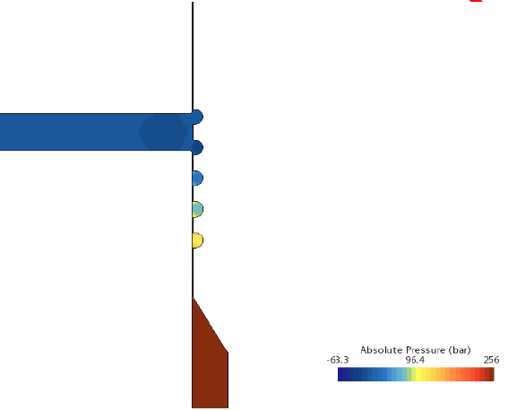
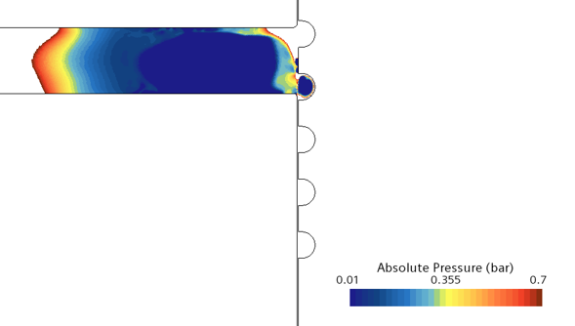
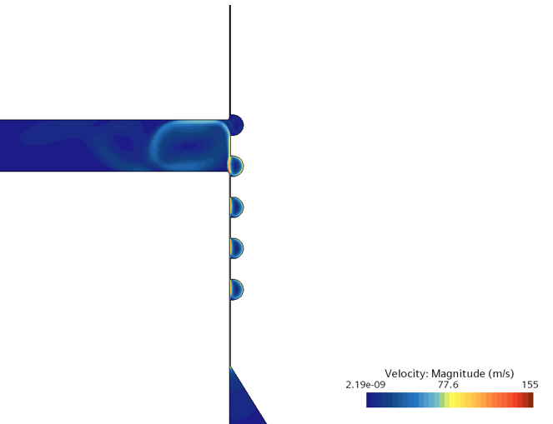
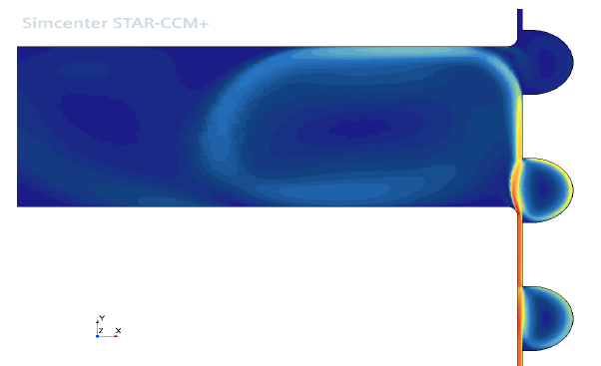
Case Study: second field feedback and design analysis
Trim got damaged in 1 month
TCC plug lost almost 1 mm on the external diameter
No significant damages on the limiphon stack (scratches)
With cavitation modeling activated
After CFD analysis:
∆P = 255 bar
The pressure minima were found at the CCF
The peak clearance speed to be 155 m/s!

Slide 24
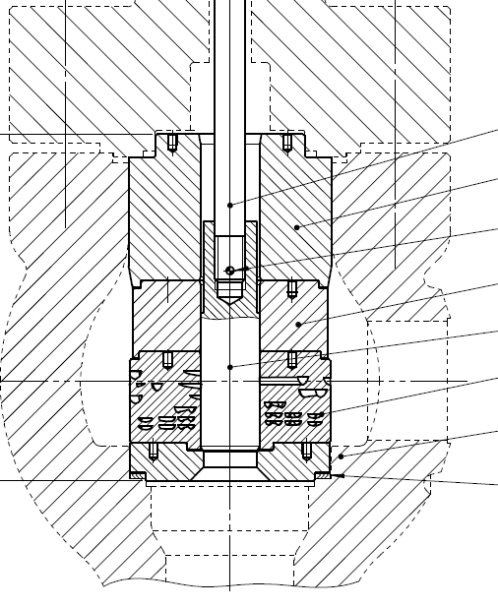
Case Study: second design analysis
Design Upgrade:
Elimination of the CCF
Change of materials:
from full TCC to INCONEL 718 44 HRC for PLUG
07 - stem
11 - adapter
12 - pin
11a - adapter
Ugraded to INCONEL 718
05 - plug
50 - limiphon pack
06 - seat
14 - gasket

Slide 25
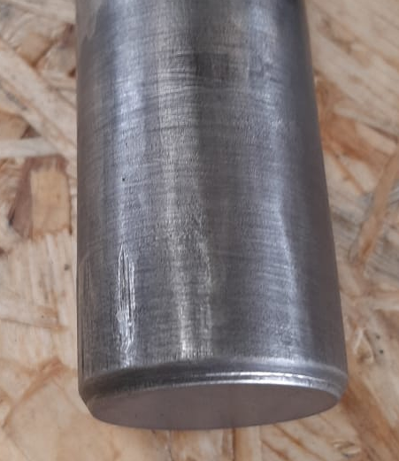
Case Study: second design analysis
Design Upgrade:
Elimination of the CCF
Change of materials:
from full TCC to INCONEL 718 44 HRC for PLUG
The final solution last more than 1.5 year
07 - stem
11 - adapter
12 - pin
11a - adapter
Ugraded to INCONEL 718
05 - plug
50 - limiphon pack
06 - seat
14 - gasket

Slide 26
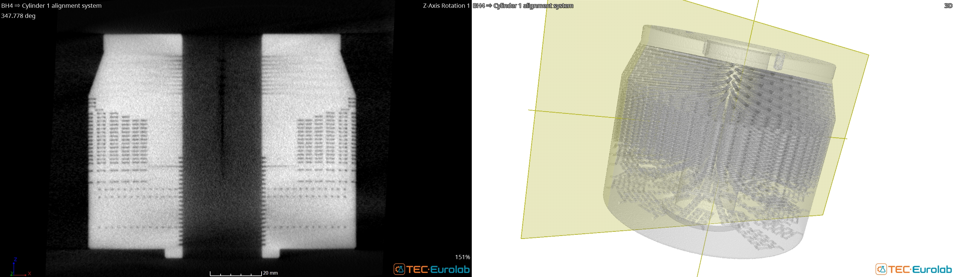
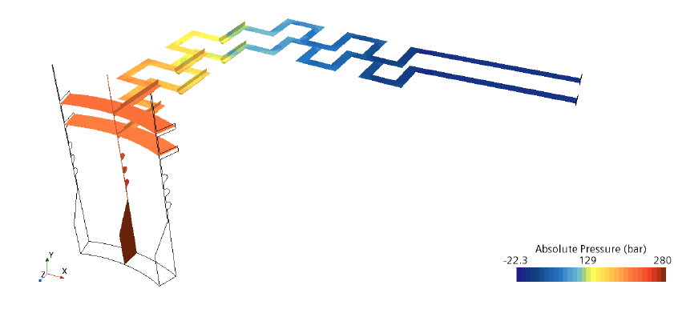
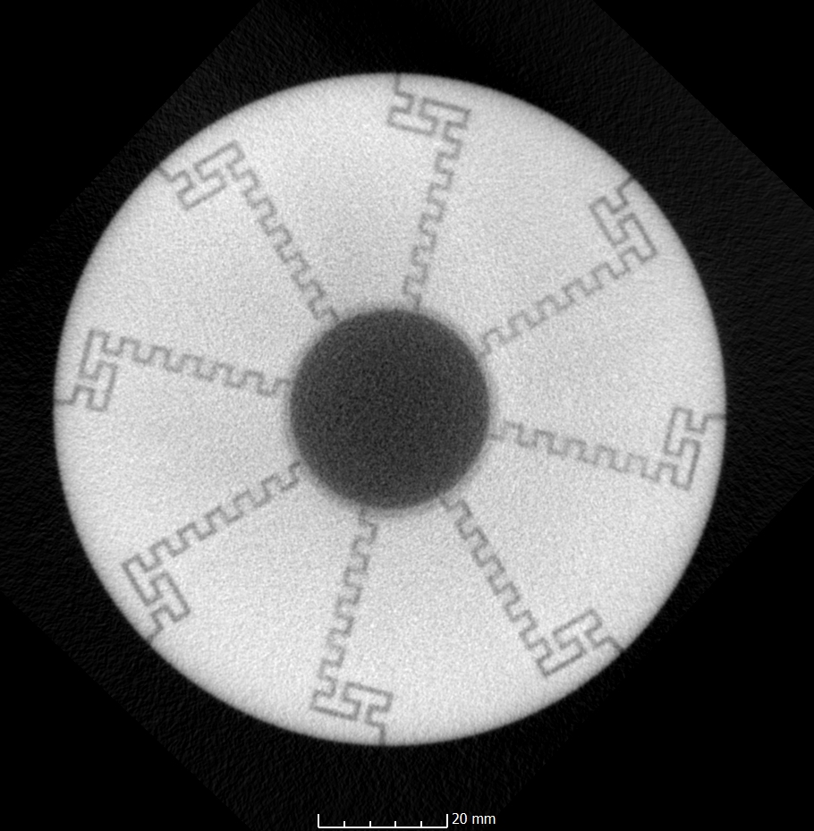
Case Study:
experimental investigation
Desing changes:
Adding of equalizing channels -> smoother velocity profile at labyrinth entrance
Reducing the labyrinth section to Øe = 0.8 mm
After CFD analysis:
∆P = 280 bar
Equalizing channels

Slide 27
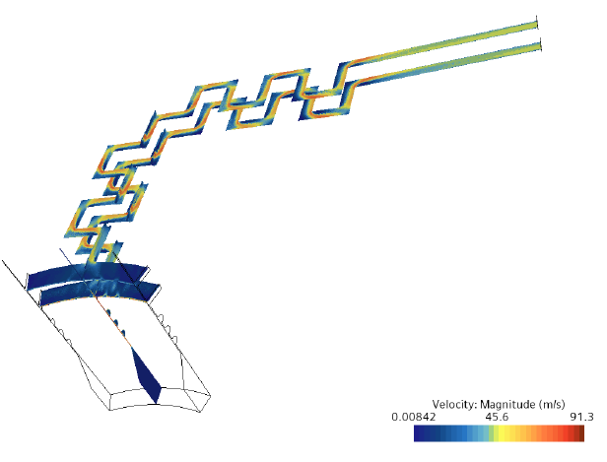
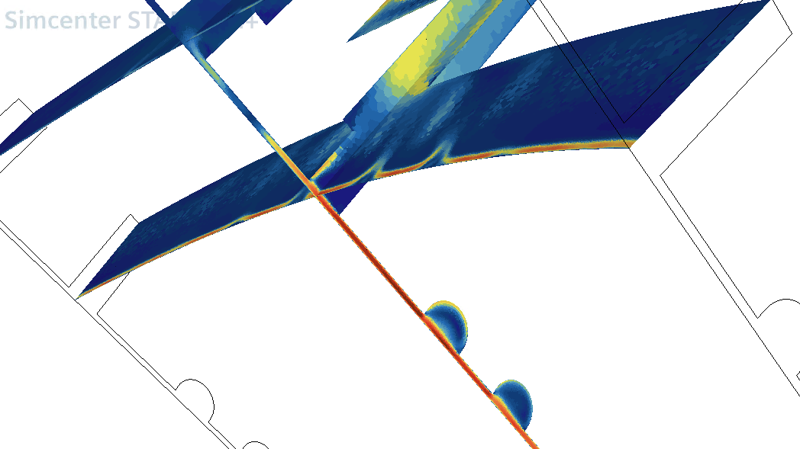
Case Study:
experimental investigation
Desing changes:
Adding of equalizing channels -> smoother velocity profile at labyrinth entrance
Reducing the labyrinth section to Øe = 0.8 mm
After CFD analysis:
∆P = 280 bar
The peak clearance speed to be 91.3 m/s
Equalizing channels

Slide 28
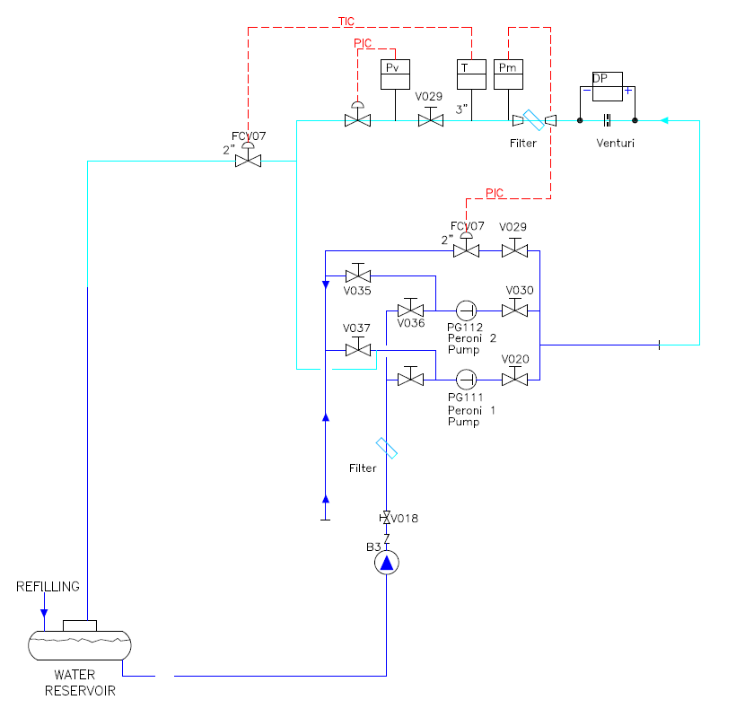
Case Study:
experimental investigation
IETI Testing loop @SIET (Piacenza, ITALY):
∆P = 230 bar
X_{F} = 0.99
Travel = 15% (first labyrinth rows fully open)
Endurance test = 5 continuous days

Slide 29
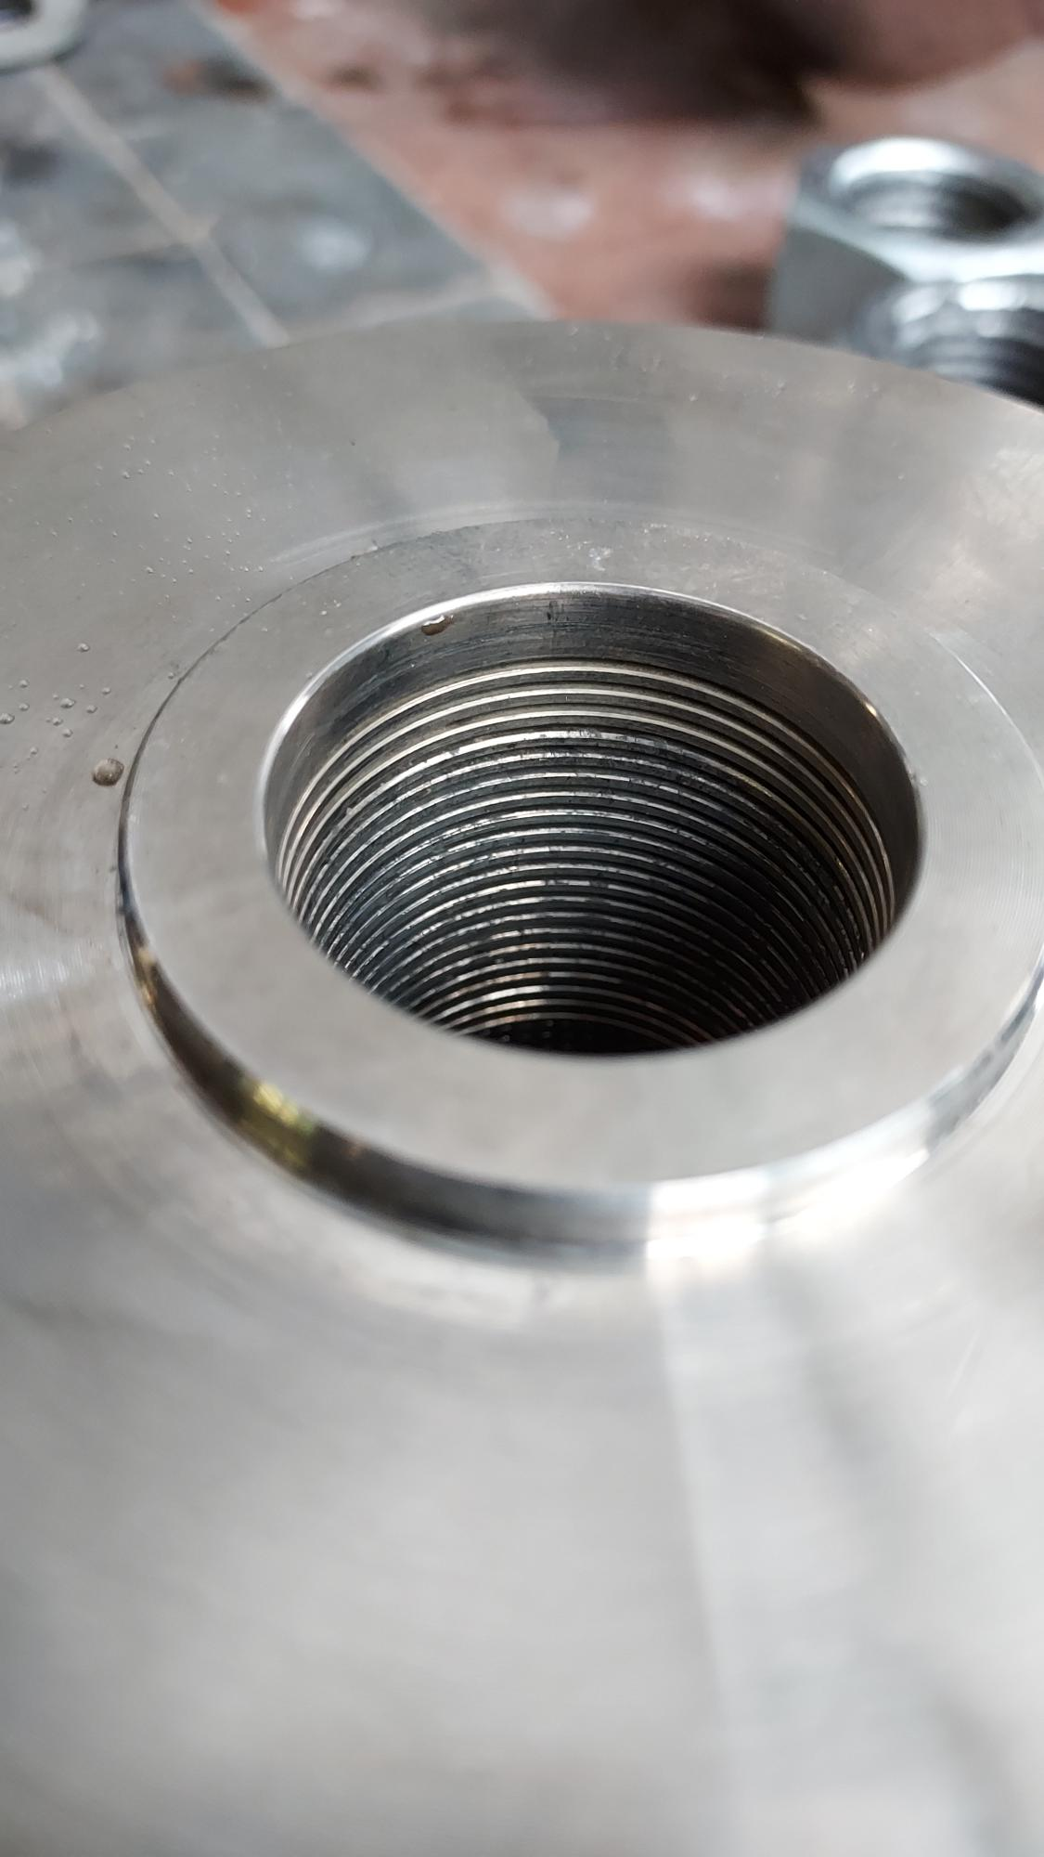
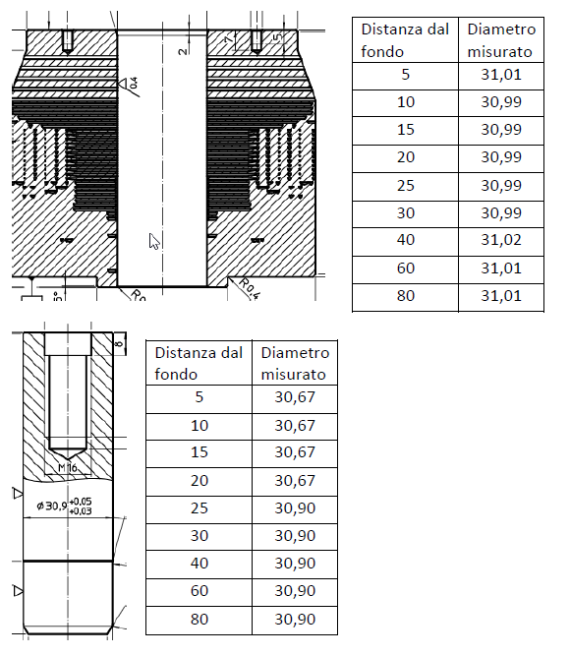
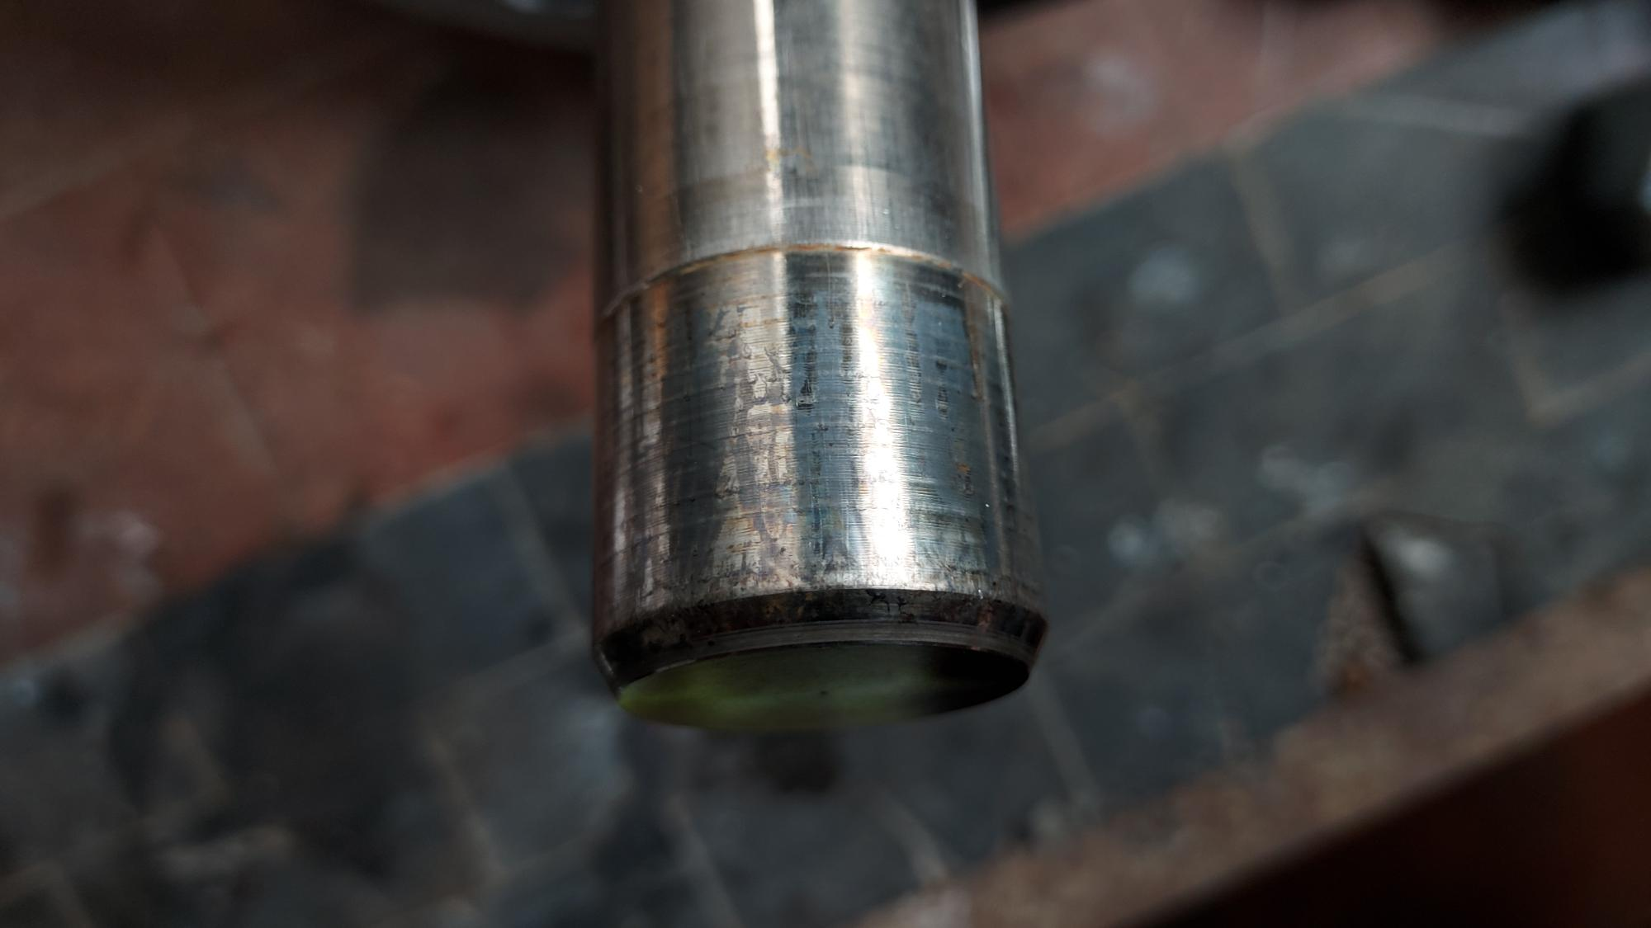
Case Study:
experimental investigation
IETI Testing loop @SIET (Piacenza, ITALY):
∆P = 230 bar
X_{F} = 0.99
Travel = 15% (first labyrinth rows fully open)
Endurance test = 5 continuous days
Results:
No damage found
Risk of clogging the small passage areas
Maching of channels and AM repetibilty are critical
Nominal value = 31 mm
Nominal value = 30.67 mm
Nominal value = 30.9 mm

Slide 30
1) Risks associated with high Pressure Drop / High Speed:
- Examples, Criteria and International standard
2) Case Studies and Previous Experiences:
- Analysis and Experiments
3) Current Project:
- Modeling of Tandem Plug
ORGANIZERS
CONFERENCE ORGANIZERS

Slide 31
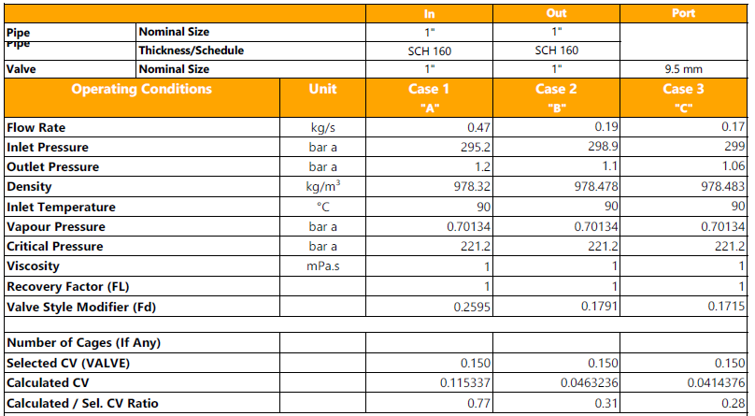
Current Project: Heat Exchange (experimental)
Service conditions:
∆P_max = 298 bar
X_{F}_max = 0.9988
Cv_max = 0.115
Cv_min = 0.0414
Rangeability = 2.78
Extreme conditions in all cases!
Microflow application!
Requested service life 1 year
Case Max
Case Min

Slide 32
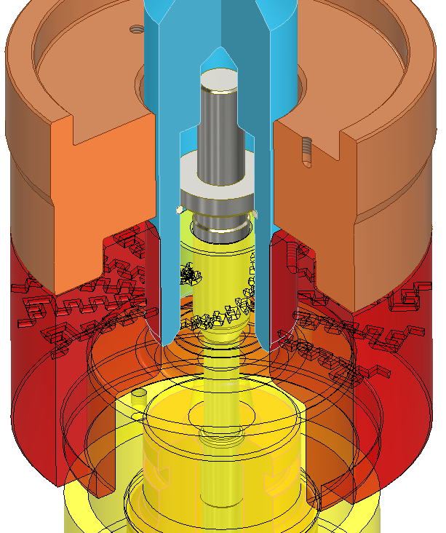
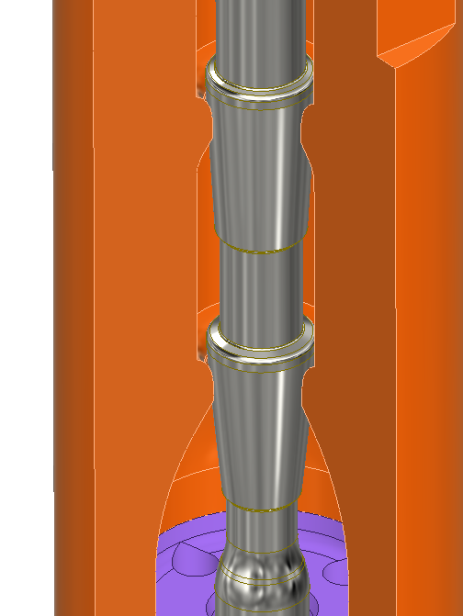
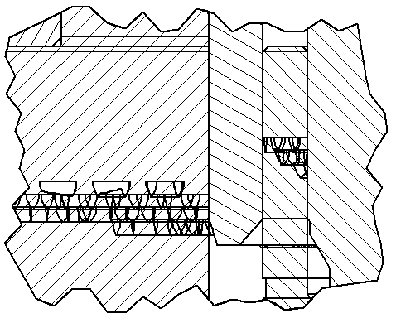
Current Project: trim selection
Hybrid Multi-Stage Tandem trim -> 2 valves in 1
Main features:
Flow to close to take the advantages of cascade trim
30 labyrinth stages + 5 cascade stages
1 additional disc at outlet (fixed resistance)
3 additional stages granted by the tandem plug
Internals in INCONEL 718 - 44 HRC

Slide 33
Current Project: modeling of Tandem Plug
Tandem plug has the function to:
increase the number stages when the plug partialized the labyrinth entrance
protect the sealing surface
Tandem plug
simplifying
Tandem cage

Slide 34

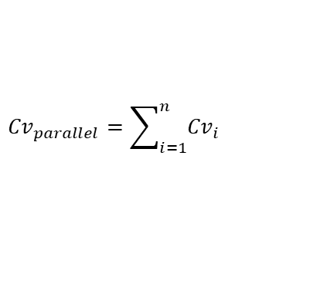
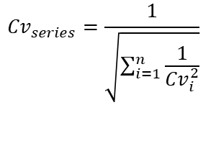
Current Project: modeling of Tandem Plug
Modeling scheme:
The flow paths can be seen a number of resistances in series and parallel
Every elements having its own parameters (Cv, F_{L}, etc…)
$$Q=k_{1}∙Cv∙\sqrt{\frac{∆p}{ρ/ρ_{0}}}$$
Stage
Clearence
Interstage
$${Cv}_{series}=\frac{1}{\sqrt{\sum_{i=1}^{n}{\frac{1}{{Cv}_{i}^{2}}}}}$$
P_in
Q_in
Conditions:
Q_in = Q_out
P_out
Q_out
$${Cv}_{parallel}=\sum_{i=1}^{n}{{Cv}_{i}}$$

Slide 35
Current Project: modeling of Tandem Plug
Modeling scheme:
Reducing to only one parallel path
Node
Stage
Clearence
Interstage
N1.2
S2
N2.2
C1
C2
P_in
Q_in
P_out
Q_out
N0
I1
N1.1
S1
N2.1
I2
N3
Conditions:
Q_in = Q_out = Q_S1+Q_C1,S2,C2
∆P_N1.1,N2.1 = ∆P_S1 = ∆P_C1,S2,C2

Slide 36
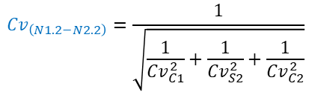
Current Project: modeling of Tandem Plug
Node
Modeling scheme:
Considering the intermediate path in series
Stage
Clearence
Interstage
Cv_series
$${Cv}_{\left(N1.2−N2.2\right)}=\frac{1}{\sqrt{\frac{1}{{Cv}_{C1}^{2}}+\frac{1}{{Cv}_{S2}^{2}}+\frac{1}{{Cv}_{C2}^{2}}}}$$
N1.2
S2
N2.2
C1
C2
P_in
Q_in
P_out
Q_out
N0
I1
N1.1
S1
N2.1
I2
N3
Conditions:
Q_in = Q_out = Q_S1+Q_C1,S2,C2
∆P_N1.1,N2.1 = ∆P_S1 = ∆P_C1,S2,C2

Slide 37

Current Project: modeling of Tandem Plug
Node
Modeling scheme:
Grouping the parallel path
Stage
Clearence
Interstage
Cv_series
$${Cv}_{\left(N1.2−N2.2\right)}=\frac{1}{\sqrt{\frac{1}{{Cv}_{C1}^{2}}+\frac{1}{{Cv}_{S2}^{2}}+\frac{1}{{Cv}_{C2}^{2}}}}$$
N1.2
S2
N2.2
C1
C2
P_in
Q_in
P_out
Q_out
N0
I1
N1.1
S1
N2.1
I2
N3
Conditions:
Q_in = Q_out = Q_S1+Q_C1,S2,C2
∆P_N1.1,N2.1 = ∆P_S1 = ∆P_C1,S2,C2
$${Cv}_{\left(N1.1−N2.1\right)}={Cv}_{S1}+{Cv}_{(N1.2−N2.2)}$$
Cv_parallel

Slide 38
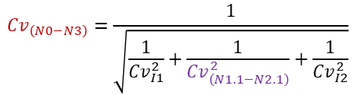
Current Project: modeling of Tandem Plug
Modeling scheme:
Obtaining the full path in series
Node
Stage
Clearence
Interstage
Cv_series
$${Cv}_{\left(N0−N3\right)}=\frac{1}{\sqrt{\frac{1}{{Cv}_{I1}^{2}}+\frac{1}{{Cv}_{\left(N1.1−N2.1\right)}^{2}}+\frac{1}{{Cv}_{I2}^{2}}}}$$
Cv_series
$${Cv}_{\left(N1.2−N2.2\right)}=\frac{1}{\sqrt{\frac{1}{{Cv}_{C1}^{2}}+\frac{1}{{Cv}_{S2}^{2}}+\frac{1}{{Cv}_{C2}^{2}}}}$$
N1.2
S2
N2.2
C1
C2
P_in
Q_in
P_out
Q_out
N0
I1
N1.1
S1
N2.1
I2
N3
Conditions:
Q_in = Q_out = Q_S1+Q_C1,S2,C2
∆P_N1.1,N2.1 = ∆P_S1 = ∆P_C1,S2,C2
$${Cv}_{\left(N1.1−N2.1\right)}={Cv}_{S1}+{Cv}_{(N1.2−N2.2)}$$
Cv_parallel

Slide 39
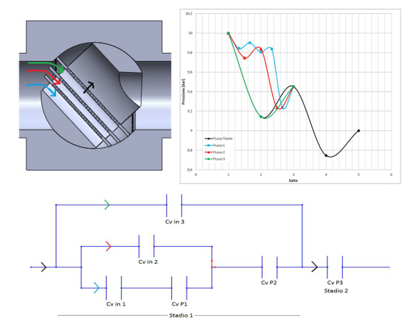

Current Project: modeling of Tandem Plug
Validation of the model:
Using CFD on multistage Ball Valve (3 plates)

Slide 40



Current Project: modeling of Tandem Plug
Effect of varing the clearances on CV

Slide 41

Current Project: modeling of Tandem Plug
Effect of varing the clearances on CV

Slide 42

Current Project: modeling of Tandem Plug
Full control of design parameters through modeling
clearance
clearance
labyrinth

Slide 43




Current Project: Combined modeling of Labyrinth, Cascade and Tandem Plug
Labyrinth Model
Tandem Plug Model
Cascade Model
Hybrid Multi-Stage Tandem Valve

Slide 44
Conclusions
When dealing with severe services, pressure drop and velocity must be adequately handled
Choose of proper materials is fundamental
Common severe service multistage trims might not be always adequate
A combination of them can be the best option to:
  Fit the customer’s requirements
  Optimize dimensions and cost
ORGANIZERS
CONFERENCE ORGANIZERS

Slide 45
Thanks
ORGANIZING SECRETARIAT
Ph. +39 035 3230904
e-mail info@industrialvalvesummit.com
CONFERENCE ORGANIZERS
Ph. +39 3474908420
e-mail segreteria@valvecampus.com
www.industrialvalvesummit.com
www.valvecampus.com

