Slide 1
Estimation of Proof Test Coverage for Emergency Shut Down Valves
CONFERENCE
ORGANIZERS

Slide 2
Estimation of Proof Test Coverage for Emergency Shut Down Valves
Steve Kriescher BEng(Hons) MSc CEng FInstMC MIMechE MIGEM MIET
Functional Safety Engineer

Slide 3




Biography
Chartered Instrument Engineer specialising in Functional Safety
BEng(Hons) Instrumentation; MSc Safety, Risk and Reliability Engineering
Diploma in Reliability and Functional Safety
+35 years industrial experience
Oil & Gas, Chemical, Nuclear
Operations/maintenance and project engineering experience
InstMC Functional Safety - Special Interest Group (FS-SIG) committee member
Currently undertaking PhD research at Swansea University (Wales)

Slide 4

Agenda
Introduction to Functional Safety
Statement of the problem
Methodology
    Analysis of Field Data to determine Proof Test Coverage (PTC)
    Predicting PTC using Failure Modes, Effects and Diagnostic Analysis (FMEDA)
    Predicting PTC using a Fuzzy Inference System
Using component failure data from BS EN 17955
Conclusions
Any questions?

Slide 5
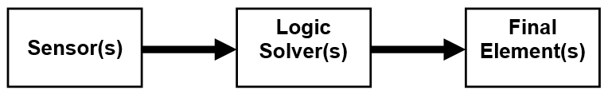
Introduction to Functional Safety
COMAH (Seveso III) - Control of Major Accident Hazards
Benchmarks...
BS EN 61508 – FS of Electrical/Electronic/Programmable Electronic Safety-related Systems
BS EN 61511 - FS: Safety Instrumented Systems for the Process Industry Sector
Safety Instrumented Systems

Slide 6
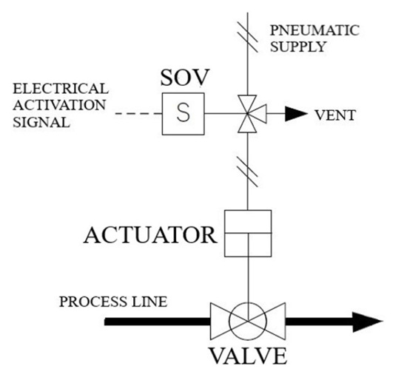
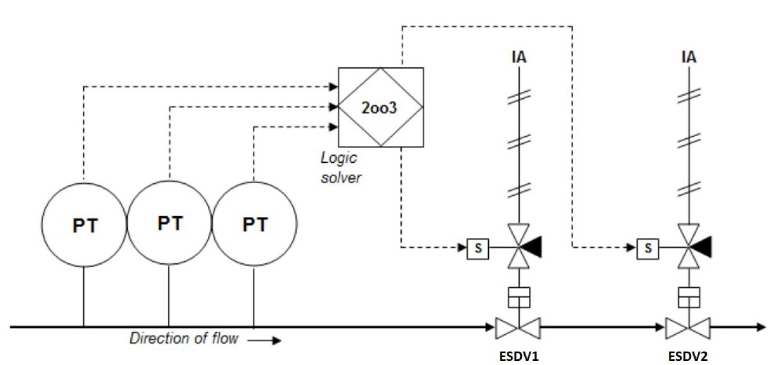
Introduction to Functional Safety
Emergency Shut Down Valve (ESDV) assembly
Safety Instrumented Functions

Slide 7
Introduction to Functional Safety
Proof Testing – why do we need to do it?
Safety Instrumented Functions are typically low demand i.e. demand rate < once per year
To reveal dangerous undetected failure (failures not detected by diagnostics)
Types of ESDV proof tests:
(1) Partial stroke test – valve moved typically 5% to 10%, at process operating conditions
(2) Full stroke test – valve moved to its closed (or open) position, offline
(3) Full stroke test at process operating conditions
(4) Full stroke test and leak test, offline
(5) Full stroke test at process operating conditions and leak test
All tests are timed.

Slide 8
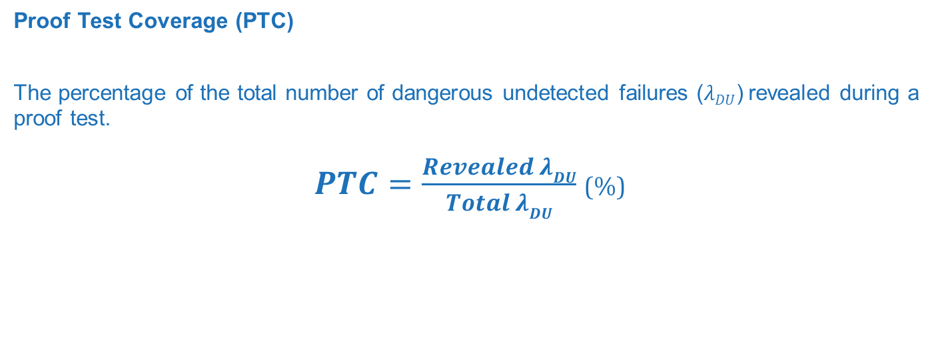
Introduction to Functional Safety
Proof Test Coverage (PTC)
The percentage of the total number of dangerous undetected failures ($λDU$) revealed during a proof test.
$PTC=\frac{Revealed λDU}{Total λDU}$ (%)

Slide 9
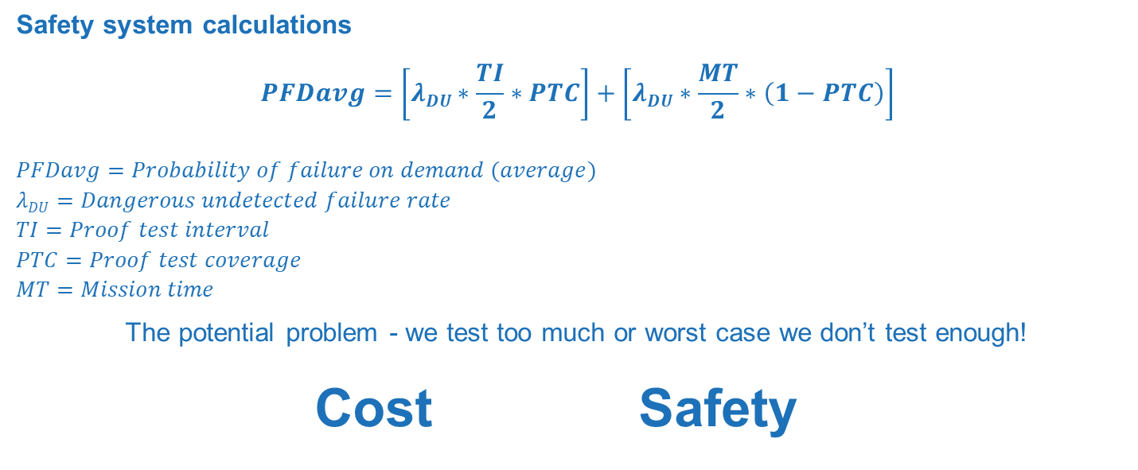
Statement of the Problem
Safety system calculations
$$PFDavg=\left[λDU∗\frac{TI}{2}∗PTC\right]+\left[λDU∗\frac{MT}{2}∗\left(1−PTC\right)\right]$$
$$PFDavg=Probability of failure on demand (average)$$
$$λDU=Dangerous undetected failure rate$$
$$TI=Proof test interval$$
$$PTC=Proof test coverage$$
$$MT=Mission time$$
The potential problem - we test too much or worst case we don’t test enough!
Cost Safety

Slide 10
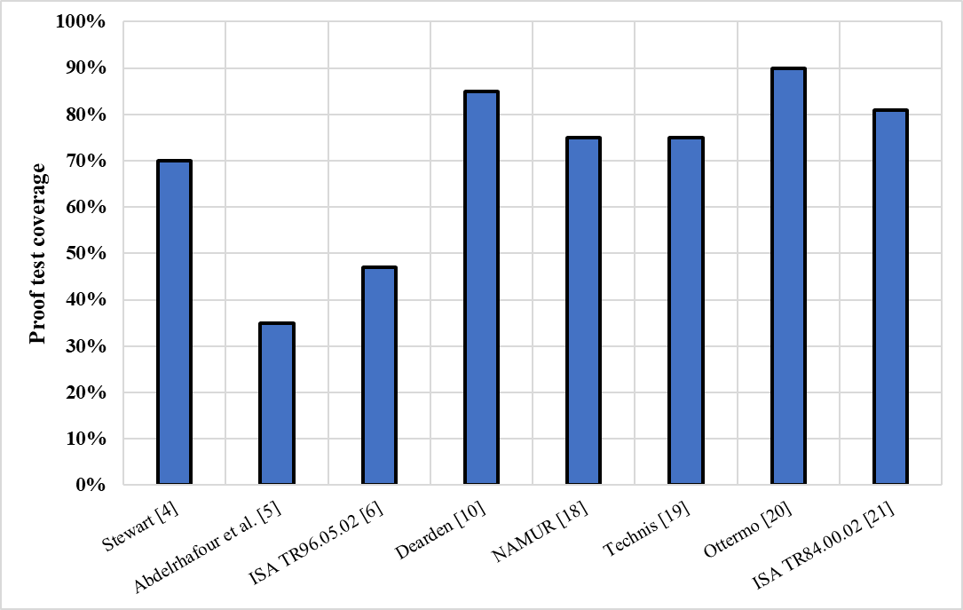
Statement of the Problem
PTC for a FST – Published Data
Proof test coverage for a
Full Stroke Test (FST)
Timed
No leak test
Offline

Slide 11
Research Methodology
  Estimation of Proof Test Coverage for an Emergency Shut Down Valve using:
  Method 1 – Field data collected from industry applying BS EN 14224
  Method 2 – A Failure Modes, Effects and Diagnostics Analysis (FMEDA)
  Method 3 – Fuzzy Inference Systems (Fuzzy-FMEDA)
Full Stroke Test (FST) as per test (2) – a fail closed valve – tight shut-off not required
Timed
No leak test
Offline

Slide 12
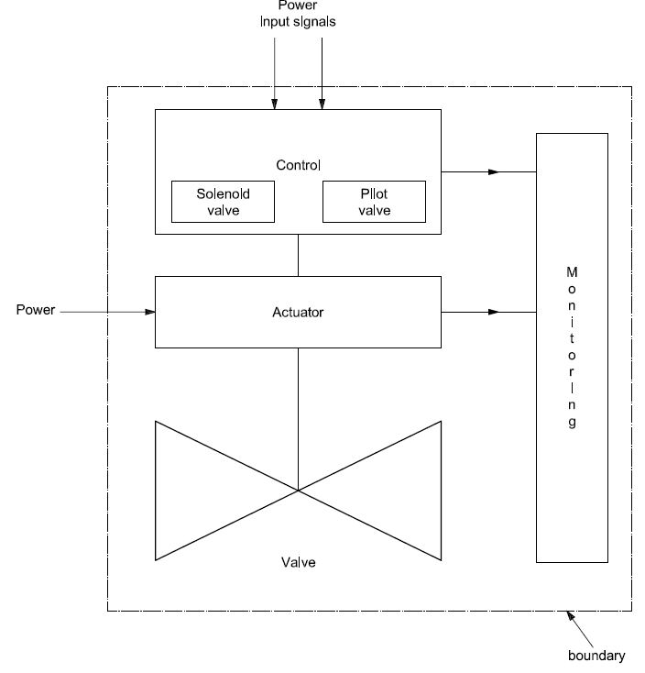
Method 1 - Field Data
BS EN 14224 - Petroleum, petrochemical and natural gas
industries – Collection and exchange of reliability and
maintenance data for equipment
Dangerous failure modes:
FTC – Stuck Open or Failure to Fully Close
DOP – Delayed Operation (Slow to Close)
LCP – Excessive Leak in the Closed Position

Slide 13
  Method 2 - FMEDA using component failure rate database
  Failure Modes, Effects and Diagnostics Analysis
  Systematic failure mode analysis
  Component level assessment (springs, seals, stem)
  Identify component failure (bind, break)
  Failure types (safe/dangerous/no effect)
  Effects of failures (slow movement, stuck open)
  Detected by diagnostics or not
  Component failure rate
  Probability of revealing a failure during proof test (revealability & reliability

Slide 14
  FMEDA
Subjective Data:
Component failure rate
Probability of revealing a failure
  Revealability – to what degree will the failure be revealed during a test
  Reliability – the reliability of the failure detection method, e.g., instrumentation reliability
Item # | Component type | Failure cause | Failure effect on comp’t | Failure effect on assembly | Failure type (S, D, NE) | Failure mode | Failure rate (FIT) | Distribution of failure rate (FIT) | Distributed failure rate (FIT) | Failure revealed by diagnostics (Y, N) | Probability of revealing failure | Weighted revealed failure rate (FIT)
1 | SOV Spring | Break | SOV fails to return to safe position | Valve does not close (stuck) | Dangerous | FTC | 10 | 50% | 5 | N | 0.95 | 4.75

Slide 15
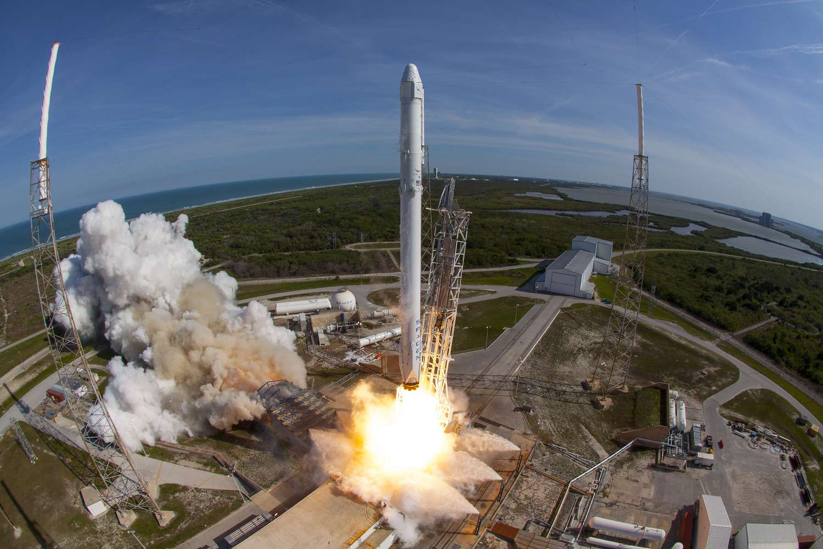
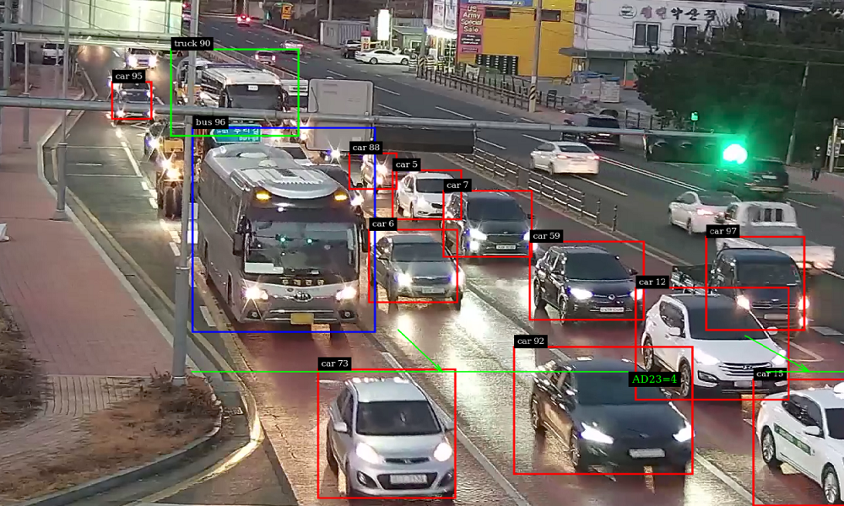


  Method 3 – Using a Fuzzy Inference System (FIS)
  Introduction to FIS
Lotfi Zadeh “the father of Fuzzy Logic”
Fuzzy sets paper 1965
Fuzzy systems applications:
Aerospace engineering
Automotive traffic control
Artificial intelligence
Machine learning
Industrial processes

Slide 16
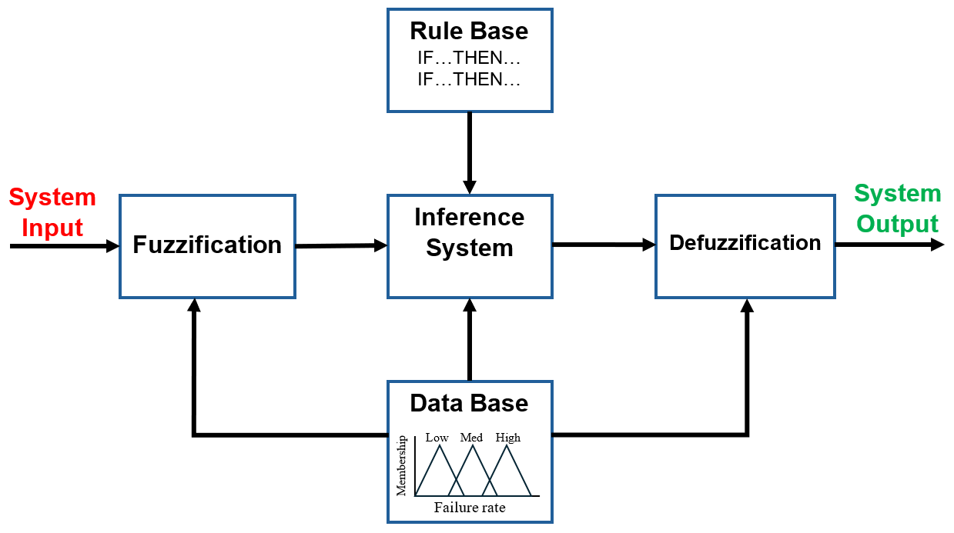
  Introduction to Fuzzy Inference Systems (FIS)
Mamdani Rule-Based FIS

Slide 17
  Linguistic Variables
At the root of fuzzy set theory lies the idea of linguistic variables.
A linguistic variable is fuzzy variable, such ‘the weather is cold’. The weather is the linguistic variable, and the linguistic value is cold.
The range of possible values of a linguistic variable represents the universe of discourse of that variable. For example, the universe of discourse for the linguistic variable component failure rate may range between 0 and 1000 FIT and may include fuzzy sets very low, low, medium, high and very high.

Slide 18
  Membership Functions
Membership functions allow us to graphically represent a fuzzy set. The x axis represents the universe of discourse, whereas the y axis represents the degree of membership in the [0,1] interval.
Low Medium High
1
y
0
0 x 100

Slide 19
  Fuzzification (Inputs)
VL L M H VH
1
0
0 100 200 300 400 FIT
Component failure rate
VL L M H VH
1
0
0 0.25 0.5 0.75 1
Probability of revealing the failure

Slide 20
  Inference & Rule Base
During inference, the fuzzy inputs are combined using fuzzy logic operators, e.g., AND, OR, to determine the activation level of each rule.
The activated rules contribute to the overall fuzzy output.
Examples…
Rule #10
IF Component Failure Rate is LOW AND Probability of Revealing Failure is VERY HIGH THEN Weighted Revealed Failure Rate is LOW
Rule #14
IF Component Failure Rate is MEDIUM AND Probability of Revealing Failure is HIGH THEN Weighted Revealed Failure Rate is MEDIUM

Slide 21
  Aggregation & Defuzzification (Output)
Defuzzification (fuzzy to crisp) is achieved by calculating the Centre of Gravity (CoG) of the resultant (output) membership function.
VL L M H VH
1
0
0 100 200 300 400 FIT
Weighted revealed failure rate

Slide 22
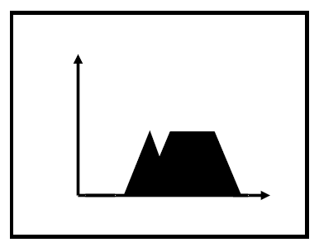
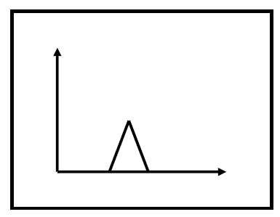
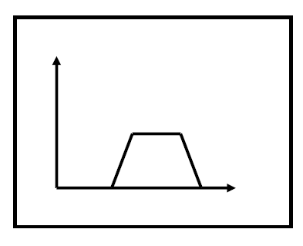
  ANDing Fuzzy Subsets
Combined Fuzzy subsets
Fuzzy subset #1
Fuzzy subset #2
AND
=
CoG

Slide 23
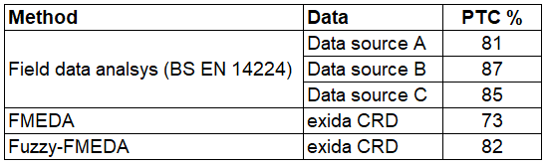
  Results from Field Data, FMEDA & Fuzzy-FMEDA

Slide 24
  Using failure data from BS EN 17955
Functional Safety of safety-related valves and actuators
Not all valve assembly components are listed
Optimistic component failure rates
PTC results align with field data

Slide 25
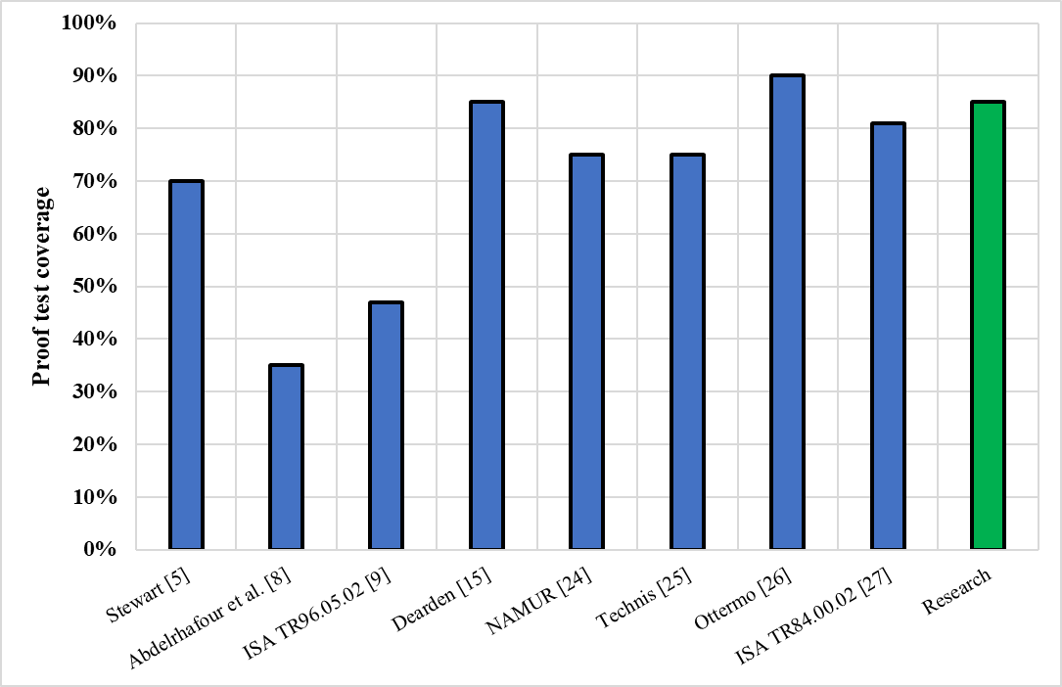
  Conclusions
PTC for a FST – Published Data
FIS PTC results align with field data.
From this study it can be concluded
that the PTC for a FST ~ 85%
FIS Advantages
Can be used to handle data uncertainty
Reconcile expert knowledge
Limitations
Use of specific FIS software

Slide 26
Any questions?

Slide 27
Thanks
ORGANIZING SECRETARIAT
Ph. +39 035 3230904
e-mail info@industrialvalvesummit.com
CONFERENCE ORGANIZERS
Ph. +39 3474908420
e-mail segreteria@valvecampus.com
www.industrialvalvesummit.com
www.valvecampus.com

