Slide 1
prEN 17955
CONFERENCE
ORGANIZERS

Slide 2
prEN 17955 more clarity in the assessment of valves and actuators for functional safety
Dr. Jörg Isenberg | Product Specialist AUMA Riester Gmbh & Co. KG

Slide 3

Dr. Jörg Isenberg, AUMA
Product Specialist Functional Safety, Product Management Dep.
Responsible for AUMA’s Functional Safety products
Related topics like fail-safe & explosion proof actuators
Other functional safety involvements:
Co-worker in German & European standardization committees
  DIN and DKE committees related to functional safety
  CEN TC 69 WG1 / AHG 3 (e.g. EN 17955)
Chair of DIN NA 003-01-01 AK 2 (“mirror” AK for CEN AHG 3)

Slide 4
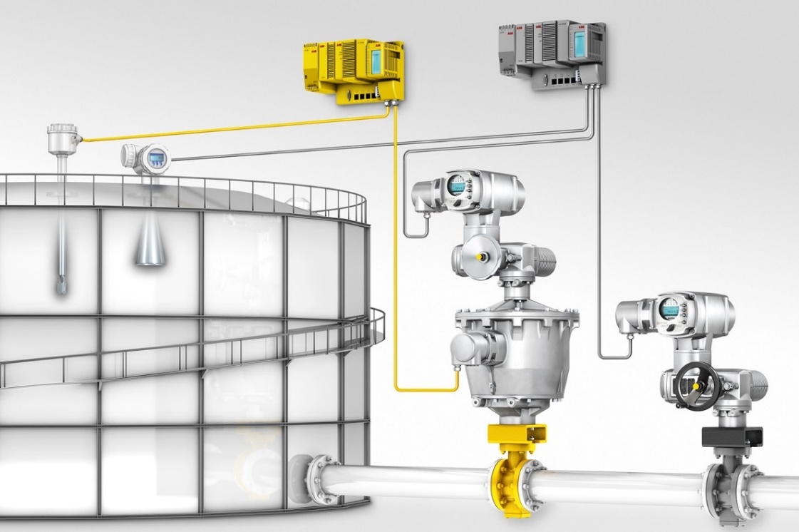
Assessment
(of mech. comp.) necessary?
  Yes!
  … if mechanical components are part of the safety chain
Observation:
Certificates on comparable mechanical products differ by
a factor of ≥ 100 ( ⇔ up to 2 SIL-levels) !

Slide 5
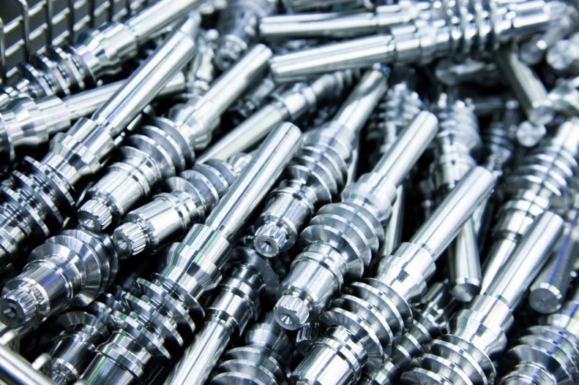
IEC 61508: “Functional Safety of electrical / electronic / programmable electronic safety-related systems”
Applicable to mechanical components?
IEC 61508-1: „… Therefore, while this International Standard is concerned with E/E/PE safety-related systems, it may also provide a framework within which safety-related systems based on other technologies may be considered.”
But: How?

Slide 6
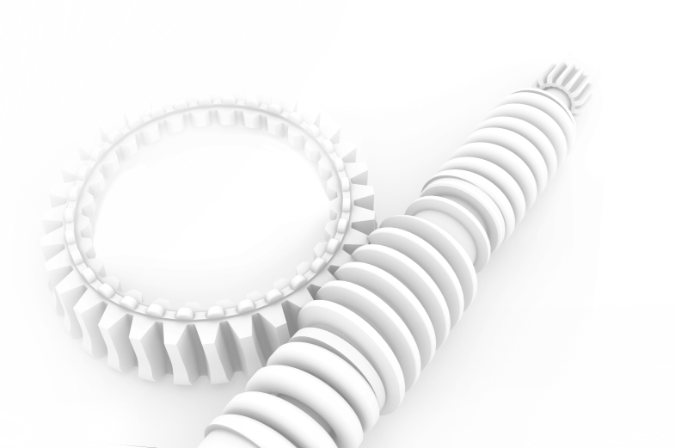
Assessment of mechanical components – how?
  Functional Safety Management / Systematic Capability
      IEC 61508 provides structure and valuable hints
      Techniques & measures proposed by IEC 61508 often not tailored to mechanical items
      Architectural constraints as req. by IEC 61508
      IEC 61508 approach to test & (online-)diagnostics often doesn’t fit mechanical items
      IEC 61508 route 1_{H} requires SFF – difficult for mechanics
  Determination of failure rates λ
  FMEDA ⇒ OK
  Sources and values of input data vary strongly
  (handbook data, field data, fault exclusion, …)

Slide 7
prEN 17955 (and prospective EN 17955)
  … intended to fill these gaps
  … addresses compliant item & final element manufacturers (not end users)
  History:
  2016 – 2018 informal German meetings
  Since 2019 CEN work item 00069217 under TC 69/WG1/AHG3
  2023/02 prEN 17955 published
  Publication of EN 17955 planned for late 2024
Hint: don’t buy E DIN EN 17955 (awful translation) – buy prEN 17955 instead

Slide 8
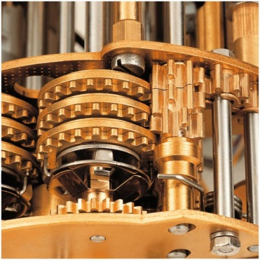
prEN 17955 – scope
  Applies to:
  Automated industrial valve packages used as final element in SIS
  Also applies to (mechanical portion of) valves, actuators, solenoid valves, …
  and assemblies of those products
  Method may also be used for other mechanical items (after expert judgement)
  Does not apply to:
  Manually operated valves
  Items in safety systems or risk-reducing devices not assessed
  and operated according to the principles of functional safety
  Relation to IEC 61508:
  Does not replace IEC 61508 but does supplement it

Slide 9

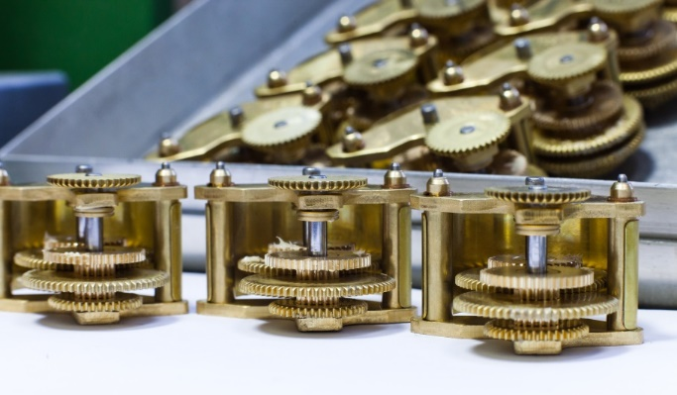
prEN 17955 – Systematic Capability (SC)
  Route 1_{S} or route 2_{S} may be applied
  Requirements of prEN 17955 represent a level of SC=3
  Requirements of IEC 61508 shall be applied at a SC=3 level of rigor
  SC=1 and SC=2 shall not be applied

Slide 10
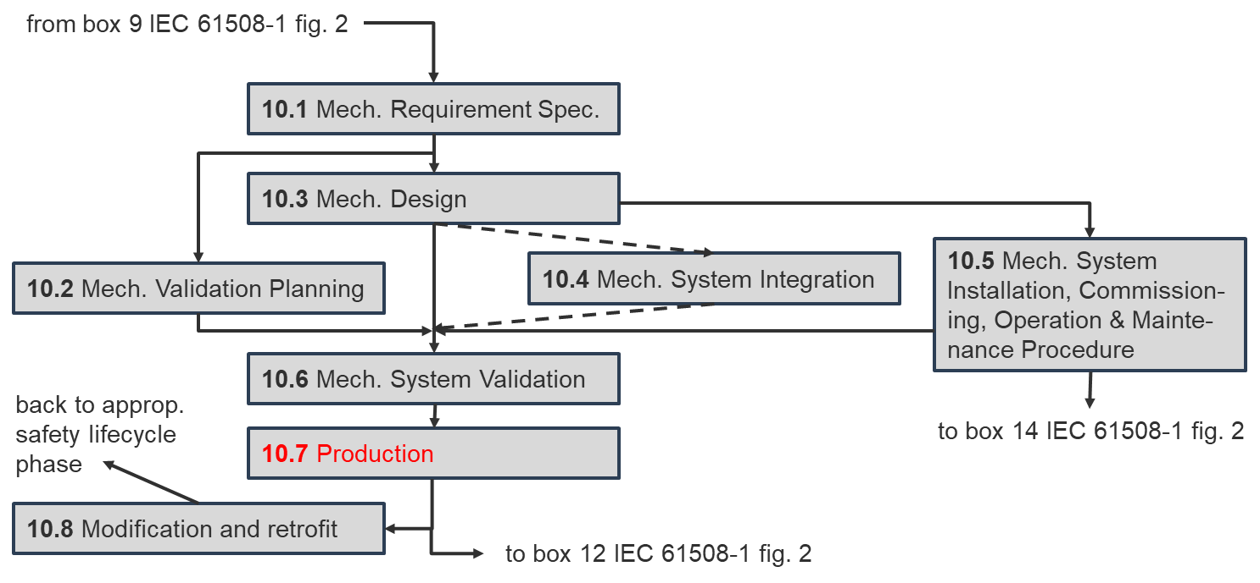
prEN 17955 – design safety lifecycle
  Safety lifecycle similar to phase 10 of IEC 61508
“Production” is added as additional phase
A design FMEA is (more explicitly) required
Own representation according to fig. 2, prEN 17955

Slide 11
prEN 17955 – Systematic Capability (SC)
  Techniques & measures to avoid systematic failures
  Annex provides tables with techniques and measures tailored to mechanical items
  Similar to IEC 61508-2 tables A.15-17 & B.1-B.5

Slide 12
prEN 17955 – Systematic Capability (SC)
  Techniques & measures to avoid systematic failures
  Additional tables of prEN 17955
  Techniques and measures to avoid and/or control systematic failures caused by…
    … mechanical design
    … environmental stress or influences
    … operational failures
    … specification of mechanical requirements
    … mechanical system design and development
    … mechanical system integration
    … operation and maintenance procedures
    … mechanical safety validation

Slide 13
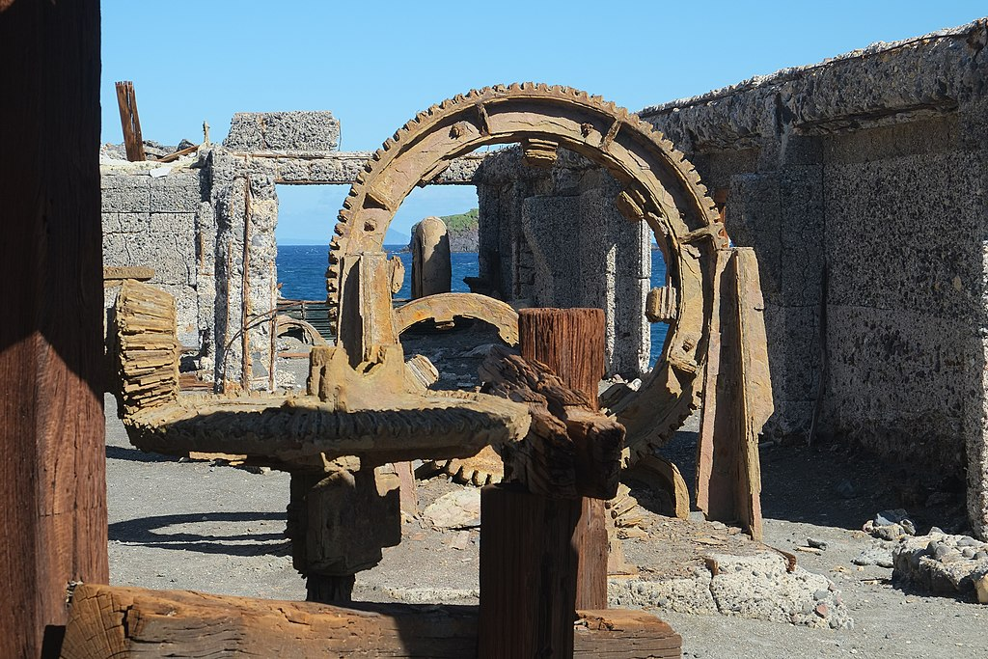
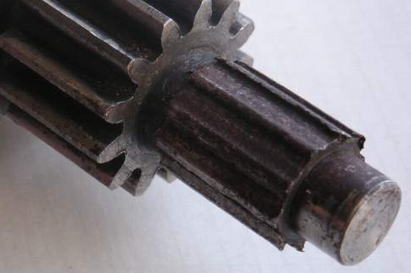
prEN 17955 – new concept: utilization rate
  IEC 61508 only concerned with “demand rate”:
  Only accounts for demands on the safety function (tests, BPCS op., … not counted)
  For mechanical (and also electro-mech.) items total rate of operations more relevant
Aging
Wear
Aging and wear are completely different failure modes.
Counter measures and safety parameters may differ significantly!

Slide 14
prEN 17955 – new concept: utilization rate
  Utilization rate = total movements of a mechanical item per year
  Low utilization rate (LUR)
  High utilization rate (HUR)
  LUR dominated by aging ⇔ HUR dominated by wear
  Shall supplement (not replace) the “demand rate” concept of IEC 61508
  Utilization rate property of compliant item or element
  Demand rate property of safety instrumented function

Slide 15
prEN 17955 – new concept: utilization rate
  Utilization rate = total movements of a mechanical item per year
  Low utilization rate (LUR)
  High utilization rate (HUR)
  LUR dominated by aging ⇔ HUR dominated by wear
  Shall supplement (not replace) the “demand rate” concept of IEC 61508
  Consequences:
  Safety statements (and failure rates) shall be given for HUR and/or LUR separately
  A statement shall be given about the limit (operations per year) of applicability

Slide 16
prEN 17955 – architectural constraints
  SFF concept of IEC 61508 route 1_{H} (always) problematic for (automated) valves:
    Often no safe failures (λ_{S}) for valves
    Often few safe failures (λ_{S}) for actuators
    Diagnostics (often) only possible by PVST
    Is PVST an on-line diagnostic test (acc. IEC 61508)? ⇒ λ_{DD}=?
  Requirements of prEN 17955 (Tab. 3)
  essentially follow EN 61508-2, 7.4.4.3.1
  ⇒ SFF requirement waved
SIL | Minimum HFT of mech. portion of final element
 | Low demand mode | High demand mode
1 | 0 | 0
2 | 0 | 1
3 | 1 | 1
Own representation according to tab. 3, prEN 17955

Slide 17
prEN 17955 – failure rates
  In the past, (declared) failure rates for mechanical components varied widely
Component | O-Ring | Standard transistor | Pneum. actuator 1 | Valve with Fail-Safe device 2
“Total” failure rate (λ_{S}+λ_{D}) | 10-300 FIT | 3 FIT | 1,4 FIT | 3,6 FIT
Source | Exida handbook | SN 29500 (base value) | Certificate notified body | Certificate notified body
In the future:
prEN 17955 provides a clear procedure for calculation of failure rates of mechanical items (including tables with failure rates)

Slide 18
prEN 17955 – failure rates
Type | Safety Function | λ_{D} [FIT]
Single / double / triple offset butterfly | OPEN | 180
 | CLOSE | 200
 | CLOSE with inline tightness | 240
Floating ball | OPEN | 120
 | CLOSE | 140
 | CLOSE with inline tightness | 200
  prEn 17955 gives base failure rates
  for compliant items
  May be used if all requirements
  of this standard are obeyed
  Lower values may be claimed only if
    a detailed FMEDA on part or
    functional unit level is done or
    an integration with field data
    acc. to prEN 17955 is done
  FMEDA also mandatory if
  compliant item not listed in
  Annex
Samples, not to be used for SIS calculation
Type | Other | Safety Function | λ_{D} [FIT]
Electric actuator (quarter turn or linear) | Spring return | Move attached valve to safe position (either fully OPEN or fully CLOSED only) | 100
 | No fail-safe | Move attached valve to safe position | 100
Electric actuator (multi-turn) | No fail-safe | Move attached valve to safe position | 75
Own representation according to Tab. C.1 & C.3, prEN 17955

Slide 19
prEN 17955 – failure rates
  FMEDA approach described in Annex
  Standard FMEDA approach
  Simplification:
  FMEDA may be done on part or functional unit level
    List of functional units with (base) failure
    rates given in Annex

Slide 20
prEN 17955 – failure rates
Sample functional units for LUR:
Functional unit | Base failure rate [FIT] | Failure modes | Examples
Body (pressurized) | 60 | Deflect (20%) Fracture (20%) Minor leak (50%) Major leak (10%) | Body with static sealing elements and connectors (screws, …)
Housing (non pressurized) | 10 | Fracture (100%) | Housing including static sealing and connectors
Drive train | 150 | Minor leak (55%) Major leak (20%) Bind (10%) Play (10%) Fracture (5%) | Stem with guiding and dynamic sealing systems and connectors (force/torque transfer) Packing system including pretension system
…
Samples, not to be used for SIS calculation
Own representation according to Tab. D.4, prEN 17955

Slide 21


Conclusion
(pr)EN 17955 will standardize the assessment of mech. components
    Systematic capability: Requirements adjusted to mech. components
    Mandatory procedure(s) for failure rate calculation
    Online diagnostics / architectural constraints adjusted
  Will it cause additional workload?
  SFF requirement waved
  Failure rate calculation significantly simplified (or even eliminated)
  Additional concept of utilization rate
  Requirements clarified and tailored to the needs and
  capabilities of mechanical components
  Conclusion: For those who tried to do functional safety of mechanical
  components carefully, (pr)EN 17955 is likely to simplify the task!
ORGANIZERS
CONFERENCE ORGANIZERS

Slide 22
Thanks
ORGANIZING SECRETARIAT
Ph. +39 035 3230904
e-mail info@industrialvalvesummit.com
CONFERENCE ORGANIZERS
Ph. +39 3474908420
e-mail segreteria@valvecampus.com
www.industrialvalvesummit.com
www.valvecampus.com

