Slide 1
A new OEM-centric, additive manufacturing-enabled on-demand spare parts inventory model and its validation with a digital clamp connector product range
CONFERENCE
ORGANIZERS

Slide 2
A new OEM-centric, additive manufacturing-enabled on-demand spare parts inventory model and its validation with a digital clamp connector product range
Ivan Arata | R&D and Continuous Improvement Manager
Michel Trapletti | Clamp Connector Specialist

Slide 3



AM Oil&Gas Expectations
Voice of Customer
OEM Active Response
✓
Less inventory (and inventory waste)
On demand manufacturing, including AM
Reduction of lead time
✓
Fast-Track
✓
Operators are urging the supply chain not to delay acquiring the necessary AM know-how while waiting for a viable financial plan
Design (DfAM)
Manufacturing (process qualification)
Quality (product qualification)
STEP 2 : Comprehensive comparison between the newly developed process and legacy production methods
STEP 1 : Acquiring and safeguarding the know-how

Slide 4
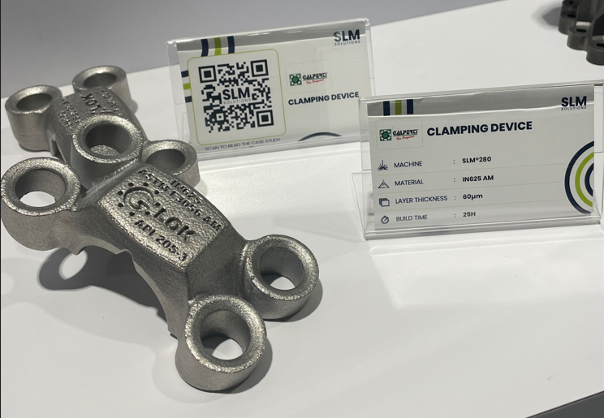
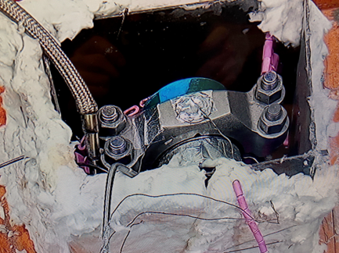
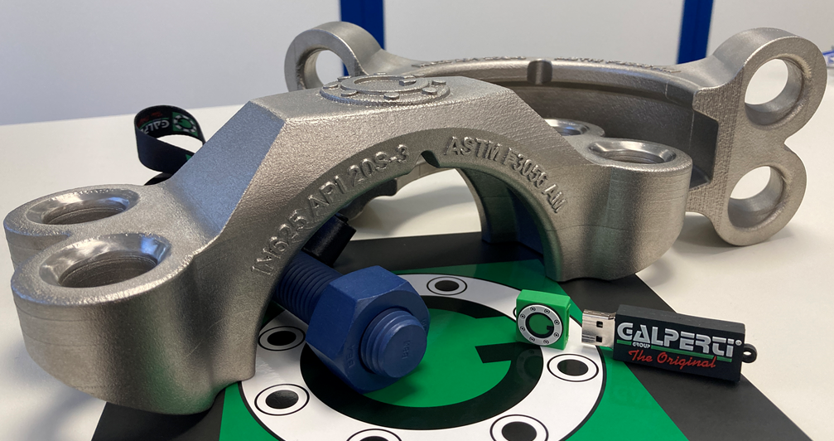
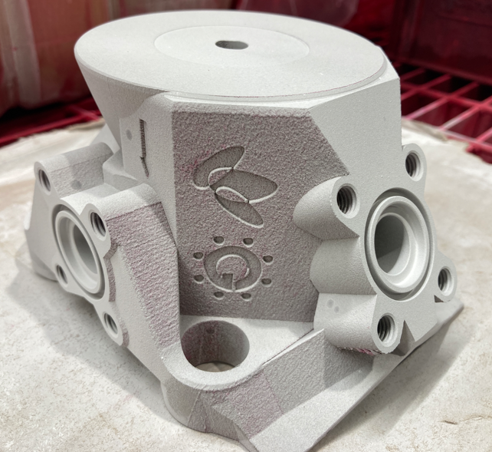

Technical Milestones: Completed
Extensive testing and validation have demonstrated the efficacy of the technology, with excellent material properties and valid businees cases especially for special alloys
Substantial investments in cutting-edge equipment
Rigorous research, thorough qualification processes and comprehensive testing methodologies
100% in-house know-how and manufacturing capabilities
Printing is easy
Technical readiness will not optimize any operator TCO: new business model is needed

Slide 5





On-Demand Stock
The OEM covers high-runner and Core product categories through a proper stocking policy with Off-the-Shelf commitment, wherein stock is maintained at the supplier's location
Model Assumptions
High
High-Runner
(few, high volume)
✓
Core
(medium volume)
High-End material standardization for AM feedstock material
Tail is covered with On-Demand additive manufacturing only
Market Demand
Tail
(low volume)
✓
Products
High
Cost awareness is essential for both additive manufacturing and legacy production methods
Digital twin design, ready and validated to cover tail range and unplanned empty-shelf conditions
STOCK
?
AM

Slide 6
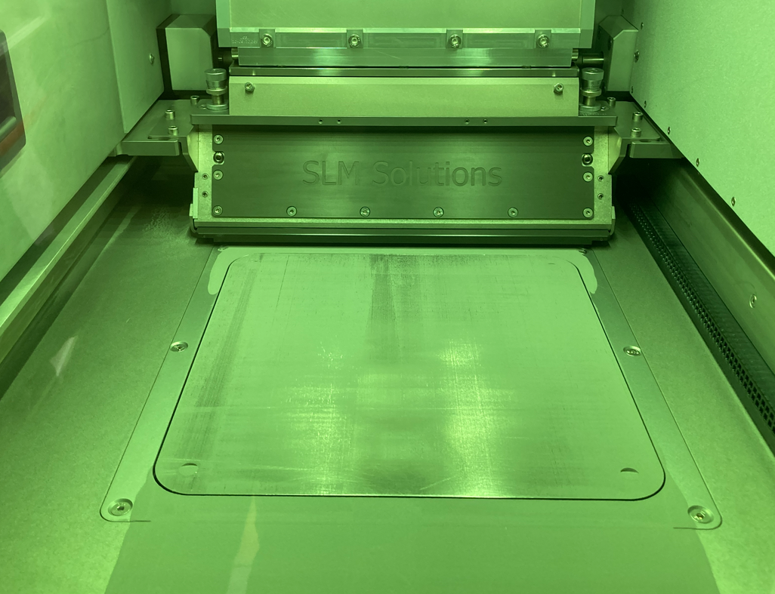
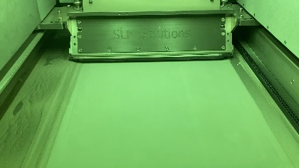
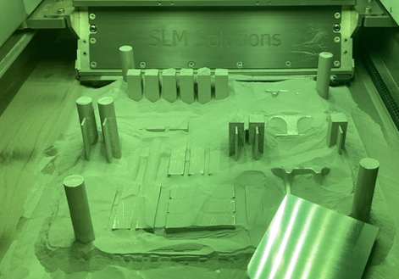
The Dynamic Cost Complication
Design
DfAM
Build-Prep
Software
Pre-Processing
Processing
AM Post-Processing
Sieve
The existing literature on cost modeling isn't tailored for efficient low-volume and fast-track manufacturing
Ideal batch size depends on the AM baseplate, allowing for diverse item combinations, though cost optimization is complex also considering API 20S requirements
Accurately estimating material waste is neither simple nor insignificant
Legacy Ops
Quality
PBF
Eqpt
Documentation
Legend
Value Creator
Product
Cost
Tool

Slide 7
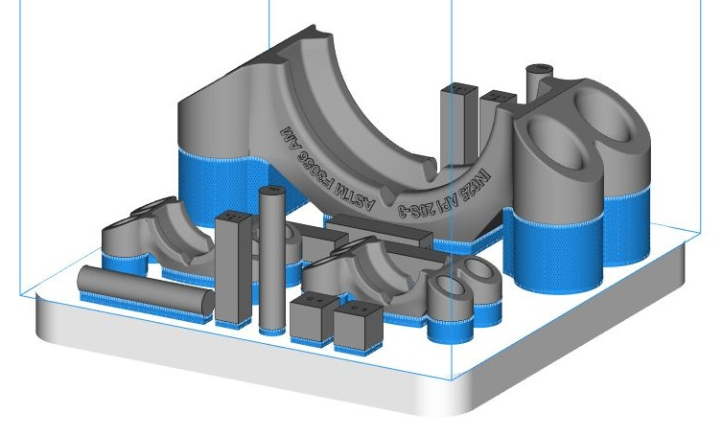


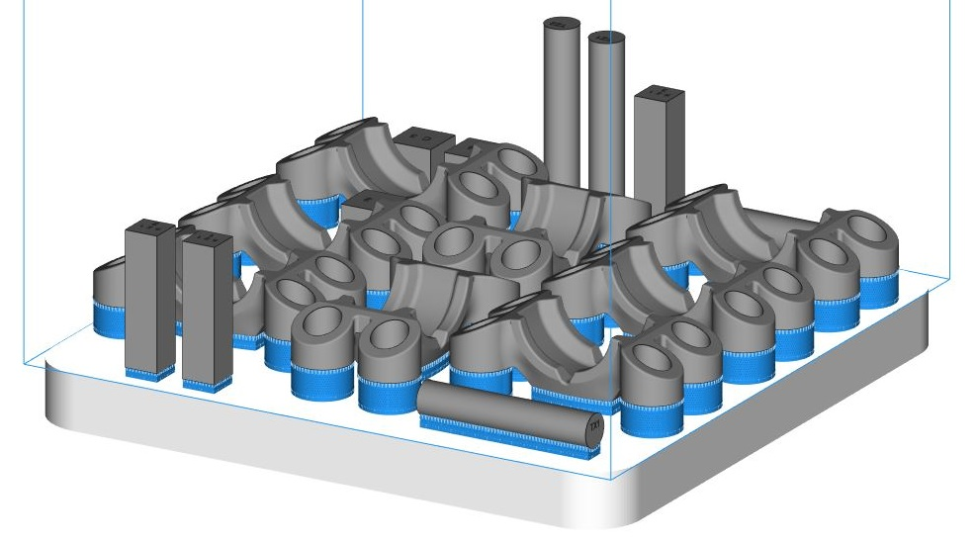
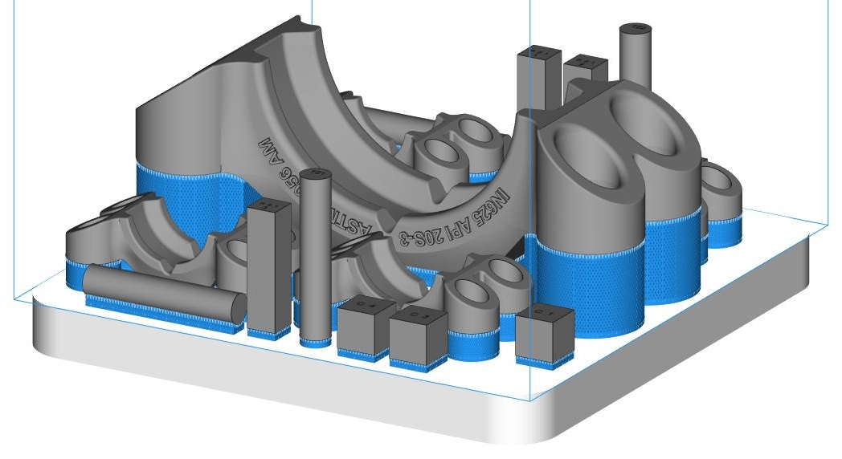
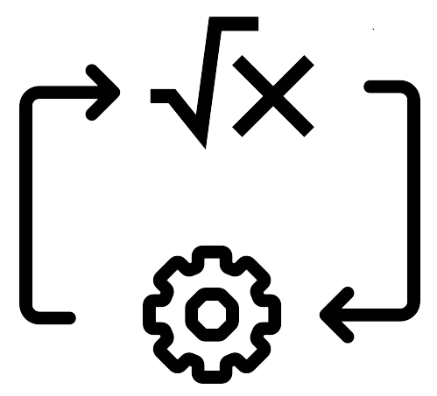
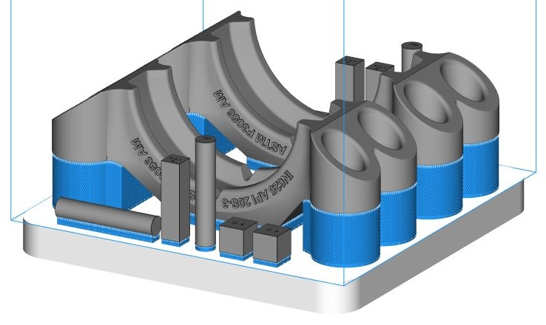
DOE: What factors are significant?
NICE TO HAVE
Part Weight
Part Volume
API 20S AMSL
Design
of
Experiment
Identify
Factors
Objective
Define and validate a cost model with well-known factors as input data
Shape Complexity
Time variables
Printing strategy
UNWANTED
Driving cost factors are:
Process time
Batch total weight
Batch total height
The precision of the analytical model is exceptional
Prediction
Model

Slide 8
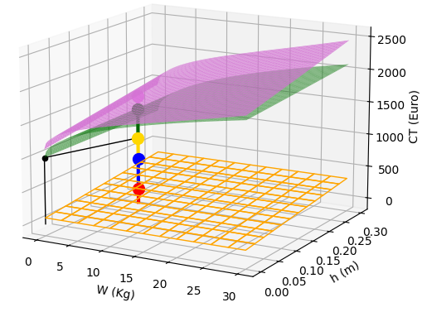

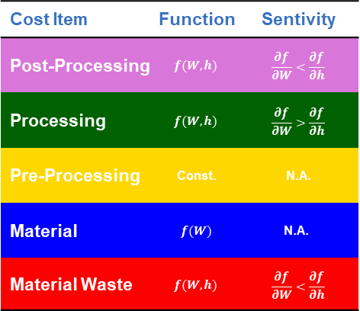
Analytical Perfection
Cost Item | Function | Sentivity
Post-Processing | $$f(W,h)$$ | $$\frac{∂f}{∂W}<\frac{∂f}{∂h}$$
Processing | $$f(W,h)$$ | $$\frac{∂f}{∂W}>\frac{∂f}{∂h}$$
Pre-Processing | Const. | N.A.
Material | $$f(W)$$ | $$\text{N}\text{.}\text{A}\text{.}$$
Material Waste | $$f(W,h)$$ | $$\frac{∂f}{∂W}<\frac{∂f}{∂h}$$
The prediction model can generate production and material costs within seconds, requiring only the total batch weight and height as input values
Validation of the prediction model has been performed with both simulation and production batches

Slide 9
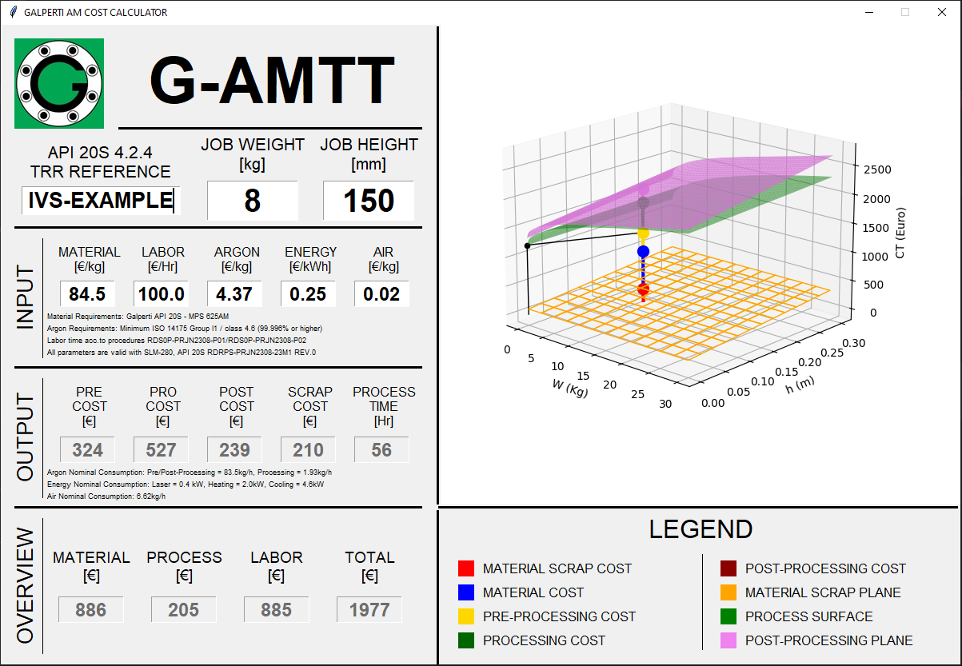
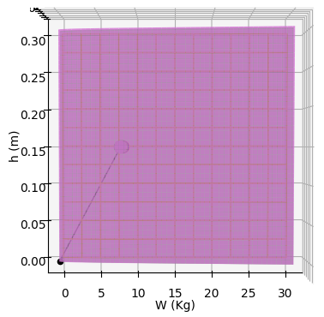
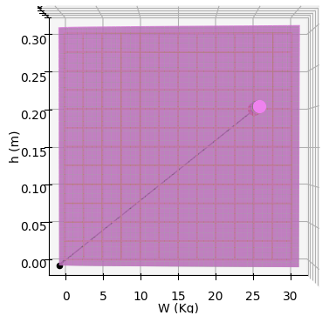
Fast-track model, faster with tools
Example 1:
WT = 8kg
h = 150mm
Example 2:
WT = 25kg
h = 200mm

Slide 10
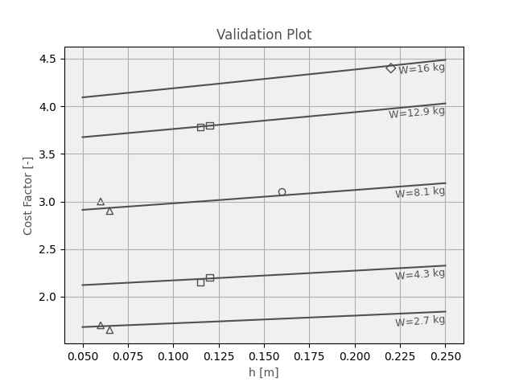
Validation Results
High
High-Runner
(few, high volume)
Core
(medium volume)
Market Demand
Tail
(low volume)
Products
High
✓
STOCK
AM
There is now the capability to accurately quantify the ideal point of separation between stock (inventory) and on-demand AM requests
Operators can achieve a 0-stock level by leveraging a fast-track model for acquiring any type of spare parts they may need
Quotation of AM fast track items can be generated at full speed

Slide 11

Q&A
Any
questions?
?
…
Thanks!
?
It's never too late for questions! Ask ivan.arata@galpeng.com
WhatsApp : +39 335 7521014

Slide 12
Thanks
ORGANIZING SECRETARIAT
Ph. +39 035 3230904
e-mail info@industrialvalvesummit.com
CONFERENCE ORGANIZERS
Ph. +39 3474908420
e-mail segreteria@valvecampus.com
www.industrialvalvesummit.com
www.valvecampus.com

