Slide 1
Myths of Leak Detection
CONFERENCE
ORGANIZERS

Slide 2
Myths of Leak Detection
How misconceptions influence our ways of pressure testing
Arthur Baars | SME Engineered Solutions

Slide 3
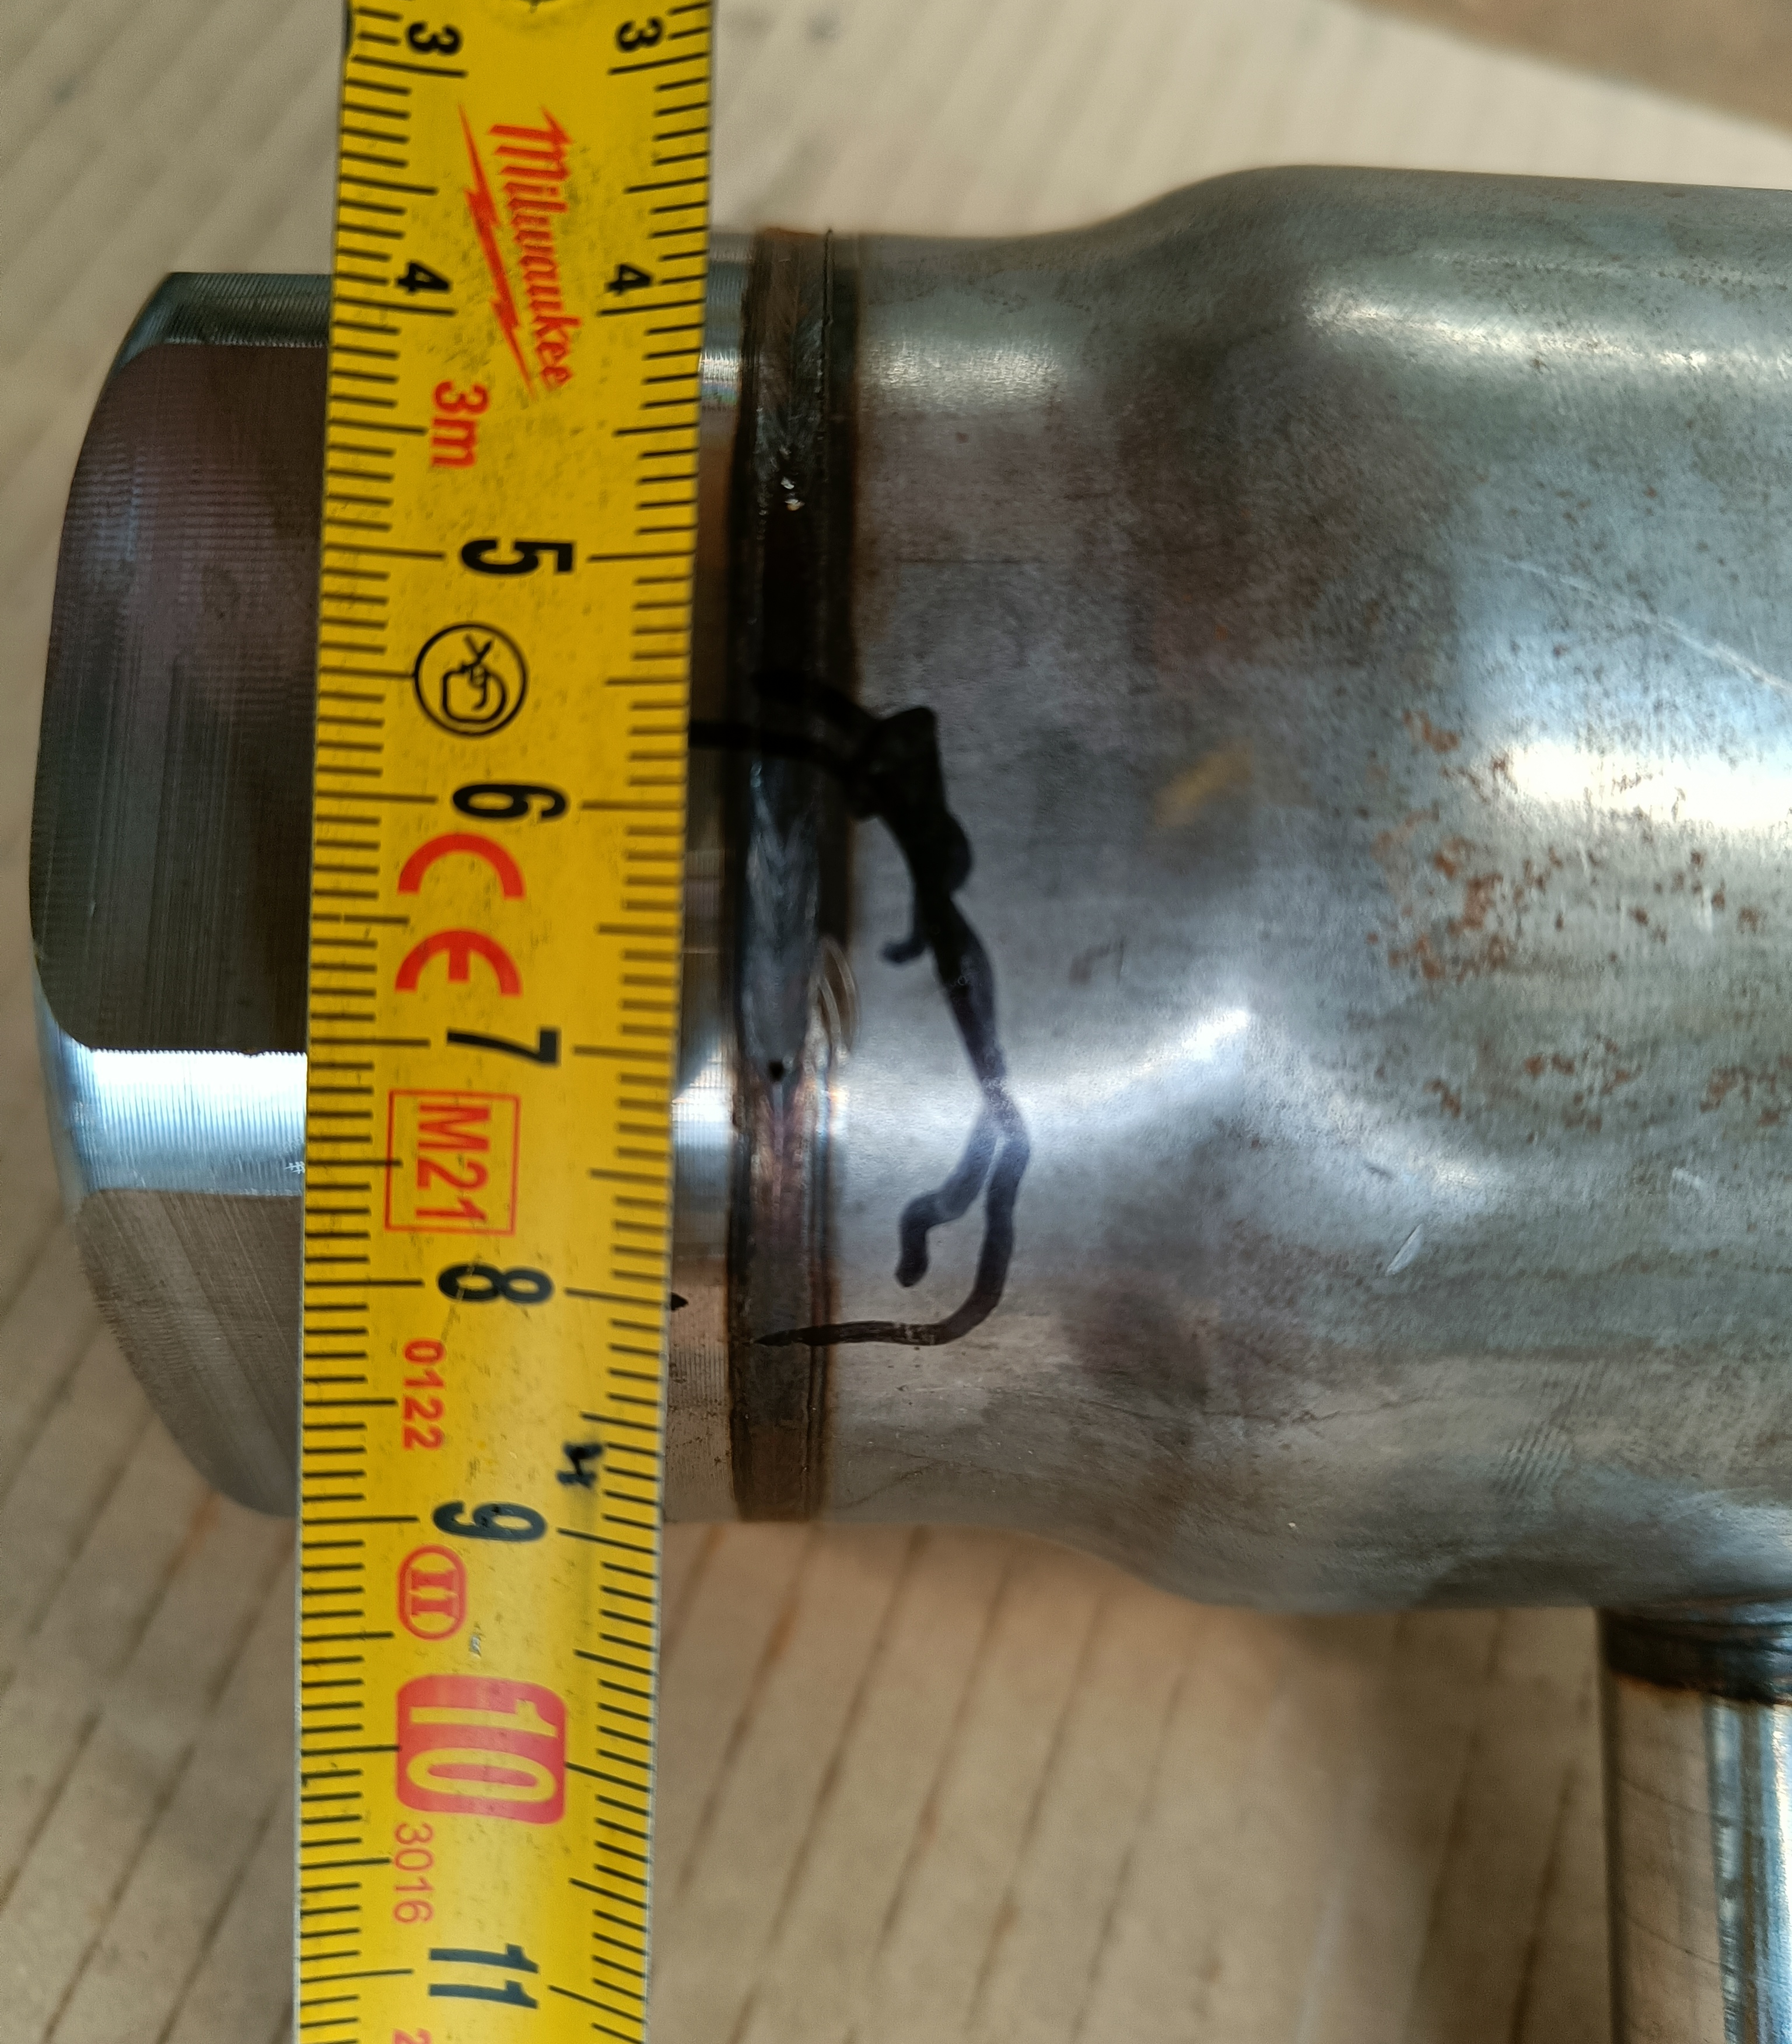
Will it Leak?
Please raise your hand if you believe it leaks

Slide 4
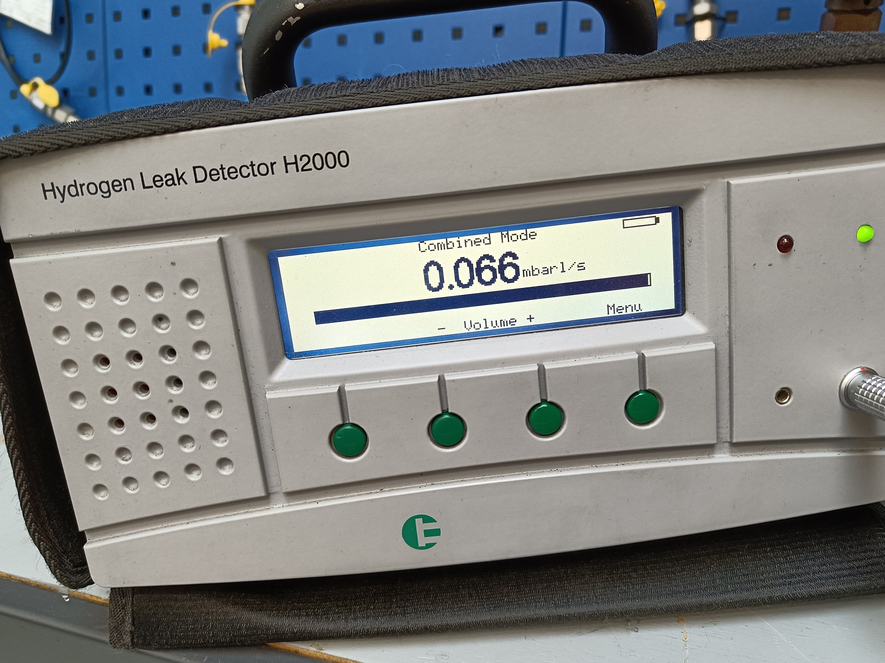
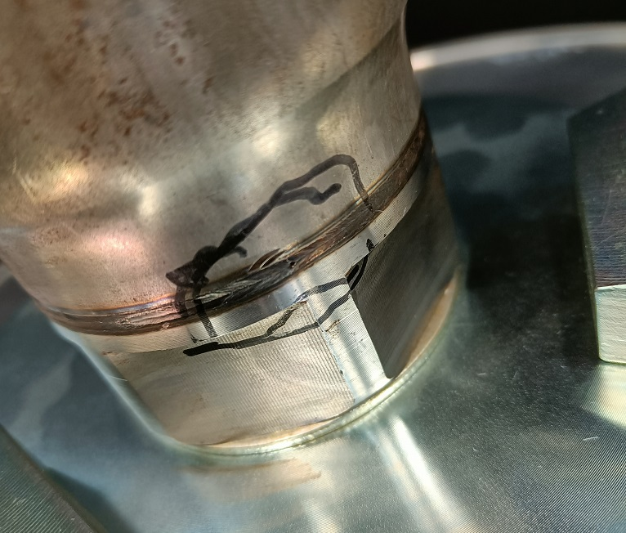
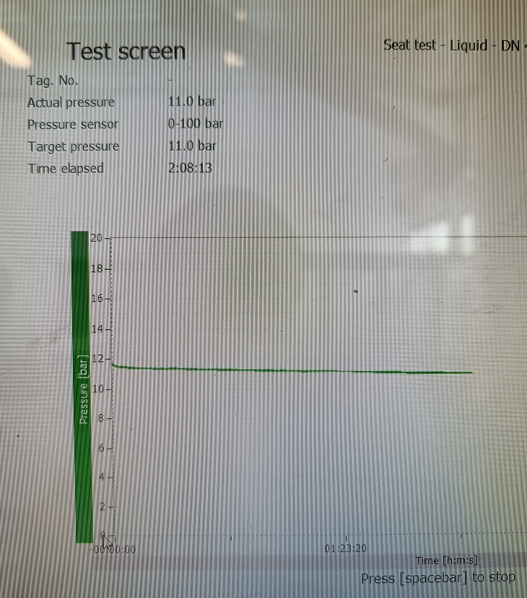
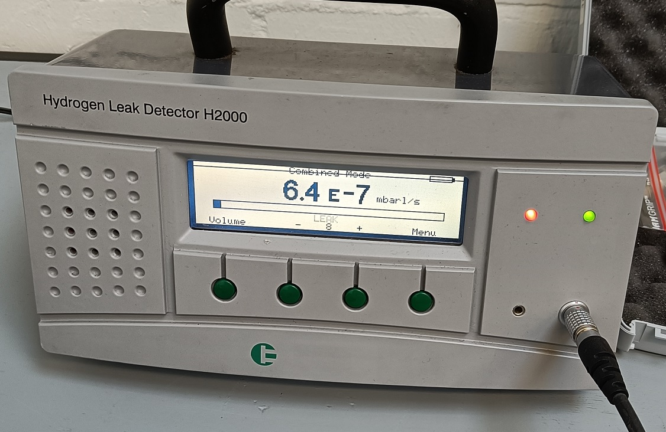
Why the conditons matter
Forming Gas
Water
Forming Gas again...
Tested @ 11 bar
Hydrogen Leak Detector
Detected – Off the charts...
Tested @ 11 bar
No visual leakage
0,3 bar loss over 2 hours
Tested @ 20 bar
Hydrogen Leak Detector
Leakage started after 15 minutes

Slide 5
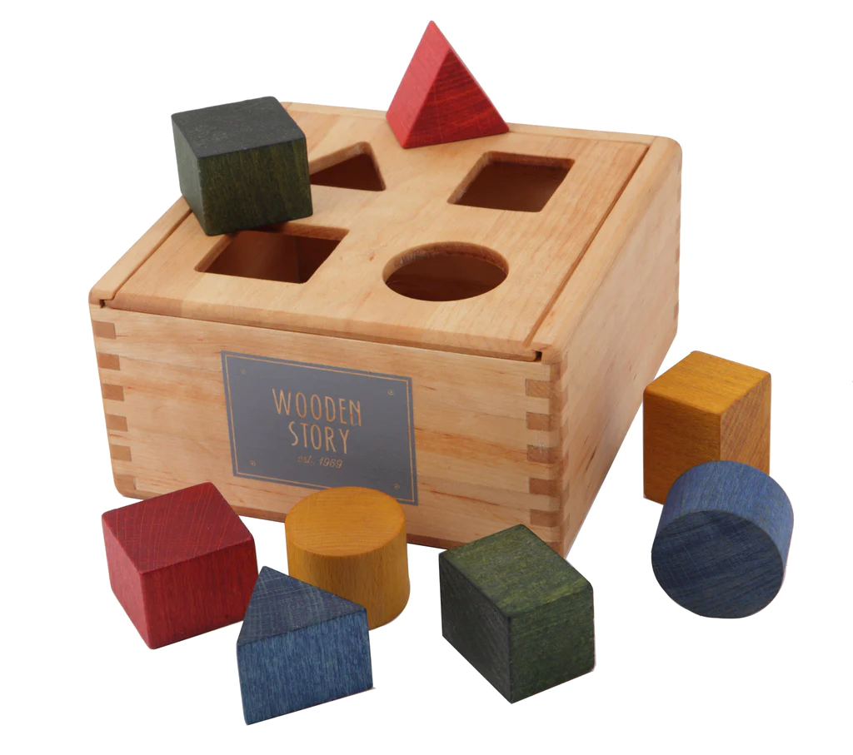
‘Helium leaks the fastest’
‘Because it has the smallest molecule size’

Slide 6
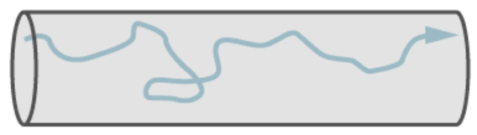
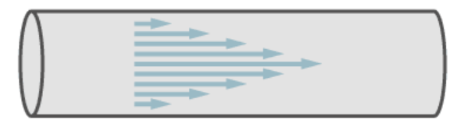
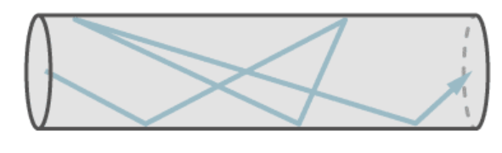
Different gas leakages
Viscous - Turbulent
turbulent flow is fluid motion characterized by chaotic changes in pressure and flow velocity.
Viscous - Laminar
laminar flow is characterized by fluid particles following smooth paths in layers
Molecular
Molecular flow is characterized by a free path larger than the area of the test object

Slide 7
Different gas leakages
Viscous - Turbulent
turbulent flow is fluid motion characterized by chaotic changes in pressure and flow velocity.
Viscous - Laminar
laminar flow is characterized by fluid particles following smooth paths in layers
Transitional
A combination of laminar and molecular
Molecular
Molecular flow is characterized by a free path larger than the area of the test object

Slide 8
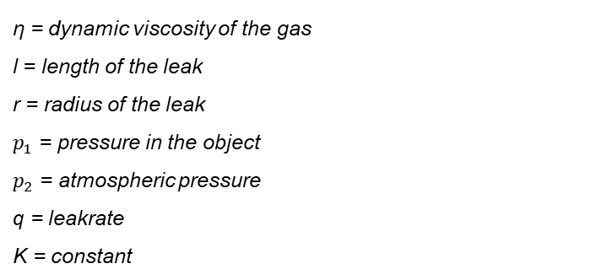

Viscous Flow
Laminar flow - a variation of Hagen Posseuille
$$q= \frac{π ∗r^{4} }{16 ∗ η∗l} ∗\left({p_{1}}^{2}−{p_{2}}^{2}\right)$$
η = dynamic viscosity of the gas
l = length of the leak
r = radius of the leak
$p_{1}$ = pressure in the object
$p_{2}$ = atmospheric pressure
q = leakrate
K = constant

Slide 9
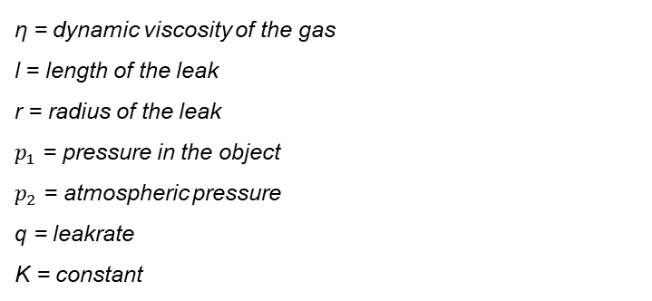

Viscous Flow
Laminar flow - a variation of Hagen Posseuille
$$q= \frac{π ∗r^{4} }{16 ∗ η∗l} ∗\left({p_{1}}^{2}−{p_{2}}^{2}\right)$$
A quick conclusion
Lower viscosity, means bigger leakage.
η = dynamic viscosity of the gas
l = length of the leak
r = radius of the leak
$p_{1}$ = pressure in the object
$p_{2}$ = atmospheric pressure
q = leakrate
K = constant

Slide 10

Viscous Flow
Laminar flow - a variation of Hagen Posseuille
$$q= \frac{π ∗r^{4} }{16 ∗ η∗l} ∗\left({p_{1}}^{2}−{p_{2}}^{2}\right)$$
A quick conclusion
Lower viscosity, means bigger leakage.
η = dynamic viscosity of the gas
l = length of the leak
r = radius of the leak
$p_{1}$ = pressure in the object
$p_{2}$ = atmospheric pressure
q = leakrate
K = constant
Gas | Viscosity @25°C [10⁻⁶ Pa s] | Conversion of Helium Leak rate
Hydrogen | 8.9 | x 2.21
Methane | 11.2 | x 1.76
Nitrogen | 17.9 | x 1.10
Air | 18.3 | x 1.08
Helium | 19.7 | -

Slide 11
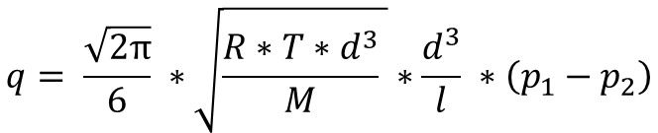

Molecular Flow
Molecular flow - Knudsen
$$q= \frac{\sqrt{2π}}{6} ∗\sqrt{\frac{R∗T∗d^{3}}{M} }∗\frac{d^{3}}{l} ∗\left(p_{1}−p_{2}\right)$$
R = universal gas constant
T = Absolute temperature (K)
M = relative mass of molecule
$p_{1}$ = pressure in the object
$p_{2}$ = atmospheric pressure
d = diameter of leak
l = length of the leak

Slide 12
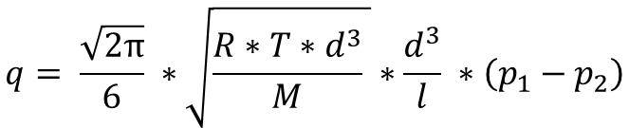

Molecular Flow
Molecular flow - Knudsen
$$q= \frac{\sqrt{2π}}{6} ∗\sqrt{\frac{R∗T∗d^{3}}{M} }∗\frac{d^{3}}{l} ∗\left(p_{1}−p_{2}\right)$$
A quick conclusion
Lower Molecular Mass, means bigger leakage.
R = universal gas constant
T = Absolute temperature (K)
M = relative mass of molecule
$p_{1}$ = pressure in the object
$p_{2}$ = atmospheric pressure
d = diameter of leak
l = length of the leak

Slide 13
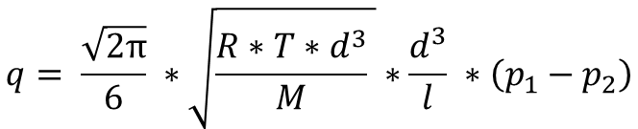

Molecular Flow
Molecular flow - Knudsen
$$q= \frac{\sqrt{2π}}{6} ∗\sqrt{\frac{R∗T∗d^{3}}{M} }∗\frac{d^{3}}{l} ∗\left(p_{1}−p_{2}\right)$$
A quick conclusion
Lower Molecular Mass, means bigger leakage.
R = universal gas constant
T = Absolute temperature (K)
M = relative mass of molecule
$p_{1}$ = pressure in the object
$p_{2}$ = atmospheric pressure
d = diameter of leak
l = length of the leak
Gas | Molecular Mass | Conversion of Helium Leak rate
Hydrogen | 2 | x 1.41
Helium | 4 | -
Methane | 16 | x 0.50
Nitrogen | 18 | x 0.38
Air | 19 | x 0.37

Slide 14
‘Helium leaks the fastest’
‘Because it has the smallest molecule size’

Slide 15


What does it mean?
1 - Helium is great for Cryogenics, and level AH and BH Fugitive Emissions
2 - It’s not about the test result.
The procedure guarantees quality
3 – Clever use of different test media can save costs and reduce test times
Shell revised MESC SP 77/312 to allow forming gas for Fugitive Emission Production Testing. Purpose is to save costs
Cycle time for testing of EN-12266 valves can be reduced by more than 75%, AND automatic detection of leaks can actually be guaranteed

Slide 16
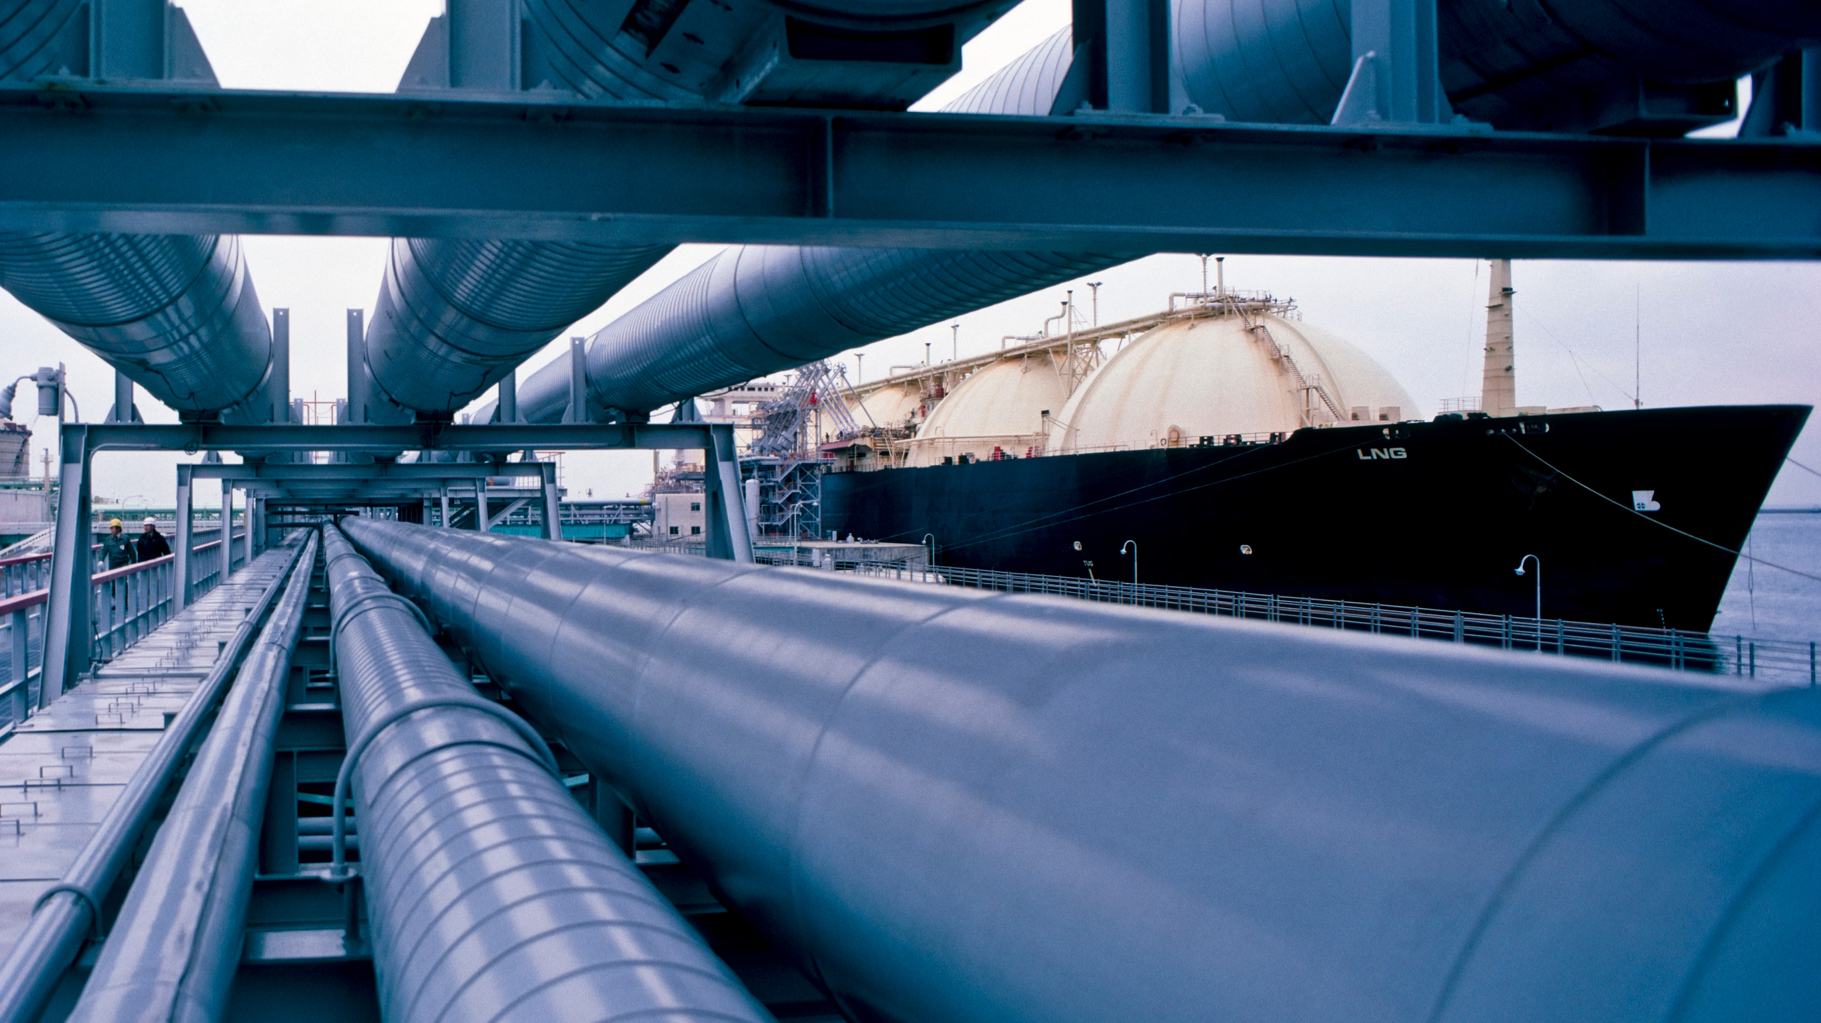
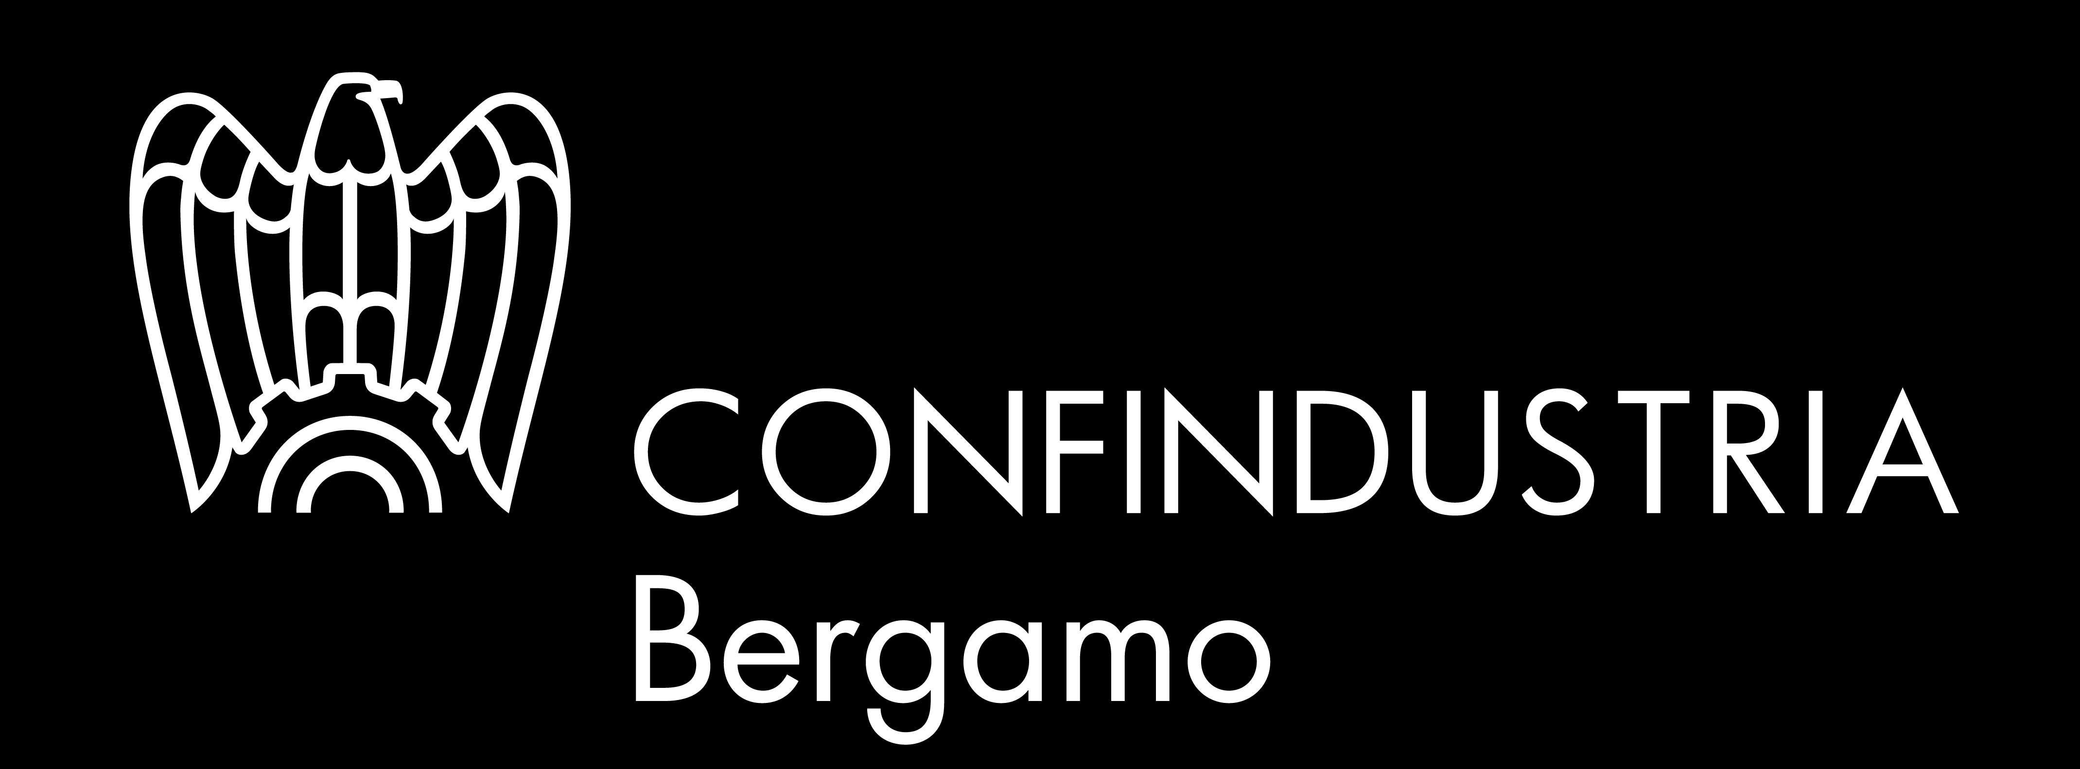
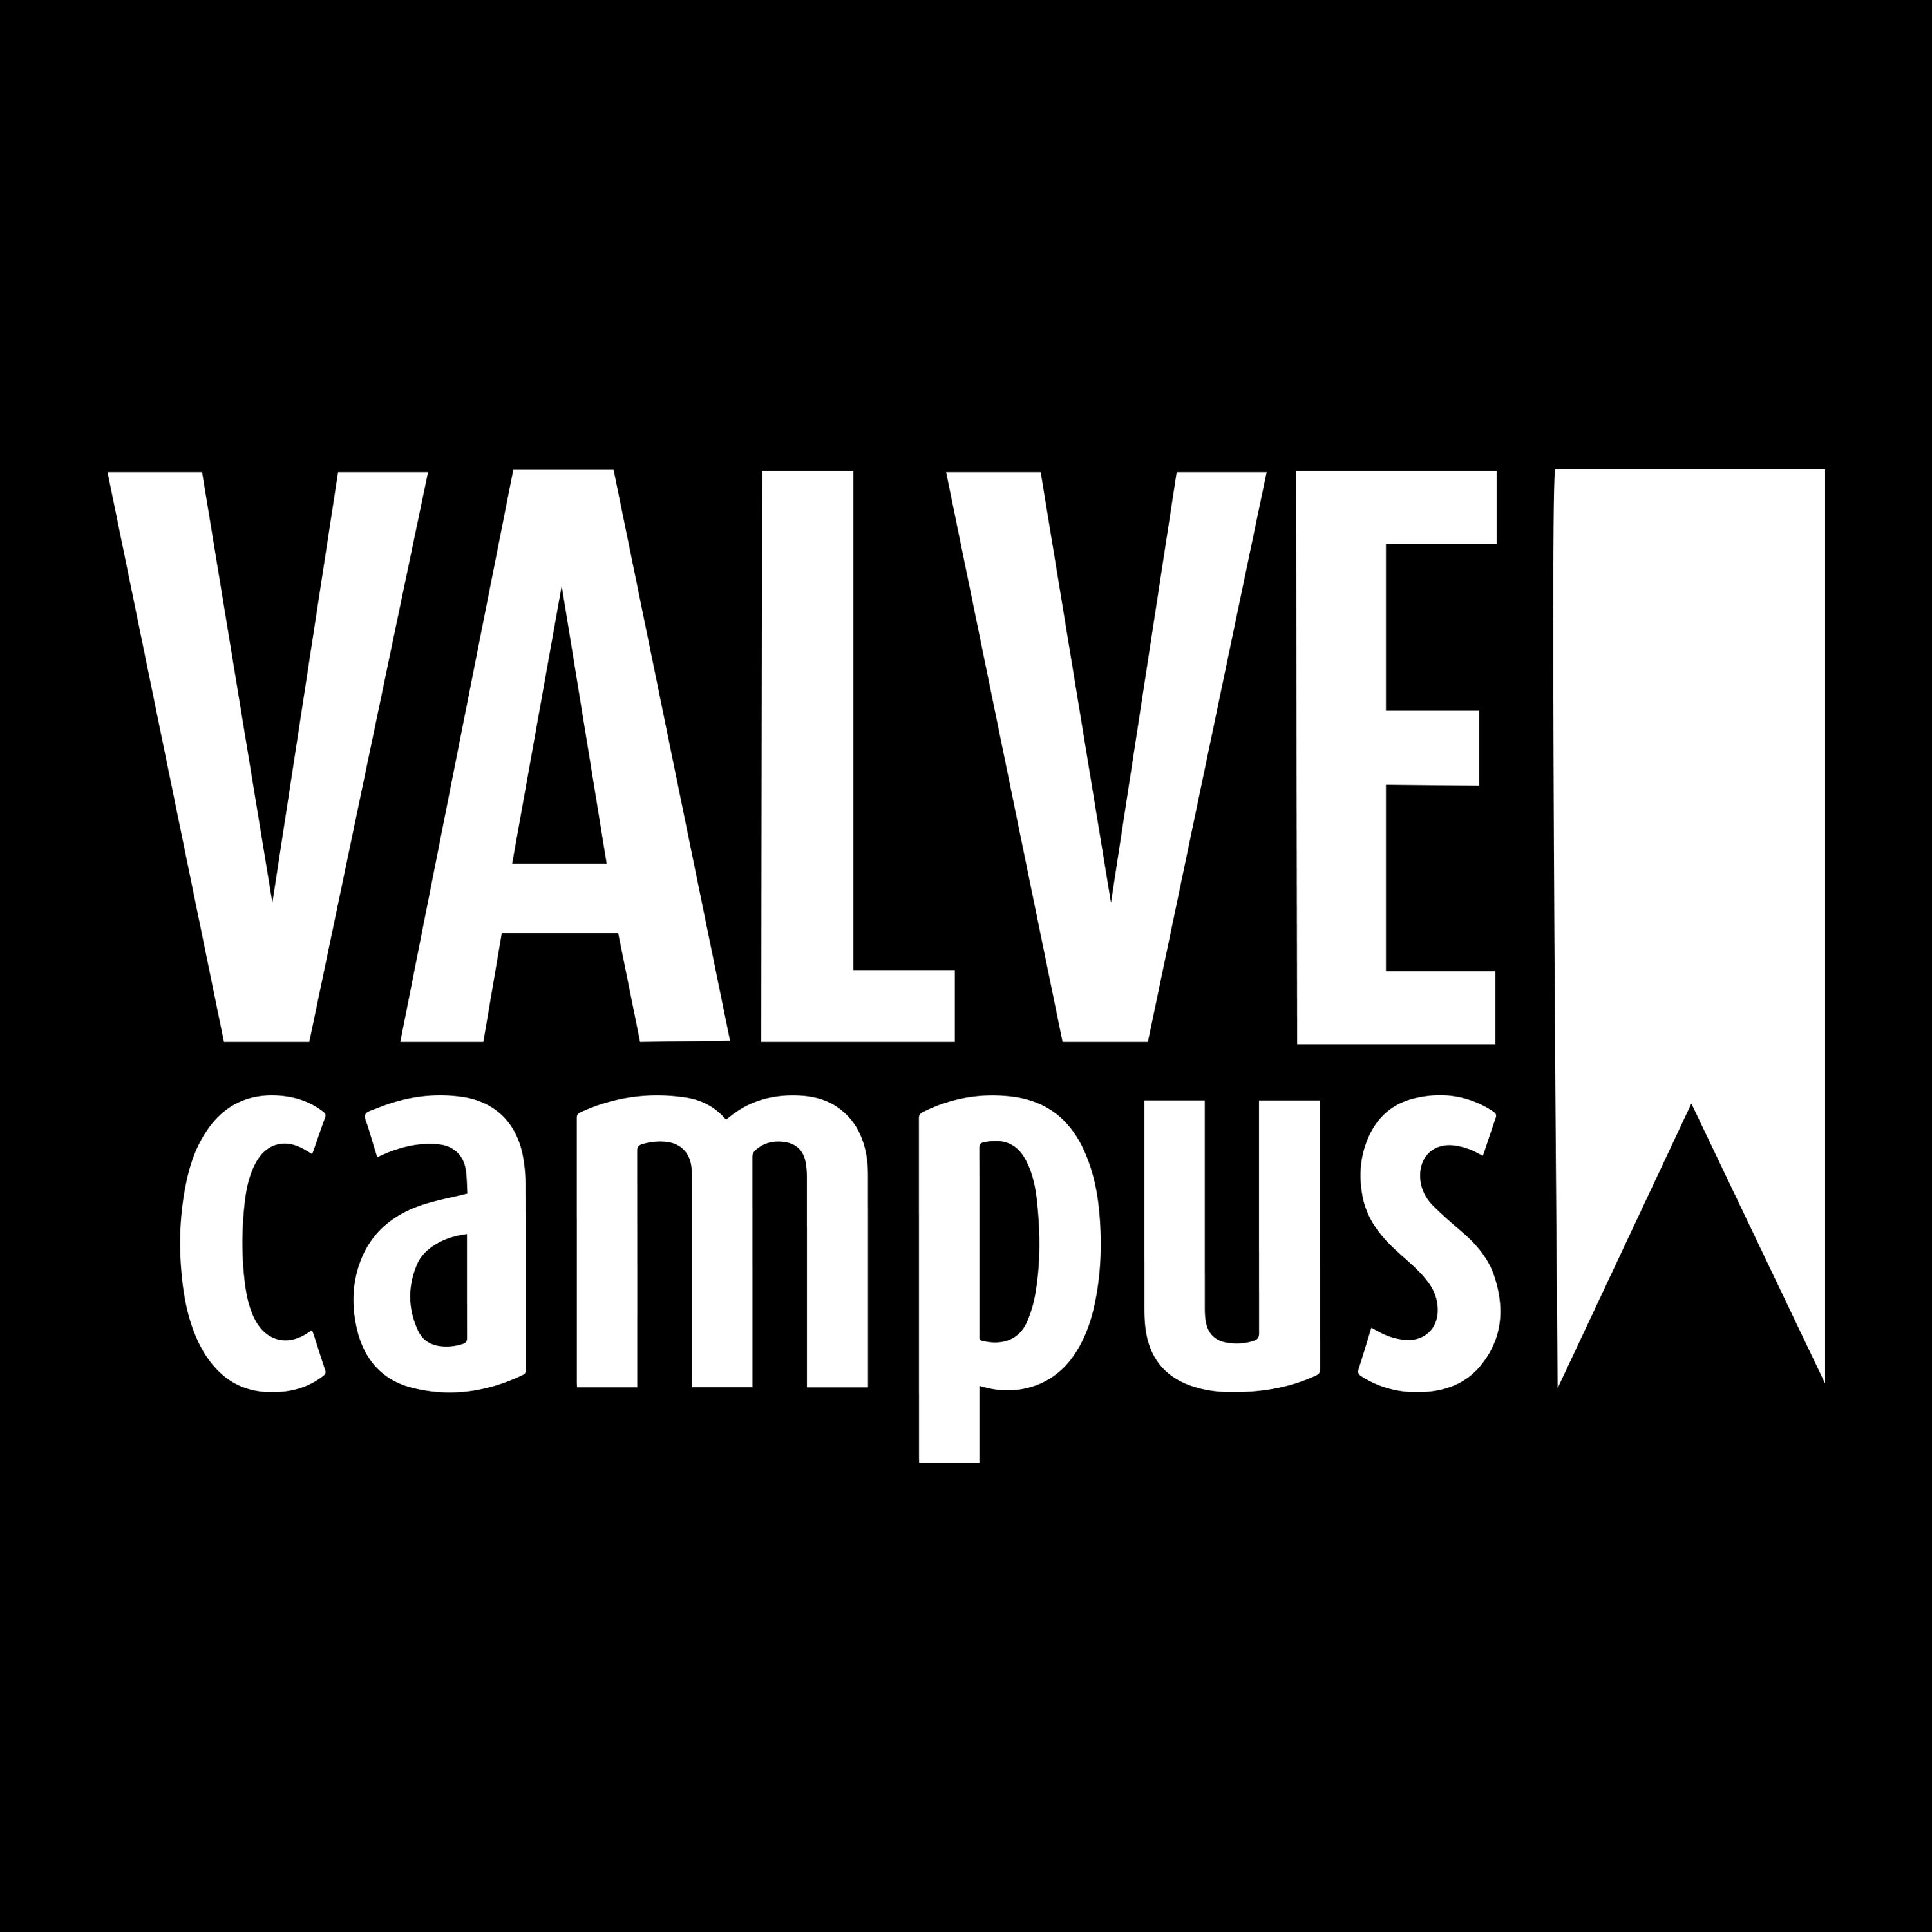
At Ventil we believe it is fundamentally important to rethink our old ways. Right use of technology will bring our industry to a next level, but our standards must allow deployment
It is essential to develop production technology and QA/QC procedures to keep up with valve trends. We simply cannot afford to continue without change
Now is the time to define a sustainable practice and purpose driven way forwards. It requires dialogue, and it starts here. Today.
ORGANIZERS
CONFERENCE ORGANIZERS

Slide 17
Get in touch! – abaars@ventil.nl

Slide 18
Thanks
ORGANIZING SECRETARIAT
Ph. +39 035 3230904
e-mail info@industrialvalvesummit.com
CONFERENCE ORGANIZERS
Ph. +39 3474908420
e-mail segreteria@valvecampus.com
www.industrialvalvesummit.com
www.valvecampus.com

