Slide 1
Reduction of Fugitive Emissions – TA Luft and ISO 15848-1
CONFERENCE
ORGANIZERS

Slide 2
Reduction of Fugitive Emissions – TA Luft and ISO 15848-1
Dr.-Ing. Manfred Schaaf
Managing Director
amtec advanced mesusurements
Messtechnischer Service GmbH
ms@amtec.de

Slide 3
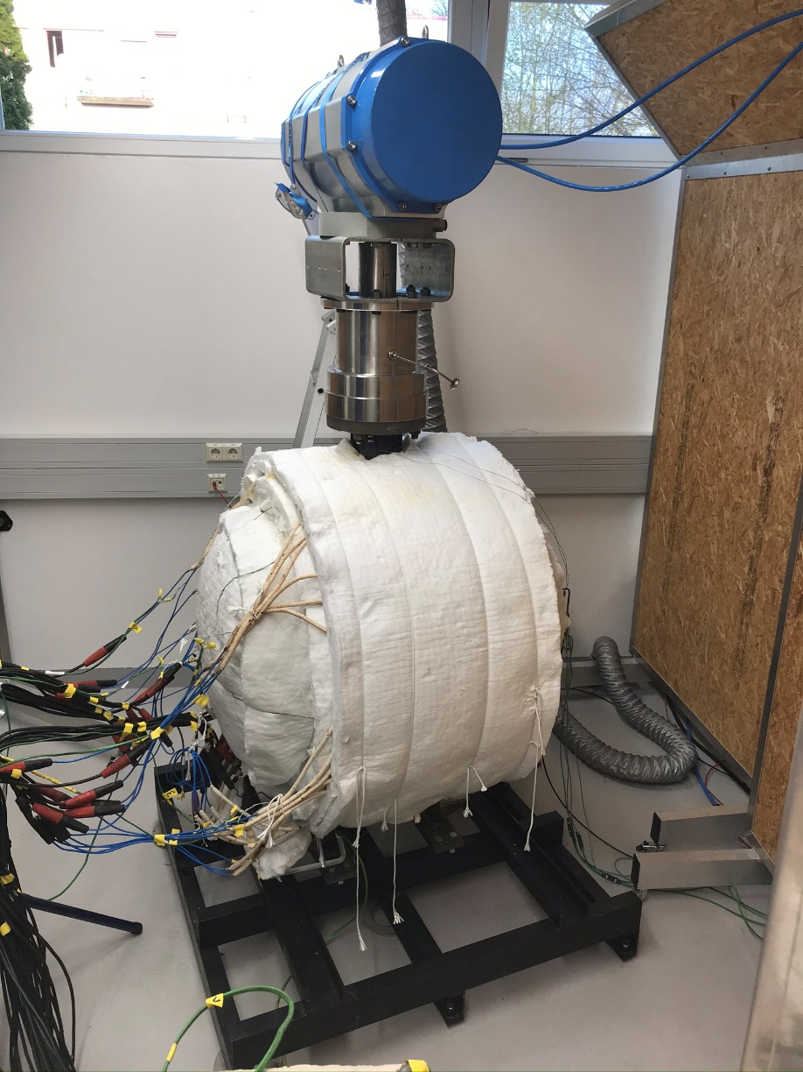
Content
Background Information
German Regulation TA Luft
Testing Equipment
Test Results
VDMA/VCI-Leitfaden
Summary

Slide 4

Tightness Demands
IED directive [2010/75/EC]
Industrial Emission Directive
energy industries (incl. oil & gas refineries)
production and processing of metals
mineral industries
chemical industry
waste management
other activities (e.g. pulp & paper industry)
prevent / reduce emissions to air, water and land
reduce generation of waste
use energy efficiently
prevent accidents
Use Best Available Technology
to achieve objectives

Slide 5
Fugitive Emission Standards
International Standards
EN ISO 15848-1 (2015 + A1:2017)
Industrial valves - Measurement, test and qualification procedures for fugitive emissions - Part 1: Classification system and qualification procedures for type testing of valves
American Standards
API 622 (2022)
Type testing of process valve packing for fugitive emissions
API 624 (2023)
Type testing of rising stem valves equipped with graphite packing for fugitive emissions
API 641 (2023)
Type testing of quarter-turn valves for fugitive emissions

Slide 6
German Legislation
German Regulations / Guidelines
First General Administrative Regulation Pertaining the Federal Immission Control Act
(Technical Instructions on Air Quality Control – TA Luft)
general regulations with details regarding BFC and stuffing box packings
VDI 2440 (2000)
general regulations with details regarding BFC and stuffing box packings
stuffing box packings:
use metallic bellows
or
limit the emission of packing materials under operational conditions in a first-time test:
10⁻⁴ mbar*l/m/s (T ≤ 250 °C)
10⁻² mbar*l/m/s (T > 250 °C)

Slide 7
New TA Luft Regulation (2021)
no first-time test
for packing material according to VDI 2440 (2000) is required anymore
Valves have to be classified according to EN ISO 15848-1 (2015)
temperature class
endurance class
tightness class

Slide 8
Tightness Demands TA Luft 2021
 | Test Medium: Helium or Methane | p ≤ 40 bar | p > 40 bar
T ≤ 200 °C | stem seal | ≤ 10⁻⁴ mg/m/s (LB) | ≤ 10⁻² mg/m/s (LC)
 | body seal | ≤ 50 ppmv | ≤ 50 ppmv
T > 200 °C | stem seal | ≤ 10⁻² mg/m/s (LC) | ≤ 10⁻² mg/m/s ¹⁾ (LC)
 | body seal | ≤ 50 ppmv | ≤ 50 ppmv

Slide 9
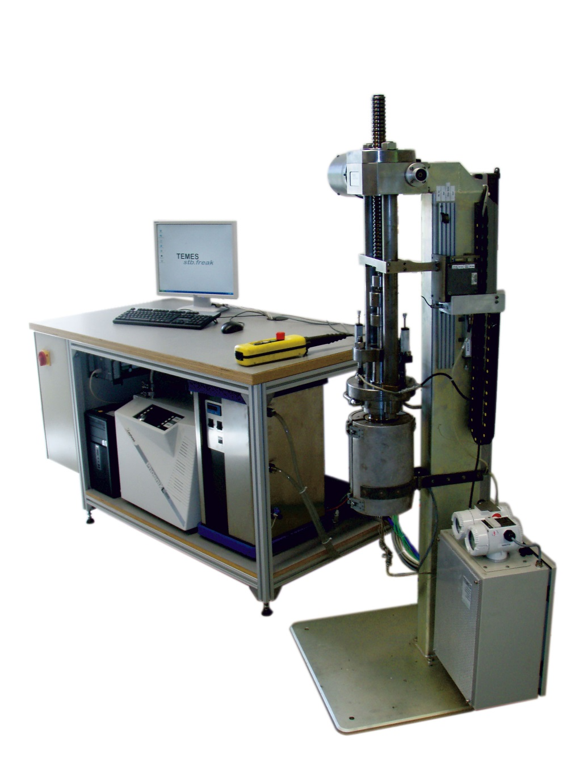
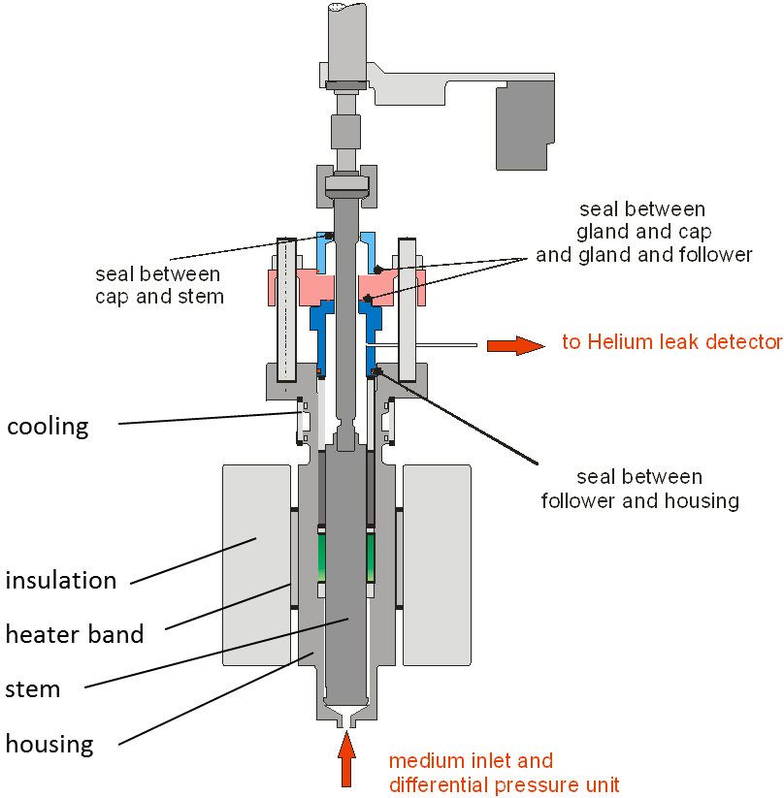
Testing Equipment for Packings
customized housing geometry
N₂, He, CH₄, H₂
vacuum method
sniffing method
ISO 12101 for prequalification of packing sets for ISO 15848-1

Slide 10
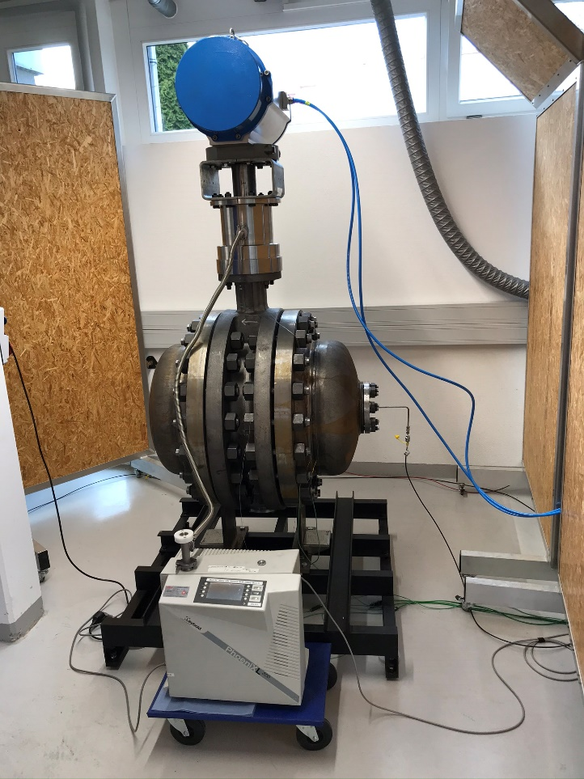
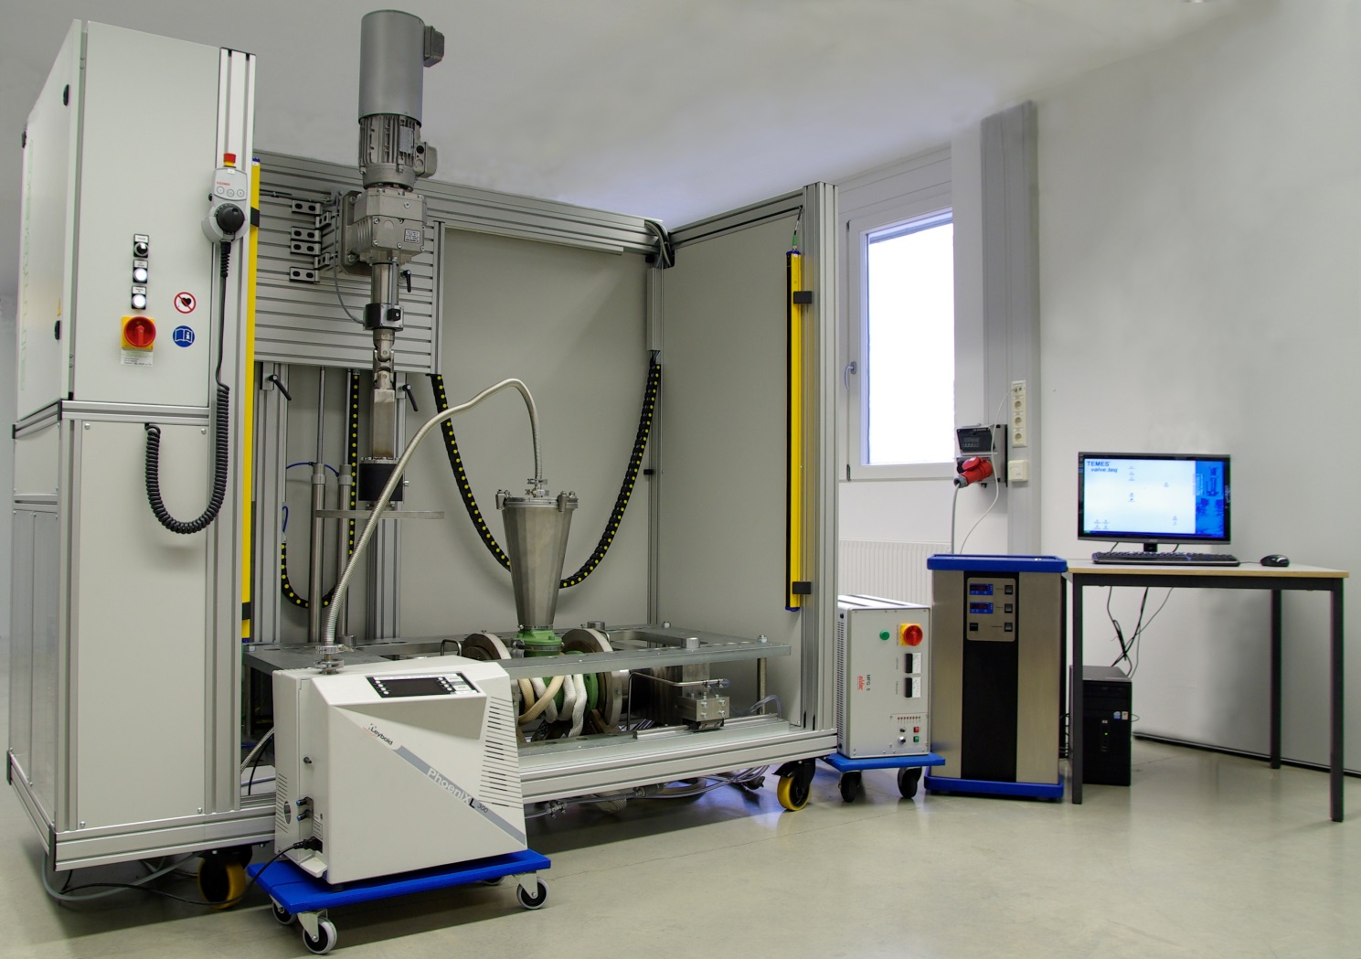
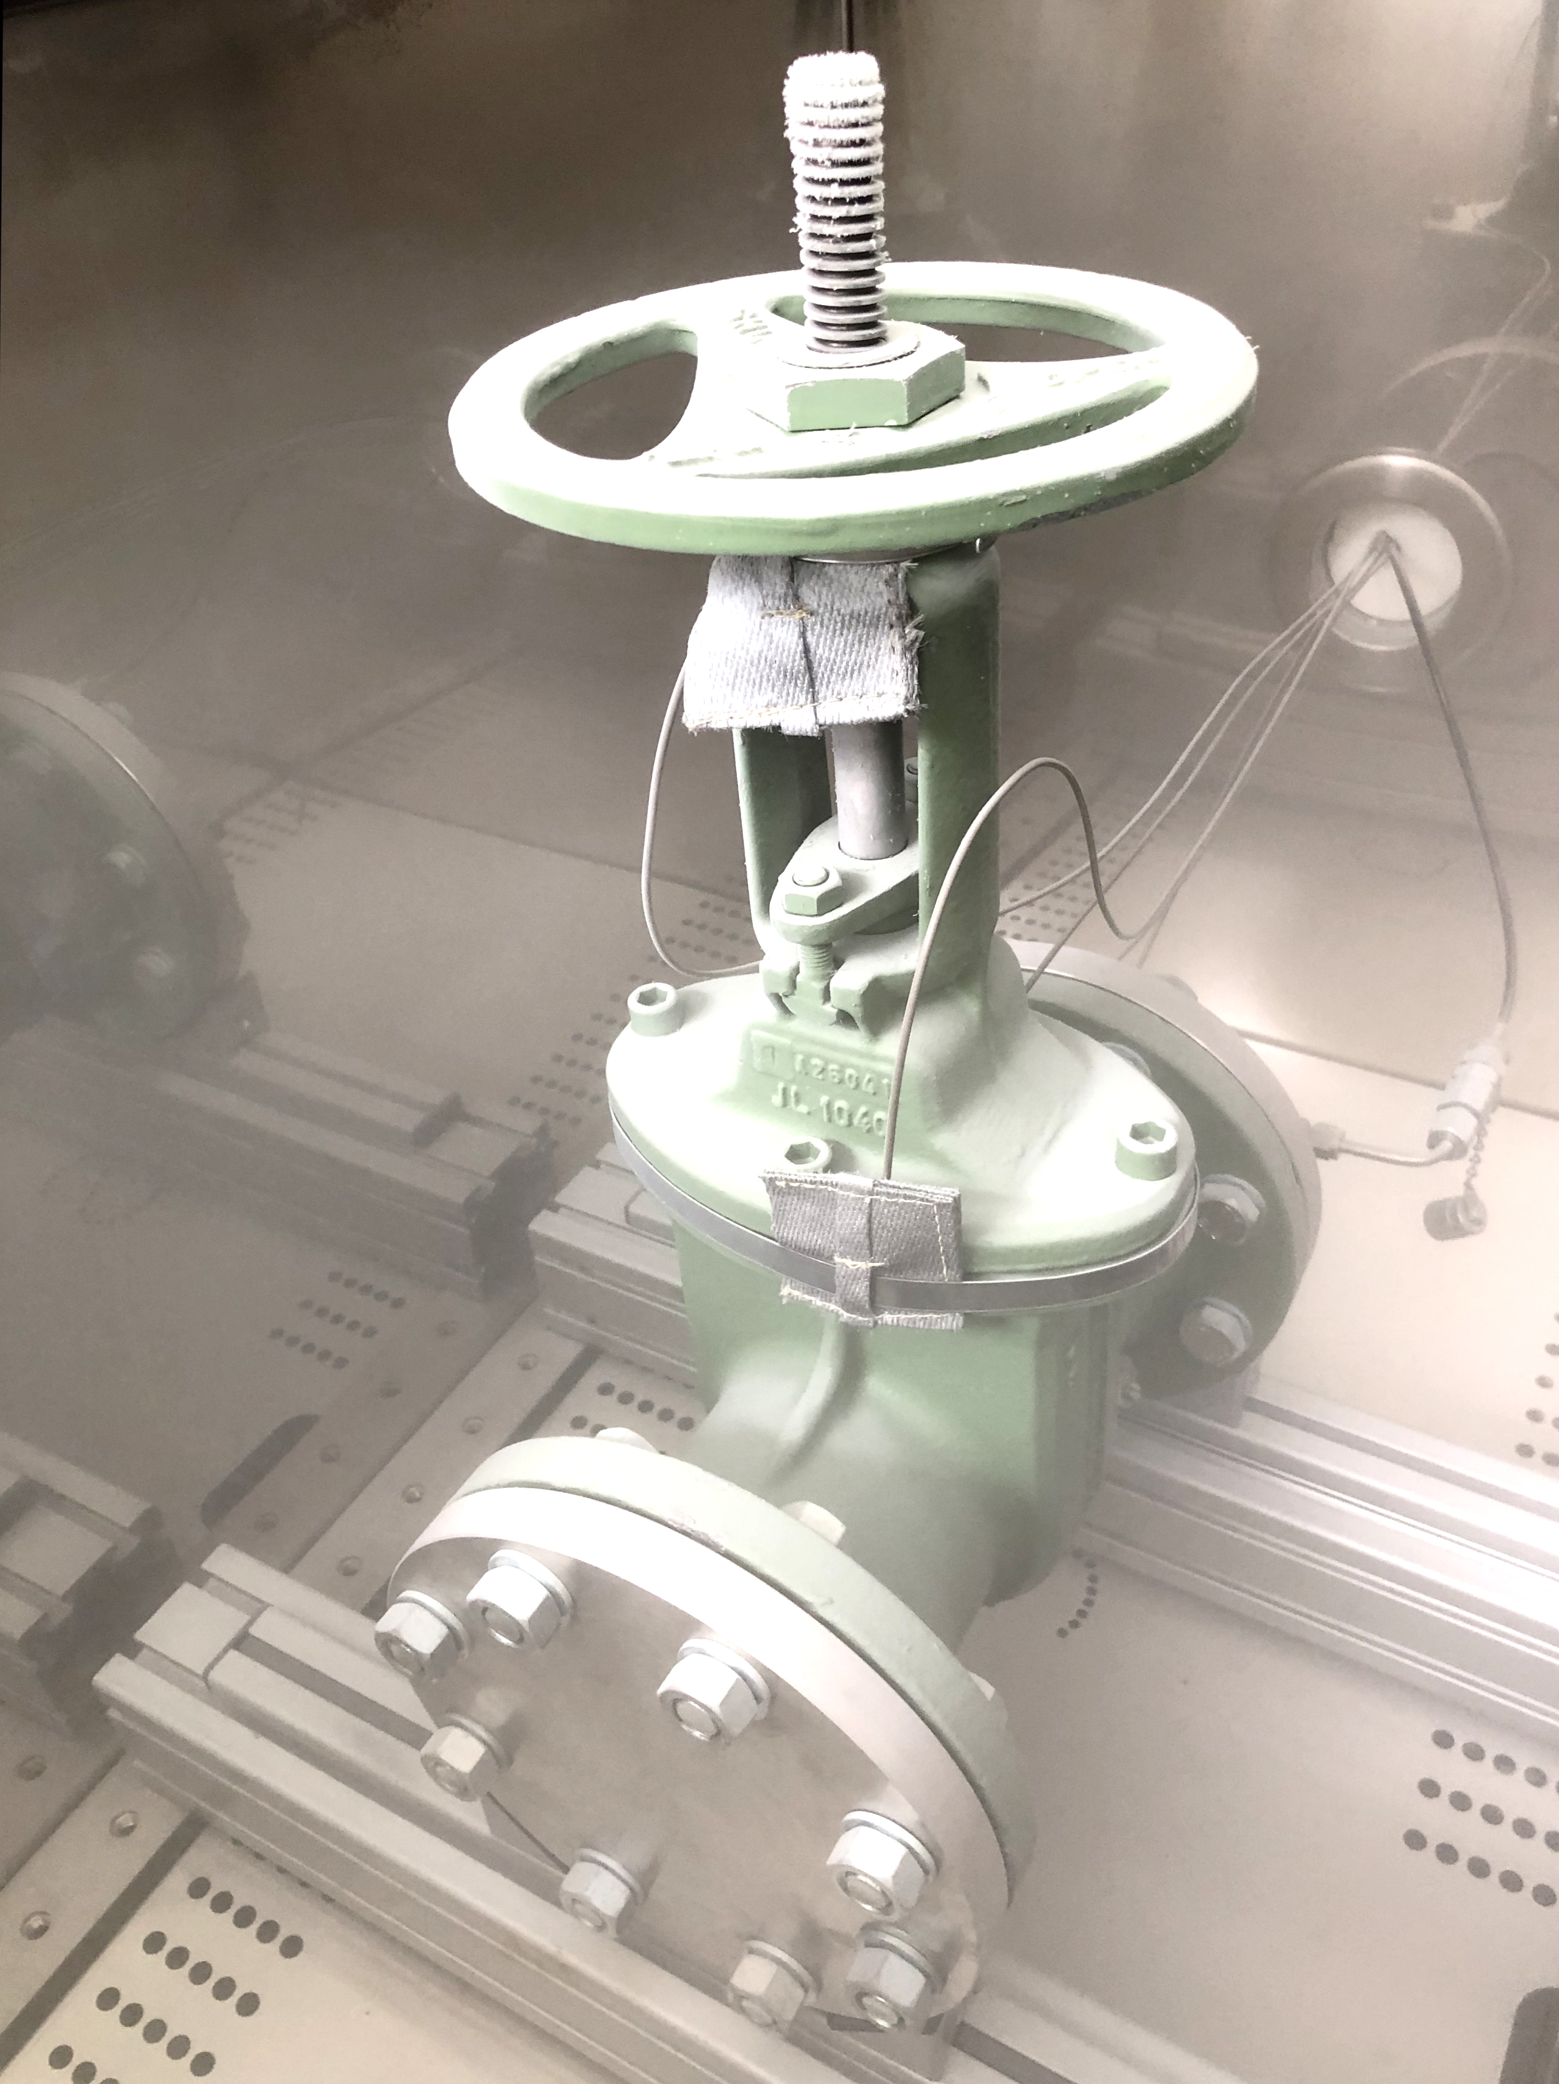
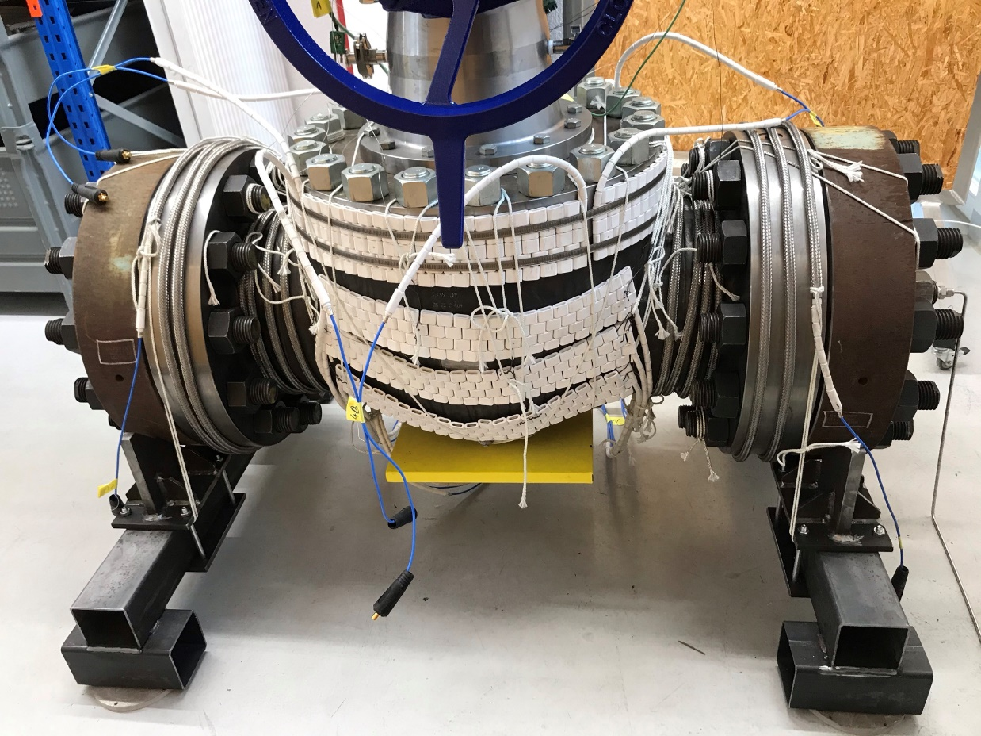
Testing Equipment for Valves
ISO 15848-1

Slide 11
Test Results VDI 2440
assembly
strokes @ RT
leakage measurement
@ RT
heating up
strokes @ T
leakage measurement @ T

Slide 12
Comparison of VDI 2440 Results
very good information about the characteristics of the packing set
basis for the selection of the packing set for valve application
Importance of testing standard for packings
API 622

Slide 13
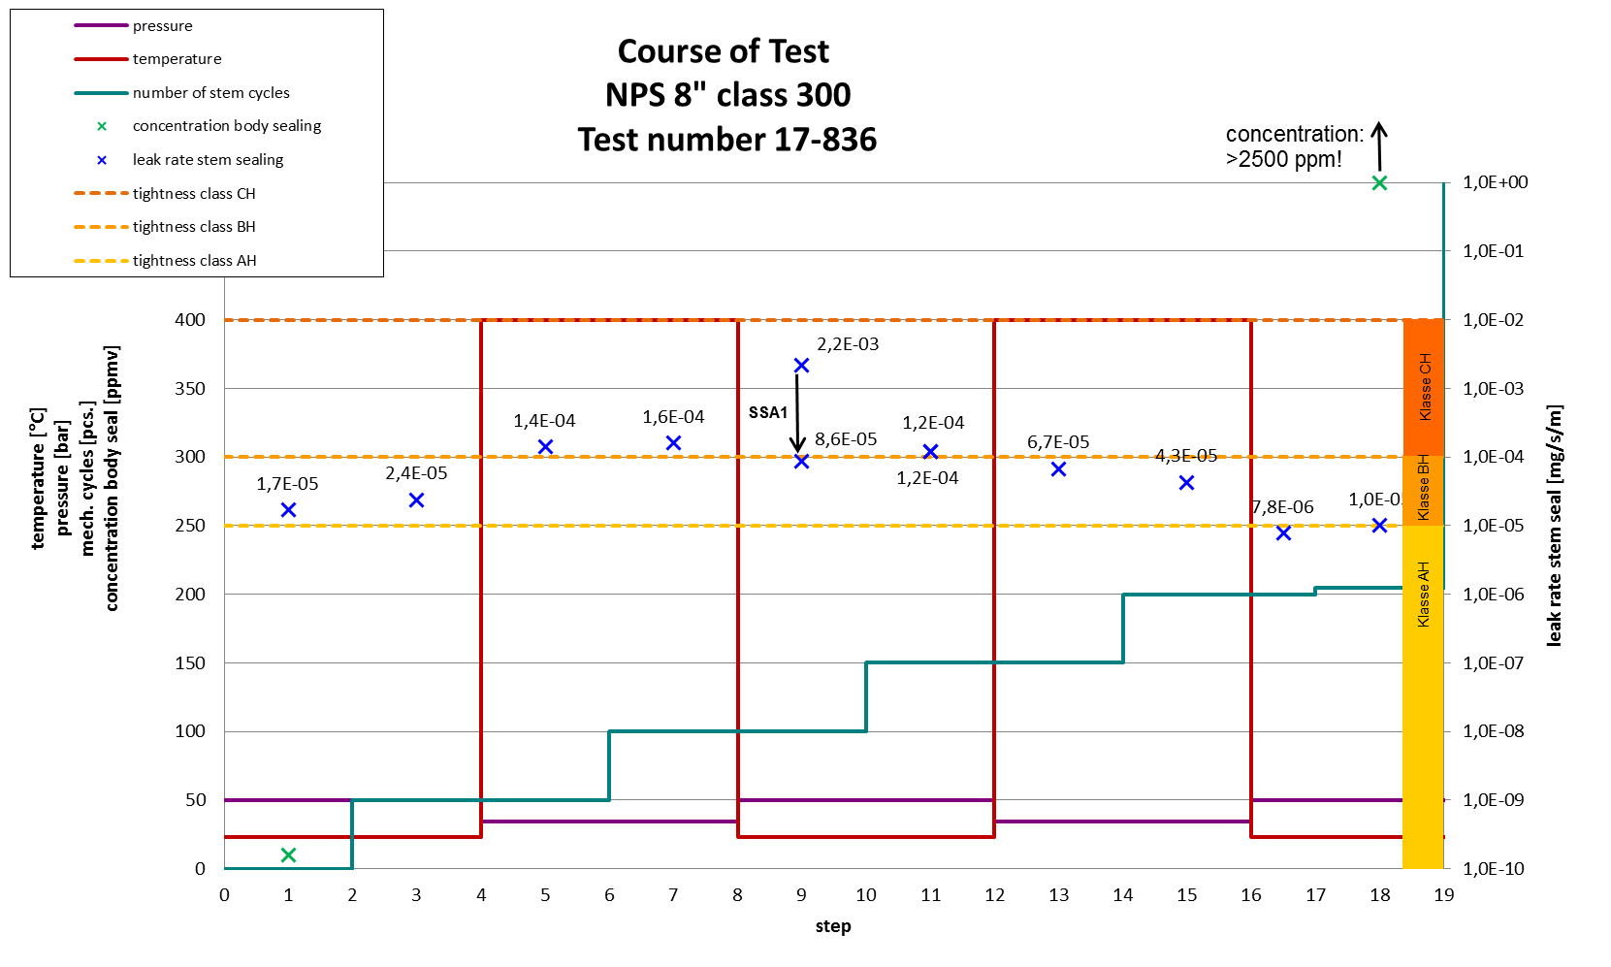
Test Results ISO 15848-1
Shut-off Valve CO1
  ISO FE CH – CO1 – SSA1 – t400 – (50/34.7) – ISO15848-1

Slide 14
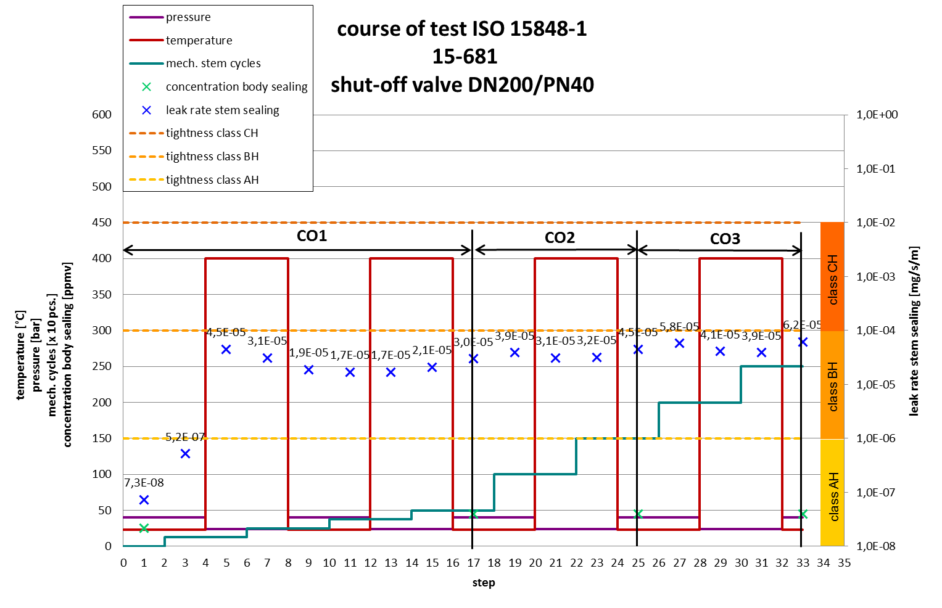
Test Results ISO 15848-1
Shut-off Valve CO3
  ISO FE BH – CO3 – SSA0 – t400 – (40/23.6) – ISO15848-1

Slide 15

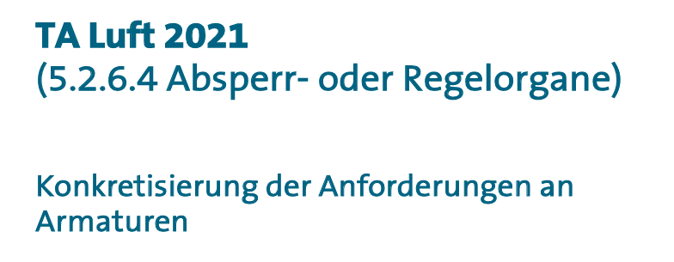
VDMA/VCI-Leitfaden
guideline to specify the
TA Luft requirements for valves in detail
Source: https://www.vdma.org/viewer/-/v2article/render/51810201

Slide 16
VDMA/VCI-Leitfaden (p/T-Ratings)
If the pressure and temperature rating includes several tightness demands, the individual tightness classes must be met.
Transferring the test to other temperature ranges is only possible if the highest tightness demand is fulfilled.
The temperature classes must cover the complete pressure and temperature rating of the valve according to the manufacturer's instructions.

Slide 17
VDMA/VCI-Leitfaden (Endurance Classes)
Endurance class CO3 for shut-off valves and CC3 for control valves should be aimed for.
A maintenance concept must be provided for shut-off valves when only the CO1 or CO2 endurance class is reached. A maintenance concept is always required for control valves.
The total number of shaft or shaft adjustments carried out as well as the stem cycles carried out up to that point must be noted in the test report.

Slide 18
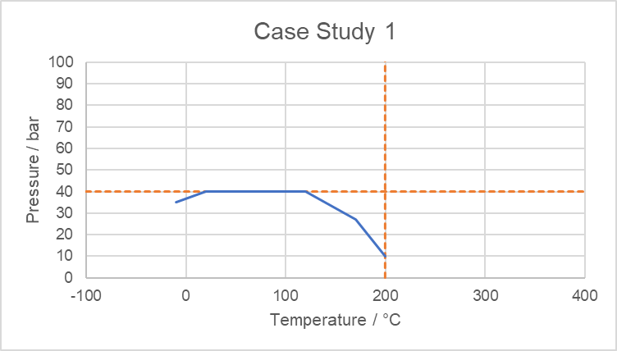
VDMA/VCI-Leitfaden (Case Study 1)
LC
LC
LB
LC

Slide 19
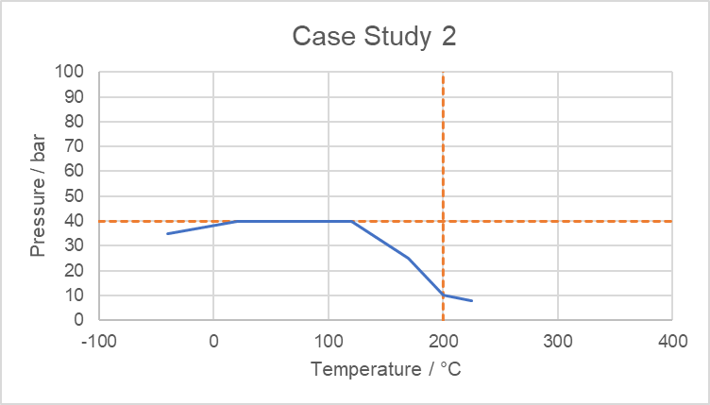
VDMA/VCI-Leitfaden (Case Study 2)
LC
LC
LB
LC
LB

Slide 20
Summary
There is no need to meet the requirements of a high-quality sealing system through an first-time test according to VDI 2440.
ISO 15848-1 (2015) is the test basis for the use of valves within the scope of TA Luft 2021.
A VDMA/VCI-Guideline gives additional information how the requirements of TA Luft can be met.

Slide 21



A strong partnership for the sealing and valve industry
Dr.-Ing. Manfred Schaaf
ms@amtec.de
ms@amtec-services.com

Slide 22
Thanks
ORGANIZING SECRETARIAT
Ph. +39 035 3230904
e-mail info@industrialvalvesummit.com
CONFERENCE ORGANIZERS
Ph. +39 3474908420
e-mail segreteria@valvecampus.com
www.industrialvalvesummit.com
www.valvecampus.com

