Slide 1
Application of AI technologies and GNN surrogate models on manufacturing processes
CONFERENCE
ORGANIZERS

Slide 2
Application of AI technologies and GNN surrogate models on manufacturing processes
Federico Fracasso | Country Manager (TRANSVALOR)

Slide 3

Background & Motivation
Use Case on Die Wear Modelling
GNN-based Surrogate Model
Conclusions

Slide 4
Four Pillars of Engineering
Experiments
Analytical model
  At the very beginning, engineers only rely on experiments
  Preliminary basic approaches to model the physics and calculate linear phenomena
IA/ML
FEM modelling
  Today, we trust in
  FEM modelling to obtain
  High-Fidelity results
  Quick AI methods able to capture non-linear behaviors at least cost

Slide 5
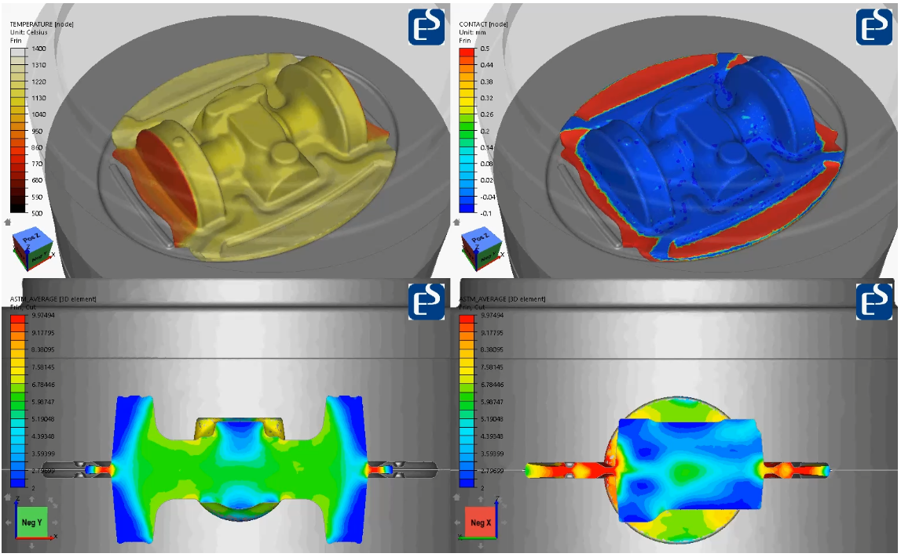
FEM simulation

Slide 6
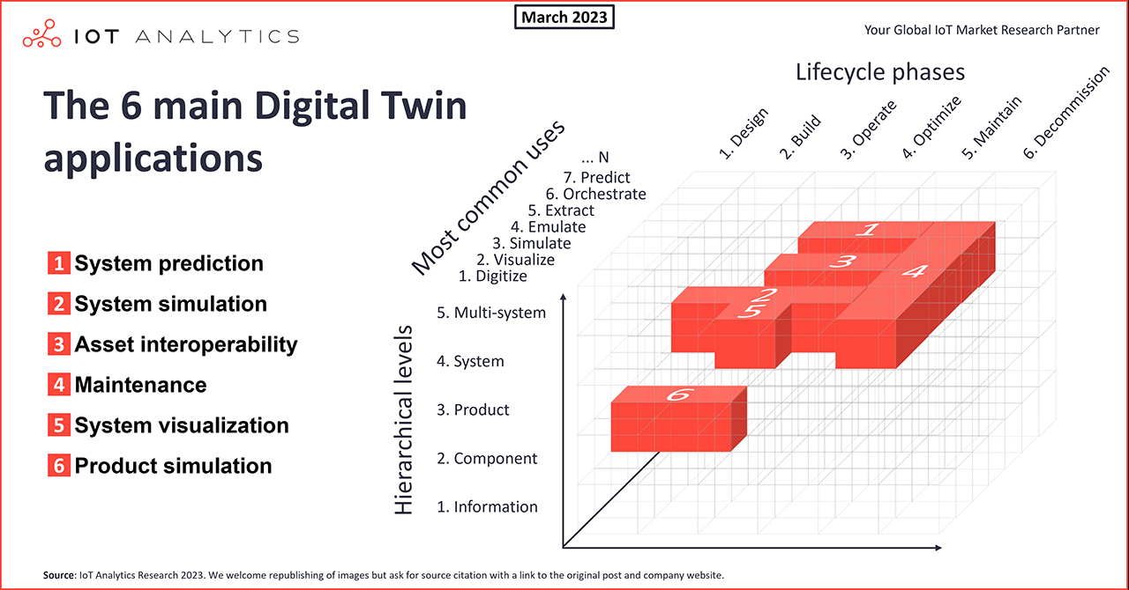
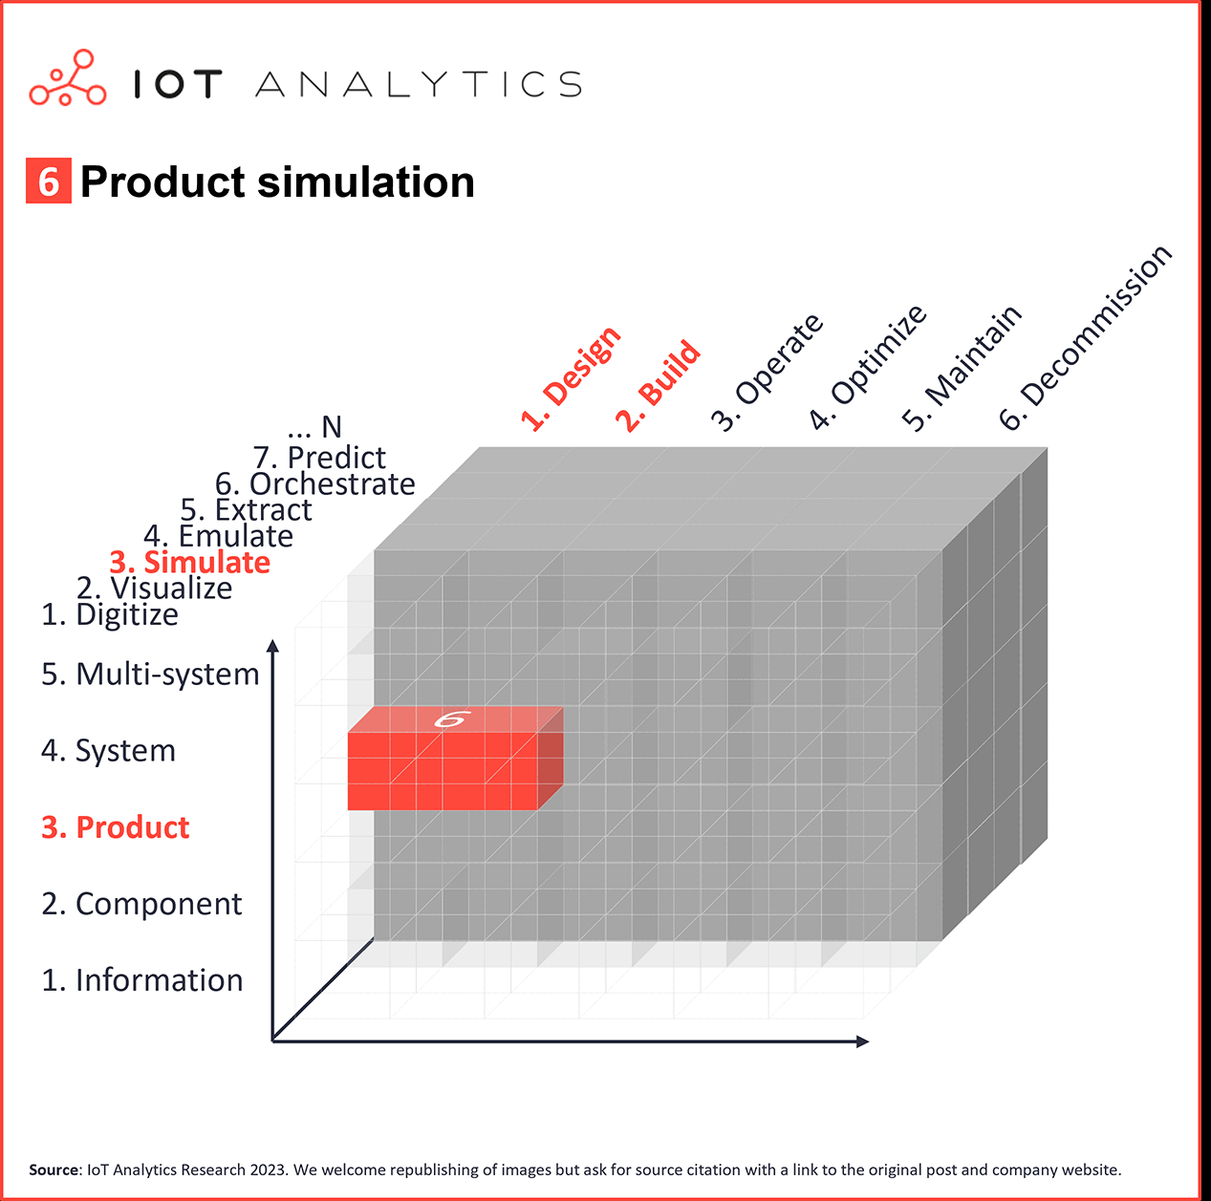
Digital Twins (DT) Applications
Twins for ‘Product / Process Simulation’ are among standard DT applications
Source: https://iot-analytics.com/6-main-digital-twin-applications-and-their-benefits
“A Digital Twin geared towards simulating the behavior of a (future) product/process in the design/build phase”

Slide 7
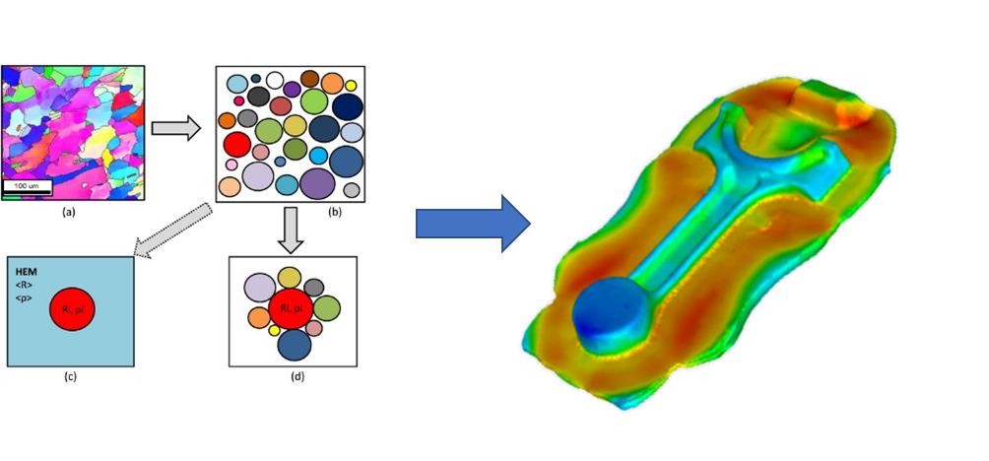
Objectives
In TRANSVALOR we develop AI in two ways
Complex material modelling
Physics-Oriented Learning
… A different way of bridging from micro to macroscale
… A Data Analytics Framework
Three main areas of interest:
Accelerate simulation run time
Fast optimization and Reverse Engineering
Building a Knowledge Database

Slide 8
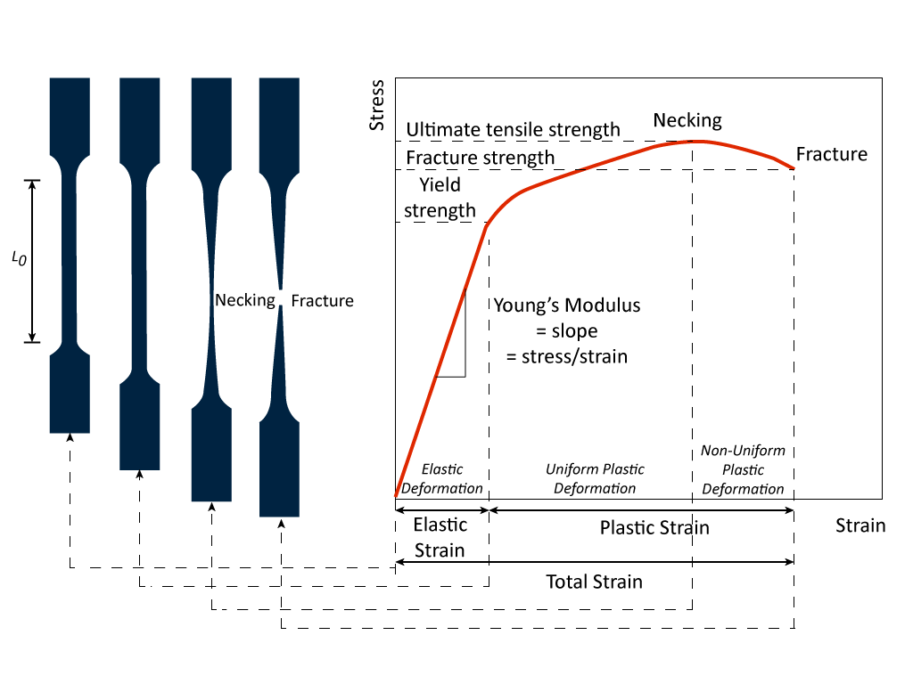
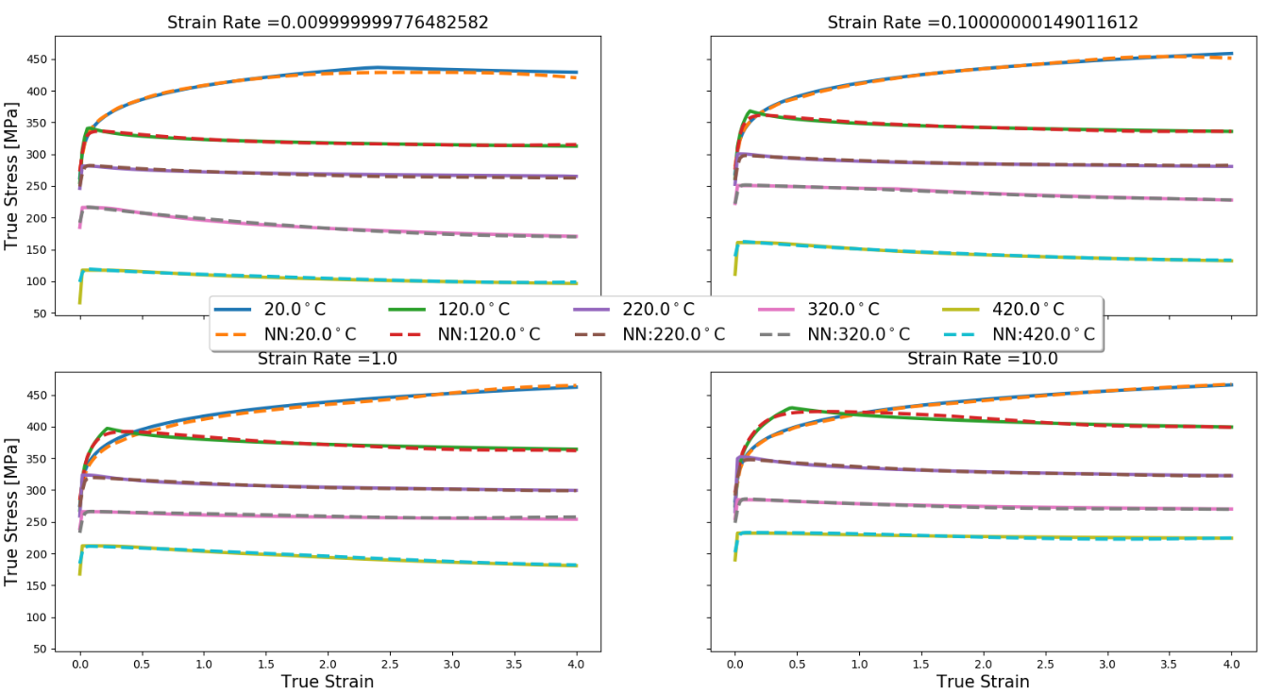
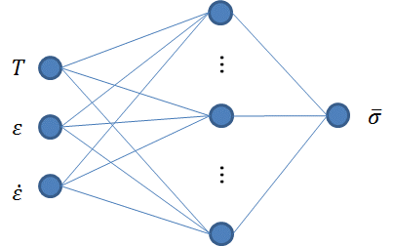
One Example related to Material Behavior
State variables: Temperature, pressure, deformation, electric potential, etc.
Constitutive material parameters: Young Modulus, heat conductivity, permeability
Physical modeling is based upon two types of variable:
… However, material parameters are also dependent on state variables…
An M.L. approach to assist process modeling:
Experimental tests
Use of Neural Network (NN) or any D.L. approach to learn from material test data
Use the ML model within a simulation framework to explore beyond
https://www.google.com/url?sa=i&url=https%3A%2F%2Fimechanica.org%2Fnode%2F21939&psig=AOvVaw1Qua2n65bREuOZKEdCpuzA&ust=1599808792930000&source=images&cd=vfe&ved=0CAIQjRxqFwoTCOjhwrWG3usCFQAAAAAdAAAAABAZ
Proof of concept using synthetic flow stress data for an Al6082 alloy from JMatPro® and learning using PyTorch

Slide 9
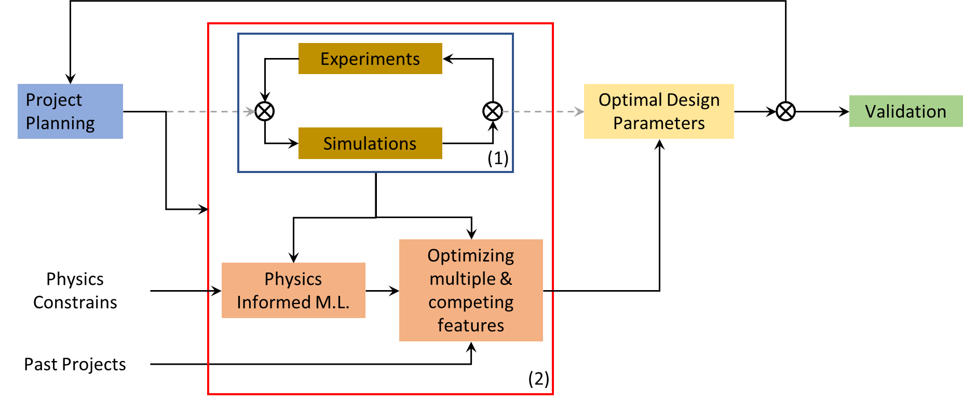
Decision-Making Process Enhancement
AI modelling at the core of the product/process development cycle

Slide 10
Background & Motivation
Use Case on Die Wear Modelling
GNN-based Surrogate Model
Conclusions

Slide 11
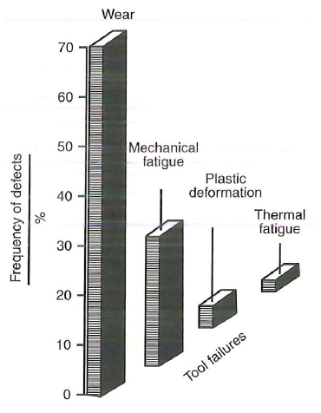
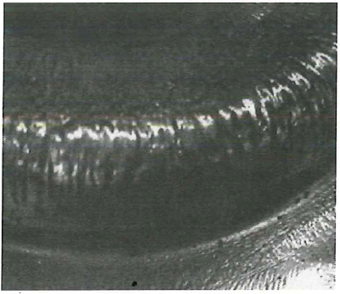
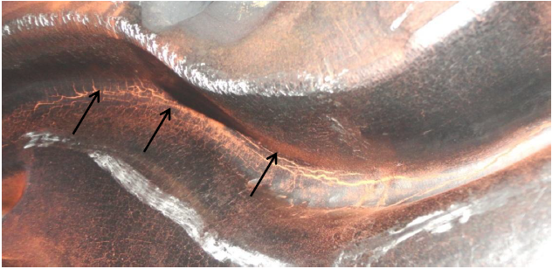
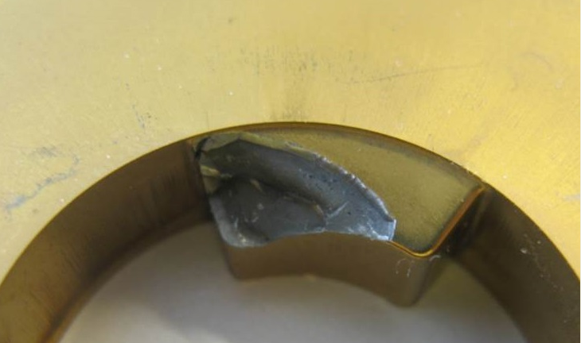
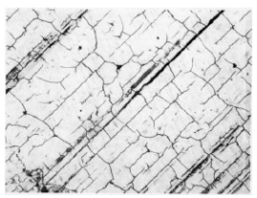
Context of Die Failure
Die lifetime is a major concern in the forging industry
Origin of failure
Abrasive die wear => forged parts are out of dimensional specifications
Gross cracking or plastic deformation
Mechanical or thermal fatigue
Nearly 70% of die failure is due to abrasive wear
Mechanical fatigue
Plastic deformation
Thermal fatigue
Abrasive wear

Slide 12

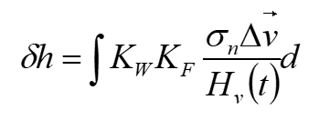
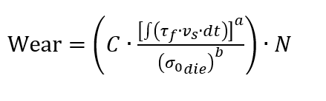
Models for abrasive wear
Standard basic model
    Based on normal stress & velocity at the interface metal / die
    No temperature dependency
    Provide a qualitative response
Archard’s model
    Varies with normal stress & interface velocity
    Local hardness (and temperature) dependency
    Depends on tooling material properties
    Provides a quantitative response
Energy model (by Tanaka et al.)
    Combines the cumulative friction work of the metal flow on the dies and the yield strength of the die materials at elevated temperatures.
    N is the number of cycle at which the wear starts

Slide 13
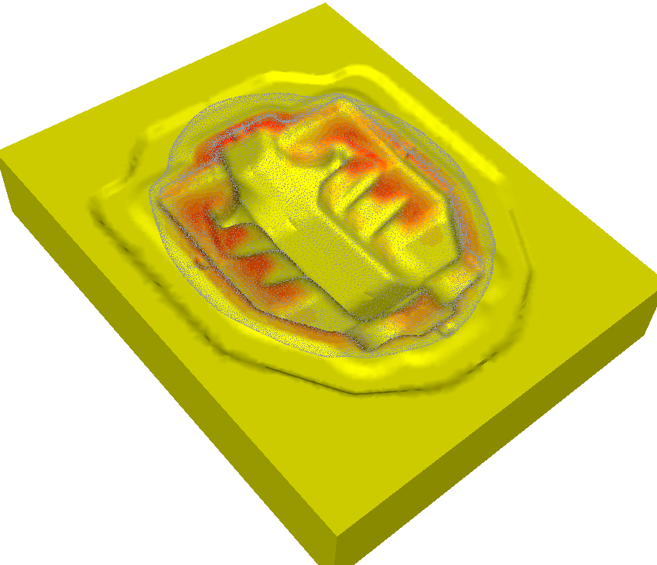
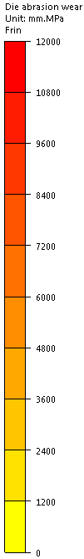
Abrasive Wear: standard model
Abrasive wear on lower die
by the end of forging
The red areas show where the wear is the largest

Slide 14
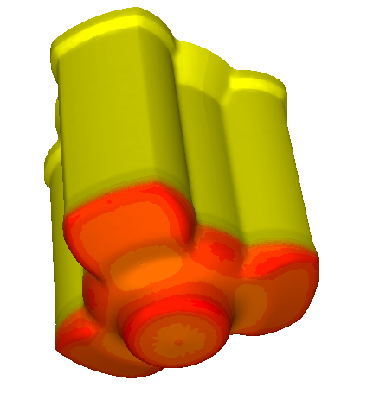

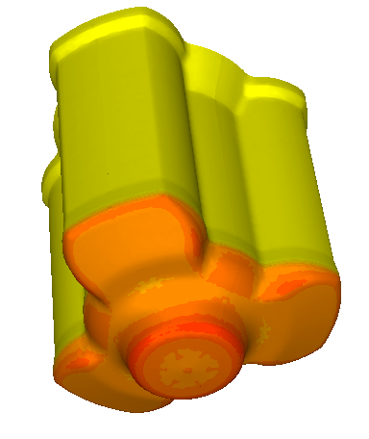
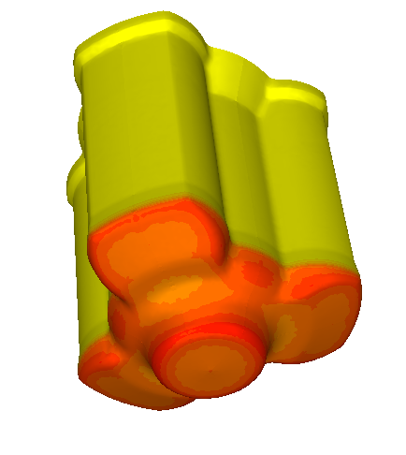
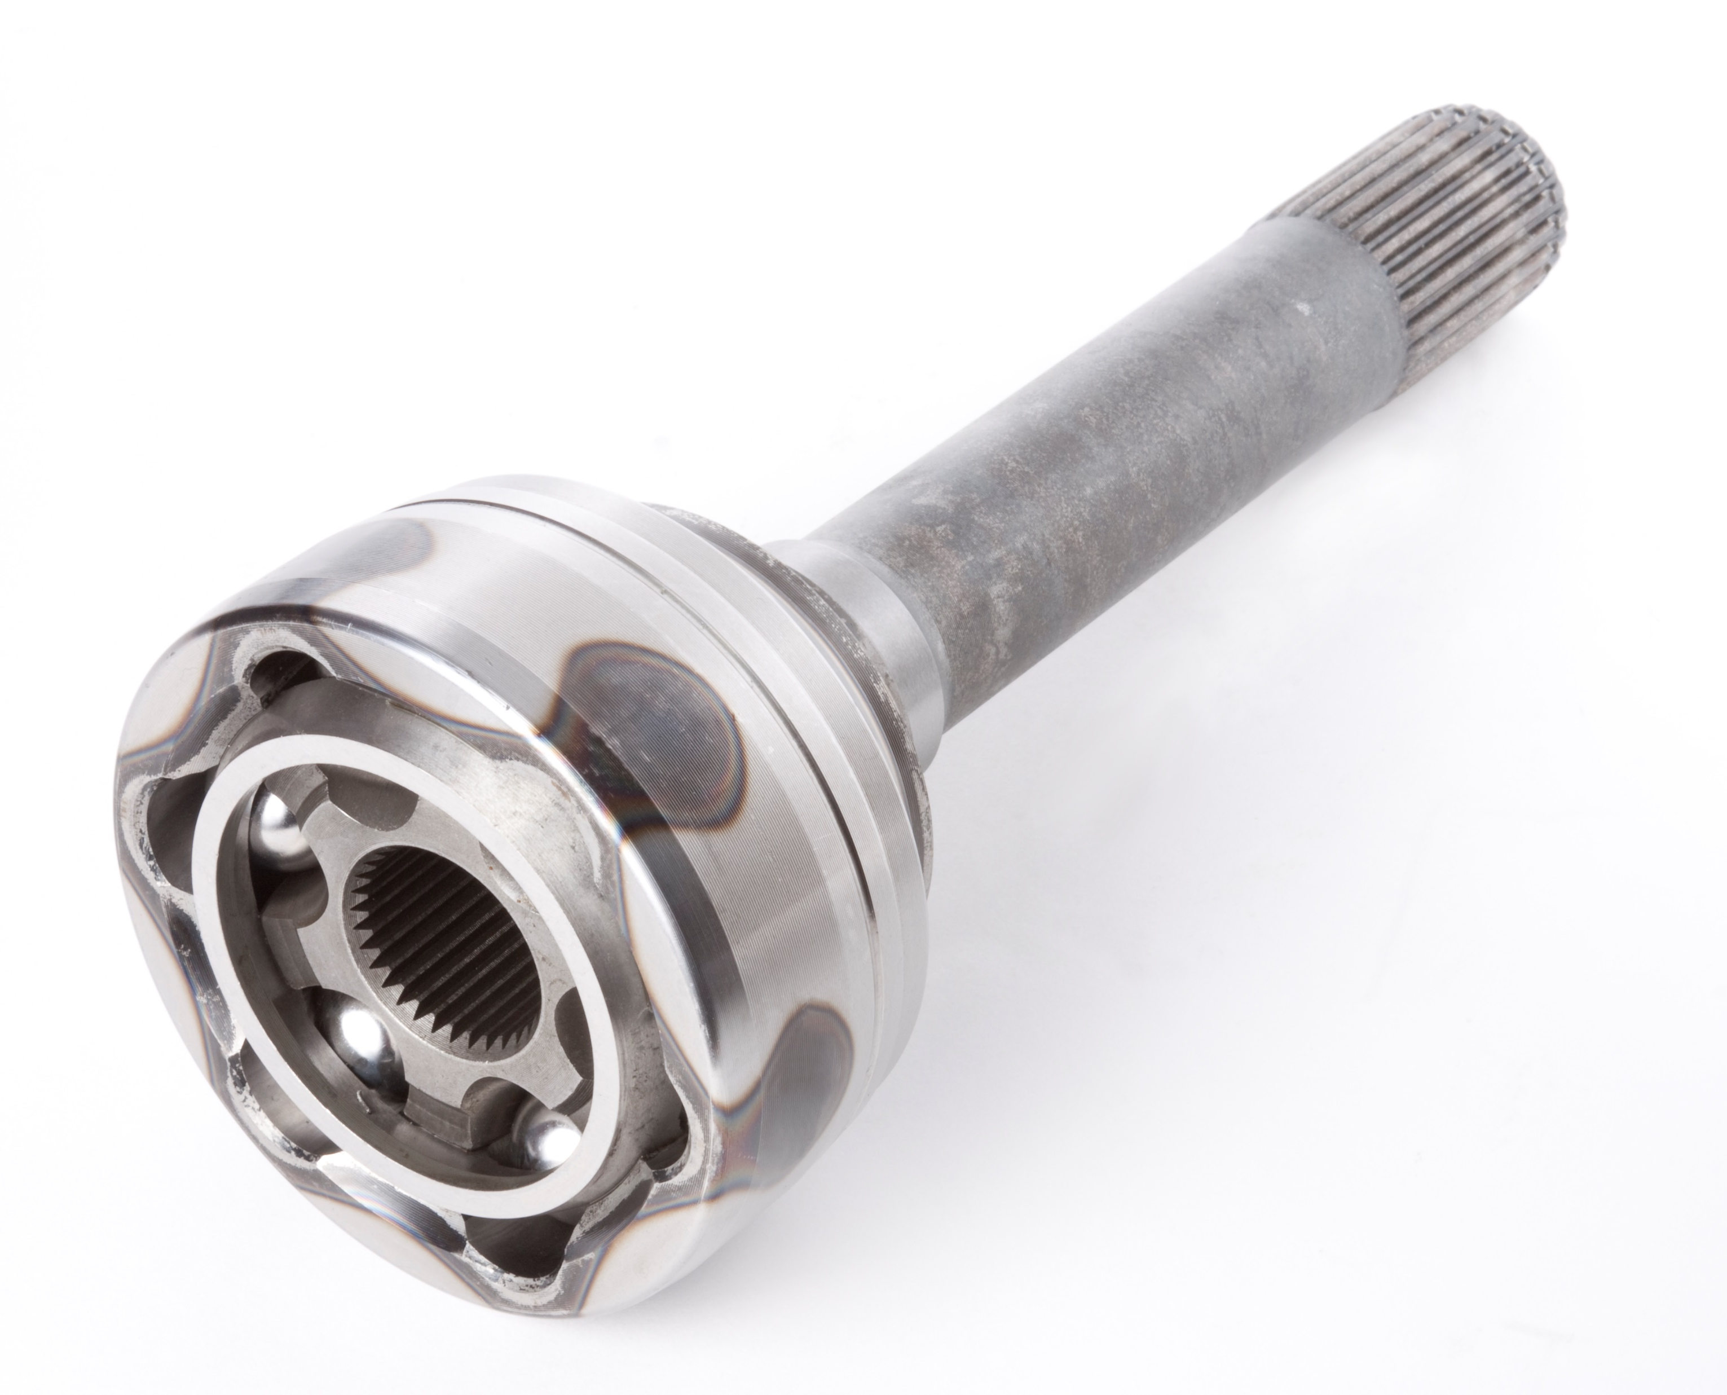
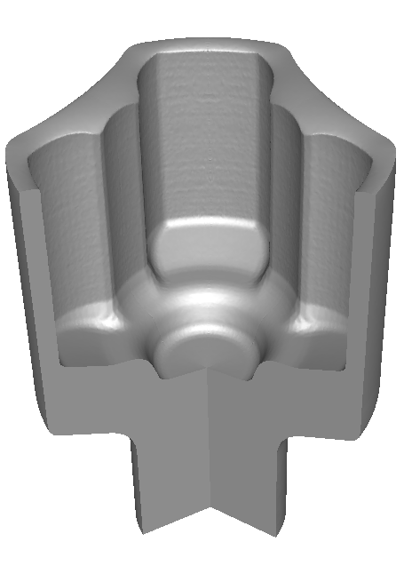
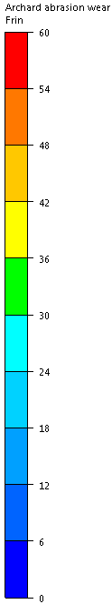
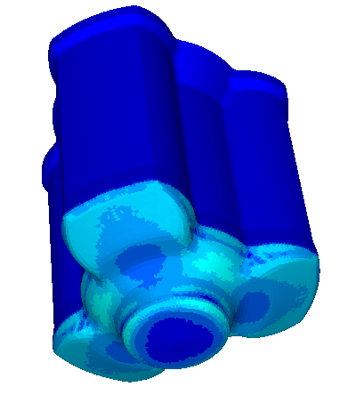
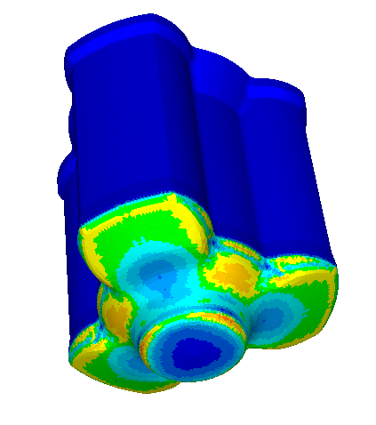
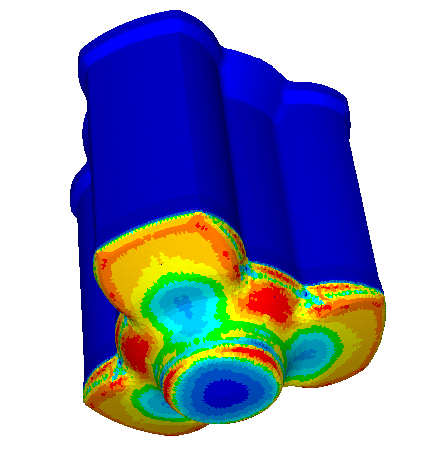
Abrasive Wear: Archard model
Impact of temperature variation on punch surface on predicted abrasive wear
Temperature (deg C)
Constant velocity joint
10mm prior
end of forging
4mm prior …
End of forging
Abrasive wear (µm)

Slide 15
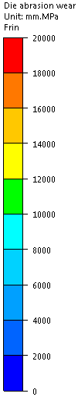
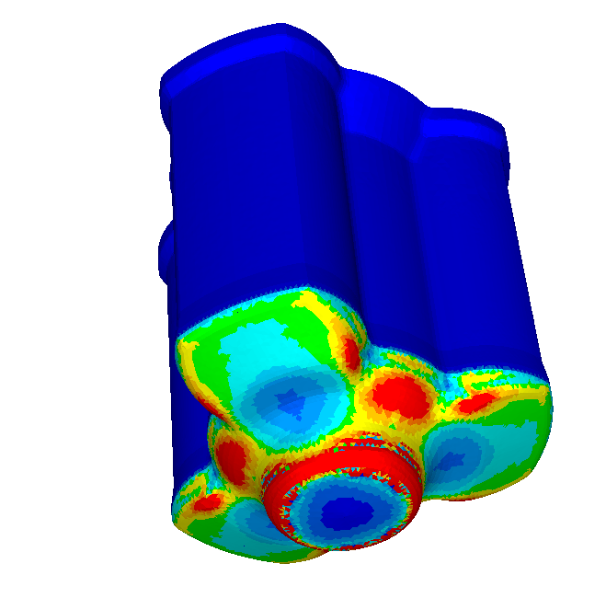
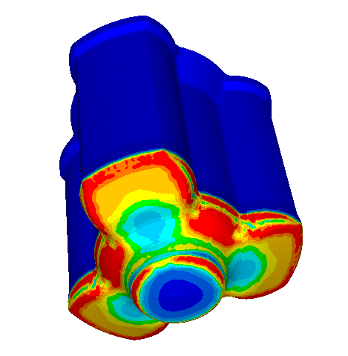
Abrasive Wear: Archard model
Comparison of abrasive wear on punch
The initial punch temperature has a strong impact on the final abrasive wear prediction
It is important to calculate a steady-state temperature obtained on the punch after several cycles (Dwell – Forging – Die Lubrication)
Standard basic model
(no temperature dependency)
Archard model
with uniform punch initial temperature
Archard model
with steady-state punch initial temperature

Slide 16

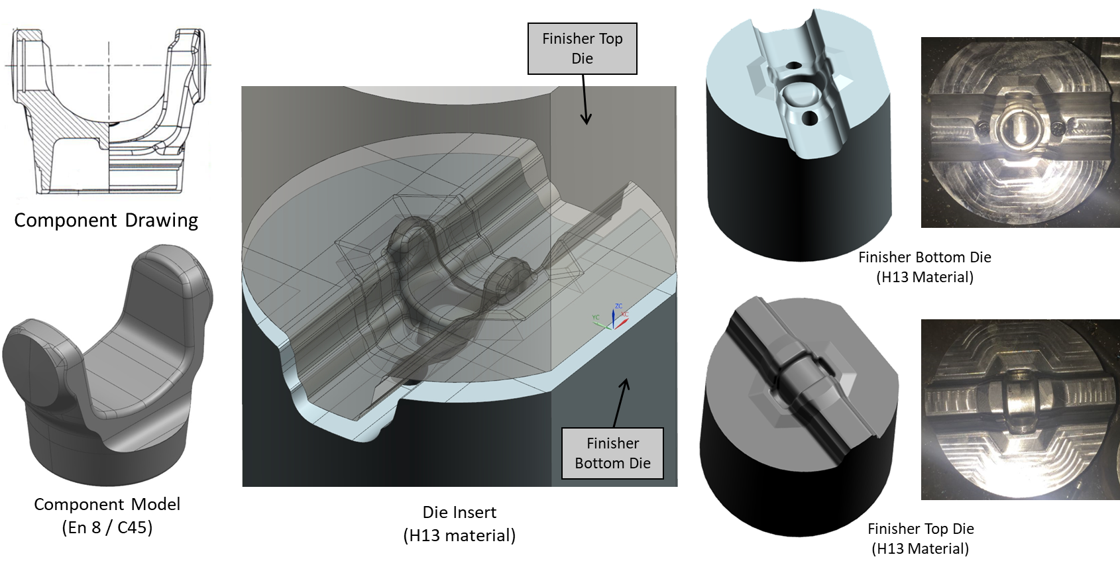
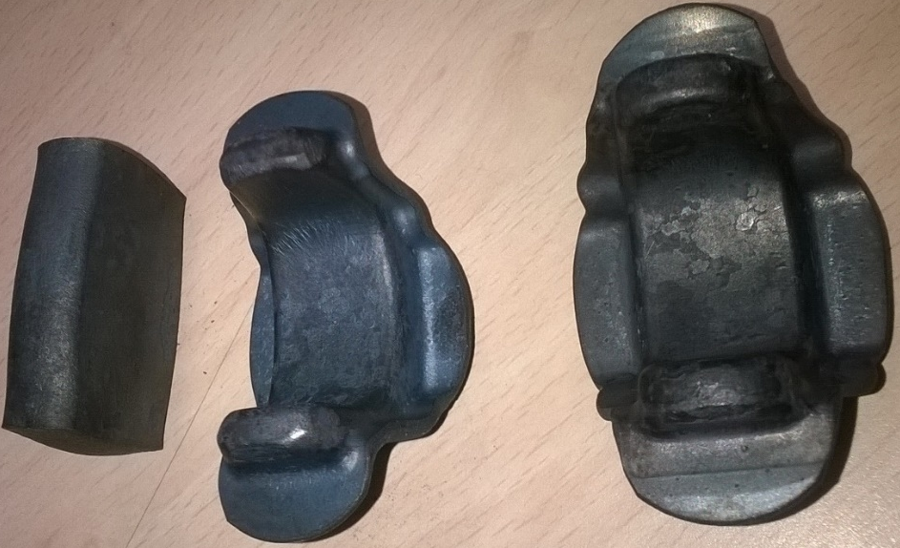
Industrial case: Steel Yoke
Description
  Part steel grade: C45 – DIN 1.0511 (0.4%C 0.65%Mn 0.2% Si)
  Die material: H13
  Forging temperature: ~ 1150 °C
  Billet size: diameter 25mm – height 45mm
  Gross weight: ~ 180 gr
  3 forging steps: Flattener / Blocker / Finisher
  Sample: 5000 pieces

Slide 17
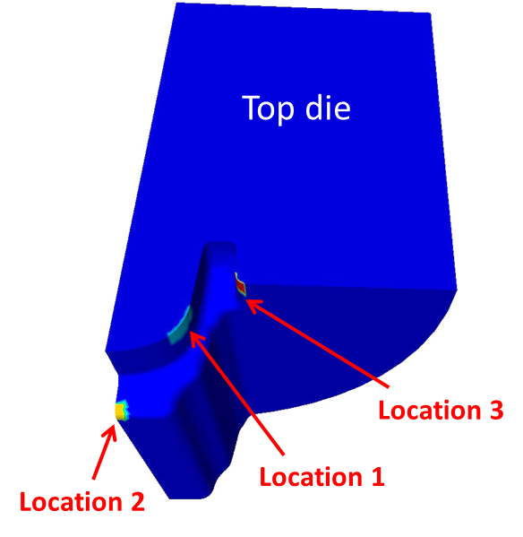
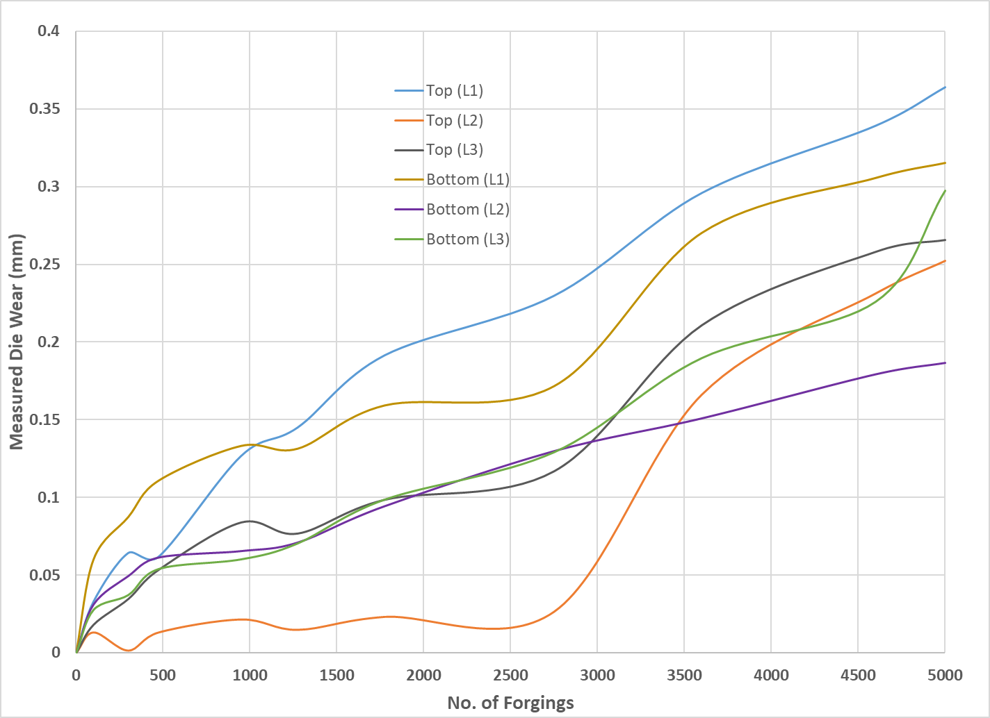
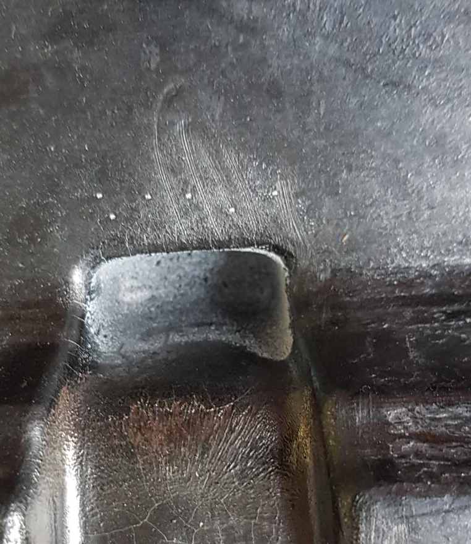
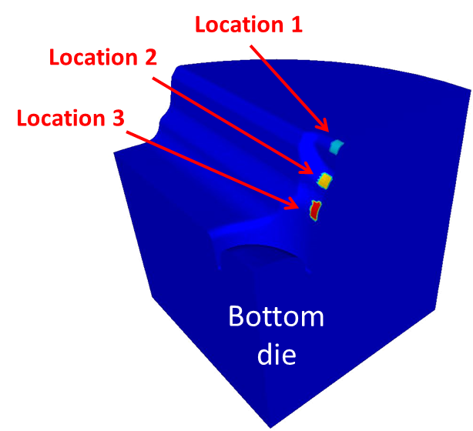
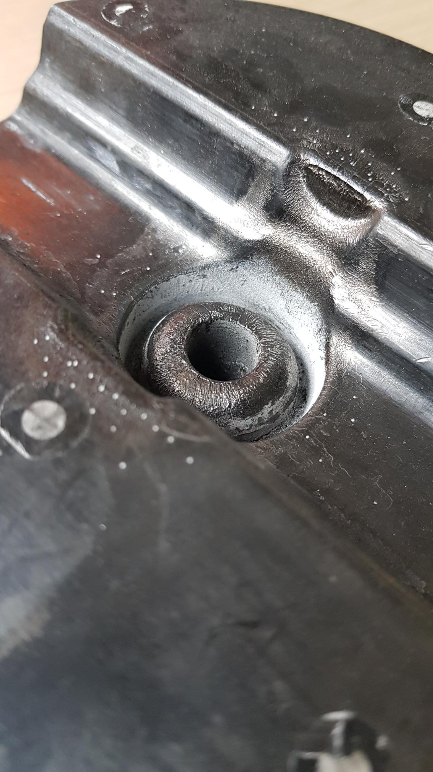
Die wear measurement by scanning

Slide 18
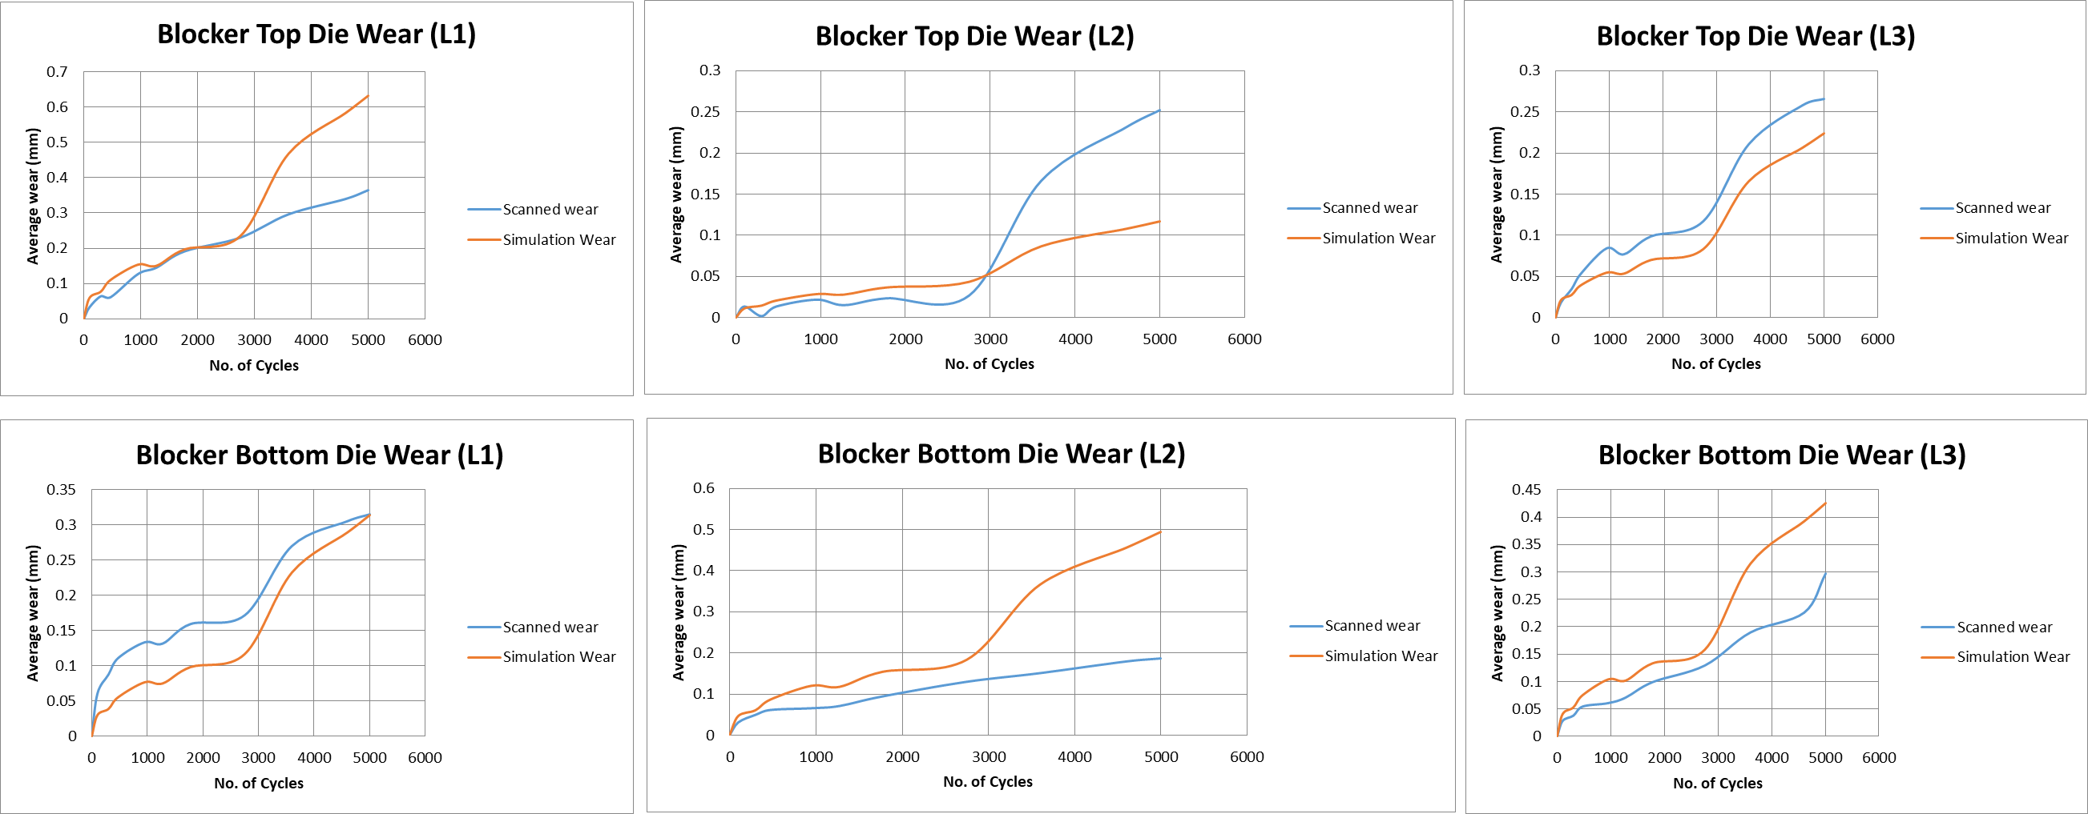
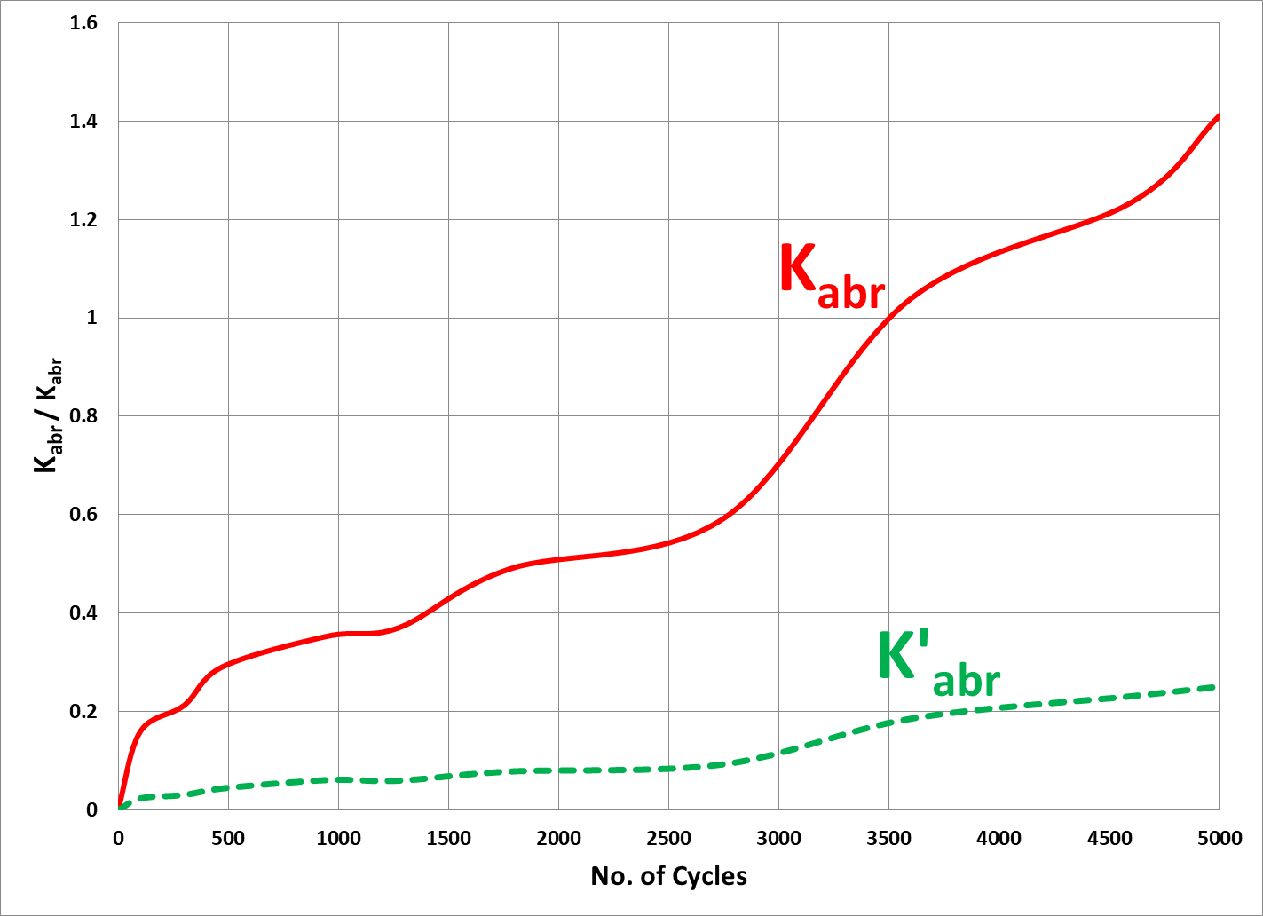
Archard Model results
Die wear prediction ‘Simulation vs Experiment’
The variable (KW x KF) varies with the number of cycles and are identified by inverse analysis
Fairly decent correlations, but the variation after 3000 pieces is not enough well captured
  K_{abrasive} = K_{w} x K_{F}

Slide 19
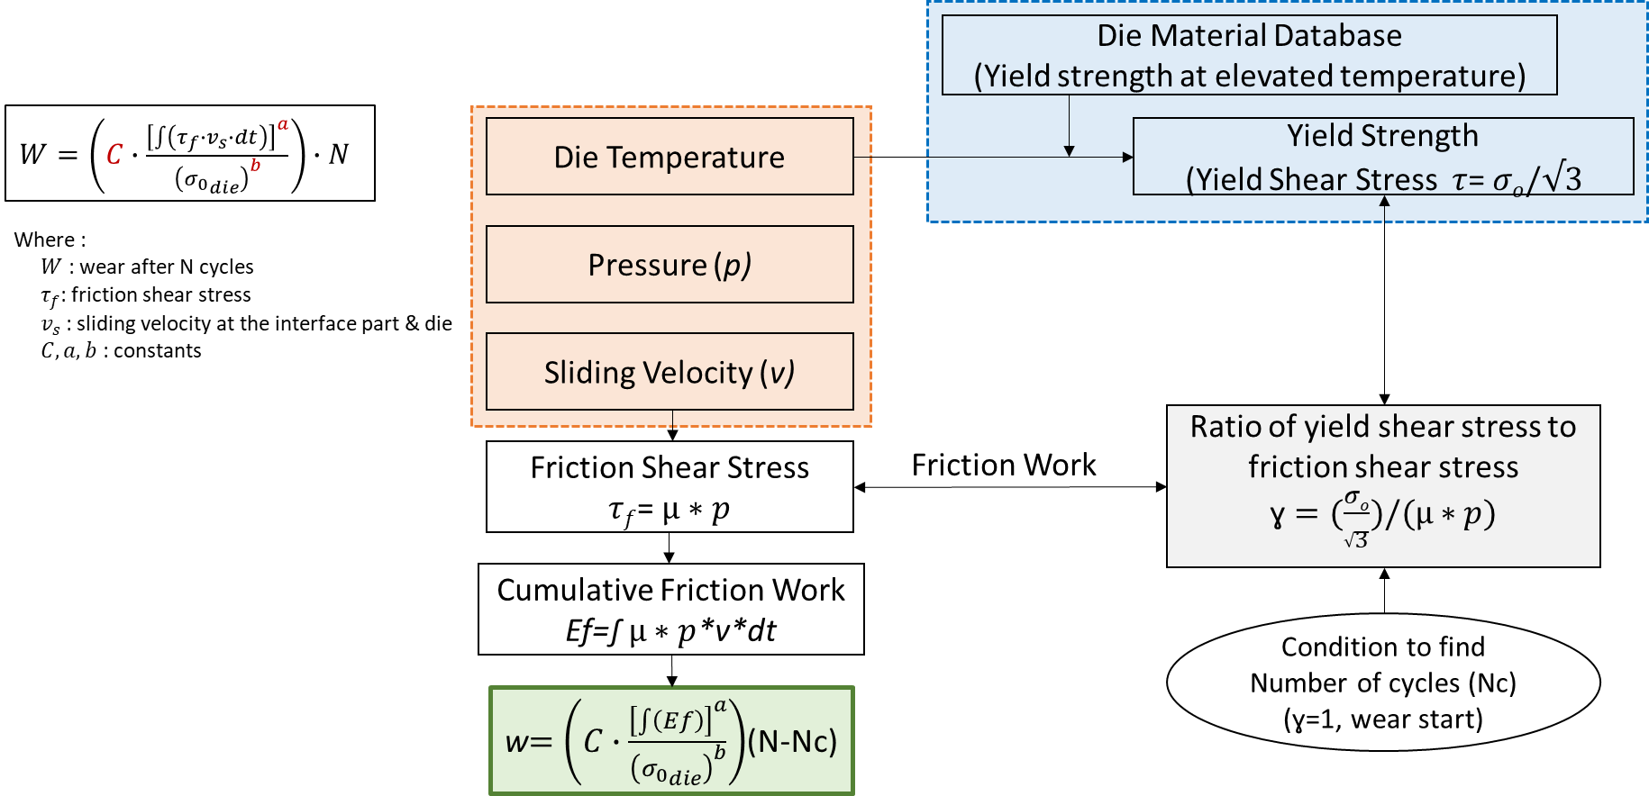
Energy wear model

Slide 20
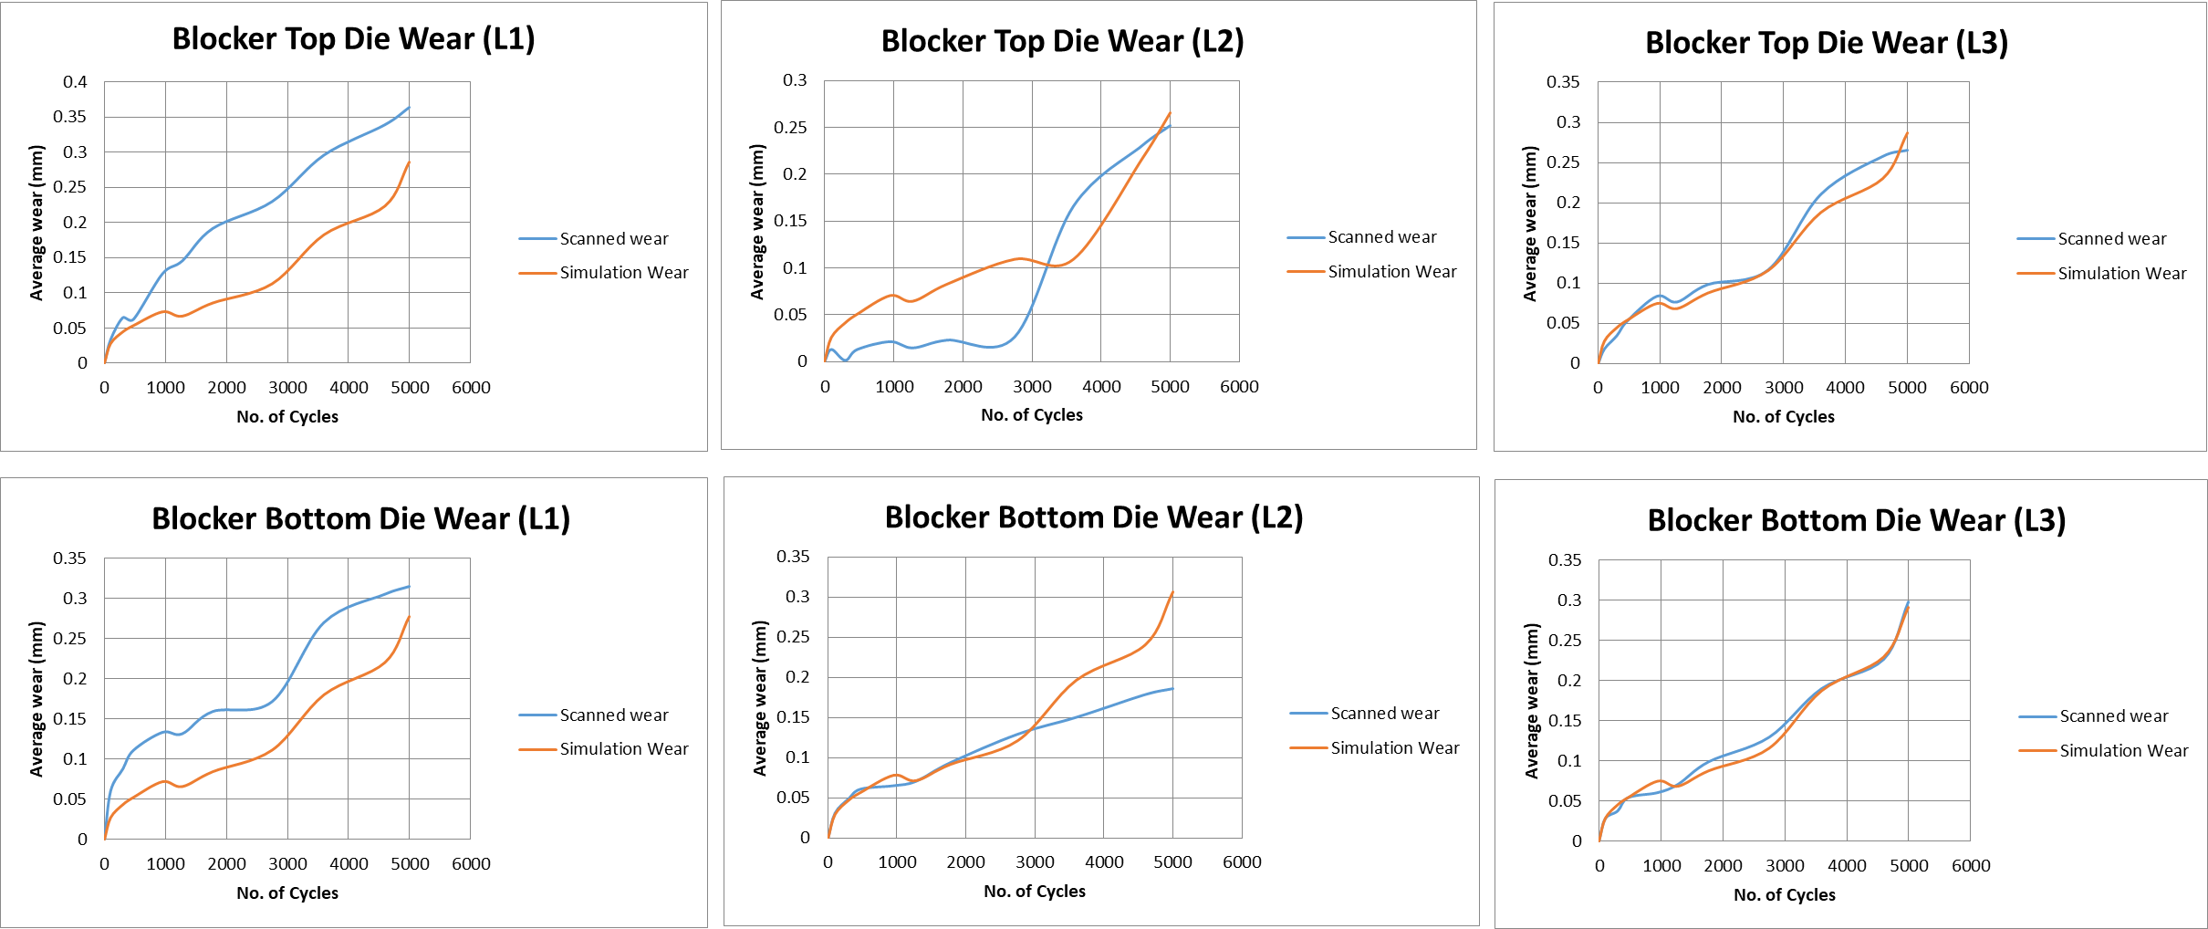
Energy wear model results
Die wear prediction ‘Simulation vs Experiment’
The energy wear model gives results very close to the experiment
A linear regression is used to identify the evolution of the parameters a, b and C with the number of cycles
One can predict wear value at the number of cycle in one single iteration

Slide 21
Background & Motivation
Use Case on Die Wear Modelling
GNN-based Surrogate Model
Conclusions

Slide 22
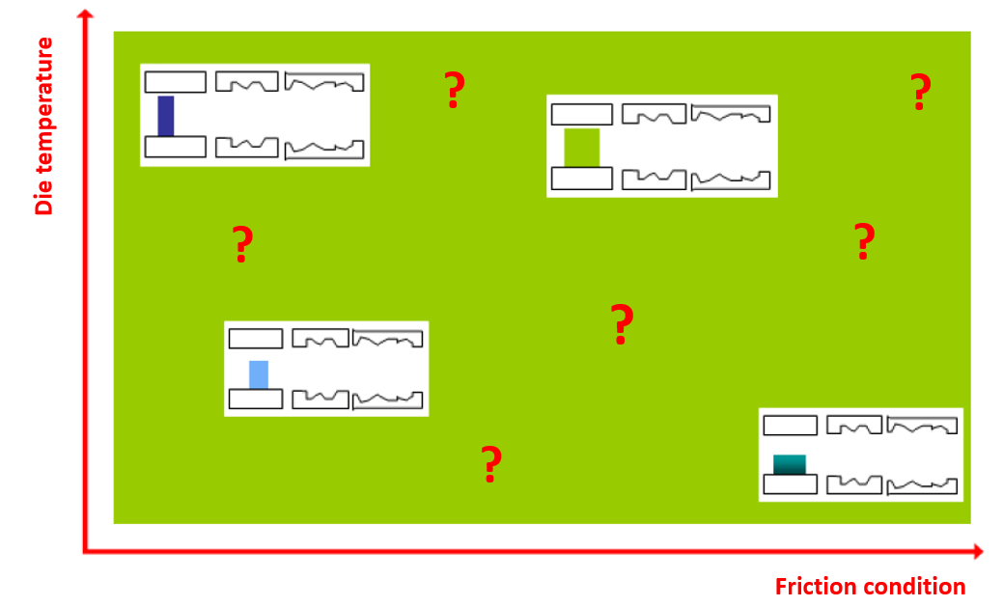
Problem statement
Why surrogate models for metal forming processes?
A typical problem to solve is: ”What are the optimum friction conditions to minimize abrasive wear under the constraint of producing a flawless forged component”
Create a hybrid approach where FEM is used to generate high resolution results to train the surrogate model
An alternative to DOEs and multi-criteria optimization conducted with FEM simulations
Goal: accelerate parametric response surface exploration and speed-up the overall resolution time

Slide 23
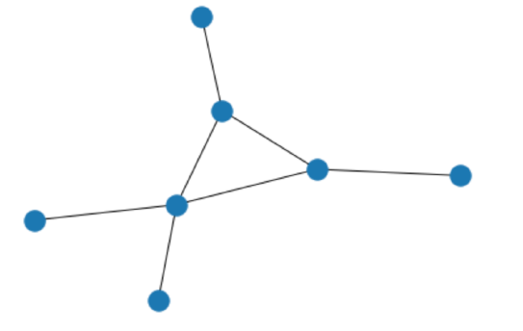
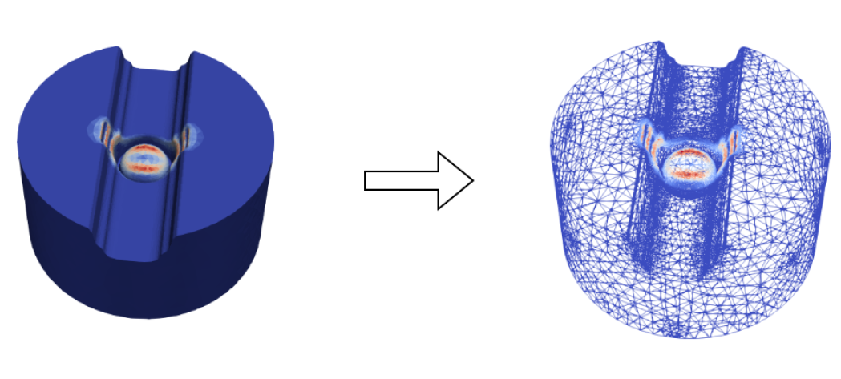

The GNN approach
GNN stands for Graph Neural Network
Why choosing a GNN-based surrogate models?
Standard CNNs are used to operate on regular structured data (e.g. pixels on a picture)
GNNs are very well adapted for 3D unstructured data of complex geometries AND with time evolution data structure (here, the shape changes with time)
More flexible as the number of nodes and connections vary and are unordered
No intrinsic dependency with the data structure used for training
Conversion from finite element mesh to graph
The conversion is natural
The graph represents the relations between a collection of entities
Direct mapping ‘Relations => Edges’ and ‘Entities => Nodes’

Slide 24
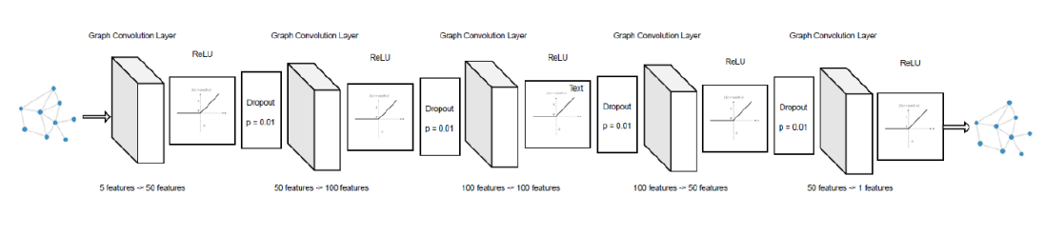
Model Architecture
A proposed GNN model architecture
5 Graph Convolutional Layers
Re-LU (Rectified Linear Unit) activation layers
Dropout method of regularization
The final Re-LU layer ensures positive output values

Slide 25
Main block diagram
The GNN model outputs the die wear prediction by the end of the forging operation

Slide 26
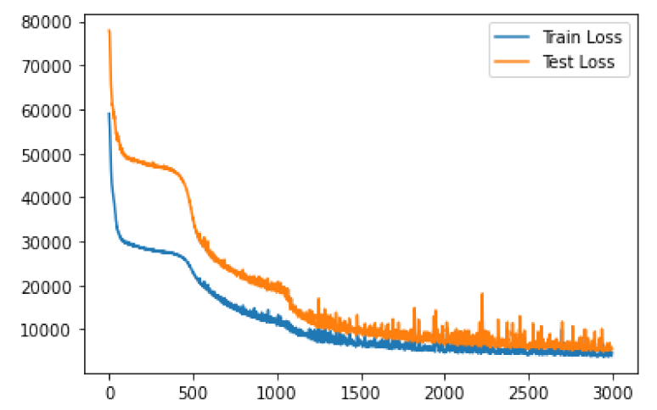
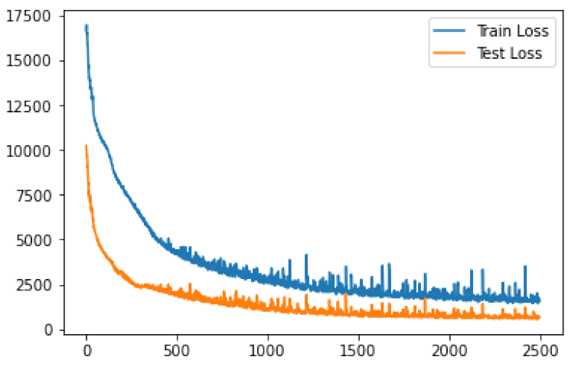
Trained model
Training loss curves on bottom & top die dataset
A Mean Squared Error (MSE) metric is used to compute the model loss
Objective is to minimize the MSE loss
Each dataset consists in 40 simulations (30 for training and 10 for testing)
After approx. 2500 epochs, the train & test loss are similar => the model is well trained
Mean Squared Error Loss
Epochs
Epochs

Slide 27
Results Analysis
Performance of various GNN methods after training
Model is trained to minimize the RMSE and maximize the R²
The proposed GNN model outperforms the other two models
 | RMSE loss on average (Root Mean Squared Error) |  | R² (Coefficient of Determination)
 | Bottom Die | Top Die | Bottom Die | Top Die
Point-Net model | 299,11 (25%) | 137,58 (17%) | - | -
DGCNN (Dynamic Graph Convolutional Neural Network) | 303,31 (25%) | 126,79 (15%) | - | -
Proposed GNN model | 73,56 (6%) | 26,43 (3%) | 93,7% | 92,8%
Max wear value | ~1200 | ~800

Slide 28
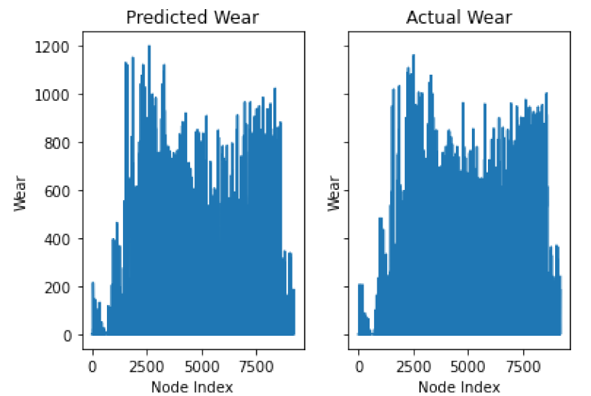
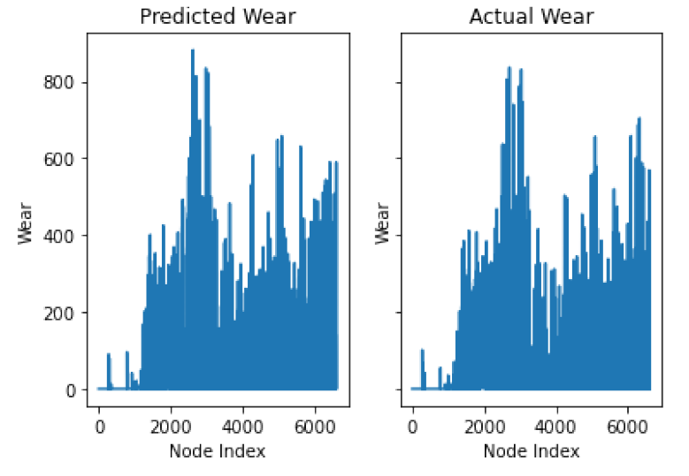
Results Analysis
Comparison of Proposed GNN model vs Actual wear
An excellent response on both datasets (bottom & top die)
Bottom Die
Top Die

Slide 29
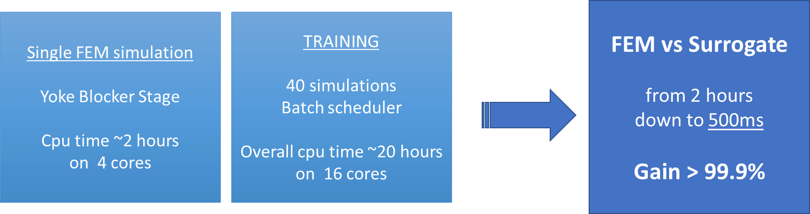
Lead Time Analysis
How fast is the GNN-based surrogate model?
Once the surrogate model is trained => one output result (die wear) is obtained in 500ms
The proposed GNN-based surrogate model is applicable for large space exploration
(exploration of ~1000 input conditions will take 8min 20s)

Slide 30
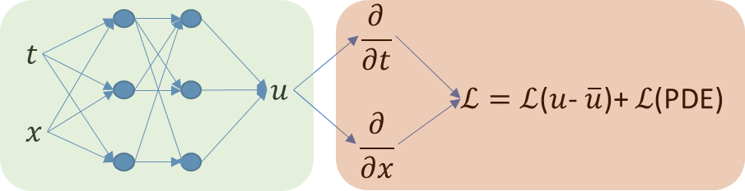


Going Further with PINNs
From Physics-Informed Neural Networks to Physics-Informed Graph Architectures
NN are efficient for interpolation, but less for extrapolation => need to include physical knowledge to eliminate incorrect solutions
Classical PINNs use physical knowledge only during training phase… and they have been designed for the analysis of structured data…
Hybrid GNN-FEM :
Towards accelerated simulations combining GNNs & FEM
GNN covers the analysis of unstructured data (meshes)
Non-linearities are included in the Neural Networks
PINNs concept can be used to include previous knowledge
Incremental combination of accurate FEM & GNN closes the gap

Slide 31
Background & Motivation
Use Case on Die Wear Modelling
GNN-based Surrogate Model
Conclusions

Slide 32


Leveraging Artificial Intelligence
A tentative workflow to set the place of AI & the role of experts
… and combine both of best worlds (AI & FEM)
Source: SIA Congrès Simulation Numérique 2023 – Vitesco (Laurent Desmet)

Slide 33
Conclusion
From FEM simulations to surrogate models
The industrial case ‘Yoke’ has demonstrated the accuracy of empirical models (Archard or Energy models)
FEM simulation is reliable and trustable to feed IA trained models
The proposed surrogate model is very fast => no limits to perform large parametric response surface exploration
Useful to quickly determine a parameter (wear) severity level on the same family of parts
This work is a preliminary milestone
Ongoing work in collaboration with CentraleSupélec on different GNNs (e.g. GraphSage or EdgeConv GNN, etc.)
Generally speaking, need to better capture the physics (e.g. surface treatment, lubrication, material properties)
Added value for manufacturers
For design phase,
  Systematic automatic optimization => Extensive parameter space exploration => Extensive sensitivity analysis
For production phase,
  Real-time data collection => Digital Twins => Predictive maintenance & Real-time product quality check

Slide 34
Thank you
ORGANIZING SECRETARIAT
Ph. +39 035 3230904
e-mail info@industrialvalvesummit.com
CONFERENCE ORGANIZERS
Ph. +39 3474908420
e-mail segreteria@valvecampus.com
www.industrialvalvesummit.com
www.valvecampus.com

