Slide 1
Gate Valve Size 1½”, Class 150, Material ASTM-F3184-S31603, Produced by AM & Certified According to European Pressure Equipment Directive (PED 2014/68/EU).
CONFERENCE
ORGANIZERS

Slide 2
Gate Valve Size 1½”, Class 150, Material ASTM-F3184-S31603, Produced by AM & Certified According to European Pressure Equipment Directive (PED 2014/68/EU).
Oscar Barcella | Service & Quality Assurance Manager

Slide 3
Oscar Barcella
Member of:
Service & Quality Assurance Manager - B.F.E. Bonney Forge
Education:
Mechanical engineering
Oil & Gas experience:
Oscar Barcella works for for B.F.E. Bonney Forge since 1996 as Manager of the following departments:
Customer Service;
Quality Assurance;
Heat treatment;
NDE;
Welding & Painting process;
Laboratory for special test;
Certification.
More recently, he has applied his knowledge and experience in certification to obtain a CE-marking for a valve made through additive manufacturing that will be installed in an operating asset, a pioneering effort in Europe.

Slide 4
Coming together is a beginning, staying together is progress, working together is success.
About Bonney Forge
Bonney Forge is a legacy brand leader in the manufacturing of critical service valves & fittings founded in 1876.
Today the corporate is a privately owned US enterprise guided by Mr John A. Leone and has over 700 employees located in 4 global manufacturing locations: B.F.E. (ITALY), BFC (USA), BFS (CHINA), WFI (USA).
Why an AM collaboration between SHELL and B.F.E. Bonney Forge?
Shell uses 3D printing to print spare parts on demand, develop novel equipment, and rapidly prototype engineering designs. They selected B.F.E. to help demonstrate the suitability of the AM process in the oil & gas sector. Valves are amongst the first lines of defense to guarantee the control and containment of all mediums, thus avoiding major accidents and dangerous exposure to people and to the environment.

Slide 6
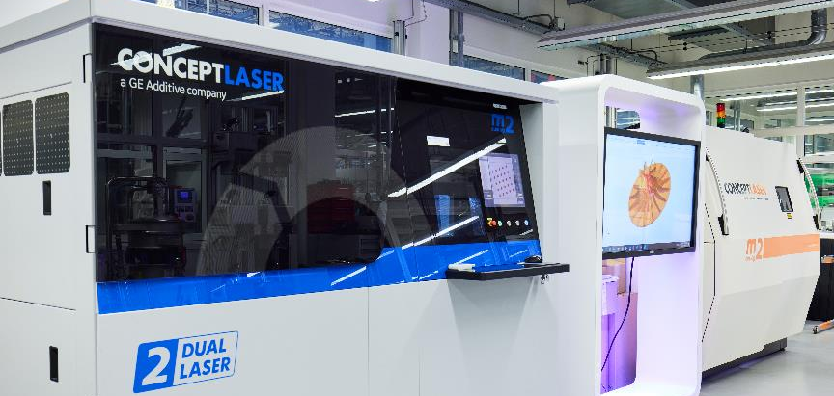
Laser Powder Bed Fusion machine (LPBF)
Additive Manufacturing in Shell
3DP facility in Shell has a quality management system and the facility has been qualified
by Lloyds Register prior to undertaking printing of pressure vessels.
Energy Transition Campus Amsterdam

Slide 7
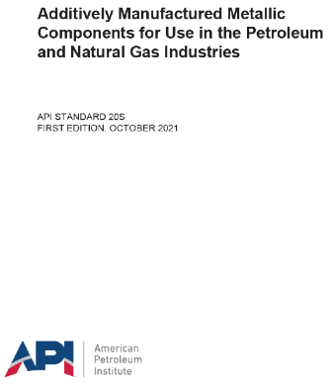
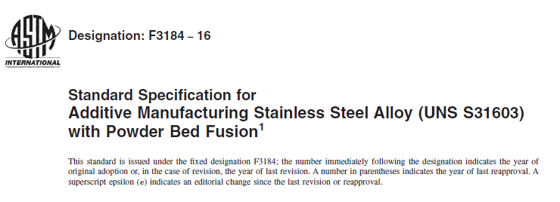
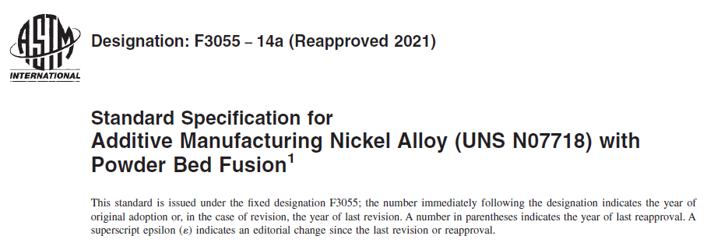
AM technology…
What about the applicable standards?

Slide 8
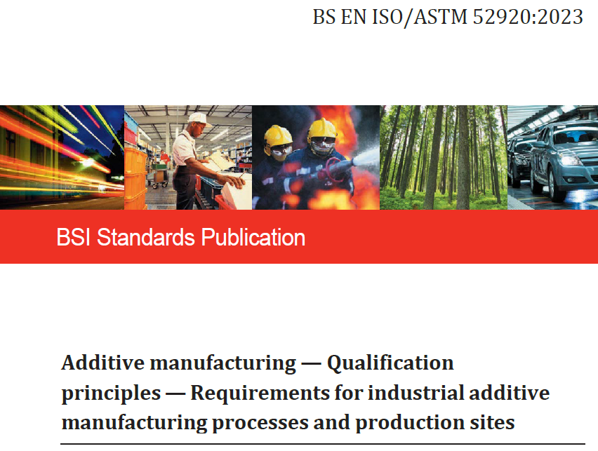
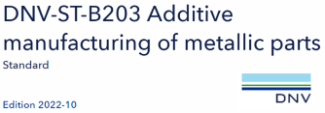
AM technology…
What about the applicable standards?

Slide 9
Additive Manufacturing Methods

Slide 10
Additive Manufacturing Methods
Metal Binder Jetting (BJ)
A liquid binder is applied to combine the powder layer by layer, building the desired object. Parts just printed are initially fragile and require post-processing sintering and infiltration to be strengthened. One of the unique benefits of binder jetting is the elimination of any melting of metal powders, which can lead to residual stress build up. It’s also one of the least expensive metal additive manufacturing techniques.
Laser-Based Powder Bed Additive (PBF)
These methods employ the use of either a laser or electron beam to melt and fuse the metal powder into a solid. All laser-based powder bed techniques require the spreading of the metal powder over previous layers, whether by a roller or a blade.
Sheet Lamination (SL) / Laminated Object Manufacturing (LOM)
This method joins sheets of material together layer by layer through bonding, ultrasonic welding or brazing to build an object. Sheet lamination methods are low-temperature processes and can bond different materials together. Typically, sheet lamination methods are for visual and aesthetic models rather than for structural use.
Directed Energy Deposition (DED)
A more complex 3D printing process. A focused energy source, such as a laser or electron beam, is directed at the building material to melt it while it is simultaneously being deposited layer by layer. This technique is commonly used to repair or to add additional material to existing structures using a heated nozzle to deposit melted material.

Slide 11
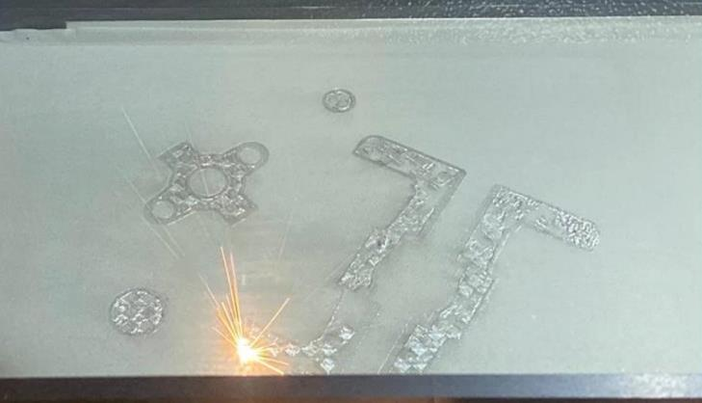
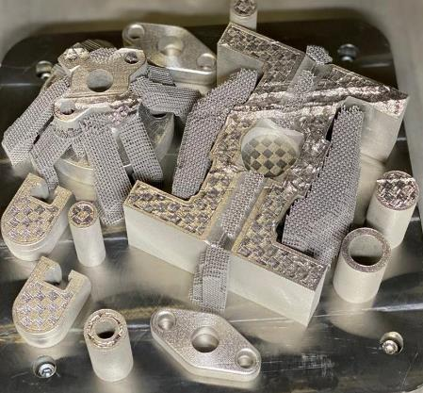
1” Gate Valve class 150
ASTM F3184 S31603 Condition A (LPBF)
Laser Powder Bed Fusion (LPBF)
Selective laser melting (SLM) also know as direct metal laser melting (DMLM).
Bonnet
Body
Wedge Gland Flange Seats

Slide 12
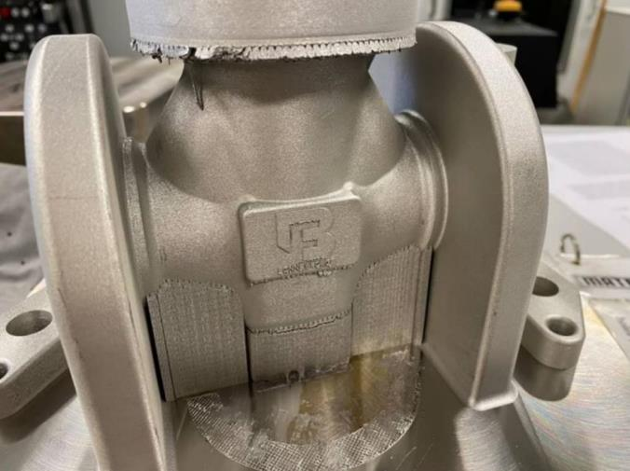
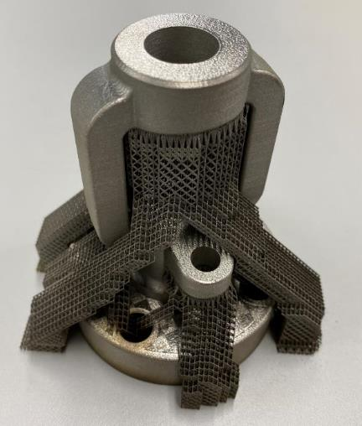
1” Gate Valve class 150
ASTM F3184 S31603 Condition A (LPBF)
Support to avoid powder falling down
Body
Bonnet

Slide 13
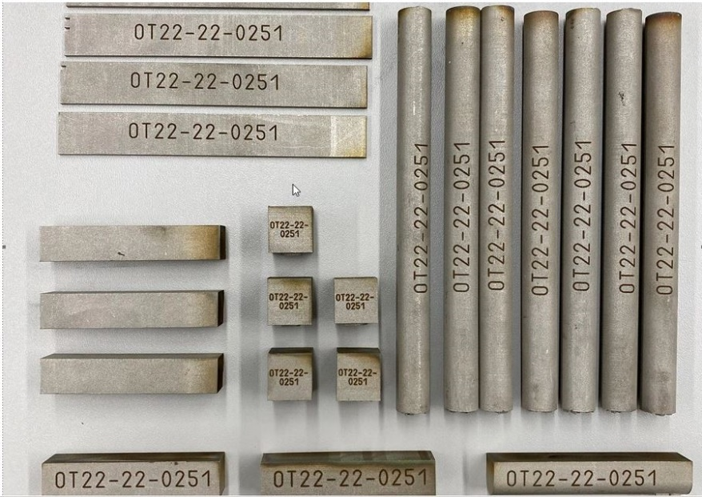
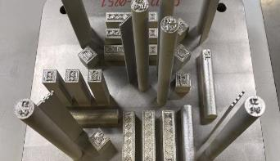
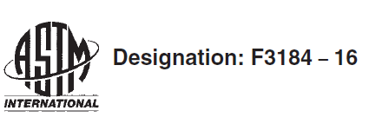
1” Gate Valve class 150
ASTM F3184 S31603 Condition A (LPBF)
Test samples for:
mechanical test (X-Y-Z)
corrosion test
metallographic examination

Slide 14
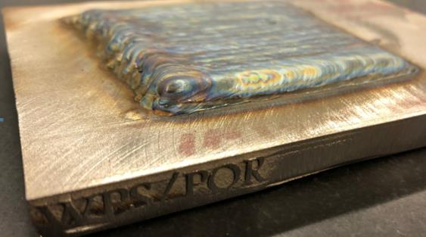
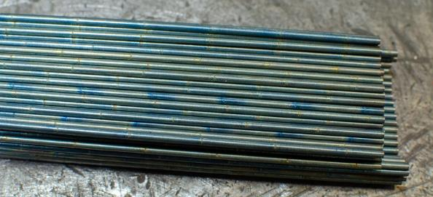
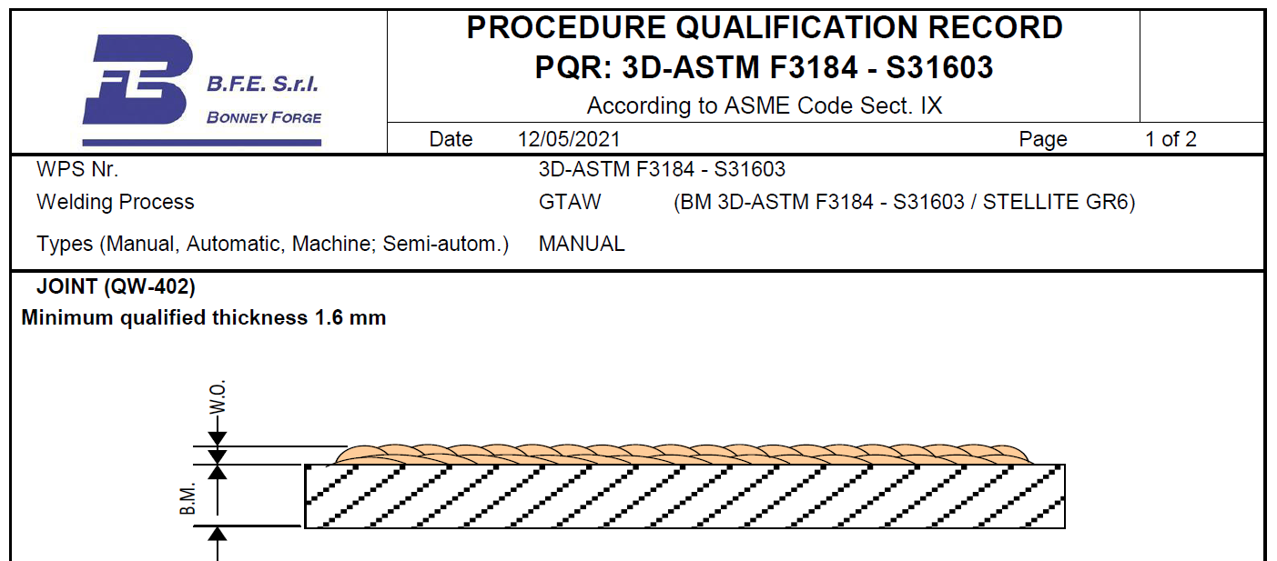
What about welding on AM base material?
Procedure Qualification Record (PQR): Satisfactory Hardfacing with Stellite ® Gr 6 (360 HB) on AM base material ASTM F3184 S31603
Stellite ® Gr 6 rod
PQR AM test coupon

Slide 15
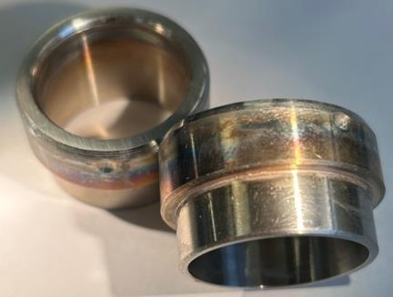
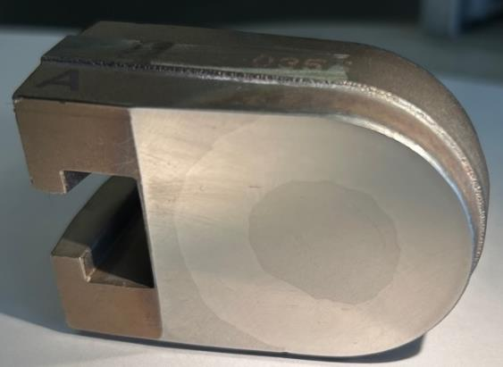
What about welding on AM base material?
Hardfacing with Stellite ® Gr 6 (360 HB) on AM seats & wedge in ASTM F3184 S31603
AM seats with Stellite Stellite ® Gr 6 rod AM wedge with Stellite

Slide 16
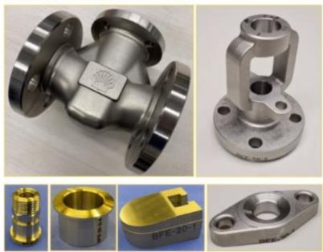
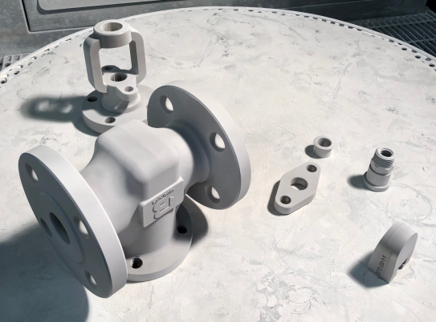
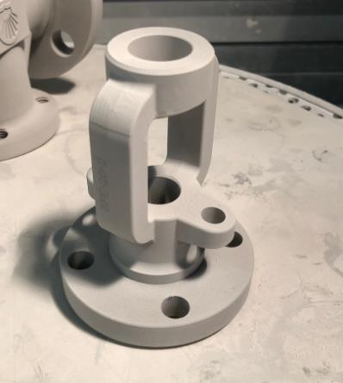
1” Gate Valve class 150
ASTM F3184 S31603 Condition A (LPBF)
Finished components
Red & Fluorescent penetrant test: No indication
Body Bonnet
Yoke sleeve Gland Wedge Gland flange

Slide 17
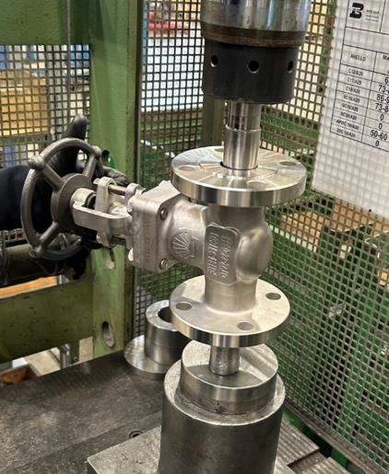
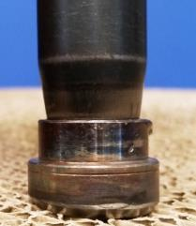
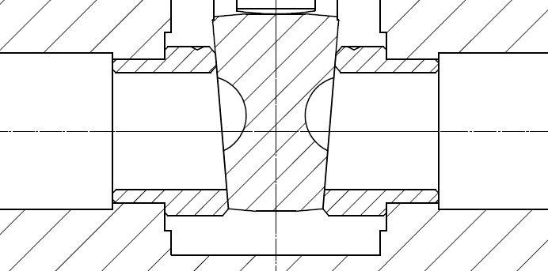
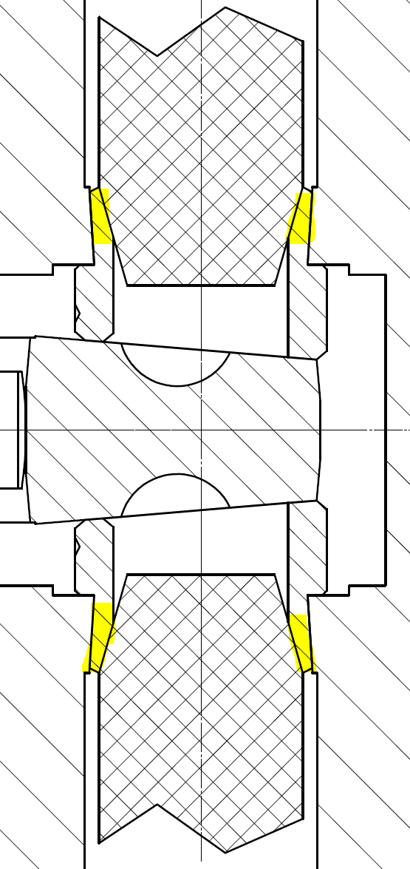
1” Gate Valve class 150
ASTM F3184 S31603 Condition A (LPBF)
AM seats have demonstrated excellent elasticity during the expanding step
Seat hydraulic press Seat conical expanding tools Before expansion After expansion

Slide 18
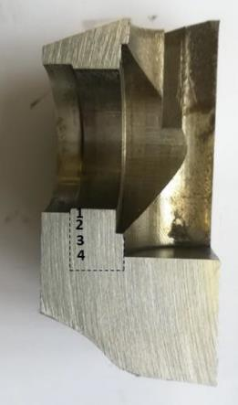
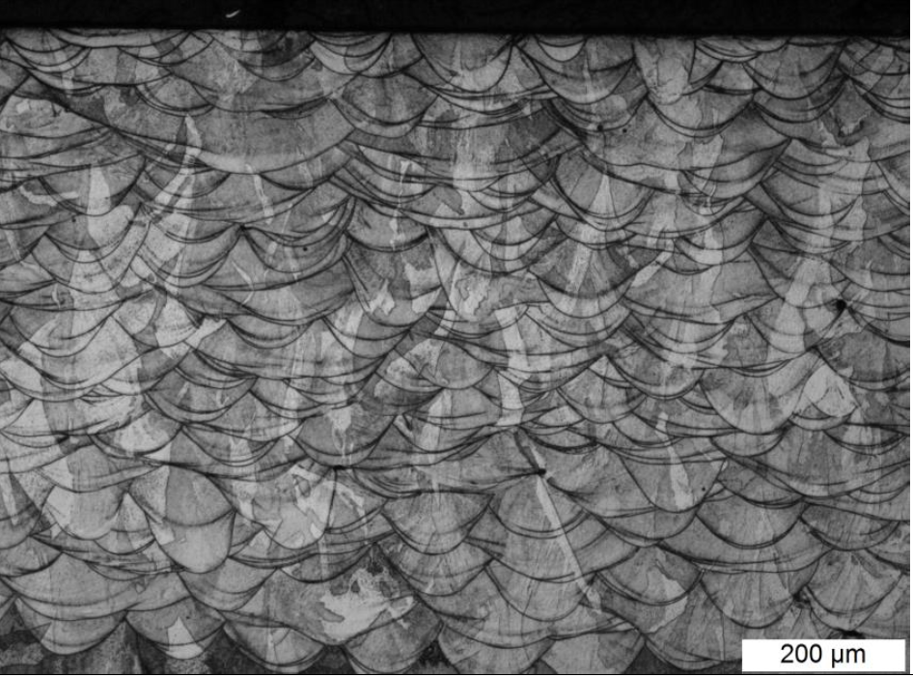
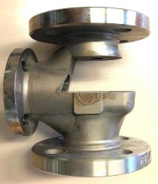
1” Gate Valve class 150
ASTM F3184 S31603 Condition A (LPBF)
Absence of cracks or other types of defects in the expanded seat zone have demonstrated an excellent material elasticity
Valve body Seat pocket section analyzed Magnification 100X
(Etchant: Electrolytic Acid Ossalic)

Slide 19
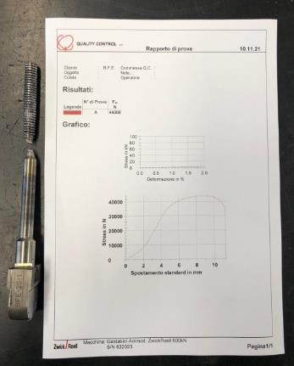
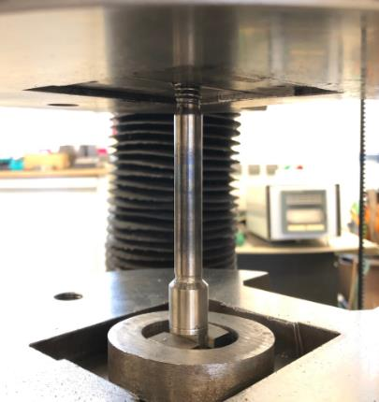
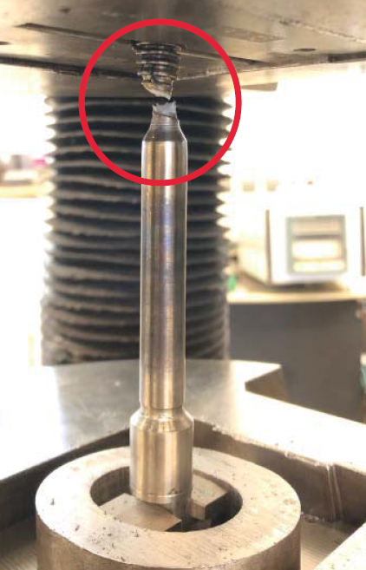
1” Gate Valve class 150
ASTM F3184 S31603 Condition A (LPBF)
Pull test (stem – AM wedge connection) acc. to API 602 & API RP 591 ANNEX B (Strength Tests for Stem/Shaft-to-closure Element Connections): Satisfactory
Stem
44.300 N
AM
Wedge
API 602 - 5.7.7: were mechanical failure to occur, it would do so at a stem section outside the valve pressure boundary

Slide 20
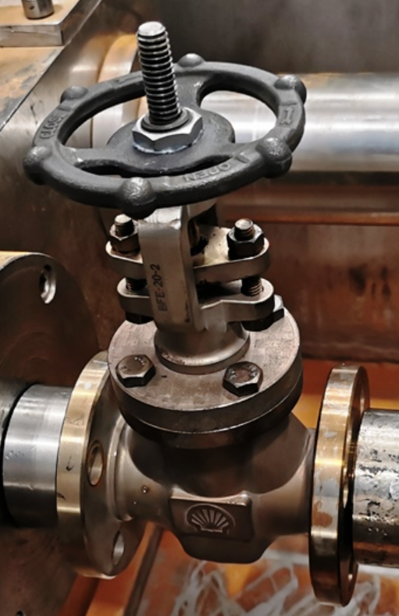
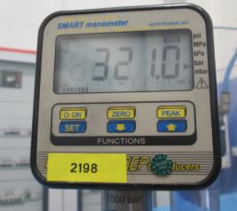
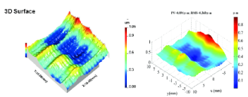
1” Gate Valve class 150
ASTM F3184 S31603 Condition A (LPBF)
Burst test: satisfactory
Standard shell test pressure: 29 bar
Pressure increased up to 321 bar (11 times greater)
Test interrupted at 321 bar due to a packing leakage but no visible and measurable deformation of the pressure boundary components was seen.

Slide 21
N° | Gate valve 1” class 150 INSPECTION STEP | FORGED VALVE MINIMUM REQUIREMENTS | 1” AM VALVE F3184-16 S31603 RESULT
1 | Mechanical test performed by external lab. ISO 17025
 | Yield Strength (RT) | A182 F316 (205 MPa) | 450 Mpa (Rp0,2)
 | Tensile Strength (RT) | A182 F316 (515 MPa) | 601 Mpa (Rm)
 | Elongation (RT) | A182 F316 (30%) | 40,6% (A _{5,62})
 | Reduction of Area (RT) | A182 F316 (50%) | 61,9% (Z)
 | Yield Strength (+538°C) rif. ASME IID | A182 F316 (115,4 MPa) | 164 MPa (Rp0,2)
 | Impact test (-196°C) | A182 F316 / PED (27 J) | 112,3 J
 | Hardness | Nace (Max 22 HRC) | 198 HB
2 | Corrosion test ASTM A262 Pr. E & ISO3651-2 | ASTM A262 Pr. E ISO3651-2 | Satisfactory
3 | Visual & Dimensional inspection | B.F.E. spec. | Satisfactory
4 | Hardfacing overlay with Stellite ® Gr 6 on 316-L (WPS/PQR) | ASME IX | Satisfactory
5 | Dye penetrant examination | ASME B16.34 | Satisfactory
6 | Hydraulic pressure test (29 Bar Shell test / 21 Bar Seat test) | API598, 77/101, 77/302 | Satisfactory
7 | 24 hours Hydraulic pressure test at 20 Bar | API598, 77/101, 77/302 | Satisfactory
8 | Shell TAT/DVT at -50°C / +400°C (included strip test) | SPE 77/300 | Satisfactory
9 | Burst test (class 150, normal Shell test pressure 29 Bar) | B.F.E. spec. | 321 Bar (no deformation)
10 | Wedge-stem pull test | API 602 | Satisfactory
11 | Hydraulic stress verification of the expanded seat zone | B.F.E. spec. | Satisfactory
12 | Burst test stress verification of the pressure boundary components | B.F.E. spec. | Satisfactory

Slide 22
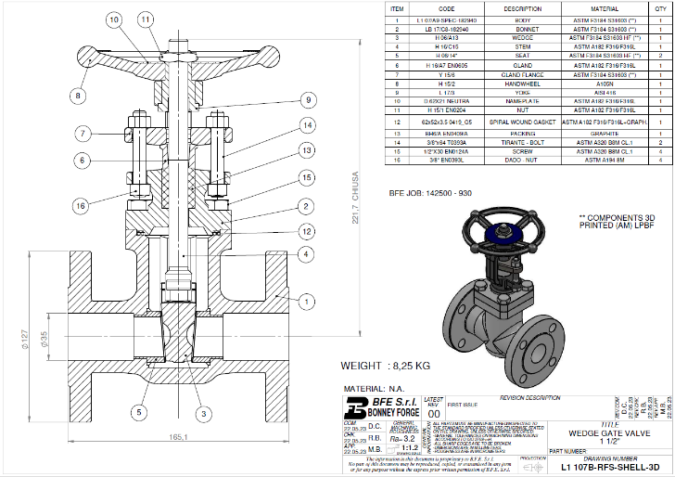
A new journey!
Even if the result of the first 1” valve exceeded our expectation, Shell and B.F.E. decided to face a further challenge! We produced an innovative 1 ½” valve obtaining the following results:
Further weight reduction;
Manufacturing time reduction;
Metallic support reduction;
European Pressure Equipment Directive
(PED 2014/68/EU) certification.

Slide 23
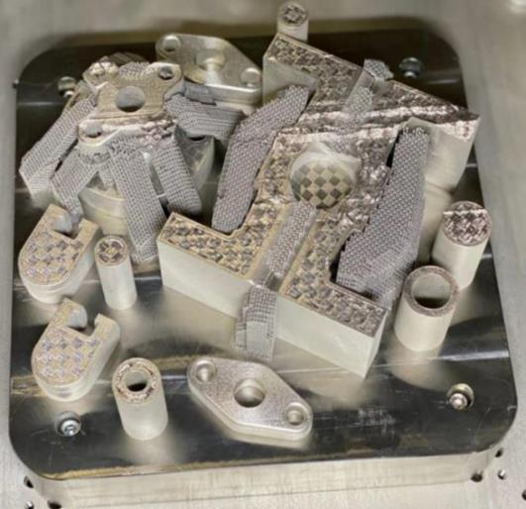
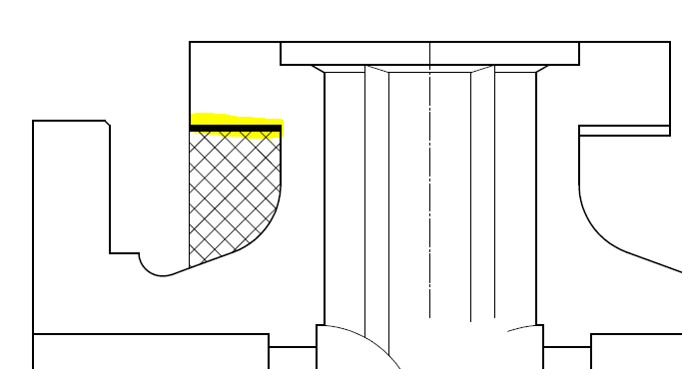
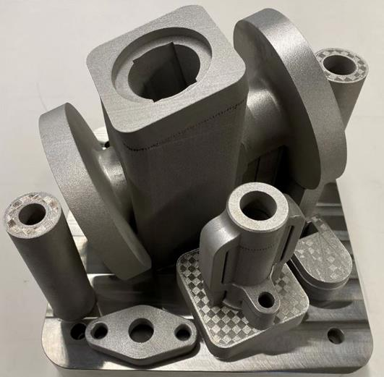
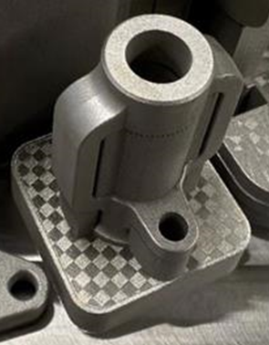
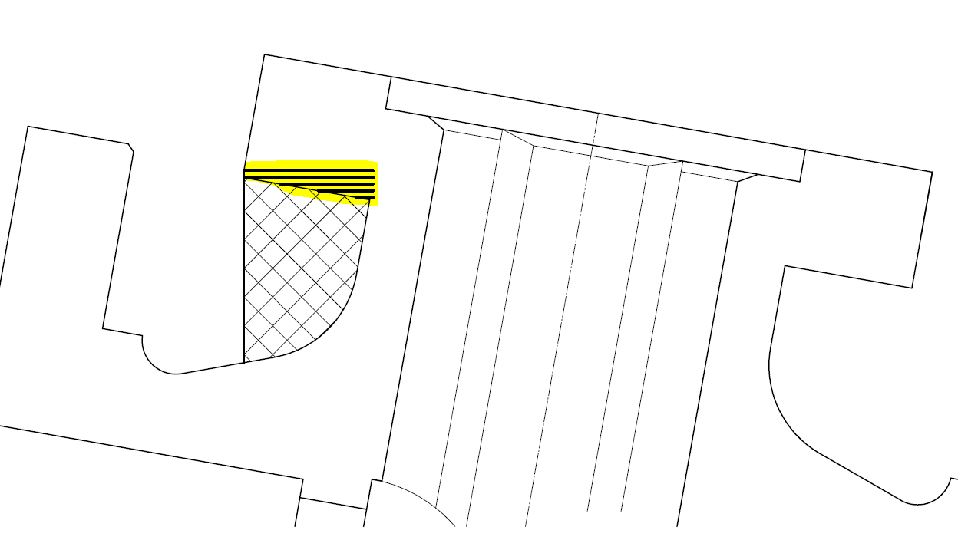
Optimization of supports and thermal stress
1” valve
Horizontal print
Single layer powder deposit (a risk of bending)
1 ½” valve
Angled print
Support reduction
less thermal stress
Layer by layer powder deposit (less thermal stress)

Slide 24
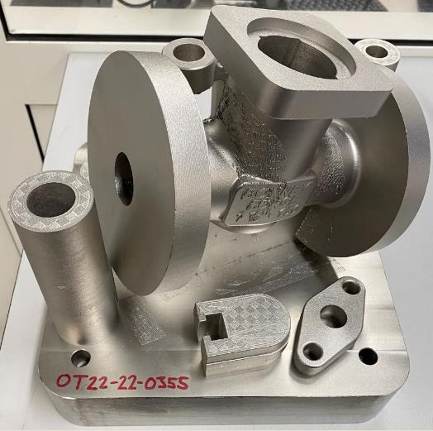
1 ½” Gate Valve class 150
ASTM F3184 S31603 Condition A (LPBF)
A new journey…. 1 ½” valve and the European Pressure Equipment Directive (PED 2014/68/EU)

Slide 25
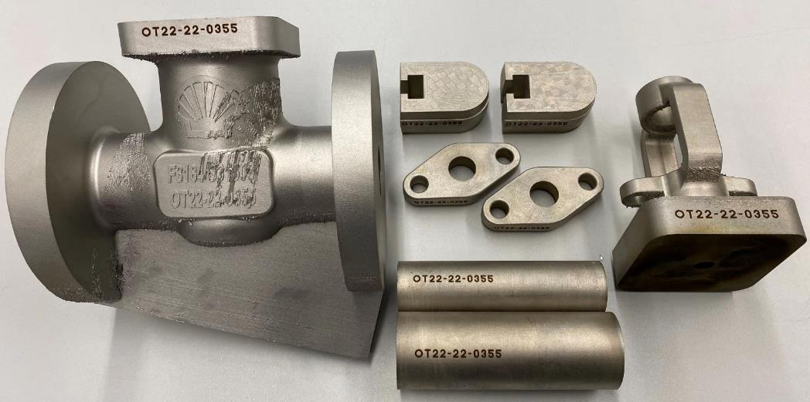
1 ½” Gate Valve class 150
ASTM F3184 S31603 Condition A (LPBF)
Wedge
Bonnet
Body
Gland flange
Seat
Integrated test coupon for mechanical test

Slide 26
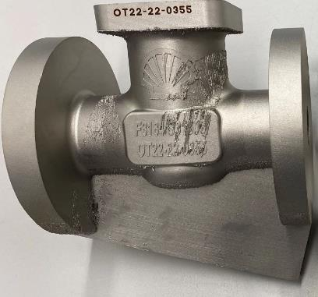
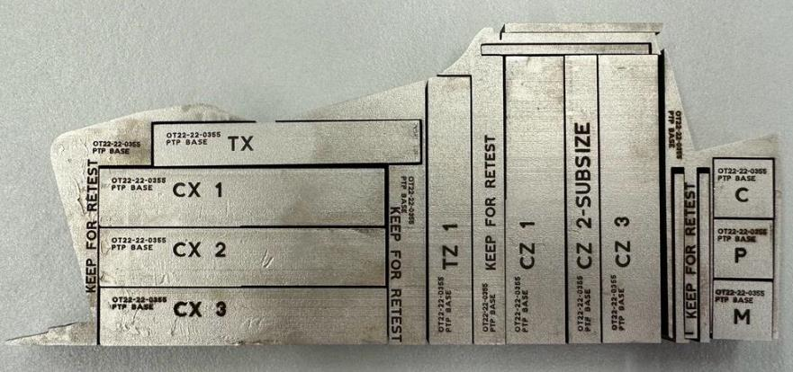
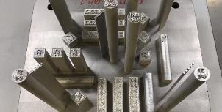
1 ½” Gate Valve class 150
ASTM F3184 S31603 Condition A (LPBF)
Integrated test coupon for:
mechanical test (X-Y-Z)
corrosion test
metallographic examination

Slide 27
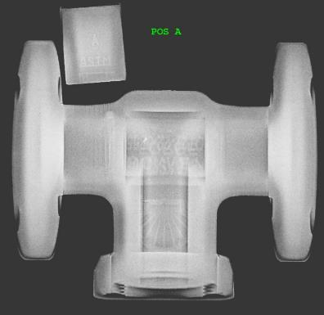
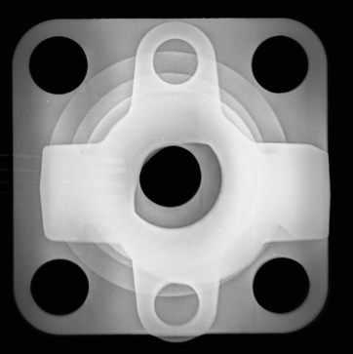
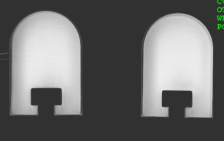
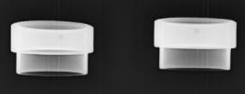
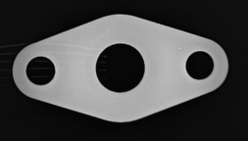
1 ½” Gate Valve class 150
ASTM F3184 S31603 Condition A (LPBF)
AM Radiographic examination according to
ASME BPVC sec V art 2 & 22 & ASME B16.34: Satisfactory

Slide 28
1 ½” Gate Valve class 150
ASTM F3184 S31603 Condition A (LPBF)
Red & Fluorescent penetrant test: No indication

Slide 29
1 ½” Gate Valve class 150
ASTM F3184 S31603 Condition A (LPBF)
Bonnet Body Wedge
Body
Wedge Gland flange Seats

Slide 30
1 ½” Gate Valve class 150
ASTM F3184 S31603 Condition A (LPBF)
Shell test at 29 bar: Satisfactory
Shell test at 20 bar (24 hours): Satisfactory
Seat test at 21 bar: Satisfactory
Seat test at 6 bar: Satisfactory
Fugitive emission acc. to 77/312: Satisfactory
Test witnessed by:

Slide 31
1 ½” Gate Valve class 150
ASTM F3184 S31603 Condition A (LPBF)
Tested and certified
finished product

Slide 32
N° | INSPECTION STEP SUMMARY | FORGED VALVE MINIMUM REQUIREMENTS | 1” AM VALVE F3184-16 S31603 RESULT | 1½” AM VALVE F3184-16 S31603 RESULT
1 | Mechanical test performed by external lab. ISO 17025
 | Yield Strength (RT) | A182 F316 (205 MPa) | 450 Mpa (Rp0,2) | 431 Mpa (Rp0,2)
 | Tensile Strength (RT) | A182 F316 (515 MPa) | 601 Mpa (Rm) | 582 Mpa (Rm)
 | Elongation (RT) | A182 F316 (30%) | 40,6 % (A _{5,62}) | 34,3 % (A _{5,62})
 | Reduction of Area (RT) | A182 F316 (50%) | 61,9 % (Z) | 63 % (Z)
 | Yield Strength (+538°C) rif. ASME IID | A182 F316 (115,4 MPa) | 164 MPa (Rp0,2) | 293 MPa (Rp0,2)
 | Impact test (-196°C) | A182 F316 / PED (27 J) | 112,3 J | 63,3 J
 | Hardness | Nace (Max 22 HRC) | 198 HB | 217 HB
2 | Corrosion test ASTM A262 Pr. E & ISO3651-2 | ASTM A262 Pr. E ISO3651-2 | Satisfactory | Satisfactory
3 | Visual & Dimensional inspection | B.F.E. spec. | Satisfactory | Satisfactory
4 | Hardfacing overlay with Stellite ® Gr 6 on 316-L (WPS/PQR) | ASME IX | Satisfactory | Satisfactory
5 | Dye penetrant examination | ASME B16.34 | Satisfactory | Satisfactory
6 | Hydraulic pressure test (29 Bar Shell test / 21 Bar Seat test) | API598, 77/101, 77/302 | Satisfactory | Satisfactory
7 | 24 hours Hydraulic pressure test at 20 Bar | API598, 77/101, 77/302 | Satisfactory | Satisfactory
8 | Shell TAT/DVT at -50°C / +400°C (included strip test) | SPE 77/300 | Satisfactory | -
9 | Burst test (class 150, normal Shell test pressure 29 Bar) | B.F.E. spec. | 321 Bar (no deformation) | -
10 | Wedge-stem pull test | API 602 | Satisfactory | -
11 | Hydraulic stress verification of the expanded seat zone | B.F.E. spec. | Satisfactory | -
12 | Burst test stress verification of the pressure boundary components | B.F.E. spec. | Satisfactory | -

Slide 33
Certification According to PED 2014/68/EU European Pressure Equipment Directive
B.F.E. in cooperation with DNV obtained the Particular Material Appraisal (PMA) for ASTM F3184 S31603.
PMA is the process by which the “pressure equipment manufacturer” demonstrates that each material proposed (that is not referenced in an harmonized standard or covered by an European Approval for Materials EAM), conforms to the applicable Essential Safety Requirements (ESR).

Slide 34
Certification According to PED 2014/68/EU European Pressure Equipment Directive
DNV witnessed all the laboratory and functional test.
Consequently, this gate valve received the certificate of absolute quality assurance for compliance with the Pressure Equipment Directive 2014/68/EU.
ASTM F3184 S31603 included into
B.F.E. PED certificate Module H Cat. III

Slide 35
Amazing material reduction !
1 ½” Forged body (FULL) 1 ½” AM body (HOLLOW)
AM allows us to reinvent the design, reducing 20% of the valve weight (forged valve 10,21 Kg vs AM valve 8,25 Kg) = - 1,96 Kg
AM allows us to produce hollow components, reducing the machining :
- 0,94 Kg for the bonnet
- 4,1 Kg for the body
1 ½” VALVE TOTAL MATERIAL REDUCTION: 7 Kg

Slide 36
Why AM for oil & gas business?
AM technology, from a valve manufacturer prospective, will work in symbiosis with the traditional forging/casting process offering the following advantages:
POSITIVE:
Bespoke: It will be a winning strategy for the production of low batches in some special materials (e.g. CW-6MC)
Freedom: you can reinvent the design, without the limits imposed by current production processes
Lightweight: Weight reduction during the design phase
Reduce tooling costs: It will avoid the use of casting/forging patterns
Material/Machining: AM allows us to print hollow components, avoiding further machining steps and saving a lot of material
Produce complex geometries: AM allows us to build components that could not be machined with conventional machine tools or electro-erosion (complex geometries, hidden features, thin walls, fine meshes….)
Quality: Mechanical and NDE results exceed the conventional standards expectations.
Delivery time: accelerating delivery for low batches in some special materials
NEGATIVE:
1) Currently not the best solution for high volume production... but there is no stopping technology!

Slide 37
Why AM for oil & gas business?
Produce complex geometries

Slide 38
Now let’s go for the next step !
1) Complete the NACE test (MR0175/ ISO15156-1-2-3, MR0103/ISO17495-1):
S.S.C.C. NACE TM0177 method A (Tensile test) 720h
S.S.C.C. NACE TM0177 method B (Bent-Beam test) 720h
S.S.C.C. NACE TM0177 method C (Stressed C-Ring test) 720h

Slide 39
Now let’s go for the next step !
2) AM valve will be installed on a Shell refinery for a live test)
(Shell Energy and Chemicals Park Rotterdam)
3) Work with ASME B16.34 committee to introduce AM materials

Slide 40
A technical milestone!
The scope of this pioneer work is to demonstrate the benefits and safety of valves manufactured with AM technology, which will open a new frontier in the energy sector.
B.F.E. Bonney Forge staff:
Oscar Barcella
SHELL staff:
Rob Hengst
Alfred Kruijer
Dennis Boon
Angeline Goh
Marc Wilms
Rik Vander Meer

Slide 41
There is real progress only when the benefits
of a new technology become for everyone.
Henry Ford
It’s time to share!
Thank you
Oscar Barcella - obarcella@bfe.it
Service & Quality Assurance Manager
B.F.E. Bonney Forge
15th May 2024

Slide 42
Thanks
ORGANIZING SECRETARIAT
Ph. +39 035 3230904
e-mail info@industrialvalvesummit.com
CONFERENCE ORGANIZERS
Ph. +39 3474908420
e-mail segreteria@valvecampus.com
www.industrialvalvesummit.com
www.valvecampus.com

