Slide 2
Mechanical behavior of polymeric seals under LH2 conditions
Francesco Apuzzo | President of IVS Scientific Committee
presidente@valvecampus.com

Slide 3
The driver of the project
Enhancing our understanding of materials to design a better future
What happens at 4 degrees Kelvin, under LH2 conditions?
The available literature on the behavior of plastic materials in cryogenic applications is extensive for conditions at -196°C but quite limited for conditions at -269°C.
Considering future industrial developments, it is therefore important to increase our knowledge about the behavior of the involved materials adopted to make sealing under LH2 conditions.

Slide 4
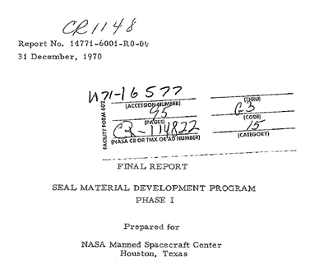
The first reference found…

Slide 5
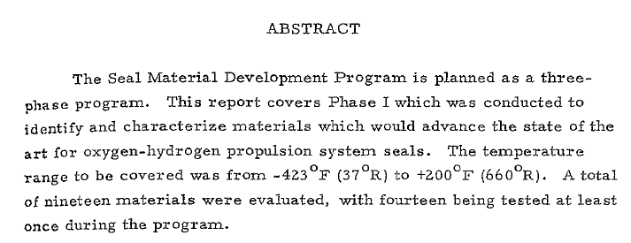
The scope of the Seal Development Program

Slide 6
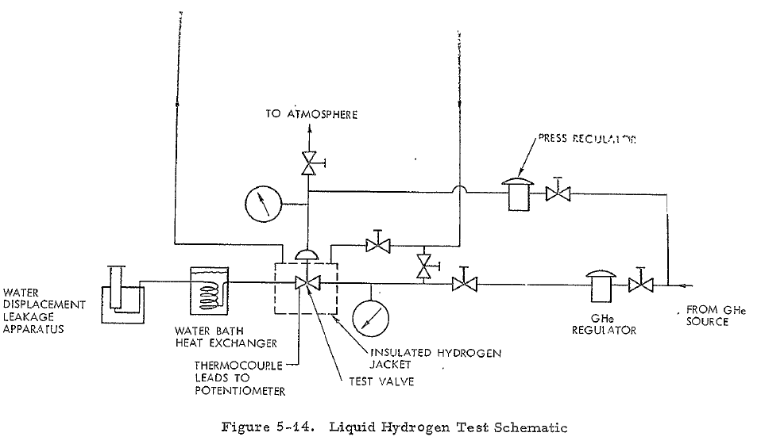
Liquid Hydrogen Test Schematic
The liquid hydrogen flows from the dewar to the test setup and is controlled by the manual cryogenic valve. The LH2 then flows into a jacket around the test valve, which is filled completely when temperature stabilized with liquid hydrogen. To maintain liquid hydrogen temperature, the hydrogen flows through the jacket and out through a vent line to atmosphere. For the first series of tests, the test media was gaseous helium which was used to determine leakage through the valve at hydrogen temperatures.

Slide 7
Liquid Hydrogen Test Schematic
Note that two thermocouples were welded to the bottom of the valve to indicate test valve temperature. Valve leakage was measured by standard water displacement methods. The line coming from the water bath heat exchanger was connected to a water displacement measurement apparatus which then measured the rate of internal leakage from the test valve.

Slide 8
Liquid Hydrogen Test Schematic
The test procedure used in the first series of liquid hydrogen tests is as follows:
Determine the valve seat load (pressure on dome) required to effect zero leakage, with helium at ambient temperature at 200 psi and 400 psia inlet pressure.
Using helium, purge through the jacket and the valve for 15 minutes.
Flowing liquid hydrogen through the jacket, cool down to -423oF with a continuous helium purge through the test valve. (In some cases the temperature is held at some intermediate point to check LNZ temperature results).
At -423 ⁰ F determine the valve seat load (pressure on dome) to obtain zero leakage⁴ through valve.

Slide 9
Liquid Hydrogen Test Schematic
The term zero leakage, as used herein, denotes no discernable helium leakage for a period of 5 minutes using a water displacement measurement apparatus.

Slide 10
Liquid Hydrogen Test Schematic
5) Cycle valve (varies from zero to 100 cycles) again determine seat loads to effect zero leakage.
6) Purge with helium and warm to approximately room ambient temperatures (ambient data were actually .taken at temperatures from +350 to +70°F because of time limitations).
7) Obtain seat loads required to effect seal after warming to ambient temperatures.

Slide 11
The project partnership involved several key stakeholders
Valvecampus Association
Dupont Switzerland
Fluorseals Spa
Fluorten Srl
Victrex Manufacturing Ltd

Slide 12
The project: Investigation of the Mechanical behavior of polymeric seals under LH2 conditions
Objective of the project was the investigation of the mechanical behavior of different plastics at 4K. In this project different cylindrical samples were used to measure the compression modulus and strength at RT and compression strength at 4°K of different materials. In addition, the stress-strain behavior till fracture was calculated out of the measurement of the compression strength using the cross-head movement and correction via the set-up stiffness

Slide 13
The tested materials
Samples
RT tests
4° K tests
Material of the samples (12 pieces per material)
Number of samples tested at RT
Number of samples tested at 4°K
A1 - Polyimide^{F1*}
A2 - Polyimide^{F2*}
B1 - PEEK^{F1*}
B2 - PCTFE^{F1*}
C1 - PEEK^{F3*}
C2 - PEEK^{F4*}
48
24
24 Compression Strenght Test
24 Compressive Modulus Test
24 Compressione Strenght Test
*it means «proprietary formulation»

Slide 14
Some test details
For the determination of the compression strength the force vs crosshead movement was measured till failure of the sample. In order to be able to estimate the strain out of the cross-head movement two effects have to be take into account: alignment of the load introduction rods (especially at 4K) and the stiffness of the testing machine and set-up. In a first step the cross-head movement was corrected by the stiffness of the testing machine and set-up (force dependent parasitic displacement were subtracted from the actual cross head movement and this displacement was used to calculate the strain by division through the sample height. In a second step, the stress-strain curve was shifted in such a way the linear part of the stress-strain curves will go through the origin. The following figure show the calculated stress-strain curve based on the uncorrected, corrected cross head movement (with and without shift) for RT (left) and 4K (right).

Slide 15
Some test details

Slide 16
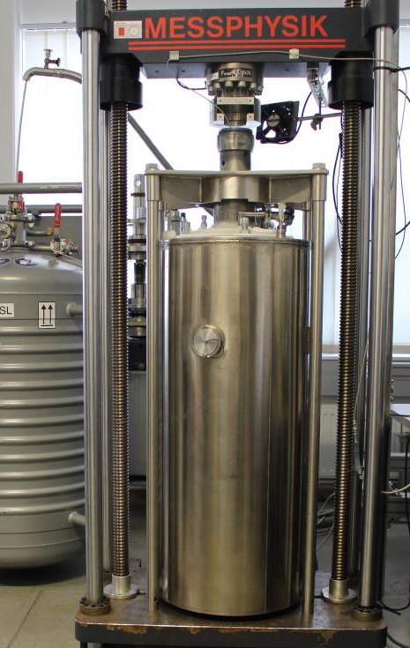
Some test details
All the mechanical tests at RT and -269°C are performed using an universal testing machine, type Messphysik BETA 200 with a maximum load of 200 kN, available not only for tensile testing, but also for compression tests and for flexural tests. It meets the requirements of a class-1-testing machine and is inspected and calibrated in regular intervals. Calibrated load cells from 10 to 200 kN load and various types of extensometers and strain gauges are available. Tensile, flexural and compression tests can be performed in a climate chamber between -160°C and 600°C, in cooling liquids down to -196°C in a bath of liquid nitrogen. Tensile, flexural and compression tests can be performed in cryogenic conditions, down to -269°C in a cryostat. For this, a force-reversing cage with a surrounding isolated tank is used.

Slide 17
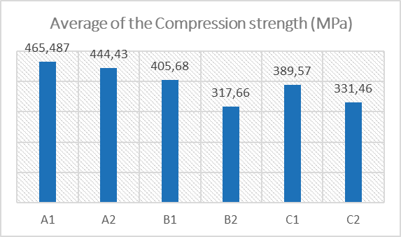
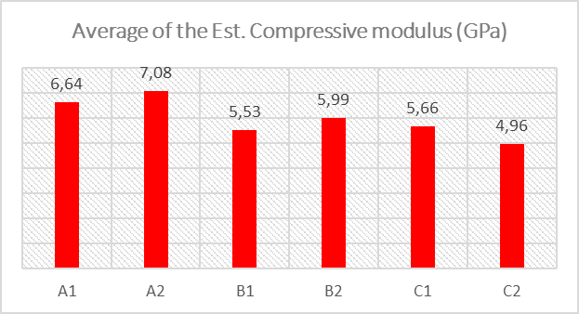
The aggregate results: average of the data collected at 4°K

Slide 18
Conclusions
The data collected in this project are not intended to classify the performance of materials for LH2 service. Indeed, the spirit of the project has been to derive some analytical insights that can be used to guide further studies and investigations.
A detailed technical paper summarizing the results will soon be drafted and possibly published in an international journal to share the findings and stimulate discussion on this topic.
A second round of testing for next year is currently under consideration among the participants to continue on the path taken.

Slide 19
Conclusions
Finally, I would like to extend sincere appreciation and thanks to the partners who participated in this project, demonstrating that even in a competitive environment, it is possible to promote initiatives that enhance technical knowledge in niche areas. For further information and details I invite you to contact directly the Partners.
Dupont Switzerland
Fluorseals Spa
Fluorten Srl
Victrex Manufacturing Ltd
ruth.jackowiak@dupont.com
giovanni.dallolio@fluorseals.it
m.salogni@fluorten.com
christian.salvatori@victrex.com

Slide 20
Thanks
ORGANIZING SECRETARIAT
Ph. +39 035 3230904
e-mail info@industrialvalvesummit.com
CONFERENCE ORGANIZERS
Ph. +39 3474908420
e-mail segreteria@valvecampus.com
www.industrialvalvesummit.com
www.valvecampus.com

