Slide 1
Presentation of an instrumentation device for a valve monitoring
CONFERENCE
ORGANIZERS

Slide 2
Presentation of an instrumentation device for a valve monitoring
Julie Pioger | Sealing Project Manager | CETIM
Pierrick Letort | Instrumentation Project Manager | CETIM

Slide 3
Contents
Background
Specifications
Instrumentation solutions
Demonstrator prototype
ATEX compliance
Monitoring data
Adaptability to other applications

Slide 4
Background
Improving the sealing performance of industrial valves is a key objective.
      Chemical and petrochemical sites are the main source of leakage.
Reducing "fugitive emissions" is an economic, safety and environmental issue.
CETIM suggests implementing a non-intrusive monitoring system for industrial valves.
      In-service monitoring of critical components in an ATEX environment.
The project enables digitalizing industry.
      Connected device with wireless data transmission.
The data accumulated from the instrumentation device can be used by implementing a "machine learning" approach.
      Predictive maintenance.

Slide 5





Background
Source CNPP.
ATEX Environment
Instrumentation device for valve monitoring
Source ifm40
Droits d'auteur : ©yingyaipumi
In-service monitoring
Source Blog Wika.
Risk of fugitive emissions
Predictive maintenance
Source Coexya.
Digital industry
Source PTC

Slide 6
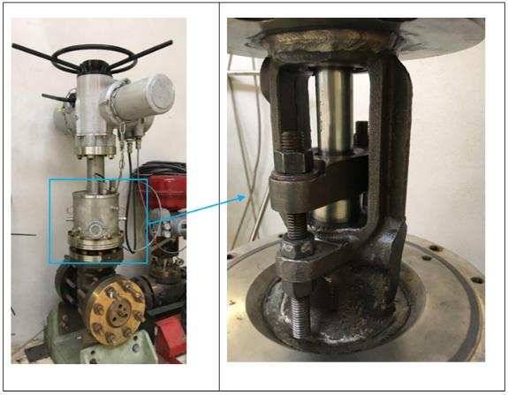
Specifications
Valve to be instrumented.
        4’’ valve MPS4 CLASS300
        available in CETIM’s FST* Laboratory
Values to be measured.
        Packing tightening force.
        Displacement / Position of operating stem.
        Temperature close to the packing.
        Gas detection close to the packing.
Device compatible with ATEX environment (II 3 G Ex IIC T4).
        Zone 2 (area where gas is present only in the event of a problem).
        Type IIC gas (most dangerous gases: hydrogen, etc.).
        Maximum surface temperature: 135°C.
        Connected device, wireless communication system.
FST* : Fluid and Sealing Technologies

Slide 7
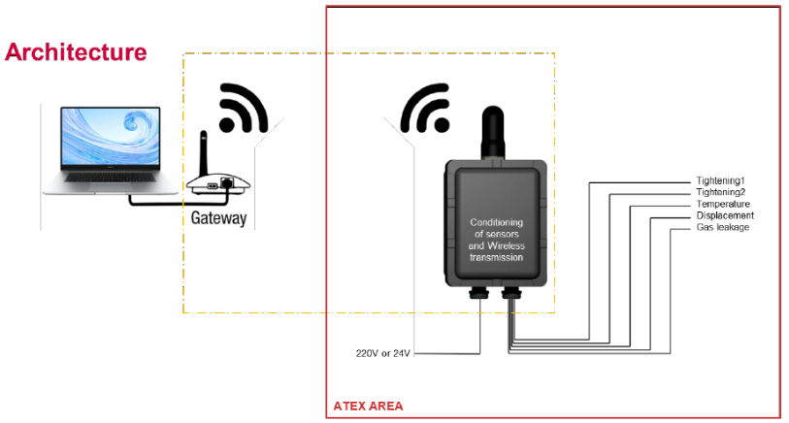
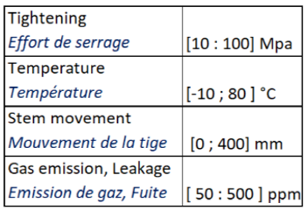
Specifications
        Wireless transmission (to minimize wiring).
        Acquisition frequency: 1 measurement/min (monitoring).

Slide 8



Instrumentation solutions : force measurement
Search for two “washer” type sensors compatible with the geometric constraints (M12 threaded rods and flange) and for a measuring range of 32 kN (corresponding to a maximum stress of 100 MPa in the packing).
Many solutions identified.
Only one meeting both dimensional constraints and the need for ATEX certification, with a measuring range greater than the expected value: sensors for M12 rod with a measuring range of 75 kN, with conditioner integrated in a cylindrical housing mounted on the cable of the sensor.
Sensor with “intrinsic safety” protection mode requiring the use of an ATEX isolated barrier.

Slide 9

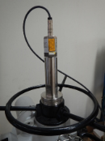
Instrumentation solutions : displacement measurement
Search for valve stem displacement sensors for a stroke of 120 mm taking into account integration and mounting constraints (on the demonstrator prototype, accessibility of the end of the stem in the upper part of the valve).
Many solutions identified, but few of them usable in an ATEX environment.
Choice of a solution that can be integrated to the valve operating stem and has a suitable measuring range and ATEX certification: magnetostrictive sensor with a measuring range of 150 mm.
Design and manufacturing of a specific support, with the magnet fixed on a tube connected to the endless screw of the valve and the sensor head mounted on a support fixed to the upper part.

Slide 10
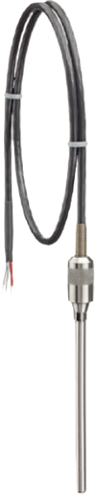
Instrumentation solutions : temperature measurement
Search for temperature sensors for a range of -10 / 70 °C with few geometric constraints and ATEX certification.
Many solutions identified.
Choice of a solution offered by the supplier of the wireless communication system : Resistance Temperature Detector and associated transmitter.

Slide 11
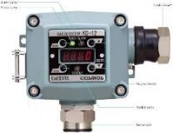
Instrumentation solutions : gas detection
Search for gas detectors for methane in concentrations of 50 to 500 ppm, giving preference to the least bulky sensors with an analog output proportional to the gas concentration (rather than those with a switching output).
Research carried out on commercial detectors available in ATEX versions for the following gases: Methane (CH₄), Hydrogen (H₂), Benzene (C₆H₆), Butadiene (C₄H₆), Ammonia (NH₃).
Few solutions suitable for methane with range in ppm (and not in % LEL*) and proportional analog output.
Among the two identified for methane and using semiconductor technology, choice of a solution particularly for its smaller size and ease of supply.
* LEL : Lower Explosive Limit

Slide 12

Instrumentation solutions : Wireless communication system
Search for a wireless communication system for 5 measurement channels without protocol specification, with:
  Local transmission on site,
  Wireless transmission distance of at least ten meters,
  Measurement transmission frequency: at least one measurement per minute for each sensor.
Transmission of raw measurement signals (no local processing).
System that can be powered by a nearby energy source (220V or 12/24V).
Several solutions identified but only one meeting the requirements and having ATEX certification: choice of a system allowing the connection of 5 sensors and communicating via mobile network.
Use of another antenna with ATEX certification.

Slide 13
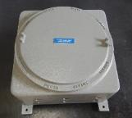
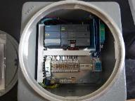
Instrumentation solutions : ATEX enclosure
Search for an enclosure meeting ATEX requirements for the measurement system, increased safety “eb” or “ec” enclosures or explosion-proof “d” enclosures being usable.
  Increased safety enclosures only support elements already compatible with the explosive environment, but are generally smaller, lighter and more affordable. Since the elements used in this box have been selected for their ATEX certifications, this solution is more interesting than an explosion-proof enclosure.
Consultation of suppliers first conducted for an increased safety enclosure defined as a “product” but which did not make it possible to obtain a suitable response from the companies contacted despite numerous exchanges.
Research redirected towards an explosion-proof enclosure.
Choice of an ATEX explosion-proof enclosure suitable for the measuring device.

Slide 14
Demonstrator : Main characteristics
Wireless communication via mobile network,
4 analog inputs (2 forces, 1 displacement, 1 gas), and a Hart channel via add-on module (temperature),
Sensors can be powered via the communication system (12 or 24V),
Setting via web interface,
  SIM card management (SMS, emails),
  Definition of input data, output data, internal variables,
  Data logging, Alert management,
Sending of measurement files by e-mail according to settings (daily sending set on the prototype),
Sending of alerts via e-mail or SMS depending on settings (threshold crossing).

Slide 15
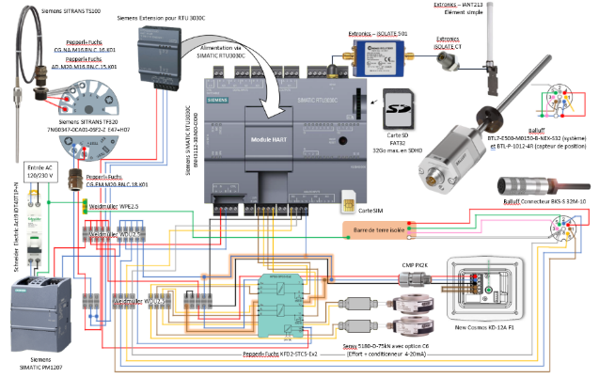
Demonstrator prototype

Slide 16
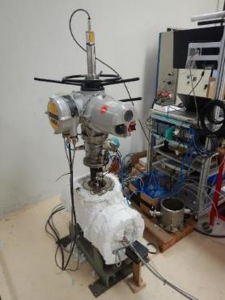
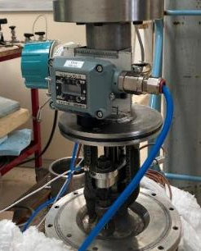
Demonstrator prototype
Temperature conditioner
Displacement sensor
Wireless communication system
Antenna
Actuator
Gas detector
Packing, with 2 force sensors and a temperature sensor
Force sensor
Insulated valve body
Temperature sensor
Pressure supply

Slide 17
ATEX compliance
Since the assembly is implemented in zone 2, the ATEX directive 2014/34/EU (article 13) allows CETIM - with the support of INERIS - to self-certify the ATEX compliance of the assembly since all elements are themselves already ATEX-certified by their respective manufacturers.
Preparation of the ATEX compliance file for the device.
Taking into account the connection of systems with different protection modes.
  Example: use of a barrier between force sensor + electronics with an “intrinsic safety” protection mode and the “ec” communication system.
Need to replace certain parts of the device.
  Example: use of an antenna meeting ATEX requirements (defined as “simple element”) instead of the antenna proposed by the system supplier
Inability of consulted suppliers to respond favorably to our request for an “increased safety” enclosure (solution initially sought because it is more interesting given the selection of ATEX certified elements to have an enclosure that is smaller, lighter and more affordable than an explosion-proof enclosure)
  Main reasons: consultation for a single enclosure, instrumentation device made up of elements supplied by several different companies and having different modes of protection, difficulties in obtaining a commitment of responsibility on a system that the supplier did not design or using a component outside its standard scope of application.
Before commissioning the device, carrying out a review of its ATEX compliance on the CETIM site with INERIS during a technical day

Slide 18
Monitoring data
        Parameters monitored during valve operation
Values / Measures | Parameters
Stem movement Cycle | « Valve Open » Position (mm) « Valve closed » Position (mm) → Instantaneous valve position (mm, %) High position threshold (%) + Alert Low position threshold (%) + Alert → Visual indicator of the alert status → Number of cycles
Packing tightening forces | Initial clamping force (daN) Instantaneous forces (sensor 1 (daN), sensor 2 (daN), average force (daN, % of initial force). Low level threshold (%) + alert → Visual indicator of the alert status

Slide 19
Monitoring data
        Parameters monitored during valve operation
Values / Measures | Parameters
CH₄ Gaz detection Leak | Instantaneous CH₄ concentration (ppm) Level threshold (ppm) + Alert → Visual indicator of the alert status
Packing temperature | Instantaneous temperature (°C) Level threshold (°C) + Alert → Visual indicator of the alert status

Slide 20
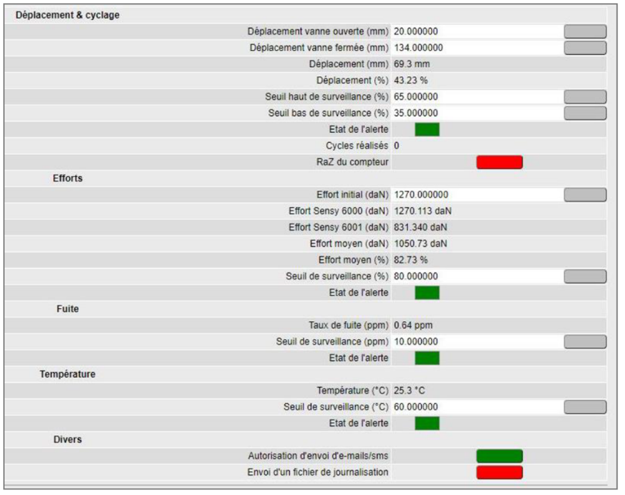
Monitoring data
        View of parameters on the interface

Slide 21
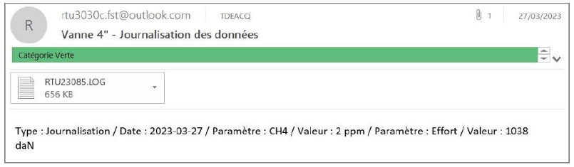
Monitoring data
        Example of a daily e-mail received.0

Slide 22
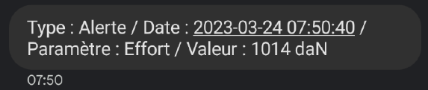
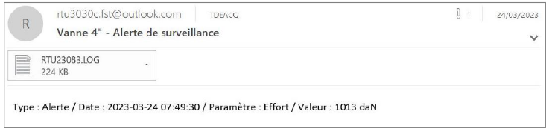
Monitoring data
        Examples of an alert received ( force threshold) : SMS and e-mail.

Slide 23
Monitoring data
Daily data processing.
        The text file received is automatically downloaded into a folder (outlook executable program) .
        Data from the text file is downloaded and integrated into an Excel file, following the previous days data (Excel executable program).
        The Excel file provides a global graphical view of the monitored parameters.
Tests program.
        Protocols based on the ISO15848-1 Standard : Industrial valves - Measurement, test and qualification procedures for fugitive emissions - Part 1 : classification system and qualification procedures for type testing of valve.

Slide 24
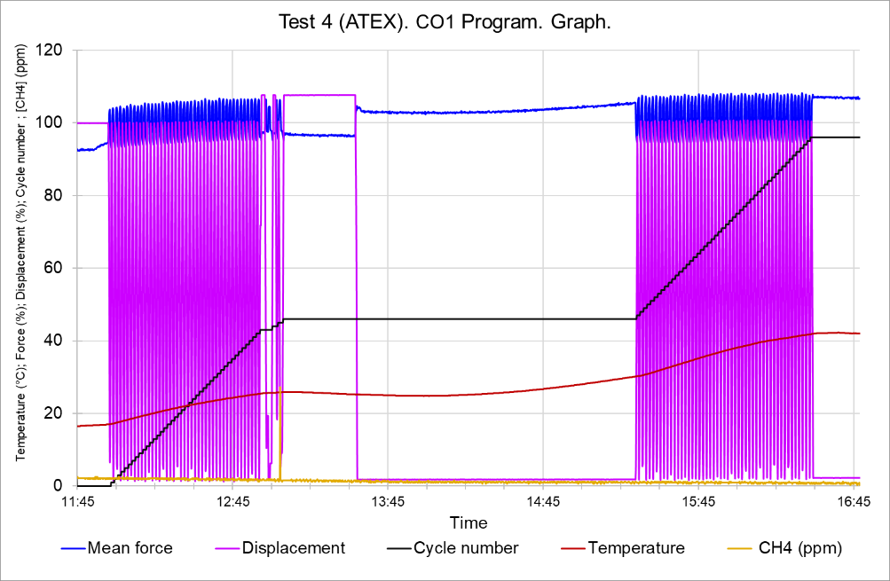
Monitoring data
Test 4 recording.

Slide 25
Adaptability to other applications
Use with another gas.
      With ATEX certification (II 3 G Ex IIC T4), the solution can be used with other gases, such as hydrogen (type IIC gas).
      The gas sensor must be changed to adapt to this gas.
      Compatibility with the communication system must be checked for each gas (radio frequency power).
Change of equipment to be monitored.
      Select the force and displacement sensors according to the geometric and accessibility constraints of the equipment.
Industrialization
      Device designed for use in an industrial ATEX environment.
      Position the cable glands (sensors, antenna) on the underside of the protection enclosure (weather reason).

Slide 26
SPEAKERS
e-mail julie.pioger@cetim.fr
e-mail pierrick.letort@cetim.fr
www.cetim.fr

Slide 27
Thanks
ORGANIZING SECRETARIAT
Ph. +39 035 3230904
e-mail info@industrialvalvesummit.com
CONFERENCE ORGANIZERS
Ph. +39 3474908420
e-mail segreteria@valvecampus.com
www.industrialvalvesummit.com
www.valvecampus.com

