Slide 1
Electrical Failsafe Actuator on HIPS Surface Safety Valve
CONFERENCE
ORGANIZERS

Slide 2
Electrical Failsafe Actuator
on HIPS Surface Safety Valve
Syed M. Nisar | Saudi Aramco
Kai Ewald | AUMA Riester

Slide 3
Agenda
  Introduction
  Brief Background
  Replace Hydraulic System
  Proposed Technology
  Design Scope and Concept
  Operation Method
  Further Possibilities
  Field Pilot
  Realized Benefits

Slide 4
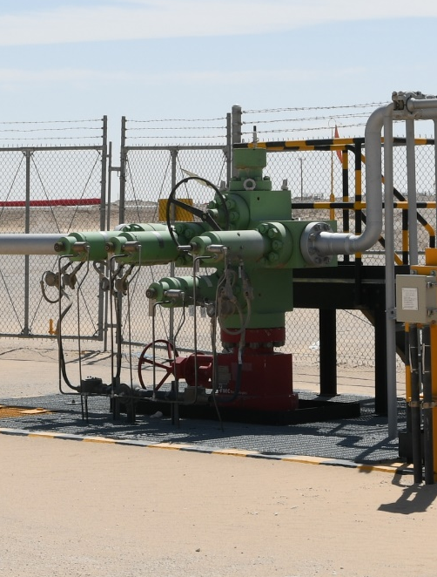

Introduction
More than 1800 Gas wells
Repetitive hydraulic failures & Spurious trips
CONFERENCE ORGANIZERS

Slide 5
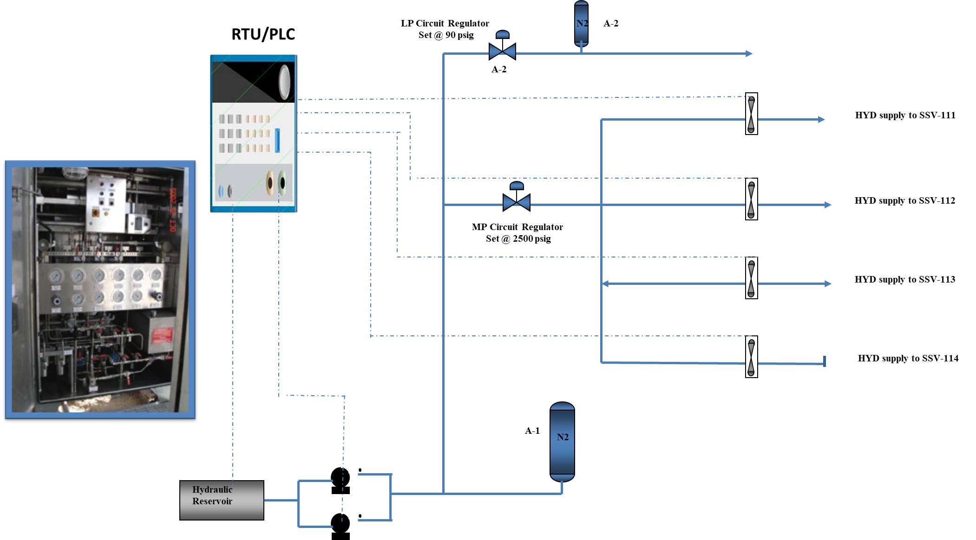
Brief Background

Slide 6
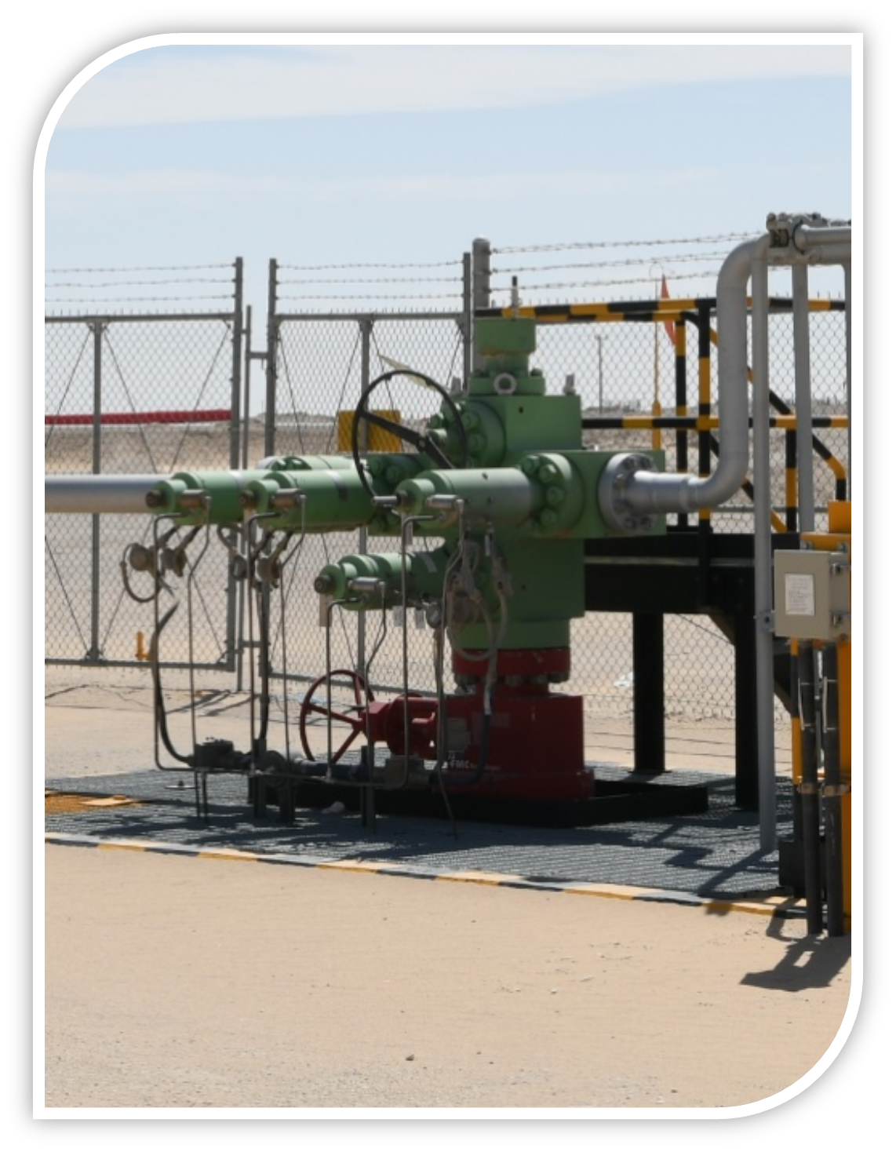
Replace Hydraulic System
Hydraulic Power Units & Actuators
Reduce OPEX
  Contamination
  Leaks
  Refills
  Alarms
  Human errors
Increase Reliability
Maintain Safety
Increase Operational Efficiency

Slide 7
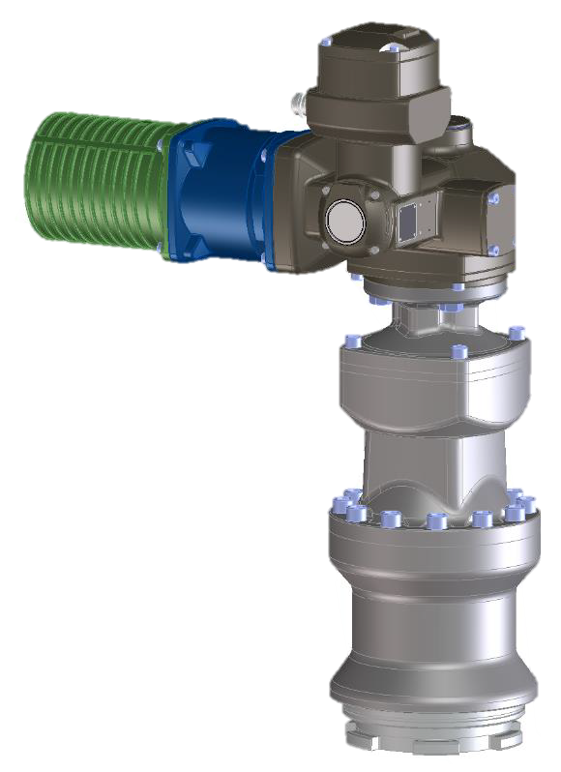
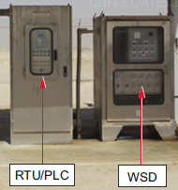
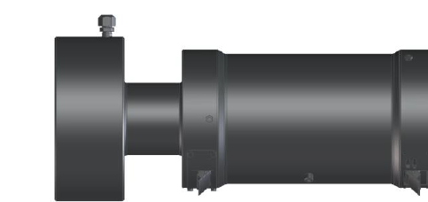
Proposed Technology
Corporate Technical Challenge
Linear Electric Fail-Safe Actuator
First Company in the World

Slide 8
DESIGN CONCEPT
Replace Hydraulic with Electric
Terminal box
Electric Motor
Electric motor to open valve
Mechanical spring-fail-safe to meet safety
Brake to maintain valve open
Modular design
Open against 10,000 psi
Close w/o pressure assistance
IEC Ex d electrical area classification
High temperature rating
Gearing system
Brake unit
Linear unit
Valve connection

Slide 9

DESIGN CONCEPT
Failsafe Electric Actuator
Electric Motor
Brake unit
Valve bonnet
Spring Unit
Linear unit
Gearing system

Slide 10
DESIGN CONCEPT
Actuator
  Motor: Using an existing motor from AUMA portfolio
  Brake unit – two integrated brakes with different functions:
    Holding brake: for locking Fail-Safe-Unit and valve in OPEN (lower) position
    Centrifugal brake, as a speed limiter of the motor speed while closing
Gearbox: non-self-locking gear system

Slide 11
OPERATION
Open by motor (only)
  Energizing motor
  Opening valve & compressing spring
  Open position feedback via limit switch
  De-energizing motor
  Energizing holding-brake
OPEN

Slide 12
OPERATION
Close by spring (fail-safe)
  ESD low active signal – releasing holding brake
  Spring moves valve & actuator to CLOSE
  Centrifugal brakes controls
  Close position feedback via limit switch
CLOSE

Slide 13

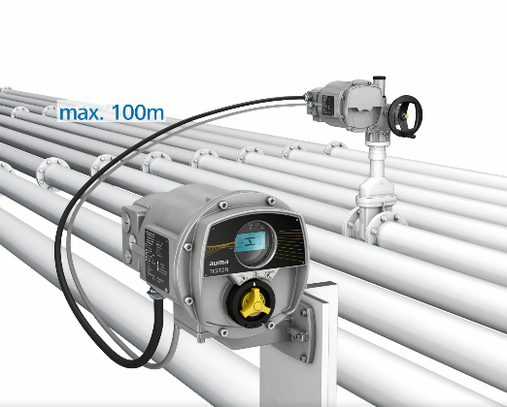


Further possibilities
AUMA modular design
  Modular design
  Away up to 100m (high temp or vibration)
  Digitalization IOT ready
  Asset management
  Remote diagnostics
  Predictive Maintenance
  Etc.

Slide 14
Realized Benefits
  Annual OPEX saving
  CAPEX saving
  Gas well startup time improvement by 93%
  Eliminate downtime of hydraulic failures
  Eliminate oil leaks
  Prevent unwanted risks
  Increase integrity of gas reservoir
  Increase sustainability of production

Slide 15
Field Pilot
Successfully completed in 2022
Saudi Aramco Engineering Report Issued
CONFERENCE ORGANIZERS

Slide 16
Thank You
SYED NISAR
e-mail syed.nisar@aramco.com
KAI EWALD
e-mail kai.ewald@auma.com

Slide 17
Thanks
ORGANIZING SECRETARIAT
Ph. +39 035 3230904
e-mail info@industrialvalvesummit.com
CONFERENCE ORGANIZERS
Ph. +39 3474908420
e-mail segreteria@valvecampus.com
www.industrialvalvesummit.com
www.valvecampus.com

