Slide 1
Enhanced PAEK polymers for LNG & LH2 services
CONFERENCE
ORGANIZERS

Slide 2


Biography
Christian Salvatori is a Business Development Manager EMEA for the Energy and Industrial Business Unit at Victrex, he is in charge of driving growth through technical skills combined with a solid sales experience, the main activities are around the development of new materials for new applications in the Energy market.
After having obtained the degree in Physics Engineering at the Politecnico of Milan in 2007 he started working in the Oil&Gas Industry at Schlumberger – Westerngeco as Seismic Acquisition Engineer on board of vessels – rigs in Western Australia learning how to perform the data acquisition and processing, inherent the scanning of the seabed for the research of oil and gas, detected with the best technologies.
Then he joined Saint-Gobain Performance Plastics as a Sales Manager building his knowledge of soft seals for the Valve Industry until 2016 when he joined Victrex
Christian Salvatori – Business Development Manager EMEA
Mobile: +39 331 658 3200
christian.salvatori@victrex.com
www.victrex.com

Slide 3
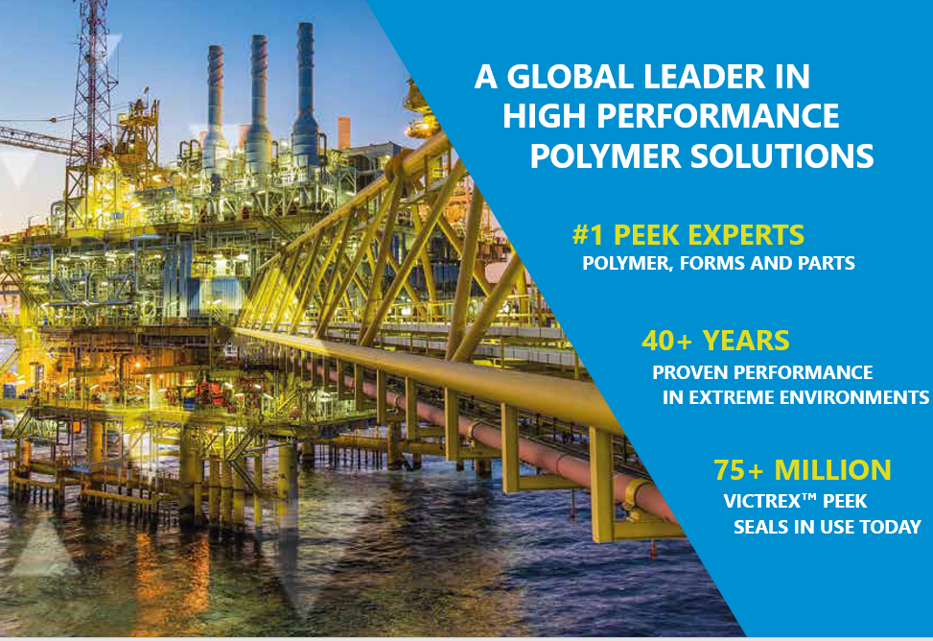
Victrex in Energy
We are the inventors of PEEK and other PAEK polymers and experts in many aspects of Polymers, Forms and Parts
In Oil and Gas, Victrex has 35 years of proven performance in providing solutions in extreme environments
We work with customers to
Improve product performance
Increase reliability
Improve operational efficiency
Contribute to health, safety, and environment
We work with customers to understand needs and select/develop the appropriate type of materials

Slide 4
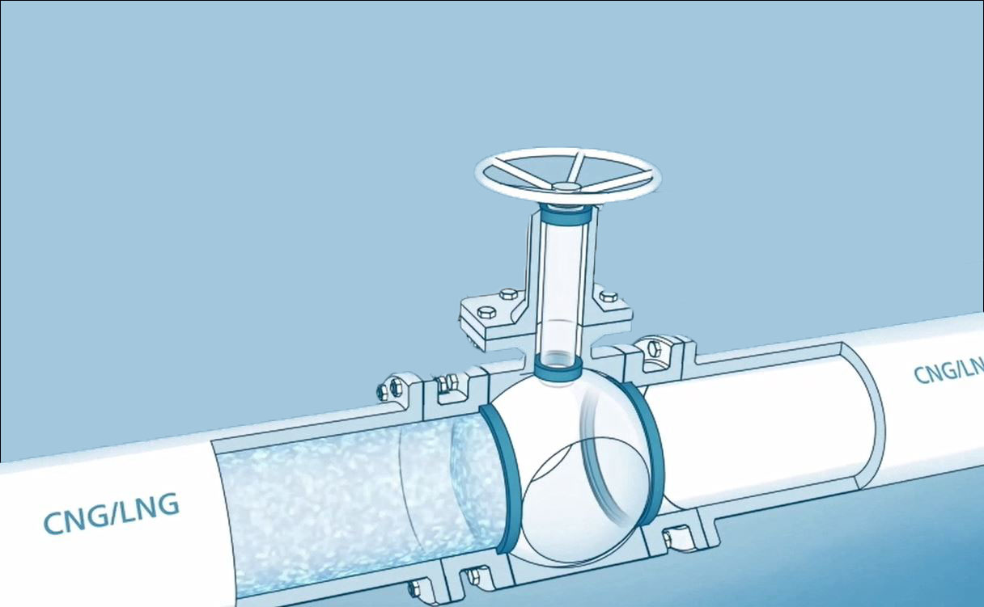
Polymer Seleaction for Cryogenic Valve Seats
PAEK polymers are normally associated with high temperature and chemically aggressive applications
The two best known polymers for cryogenic sealing are Modified Polytetrafluoroethylene (MPTFE), and Polychlorotrifluoroethene (PCTFE or PTFCE)
In the last years the growing trend of LNG and the transition to clean energy with a particular eye on H2 production and CO2 storage have led to the need of new materials that:
  Extend the range of Temperature
  Offer a more reliable sealing
  Lower the torque
  Allow cost savings

Slide 5
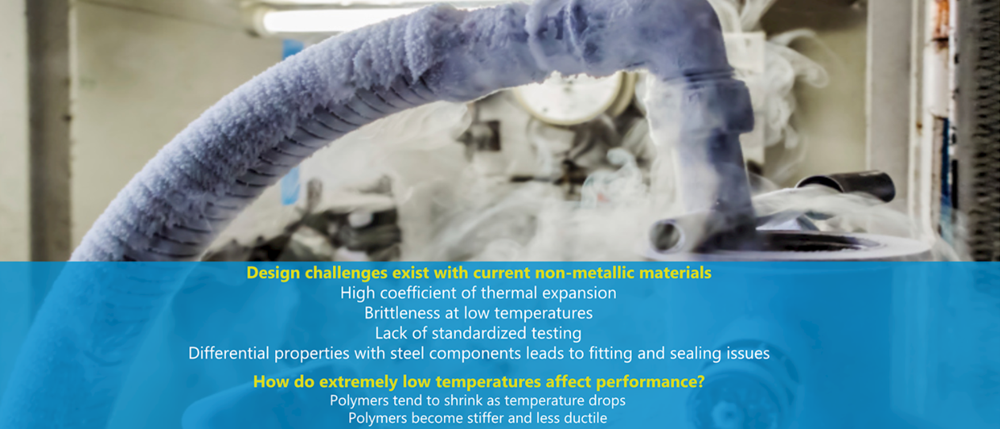
Outlining the Challenge

Slide 6
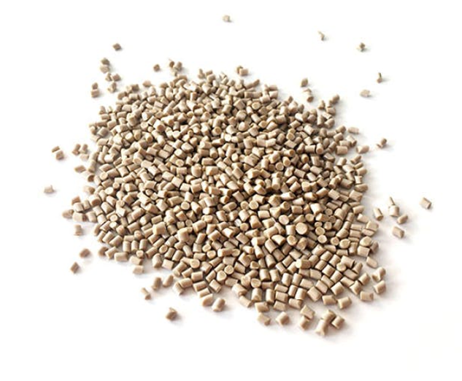
VICTREX CRYO PEEK introduction
VICTREX CT™100: Natural Cryogenic PEEK
  Color: Beige
  Forms: Pellets and powder
VICTREX CT™200: Self-Lubricated Cryogenic PEEK
  Color: Green
  Forms: Micropellets, soon Pellets

Slide 7
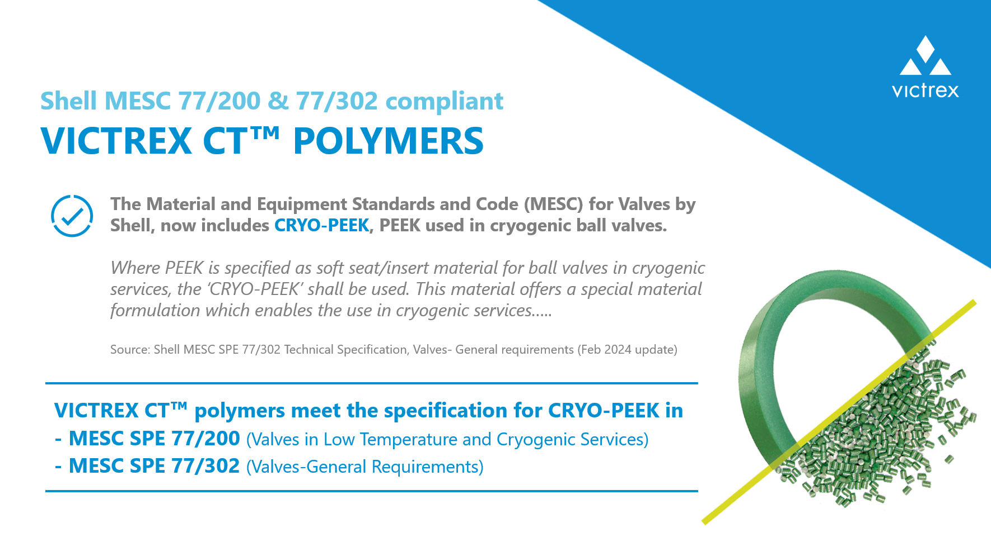
The Shell Specification

Slide 8
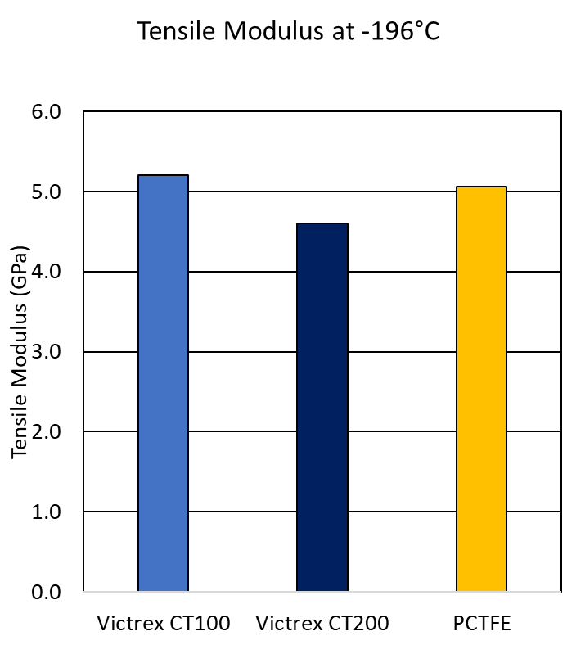
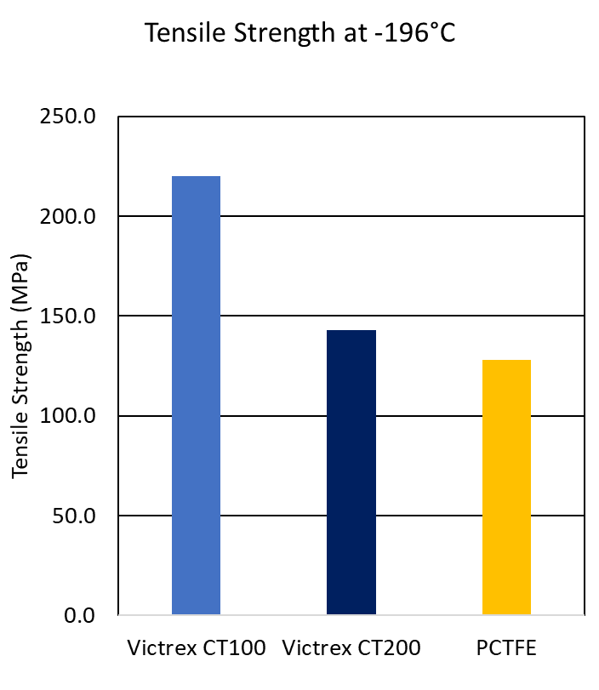
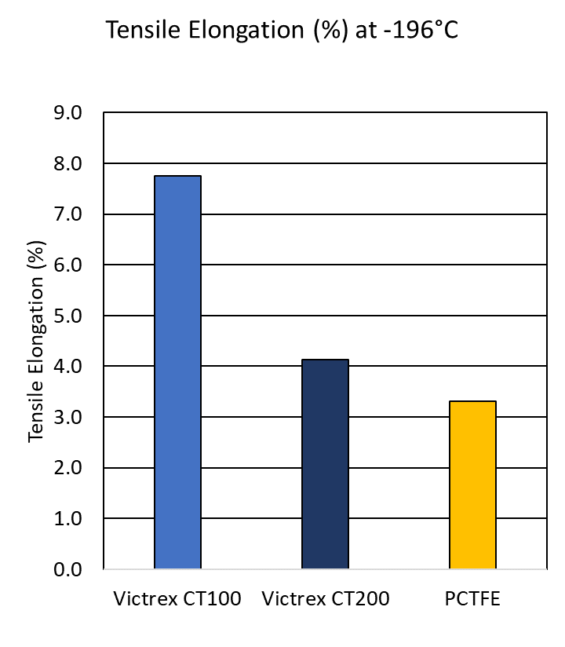
Tensile Behaviour at -196°C
VICTREX
CT™100
VICTREX
CT™200
PCTFE
VICTREX
CT™100
VICTREX
CT™200
PCTFE
VICTREX
CT™100
VICTREX
CT™200
PCTFE
Tensile moduli are similar at -196°C
VICTREX CT™ family have higher strength and elongation compared to PCTFE
Conclusion: VICTREX CT™100 and VICTREX CT™200 exhibit stronger and more ductile performance at -196°C

Slide 9
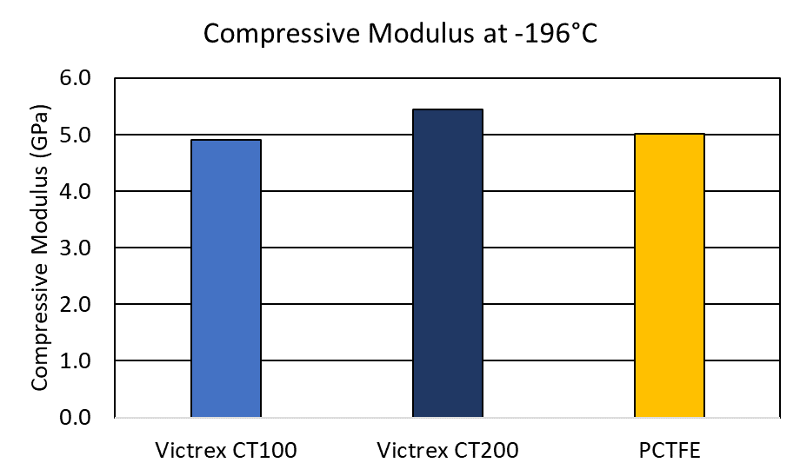
Compressive Modulus at -196°C
Modulus indicates how much a material will deform under an applied load
Compressive modulus indicates the typical sealing performance of a thermoplastic material where a lower modulus allows a greater deformation and therefore sealing capacity
VICTREX CT™100 and CT™200 have similar Compressive Moduli to PCTFE
Sealing performance is, however, a balance of properties, such as strength and tribology in addition to modulus
Victrex CT™100
Victrex CT™200

Slide 10
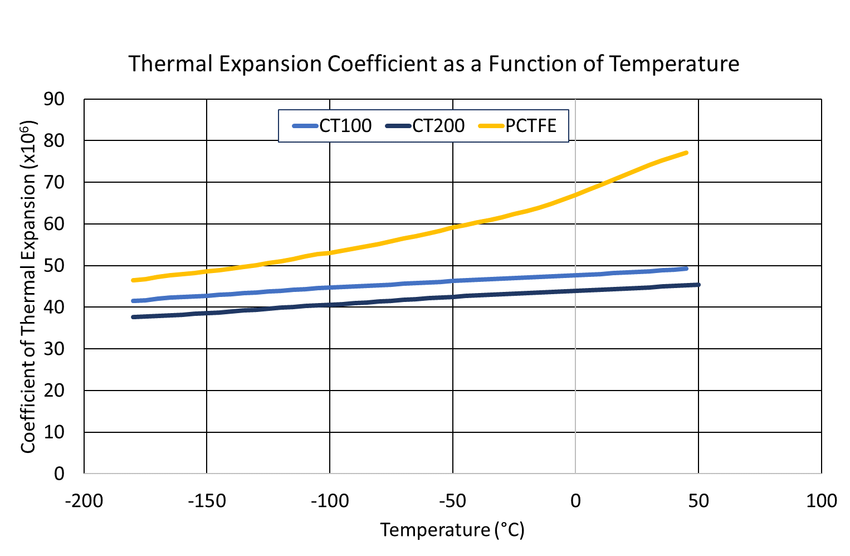
Lower and Stable Coefficient of Thermal Expansion
Coefficient of thermal expansion describes how the size and the shape of a material changes as a function of temperature
VICTREX CT™ family show a clear benefit over PCTFE and are dimensionally more stable with consistency observed over a wide range of temperature

Slide 11
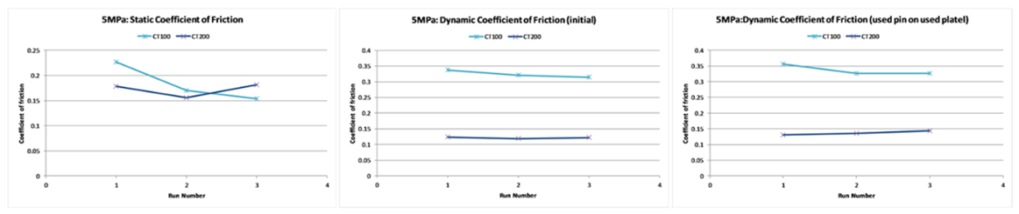
Improved Coefficient of Friction
The static coefficient is a measure of the force required to get the object moving after it’s been stationary on a surface
PCTFE Coefficient of friction = 0.35 (testing method: on steel)
VICTREX CT™ family provide low and stable static and dynamic coefficients of friction which allow lower opening force and turning force for the ball valve
VICTREX CT™200 is suggested over VICTREX CT™100 when ball valves are made of soft steel and lower friction is required

Slide 12
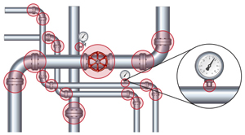
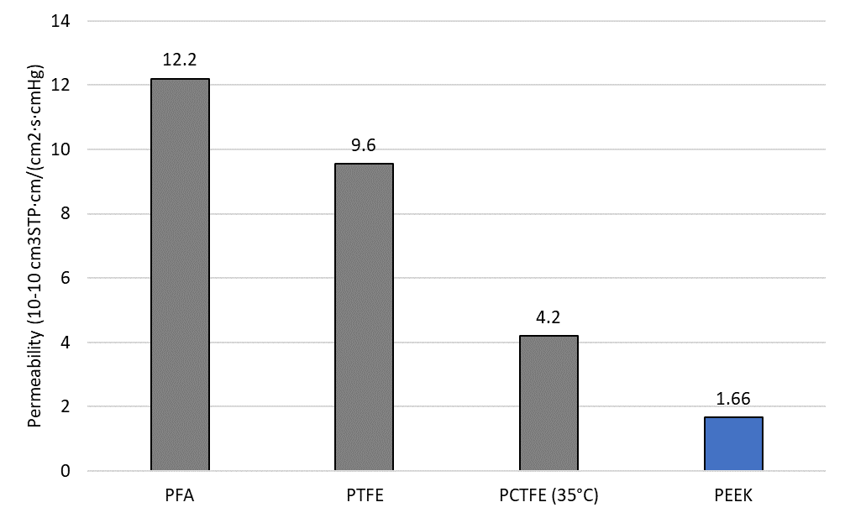
LH2 - Preliminary Summary
PEEK polymers are anticipated to exhibit
  Low Permeability: minimal loss of hydrogen across a broad range of temperatures.
  Lack of Hydrogen Embrittlement: none to minimal effects hydrogen embrittlement unlike certain metals.
  Minimal Effects of Rapid Gas Depressurization (RGD): resistance to rapid gas depressurization for many gases.
  UL 94 Classification and Flame-Retardant Thermoplastics: UL 94 ‘V0’ rating – burning stops within 10 seconds on a vertical specimen; drips of particles not inflamed.
References:
Gas Permeation Resistance of Fluoropolymers (Entegris Inc.)
Menon et. al., Proc of the ASME 2016 Pressure Vessels and Piping Conf PVP2016-63713
Yavari et.al. J Membrane Sci 548 (2018) 380-389.
Monson et. al J App Polym Sci 127 (3) 1637-1642.

Slide 13
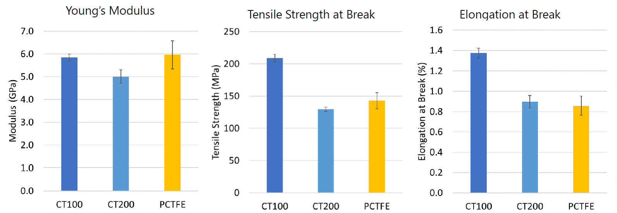
Tensile testing at -269°C
VICTREX CT™100 exhibits higher strength and elongation at similar modulus compared to PCTFE
VICTREX CT™200 exhibits slighlty lower modulus and comparable strength and elongation with PCTFE
VICTREX CT™ Polymers exhibit better sealing capabilities than PCTFE

Slide 14


Testing program in LHe
Stage 1: Mechanical properties
    Tensile testing at 4K in Helium vs PCTFE
    Compressive testing at 4K in Helium vs PCTFE, PI, other PEEK
Stage 2: Thermal properties
    Coefficient of thermal expansion
    Thermal conductivity
Stage 3: Tribological properties
    Static and dynamic coefficient of friction (COF)
    Wear performance

Slide 15
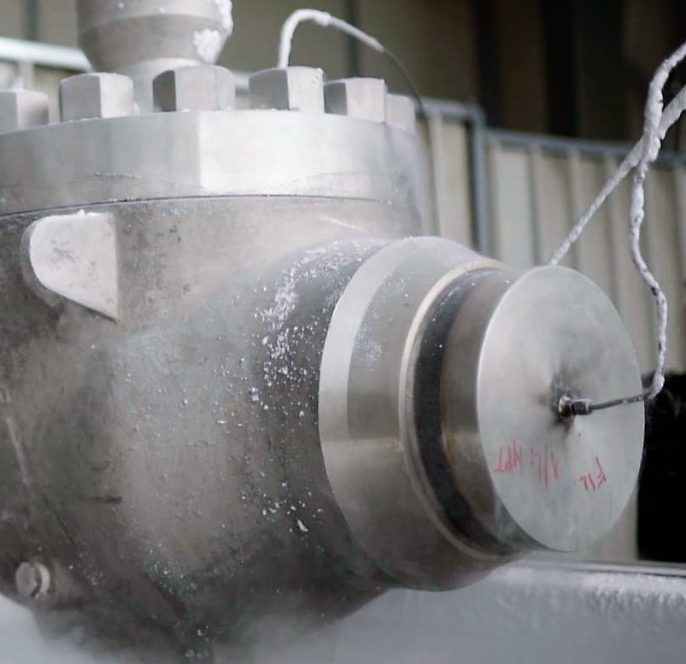
Valve testing
Completed testing campaign for 6+ years
Comparison tests: PCTFE vs VICTREX CT™ Polymers
FBV & TMBV
Up to 48 inches
Up to Class 1500
From -196°C to +150°C
Partnership with Valve Manufacturers to build trust and confidence on VICTREX CT™ Polymers and create a testing reference list

Slide 16
Grade comparison
VICTREX CT™ 100 GRA
VICTREX CT™ 200 MIC
For Dynamic Seals
Incrementally better thermal properties than CT100
Lower coefficient of thermal expansion (CTE) and higher thermal conductivity
Lower static and dynamic coefficient of friction which allows for lower torque
Suggested over CT100 when ball valves are made of softer steel
Form: Micropellets for injection or compression molding
For Static Seals
Improved Ductility at -196°C → higher tensile
elongation and slightly lower compressive modulus
Victrex CT™ 100 is tougher than Victrex CT™ 200 at lower temperatures.
Forms:
  Pellets for injection molding
  Powder for compression molding

Slide 17
Key Takeaways
VICTREX CT™ polymers demonstrate superior performance in cryo-temperature applications on key metrics, when compared to incumbent materials. Optimised grades available for static and dynamic situations.
Use of PAEK materials across cryo-temperature scenarios, including valves and seals, is backed by over 6 years of testing and expertise.
Customers can use VICTREX granted and pending patents¹ with purchased material, enabling you to leverage VICTREX technology and innovation for your Cryo-PEEK applications.
Shell MESC 77/200 & 77/302 compliant
Please contact me to explore how we can assist you further
1. Including EP3274394, EP3873988, PCT/GB2023/052226, PCT/GB2023/052227 patent families

Slide 18
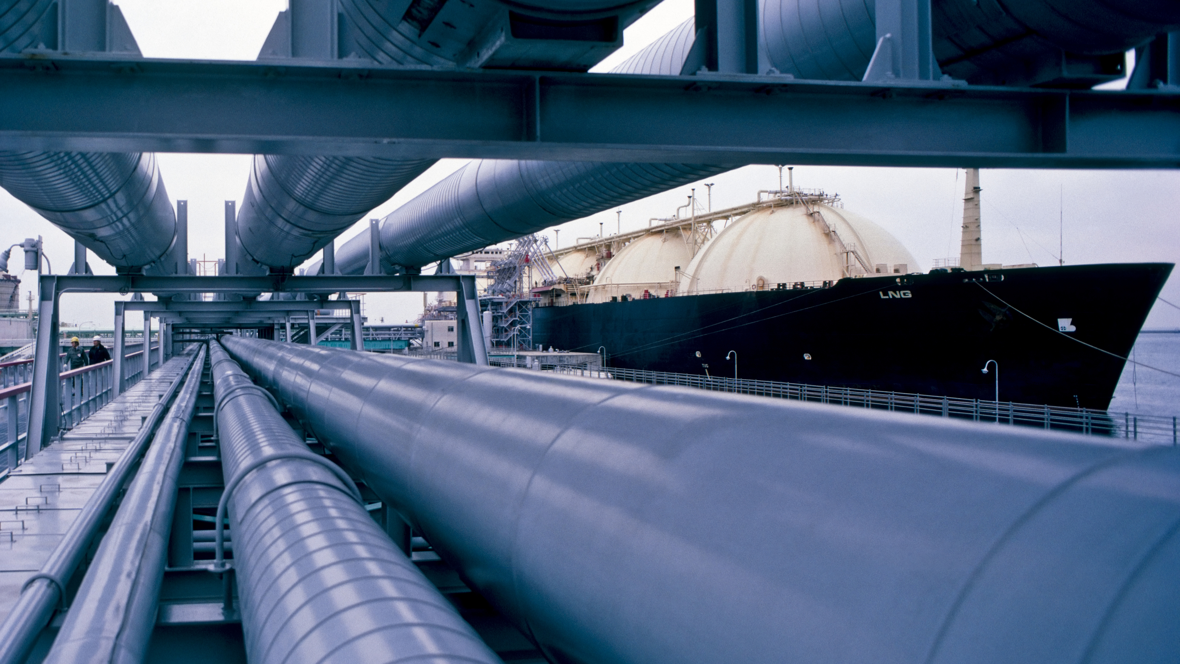


Christian Salvatori – Business Development Manager EMEA
Mobile: +39 331 658 3200
christian.salvatori@victrex.com
www.victrex.com
ORGANIZERS
CONFERENCE ORGANIZERS

Slide 19
Thank You
ORGANIZING SECRETARIAT
Ph. +39 035 3230904
e-mail info@industrialvalvesummit.com
CONFERENCE ORGANIZERS
Ph. +39 3474908420
e-mail segreteria@valvecampus.com
www.industrialvalvesummit.com
www.valvecampus.com

