Slide 1
Numerical investigation on the performance of safety relief valves
CONFERENCE
ORGANIZERS

Slide 2
Numerical investigation on the performance of safety relief valves
Nicoletta Franchina | Researcher - UniBG

Slide 3
SRV: direct loaded SRV
Gases/Fluids characterized by different thermo-ﬂuid-dynamic properties
SRVs may operate with both compressible and incompressible flows, e.g. in shell-type water-gas heat exchangers
→ Proper valve trim
→ Satisfactory functional characteristics
High resolution CFD computations.
SRV operating under varying conditions and using different gases/fluids.
Exhaust mass flow rate must be ensured – Reliable prediction of the discharge coefficient.

Slide 4
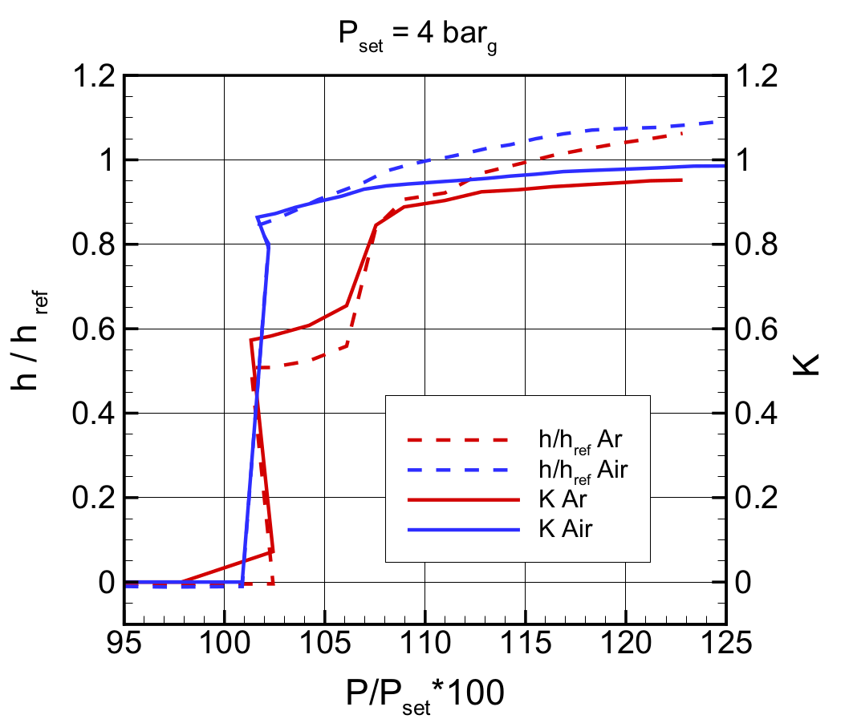
Orifice D SRV with air, argon and ethylene
CE-ISO, ASME, ASME PTC25, ISO4126:1 require lab testing to evaluate disc lift and discharge coefficient (%Pset)
Standard procedure: assume the functional and ﬂowing safety valve characteristics as independent of the gas
Petrochemical applications: thermo and fluid-dynamic properties of actual exhausted gas are very different from tests
Topic of investigation:
Flowing characteristic as a function of the flow compressibility
- Discharge
coefficient K
- Actual lift
- Relevant flow
phenomena
Standard procedure: lab tests using air
(not feasible with certain gases/sizes)
Argon & Air exp tests: orifice D 1/2”x1” relative Pset of 4 barg

Slide 5
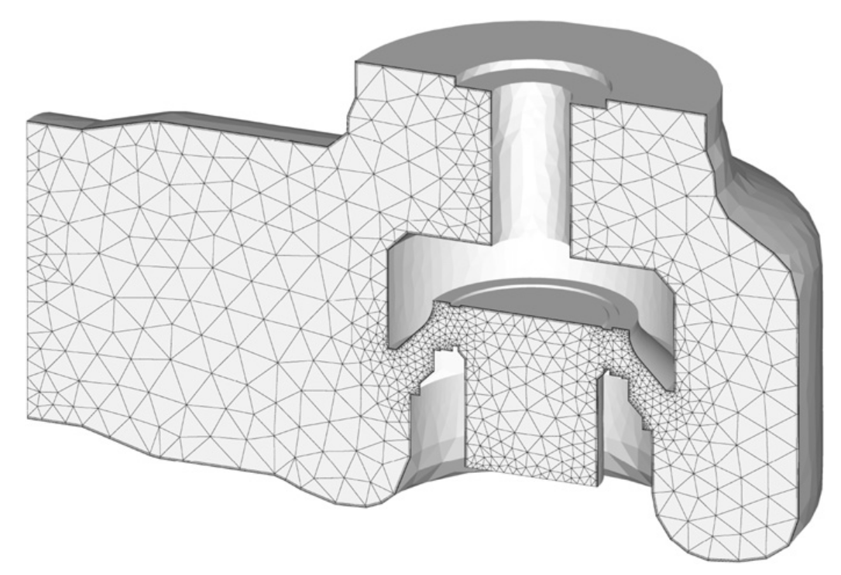
Hi-resolution CFD: high-order DG
Finite element discretization
Discontinuous functional discretization
Proper numerical fluxes must be used at interfaces
Discretization: RANS, realizable k-ω model by Menter; “exact” Godunov-type solution of the Riemann problem & BRMPS; local shock-capturing
PROs: Great flexibility and accuracy; compact num schemes
CONs: Increase in the number of DOFs; high CPU cost
SRV results presented: (k+1)-order accurate solutions (converged up to a L² norm of residuals lower than 10_x0003_⁻⁵).
Computational grid: 315k elements [half domain]
Standard procedure: lab tests using air
(not feasible with certain gases/sizes)
Reynolds number (based on the total upstream conditions and oriﬁce radius) approx 4 10⁶ for both air and argon almost twice this value for ethylene.

Slide 6
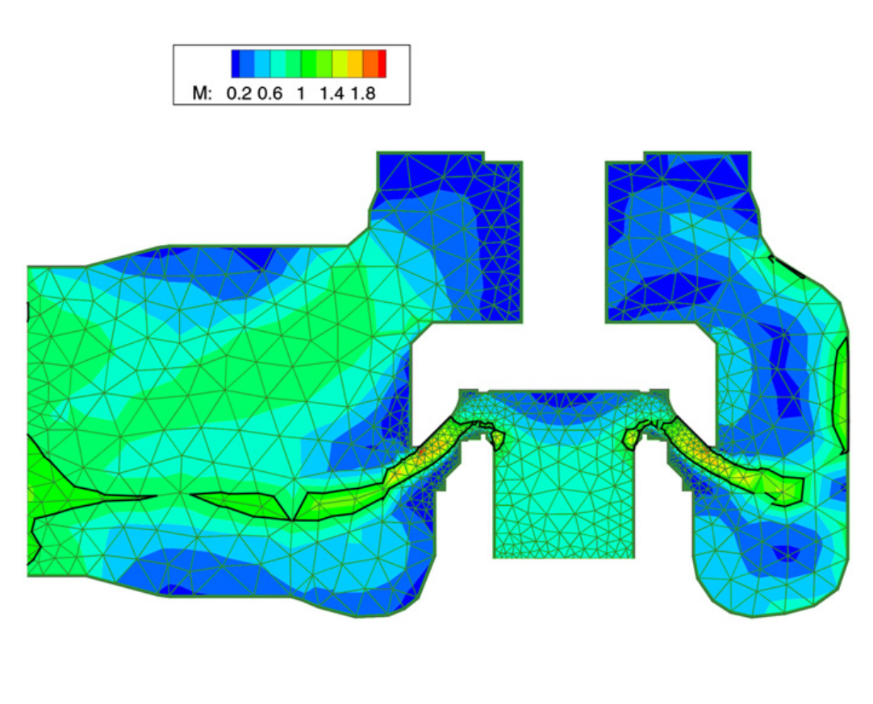
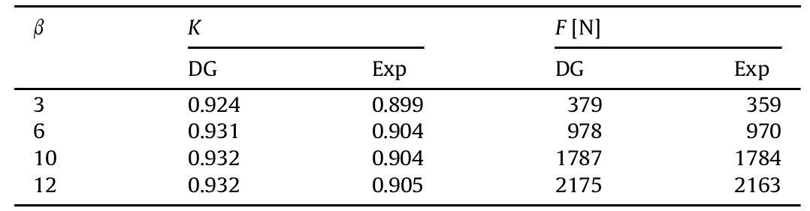
Hi-resolution CFD: high-order DG
Validation: air
Computations: at nominal disc lift, four overall pressure ratios 3,6,10,12 barg
→ from choked throat condition to nearly sonic outlet
ﬂange, for the selected gases
→ Net force acting on the valve stem: well predicted
→ Discharge coefficient: exp trend reproduced though somewhat overestimated
Mach contours at sym plane - P=10barg

Slide 7
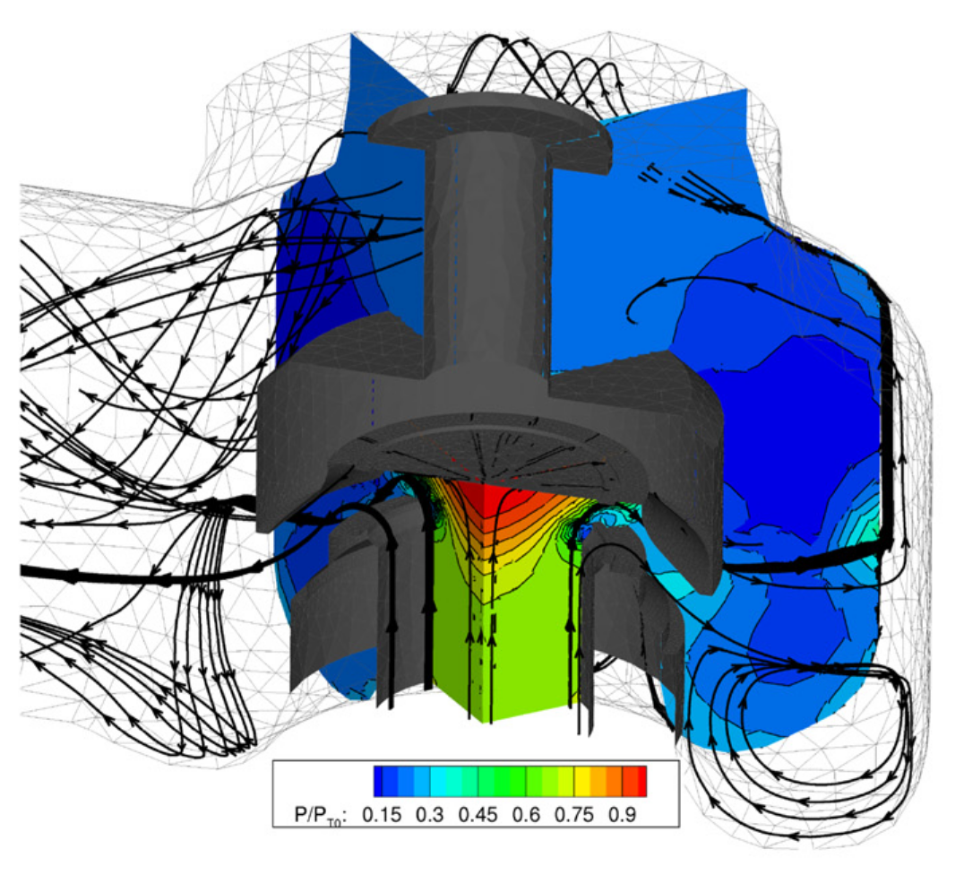
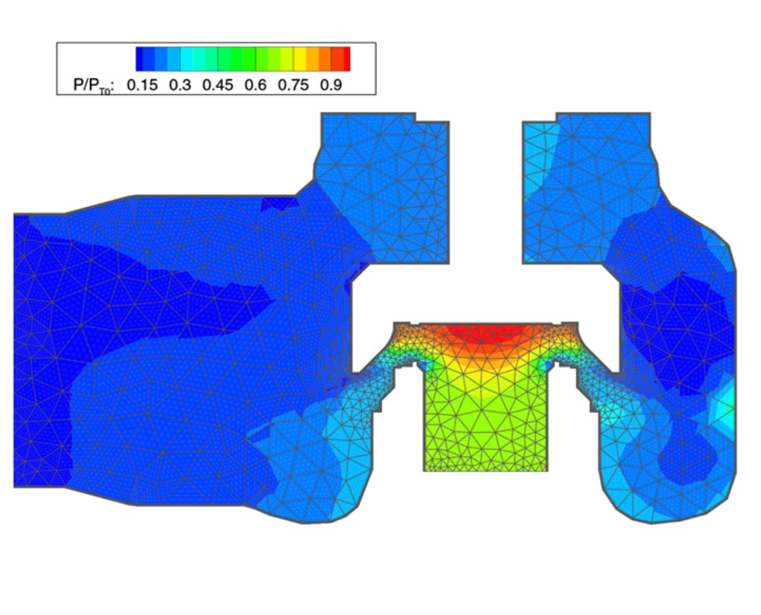
Hi-resolution CFD: high-order DG
Validation: air
→ Complex pattern of shocks and expansion waves takes place inside the body
→ Evolution of streamlines originated at the valve oriﬁce
Total P contours at sym plane - P=10barg

Slide 8
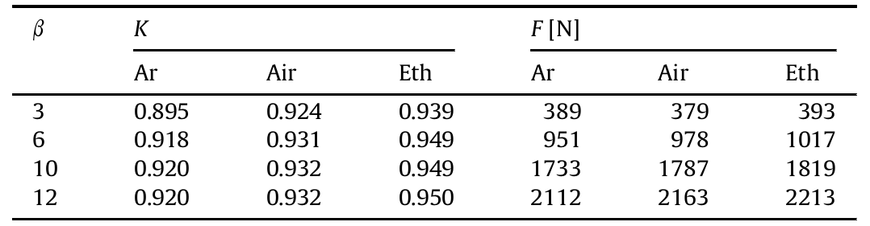
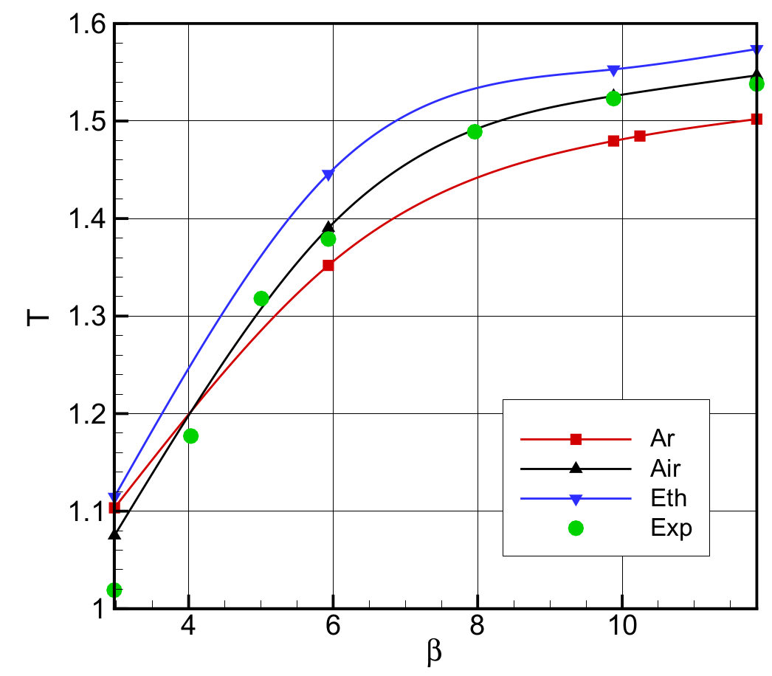
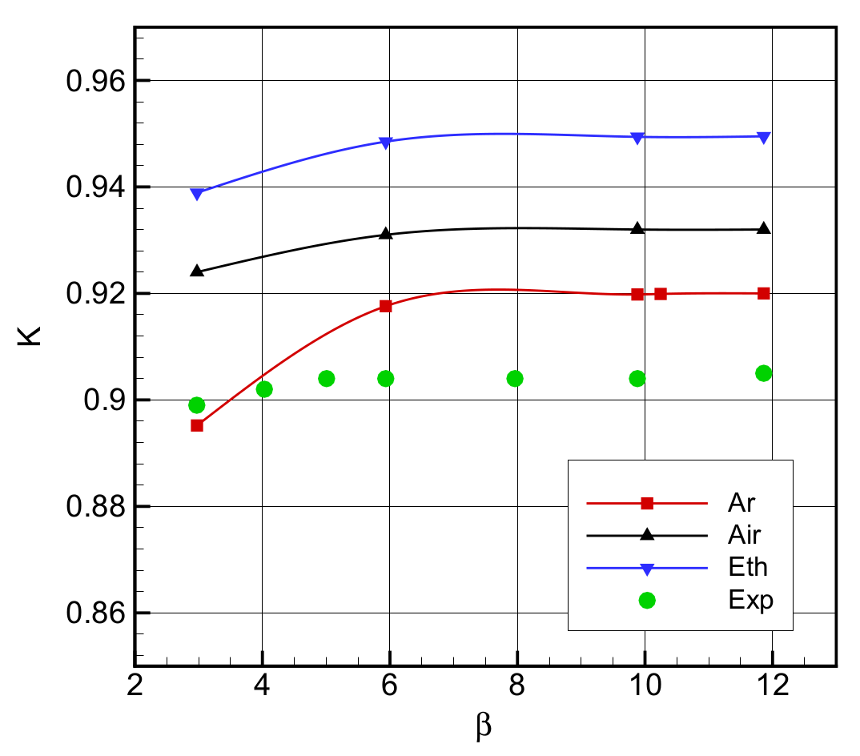
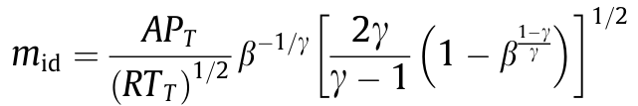
Hi-resolution CFD
Air, Ar, C2H4
→ Increasing the speciﬁc heat ratio: both thrust exerted on the spring and K coefﬁcient decrease
→ Consistent with the outcomes of the Ar exp
K ratio of actual to ideal mass flow rate:
Thrust acting on the bonnet rear part
Discharge coefficient K

Slide 9
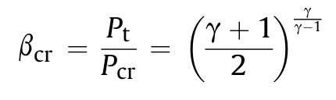
Hi-resolution CFD
Air, Ar, C2H4
γ=1.255
The critical pressure ratio is greater at higher gamma →At Pt fixed, the static pressure near and before the sonic line is lower thereby reducing the upward thrust on the disc.
Between valve inner volume and exhaust:
Backpressure on the rear of the moving device is also expected to increase with gamma (as it occurs at flange exit)
→ Again lower net opening force
γ=1.667
Thrust acting on the bonnet rear part
Thrust acting on the bonnet rear part

Slide 10
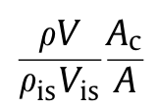
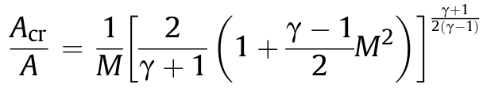
Hi-resolution CFD
Air, Ar, C2H4
γ=1.255
Discharge coefficient: as
composed by the product of
a viscous coefﬁcient and a
geometrical one
→ Compressibility inﬂuences the formation of the vena contracta
→ Increased minimum area at ﬂow disposal in the higher subsonic regimes.
Effect more relevant @ low gamma
γ=1.667
Discharge coefficient

Slide 11
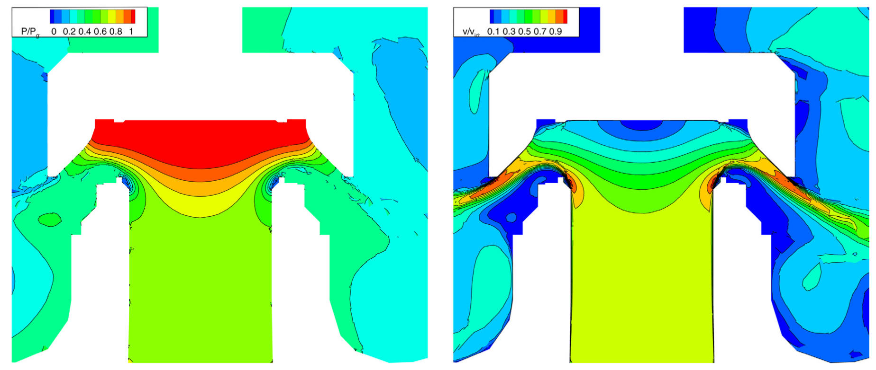
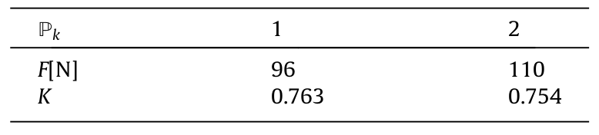
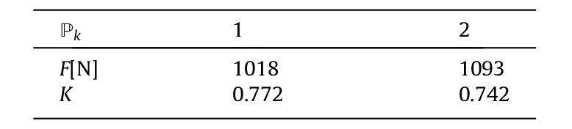
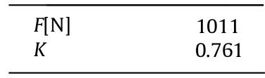
Hi-resolution CFD: high-order DG
Water 2”J 3”according to API 526) designed for steam–water double protection
DG SRV in water (beta=1.5)
DG SRV in water (beta=5.9)
Exp (beta=5.9)
Pressure and velocity contours at sym plane – P=5.89barg - Nominal lift

Slide 12
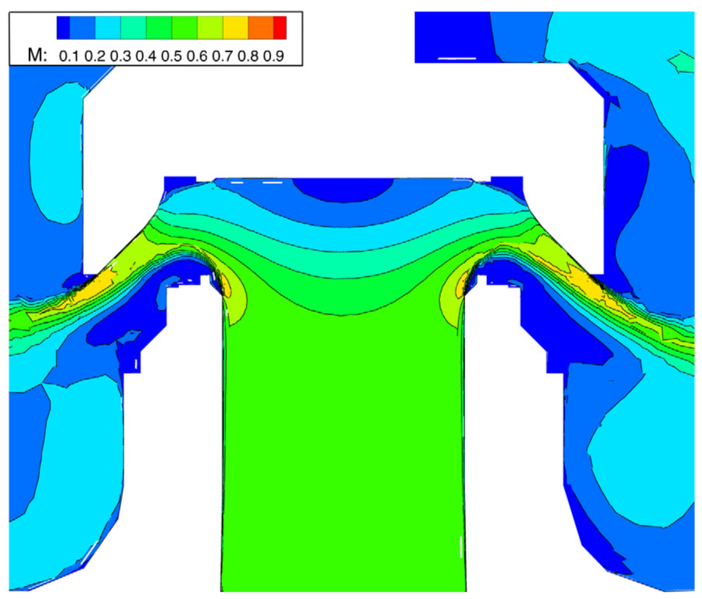
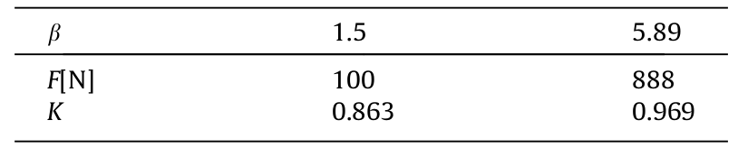
Hi-resolution CFD: high-order DG
Air 2”J 3”according to API 526) designed for steam–water double protection
Discharge coefficient:
Higher in air
(even in subsonic condition)
→positive compressibility effects
→viscous losses only up to sonic throat
DG SRV in water (beta=1.5)
SRV in air (beta=1.5,5.89)
K air > K water
Air: Mach contours at sym plane – P=1.5barg Nominal lift

Slide 13
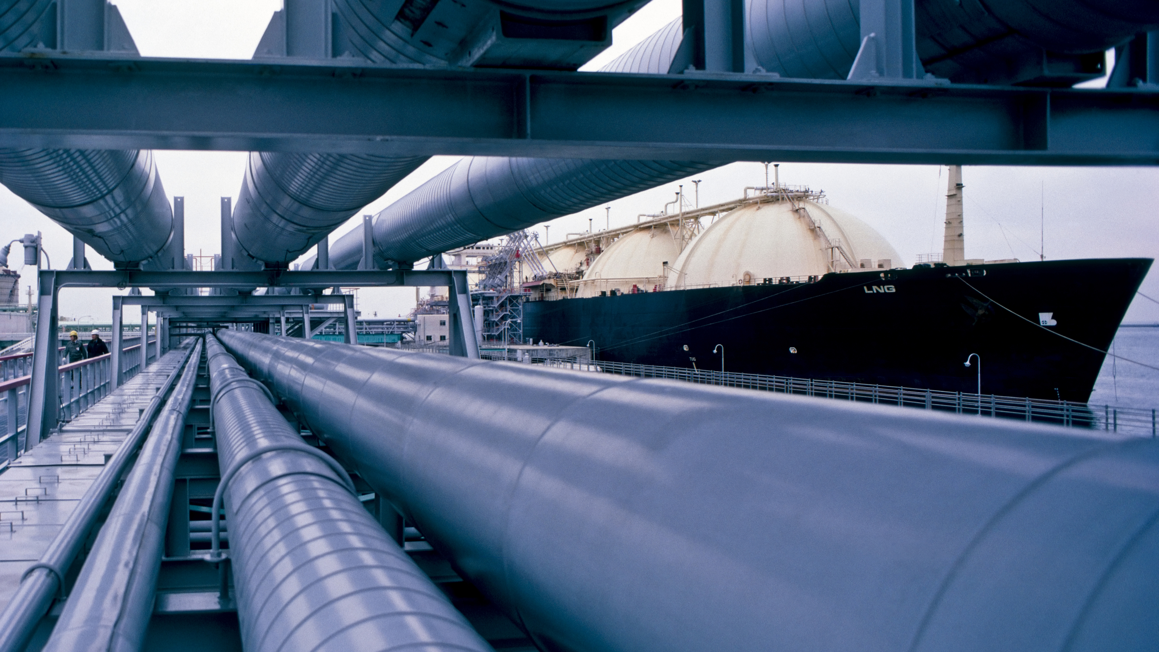


When dealing with gases with γ higher than air:
* At the same overpressure the disc lift is reduced due to a decrease of the opening force acting on the disc
* The discharge coefﬁcient is lower than expected due to a less favorable compressibility effect on the vena contracta
Final Remarks 1
ORGANIZERS
CONFERENCE ORGANIZERS

Slide 14
When dealing with gases with lower γ (e.g. steam), both thrust and discharge coefﬁcient are expected to be higher than in air, with no risk in principle for the protected device.
Nevertheless, the general increase in thrust can strongly inﬂuence the reclosing pressure implying a higher blowdown rate that might be balanced by a proper adjustment of the setting ring.
Final Remarks 2
ORGANIZERS
CONFERENCE ORGANIZERS

Slide 15
Discharge coefficient reduction
Reduced disc lift due to decreasing opening force
Less favorable compressibility effects
4%
2.3%
5.1%
g4%
2.3%
ORGANIZERS
CONFERENCE ORGANIZERS

Slide 16
Thanks
ORGANIZING SECRETARIAT
Ph. +39 035 3230904
e-mail info@industrialvalvesummit.com
CONFERENCE ORGANIZERS
Ph. +39 3474908420
e-mail segreteria@valvecampus.com
www.industrialvalvesummit.com
www.valvecampus.com

