Slide 1
Retrofitting of a Valve using Additive Manufacturing for Improved Sustainability
CONFERENCE
ORGANIZERS

Slide 2
Retrofitting of a Valve using Additive Manufacturing for Improved Sustainability
Gianluca Acquistapace | AM Manager, Valland S.p.A
Trine Boyer | Principal R&D Engineer, Var Energi ASA

Slide 3
Similar issues amongst all operators have been identified, and a joint effort is required to find and implement a solution for the future
Suppliers no longer support an increasing number of components requiring replacement
Increasing
Obsolete Parts
Excessive
CO2 Emissions
Wasteful manufacturing and global transportation significantly contribute to increased CO2 emissions
Unused
Inventory
Long
Lead Time
Complex supply chains and traditional manufacturing extend lead times significantly
Large portion of inventory never get used; High costs due to storage and tied-up capital

Slide 4
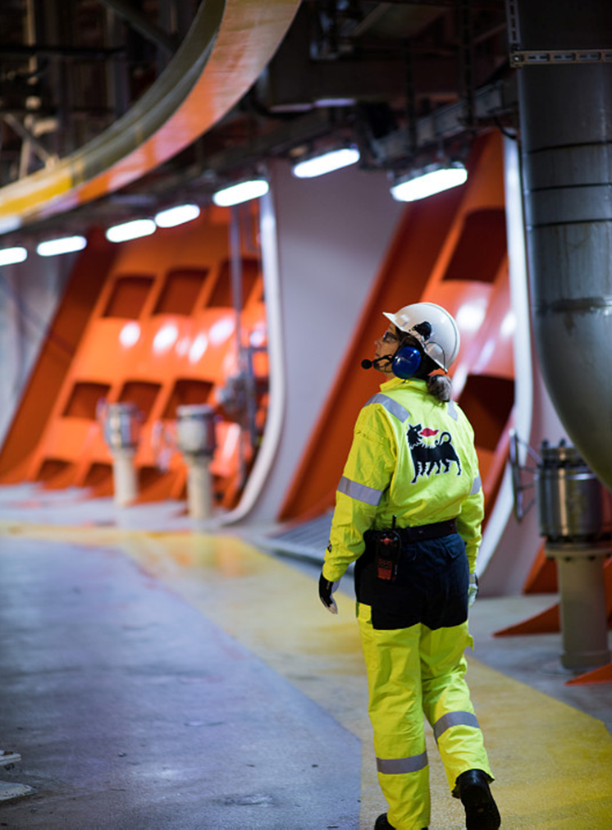
On-demand manufacturing is the critical piece required to solve the inefficiencies of Today
Shorter lead time
Reduced Inventory
Advanced manufacturing methods and digital platforms streamline processes
Made to order parts reduces the requirements for having parts on-hand
Replacement of obsolete parts
Lower CO2 emissions
3D files can be created for obsolete parts to ensure availability in perpetuity
High precision and energy-efficient processes only use the material needed
Optimized design
Increased local value creation
Ability to customize parts for specific requirements and material choices
Localized networks reduce long-distance shipping and boost the workforce

Slide 5
The AM Supply Chain: 2 different paths
OEM – Centric Approach
On-Demand Manufacturing
Suitable for new parts
Pros:
OEM takes care of product certification
High Volumes
Short Lead Time (Just need to print and test!)
Lower cost-per-part
Parts are Designed for AM (lower process complexity)
Cons:
Lower Flexibility
Suitable for spare parts, refurbishment, one-of-a-kind, …
Pros:
High flexibility
On-demand production (no warehouse)
On-site manufacturing
Much shorter LT (traditional manufacturing)
High flexibility
Cons:
Higher process complexity
Higher Lead time (design, certification, printing, testing)
Higher cost (a lot of work for a single component)
Spare parts are not Designed for AM
Long and difficult certification process

Slide 6
Valland and Vår Energi’s partnership highlights the Operator-Supplier synergies and forges stronger results
1
2
3
4
5
6
7
Valve Sent
for Repair
Obsolete Part Identified
Scanned & Re-Engineered
3D Printed with Recycled Powder
Part Machined
Cage and Process Qualified & Tested
Install Valve & Upload to Digital Inventory

Slide 7
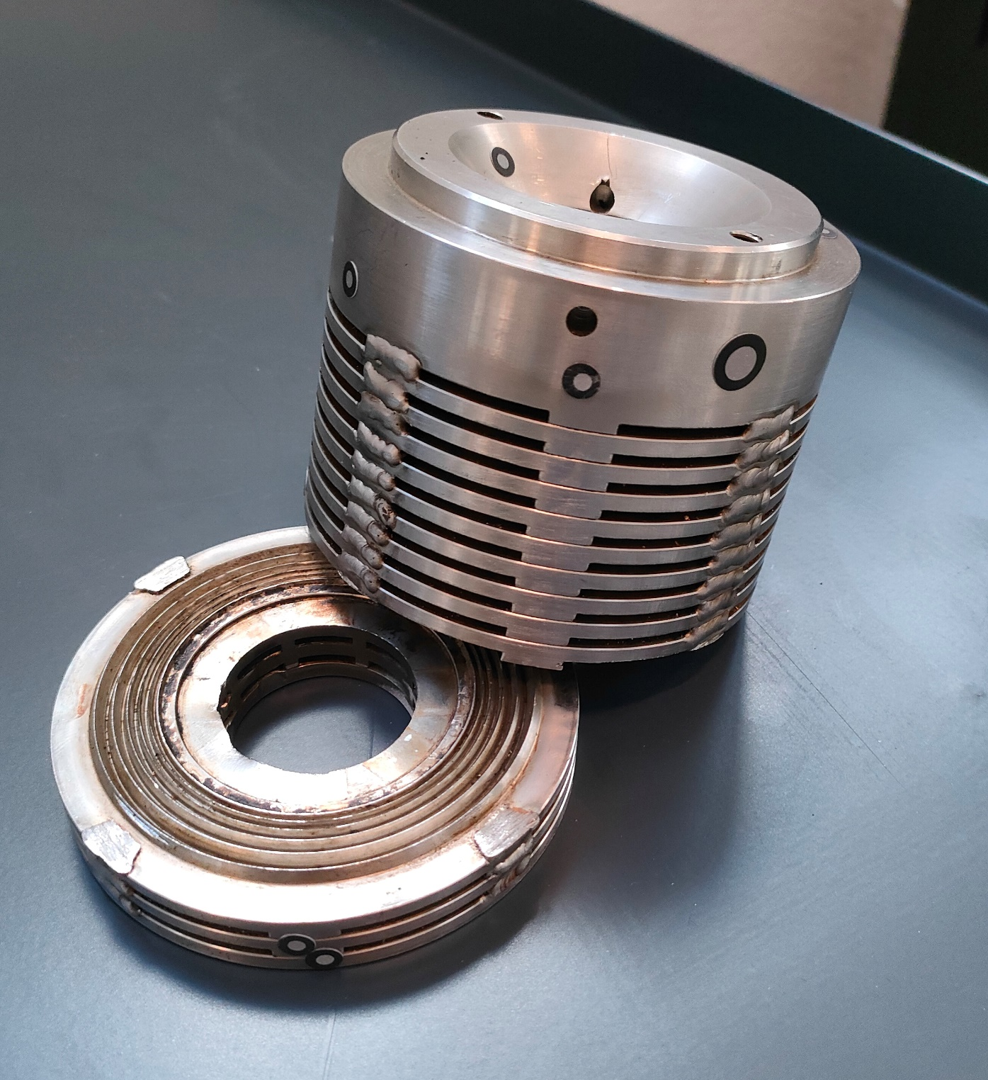
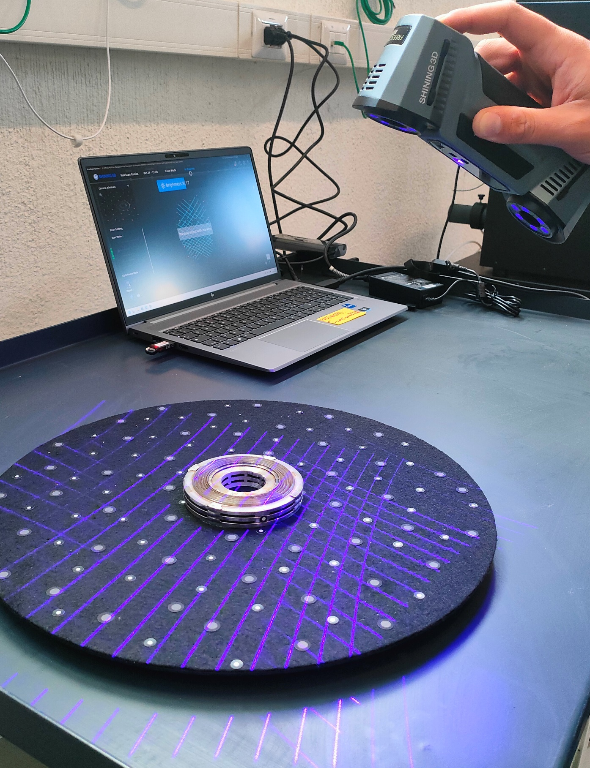
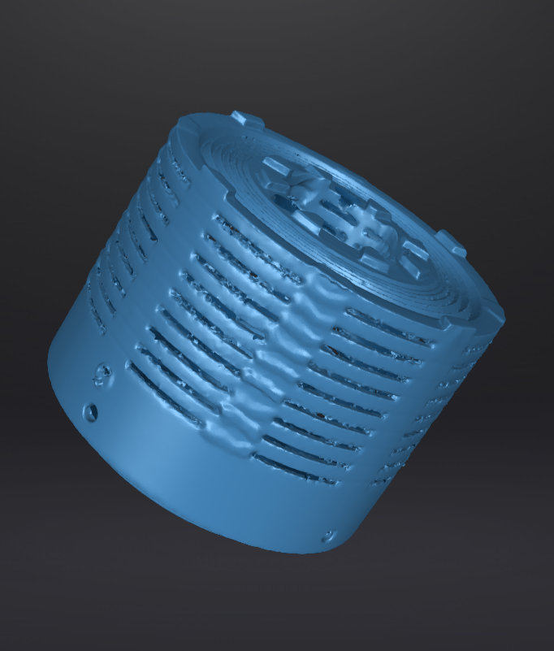
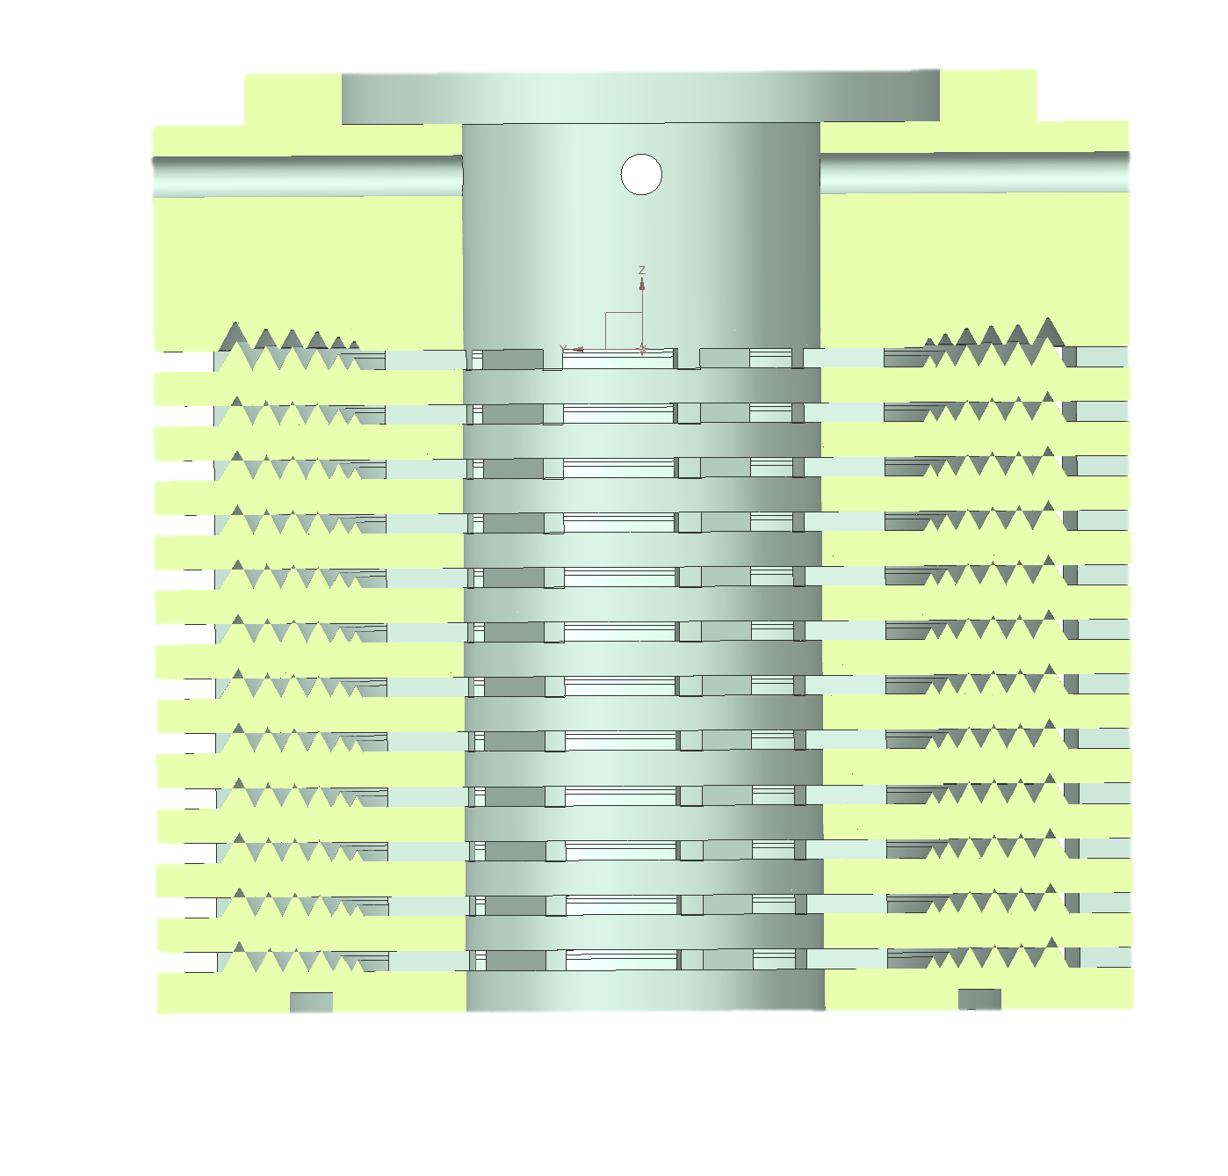
Re-design and reverse engineering
Original broken part
3D Scanning
STL generation
Final CAD file of the original part
Output of Reverse Engineering

Slide 8
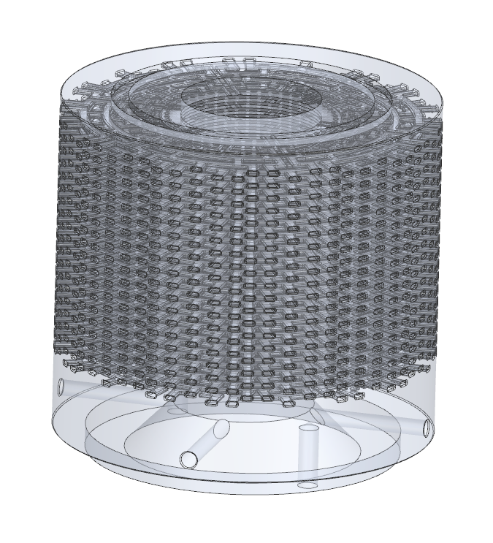
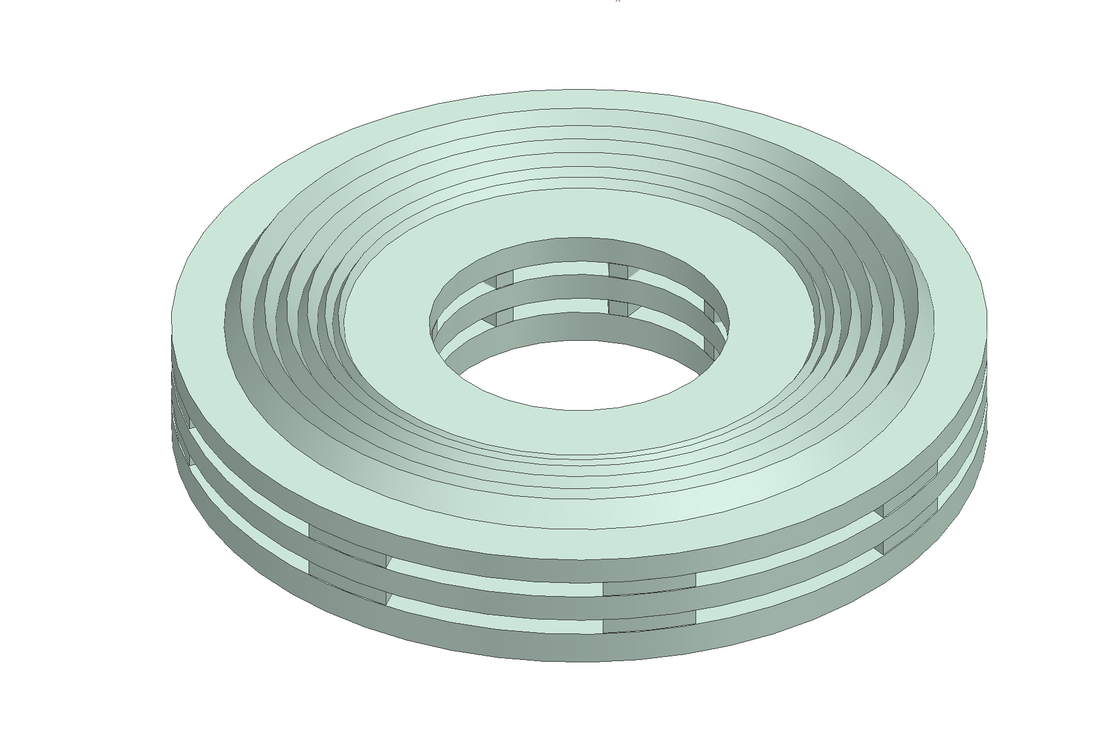
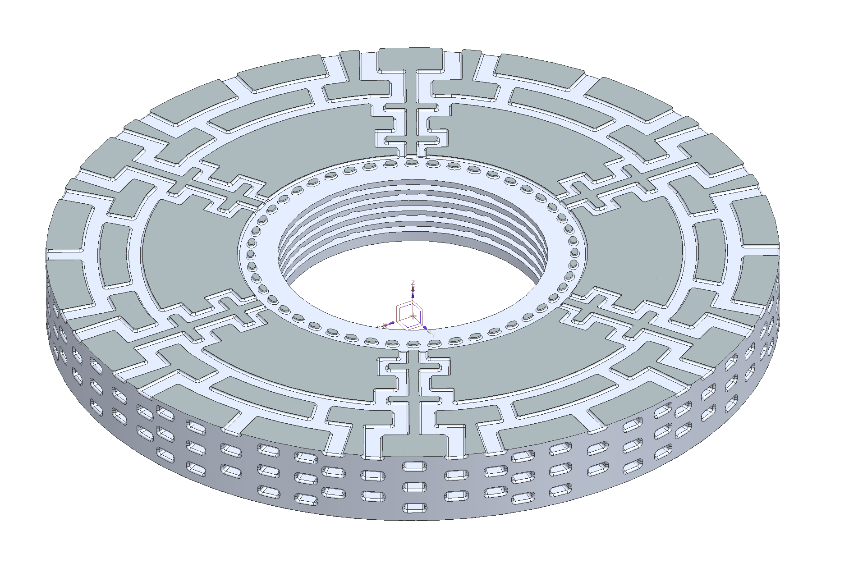
Standard VS AM: Valve Flow Coefficient (CV)
Design Optimization
Technical Details
Material: Stainless steel 316L
Pressure class 600#
Type: Tiger-tooth (6-teeth)
Fluid: Gas (molecular weight 19.5)
Max CV: 12
Description
Description
Description

Slide 9
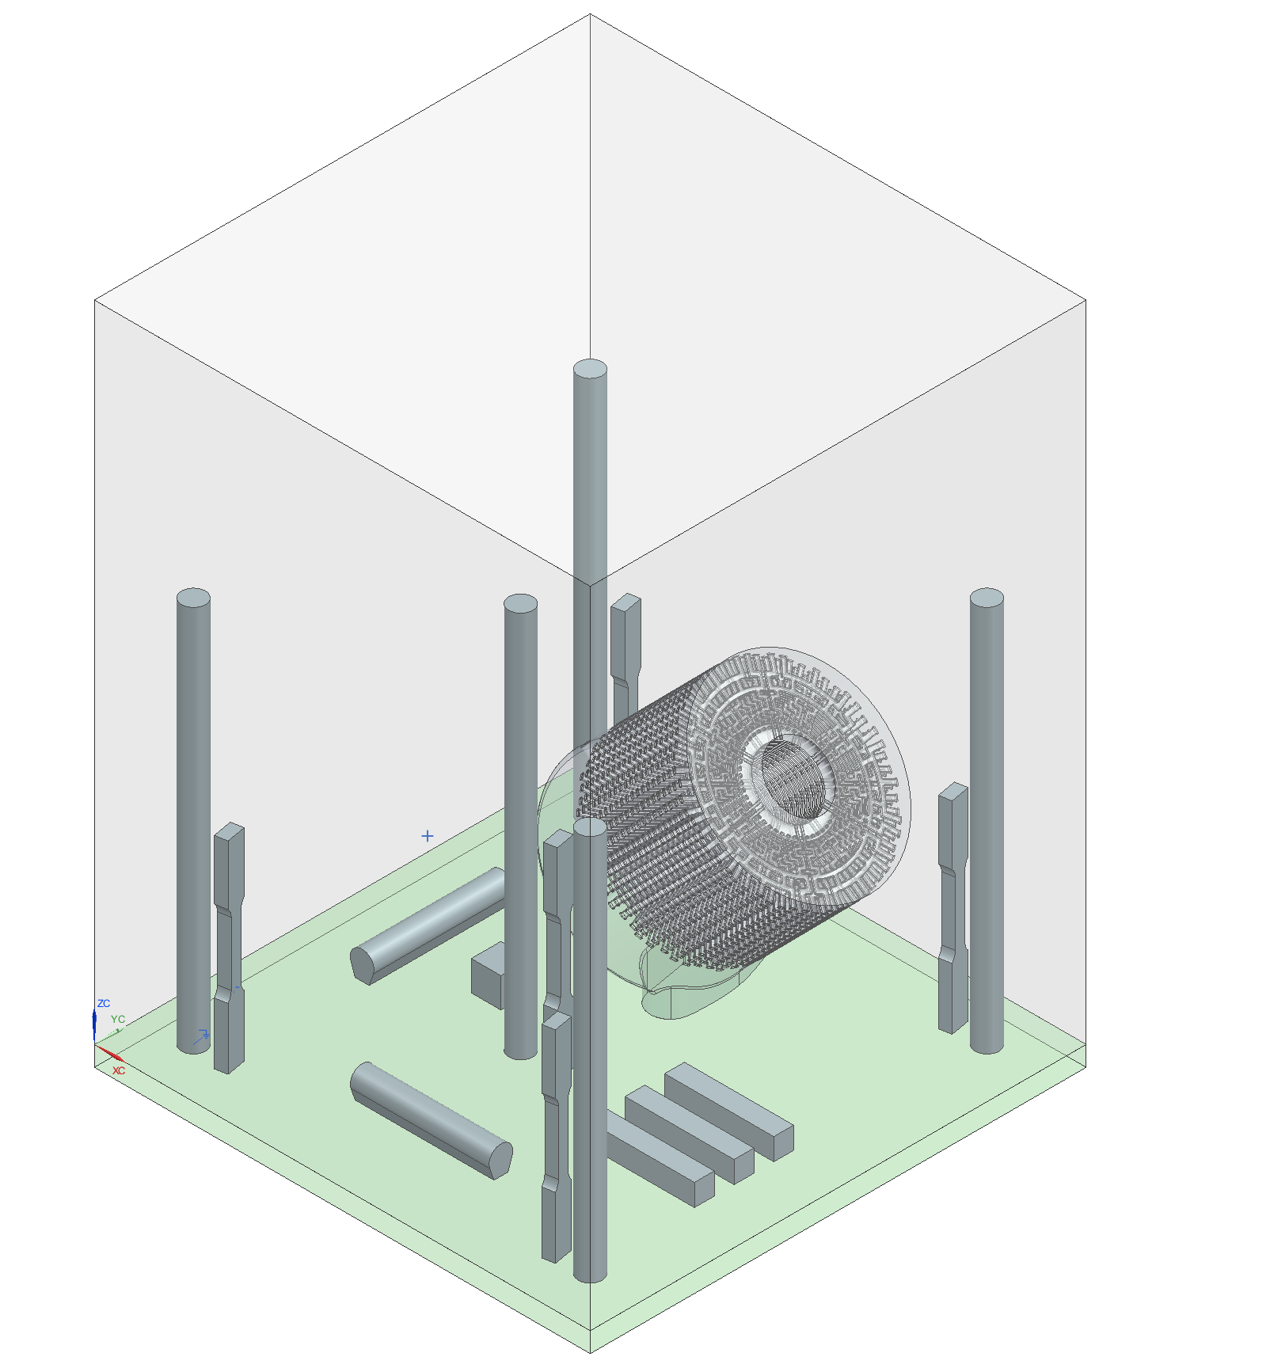
Printing of AM labyrinth cage
Design Optimization
Technical Details
Printing:
Printer: AMCM M290-1kW
Gas type: Argon 5.0
Process parameters: Valland_316L_80$μm$
Exposure time: 24 h
Total printing time: $≈$29 h
Specimens:
Tensile
Thin-walled
Charpy
Cube (Hardness, micrography, density)
Description

Slide 10
The cage pilot demonstrates the significant advantages of additive manufacturing such as reduced lead time, cost savings, and design optimization
Reduced Leadtime
Cost Savings
Other Benefit
59 days
56%
Single Piece Design
New: 25 vs. Old: 84
Energy Consumption
CO2 Emissions
-31%
-40%
Reduction
Reduction

Slide 11
Raw material
Disassembly
Collaboration is the key to realizing the benefits of
Additive Manufacturing and Circular Economy
Production
Operation and
maintenance

Slide 12
Thanks
ORGANIZING SECRETARIAT
Ph. +39 035 3230904
e-mail info@industrialvalvesummit.com
CONFERENCE ORGANIZERS
Ph. +39 3474908420
e-mail segreteria@valvecampus.com
www.industrialvalvesummit.com
www.valvecampus.com

