Slide 1
AI in BoM/RFQ Process
CONFERENCE
ORGANIZERS

Slide 2
AI in BoM/RFQ Process
Marty Dytrych

Slide 3
AI in BoM/RFQ Process
Marty Dytrych
marty@industrialdatalabs.com

Slide 4
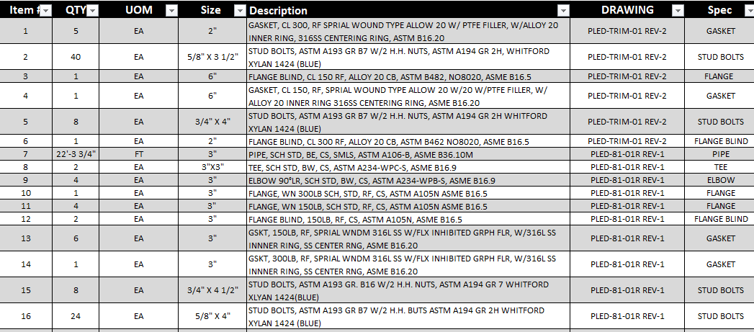
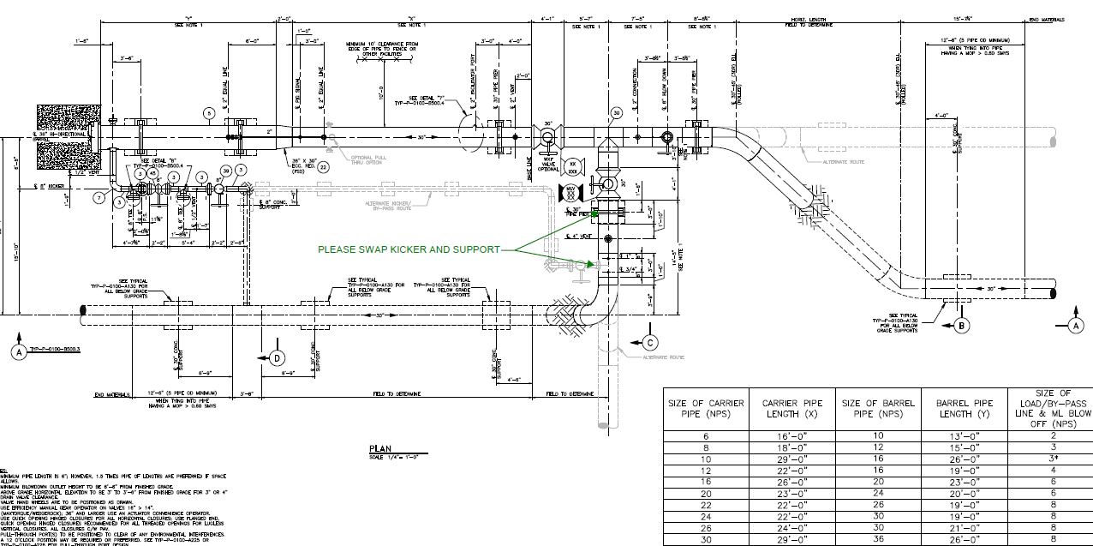
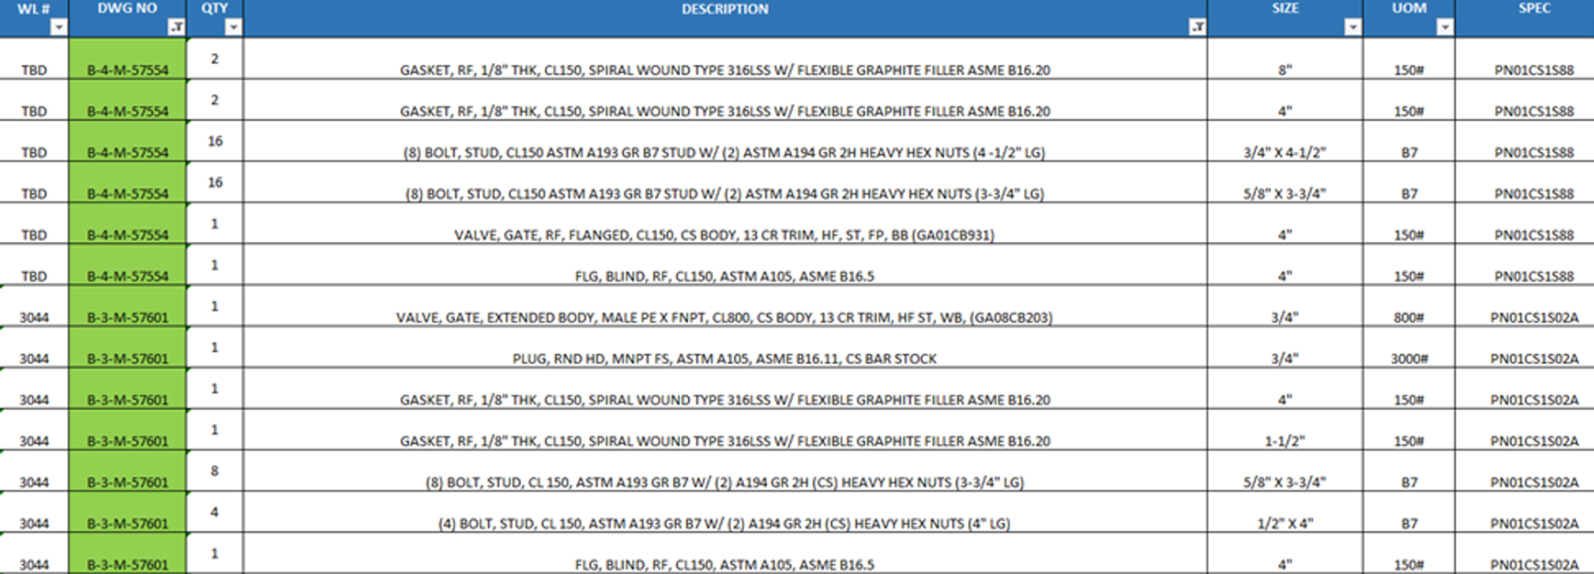
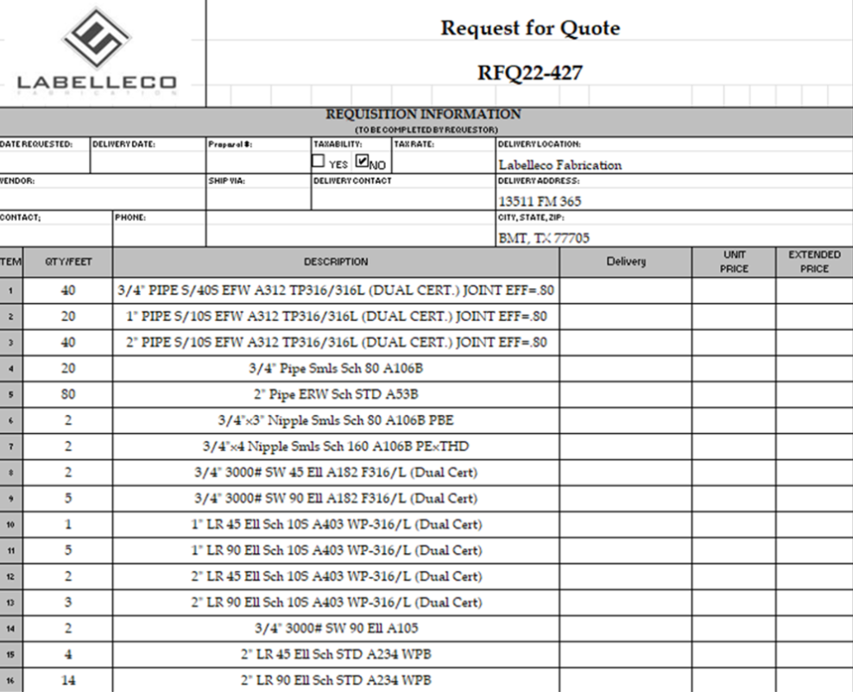
Common Problems with BOMs:
- Time consuming manual data entry
- Inconsistent RFQ formats
- Complex product descriptions
- Line-item by line-item pricing
- Managing customer deadlines &
- Limited market visibility…
wreak havoc on KPIs!

Slide 5
What if an industry-specific
model was put into production…

Slide 6
Common Description within BOMs:
Valve - Check, Carbon Steel Per ASTM A105, ASME Class 150, Spring Loaded Piston Type, Flanged Raised Face End, ASME B16.5, Standard Facing Finish, ASME B16.34 with Wall Thickness per API 602, Bolted Cover, API 600 Trim 8 (13Cr Disc/Wdg & HF Stell 6 Seat,13Cr Stm/Hng Pin), Vertical Pattern, Per ASME B16.10, Bolts Per A193-B7/A194-2H, Marked per MSS SP 25, 316SS Spiral Wound Graphite Filled Cover Gasket _x000D_
Project Stock Code Size PVVCGZ10G303-CM 1.5

Slide 7
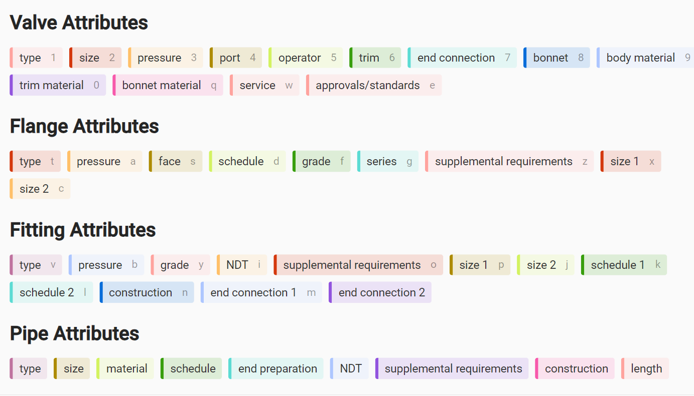

Slide 8
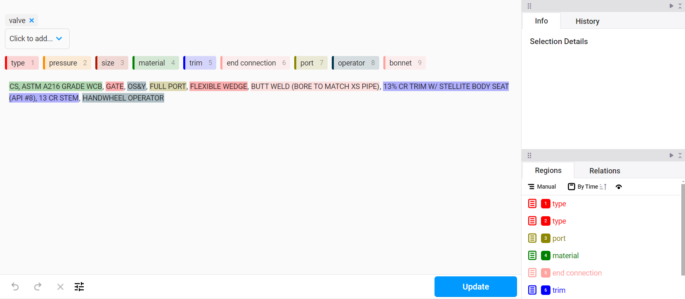

Slide 9
{
"valve_type": "Spring-loaded piston check valve",
"material": "Carbon steel conforming to ASTM A105",
"pressure_class": "ASME Class 150",
"end_connection": {
"type": "Flanged",
"face": "Raised face",
"standard": "ASME B16.5"
},
"flange_facing_finish": "Standard facing finish",
"wall_thickness": "As per API 602",
"cover": "Bolted cover",
"trim": {
"standard": "API 600 Trim 8",
"disc_and_wedge": "13% chromium stainless steel",
"seat": "Hardened stainless steel (Grade 6)",
"stem_and_hinge_pin": "13% chromium stainless steel"
},
"pattern": {
"type": "Vertical",
"standard": "ASME B16.10"
},
"bolts": {
"bolts_standard": "A193 Grade B7",
"nuts_standard": "A194 Grade 2H"
},
"marking": "As per MSS SP-25",
"cover_gasket": "316 stainless steel spiral wound with graphite fill",
"project_stock_code": "PVVCGZ10G303-CM",
"size": 1.5
}
AI can turn any non-standard complex description…
into structured data.

Slide 12
Thanks
ORGANIZING SECRETARIAT
Ph. +39 035 3230904
e-mail info@industrialvalvesummit.com
CONFERENCE ORGANIZERS
Ph. +39 3474908420
e-mail segreteria@valvecampus.com
www.industrialvalvesummit.com
www.valvecampus.com

