Slide 1
JIP33 Adoption & Variance Survey/KPIs
CONFERENCE
ORGANIZERS

Slide 2
JIP33 Adoption & Variance Survey/KPIs
Michael / Khairil

Slide 3
JIP33 Adoption &
Variance Survey/KPIs
Milan ELC
Michael/Khairil

Slide 4
IOGP Introduction
We are the global voice of our industry
We bring
the industry
together
We drive good
practices
We serve stakeholders around the globe as go-to experts

Slide 5
JIP33 Status

Slide 6
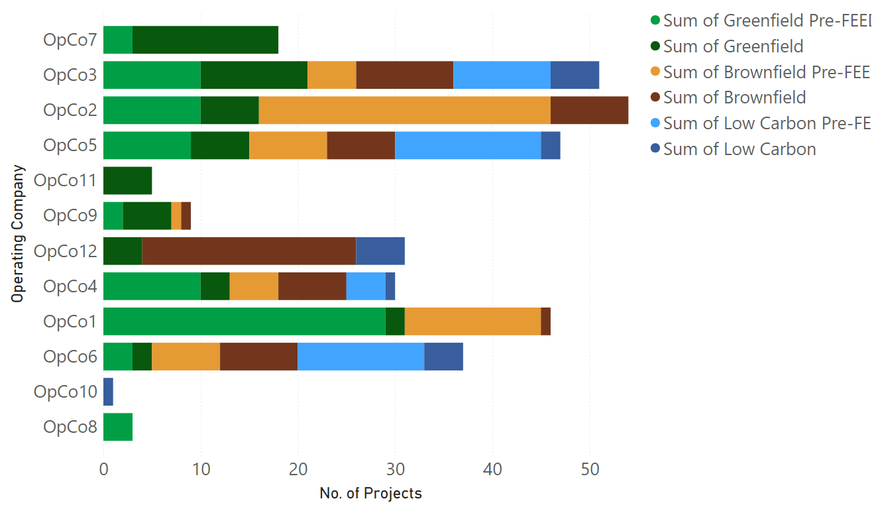
Project Portfolio: Sponsoring Operating Companies (Sep ‘23)

Slide 7
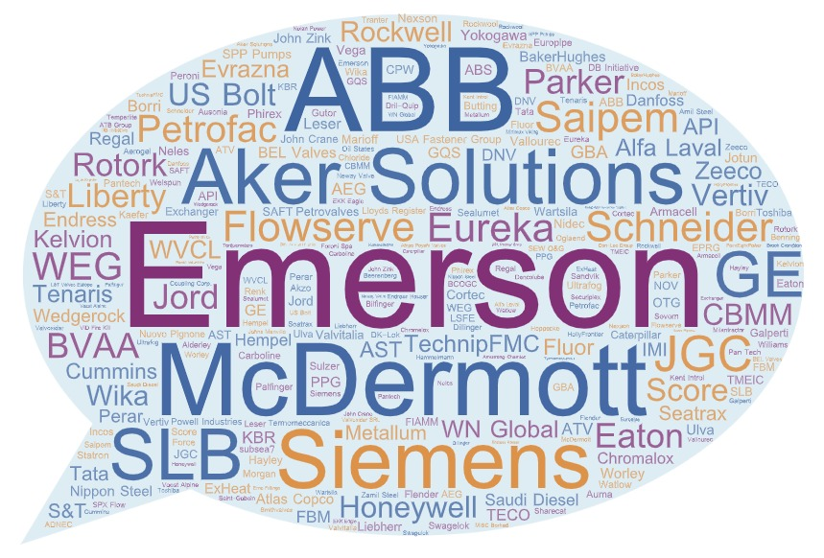
Participation & Outreach

Slide 8
JIP33 Journey Ahead
Continued digital specification development
Relevance for emerging markets and applications
Adoption
Implementation

Slide 9
For more information please contact:
Khairil Hatta JIP33 Principal Manager kha@iogp.org
David Harris JIP33 Transition Lead dh@iogp.org
IOGP Headquarters
City Tower, 40 Basinghall St, London EC2V 5DE, United Kingdom
T: +44 (0)20 3763 9700
E: reception@iogp.org
IOGP Americas
T: +1 713 261 0411
E: reception-americas@iogp.org
IOGP Europe
T: +32 (0)2 790 7762
E: reception-europe@iogp.org
IOGP Middle East & Africa
T: +1 713 261 0411
E: reception-mea@iogp.org
IOGP Asia Pacific
T: +60 3-3099 2286
E: reception-asiapacific@iogp.org
www.iogp-jip33.org

Slide 10
Thanks
ORGANIZING SECRETARIAT
Ph. +39 035 3230904
e-mail info@industrialvalvesummit.com
CONFERENCE ORGANIZERS
Ph. +39 3474908420
e-mail segreteria@valvecampus.com
www.industrialvalvesummit.com
www.valvecampus.com

