Slide 1
Corrosion performances and qualification challenges of alloy 625 produced by different additive manufacturing technologies
CONFERENCE
ORGANIZERS

Slide 2
Corrosion performances and qualification challenges of alloy 625 produced by different additive manufacturing technologies
The pathway through AM alloys qualification
Sergio Lorenzi | Professor

Slide 3
AIM
Evaluate the role of macro/microstructural features and defects on the corrosion behaviour - localised and selective - of AM Alloy 625.
Compare the performances of wrought and well established AM materials manufactured by L-PBF and DED in the light of the emerging ones based on metal/polymer systems i.e. Mex and BJ

Slide 4
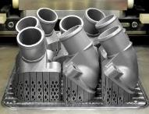
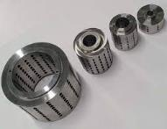
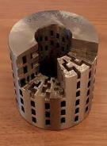
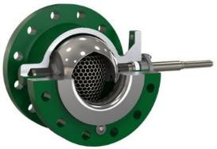
Alloy 625
Excellent combination of mechanical properties and corrosion resistance in several aggressive environments
Adopted in high added value industrial fields with medium to small lot productions (e.g. aerospace, chemical, oil & gas)
C | Si | Mn | P | S | Cr | Mo | Ni | Nb | Ti | Al | Fe | Nb+Ta | Cu
0.036 | 0.25 | 0.19 | 0.007 |  | 21.6 | 8.26 | 61.92 | 3.660 | 0.243 | 0.199 | 3.11 | 3.67 | -

Slide 5
Alloy 625

Slide 6
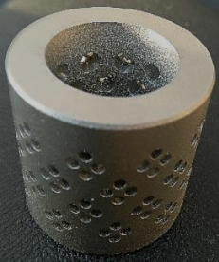



AM materials and qualification
Standards
Certification
Materials qualification
Mechanical, physical
Corrosion
According to?
…in 2016

Slide 7
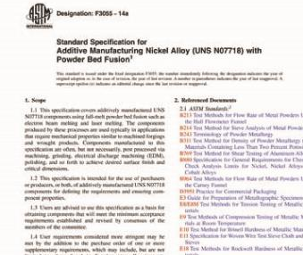
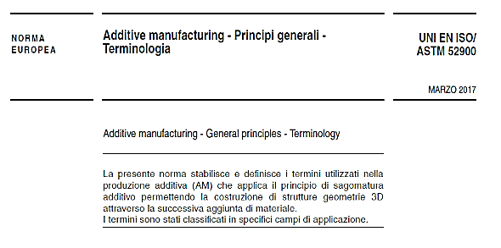
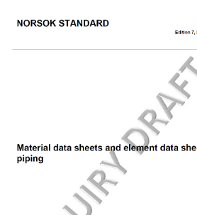
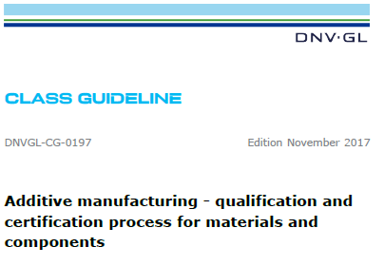
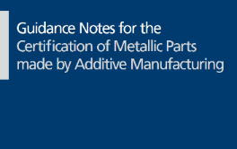


AM materials and qualification
API-20s
TR21522
Corrosion Testing for Additive Manufacturing

Slide 8
AM corrosion, microstructure and technology related challenges
Process parameters/technologies and corrosion:
  Non-equilibrium microstructures
  Surface finishing (as-build, defects, shot peening, polishing, etching ecc.)
  Porosities
  Residual stresses
  Oxides, segregations
G. Sander, J. Tan, P. Balan, O. Gharbi, D.R. Feenstra, L. Singer, S. Thomas, R.G. Kelly, J.R. Scully and N. Birbilis, Corrosion of Additively Manufactured Alloys: A Review, Corrosion (2018)

Slide 9
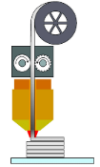
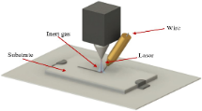
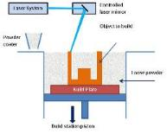
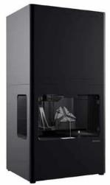
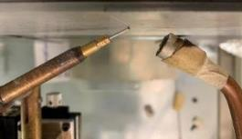
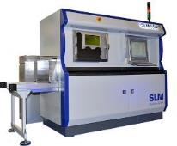
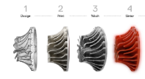

Metal AM
Atomic Diffusion Additive Manufacturing (MFFF, BJ)
Direct Energy Deposition
(DED)
Laser Powder Bed Fusion
(LPBF, EBM)

Slide 10
Composition - Alloy 625
Elemento (%) | C | Si | Mn | P | S | Cr | Mo | Ni | Nb | Ti | Al | Co | Ta | Fe
L-PBF powder | 0.01 | 0.08 | 0.03 | <0.001 | 0.002 | 22.4 | 8.2 | Bal. | 3.73 | 0.18 | <0.01 | 0.17 | 0.13 | 0.45
DED wire | 0.01 | 0.07 | 0.01 | 0.003 | <0.001 | 22.31 | 9.03 | Bal. | 3.47 | 0.22 | 0.10 | 0.01 | 0.01 | 0.19
MFFF specimen | 0.08 | 0.52 | 0.40 | 0.006 | 0.004 | 19.55 | 8.57 | Bal. | 3.28 | 0.022 | <0.001 | 0.047 | - | 2.61
HW | 0.036 | 0.25 | 0.19 | 0.007 | 0.0010 | 21.60 | 8.26 | Bal. | 3.660 | 0.243 | 0.199 | 0.020 | 0.010 | 3.11
ASTM B443 | Max 0.1 | Max 0.5 | Max 0.5 | - | - | 20-23 | 8-10 | Bal. | 3.15-4.15 | Max 0.4 | Max 0.4 | Max 1 | - | Max 5

Slide 11
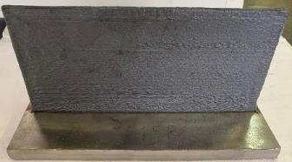



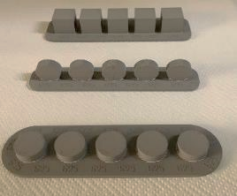

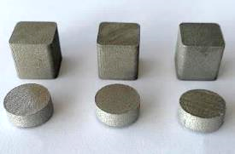

Specimens
DED
Hight 124 mm
Length 230 mm
Thickness 5 mm
70 cm³/h
L-PBF
10 cm³/h
MFFF
Cylinder, 15 mm diameter, 5 mm height
Cubic, 15 mm
Corrosion tests
ASTM G5
0.6M NaCl, ph 7 and 3
IGC, ASTM G28
10 cm³/h

Slide 12
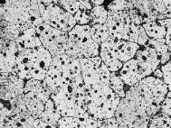
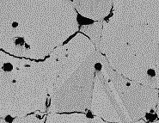
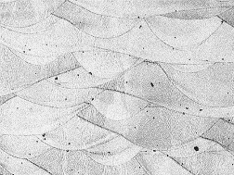
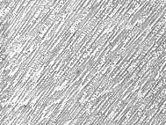
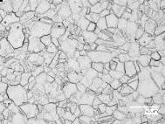
Microstructure…
…and properties
50 µm
50 µm
50 µm
50 µm
50 µm

Slide 13
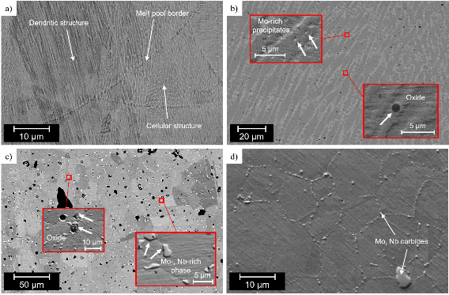
«Unique microstructure»

Slide 14

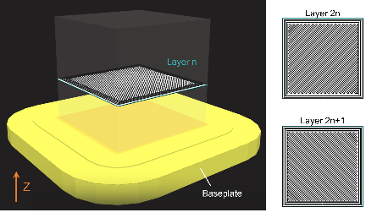
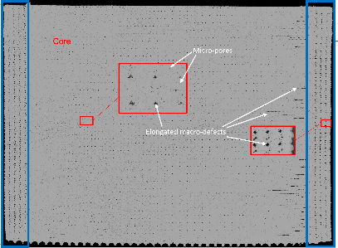
Macroporosities (technology related defects)

Slide 15

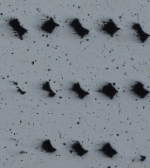
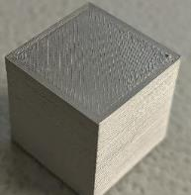
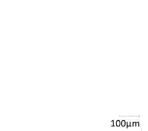
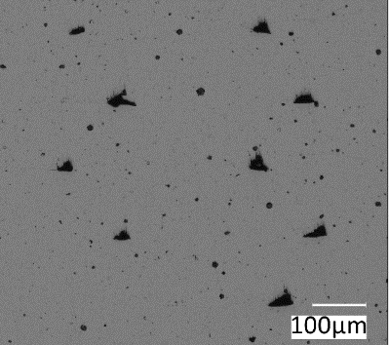
Macroporosities (technology related defects)
 | LPBF | DED | MEX
Porosity (%) | 0.06 | 0.06 | 3.04
Pores > 50 µm (%) | 0 | 0.02 | 0.37
CORE
layer ± 45°
CONTOUR
CONTOUR
CORE
7,7%
Building
direction
1,3%

Slide 16
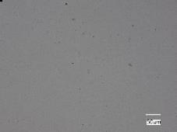
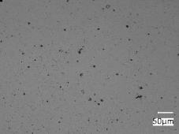
Microporosity
LPBF
MFFF
Specimens | LPBF | Mex | DED
Diameter, mean value [μm] | 2,37 | 4,42 | 2,34
Microporosity | 0,07% | 1,07% | 0,07%
DED

Slide 17
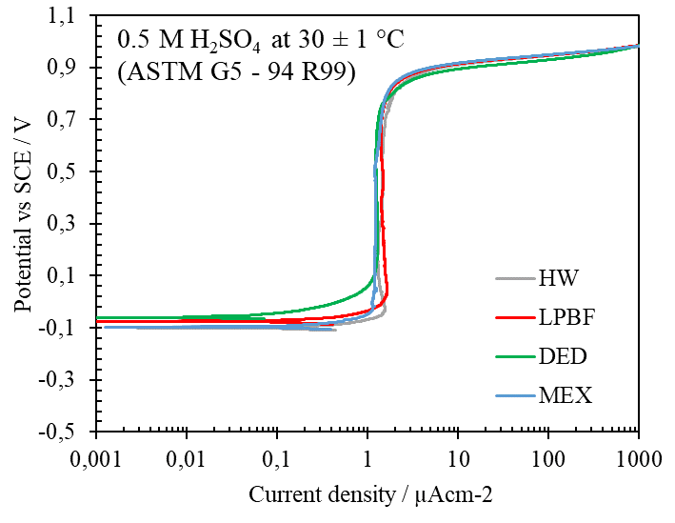
Corrosion behaviour
10 mV/min scan rate
Deaerated solution (nitrogen)

Slide 18
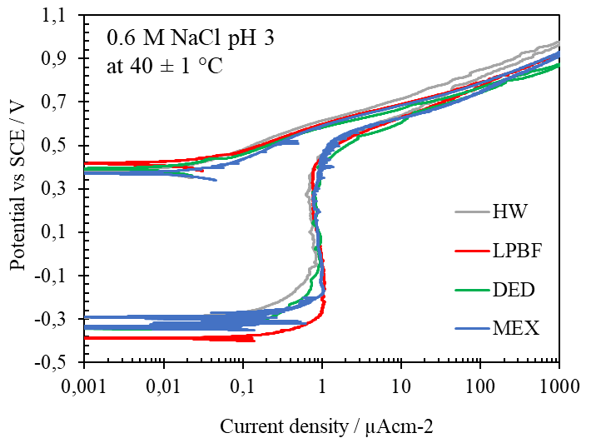
Corrosion behaviour
7
10 mV/min scan rate
Deaerated solution (nitrogen)

Slide 19
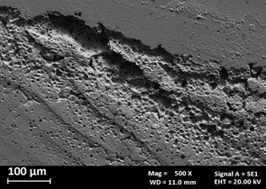
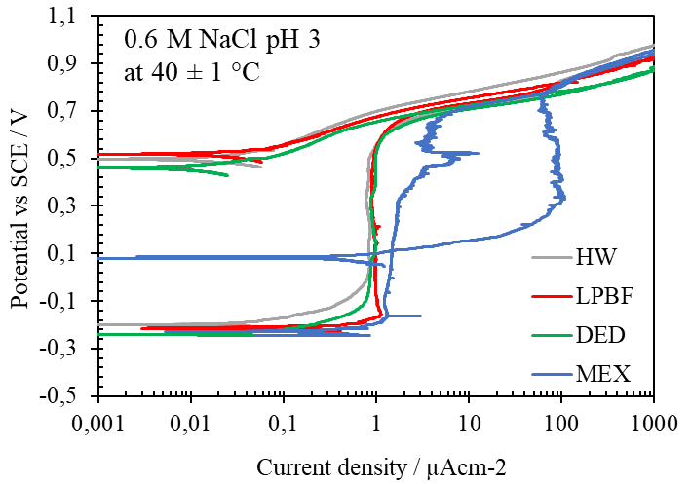
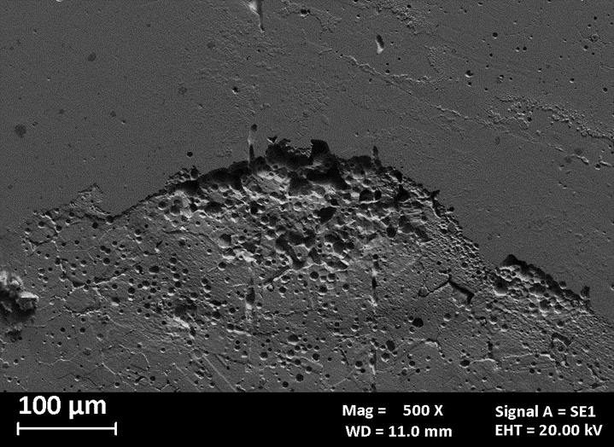
Corrosion behaviour
10 mV/min scan rate
Deaerated solution (nitrogen)

Slide 20
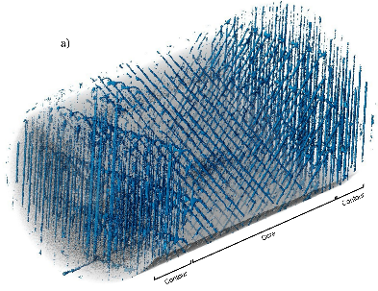
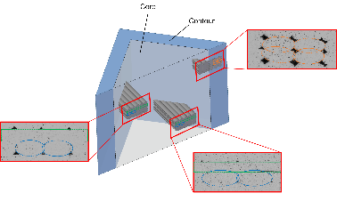

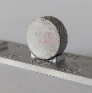

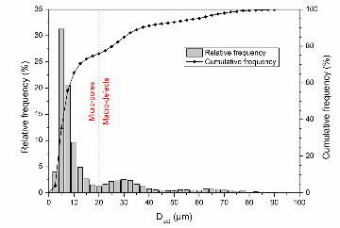
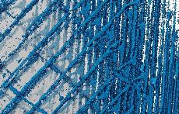
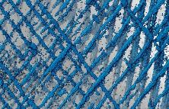
Micro-CT reconstruction
Total porosity: 3.54%

Slide 21
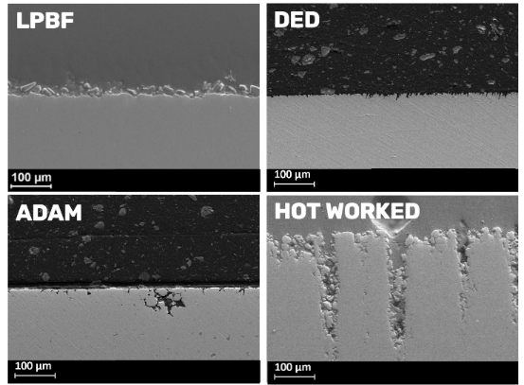
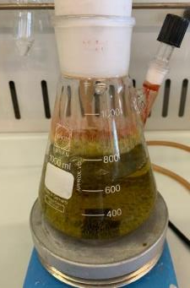
Corrosion behaviour – IGC tests
DED
LPBF
DED
LPBF
ADAM
HOT WORKED
Mex
HOT WORKED
ASTM G28

Slide 22
IGC tests
50% suphuric acid, 25 ferric sulphate
Metal systems
Metal + polymer systems
Conventional
ASTM G28 - method A

Slide 23
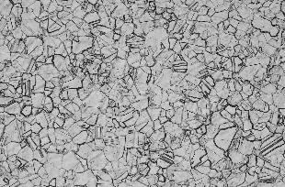
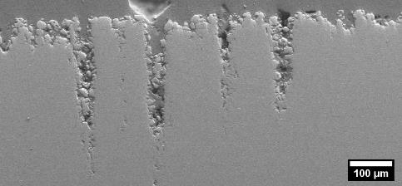
Hot worked
Twinning
100 µm
Mo-, Nb-rich carbides
100 µm
Cross-section, after G28-A
20 µm

Slide 24
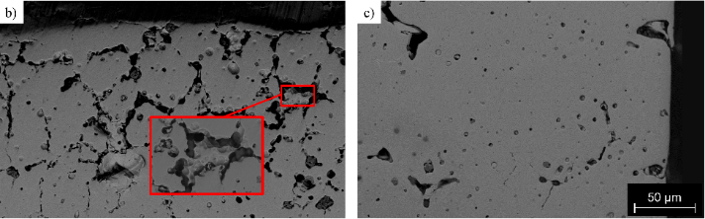


CORE
CONTOUR
Mex
Mo-, Nb- e Si rich precipitates

Slide 25



Microstructure

Slide 26







BJ
Second phase at grain boundaries is enriched in Mo, Nb and C
Twinning
2nd phase
Ni
Cr
Mo
Nb
C
Ni(γ)
MC-type carbide (NbC)
Pores
200 µm
High porosity (1.70%)

Slide 27
Conclusions
The experimental work studied AM-Alloy 625 manufactured with 4 different technology to highlight the relevant qualification challenges of a strategic alloy for Oil&Gas industry
Corrosion tests have been performed in order to study the effect of unique macrostructure and microstructure of the material –strictly related to the specific AM technology- on the corrosion performance of the alloy
All the evaluations performed allowed to establish a connection between the different AM technologies adopted and the corrosion behavior of the material, which proved to be very different according to the considered additive manufacturing technology.

Slide 28
Considerations
AM alloys are for sure «new materials» as the performances – of course mechanical but also corrosion, open the need of specific in depth study to qualify and certify the use in strategic industrial districts
Standardisation is moving fast in a lot of industrial districts and it is a key factor for opening the market of AM metals in relevant industrila sectors such as O&G and Energy (alternative fuels)
From corrosion enginering back to the corrosion science!

Slide 29
Thanks
ORGANIZING SECRETARIAT
Ph. +39 035 3230904
e-mail info@industrialvalvesummit.com
CONFERENCE ORGANIZERS
Ph. +39 3474908420
e-mail segreteria@valvecampus.com
www.industrialvalvesummit.com
www.valvecampus.com

