Slide 1
Presenting S3EEM: a flexible and user-friendly tool to assess GHG emissions in the Oil&Gas Industry
CONFERENCE
ORGANIZERS

Slide 2
Presenting S3EEM: a flexible and user-friendly tool to assess GHG emissions in the Oil&Gas Industry
Eng. Alex Giorgini | Managing Director, Eartha Srl

Slide 3
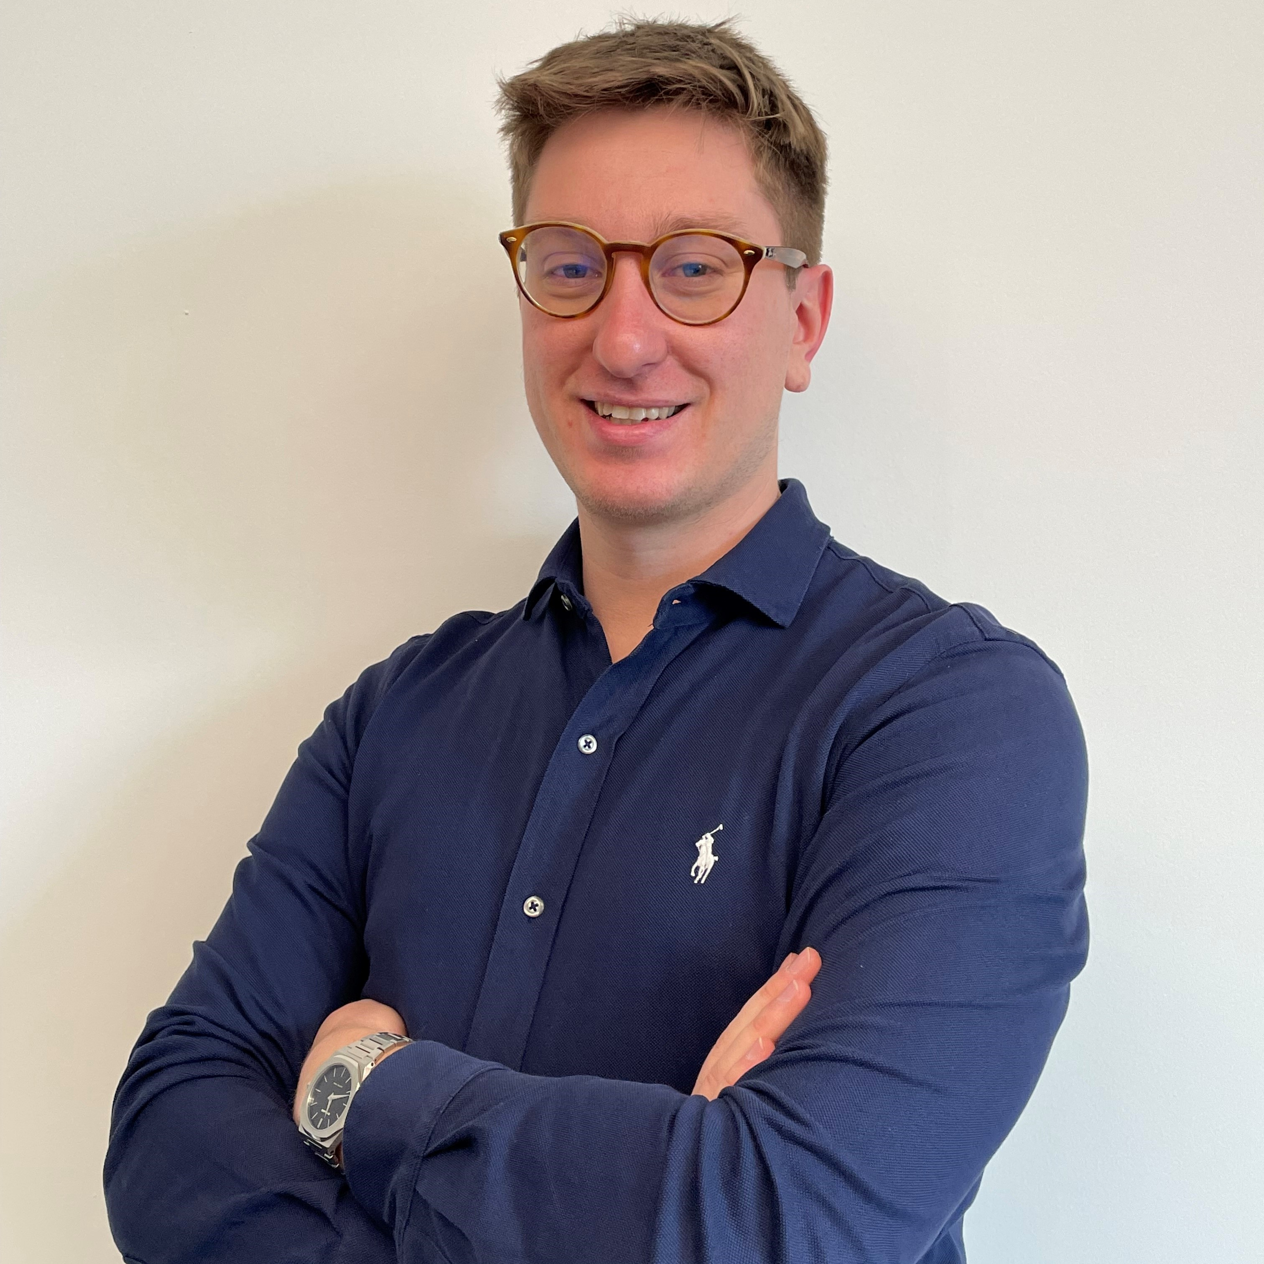

Biography
M.Sc. in Energy Engineering at Politecnico di Milano
Co-founder and Managing Director at Eartha Srl
Expertise in Environmental Sustainability assessment
Visit us at Hall B – Booth n. 136
Let's connect, be part of the Sustainable Revolution!

Slide 4

Outline
Introduction
  About Eartha
Greenhouse Gases (GHGs) Emissions Inventory
  What, why and how it is carried out
  Major issues
The S3EEM Tool
  Principles and strengths
  Benefits (Oil&Gas Industry)
Q&A Session

Slide 5










About Eartha
In practice...
Who is Eartha? An innovative Consultancy Company that carries out Analysis and Research activities in the field of Environmental Sustainability for Oil&Gas Industry
What we offer? Simple and flexible tailor-made solutions to support our Clients in identifying strategies and actions to reduce their environmental impact and demonstrate the added value of their products, processes, and organizations to the Stakeholders.
Analyzing to Understand
Measuring to Quantify
Comparing to Interpret
Suggesting to Optimize
Supporting to Communicate

Slide 6
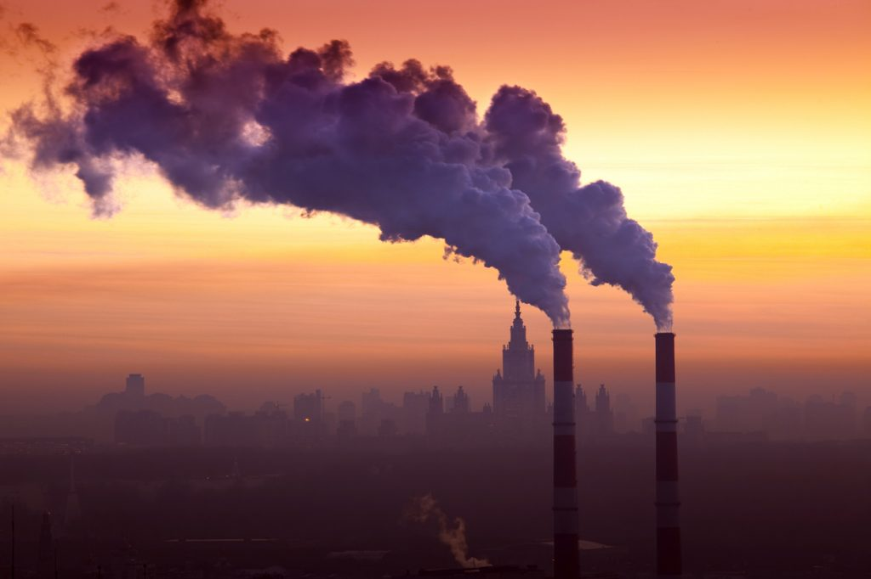
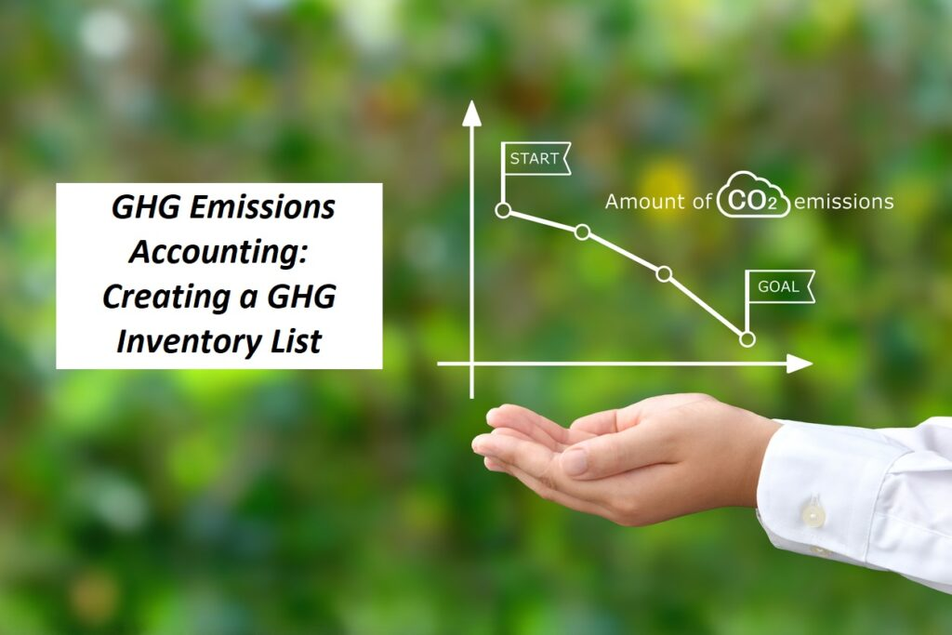
GHGs Emissions Inventory: what
Calculation of the overall emissions associated to the Company’s activities/processes (whole supply chain upstream and downstream) for a specific period (1 year).

Slide 7


GHGs Emissions Inventory: why
  European Sustainability Reporting Standards (ESRS) E1 – Climate Change: mandatory application of GHG Protocol Scope 2 Guidance (2015), and GHG Protocol Corporate Value Chain (Scope 3) Accounting and Reporting Standard (2011) for GHGs emissions assessment.
  Companies able to:
  Prioritize Actions: identify high-emissions activities/processes that mostly contribute to environmental impacts.
  Set Targets: roadmap for action and accountability, driving progress toward sustainability goals and manage related risks.
  Optimize Operations: implement changes and innovations in low-carbon technologies and practices while also driving market competitiveness and resilience.

Slide 8
GHG Emissions Inventory: how
Definition of Company’s Inventory boundaries: organizational boundaries (the Company itself) + operational boundaries (all other activities/processes upstream and downstream the Supply Chain);
Identification and classification of emissions sources within the boundaries (GHG Protocol Guidelines):
Scope 1 (mandatory): direct emissions from sources owned/controlled by the Company (e.g., fuel combustion, vehicles use, refrigerant gases leakage).
Scope 2 (mandatory): indirect emissions from the generation of purchased energy (electricity, steam & heat, cooling) from sources not owned/ controlled by the Company.
Scope 3 (optional): indirect emissions from sources outside the Company’s organizational boundaries (upstream and downstream).

Slide 9
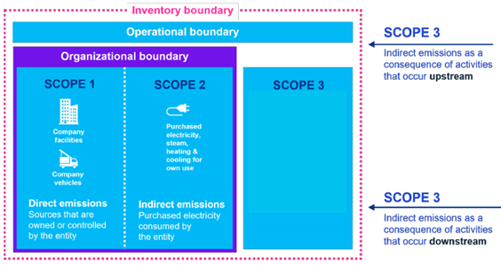
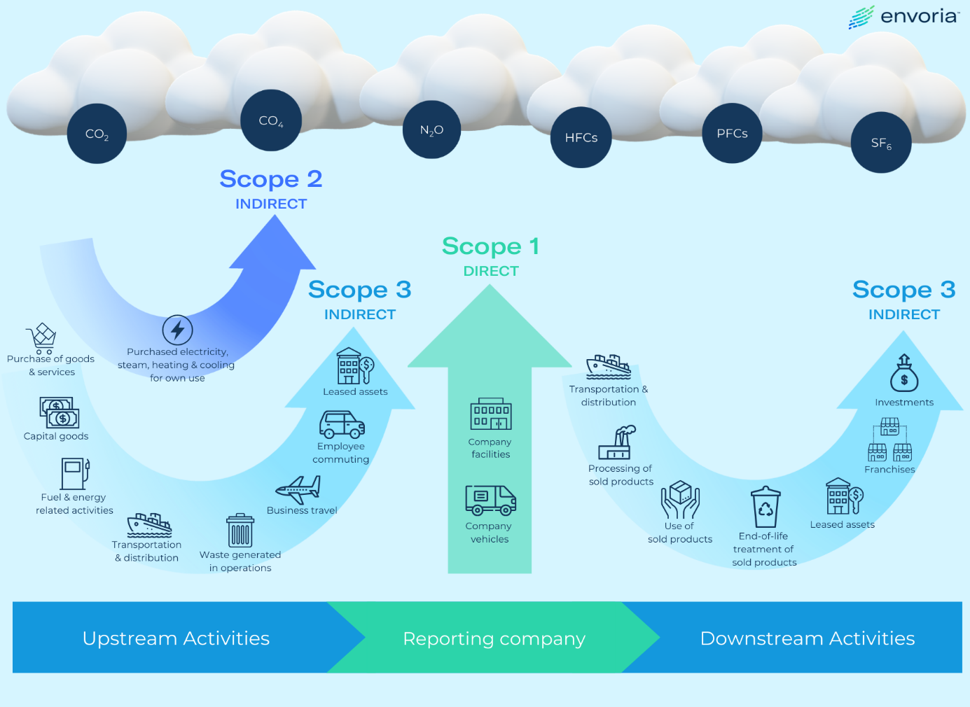
GHG Emissions Inventory: how
Emissions Sources → 20 Categories → 3 Scopes

Slide 10
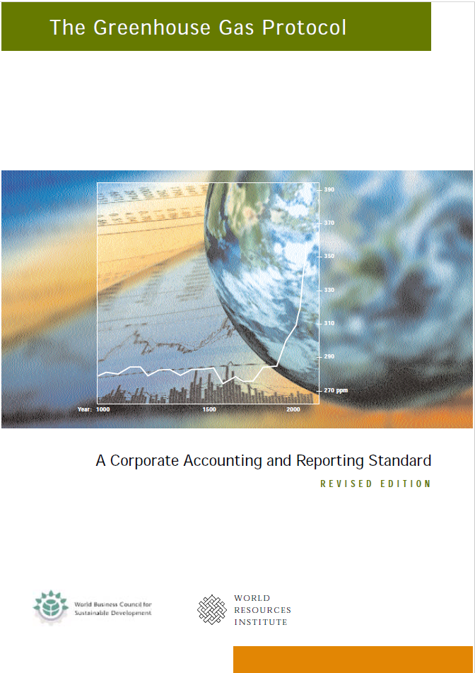

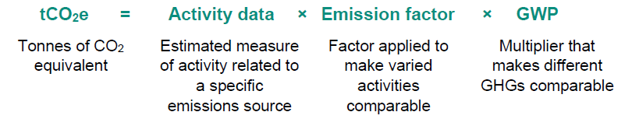
GHG Emissions Inventory: how
Data collection from all the emission sources (Data quality requirement).
GHGs emissions calculation (ton CO₂eq) from each source (emission factors) and aggregation (Emission sources → Category → Scope) (GHG Protocol; ISO 14064-1).

Slide 11

GHG Emissions Inventory: major issues
Calculation of Scope 3 emissions particularly complex and time-consuming (resources & expertise).
Incomplete or unreliable data on upstream and downstream activities/processes (especially physical quantities, e.g., quantity, distance, etc.).
Results:
Difficulty in assessing the total GHGs emissions (Carbon Footprint) comprehensively.
Difficulty in identifying emissions reductions opportunities throughout the supply chain.
Lack of transparency and accountability in reporting environmental performance and progress towards sustainability goals.

Slide 12

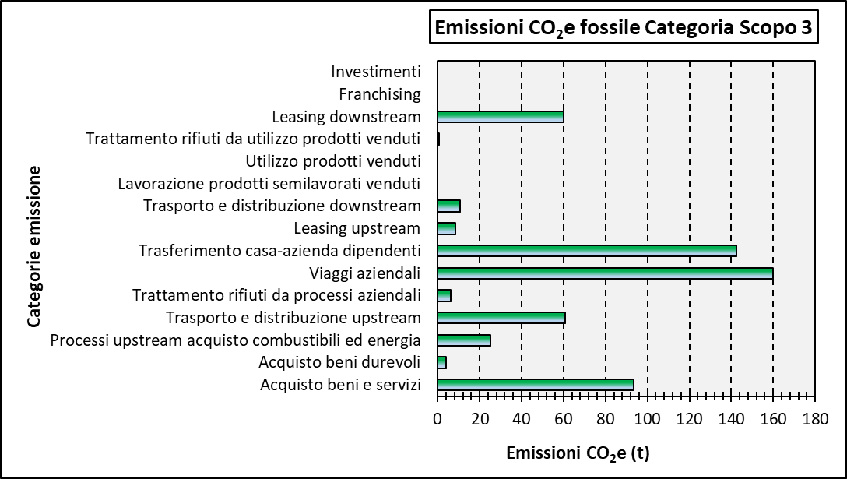


Solution: The S3EEM Tool - Introduction
Scope 3 Emissions Estimation Tool: flexible and user-friendly generalized model developed at the request of VALVECampus Association and made available to the associated Companies.
Quantification of GHGs emissions related to the whole supply chain.
USER INPUT DATA (SURVEY)
UPSTREAM ACTIVITIES
S3EEM TOOL
GHGs EMISSIONS CALCULATIONS
GHGs EMISSIONS RESULTS
COMPANY ACTIVITIES
DOWNSTREAM ACTIVITIES
OUTPUT RESULTS
(GHGs categories & Scopes)

Slide 13

The S3EEM Tool – Principles and strengths
Methodological approaches based on the standardized GHGs Protocol Guidelines.
User data uploading through a survey (different topics).
Reference period: 1 solar year.
Mandatory and optional questions to increase calculation accuracy.
Topic exclusion from the analysis if data unavailable or unreliable.
New calculations algorithms and updated parameters to limit user data collection time.
If physical input data not available: economic approach (spend-based emissions factors, e.g., kg CO₂eq/€ spend for a given activity/process).

Slide 14
The S3EEM Tool – Principles and strengths
Why the economic approach?
For some activity/processes (e.g., purchase good and services) data related to cost always available, quick and easy to collect.
Spend-based emission factors: average level of GHGs emissions per unit of currency through high-level modelling and easy to use.
Combination of cost data with spend-based emission factors powerful first approximation of a Company’s Scope 3 Carbon Footprint.

Slide 15

The S3EEM Tool – Oil&Gas Industry Benefits
Survey filled out by the Associate even with incomplete supplier or final user data → Accurate calculation of Scope 1, Scope 2 and Scope 3 emissions.
Reduced reliance on external expertise or extensive data collection efforts and time → more efficient and cost-effective GHGs emissions assessment process management.
Scope 3 analysis already represents a preliminary Product Carbon Footprint analysis → S3EEM can be further customized and improved to adapt to the Companies’ specific needs.

Slide 16

Would you like to be supported along the Sustainability journey of your company?
Contact us!
info@eartha.it

Slide 17
Thank you
ORGANIZING SECRETARIAT
Ph. +39 035 3230904
e-mail info@industrialvalvesummit.com
CONFERENCE ORGANIZERS
Ph. +39 3474908420
e-mail segreteria@valvecampus.com
www.industrialvalvesummit.com
www.valvecampus.com

