Slide 1
Co-design of valves and seals for extreme applications: a success case
CONFERENCE
ORGANIZERS

Slide 2
Co-design of valves and seals for extreme applications: a success case
Simona Macchi | Quality and R&D Manager – Effeciemme Componenti
Alessandro Panichella | Technical and R&D Director – TIV Valves

Slide 3
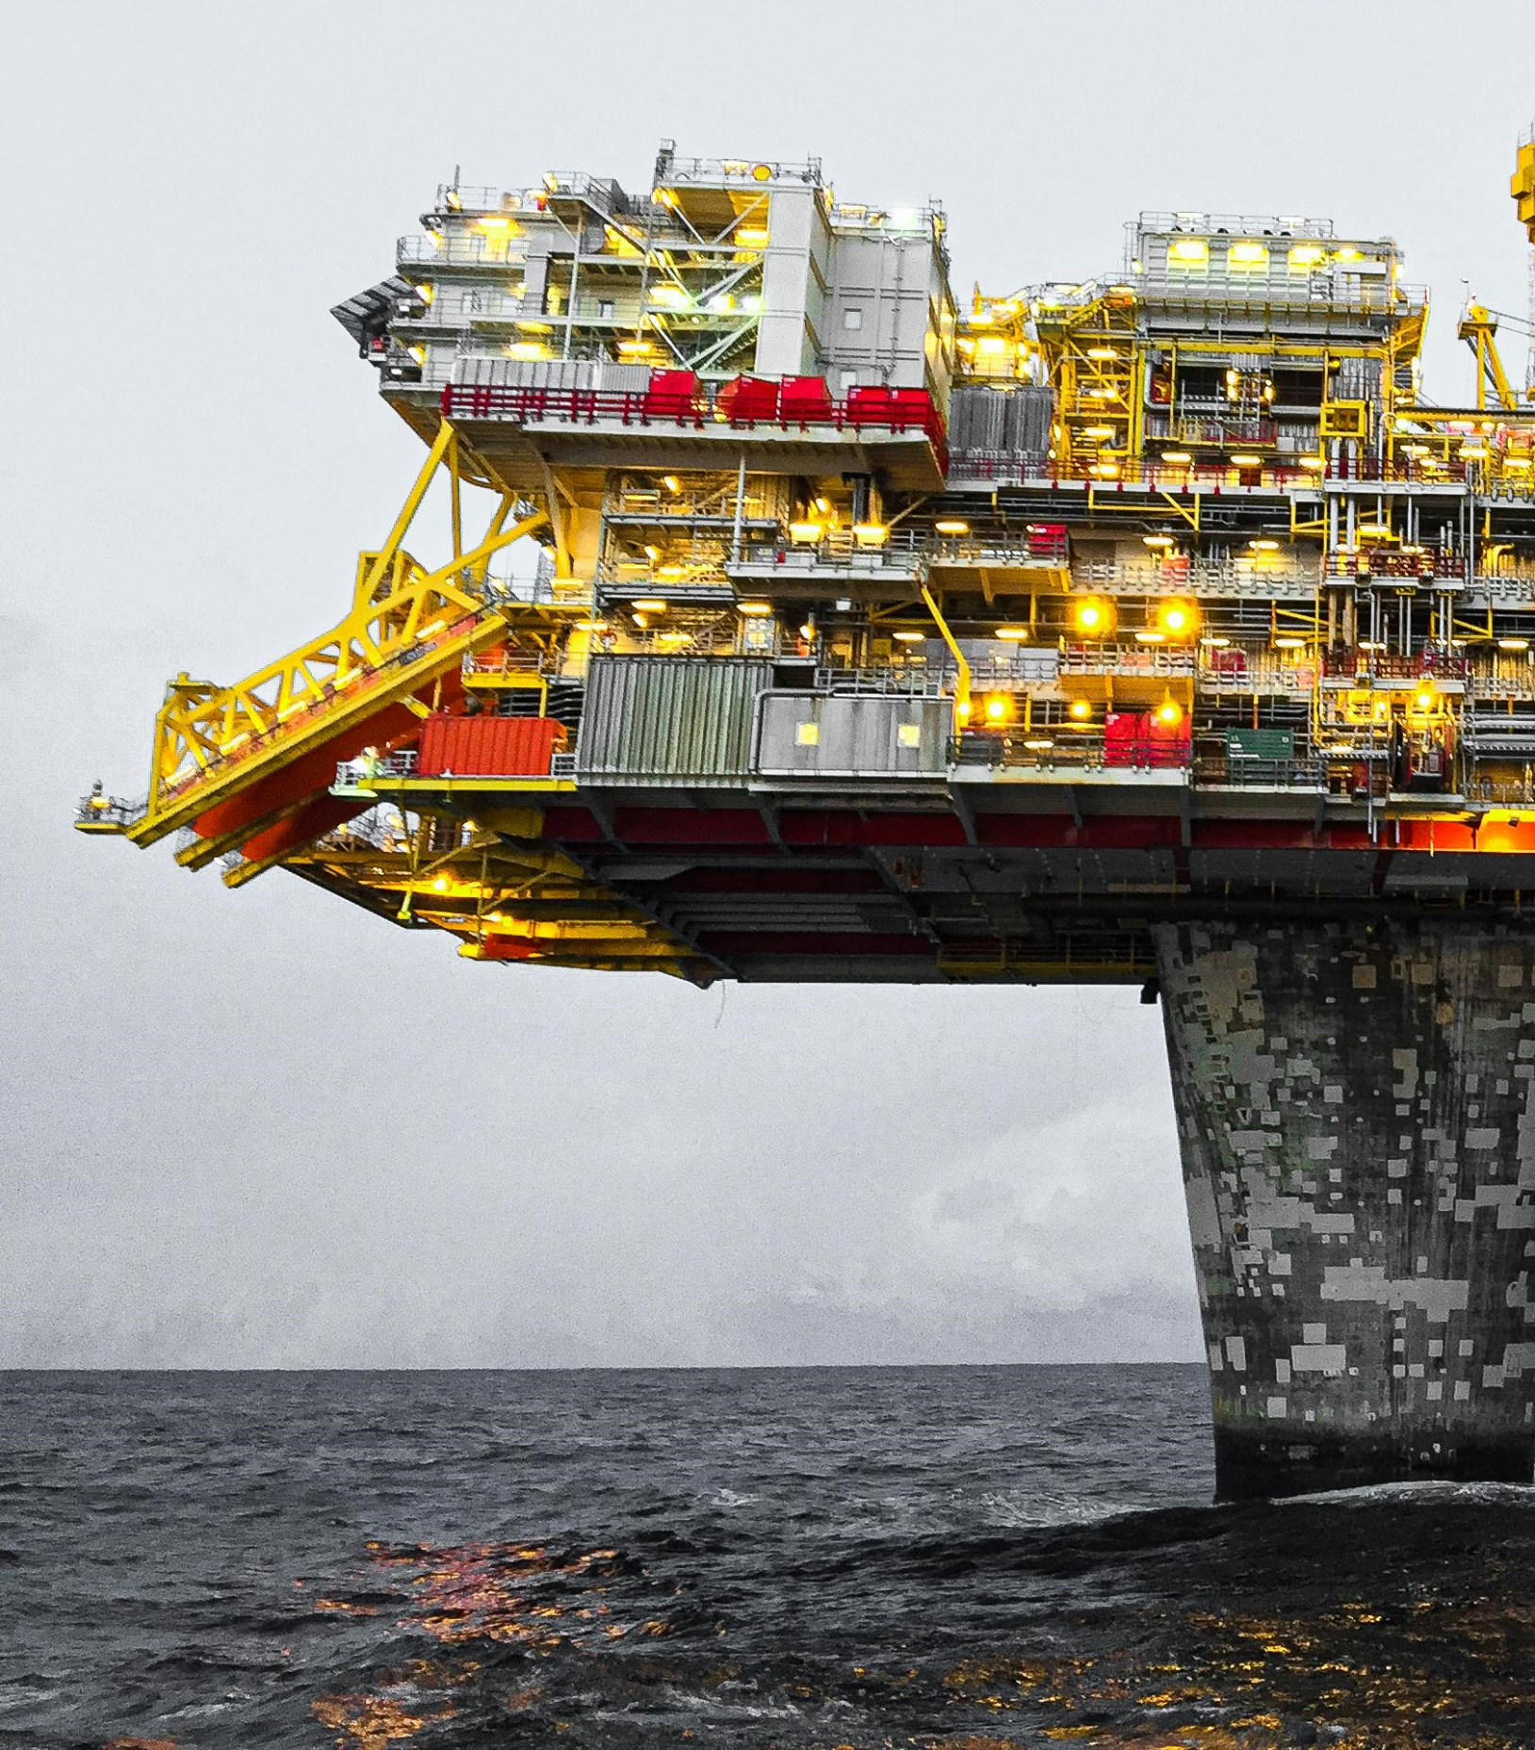
The challenge
More efficiency, more safety, but in more severe operating conditions.
In the last decades, valves requirements for energy sector are becoming more and more demanding, asking manufacturers and suppliers for challenging design activities and proper materials selection to satisfy severe process conditions.
Specially, EPC’s and end users are focusing on environmental emissions and safety concerns.

Slide 4
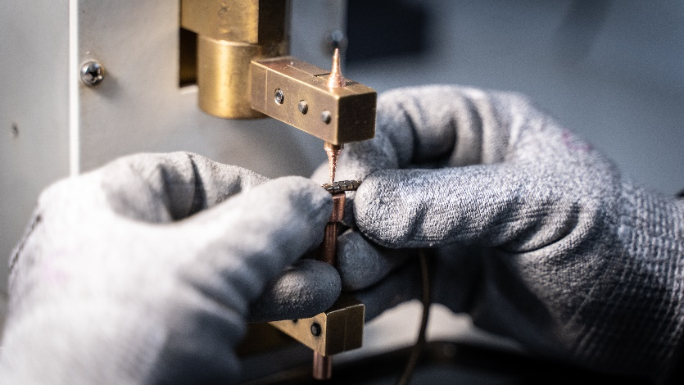
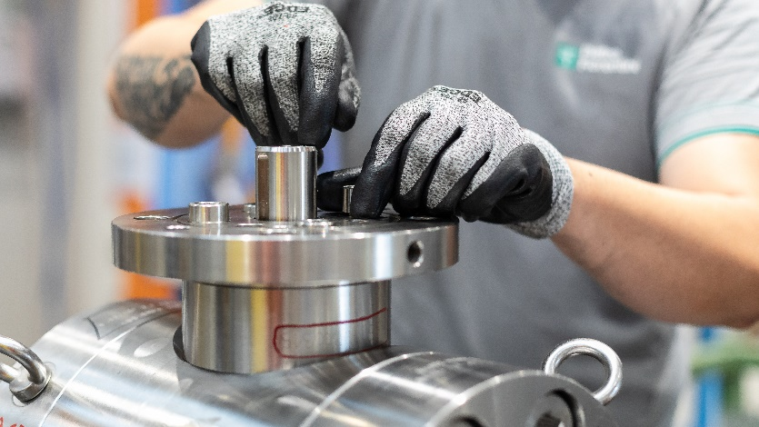
The co-design basis
In this context, valves and seals manufacturers can work together to develop tailor-made solutions to face specific process conditions.
The co-design experience can have a positive impact on time to market reducing the reworks and minimizing misunderstandings during the design phases.
Effeciemme Componenti has been operating since 1995 in the field of sealing systems and components for valves.
TIV Valves, founded in 2011, is an italian manufacturer of ball valves, involved in major international projects.

Slide 5
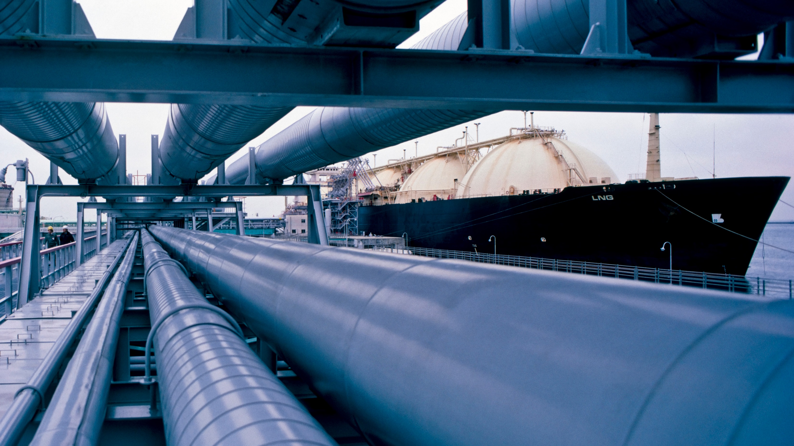


In this context TIV Valves (TIV) and Effeciemme Componenti (Effeciemme), as valves and seals manufacturers respectively, are pleased to share a success case of close collaboration to develop a solution for an extreme application.
The case study is based on a critical offshore ball valve with non-standard size and pressure class.
ORGANIZERS
CONFERENCE ORGANIZERS

Slide 6
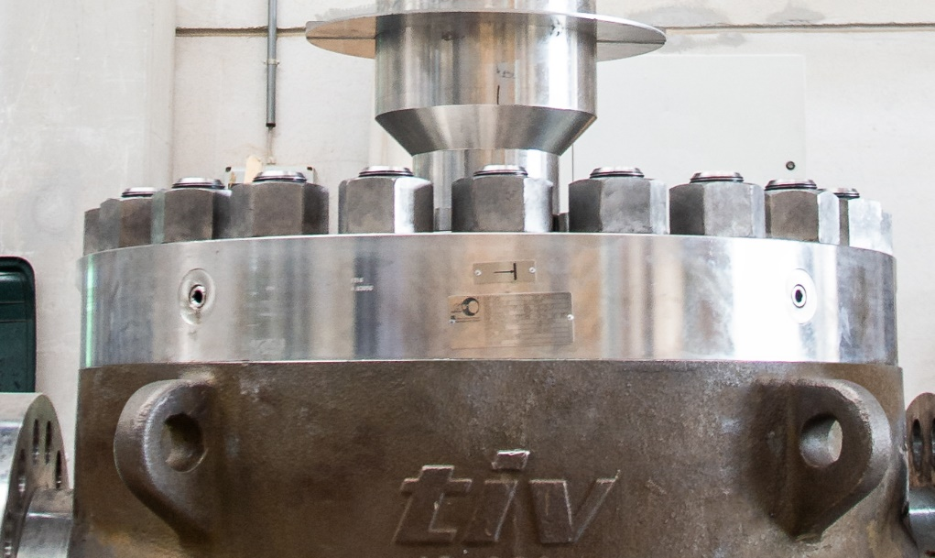
Case study – Main features
Valve type
Trunnion mounted ESD ball valve, top-entry, metal seated

Slide 7
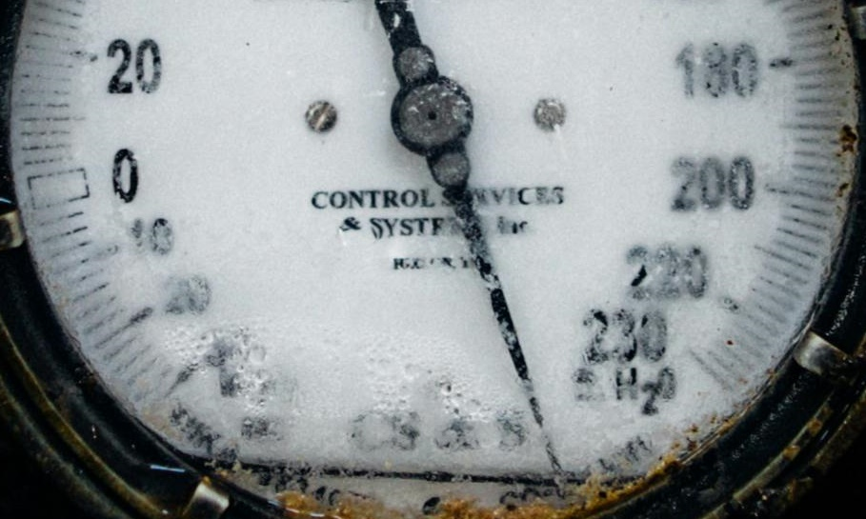
Case study – Main features
Valve type
Pressure class
Trunnion mounted ESD ball valve, top-entry, metal seated
12,000 psi - 827 bar (design)
10,675 psi - 736 bar (process)

Slide 8
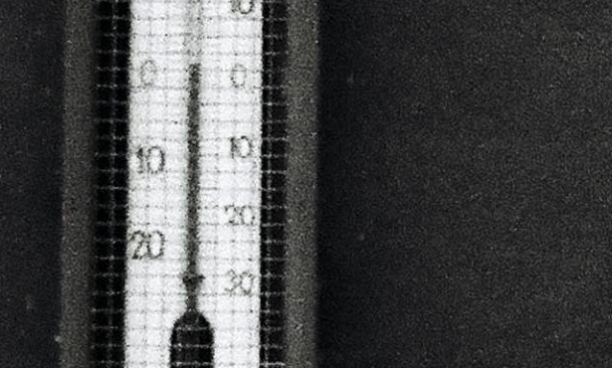
Case study – Main features
Valve type
Pressure class
Temperature range
Trunnion mounted ESD ball valve, top-entry, metal seated
12,000 psi - 827 bar (design)
10,675 psi - 736 bar (process)
-50/130 °C (design)
4/96 °C (operative)

Slide 9
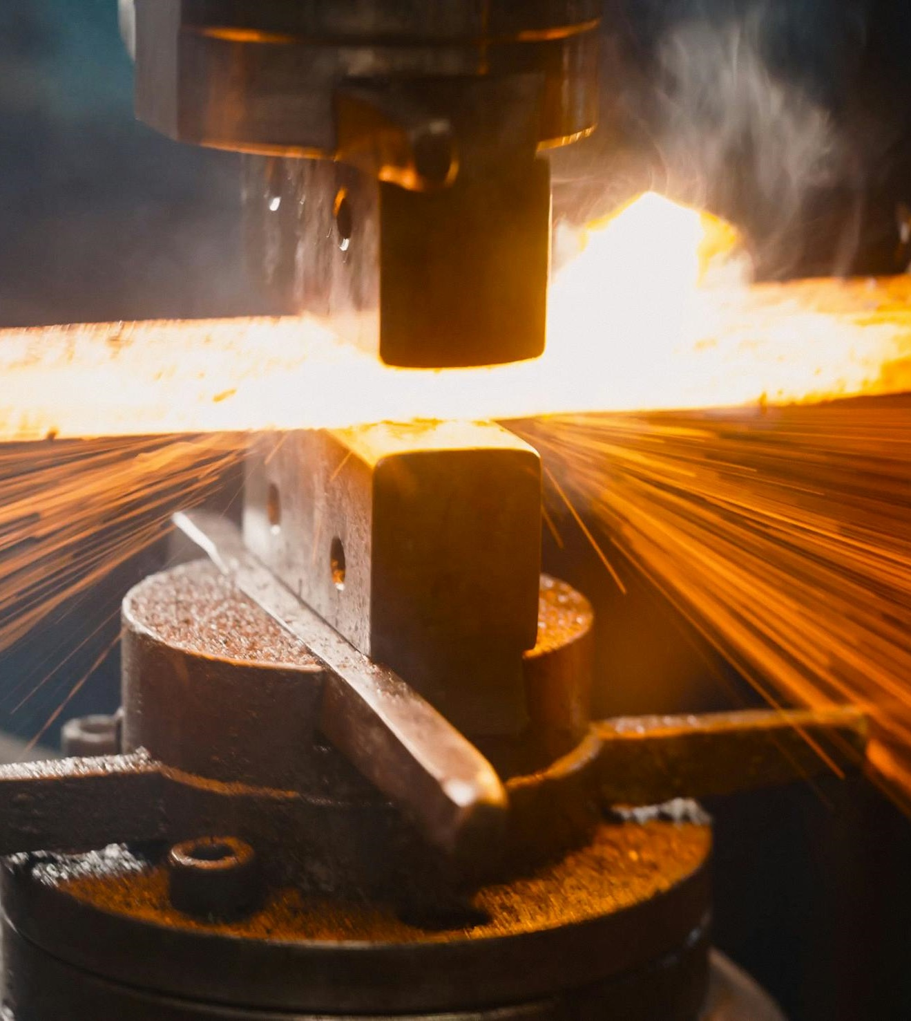
Material requirements
Process fluid for this application is a sour multiphase mixture, whose main components are sour hydrocarbon gas, liquid hydrocarbon, produced water and sand.
Body: ASTM A694 F60 + 625 cladding
Ball: ASTM A694 F60 + 625 cladding + TCC
Seats: ASTM B564 N06625 + TCC
Stem: API 6ACRA N07718 120k
Bolts and nuts: API 6ACRA N07718 140k

Slide 10
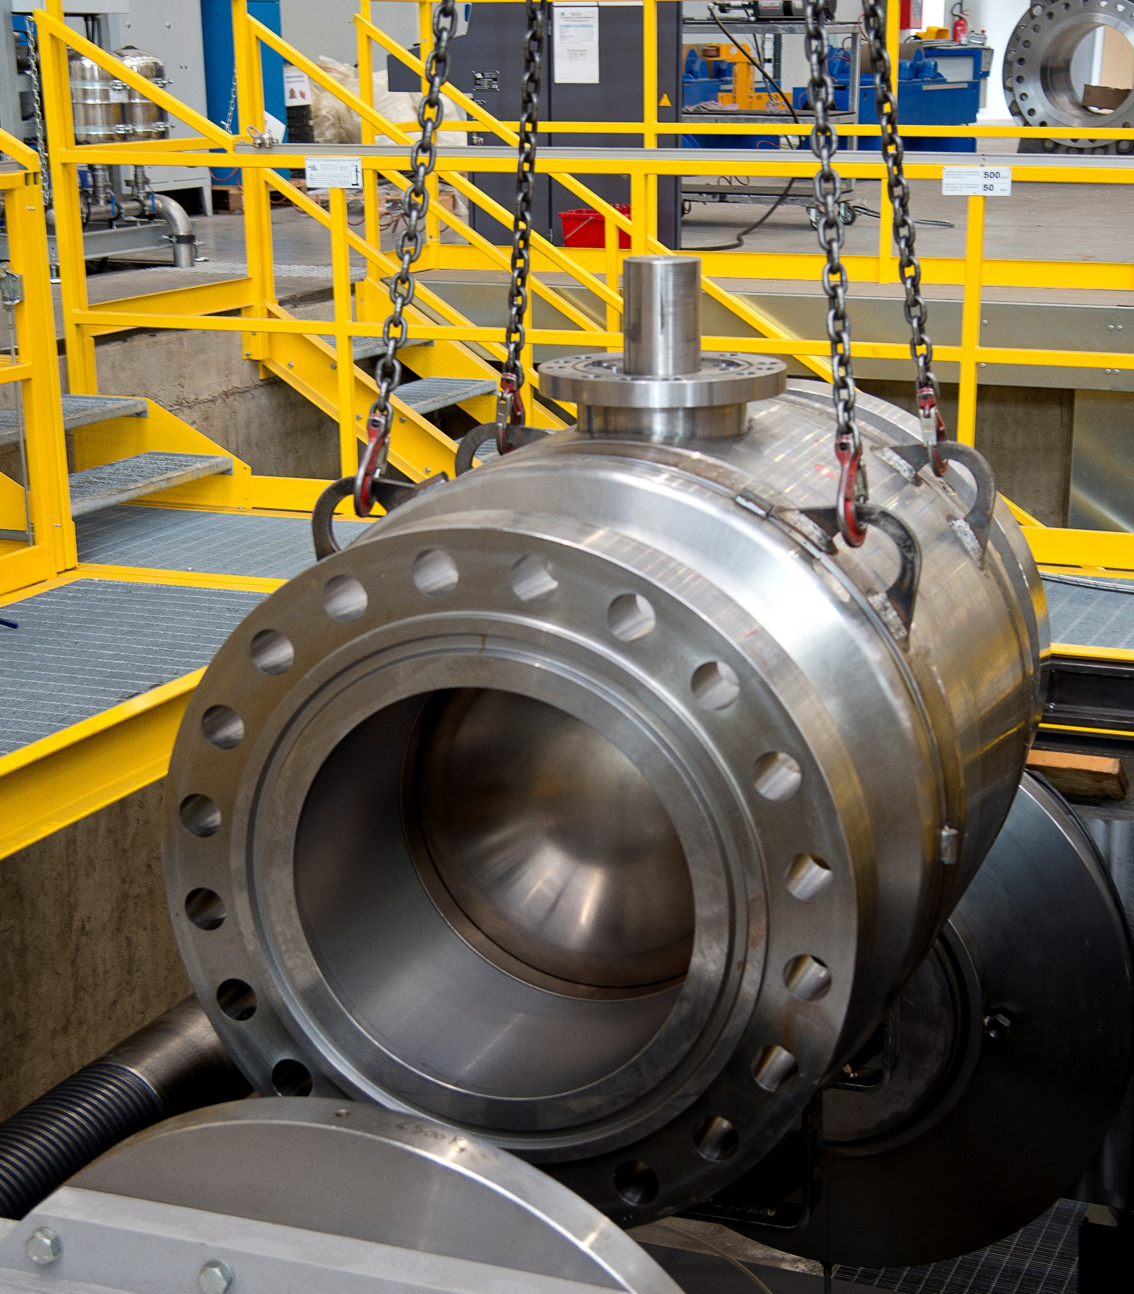
Testing requirements
This critical application requires a strict testing protocol to validate the API 6A based design.
PSL 3G testing requirements
ISO 15848-1 coverage
ISO 15848-2 production test (rate B)
API 6A PR2F design validation

Slide 11
Starting from the bid stage, TIV Valves and Effeciemme Componenti supported each other in the development of a preliminary design both for valve and seals. The continuous information exchange is the underlying theme of all design phases.
Seals arrangement
and materials
testing
campaign
Seal definition: strain
analysis
Iterative FEA
Prel. FEA
Final design
ORGANIZERS
CONFERENCE ORGANIZERS

Slide 12

Seals arrangement
and materials
testing
campaign
Seal definition: strain
analysis
Iterative FEA
Prel. FEA
Final design
ORGANIZERS
CONFERENCE ORGANIZERS

Slide 13
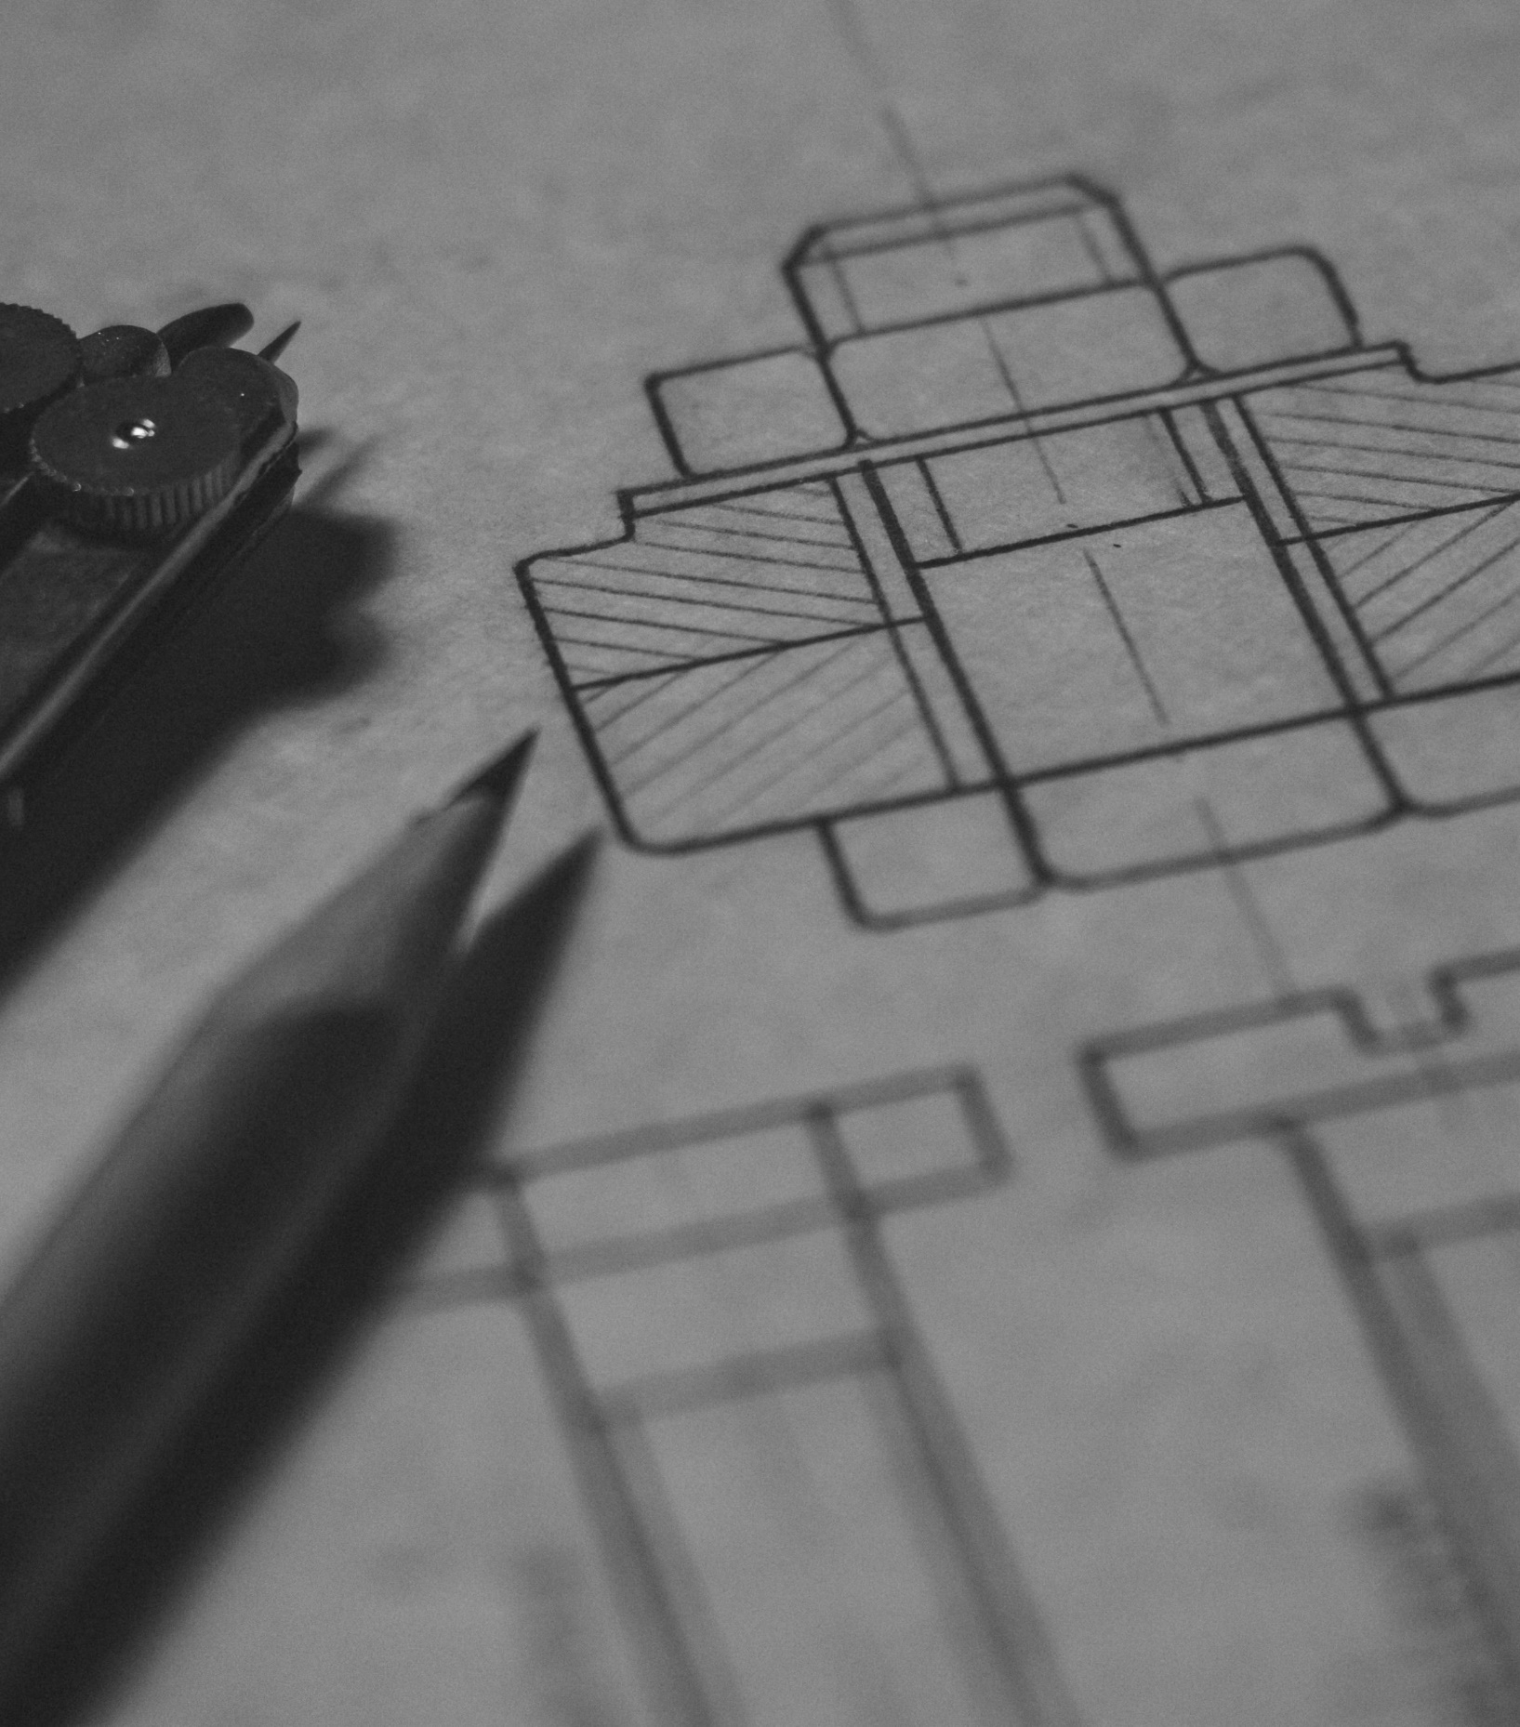
Design requirements
The design bases on ASME B31.3, chapter IX, that, in turn, recalls ASME Boiler and Pressure Vessel Code, Section VIII, div. 3.
This approach requires to consider several aspects during the design stage:
Mechanical integrity at test and rated pressure
Elastic behavior of components (i.e. grooves and sealing elements deformation under design loads)
Plastic behavior of metallic parts

Slide 14
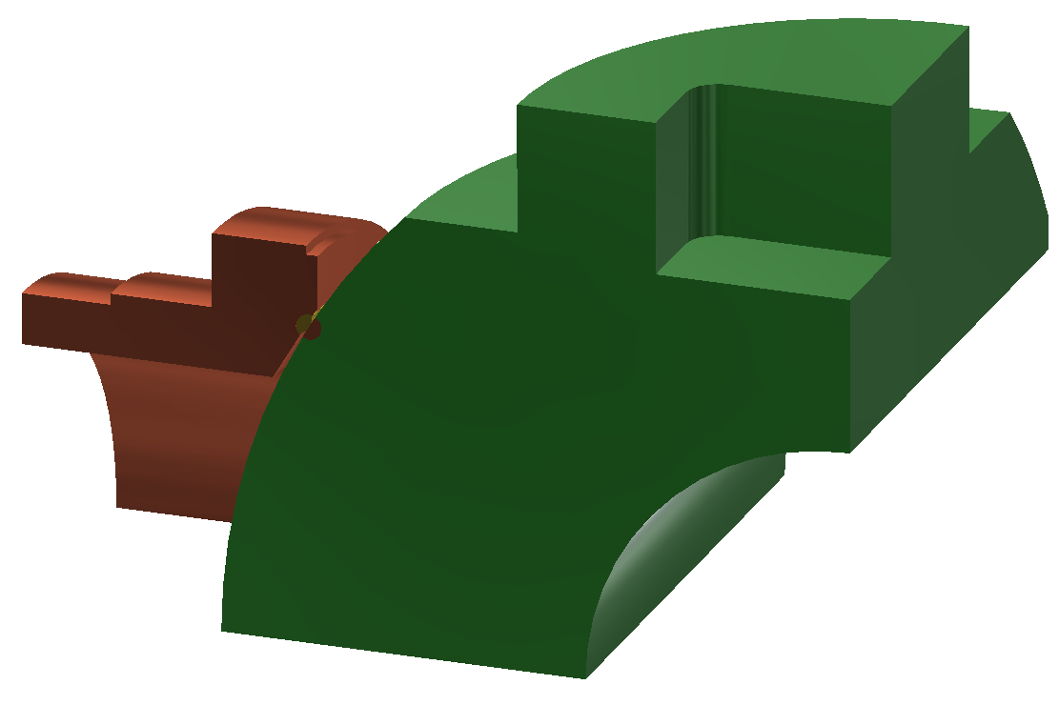
Preliminary FEA
During bid stage the preliminary design has been analyzed through finite elements method.
In this stage the focus was to give the seals manufacturer a range of grooves elastic deformations to determine preliminary seals cross sections and configurations.
Static structural pressure containing parts simulation performed at test pressure (1.5 rated pressure).
Static structural trim simulation at rated pressure.
Perfectly elastic material behavior
Minimum consideration of non-linearities (ball/seat contact only)

Slide 15
Seals arrangement
and materials
testing
campaign
Materials
testing campaign and
seal definition
Iterative FEA
Prel. FEA
Final design
ORGANIZERS
CONFERENCE ORGANIZERS

Slide 16
First groove and seals arrangement
Based on the information shared by TIV about FEA, Effeciemme developed its first-attempt proposal.
Some aspects have been clarified in this stage:
Body/bonnet lip-seal configuration (axial/radial), cross section and groove
Seat lip-seals and stem packing cross sections and grooves
Spring configuration

Slide 17
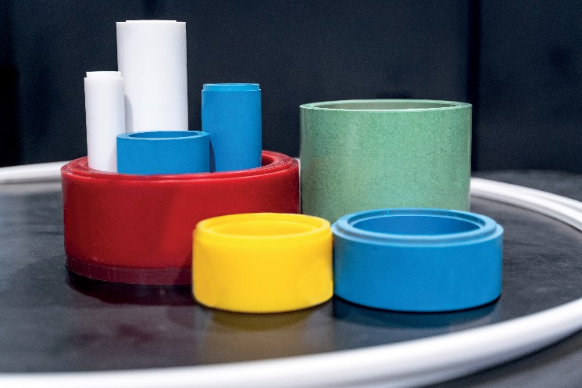
Seal definition: pre-selection
Pressure 12000 psi
Temperature 130°C
Groove deformation
body/bonnet lip seal
  Pre-selection of polymeric materials
  Selection of the spring type
  Definition of the body/bonnet lip seal components:
    Jacket
    Spring back up
    Back up
    Anti collapse ring

Slide 18
Seal definition: pre-selection
  Selection of the spring type
  Selection of the lip seal geometry
    Experience at the same o similar condition
    Geometry already analyzed with FEA
Body/Bonnet Lip seal type
U type
Jacket geometry
groove dimensions
profile
Backup geometry
Anti collapse ring geometry
Back up ring is the main component looking to the groove deformation!
The service condition needs
a special design
“expansion back up”
considering
the metal groove
deformation under pressure

Slide 19
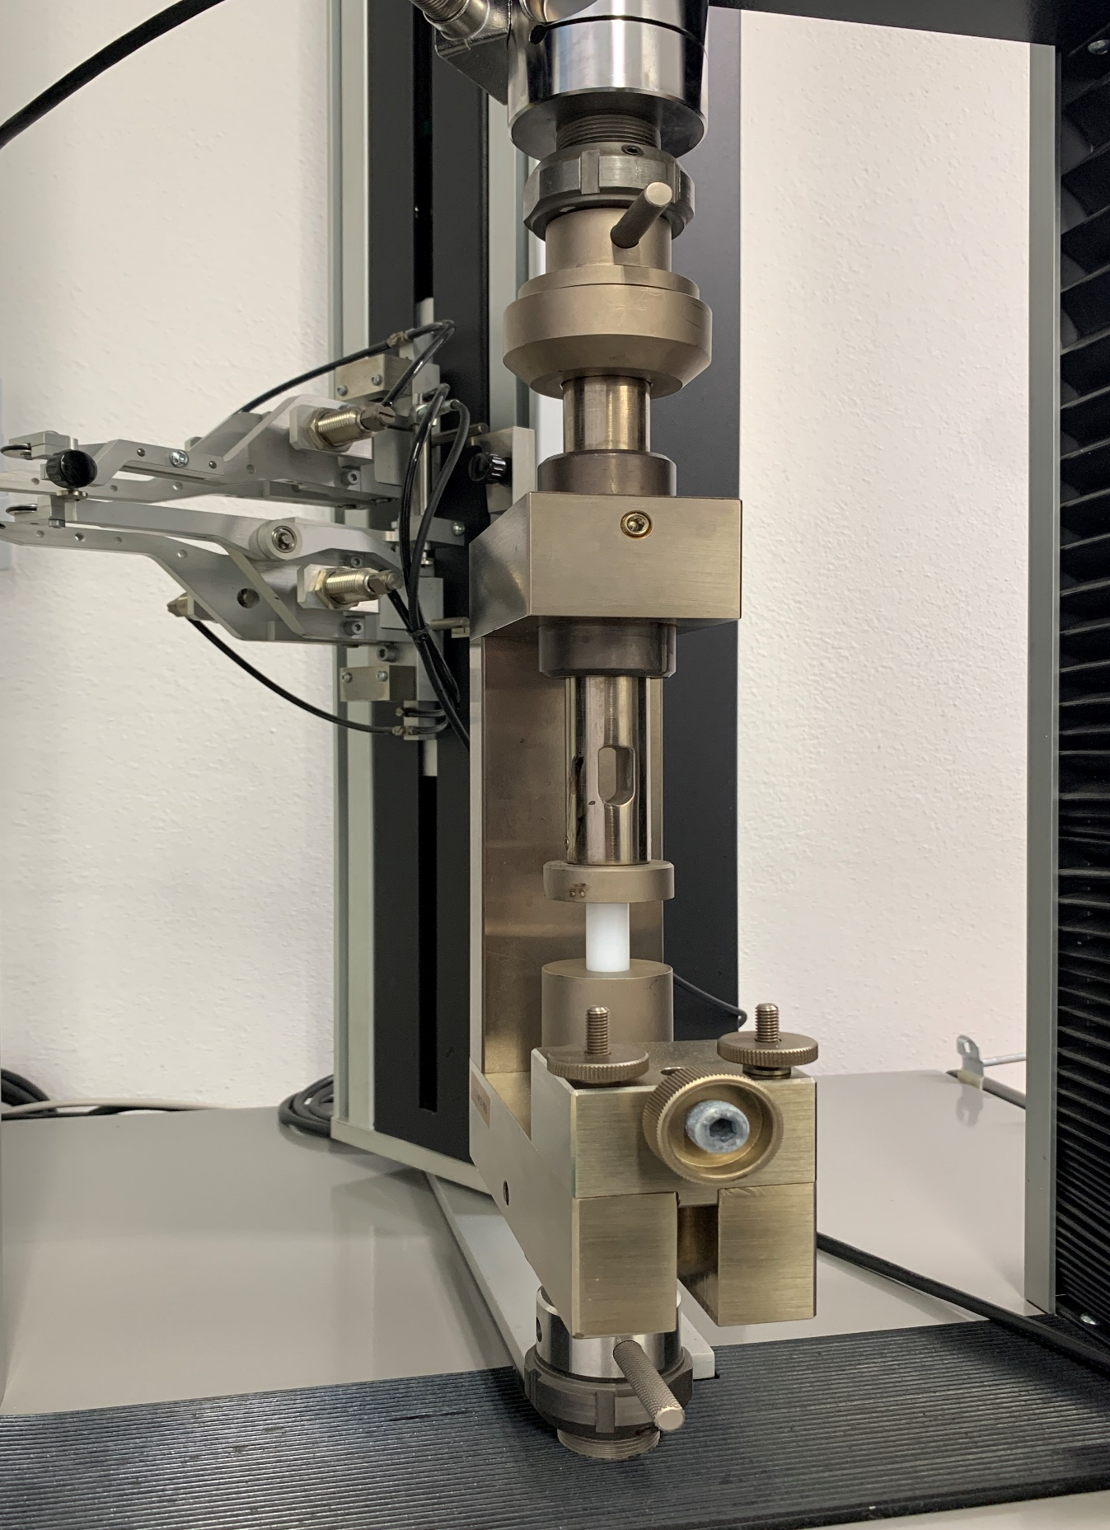
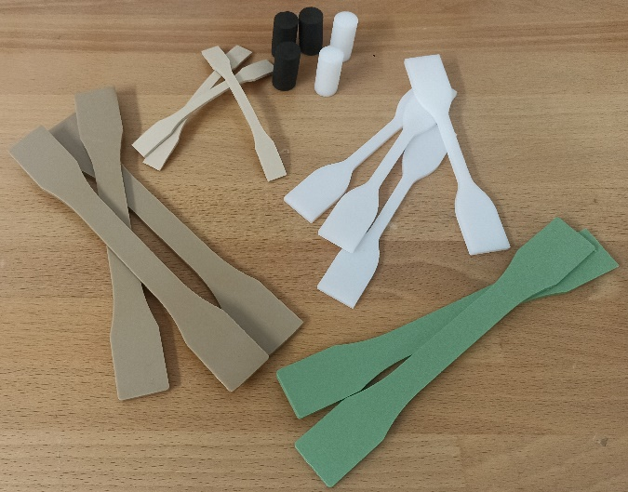
Seal definition: pre-selection
Materials tested in Effeciemme Lab
Materials
PTFE base, jacket
PEEK base, back up / anti collapse ring
Spring in Elgiloy UNS R30003
  Jacket: Polythem® E
  Spring back up: Polythem® K
  Back up: Polythem® K
  Anti collapse ring: Polythem® K

Slide 20
Seal definition: pre-selection
  Jacket: Polyhtem® E
  Spring back up: Polythem® K
  Back up: Polythem® K
  Anti collapse ring: Polythem® K
Materials
PTFE base, jacket
PEEK base, back up / anti collapse ring
Room temperature At 130°C Comparison

Slide 21
Seals arrangement
and materials
testing
campaign
Seal definition: strain
analysis
Iterative FEA
Prel. FEA
Final design
ORGANIZERS
CONFERENCE ORGANIZERS

Slide 22

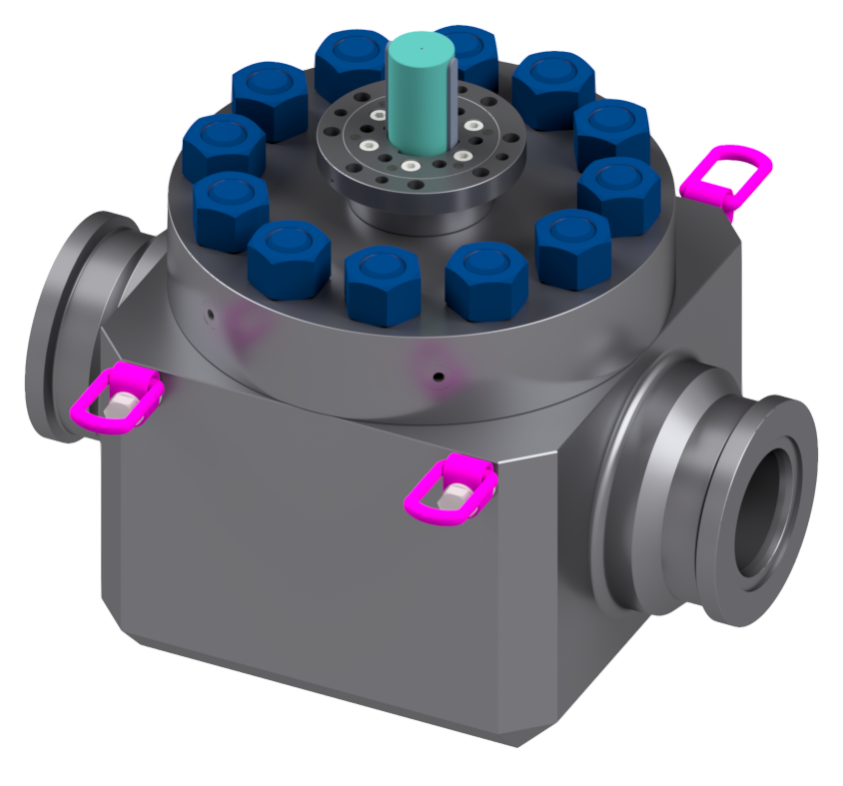
Iterative FEA
After receiving the PO by the customer, the preliminary design moved to the industrialization phase.
A close-to-final design has been developed considering detailed information:
Design temperature range
End connection configuration
Non-linear material model

Slide 23
Trim FEA (proprietary method)
The analysis of the valve trim (ball and seats) is carried out to obtain three important information.
In this stage the focus was to give the seals manufacturer a range of grooves elastic deformations to determine preliminary seals cross sections and configurations.
The analysis of the valve trim (ball and seats) is carried out to obtain three important information:
Maximum value of contact pressure between ball and seat and contact continuity
Stress level
Ball and seats elastic deformation, that contributes to tightness capability

Slide 24
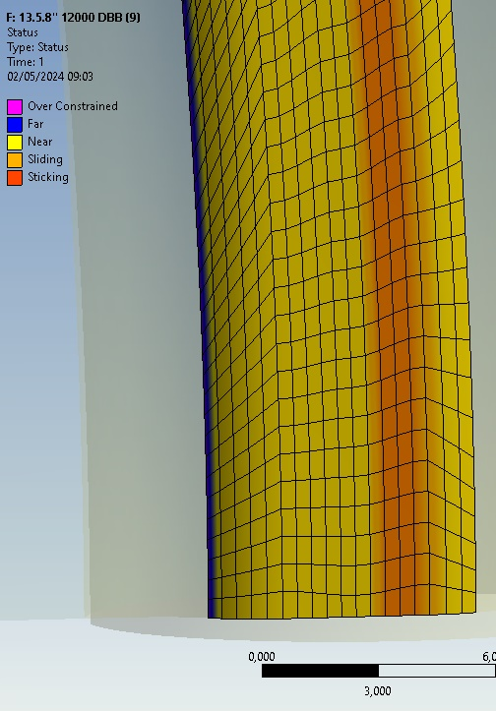
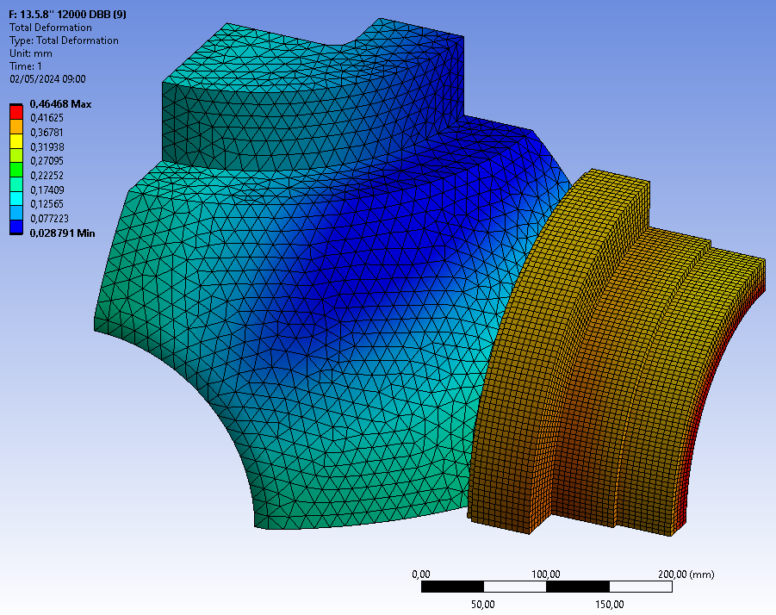
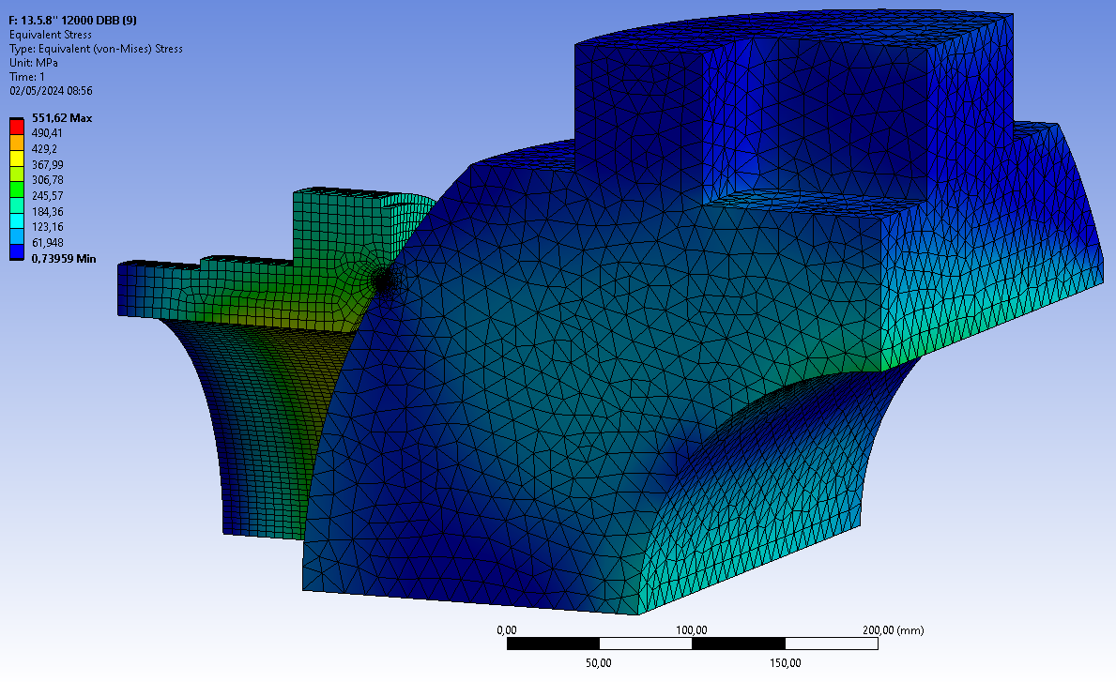
Trim verification
Finite element analysis of trim components is the first step to define the design of the valve.
This test is carried out at the maximum rated pressure considering elastic-perfectly-plastic material model and frictional contact between ball and seat:
DBB load case (worse condition for resulting stress and strain levels)
Single-side load case (to evaluate upper trunnion stress map)

Slide 25
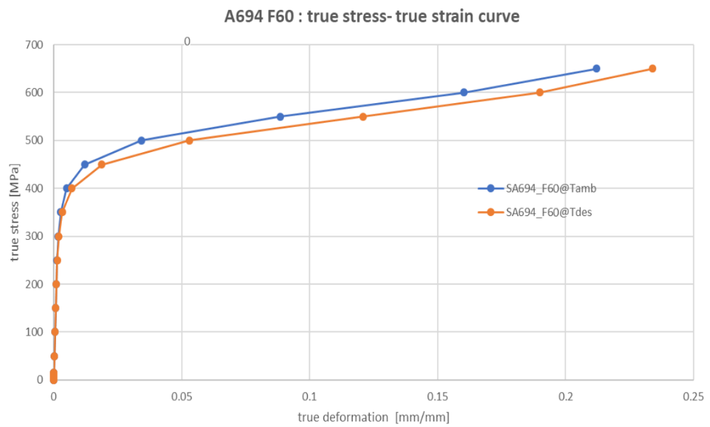
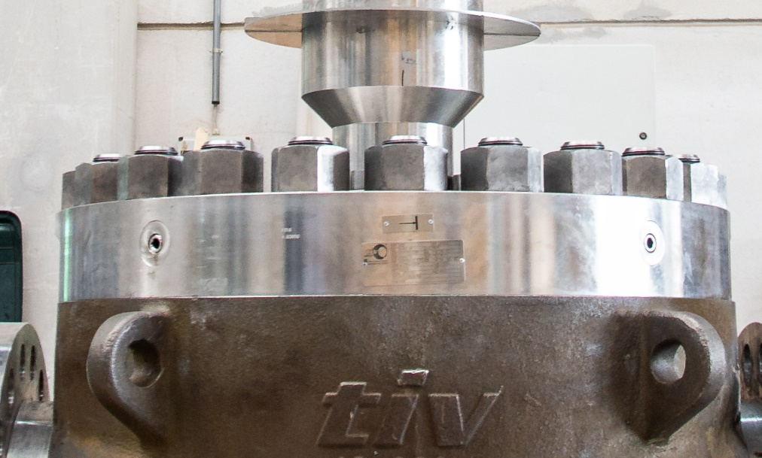
Body FEA (ASME BPVC sect. VIII div. 3)
Global collapse
Elastic-plastic material
Load factor 1,8

Slide 26
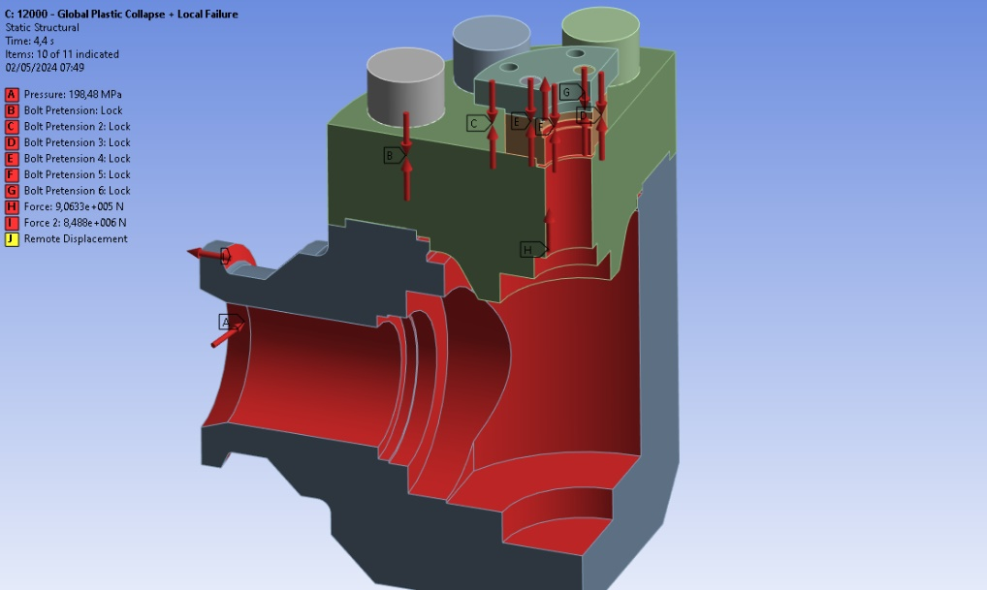
Body FEA (ASME BPVC sect. VIII div. 3)
Global collapse
Local failure
Elastic-plastic material
Load factor 1,8
Elastic-plastic material
Load factor 1,28

Slide 27
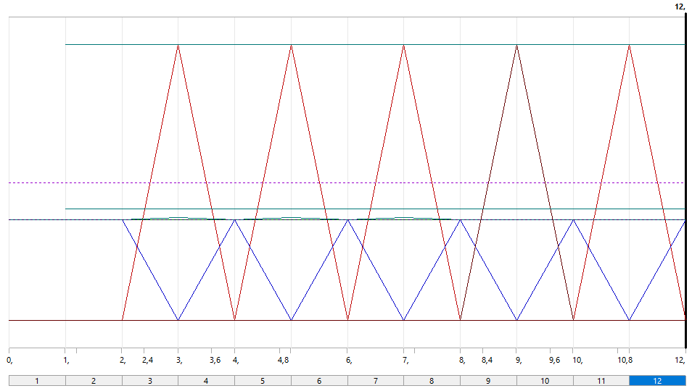
Body FEA (ASME BPVC sect. VIII div. 3)
Global collapse
Local failure
Ratcheting
Elastic-plastic material
Load factor 1,8
Elastic-plastic material
Load factor 1,28
Elastic-perfectly-plastic material
Load factor 1 – 5 cycles

Slide 28
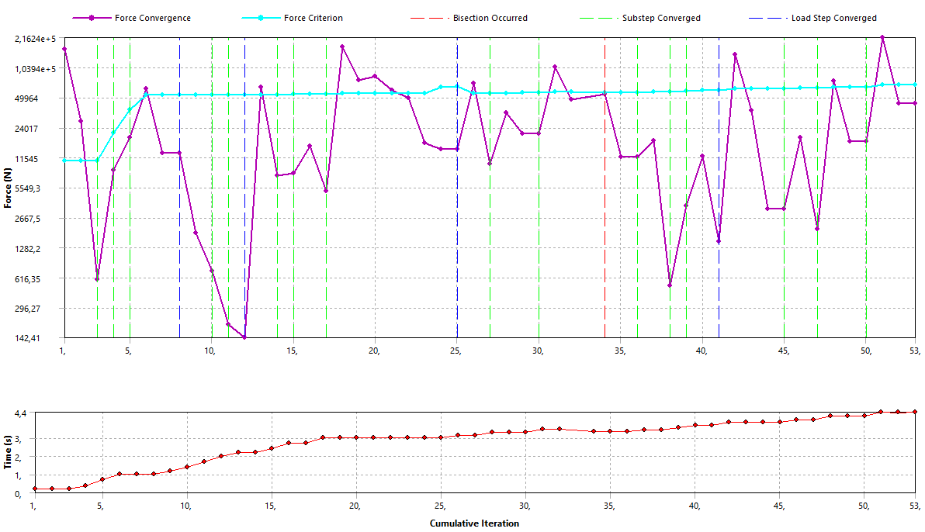
Assessment against global collapse
The aim of this analysis is to check the stability of the pressure containing components.
The test is performed considering a load factor defined by the code under these assumptions:
True stress-true strain material model at the maximum design temperature
Non-linear effects are to be considered
Acceptance criterion is the FEA convergence.

Slide 29
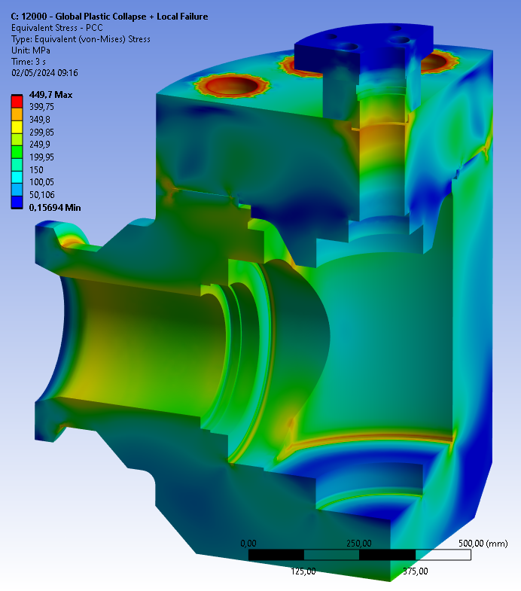
Assessment against local failure
The aim of this analysis is to verify that the triaxial plastic strain is below the limit defined by the code.
The plastic strain limit depends on the following:
Yield VS tensile strength ratio
Elongation and reduction of area (tensile test)
Material family (e.g. duplex or nickel alloys)
The material model is the same of the global collapse step. The load factor used is 1,28.

Slide 30
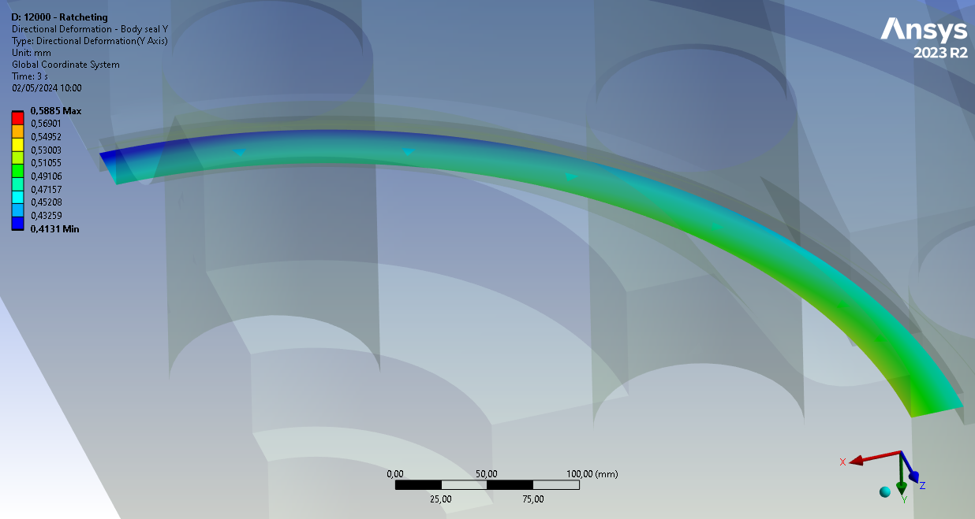
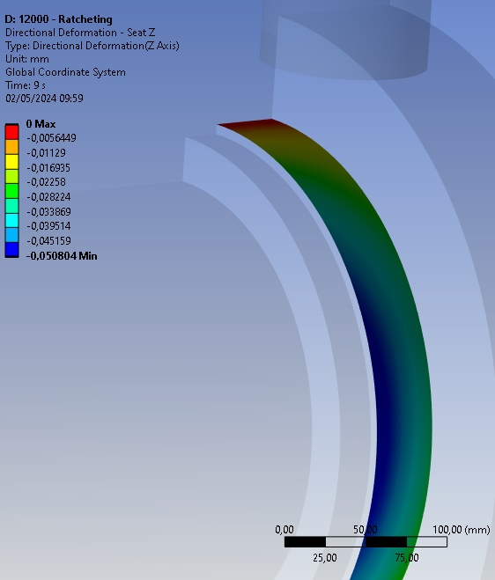
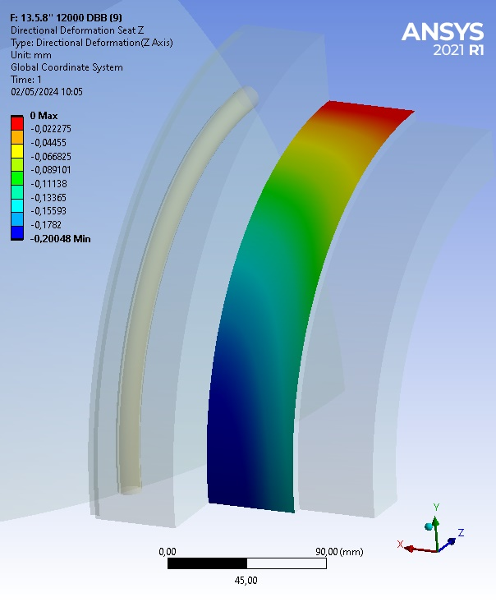
Assessment against ratcheting
The third step verifies there is no incremental plastic strain of the pressure containing parts after cycling at maximum rated pressure.
The analysis is based on these assumptions:
Elastic-perfectly-plastic material model (with yield strength at maximum design temp.)
Pressure cycling between 0 and 827 bar
Five cycles (the minimum defined by the code is three)

Slide 31
Seals arrangement
and materials
testing
campaign
Seal definition: strain
analysis
Iterative FEA
Prel. FEA
Final design
ORGANIZERS
CONFERENCE ORGANIZERS

Slide 32
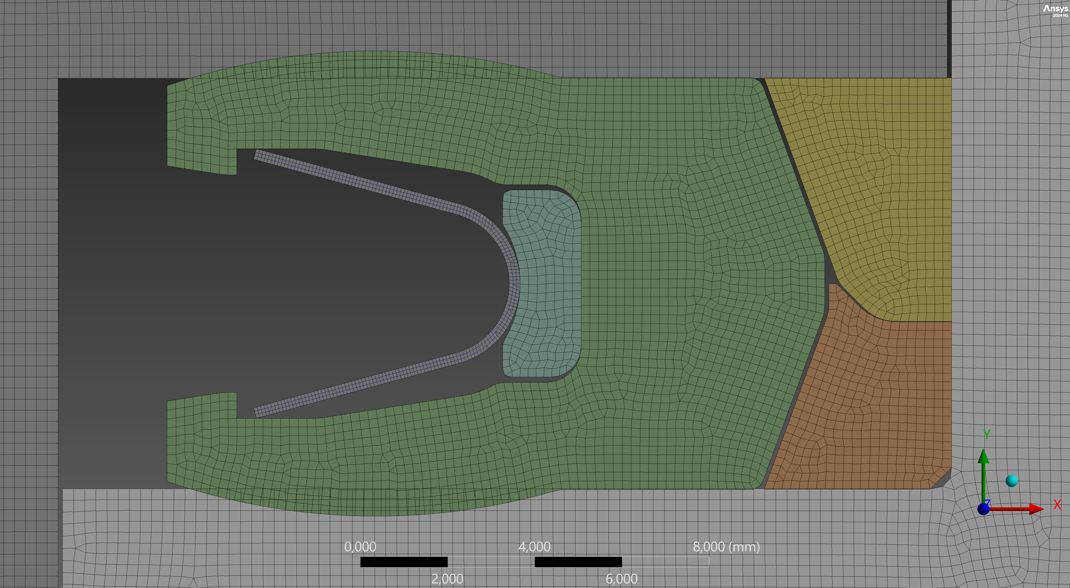
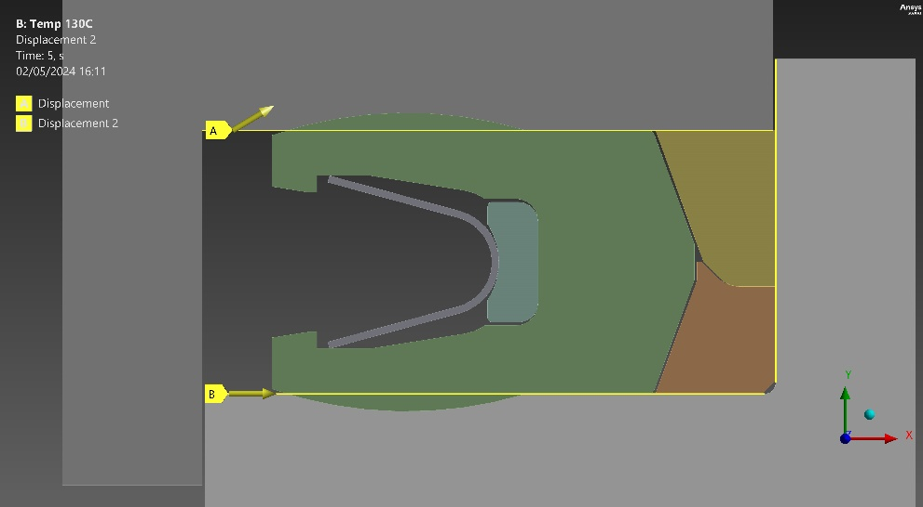
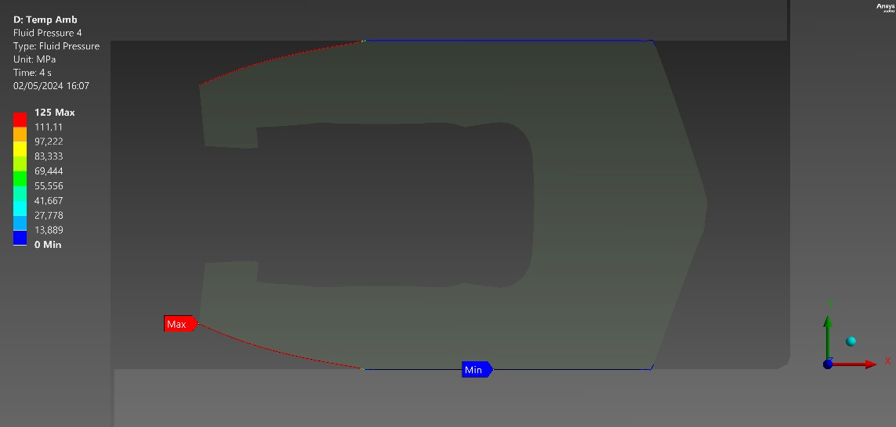
Seal definition: analysis with FEA
Analysis type
2D axisymmetric
materials curves by Effeciemme mechanical tests (tensile and compression)
Geometry and mesh
Constraints
Loads at room temperature
Loads at 130°C
Metal groove
Displacement due to groove temperature and pressure deformation
External load on seal jacket
Internal load on seal jacket

Slide 33
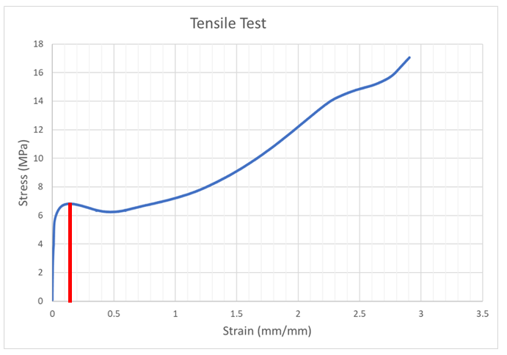
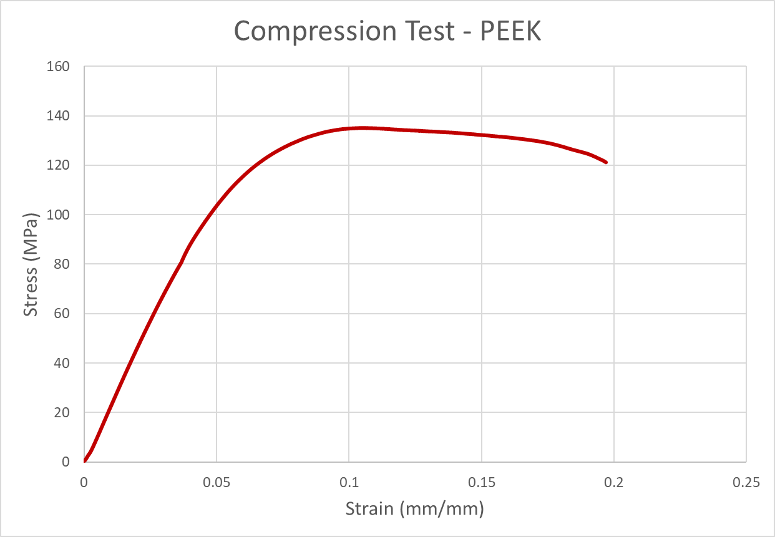
Seal definition: analysis with FEA
Acceptable criteria: based on deformation
Tensile
Chart strain/stress
Compression
Chart strain/stress
Acceptable Criteria
Compression limit = Tensile limit
  CONSERVATIVE CONDITION
50 % of section within the limit

Slide 34
Seal definition: analysis with FEA
Results
Room temperature
130°C
Total deformation
Equivalent elastic strain
1. TIME 1 – assembling (room temperature and T=130°C)
2. TIME 2’- temperature +130°C – thermal expansion +0.83 (T=130°C)
2. TIME 2 - Pressure 42 MPa – groove deformation +0.16 mm (room temperature and T=130°C)
3. TIME 3 - Pressure 83 MPa – groove deformation +0.33 mm (room temperature and T=130°C)
4. TIME 4 - Pressure 125 MPa – groove deformation +0.50 mm (room temperature and T=130°C)

Slide 35
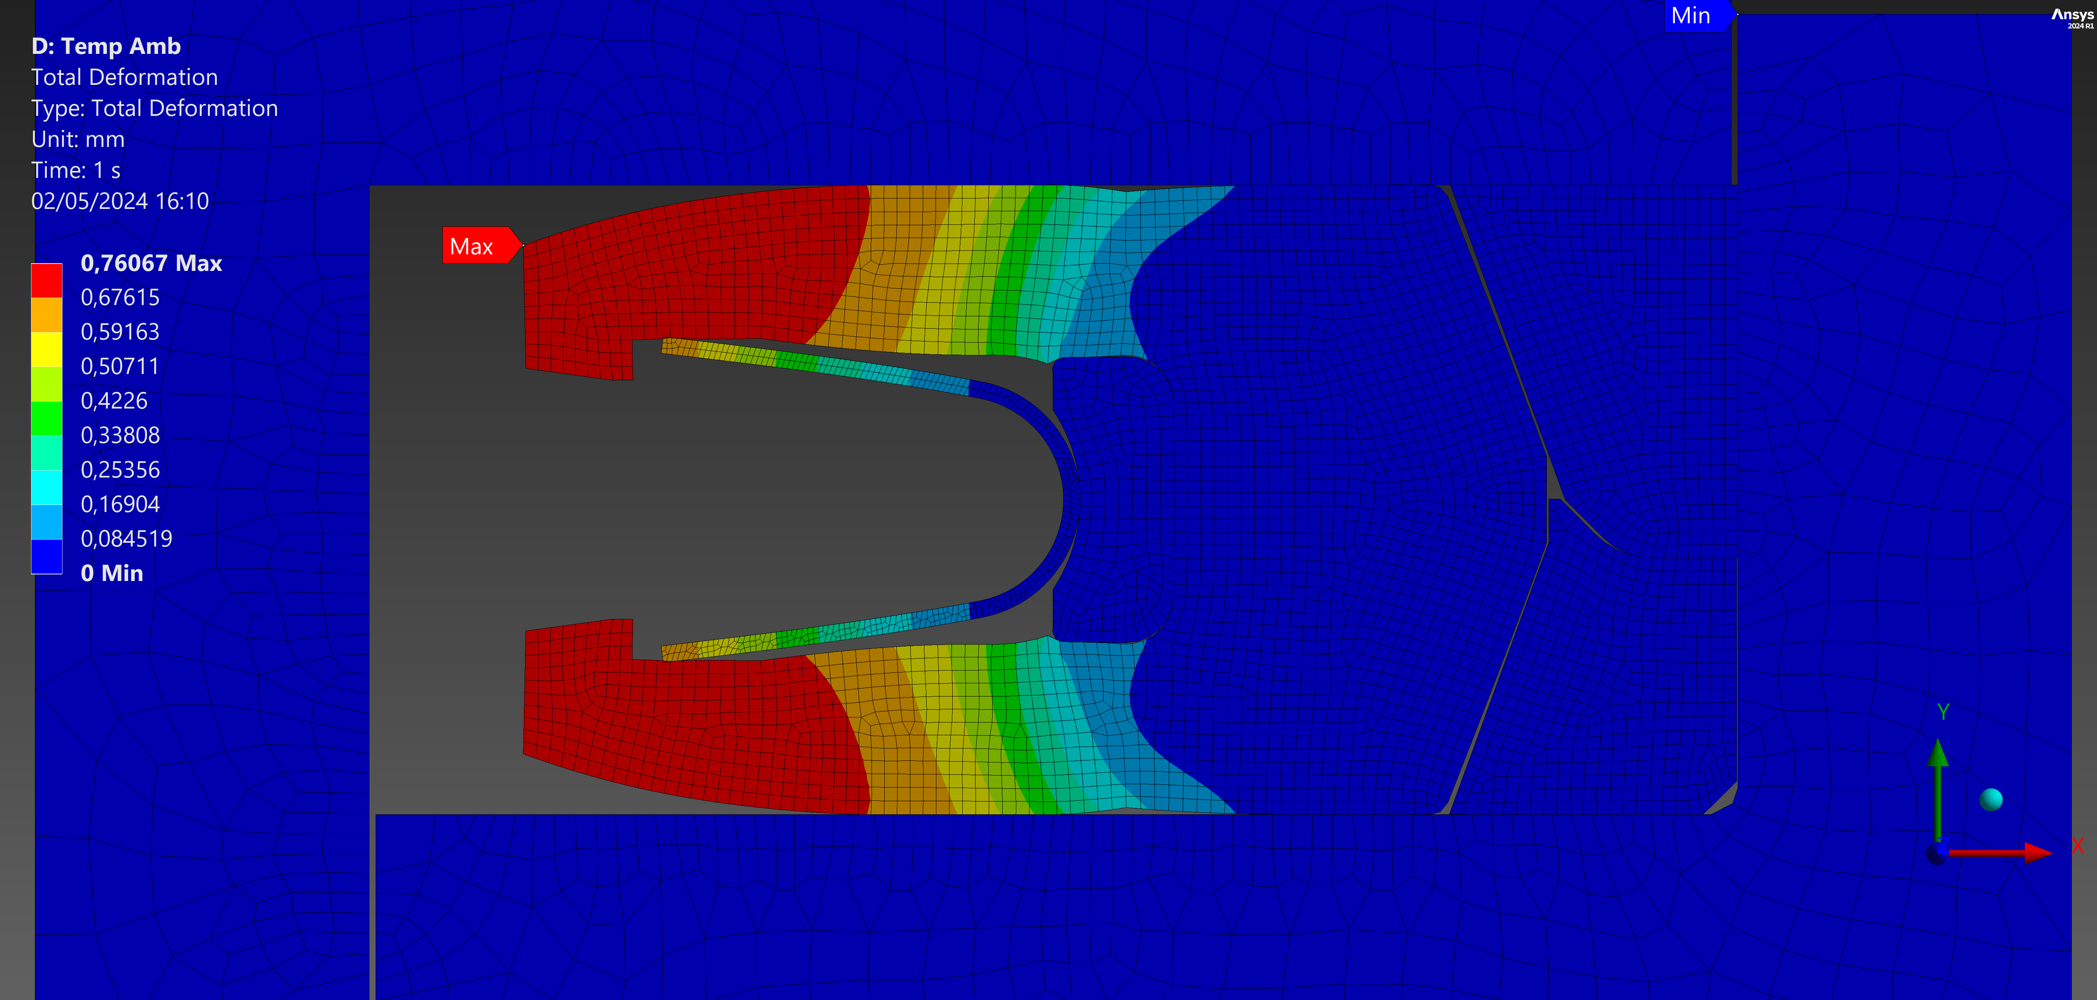
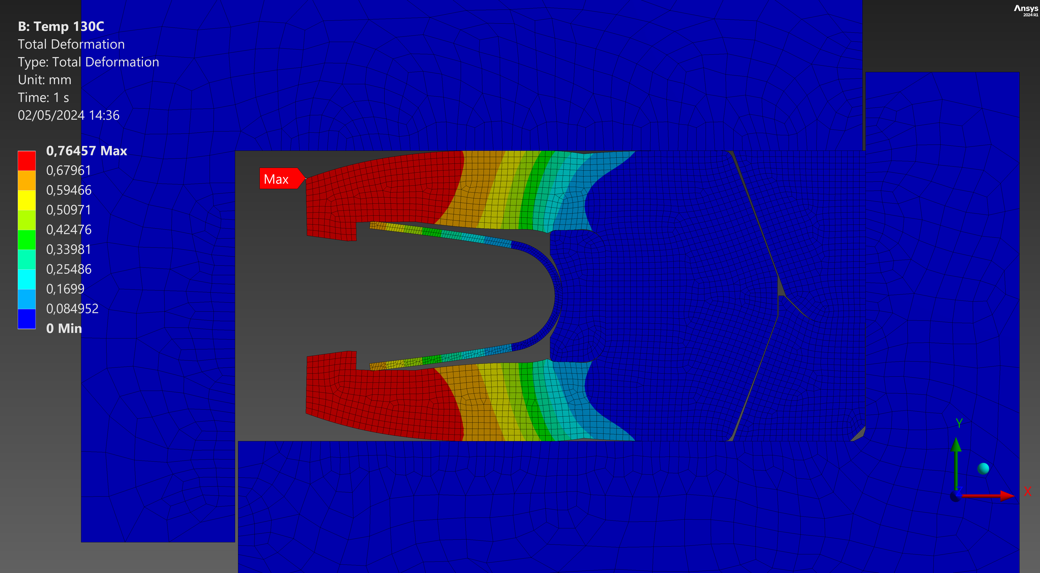
Seal definition: analysis with FEA
Results: Room temperature 130°C
Total deformation
TIME 1- Assembling

Slide 36
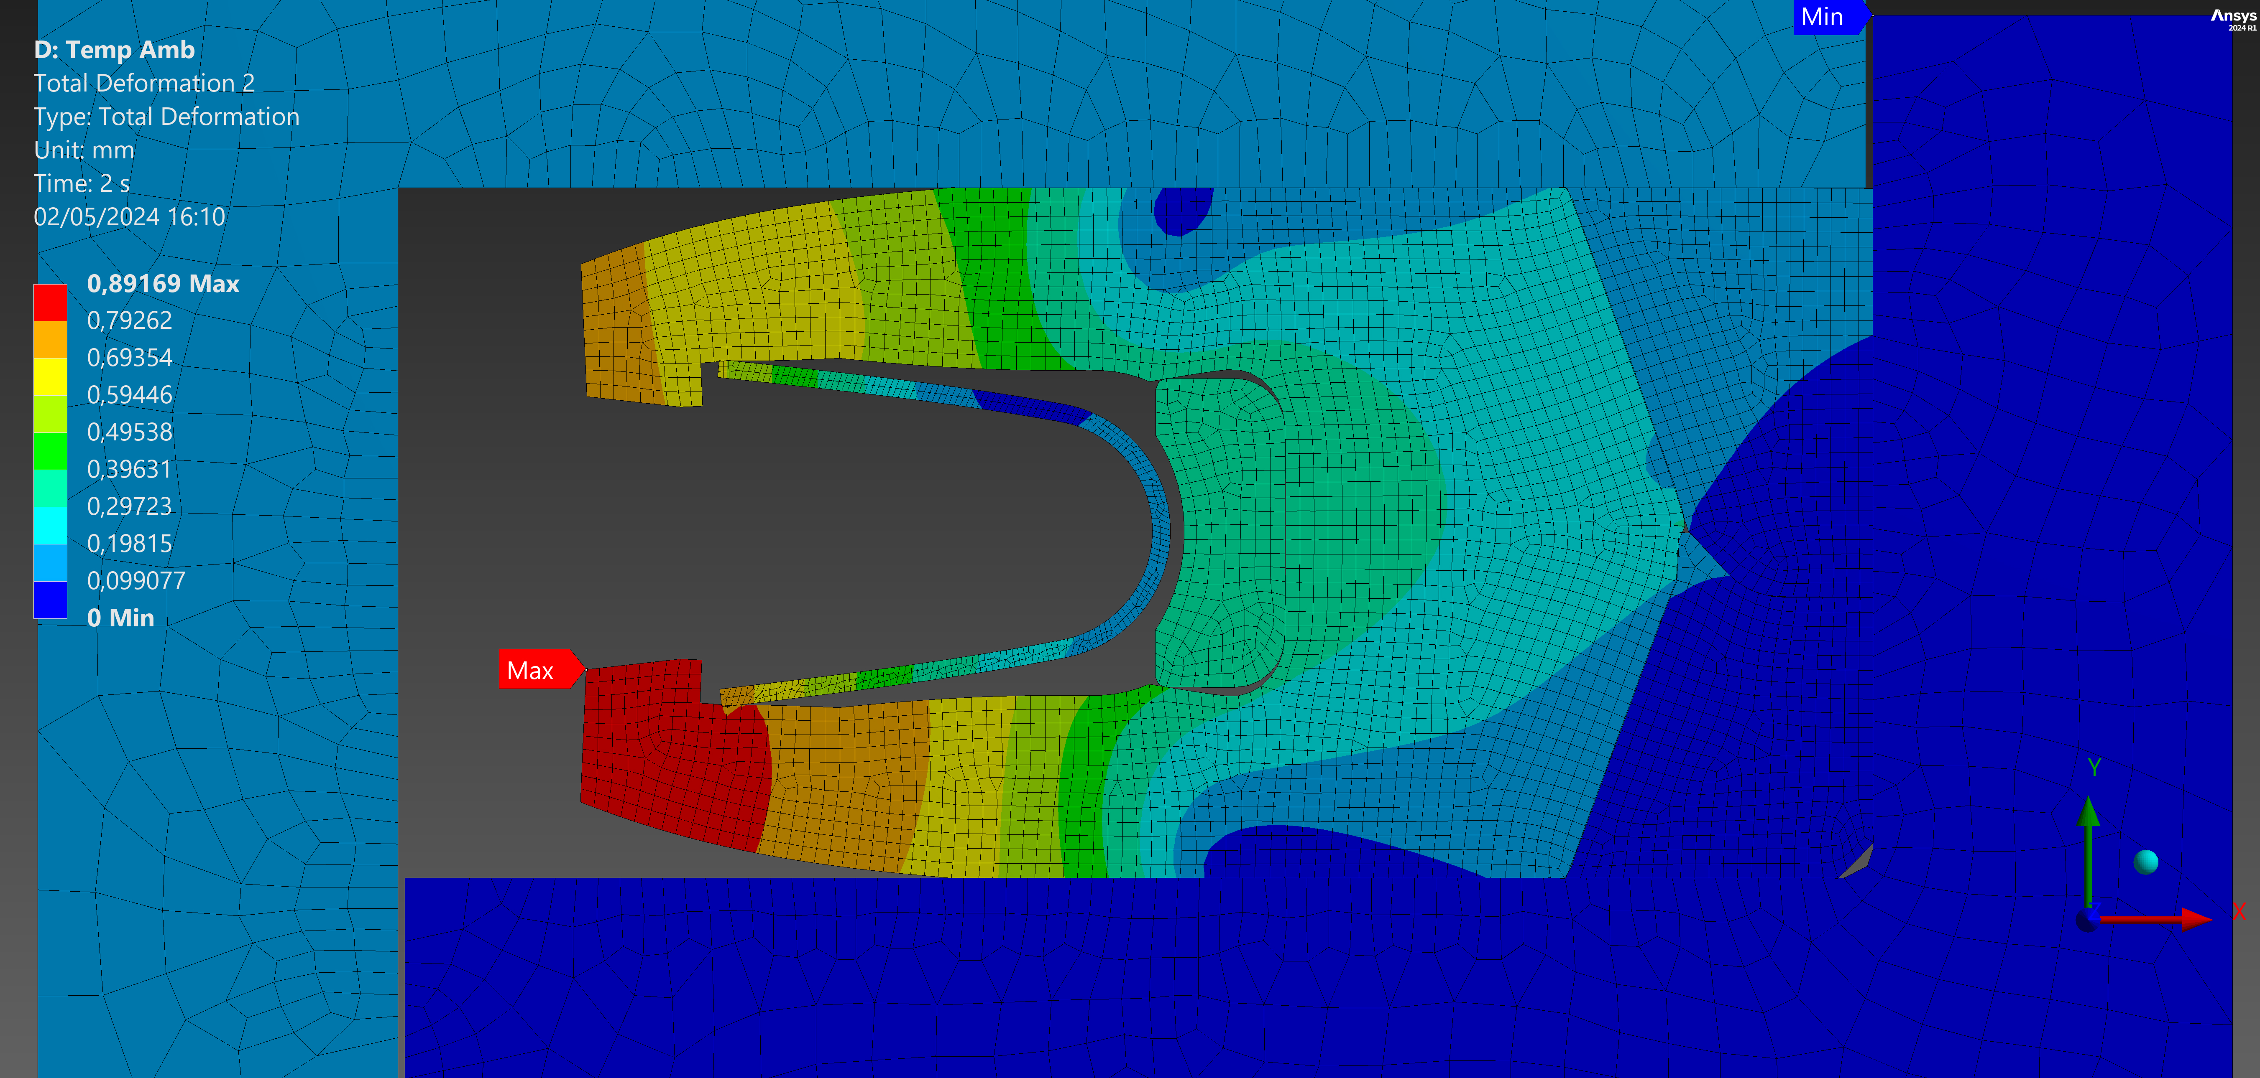
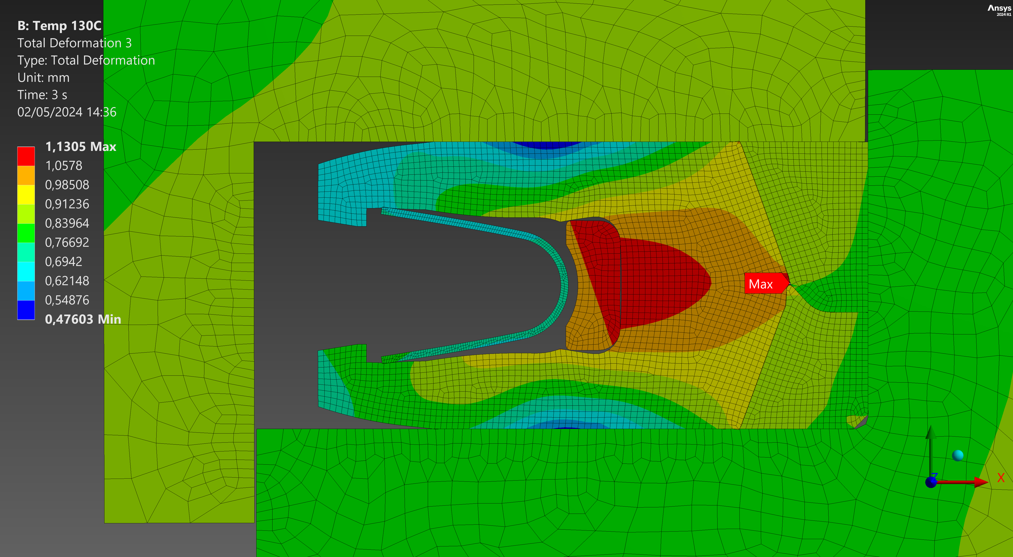
Seal definition: analysis with FEA
Results: Room temperature 130°C
Total deformation
TIME 2 - Pressure 42 MPa – groove deformation +0.16 mm

Slide 37
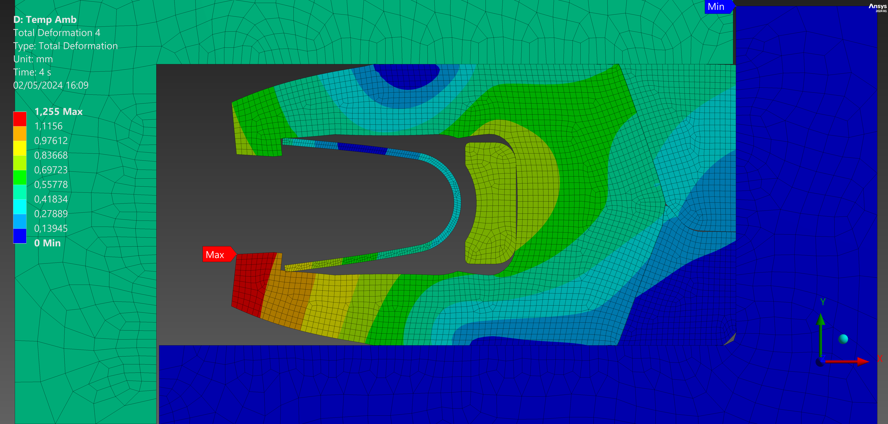
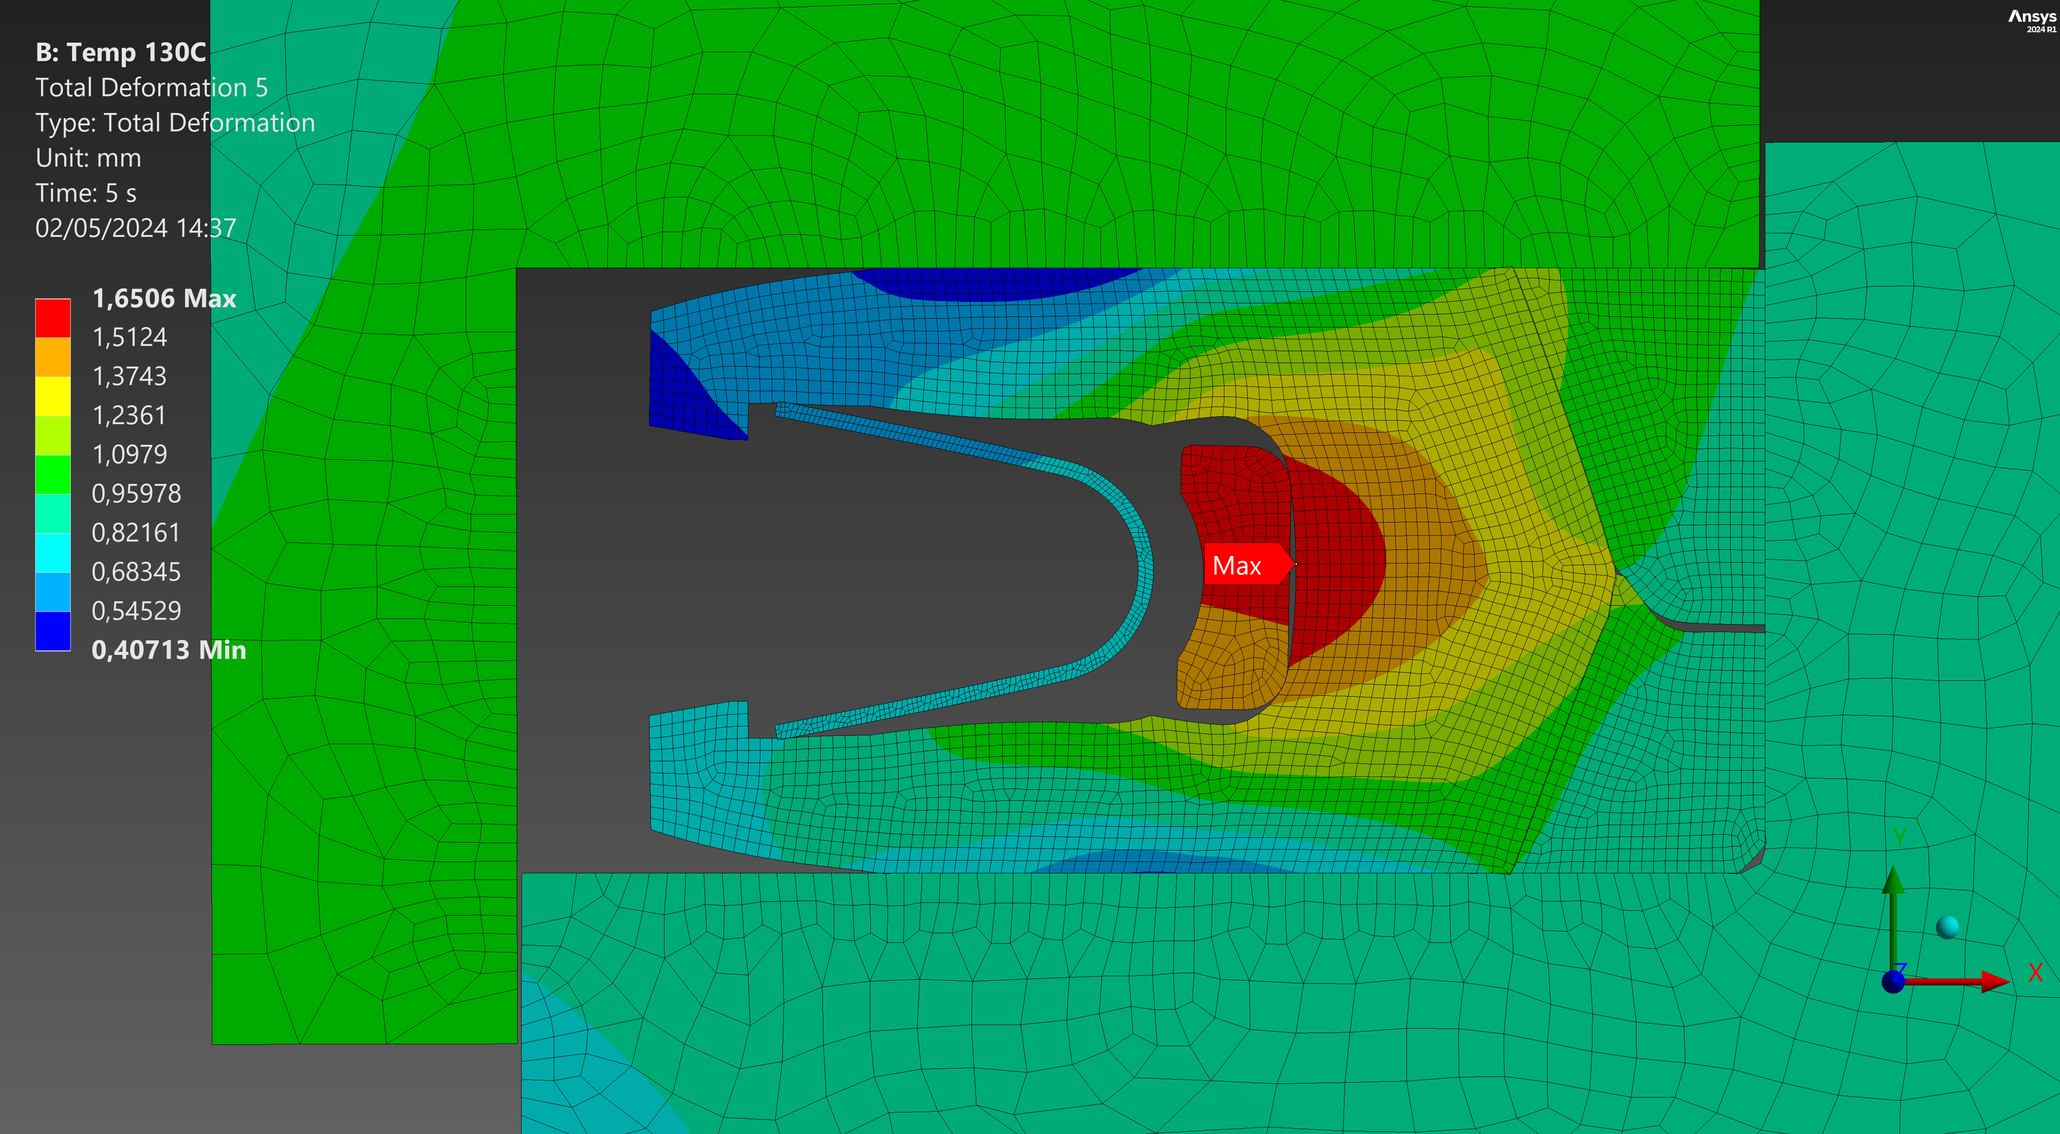
Seal definition: analysis with FEA
Results: Room temperature 130°C
Total deformation
TIME 4 - Pressure 125 MPa – groove deformation +0.50 mm

Slide 38
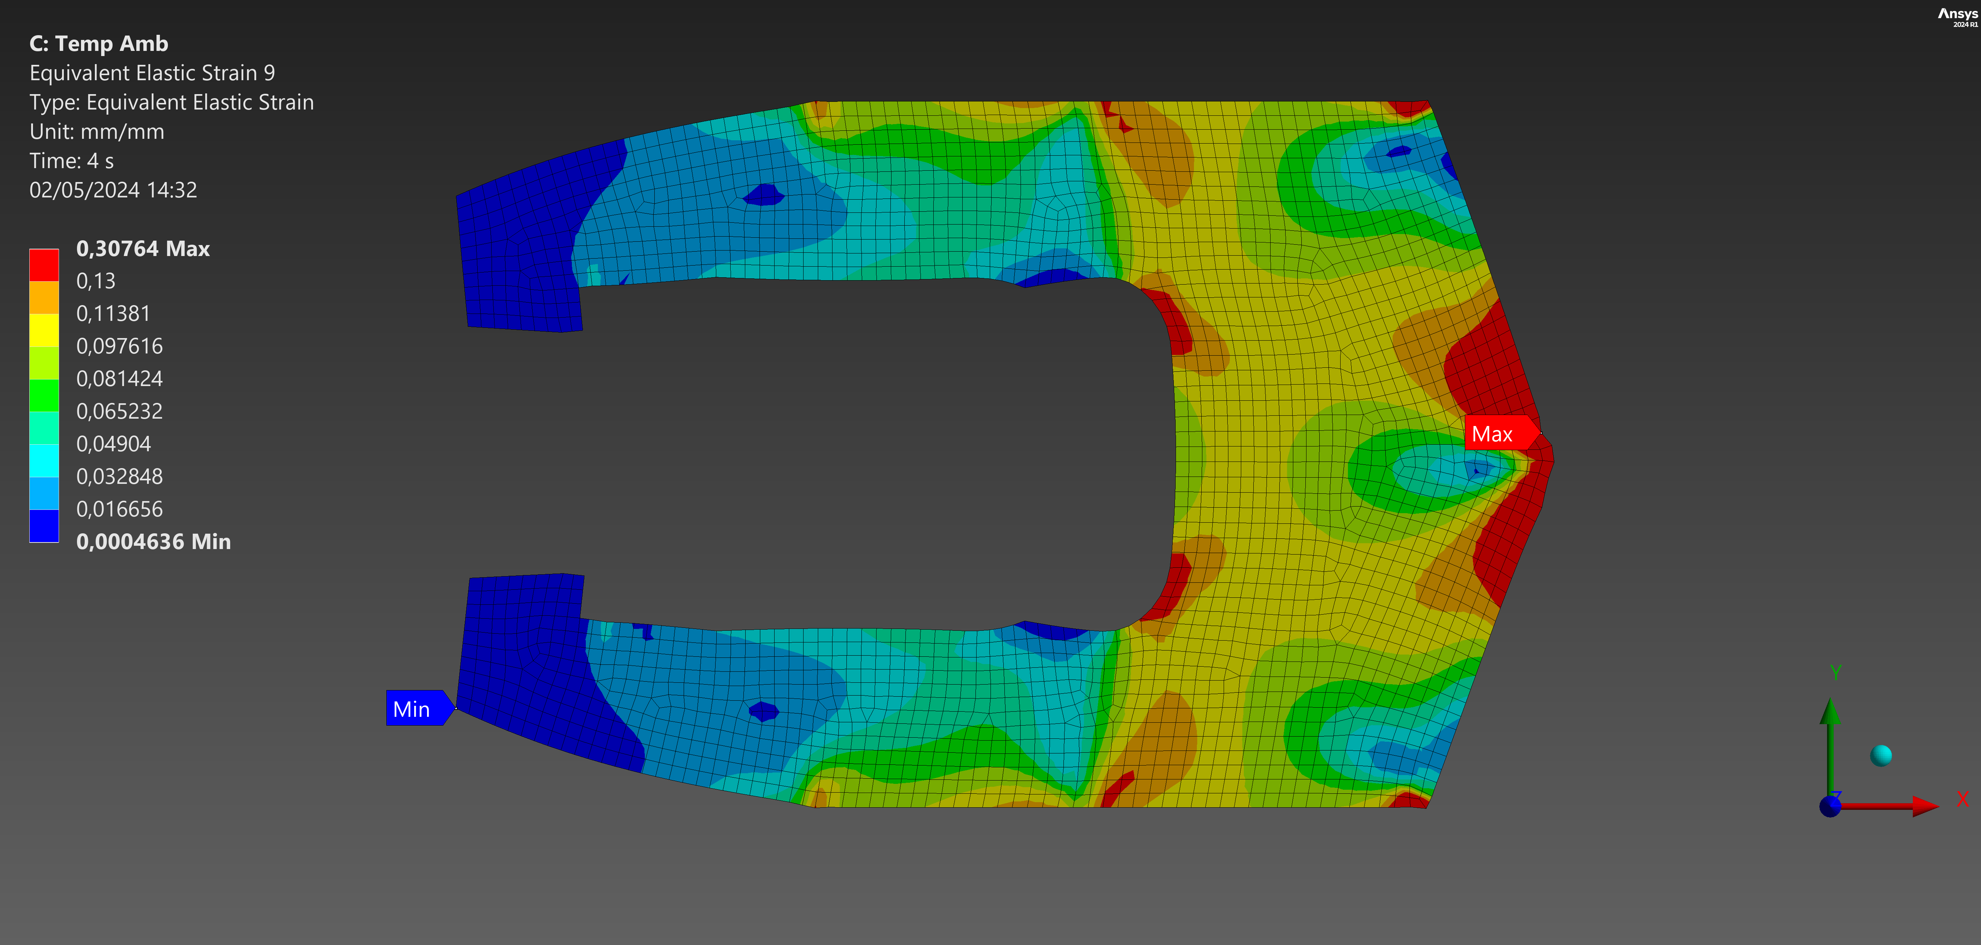
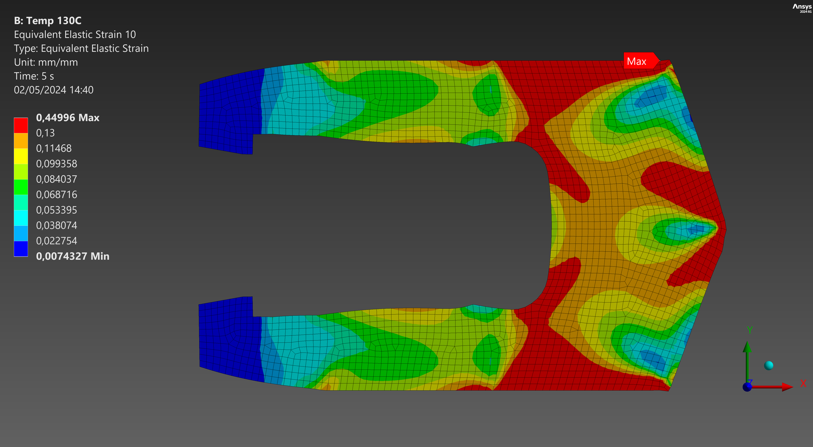
Seal definition: analysis with FEA
Results: Room temperature 130°C
Equivalent Elastic Strain
TIME 4 - Pressure 125 MPa – groove deformation +0.50 mm

Slide 39
Seals arrangement
and materials
testing
campaign
Seal definition: strain
analysis
Iterative FEA
Prel. FEA
Final design
ORGANIZERS
CONFERENCE ORGANIZERS

Slide 40
Seal geometry
Back up has a good behaviour:
- it follows the groove deformation
- jacket has no extrusion
Recommendations for metal groove design:
- groove dimensions
- tollerance
- surface finishing
- chamfer
.
Seal’s design final verification
ORGANIZERS
CONFERENCE ORGANIZERS

Slide 41
Mechanical integrity
The valve assembly satisfies project requirements:
- Acceptable stress level at test condition
- No progressive distortion of components
Pressure sealing integrity:
Combined elastic deformation of valves components and seals do not represent an issue both at test and operating conditions
Valve’s design final verification
ORGANIZERS
CONFERENCE ORGANIZERS

Slide 42
The results collected by TIV about both trim and pressure containing components elastic deformation formed the input information for the design and development of the final version of static and dynamic seals.
Together with project specifications and operating conditions, this study gave fully awareness to Effeciemme to define a fully customized solution.
Conclusions
ORGANIZERS
CONFERENCE ORGANIZERS

Slide 43


Slide 44
Thanks
ORGANIZING SECRETARIAT
Ph. +39 035 3230904
e-mail info@industrialvalvesummit.com
CONFERENCE ORGANIZERS
Ph. +39 3474908420
e-mail segreteria@valvecampus.com
www.industrialvalvesummit.com
www.valvecampus.com

