Slide 1
Magnetic Applications for Severe Services
CONFERENCE
ORGANIZERS

Slide 2
Magnetic Applications for Severe Services
Elimnate Fugitive Emissions Through Magnetic Actuation
Stephen Sanford | COO, MagDrive Technologies, Inc.

Slide 3
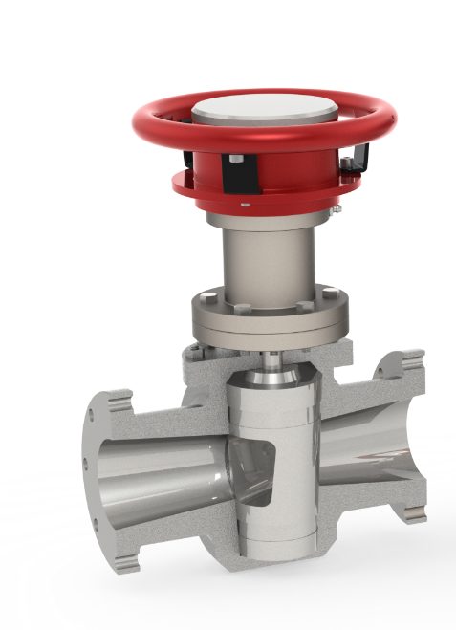
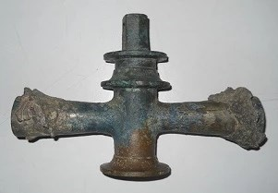
History
Valves have been in use since the Roman Aqueducts
Photo credit, all: Ministry for Better Cultural Activities — Superintendent for Archaeological Good of Naples and Pompeii (Valve World Mag 2013)

Slide 4
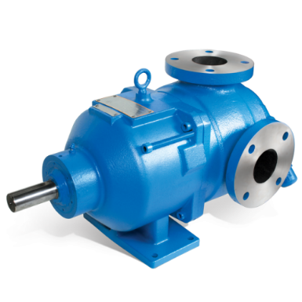
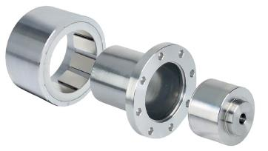
History
Magnetic Drive Pumps have been in use for over 70 years
Considered Inherently leak-free since dynamic seals have been replaced with magnetic couplings
No drive shaft penetrates the fluid chamber, which has been associated with leakage
Notes:
If magnetically driven pumps have been around for some time preventing leakage of hazardous fluids and chemicals, why haven't we seen valves make the same breakthrough?

Slide 5
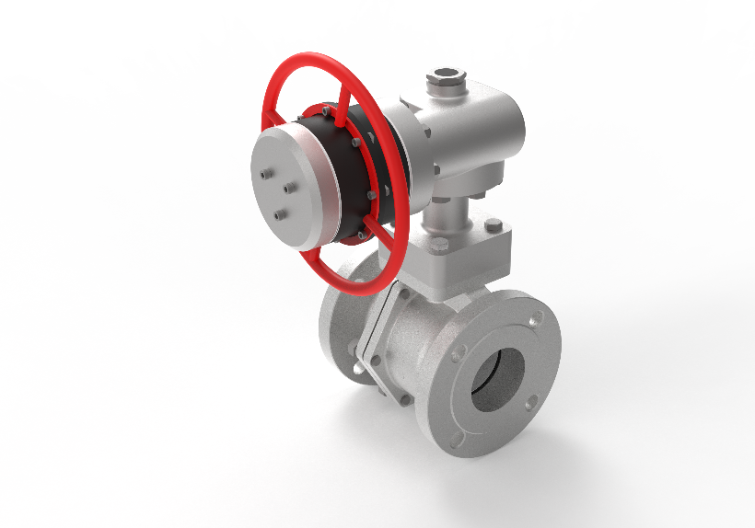
History
Magnetic Drive Valves were actually first developed in the 1940’s
Similar to pumps, but pumps need high speed, low torque
Valves need low speed, high torque
Advancements in magnets and the coupling of gear reduction has allowed us to bring magnetic actuation into real applications through retrofits and custom valves

Slide 6
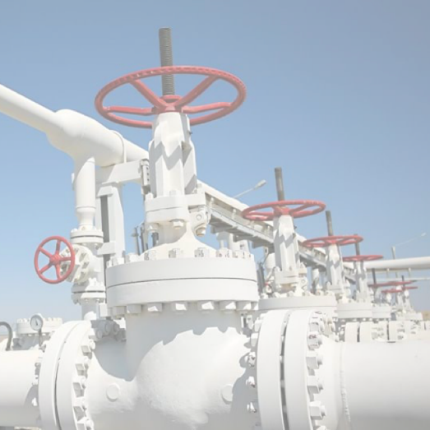
Industry Has a Leak
Leaking Valves are the #1 recorded source of fugitive emissions, loss of product, and cause of EPA fines.
60% of all Fugitive Emissions come from valves, primarily from the valve stem.

Slide 7
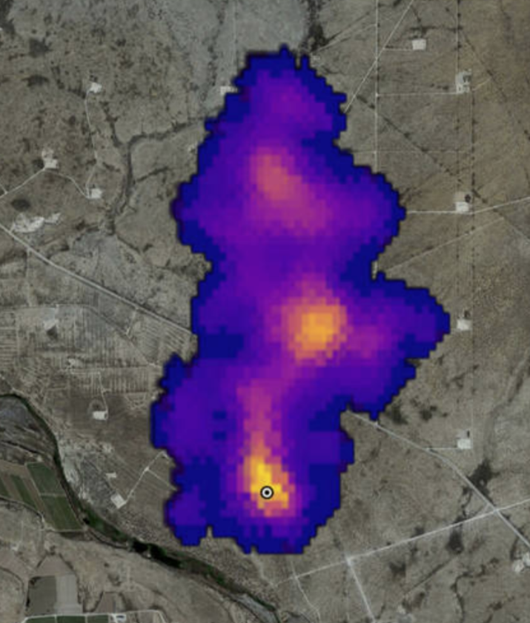
Methane
Methane Super-Emitters Mapped By NASA
Magnetic Actuation is ideal for fluids and gases that are:
Hazardous
Lethal
Costly

Slide 8
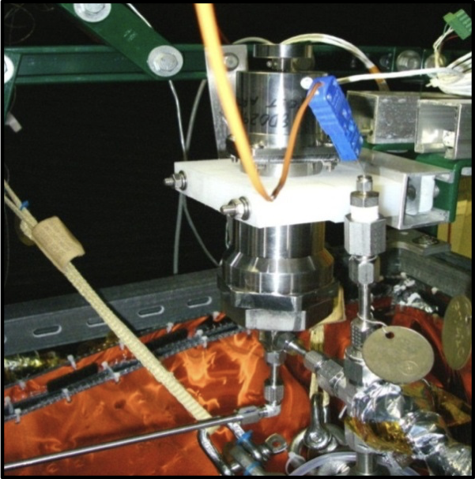
Cryogenic Application For NASA
3500 psi
-300 F
Helium
Super Sonic Speeds
Hermetically Sealed
Replaced large stems and payload cost
ZERO EMISSIONS!
CONFERENCE ORGANIZERS
Notes:
Magnetic valve installed in the cryogenic feed system test stand: JSC-Houston

Slide 9
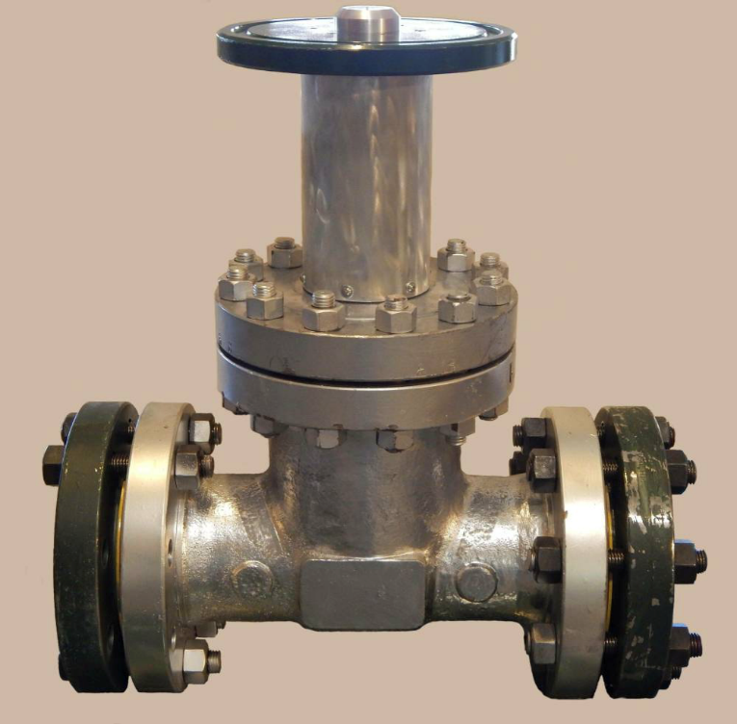
Testing
CERTIFICATION
ISO & American Petroleum Institute Validation
Magnetically driven valves have gone through rigorous testing and have been certified by independent testing laboratories passing some of the most stringent tests for oil and gas valves: Tests like ISO 15848-1 & 2, API 624, and API 6FA.

Slide 10
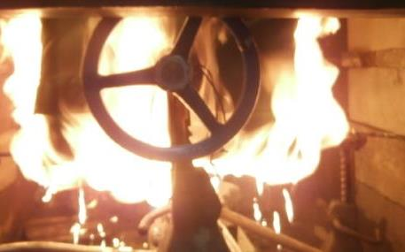
Testing
Magnetically-driven valves have Passed the API 6FA Test
Heat with flame to 1800F for 20 min
Let cool to ambient temp
Rapid Succession - No Adjustments
Measure how much they leak
Did not leak - 0 ppm
Then completed over 40,000 additional actuations

Slide 11
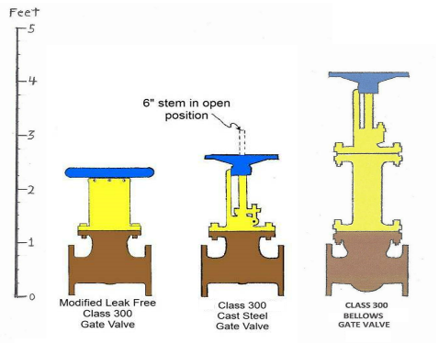
Compared To Bellows
Bellows Valves
Primarily rising stem valves
Often much taller
Limited actuations
MagDrive Valves
Both rising stem and quarter turn
Compact Size
Many actuations

Slide 12
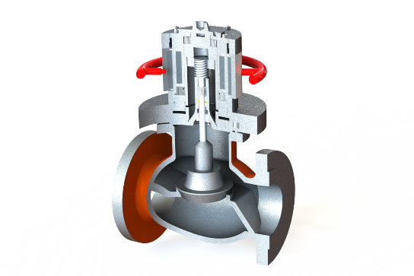
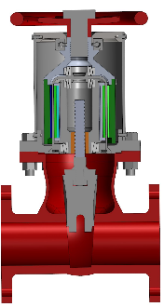
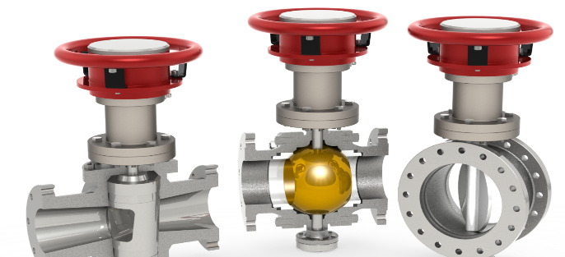
Applications
¼”-48”+
It is not the valve but works in conjunction with many standard valves
Plug, Ball, Butterfly, Gate & Globe

Slide 13
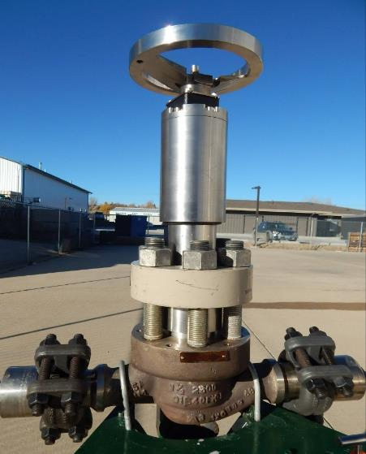
Naval Marine Power
1 ½ Inch Class 2500 Globe Valve Operator
High pressure, High temperature
Specialty: Water & CO2
100 in-lbs. of torque
Hydrostatic Tested to 5250 psig,
1770 lbf of seating force

Slide 14
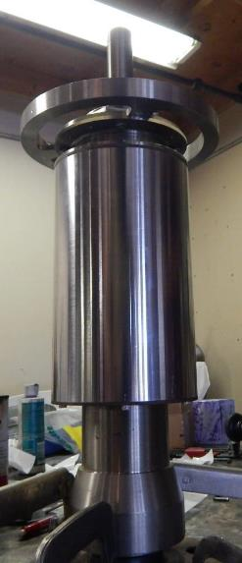
Torque Limiter
4” Globe Valve Operator
900-1000 in-lbs of torque
High pressure - High temperature
½” dia. shaft twisted by the magnetic coupling
Can calculate for Infinite Shear Pin

Slide 15
Torque Limiter
Since Torque can be calculated precisely for the magnetic array and gear reduction, we create a torque limiter
Useful for Electronic and Pneumatic Actuation
No Failure Inside Pressure Boundary
No Broken Parts
Immediately Resets

Slide 16
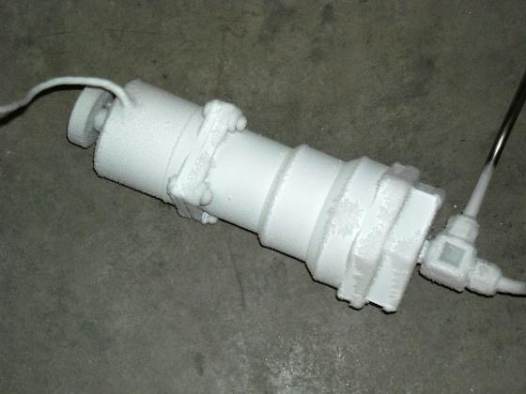
Cryogenic Applications
Able to eliminate packing altogether
Eliminates Stem/Bonnet Extensions
Low friction operation
Temperature change does not cause leak through stem seals when valves are chilled since dynamic seals are eliminated
Magnets are stronger in cold!

Slide 17
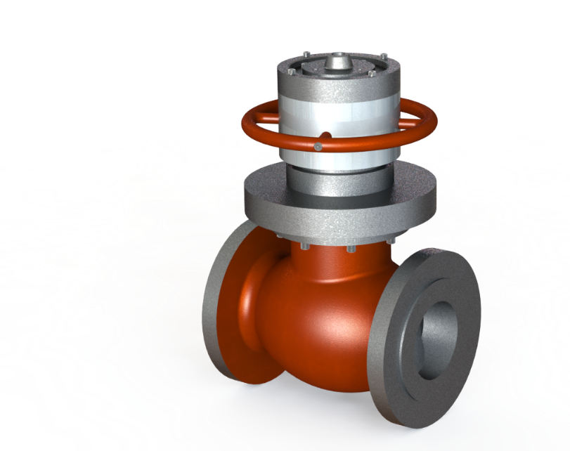
High Temperature Applications
Operating at high temps has always a problem for packing
Many Magnets can operate up to 650F
Some specialty magnets can operate up to 1000F and beyond
Does not depend on Stem Packing

Slide 18
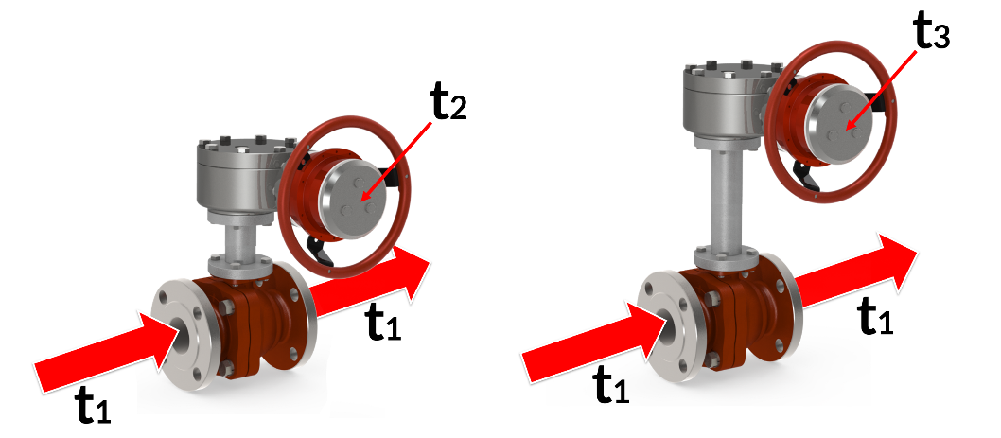
High Temperature Applications
Temperature of the magnetic coupling is not the same as the process fluid
Notes:
Something to keep in mind for magnetic performance…

Slide 19
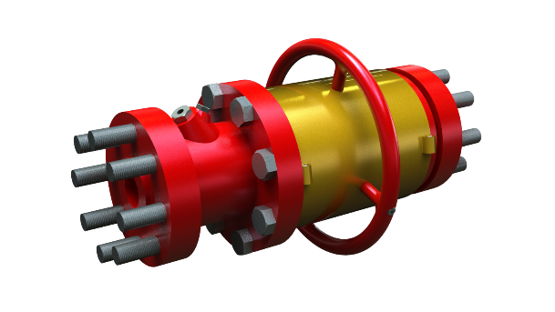
Hazardous Fluid Applications
Personnel Safety
Ammonia (NH3) - 5,000 PPM
Hydrogen Sulfide (H2S) - 500~1000 PPM
Hydrofluoric Acid (HF) leak
Sulfur Dioxide (SO2) - 50-100ppm
Also Phosgene, Benzene, other Hazardous Fluids
Notes:
Something to keep in mind for magnetic performance…

Slide 20
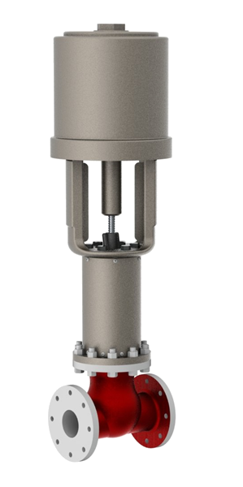
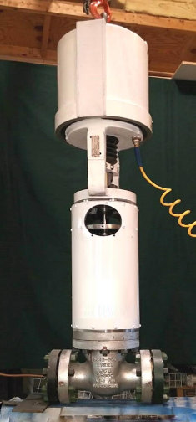
Zero Emission Control Valves
Control valves are often the chronic leakers in facilities
Useful for Pneumatic and Electric
Ideal for high pressures without adding additional friction load
Reduces the need to service a leaking valve, lost product, and potential fines
Notes:
Something to keep in mind for magnetic performance…

Slide 21
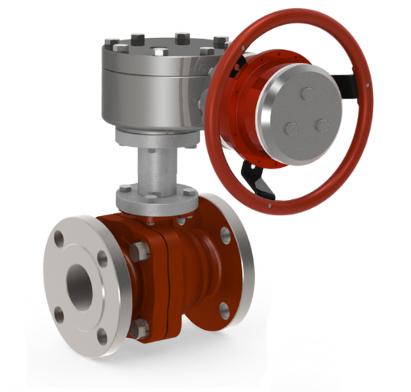
Why Magnetic Actuation?
It eliminates all valve stem leaks from cold cryogenic to high temp applications
It can reduce testing requirements from quarterly to annual monitoring (potentially less)
It reduces costs by reducing/eliminating lost product, fines, repairs, and plant downtime due to leaks
It is the zero-emission solution for lethal service
Notes:
Something to keep in mind for magnetic performance…

Slide 22
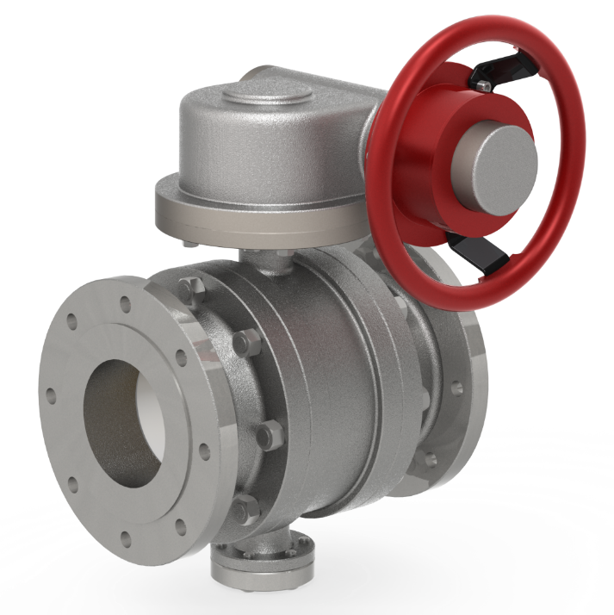
Stephen Sanford
MagDrive Technologies, Inc.
Email: steve@magdrive.tech

Slide 23
Thanks
ORGANIZING SECRETARIAT
Ph. +39 035 3230904
e-mail info@industrialvalvesummit.com
CONFERENCE ORGANIZERS
Ph. +39 3474908420
e-mail segreteria@valvecampus.com
www.industrialvalvesummit.com
www.valvecampus.com

