Slide 1
Specification for Valves for Hydrogen
CONFERENCE
ORGANIZERS

Slide 2
Specification for Valves for Hydrogen
Development and Requirements of API Specification for Valves for Hydrogen Gas Service
Jonathan Geleijns | Energy Transition Technologies Manager
jgeleijns@slb.com

Slide 3
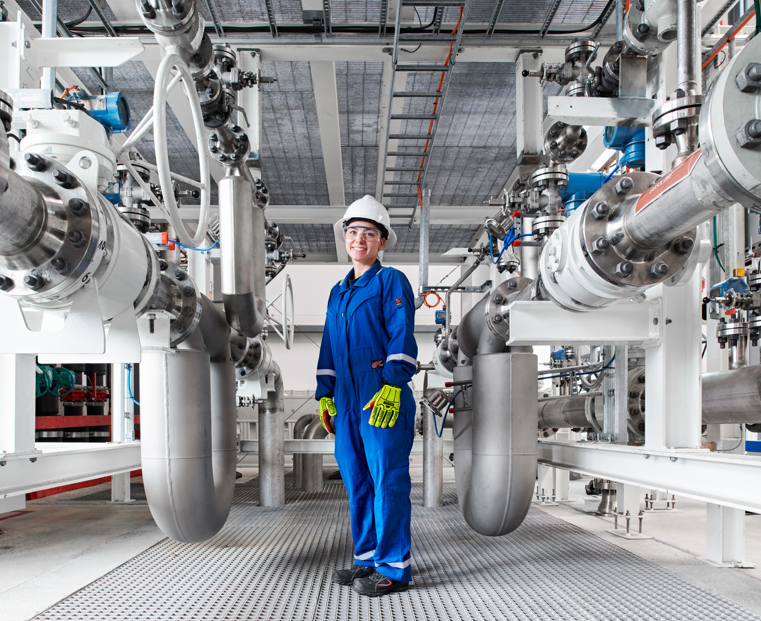
Contents
Key concerns about H₂
API task group
Main requirements

Slide 4
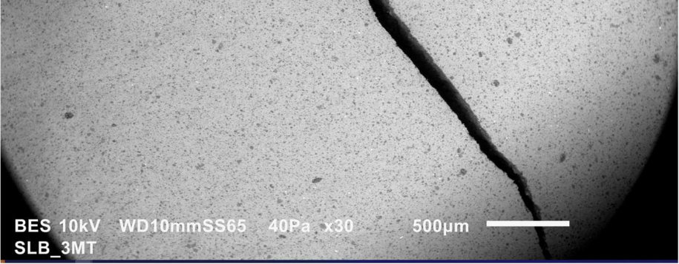
Key concerns about H₂
Hydrogen-related materials damage
Effects on soft materials
Seal ability
Fire and explosion hazards
Source: SLB-ETD, Materials CPE
CONFERENCE ORGANIZERS
Notes:
Impact mechanical characteristics (elastomers, thermoplastics)
RGD
Sealing : internal and external

Slide 5
API task group
172 members
11 countries
18 end users
52 valve manufacturers
4 seal manufacturers
4 test centers
API members
Independents
Initiated by SLB
API 6Z → API Spec 6D, Annex M
Task group configuration
Meeting locations
Materials work group
CONFERENCE ORGANIZERS
Notes:
SRRR April ’22; approved Sep ’22, 1st meeting Oct ‘22
Global input : WH + EH (11 countries)
97 → 172 members
14 → 18 end users
33 → 52 valve manufcaturers
4 seal manufacturers
4 test centers
Scope : To develop a new standard to address valve design, materials, qualifications, testing and manufacturing for use in hydrogen pipeline and piping service.

Slide 6
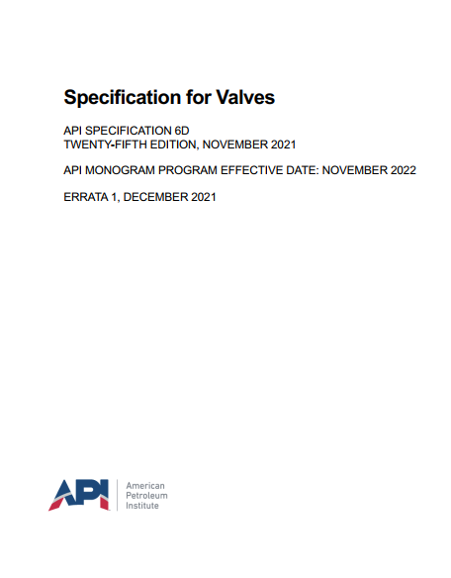
Main requirements
Specification levels for hydrogen
Design validation tests
Materials requirements
Supplemental acceptance testing
Nondestructive examination
Quality control
Marking
Documentation
Notes:
The following topics may be used for the determination of desired HSL:
Location of valve (confined space, buried, open air, rural/remote)
Percentage H₂ in gas
Chemical elements in gas that could impact materials.
Design pressure
Cyclic Pressure service

Slide 7
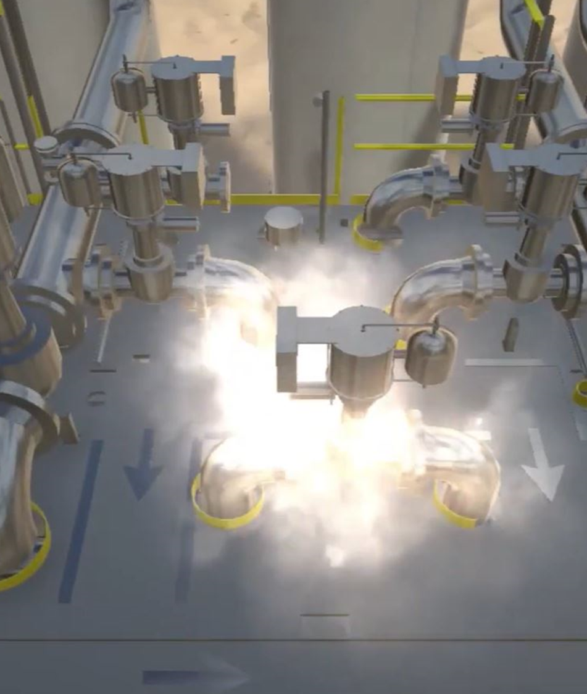
Main requirements Design validation
High-pressure gas tests
Fugitive emissions test
Antistatic test
Fire-safe design
Notes:
Shell : 24” and smaller submerged
Increased test duration
SLH3&4 per annex F with N2
Seat : Increased test duration
lower acceptance criteria
SLH3&4 per annex F with N2
FE : CH – AH, ancillary valves included or certified

Slide 8
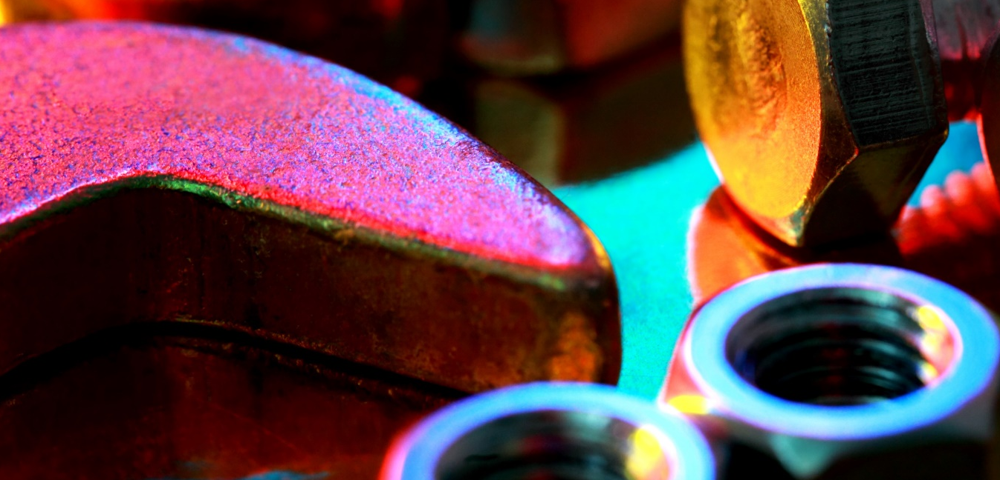
Main requirements Metallic materials
NACE MR0175/ISO 15156 compliance
Permitted materials
Materials requiring additional testing
Springs
Welds
Bolting
Notes:
All : - CS with content restrictions
- Low alloy carbon steel
- Austenitic stainless steel
P. Cont w/ tests
P. Contr + drive train : - Material restrictions
Coil springs :
Weld : - Material restrictions
- Hardness NACE
Bolting : - NACE

Slide 9
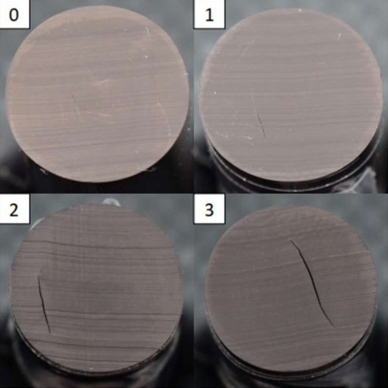
Main requirements Nonmetallic materials
Rapid gas decompression (RGD)
Compatibility/aging
Source : SLB-ETD, Materials CPE
Notes:
RGD : - Per ISO 23936-2 or NORSOK M-710
- Tested with 100% Hydrogen gas or 100% CO2
Aeging : - Elastomers per ISO 23936-2, using 100% Hydrogen gas
- Thermoplastics per ISO 23936-1, using 100% Hydrogen gas

Slide 10
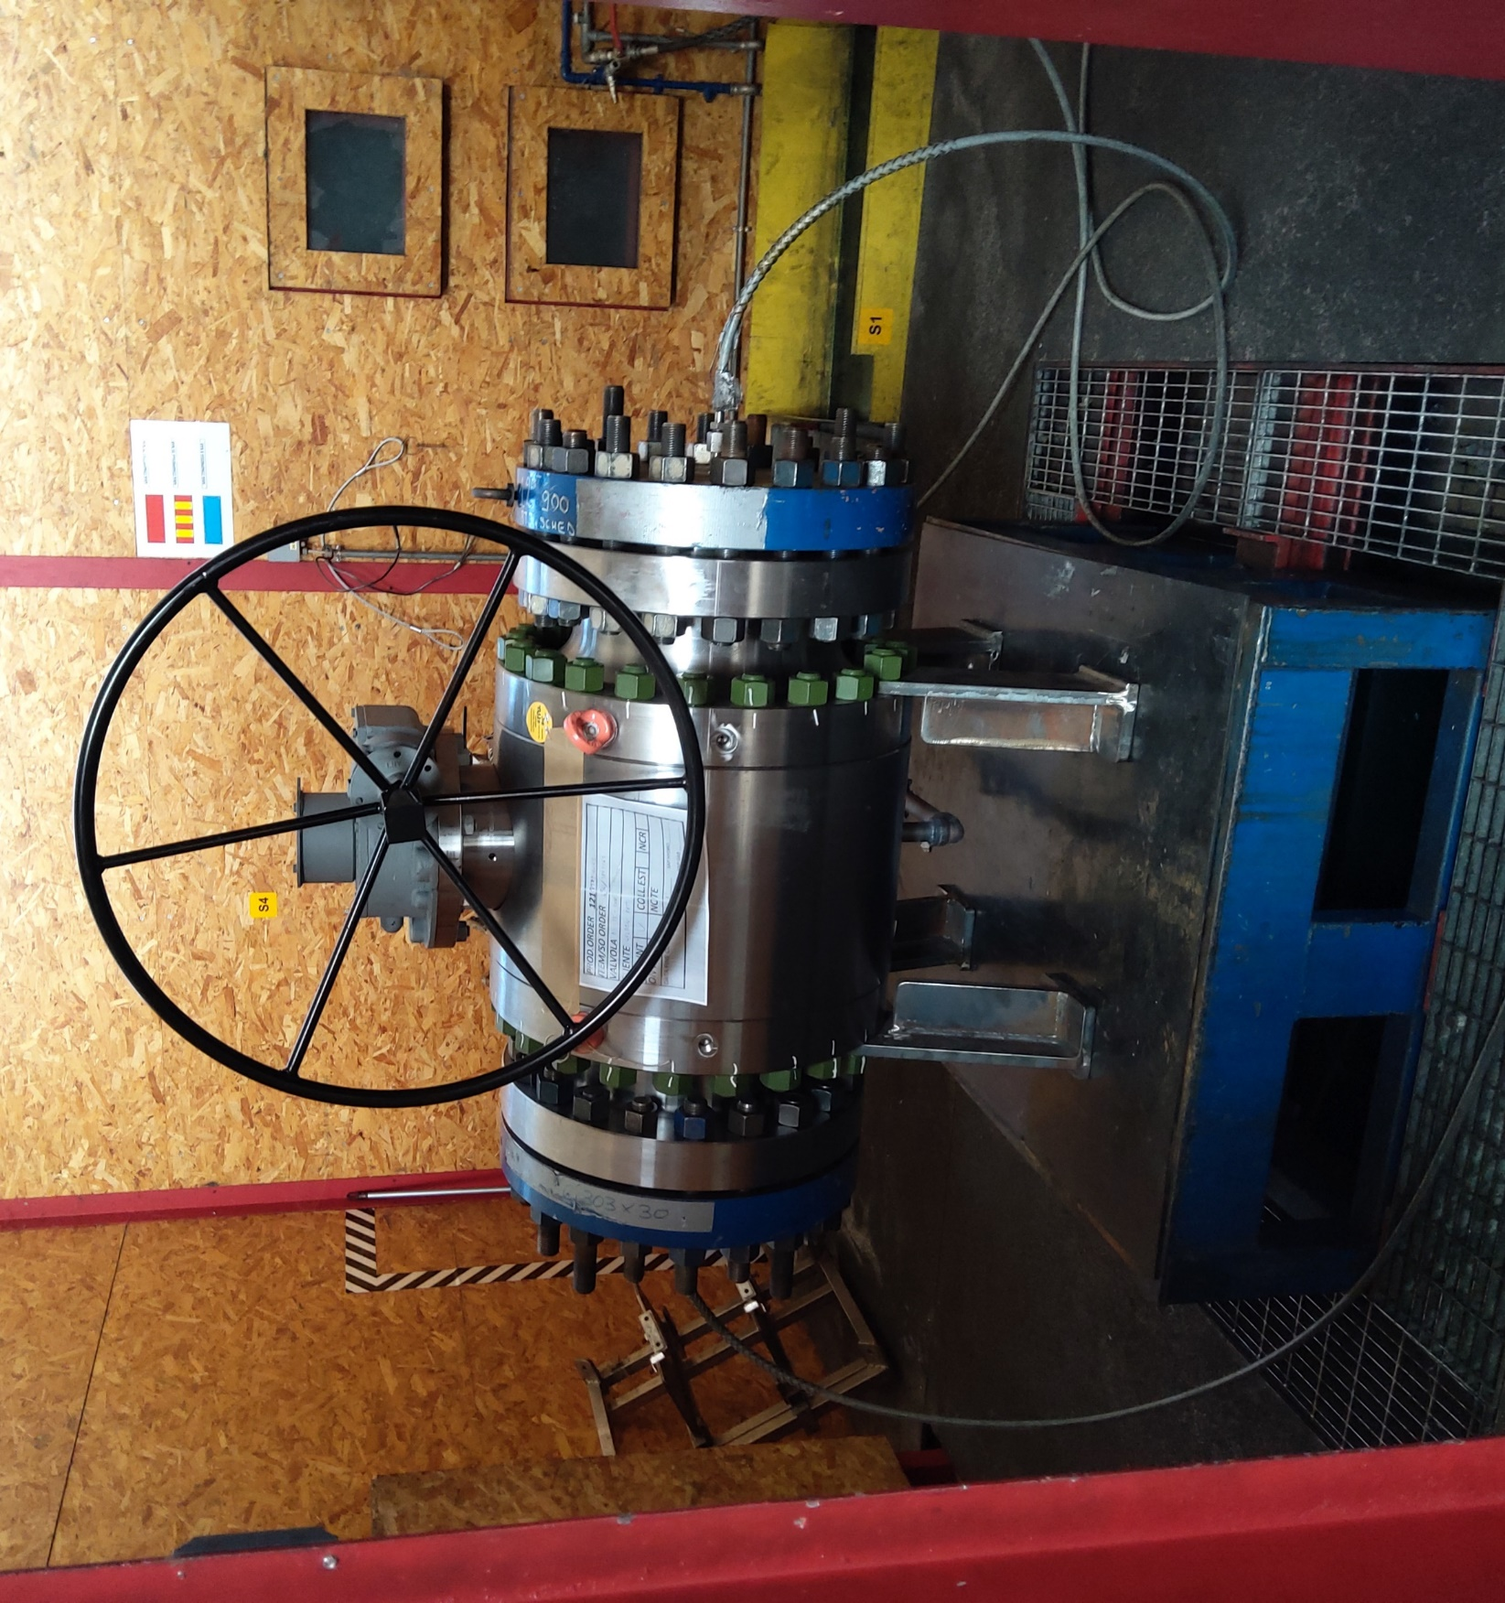
Main requirements Supplemental acceptance testing
High-pressure shell test
High-pressure seat test
Fugitive emissions test
Antistatic test
Notes:
Shell : SLH2 onwards
24” and smaller submerged
Increased test duration
Seat : Increased test duration
lower acceptance criteria
SLH4 with hydrostatic end load
FE : with helium or forming gas with applicable acceptance criteria

Slide 11
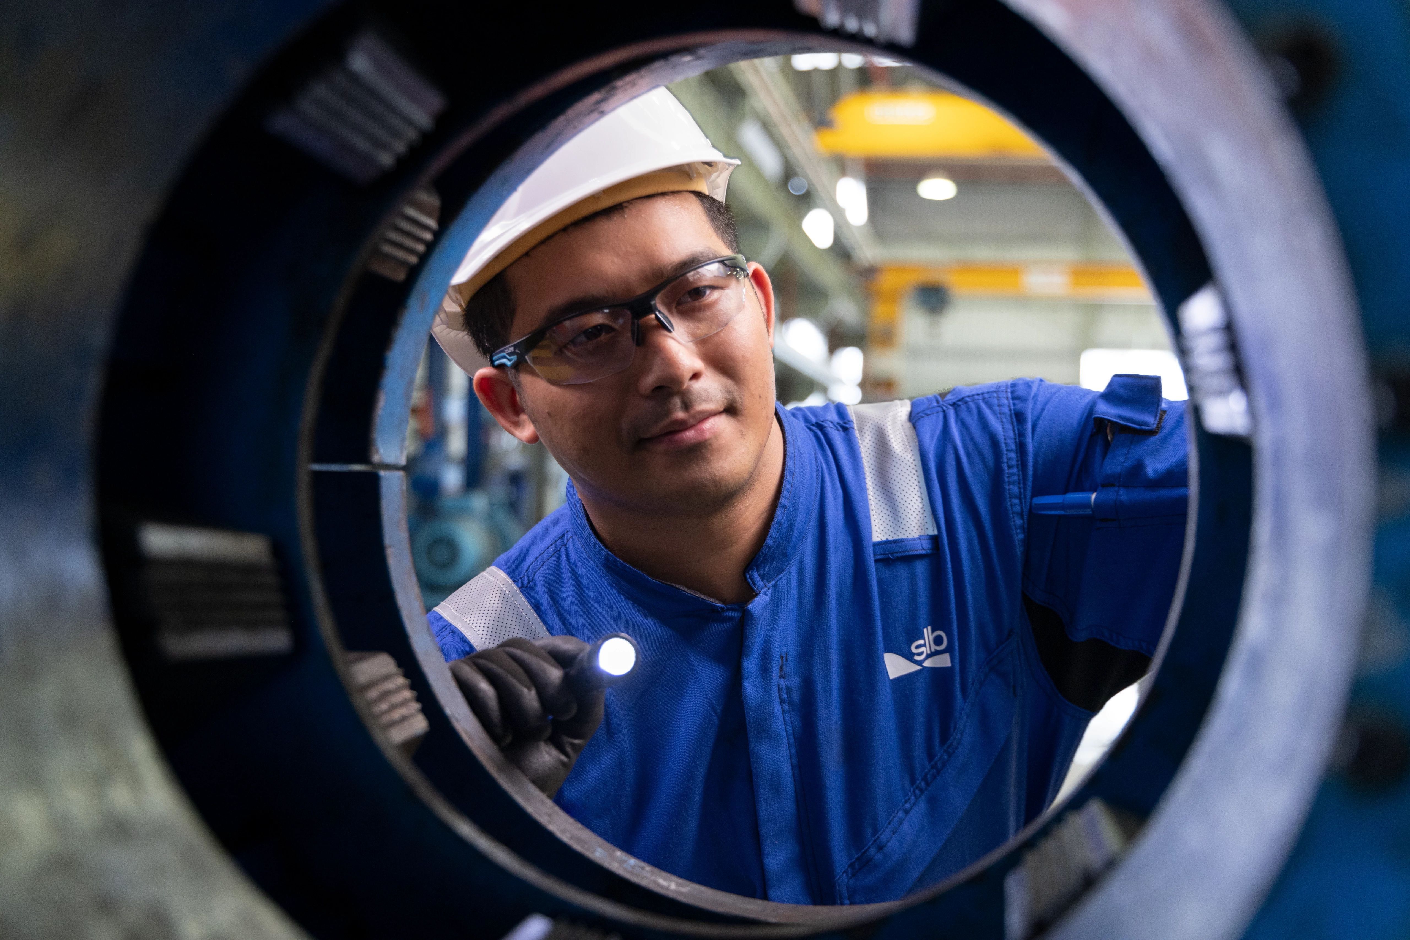
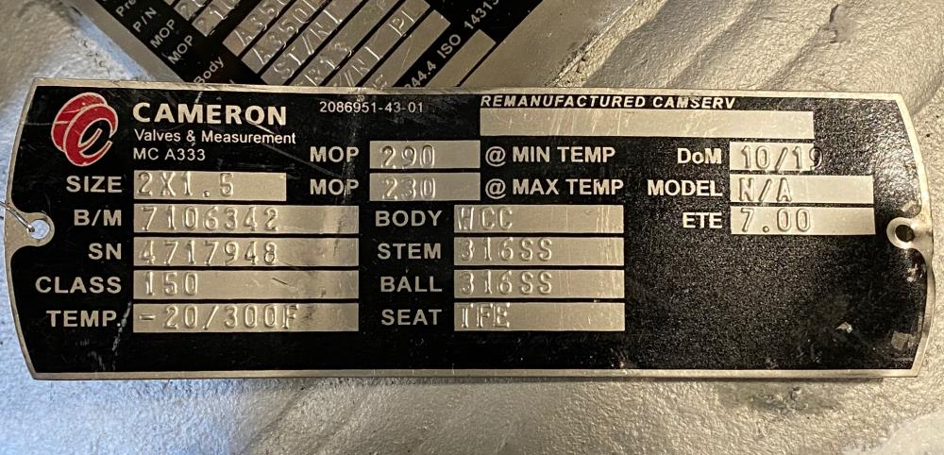
Main requirements Miscellaneous
Nondestructive examination
Quality control
Marking
Documentation
SLH3
QSL3G
Notes:
QSLs
NDE : P. containing welds
SLH + QSL
Doc : per additional requirements

Slide 12
Thanks
ORGANIZING SECRETARIAT
Ph. +39 035 3230904
e-mail info@industrialvalvesummit.com
CONFERENCE ORGANIZERS
Ph. +39 3474908420
e-mail segreteria@valvecampus.com
www.industrialvalvesummit.com
www.valvecampus.com

