Slide 1
LNG, Hydrogen and CCUS: a data-driven approach to testing and selecting sealing elements for valves
CONFERENCE
ORGANIZERS

Slide 2
LNG, Hydrogen and CCUS: a data-driven approach to testing and selecting sealing elements for valves
Alessandro Bielli | Applications Engineer, James Walker

Slide 3
James Walker Locations
51 sites
£200m turnover
Notes:
James Walker has been going for over 135 years,
As most critical performing business's are global we have a global infrastructure to support this requirement, most of our manufacturing sites are UK based and we have been able to establish a global presence which not only provides jobs and personal development opportunities but also provides local support to our customer around the world.

Slide 4
O&G Certifications
API 6D / API 6A
Norsok M-710 / ISO 23936
NACE MR0175 and NACE MR0178
Fugitive Emission (ISO 15848-1 / API 622 / TA Luft 2440)
Company material specifications (e.g. Total, Shell, Aramco…)

Slide 5
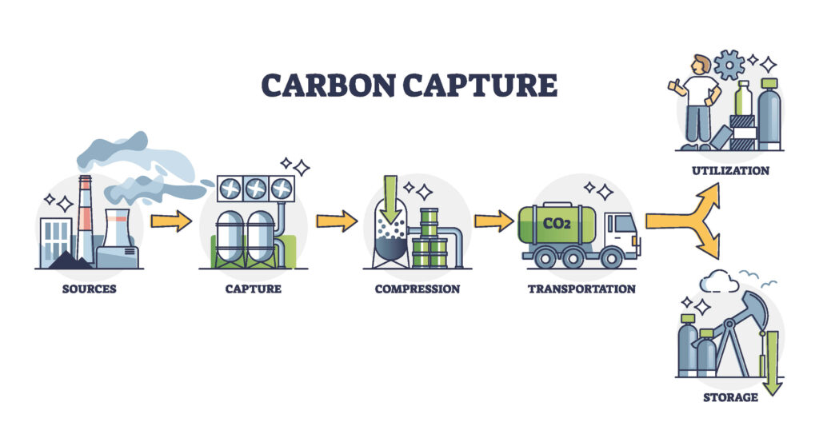
Carbon
Capture
Utilisation &
Storage
Notes:
Power supply and carbon-intensive industries account for a large share of CO₂ emissions. Carbon Capture Utilisation and Storage (CCUS) is the process consisting in the separation of CO₂ from industrial and energy related sources, its transportation to a storage location and finally its long-term isolation from the atmosphere.
CCUS is a technology solution that can significantly reduce emissions from these key industrial processes (all of which will remain vital to modern society) and deliver the deep emissions reduction needed.
When we talk about carbon capture, we mean the capture of carbon dioxide. The technology has been around for decades. As early as 1972 in Texas a natural gas processing plant began delivering carbon dioxide through the first large-scale, long-distance CO₂ pipeline to an oil field. However, the application of carbon capture technology to energy generation is relatively recent.
There are three industrial CO2 capture systems:
Pre-combustion: in which the fuel is gasified (rather than burned) to produce syngas, a synthesis gas consisting mostly of carbon monoxide (CO) and hydrogen (H2). A subsequent transfer reaction converts CO to CO₂ and a physical solvent separates the carbon dioxide from the hydrogen.
Post-combustion: it uses chemical solvents to separate carbon dioxide from fossil fuel combustion fumes.
Oxyfuel capture, which requires burning fossil fuels in pure oxygen (rather than air), so that the exhaust gases are rich in carbon dioxide, facilitating capture.
After the “capture” we have 2 different paths
Utilisation: captured CO₂ can be converted into a wide range of commercial products and applications.
including CO₂ conversion to other chemicals, fuels, and durable materials, CO₂ to mineral carbonation and construction materials, as well as CO₂ to biological cultivation and enzymatic conversion.
Storage: Captured CO₂ can be geologically stored, either permanently or over geological time scales, in saline aquifer, oil and gas reservoirs, or potentially in unmineable coal seams.
Today, CCUS facilities around the world have the capacity to capture more than 40 Million Tons of CO₂ each year. (iea.org)

Slide 6
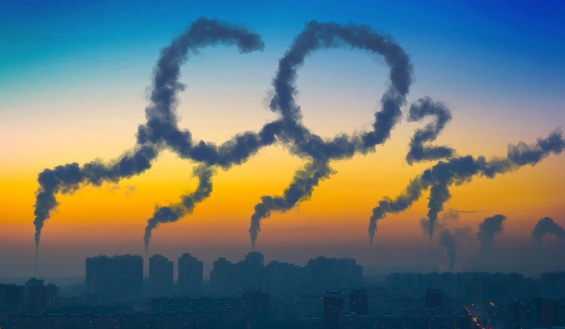
CO₂
CO₂ is found in gas state in normal conditions.
It has wide range of uses, it is also considered as a waste gas in many industries (e.g. Power generation)
Notes:
Carvon Dioxide is one of the most common gas in the atmosphere (0,04%). It is found in the gas state at room temperature, and as the source of available carbon in the carbon cycle, atmospheric CO₂ is the primary carbon source for life on Earth.
In the air, carbon dioxide is transparent to visible light but absorbs infrared radiation, acting as a greenhouse gas.
Industrially, carbon dioxide is predominantly an unrecovered waste product, produced by several methods which may be practiced at various scales.
The combustion of all carbon-based fuels, such as methane, natual gas, petroleum distillates (gasoline, diesel, kerosene, propane), coal, wood and generic organic matter produces carbon dioxide.
Carbon Dioxide has varied commercial uses but one of its greatest uses as a chemical is in the production of carbonated beverages. It is also used ad refrigerant, fire estinguisher, as precursor to produce Urea, and as solvent, especially in the ”supercritical state”
CO2 will enter a super critical phase above about 31 deg C and 74 bar. This has the potential to present significant challenges to some elastomers.

Slide 7
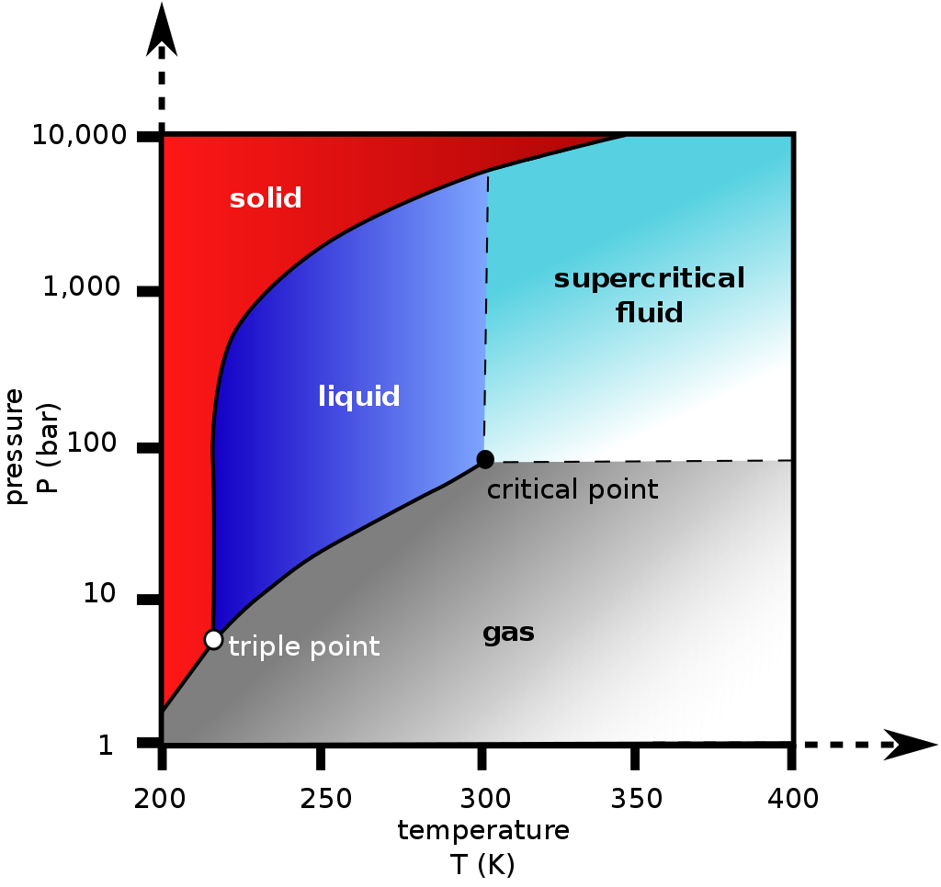
CO₂
CO₂ is found in gas state in normal conditions.
It has wide range of uses, it is also considered as a waste gas in many industries (e.g. Power generation)
Supercritical CO₂ is a potential challenge to elastomers and plastic materials.
T > 31°C, P> 74 bar
Notes:
Carbon Dioxide is one of the most common gas in the atmosphere (0,04%). It is found in the gas state at room temperature, and as the source of available carbon in the carbon cycle, atmospheric CO₂ is the primary carbon source for life on Earth.
In the air, carbon dioxide is transparent to visible light but absorbs infrared radiation, acting as a greenhouse gas.
Industrially, carbon dioxide is predominantly an unrecovered waste product, produced by several methods which may be practiced at various scales.
The combustion of all carbon-based fuels, such as methane, natual gas, petroleum distillates (gasoline, diesel, kerosene, propane), coal, wood and generic organic matter produces carbon dioxide.
Carbon Dioxide has varied commercial uses but one of its greatest uses as a chemical is in the production of carbonated beverages. It is also used ad refrigerant, fire estinguisher, as precursor to produce Urea, and as solvent, especially in the ”supercritical state”
CO2 will enter a super critical phase above about 31 deg C and 74 bar. This has the potential to present significant challenges to some elastomers.

Slide 8
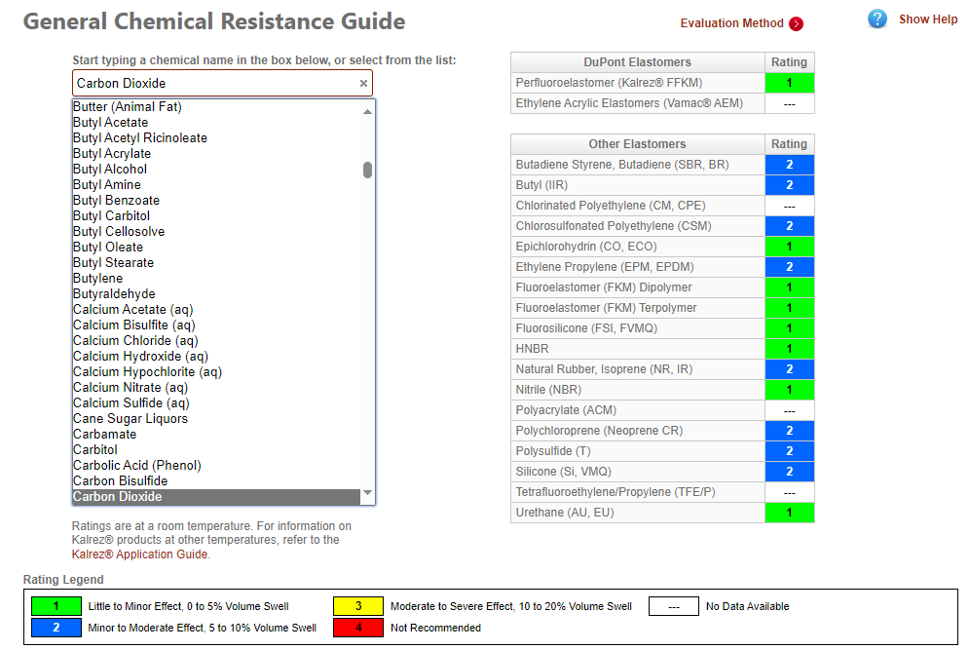
CO₂ Chemical compatibility
Elastomers are in general chemically compatible with CO₂.
Supercritical CO₂ cause swell, softening and heavy RGD damages.
(Supercritical CO₂ can also improve low T behaviour of elastomers)
(credit: DuPont website)
Notes:
Chemical interaction with the polymer changing the materials properties. These are usually permanent and irreversible
Physical interactions are often reversible
Solvents or gases diffuse into the elastomer (permeation)
Induce physical changes and affects (e.g. swelling and softening)
CO2 will enter a super critical phase above about 31 deg C and 74 bar. This has the potential to present significant challenges to some elastomers.
The super critical phase can act as a strong solvent, and can in some case extract some components of lower grade elastomers.
The supercritical phase also has the potential to cause significant swell, and this has been shown in cases of unconstrained elastomers. This seems to be particularly prevalent in FKM elastomers.
The same solvent effects that cause swell, also have the effect of plasticising the elastomers. This then manifests itself as an improving the low temperature performance of elastomers typically by a few degrees. This is commonly called TG suppression, and can improve the low temperature flexibility of the material.
As a direct result of the supercritical phase change that CO2 goes through at relatively low pressures and temperatures, and resulting volume shift that this phase change causes in the media, combined with the solvent effects, this can cause a significant challenge from an RGD perspective.
This combination of properties makes CO2 one of the most challenging gasses to seal from an RGD perspective, with the gas typically causing significantly more damage in comparative testing compared with other typical test gasses such as Methane or Nitrogen.
for example an unconstrained block of nitrile rubber exposed to compressed air at 5000psi until saturated will release an amount of air approximately 14 times the volume of the rubber when the external pressure is removed

Slide 9
RGD behaviour
Elastomer Grade | Test location | Conditions | Result
HNBR (‘Medium’ ACN) | James Walker | 23°C, 150 Bar, 100% CO₂, 5.33 | 0000
FKM terpolymer (bisphenol) | James Walker | 23°C, 150 Bar, 100% CO₂, 5.33 | 0000
FKM GLT type | James Walker | 50°C, 150 Bar, 100% CO₂, 5.33 | 0000
FKM GLT type | James Walker | 50°C, 150 Bar, 100% CO₂, 6.99 | 0000
FKM GFLT type | James Walker | 23°C, 150 Bar, 100% CO₂, 5.33 | 0000
FKM GFLT type | James Walker | 50°C, 150 Bar, 100% CO₂, 5.33 | 0000
FKM GFLT type | Element UK | 50°C, 310 Bar, 100% CO₂, 6.99 | 0000
FKM terpolymer (peroxide) | James Walker | 100°C, 150 Bar, 100% CO₂, 6.99 | 0000
FKM terpolymer (peroxide) | James Walker | 150°C, 150 Bar, 100% CO₂, 5.33 | 0000
FKM GLT type | Element UK | 121°C, 690 Bar, 85% CO₂, 5.33 | 0000
Ref Norsok conditions | - | 100°C, 150 Bar, 90% CH4 / 10% CO₂, 5.33 | -
Notes:
As a result of the clanging RGD environment, JW have undertaken a significant amount of in-house testing to understand the effects of CO2 RGD events on our materials. A number of the grades have come through with excellent results.
This testing program means that a full portfolio of materials are available, tested in a rang of different environments including using third parties and by JW in CCM
Data is continuously being updated as new results are available.

Slide 10
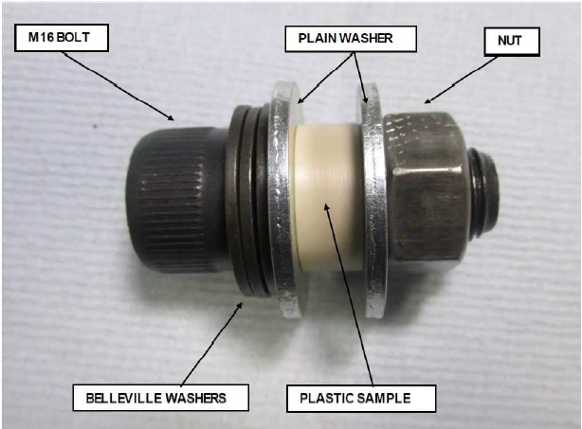
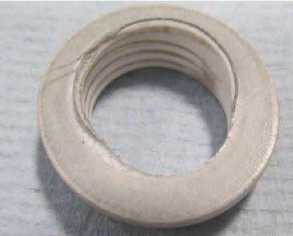
CO₂ - Plastic materials
Plastics are in general chemically compatible with CO₂.
Supercritical CO₂ can cause swell and softening.
It is necessary to test the resistance of plastics to Supercritical CO₂
PTFE after exposure.
Notes:
Chemical interaction with the polymer changing the materials properties. These are usually permanent and irreversible
Physical interactions are often reversible
Solvents or gases diffuse into the elastomer (permeation)
Induce physical changes and affects (e.g. swelling and softening)
CO2 will enter a super critical phase above about 31 deg C and 74 bar. This has the potential to present significant challenges to some elastomers.
The super critical phase can act as a strong solvent, and can in some case extract some components of lower grade elastomers.
The supercritical phase also has the potential to cause significant swell, and this has been shown in cases of unconstrained elastomers. This seems to be particularly prevalent in FKM elastomers.
The same solvent effects that cause swell, also have the effect of plasticising the elastomers. This then manifests itself as an improving the low temperature performance of elastomers typically by a few degrees. This is commonly called TG suppression, and can improve the low temperature flexibility of the material.
As a direct result of the supercritical phase change that CO2 goes through at relatively low pressures and temperatures, and resulting volume shift that this phase change causes in the media, combined with the solvent effects, this can cause a significant challenge from an RGD perspective.
This combination of properties makes CO2 one of the most challenging gasses to seal from an RGD perspective, with the gas typically causing significantly more damage in comparative testing compared with other typical test gasses such as Methane or Nitrogen.
for example an unconstrained block of nitrile rubber exposed to compressed air at 5000psi until saturated will release an amount of air approximately 14 times the volume of the rubber when the external pressure is removed

Slide 11
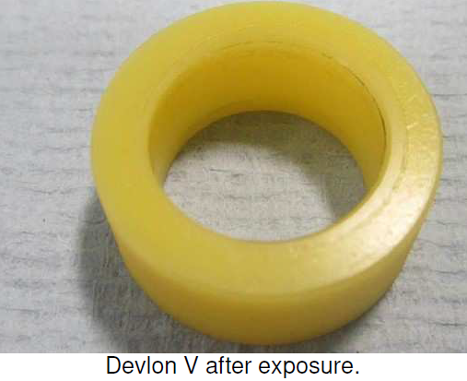
CO₂ - Plastic materials
Plastics are in general chemically compatible with CO₂.
Supercritical CO₂ can cause swell and softening.
There are termoplastics that are not affected by Supercritical CO₂ (e.g. Devlon V)
Devlon V after exposure.
Notes:
Chemical interaction with the polymer changing the materials properties. These are usually permanent and irreversible
Physical interactions are often reversible
Solvents or gases diffuse into the elastomer (permeation)
Induce physical changes and affects (e.g. swelling and softening)
CO2 will enter a super critical phase above about 31 deg C and 74 bar. This has the potential to present significant challenges to some elastomers.
The super critical phase can act as a strong solvent, and can in some case extract some components of lower grade elastomers.
The supercritical phase also has the potential to cause significant swell, and this has been shown in cases of unconstrained elastomers. This seems to be particularly prevalent in FKM elastomers.
The same solvent effects that cause swell, also have the effect of plasticising the elastomers. This then manifests itself as an improving the low temperature performance of elastomers typically by a few degrees. This is commonly called TG suppression, and can improve the low temperature flexibility of the material.
As a direct result of the supercritical phase change that CO2 goes through at relatively low pressures and temperatures, and resulting volume shift that this phase change causes in the media, combined with the solvent effects, this can cause a significant challenge from an RGD perspective.
This combination of properties makes CO2 one of the most challenging gasses to seal from an RGD perspective, with the gas typically causing significantly more damage in comparative testing compared with other typical test gasses such as Methane or Nitrogen.
for example an unconstrained block of nitrile rubber exposed to compressed air at 5000psi until saturated will release an amount of air approximately 14 times the volume of the rubber when the external pressure is removed

Slide 12
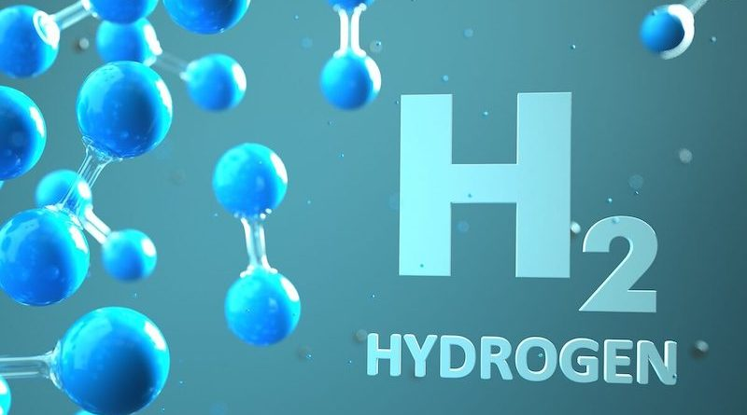
H₂
Most abundant element in nature
Gas @ standard conditions
Colorless, odorless, tasteless, non-toxic, and highly combustible
Flammability range: 4%-74% (air); 4%-94% (oxygen)
Notes:
Hydrogen is the chemical element with the symbol H and atomic number 1. Hydrogen is the lightest element in nature.
At standard conditions hydrogen is a gas of diatomic molecules having the formula H2. It is colorless, odorless, tasteless, non-toxic, and highly combustible. Hydrogen is the most abundant chemical substance in the universe, constituting roughly 75% of all normal matter.
Diatomic Hydrogen (H2) is very stable, almost chemically inert, it has high bond energy. All of these characteristics make Hydrogen a great «energy carrier».
On the other hand, the same characteristics make Hydrogen a very dangerous gas in eventuality of a leakage, which would be hard to detect and potentially catastrophic. Hydrogen has a very broad flammability range— a 4 percent to 74 percent concentration in air and 4 percent to 94 percent in oxygen; therefore, keeping air or oxygen from mixing with hydrogen is very important. Despite it is highly combustible H2 does not react spontaneously with O2 but there is the need of a catalyst or an ignition (spark, flame, etc.).
Sealing solutions for valves Once the hydrogen is produced it is important to find a safe way to be stored and transported. Hence, valves and pipelines become important and avoid any leakage is mandatory, both for safety and economic reasons.
High Performance elastomers ORs Engineering Plastic Seats and Lip Seals Graphite Compression packing
Gaskets (flat gasket or with different design)

Slide 13
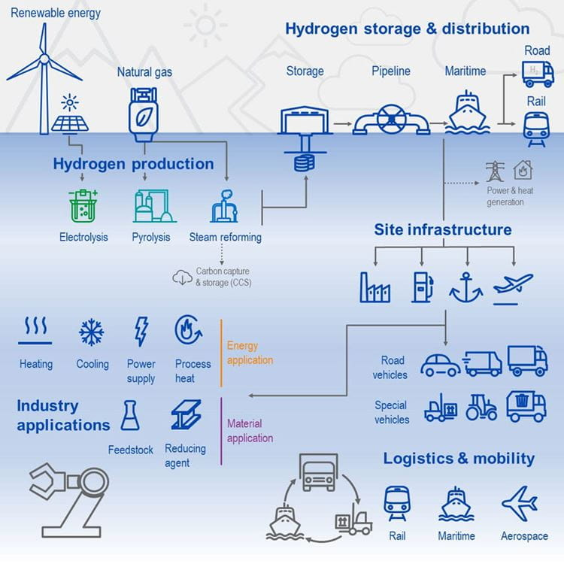
H₂ Sector
NH₃ and MeOH production
Saturated fats and oils
Reducing agent for metals production from ores
Coolant
Fuel
Energy Carrier
Notes:
Hydrogenation of CO2 for Methanol production and N2 for ammonia production are the most important use of H2. The element is also added to fats and oils to obtain saturated products, for example margarine.
Other examples of hydrogen use include rocket fuel, welding, producing hydrochloric acid, reducing metallic ores, coolant in power stations and fuel in the aerospace sector
In the early 20th century it was even used for airships, like the Zeppelin, then replaced with Helium for safety reasons.
It is also used in batteries or to create clean energy in fuel cells, combined with O2 ,with the only production on water.
Downstream, national gas distribution networks are now undertaking trials in adding hydrogen to supply heat to domestic and industrial users, whilst other sectors are evaluating the use of hydrogen to power a range of applications including rail, marine, large road transport and even planes.

Slide 14
H₂ Production
Steam Reforming
Pyrolisis
Coal gasification
Electrolysis
Notes:
Grey Grey hydrogen is currently the most common, and the cheapest, form of hydrogen production. It is used as a fuel and doesn't generate greenhouse gas emissions itself, but its production process does. Grey hydrogen is created from natural gas using steam reforming, which separates the hydrogen from the natural gas. However, the technologies used don’t capture the carbon emissions created during the process, which are instead released into the atmosphere.
Blue Blue hydrogen is also extracted using the steam reforming process, but it differs from grey as the carbon emissions released are captured and stored, which reduces the emissions in the atmosphere, but doesn’t eliminate them. Blue hydrogen is sometimes called ‘low-carbon hydrogen’ as the production process doesn’t avoid the creation of greenhouse gases, just stores them away.
Green Green hydrogen doesn’t generate any emissions in its entire life cycle as it uses renewable energies in the production process, making it a true source of clean energy.
Black and brown Black and Brown hydrogen is created using either type of coal in the extraction process. This process, called gasification, is the process on the opposite end of the spectrum from green hydrogen’s electrolysis. It’s an established process used in many industries that convert carbon-rich materials into hydrogen and carbon dioxide. The emissions are then released into the air, causing pollution and becoming the most harmful hydrogen for the environment.
Pink Pink hydrogen is extracted through electrolysis powered by nuclear energy.
Turquoise Turquoise hydrogen is very new and is still in the process of discovering if it can be used well at a large scale if proven to be effective, turquoise may join blue as a ‘low-carbon hydrogen’ if the carbon can be permanently stored in an environmentally safe way.
Yellow Yellow hydrogen is another new entry and is made through electrolysis specifically using solar power, similar to the process used to create green hydrogen.

Slide 15
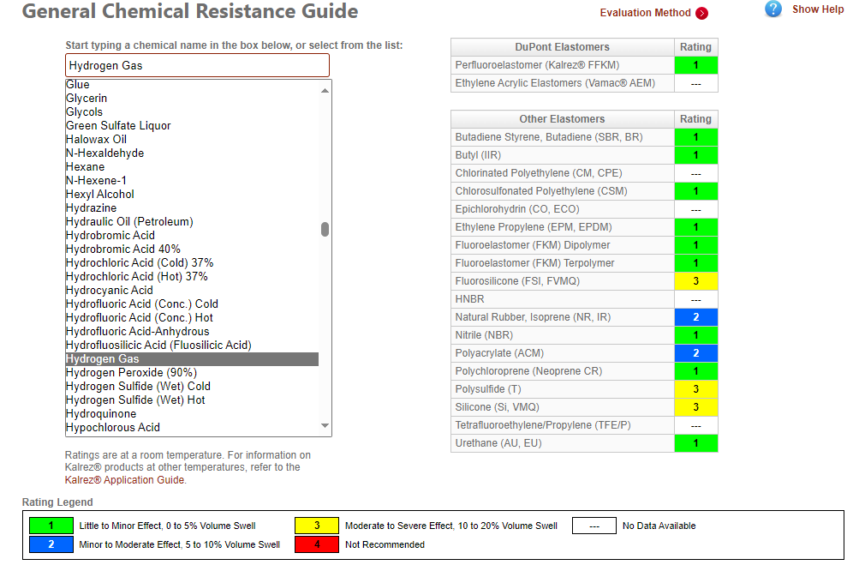
Elastomers - H₂ Compatibility
Elastomers are in general chemically compatible with H₂.
(credit: DuPont website)

Slide 16
Elastomers - H₂ Compatibility
Elastomers are in general chemically compatible with H₂.
450h immersion, 100°C, min. 100 bar
No mass, hardness or volume change observed → No chemical interactions
 | FKM ter (P) | FKM GLT | FKM ter (bisphenol)
Tensile strength change, % | -7.0 | No change | +2.3
Elongation at break change, % | -7.4 | -1.6 | +3.2
Modulus at 25% elongation change, % | +2.1 | +4.8 | +3.8
Modulus at 50% elongation change, % | -1.3 | +6.5 | No change
Modulus at 100% elongation change, % | -4.6 | +5.1 | +2.0

Slide 17
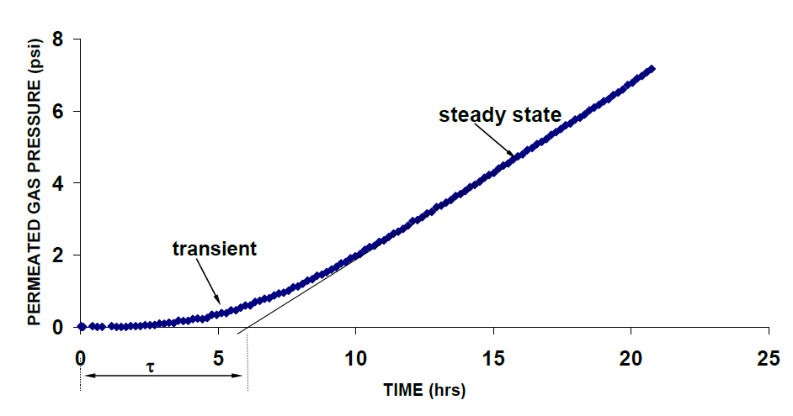
Elastomers - H₂ Permeability
Physical interactions are possible:
H₂ can permeate in the elastomer structure
Permeation coefficient (Q)
Diffusion coefficient (D)
Solubility coefficient (s)
$Q=D.s$

Slide 18
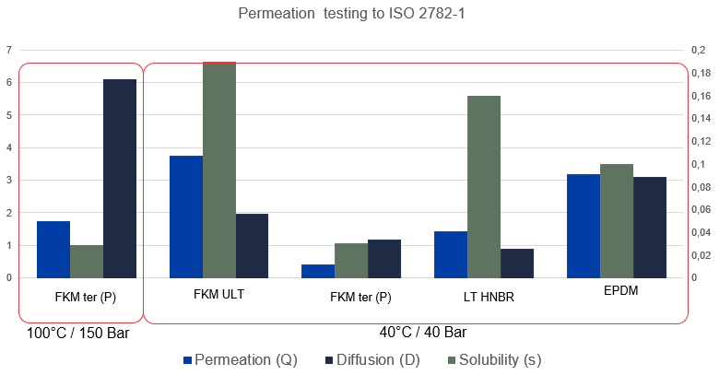
Elastomers - H₂ Permeability
Physical interactions are possible:
H₂ can permeate in the elastomer structure
Permeation coefficient (Q)
Diffusion coefficient (D)
Solubility coefficient (s)
$Q=D.s$

Slide 19
Elastomers - H₂ RGD behaviour
Elastomer Grade | Test location | Conditions | Result
FKM ULT | Element UK | 100°C, 150 Bar, 100% H2, 5.33 | 0000
FKM GFLT | James Walker | 100°C, 150 Bar, 100% H2, 5.33 | 0000
FKM GLT type | JW Customer | 100°C, 150 Bar, 100% H2, 5.33 | Pass
FKM GLT type | James Walker | 100°C, 150 Bar, 100% H2, 5.33 | 0000
FKM terpolymer (P) | Element UK | 100°C, 150 Bar, 100% H2, 5.33 | 0000
FKM terpolymer (P) | James Walker | 100°C, 150 Bar, 100% H2, 5.33 | 0000
HNBR (low ACN) | JW Customer | 100°C, 150 Bar, 100% H2, 5.33 | Pass
HNBR (low ACN) | James Walker | 100°C, 150 Bar, 100% H2, 5.33 | 0000
HNBR (med ACN) | James Walker | 100°C, 150 Bar, 100% H2, 5.33 | Pass
FKM terpolymer (P) 95 IRHD | James Walker | 100°C, 150 Bar, 100% H2, 5.33 | 0000
FKM terpolymer (P) 95 IRHD | James Walker | 100°C, 150 Bar, 100% H2, 6.99 | 0000
EPDM (P) | Element UK | 100°C, 150 Bar, 100% H2, 5.33 | 4433 – Fail

Slide 20
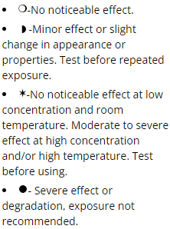
Plastics - H₂ Compatibility

Slide 21
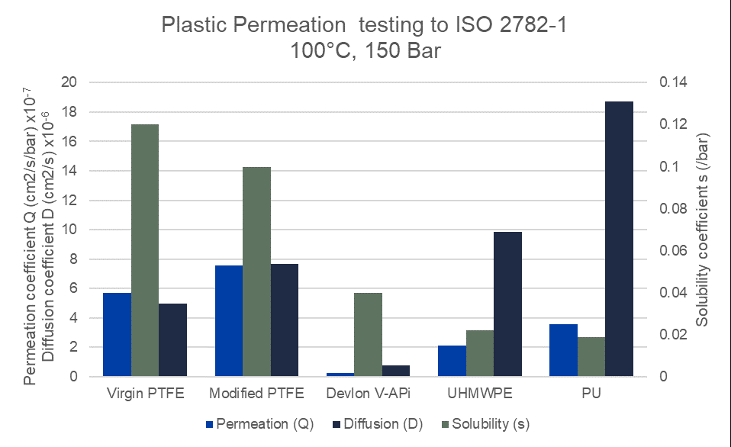
Plastics - H₂ Permeability
Physical interactions are possible:
H₂ can permeate in the polymeric structure
Permeation coefficient (Q)
Diffusion coefficient (D)
Solubility coefficient (s)
$Q=D.s$

Slide 22
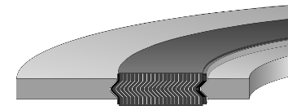
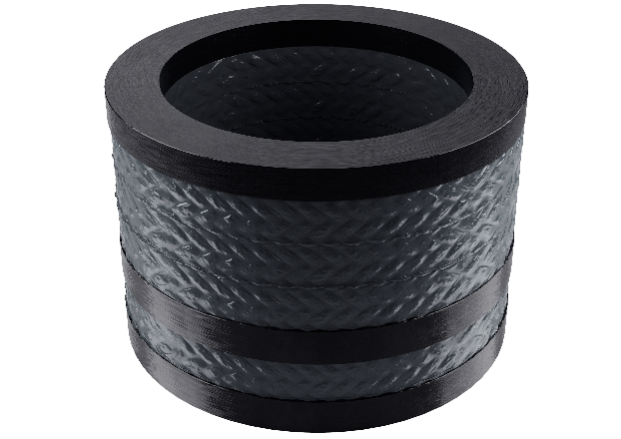
Graphite - H₂ Compatibility
No chemical interaction
No swelling / softening
Media compatibility (pH Range 0-14)
Temperature range: – 253°C up to 450°C

Slide 23
Graphite - H₂ Compatibility
No chemical interaction
No swelling / softening
Leakage test for Fugitive Emission
→ ISO 15848-1 (compression packing)
→ EN 13555 (gasket)

Slide 24
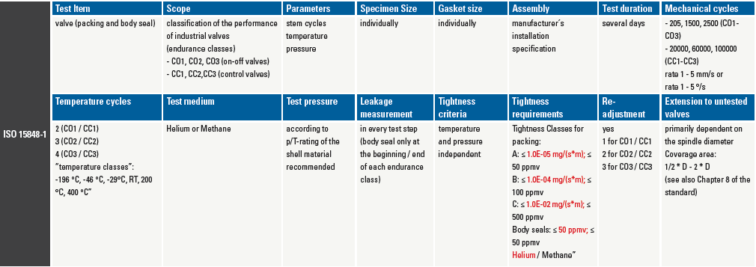
ISO 15848-1

Slide 25
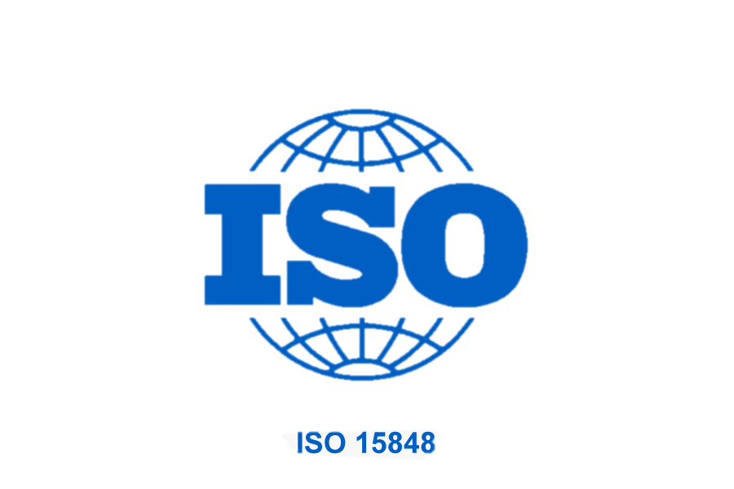
ISO 15848-1 certified with H₂
99.9% hydrogen test media, CO1 endurance class, RT
Class BH leakage rate: 4.8E-07 mbar / lsec)
ISO FE BH* - CO1 - SSA 0 - tRT - ANSI Class 300 - ISO 15848-1
*Note: BH volumetric leak rate used for Hydrogen gas

Slide 26
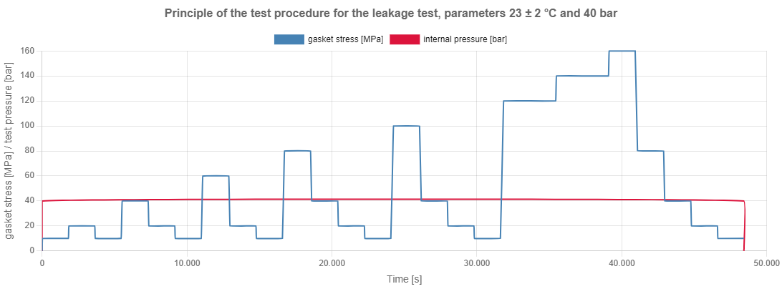
EN 13555
Notes:
The test according to the EN 13555 standard defines the use of helium as the test gas at a pressure of 40 bar and measurement at room temperature.
The pressure of 40 bar is deviated from for certain gaskets if the intended use of the gasket material is for lower or even higher pressures. For gaskets that have a wider range of applications, more than one pressure is used for testing (e.g. 10, 40 and 160bar), each as a individual characteristic. The standard also specifies surface pressures up to which the gasket is loaded in order to carry out a leakage measurement. The load is usually followed by unloading (in several stages) in order to measure the leakage there as well. The first surface pressure is mentioned as 5 MPa in the standard, the highest is 160 MPa or, if the Q_{Smax} of the gasket is lower than 160 MPa, a surface pressure which not not overloads it. The leakage measurement is done by either mass spectrometry, mass flow measurement or pressure drop method at the particular surface pressure level until the leakage is constant (<= 2% over 20 minutes)
In practice, the test is carried out by mounting the gasket in a test rig that is modelled like a real flange. However, the surface pressure is not applied with bolts but with a hydraulic cylinder and can be maintained and adjusted. The inner space, which is the pipe in real use, is first evacuated and then filled with helium up to the specified pressure. Between the outer edge of the flanges and the outer diameter of the gasket there is an additional seal, e.g. an O-ring, so that the helium escaping from the interior space via and through the seal can be collected and measured. .

Slide 27
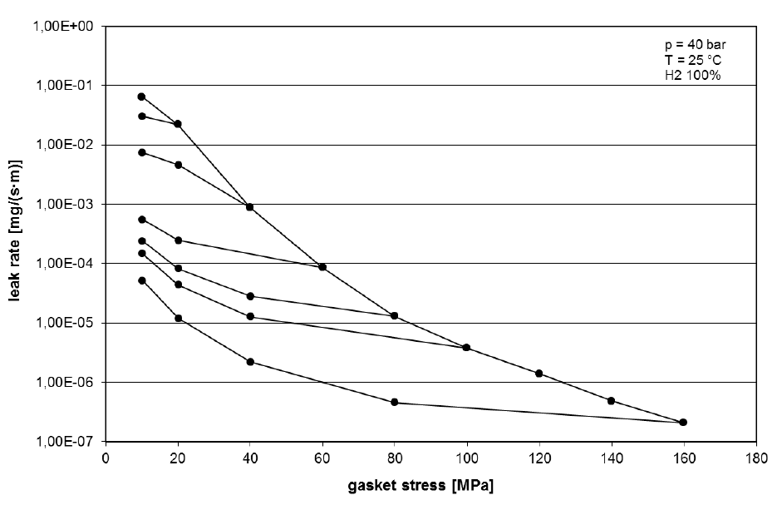
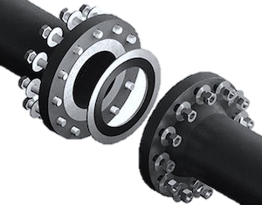
EN 13555 certified with H₂

Slide 28
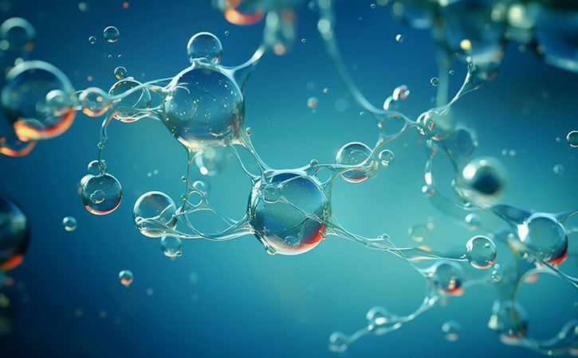
Natural Gas
Predominantly CH₄ (85-96%), with some mixture of C₂H₆
Colorless, odorless, non-corrosive, non-toxic
Boiling point ~ -162°C

Slide 29
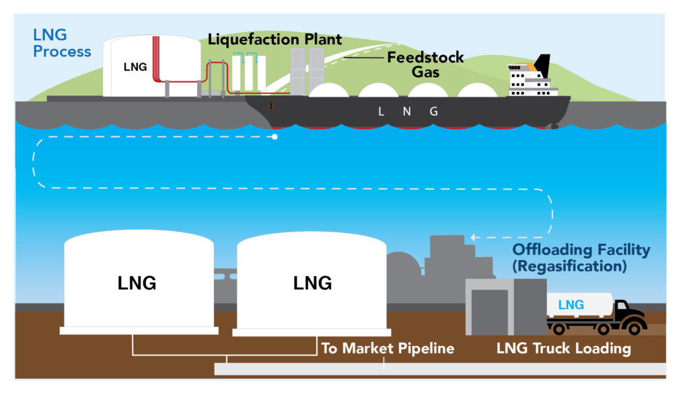
LNG
Most efficient method for transporting Natural Gas (Volume is 1/600th of equivalent CH4)
Reduction of emission when used as fuel
CO2: 20-25% NOx: 80-85% SOx: 100%
Notes:
Challenges: cryogenic conditions

Slide 30
Graphite - LNG Compatibility
No chemical interaction
No swelling / softening
Temperature range: – 253°C up to 450°C

Slide 31
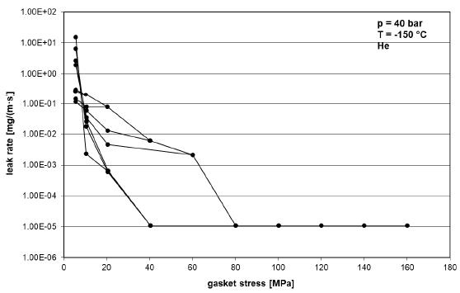
EN 13555 certified (Cryogenic)

Slide 32
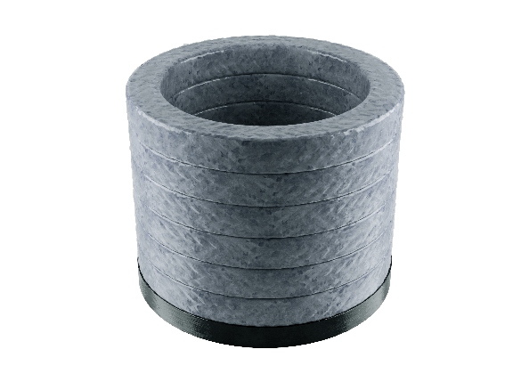
ISO 15848-1 certified (Cryogenic)
100% Helium test media, CO1 endurance class, T = -196°C
Class BH max leakage rate: 1,93E-07 (mbar / lsec)
Stem packing exposed to min temperature of -139°C [-218°F]

Slide 33
Plastics - LNG Compatibility
No chemical interaction
No physical interaction
Temperature range: -196°C to 260°C

Slide 34
Plastics - LNG Compatibility

Slide 35
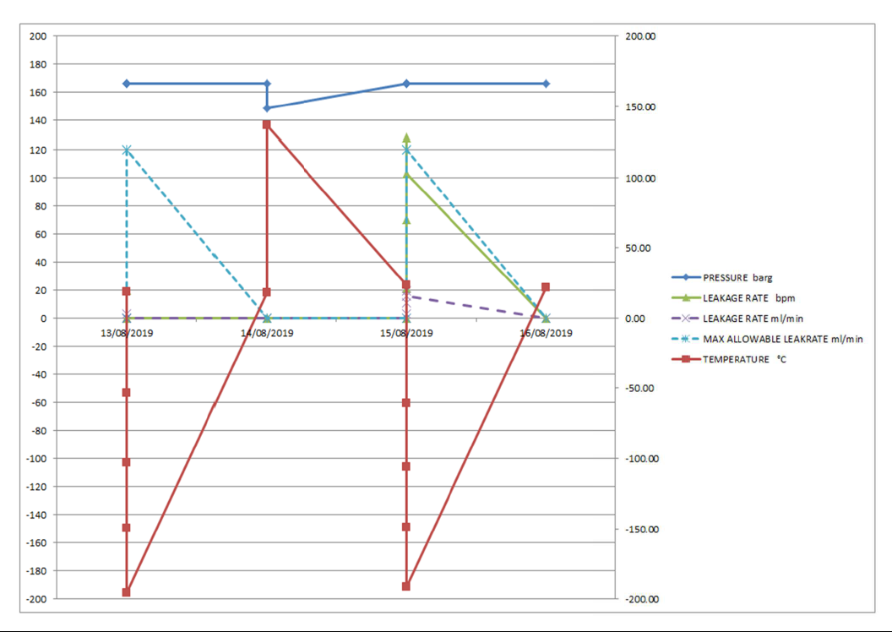
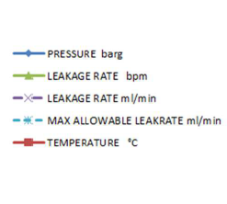
Lip Seals - Cryogenic Sealing Test

Slide 36
Conclusions
O&G Standards are not always enough to predict the suitability of a sealing material
Hydrogen - Helium testing is not 100% equal to H₂
CO₂ - Supercritical state changes material’s behaviour
LNG - Cryogenic qualification is not always clear
Notes:
O&G standards are often based on Helium testing, which is a good approximation, but
Gas permeability is different
RGD behaviour is different
F.E. tests do not always give the same results
O&G standards consider only low CO2 concentration, up to 20%
Chemical resistance alone is not enough
RGD damages are related to CO₂ concentration
CO₂ can enter in Supercritical conditions even at ambient temperature

Slide 37
Acknowledgements
Andrew Douglas
Andrew Hambleton
Jakub Marczyk

Slide 38
Thanks
ORGANIZING SECRETARIAT
Ph. +39 035 3230904
e-mail info@industrialvalvesummit.com
CONFERENCE ORGANIZERS
Ph. +39 3474908420
e-mail segreteria@valvecampus.com
www.industrialvalvesummit.com
www.valvecampus.com

