Slide 1
Fugitive emissions of a valve with gaseous hydrogen
CONFERENCE
ORGANIZERS

Slide 2
Fugitive emissions of a valve with gaseous hydrogen
Emmanuel Sauger | Cetim, Fluid & Sealing Technologies Department, France
Author:
E. Sauger, C. Plumecocq, J. Leray, L. Cougnon

Slide 3

Context and objectives of the works
Hydrogen is extremely flammable and forms explosive atmospheres very easily.
Sealing systems are a major factor in safety, equipment reliability and environmental impact control.
To develop a test bench for characterization of fugitive emissions with gaseous hydrogen
To measure fugitive emissions of a standard Oil & Gas valve

Slide 4
Outlook
1 - Approach and Development of test installation
2 - Test procedure
3 - Test results
4 - Conclusions

Slide 5
1 - Approach and
Development of test installation

Slide 6
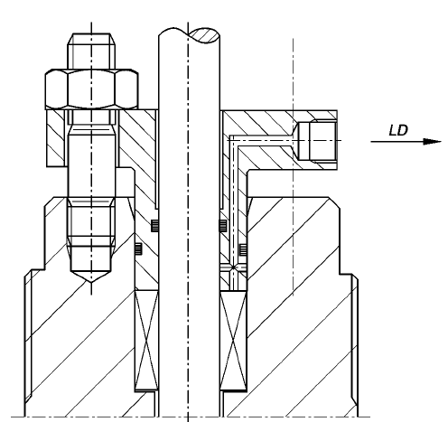
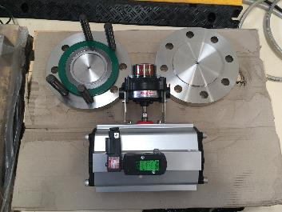
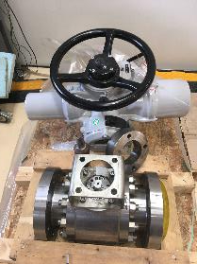
Approach & test installation
Tested valve
  4’’ Class600 ball valve with Atex IIC actuator
  Equipped to measure leak rate using the vacuum test method
  Stem seal : elastomer O-rings
  Internal metal seal
  Flanges: graphite spiral wound
  gaskets

Slide 7
Approach & test installation
P&ID presentation
H₂ supply
H₂ leak measurement
Pressure control

Slide 8
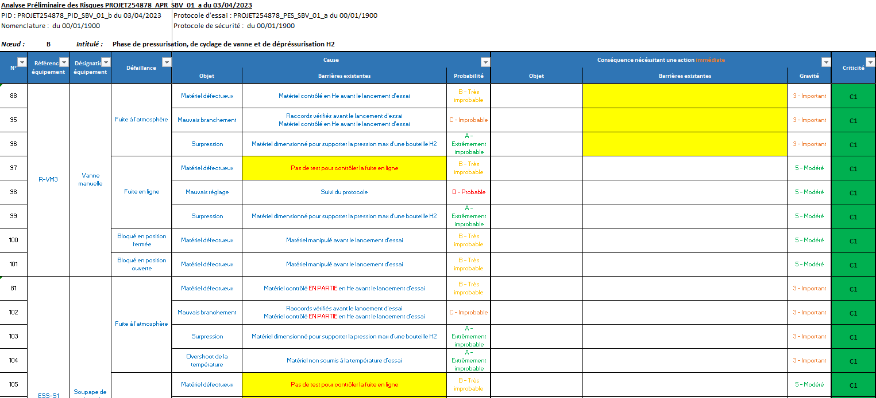
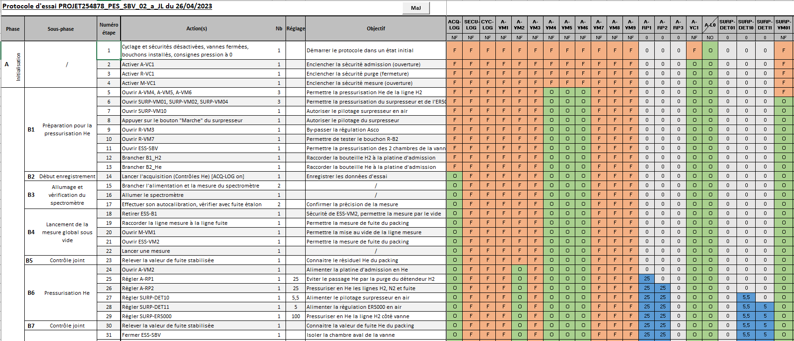
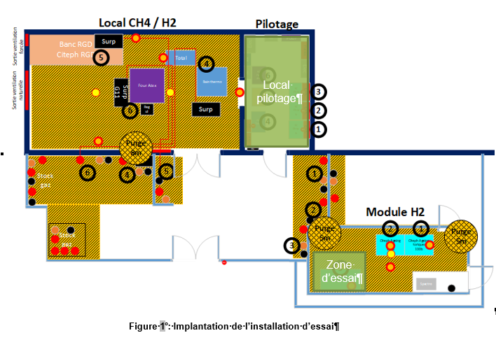
Approach & test installation
Safety approach from P&ID
Risk assessment
Test protocol
Safety protocol

Slide 9
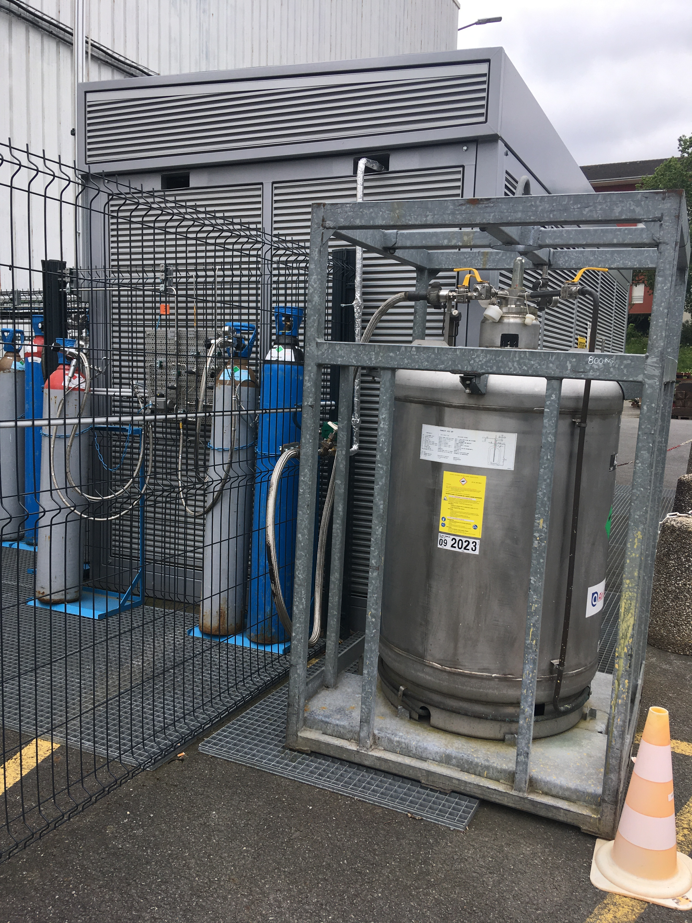
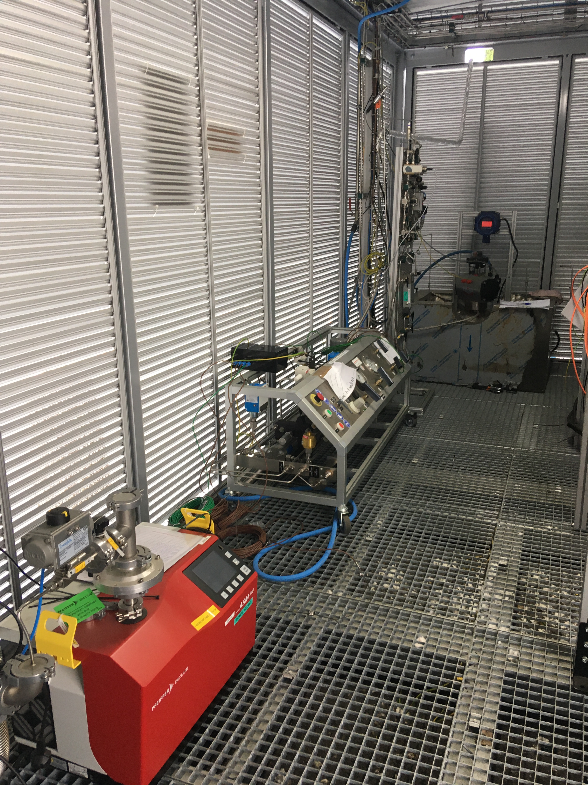
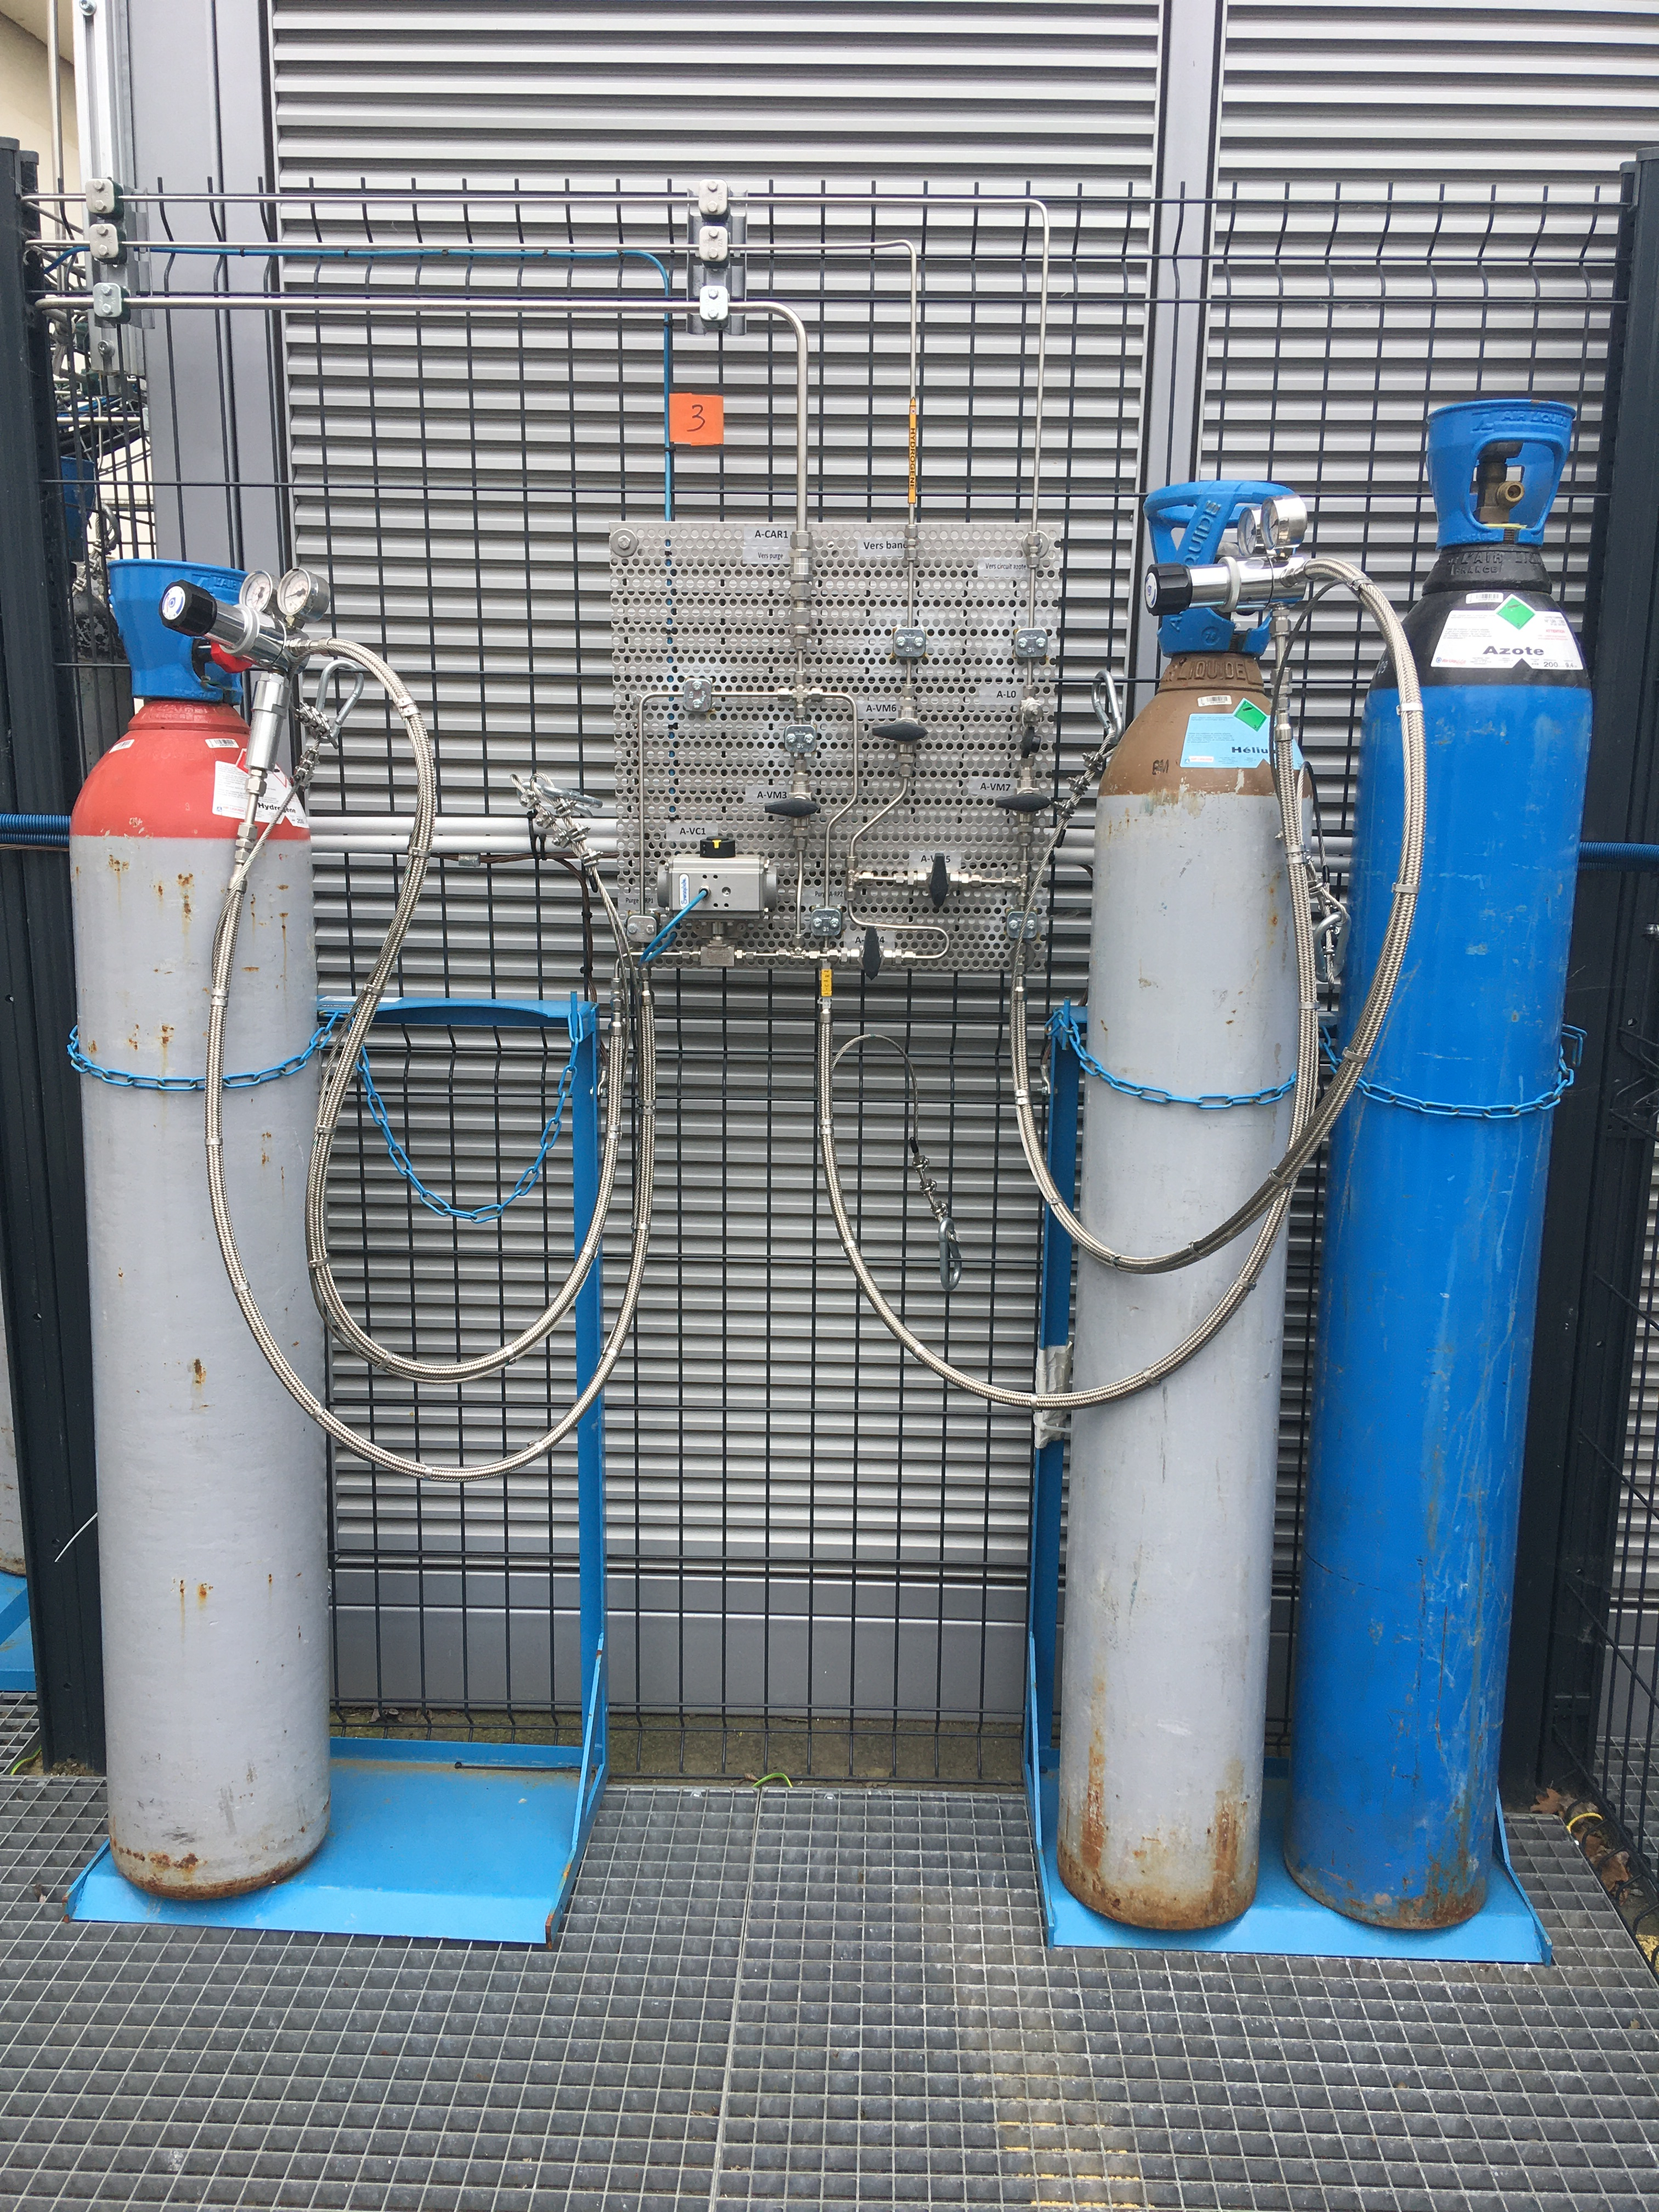
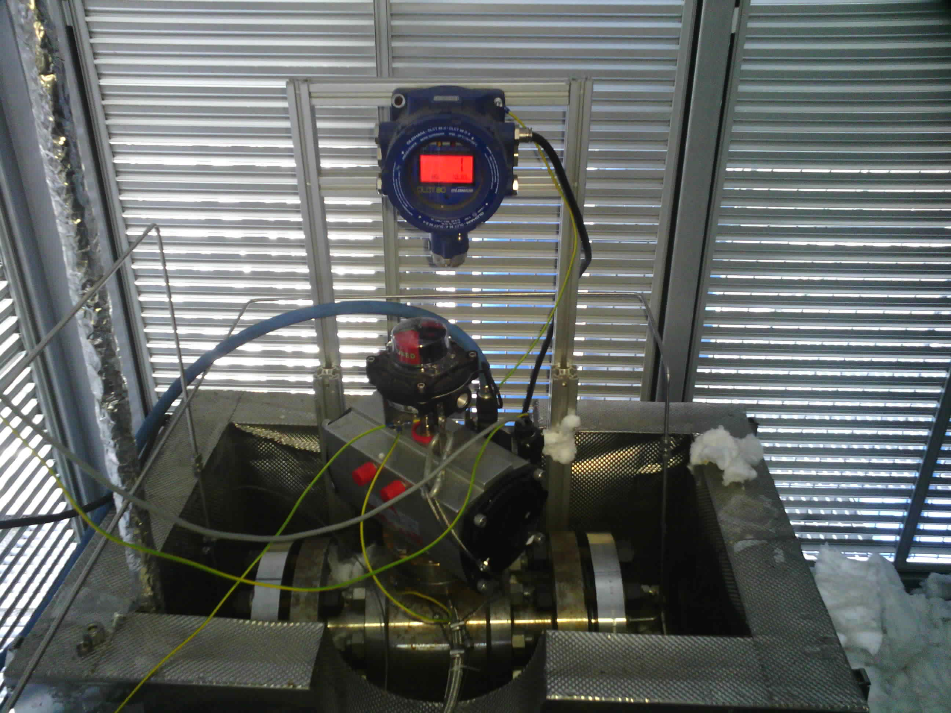
Approach & test installation
Valve installation
Test installation at low temperature
Hydrogen unit
H₂ sensor
Pressure control panel
Tested valve
Cooling
with LN₂
H₂ booster
Leak rate measurement
H₂ mass spectrometer
Thermal enclosure
Supply of
H₂, He and N₂

Slide 10
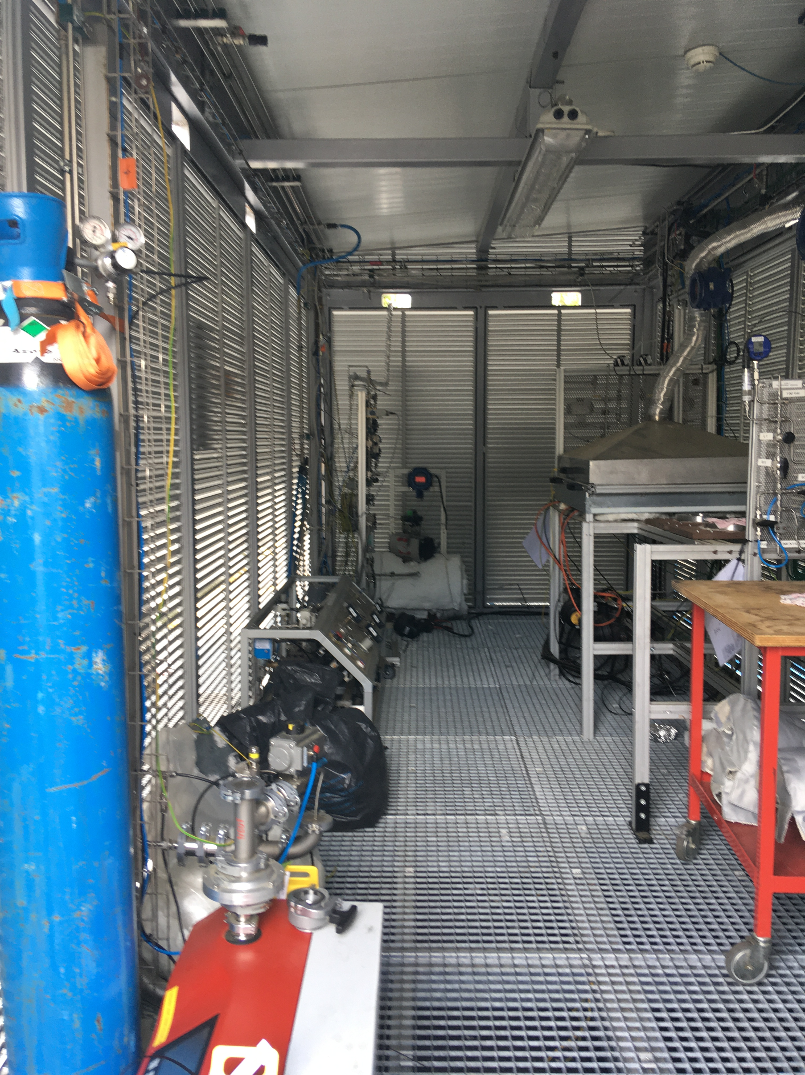
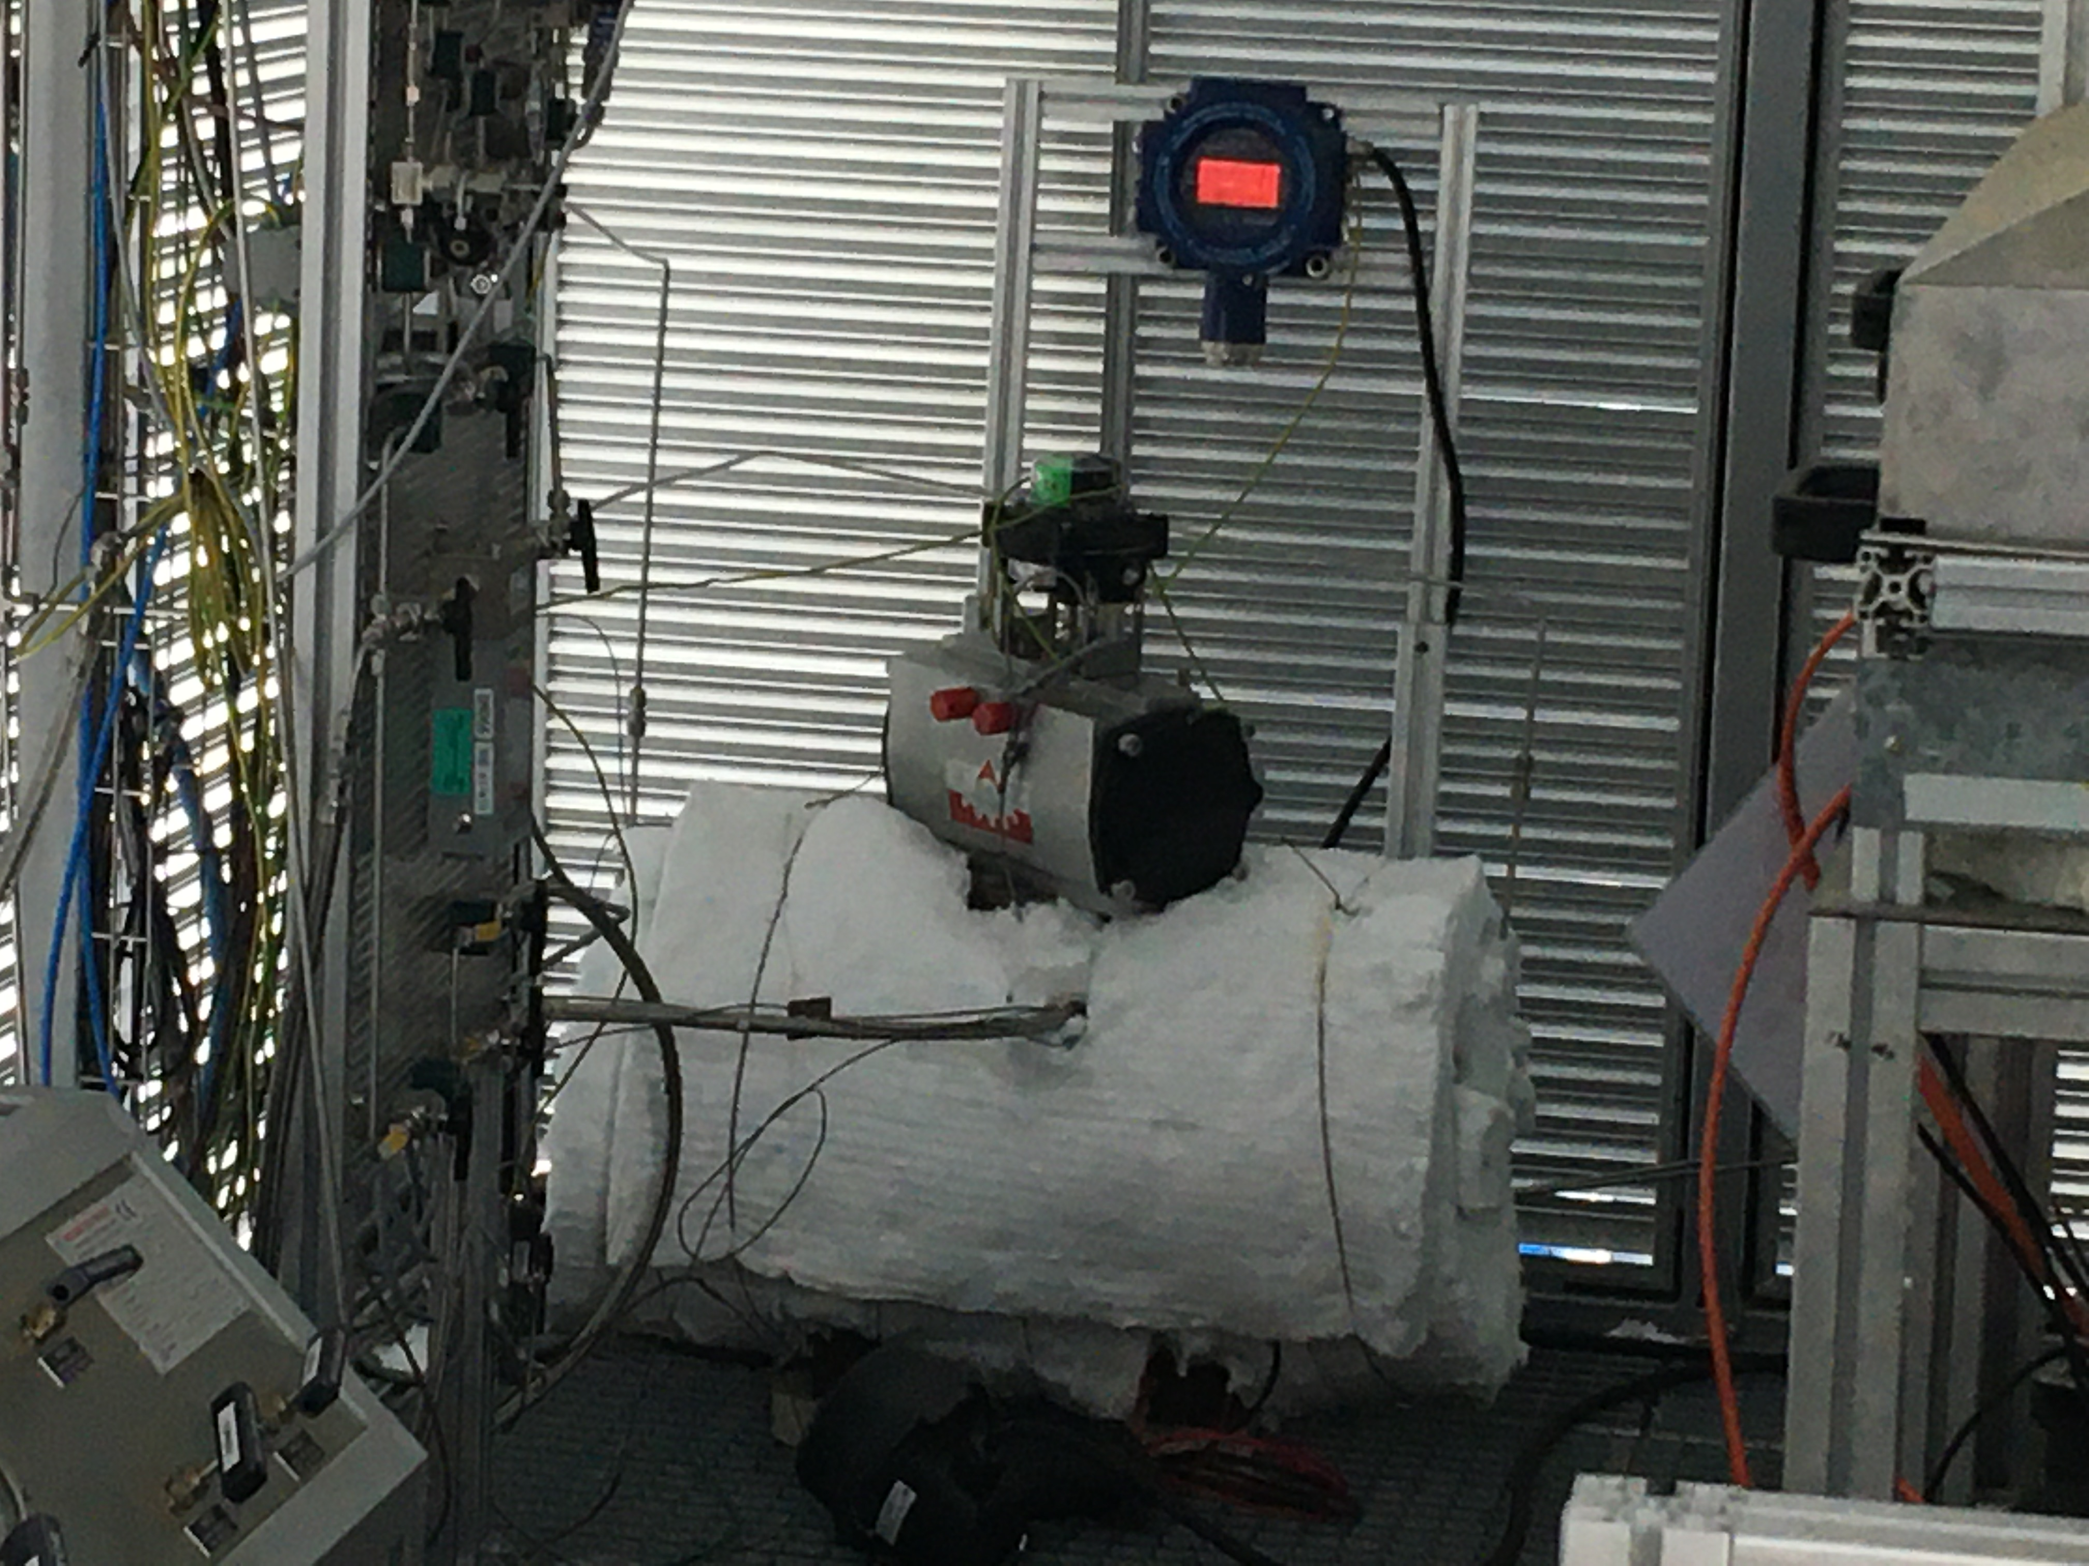
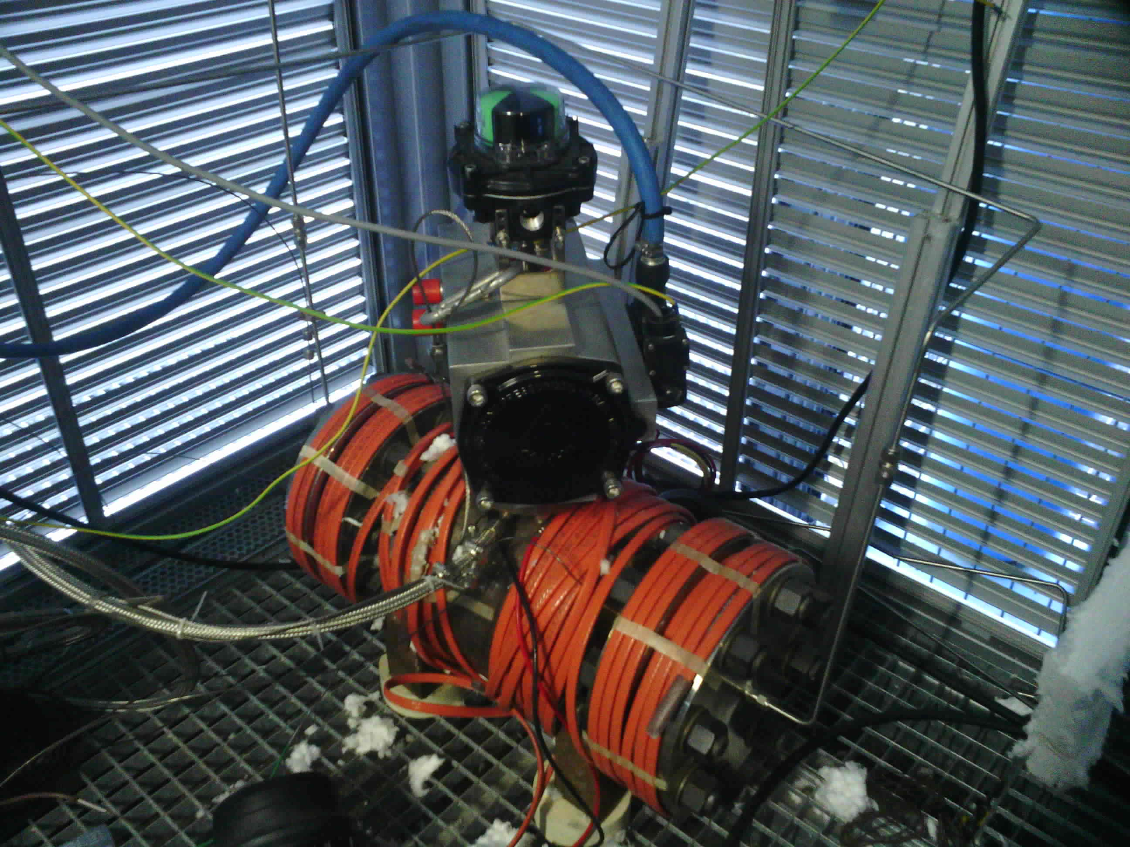
Approach & test installation
Test installation at high temperature
Hydrogen unit
Valve installation
Pressure control panel
Tested valve
H₂ Booster
H2 mass spectrometer
Leak rate measurements
Thermal insulation
Atex Heating elements

Slide 11
2 - Test procedure

Slide 12
Test procedure
ISO 15848-1 / CO1 at 150°C and -29°C (FE – H₂ mass spectrometer)
Internal tightness (ISO 5208) - H₂ Flowmeter
With He before and after test, Preferred Flow Direction (PFD)
With H₂ before and after cycling at Tamb, PFD
With H₂ at (T_{est}, 50 cycles) and (T_{est}; 205 cycles) T_{test}=-29°C or +150°C, PFD
Test at +150°C
Test at -29°C

Slide 13

Test procedure
Performance class (ISO15848-1) – reminder of classification
Internal tightness (ISO 5208) - criterion
  Tightness Class : AH, BH, CH (H : He; M : methane) → « AH₂, BH₂, CH₂ »
  Endurance: CO₁, CO₂, CO₃ (ON/OFF valve); CC₁, CC₂, CC₃ (control valve)
  Temperature (T_{test} at the fluid line )
  Pressure: valve pressure class
  Example of valve classification with helium
    CH - CO1 - SSA 1 - tRT (150°C) – PN100 - ISO 15848-1:2015\Amd.1:2017
  Tightness: rate D (metallic seat) → 30 xDN = 30 x 100 = 3 000 mm³.s⁻¹= 180 ml/min
  Problem : unstable leakages + leakages higher than flowmeter range
  → pressure stages up to 100 bar and down to Patm.
Notes:
It is only a remind of classification and criteria

Slide 14
3 - Test results

Slide 15
Test results
ISO 15848-1 test at -29°C
  Few variation of leak rates → low interfacial leak with this material O-ring
  Performance Class « BH₂ »-CO1- SSA0-(t-29°C)-ISO 15848-1:2015\2017

Slide 16
Test results
Internal tightness test at -29°C
Flowmeter saturation with He
Flowmeter saturation with H₂
  Increasing pressure: H₂-leakage at lower pressure than He-leakage
  depressurisation : H₂-leakage / He-leakage is between 2-3

Slide 17
Test results
ISO 15848-1 test at 150°C
  Tightness Class « CH₂ » → influence of O-ring material permeability at high temperatures
  Performance Class « CH₂ »- CO1- SSA0-tRT(+150°C)-ISO 15848-1:2015\2017

Slide 18
Test results
ISO 15848-1 test at 150°C
Helium
Flowmeter saturation
Hydrogen
Flowmeter saturation
(Tamb; 205 cy)
(Tamb; 205 cy)
(150°C; 205 cy)
(150°C; 205 cy)
(150°C; 50 cy)
(150°C; 50 cy)
(Tamb; 50 cy)
(Tamb; 50 cy)
  Better tightness behaviour at high temperature and high pressure
  Same kind of variations between H₂ and He observed at low temperature

Slide 19
Test results
ISO 15848-1 test at 150°C - Comparison of H₂ and He
Hydrogen (100 bar)
Helium (425 bar)
  It takes more time to perform H₂ measurements (safety)
  Same kind of leak rate variations with H₂ and He
  Higher leak rates with H₂

Slide 20
4 - CONCLUSIONS

Slide 21
Conclusions
  Cetim has developed:
    A safety approach to perform H₂ test of valves
    A testing facility to measure fugitive emission of H₂ at high and negative temperatures
  Test program is carried out on a ball valve
  Fugitive Emission measurements following ISO 15848-1
    Test at -29°C : « BH₂ »-CO1- SSA0-(t-29°C)-ISO 15848-1:2015\2017
    Test at +150°C : « CH₂ »-CO1- SSA0-tRT(+150°C)-ISO 15848-1:2015\2017
    Same kind of leak rate variation with He and H₂. Higher levels of H₂ leak rates.
  Internal tightness measurements following ISO 5208
    With the tested valve leaks are much higher than rate D of ISO 5208 at 100 bar
    Difficulties to obtain leak stabilizations
    Ratio H2-leakage / He-leakage is between 2-3
Notes:
During this project, Cetim has …

Slide 22
Thank you for your attention
Do you have any questions ?
Notes:
During this project, Cetim has …

Slide 23
Thanks
ORGANIZING SECRETARIAT
Ph. +39 035 3230904
e-mail info@industrialvalvesummit.com
CONFERENCE ORGANIZERS
Ph. +39 3474908420
e-mail segreteria@valvecampus.com
www.industrialvalvesummit.com
www.valvecampus.com

