Slide 1
ORGANIZERS
SCIENTIFIC COMMITTEE
ROLAND MITTELHAMMER
Senior Technical Sales Manager, SGL Carbon
Flexible Graphite Gaskets for Hydrogen Applications
IVS 2022
Technical Conference

Slide 2
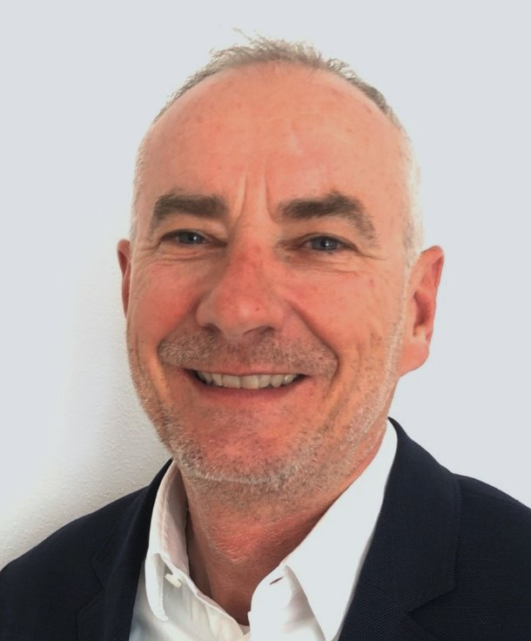
Biography
Roland Mittelhammer is a Senior Technical Sales Manager for SGL Carbon’s Product Segment Expanded Graphite of the Business Unit Graphite Solutions.
Roland holds Bachelor’s degrees in Business Administration and Operations. He has more than 20 years of experience in the field of sealing technology and is an expert in the use of flexible graphite products made from expanded natural graphite as high-performance sealing materials for many highly-demanding industrial processes in power plants, chemical and petrochemical plants and refineries.
He has been with SGL Carbon for 33 years in various positions e. g. Application Engineer Carbon Fiber Products, Inside Sales Manager Expanded Graphite, Technical Sales Manager Expanded Graphite, and Senior Technical Sales Manager Expanded Graphite.
In his current position he is responsible for both sales and technical service of flexible graphite materials with a special focus on supporting his customers and end-users of gaskets and seals to minimize fugitive emissions and downtimes, run plants at maximum safety and improve process reliability and service life of the equipment.
Roland Mittelhammer l Flexible Graphite Gaskets for Hydrogen Applications

Slide 3
Agenda
Hydrogen production, properties, and use
Hydrogen sealing: Difficulties and solutions
Optimum graphite gaskets for hydrogen sealing
Roland Mittelhammer l Flexible Graphite Gaskets for Hydrogen Applications

Slide 4
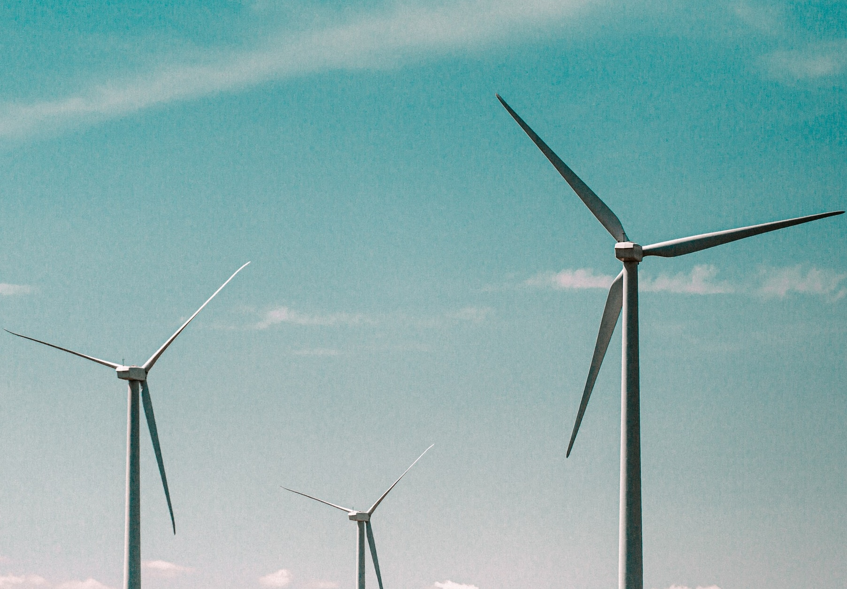
Hydrogen can be produced by several different processes; it is commonplace to use a color to describe the manufacturing process
Hydrogen production processes
Grey hydrogen
Conversion of methane to hydrogen and carbon dioxide.
Carbon dioxide is released into the atmosphere.
Blue hydrogen
Same production process as grey hydrogen
Carbon dioxide is captured and stored or used in other industrial processes.
Green hydrogen
Electrolysis of water using electricity from regenerative energy sources.
Most environmentally friendly production method
Photo by Mike Setchell, Unsplash
Roland Mittelhammer l Flexible Graphite Gaskets for Hydrogen Applications

Slide 5
Properties, handling and end uses of hydrogen
Hydrogen at a glance
Properties
Most abundant element in the universe, melting point: -259°C, boiling point: -253°C
At standard conditions it is a gas of diatomic molecules H₂
Lightest gaseous element, density is ~14x lower than air
Color-, odor- and tasteless, non-toxic, highly combustible
Transport and storage
Most cost-effective way is using existing infrastructure and equipment (shipping, trucks, pipelines, vessels, tanks etc.)
End use
In many industrial processes in the steel and chemical industries and refineries e. g. ammonia production
Clean fuel for transport, heating, and power generation (e. g. in fuel cells to reduce emission of greenhouse gases)
H₂
Hydrogen
Photo by Carmine Savarese, Unsplash
Roland Mittelhammer l Flexible Graphite Gaskets for Hydrogen Applications

Slide 6
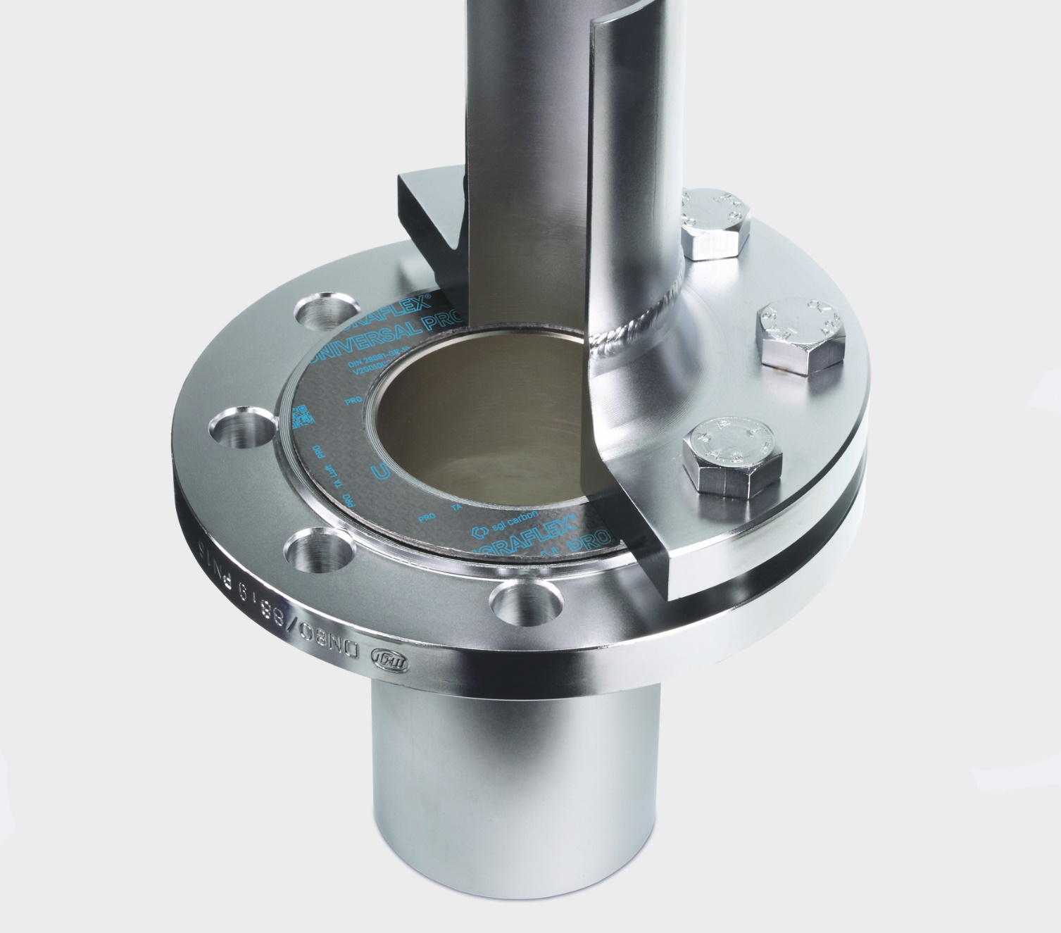
Safe and effective sealing of hydrogen: A big challenge
Hydrogen owns potential explosive properties due to its
Wide range of flammable concentrations
Low ignition energy
Another typical hazard of hydrogen is material embrittlement.
Therefore, high safety standards must apply for hydrogen
Production
Transport and storage
Processing
including resistant, safe and leak tight gaskets and seals.
H₂
Hydrogen
Roland Mittelhammer l Flexible Graphite Gaskets for Hydrogen Applications

Slide 7
Hydrogen leakage behavior and testing
Safe plant and equipment operation require of a gasket or sealing material
Chemical resistance against the media
Long-term mechanical stability
In addition, the leakage behavior is crucial
Leakage rates are usually measured at several effective gasket stress levels with an internal gas pressure of 40 bar. Test gases used are e. g. helium.
Gasket leakage depends largely on the atomic / molecular size of the media.
The hydrogen atom is smaller than the helium atom.
But since it only comes along as H₂ molecule, the leakage behavior of hydrogen is similar to that of helium.
H
Hydrogen
1
1.008
hydrogen molecule
He
Helium
2
4.003
helium atom
Roland Mittelhammer l Flexible Graphite Gaskets for Hydrogen Applications

Slide 8
Hydrogen and helium leakage rates of SIGRAFLEX® HOCHDRUCK PRO 2 mm gaskets are comparable
H₂ and He EN13555 leakage rates of V20011Z3IP at 40 bar, TA Luft sealing class L0.01
L0.01
Helium
Hydrogen
Typical assembly stress (EN1092-1 RF flanges)
Roland Mittelhammer l Flexible Graphite Gaskets for Hydrogen Applications

Slide 9
Also, hydrogen and helium leakage rates of SIGRAFLEX® UNIVERSAL PRO 2 mm gaskets are in the same range
H₂ and He EN13555 leakage rates of V20010C2IP at 40 bar, TA Luft sealing class L0.01
L0.01
Helium
Hydrogen
Typical assembly stress (EN1092-1 RF flanges)
Roland Mittelhammer l Flexible Graphite Gaskets for Hydrogen Applications

Slide 10
Leakage of 2 mm thick SIGRAFLEX® HOCHDRUCK PRO gaskets compared to tanged reinforced graphite gaskets is by far lower
EN13555 leakage at 40 bar: V20011Z3IP (H₂, He) vs. tanged reinf. graphite gasket (He)
L0.01
Typical tanged reinforced graphite gasket Helium
Factor 30
V20011Z3IP Helium
V20011Z3IP Hydrogen
Typical assembly stress (EN1092-1 RF flanges)
Roland Mittelhammer l Flexible Graphite Gaskets for Hydrogen Applications

Slide 11
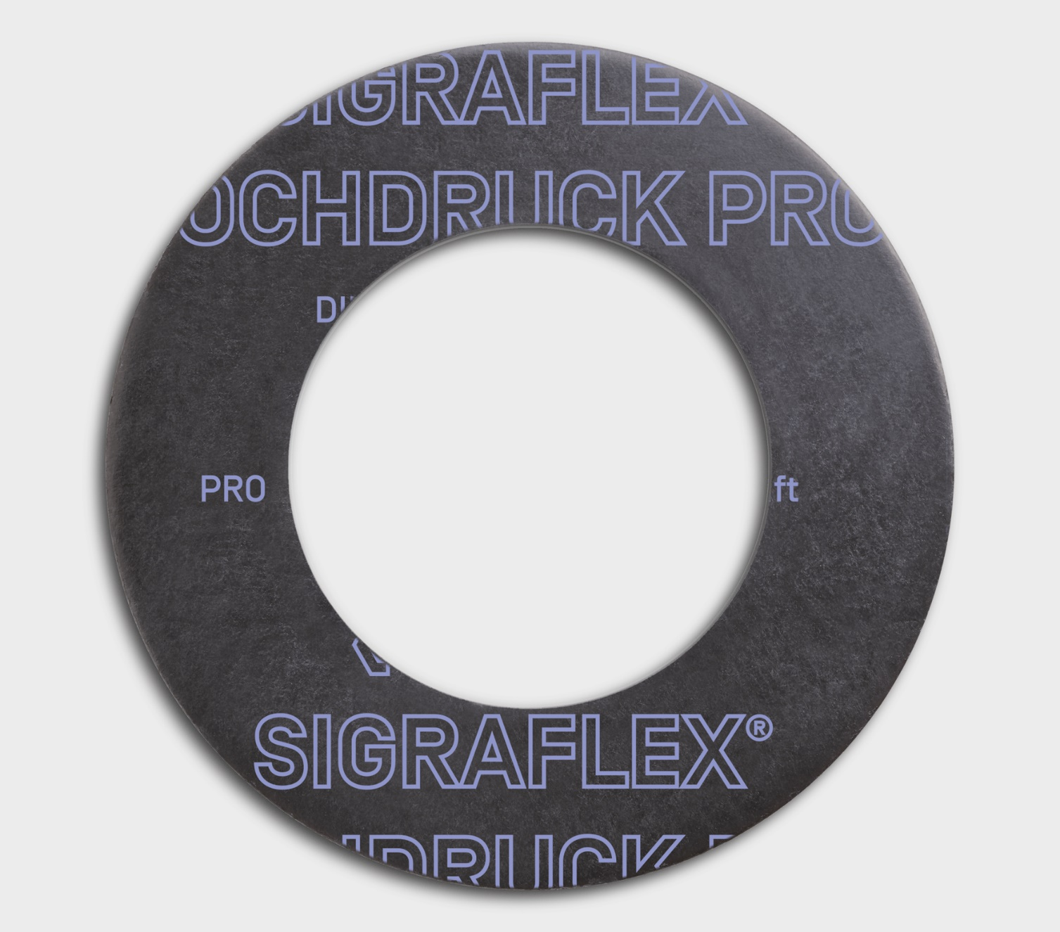
Hydrogen leakage tests with SIGRAFLEX® graphite gaskets resulted in important findings for choosing the best sealing material
Results of leakage tests
Measurements at company AMTEC with pure hydrogen acc. to EN 13555 show hydrogen low leakage rates, even below L 0.01 as defined by the German Clean Air Act (TA Luft).
Leakage measurements at the typical operational gasket stresses show a comparable leakage behavior of hydrogen and helium.
Conclusions for hydrogen sealing
Due to its potential explosive properties reliable hydrogen sealing is very important.
Safety aspects demand gaskets which are far above customary standard gaskets.
Long-term sealing expertise is required to choose the best material
Roland Mittelhammer l Flexible Graphite Gaskets for Hydrogen Applications

Slide 12
Flexible graphite comes into play where other gasket materials fail
Low permeability to gases and liquids
Corrosion and chemical resistance, resistance against H₂
Flexibility and softness
High purity; contains no adhesives or binders
Outstanding thermal resistance
Roland Mittelhammer l Flexible Graphite Gaskets for Hydrogen Applications

Slide 13
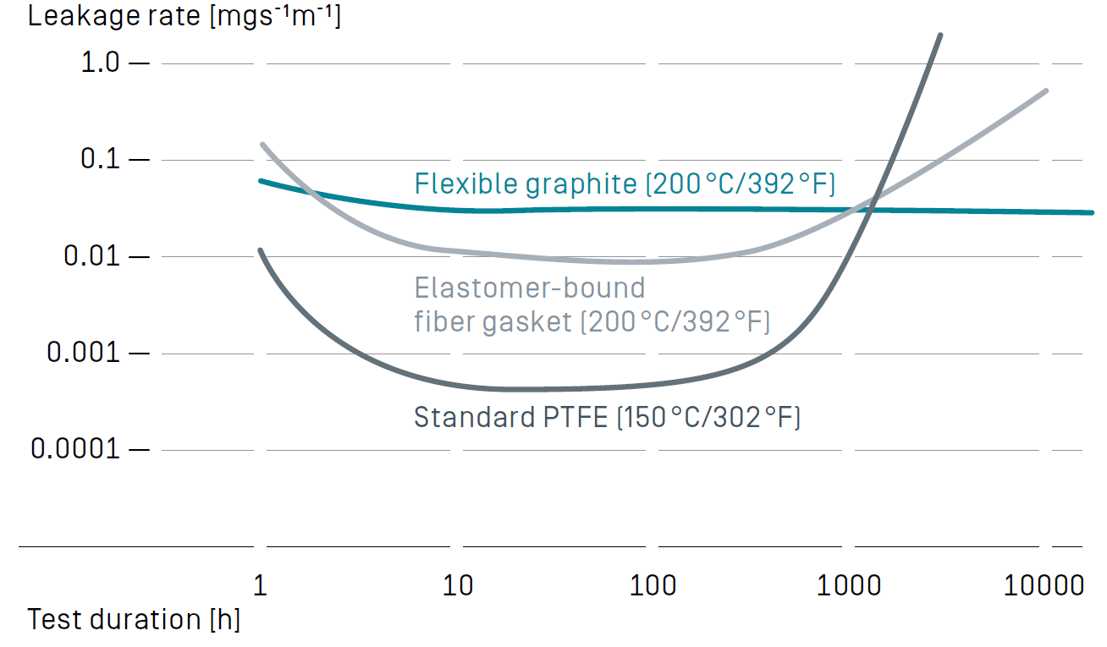
Over 10,000 hours and beyond stable leakage rate
Ensuring low leakage
Flexible graphite is the best sealing material when stable leakage rates are requested
Graphite leakage rates remain comparably stable over time
At high gasket pressure leakage rates decline when the installed gaskets have a high bulk density in their compressed state
The sealing effect is retained even when the gasket pressure is reduced
Graphite does not age or embrittle when in contact with hydrogen. The same is true for die formed packing rings made from SIGRAFLEX® flexible graphite foil
Change in leakage rates of various sealing materials in long-term trials*
*Measured on a DN 40 PN 40 flange in accordance with DIN 28090-1 and -2; Due to the warm flow characteristics of PTFE, its test temperature was set at only 150 °C
Roland Mittelhammer l Flexible Graphite Gaskets for Hydrogen Applications

Slide 14
Graphite gaskets have some important quality characteristics which depend strongly on graphite quality
Quality characteristic | High quality | Standard quality
Low sulfur content avoids corrosion | < 300 ppm | 700 - 1500 ppm
Low oxidation rate extends gasket lifetime | @670°C < 3%/h | 4 - 40%
Low leakage rate at low gasket stress | 16 MPa to achieve L0.01 acc. to EN 13555 | 60 MPa to achieve L0.01 acc. to EN 13555
Roland Mittelhammer l Flexible Graphite Gaskets for Hydrogen Applications

Slide 15
SIGRAFLEX® is the #1 for high performance and safety including hydrogen applications
Our graphite sealing solutions play a major role in
Minimizing emissions
Protecting the environment
Ensuring process and plant safety
Extending plant service life and reliability
Reducing operating costs
For 50 years, customers do not only buy gasket materials, but they also purchase support in
Process safety
Compliance to legislative demands and regulations.
Photo by Joshua J Cotten, Unsplash
Roland Mittelhammer l Flexible Graphite Gaskets for Hydrogen Applications

Slide 16
Q & A SESSION
ORGANIZERS
SCIENTIFIC COMMITTEE
Thank you for your attention!
IVS 2022
Technical Conference

