Slide 1
Stem Friction and Packing Stress Influence on the Sealing Behavior of Fugitive Emission Control Valves
CONFERENCE
ORGANIZERS

Slide 2
Stem Friction and Packing Stress Influence on the Sealing Behavior of Fugitive Emission Control Valves
How to evaluate Control Valve packings performance and what is the friction role in these products?
Carlos D. Girão | Technical Director at Teadit

Slide 3
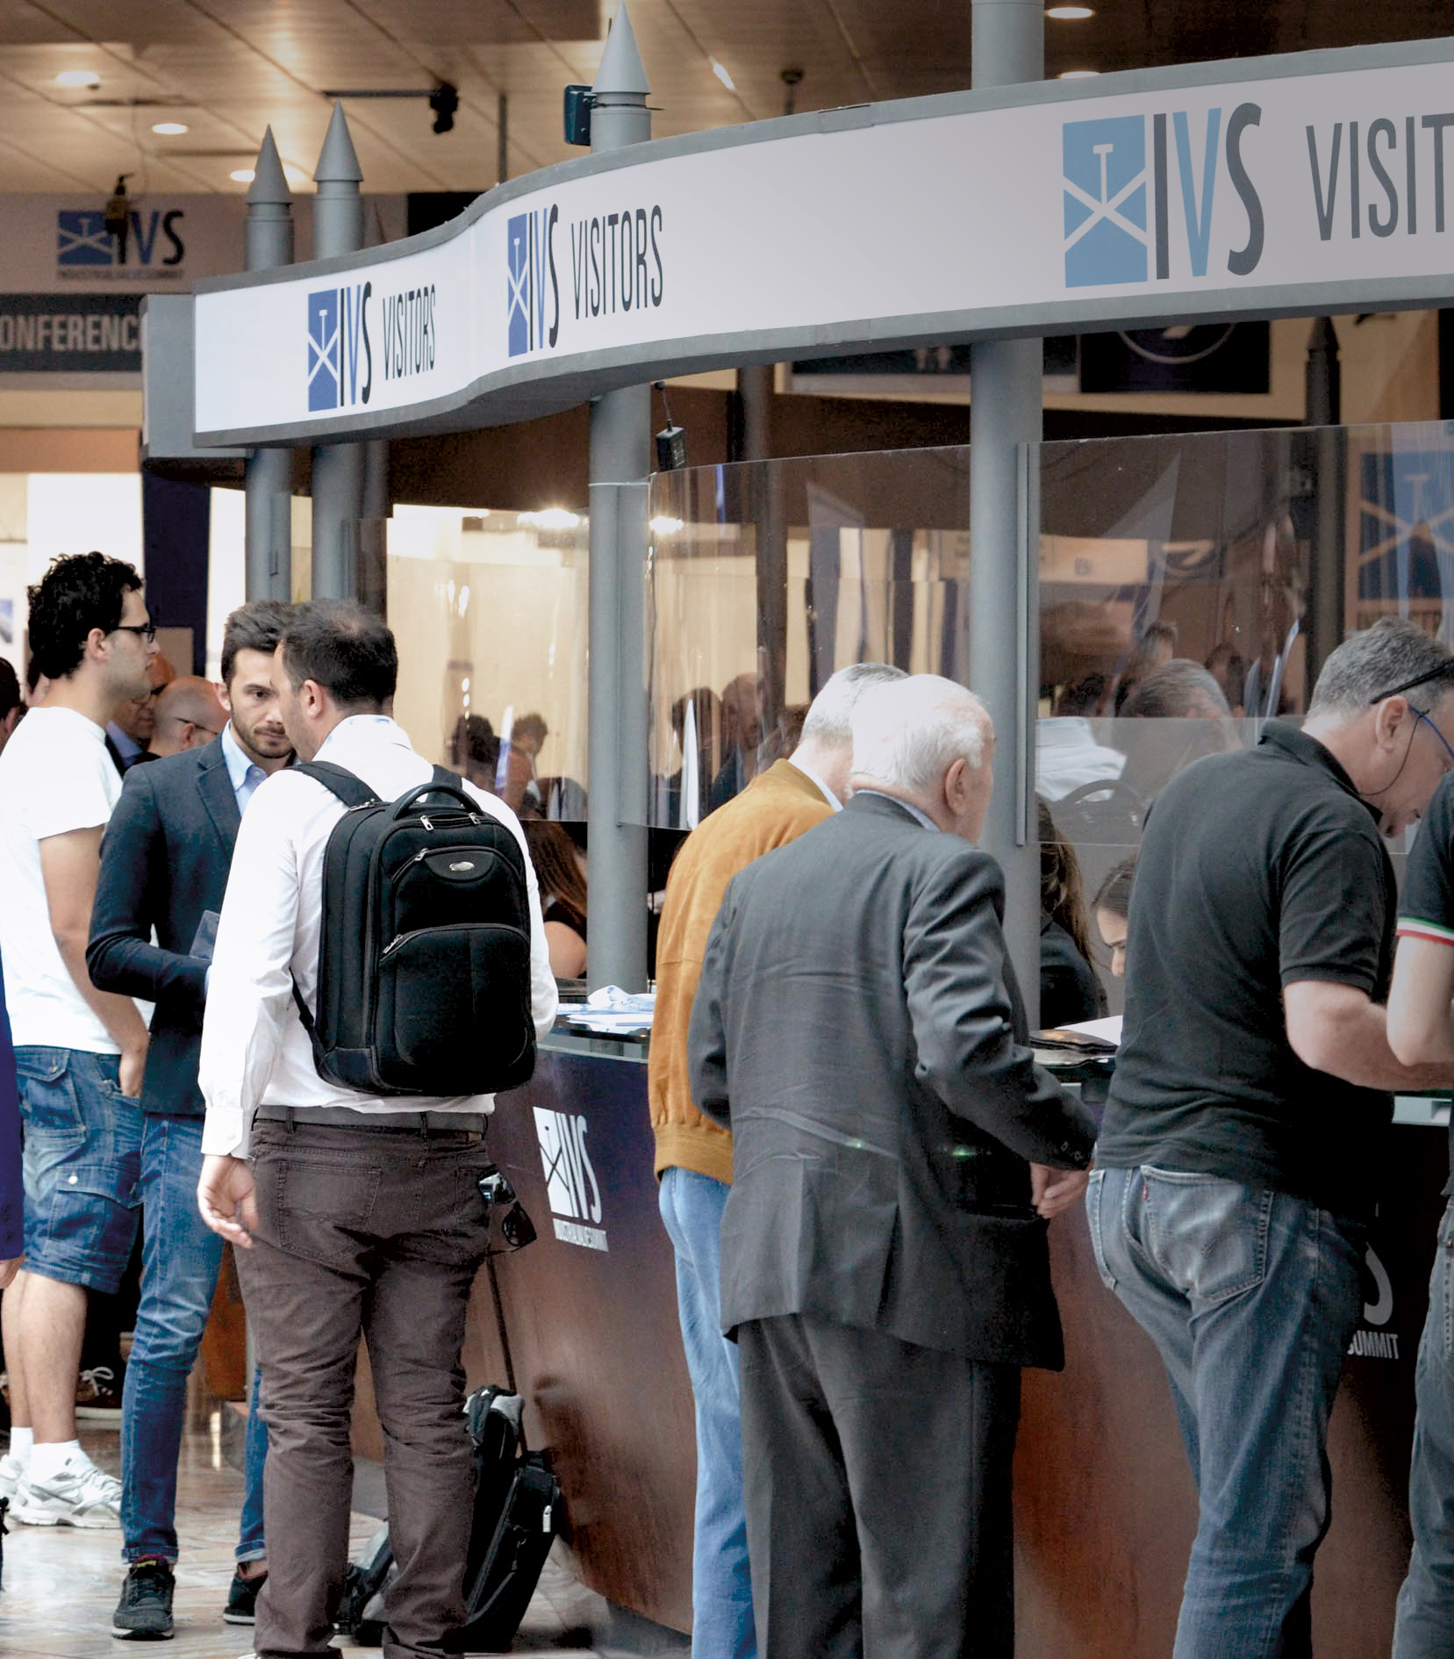

Agenda
Main Fugitive Emissions (FE) Standards
Fugitive Emissions (FE) Packings
Friction Test
Fugitive Emissions Testing
High Temperature Performance
Preparing for the Future
Conclusion
CONFERENCE ORGANIZERS

Slide 4
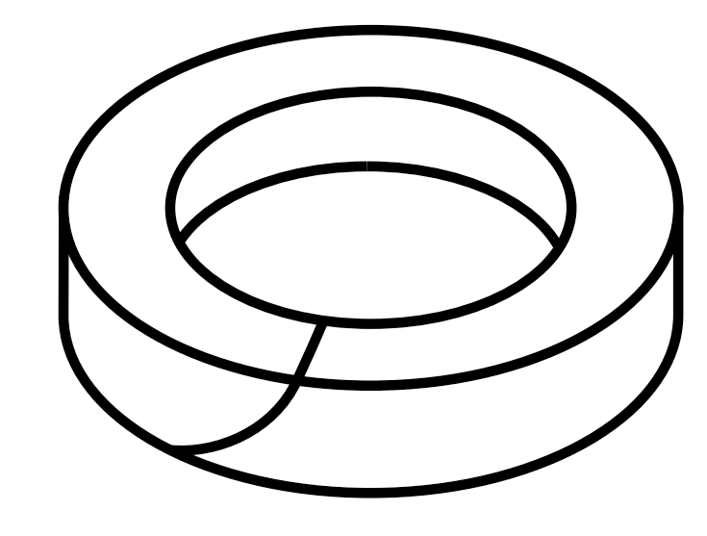
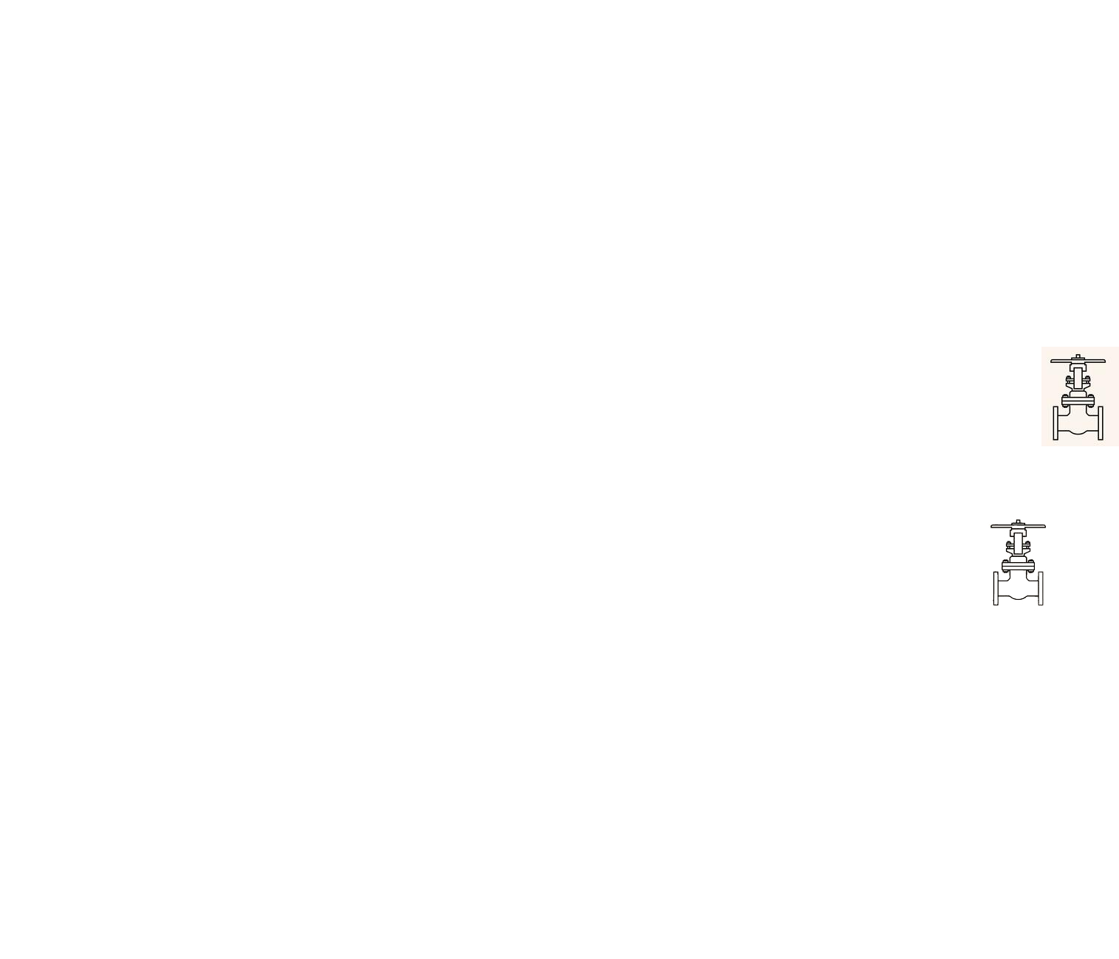
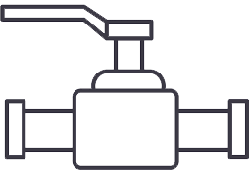
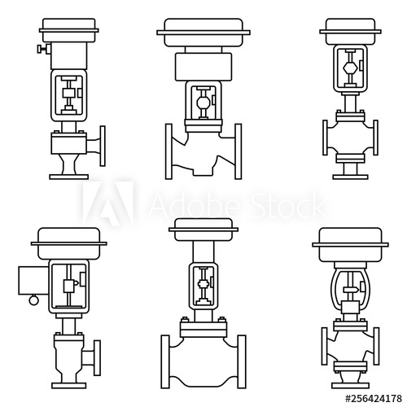
Main Fugitive Emissions Standards
624
641
622
API
Packing Test
Valve Test
Multi-Turn
Valve Test
Quarter-Turn
15848-1
15848-2
ISO
Valve Test
Multi & Quarter
API 641 and ISO 15848-1 are the most required test for Control Valves
Valve Test
Quality Control

Slide 5
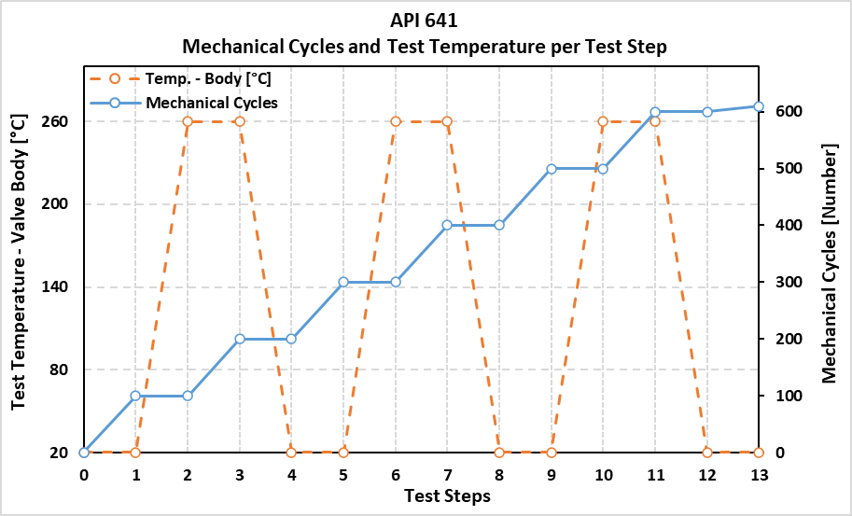
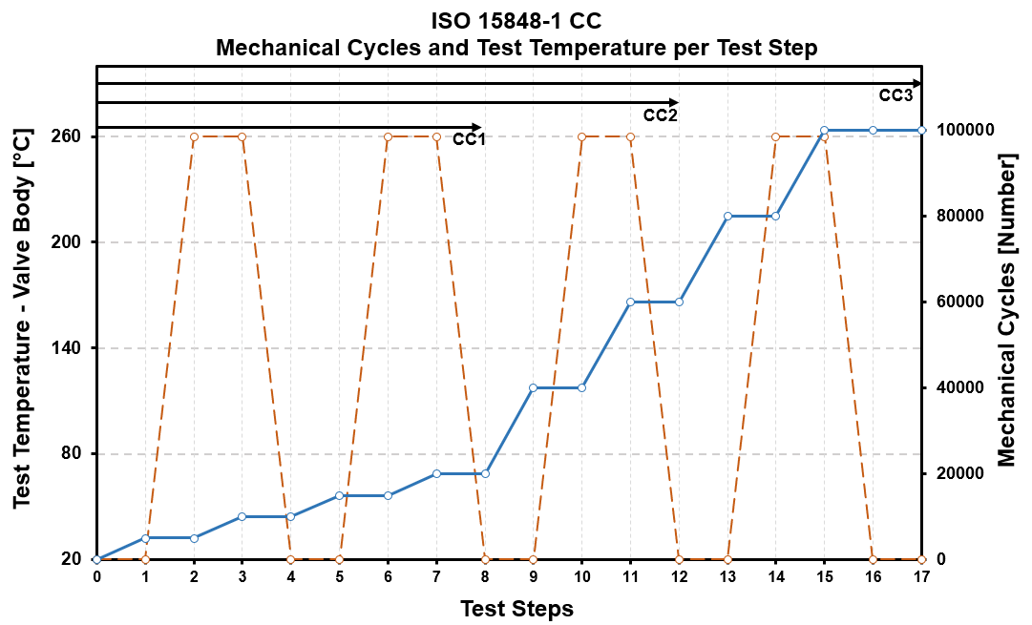
Main FE Standards
API 641 2nd Ed. (Isolating Valve)
ISO 15848-1:2015 CC (Control Valves)
Thermal Cycles: 3 (260°C)
Mechanical Cycles: 610
Test Media: Methane
Max. Leakage: 100 ppm
Thermal Cycles: 2, 3 or 4 (User Temp)
Mechanical Cycles: 20k, 40k or 100k
Test Media: Methane or Helium
Allowable Leakage Tiers:
  50, 100, 500 ppm (for Methane)

Slide 6
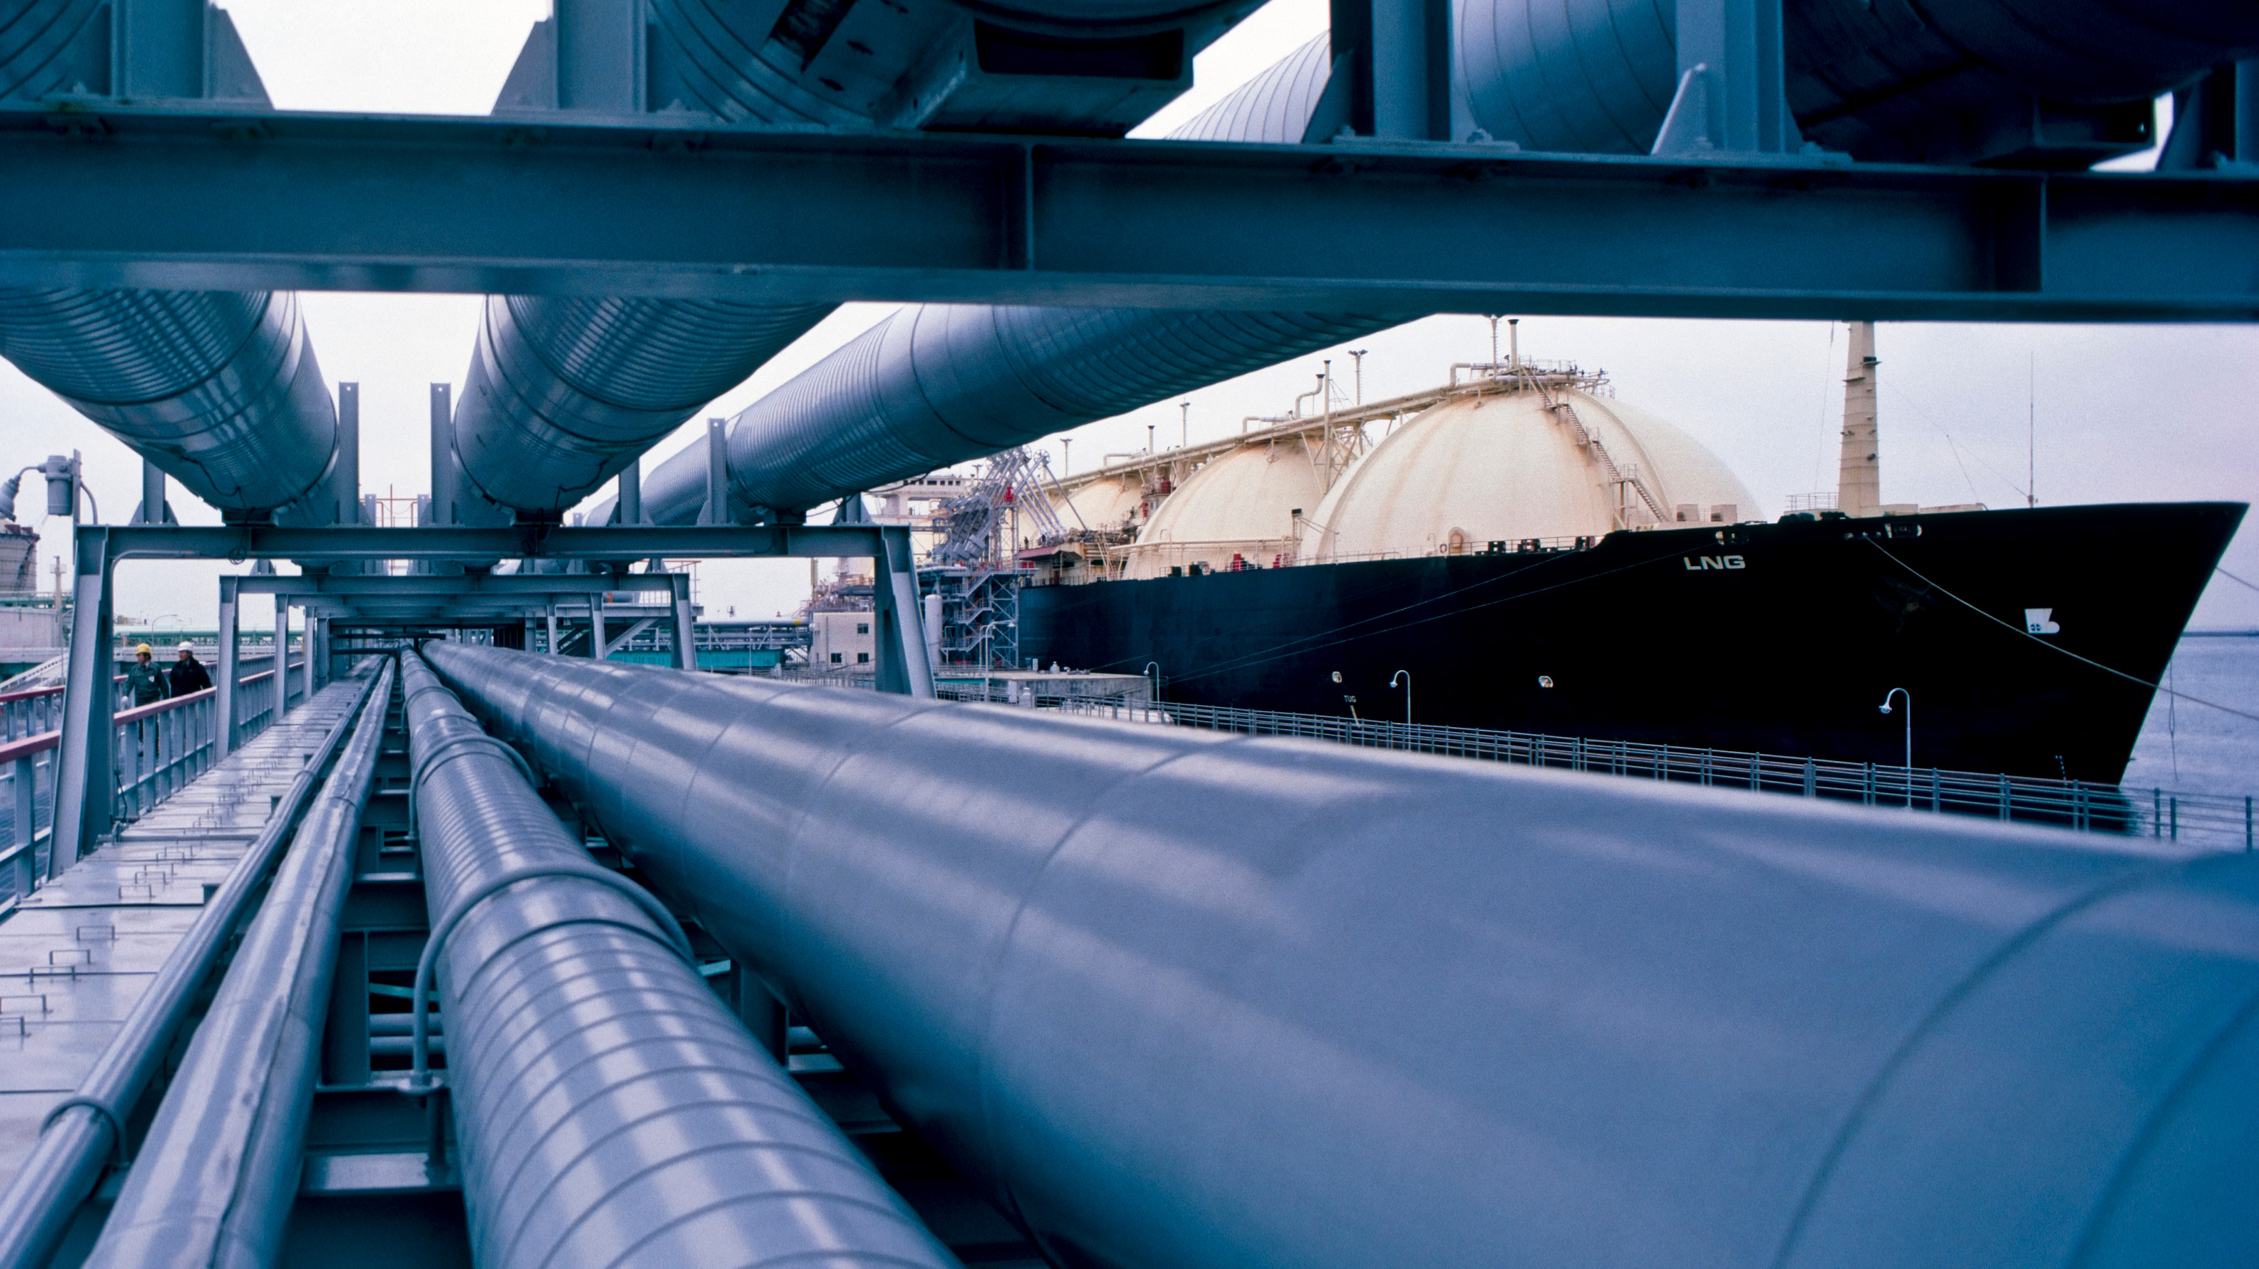


Fugitive Emissions Packings
PTFE Coating
Flexible Graphite
Metallic Alloy Jacket
ORGANIZERS
CONFERENCE ORGANIZERS

Slide 7
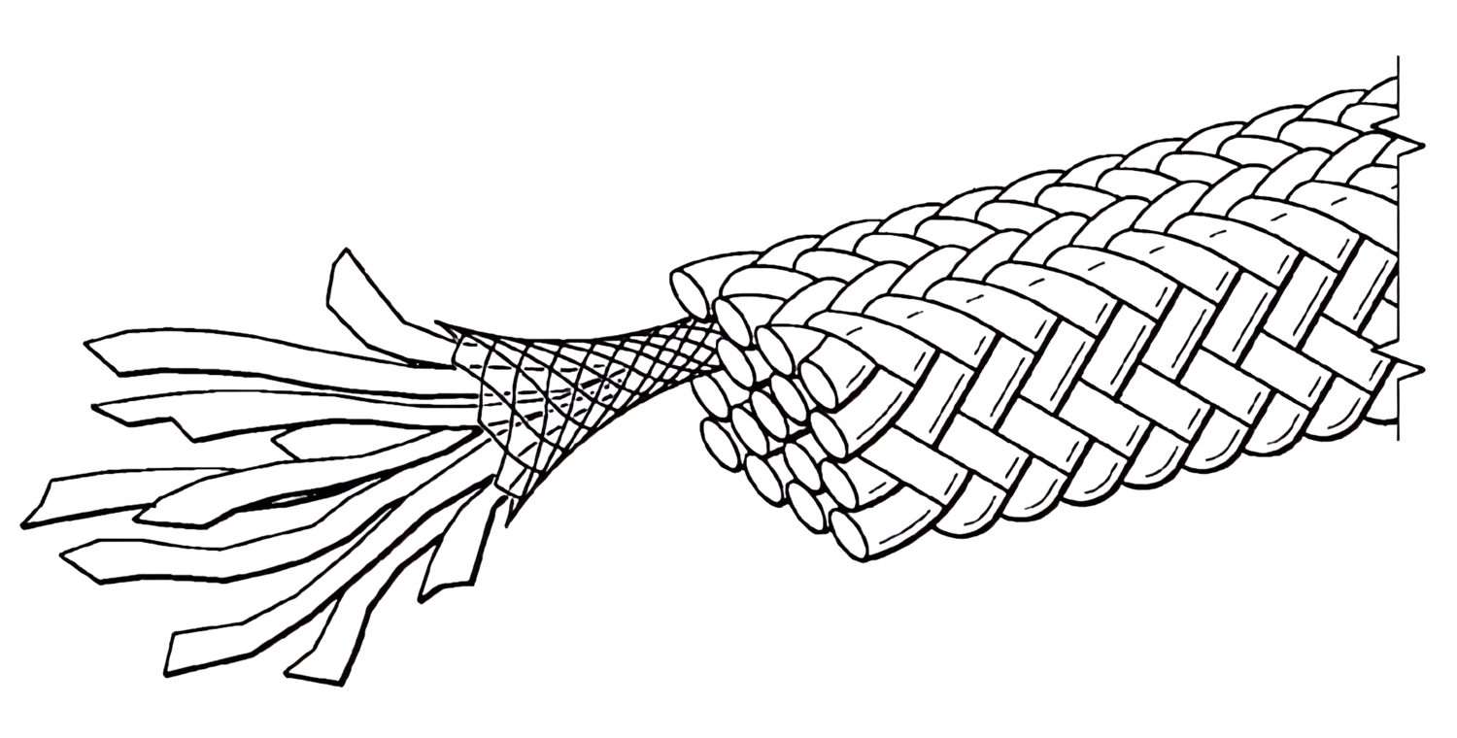
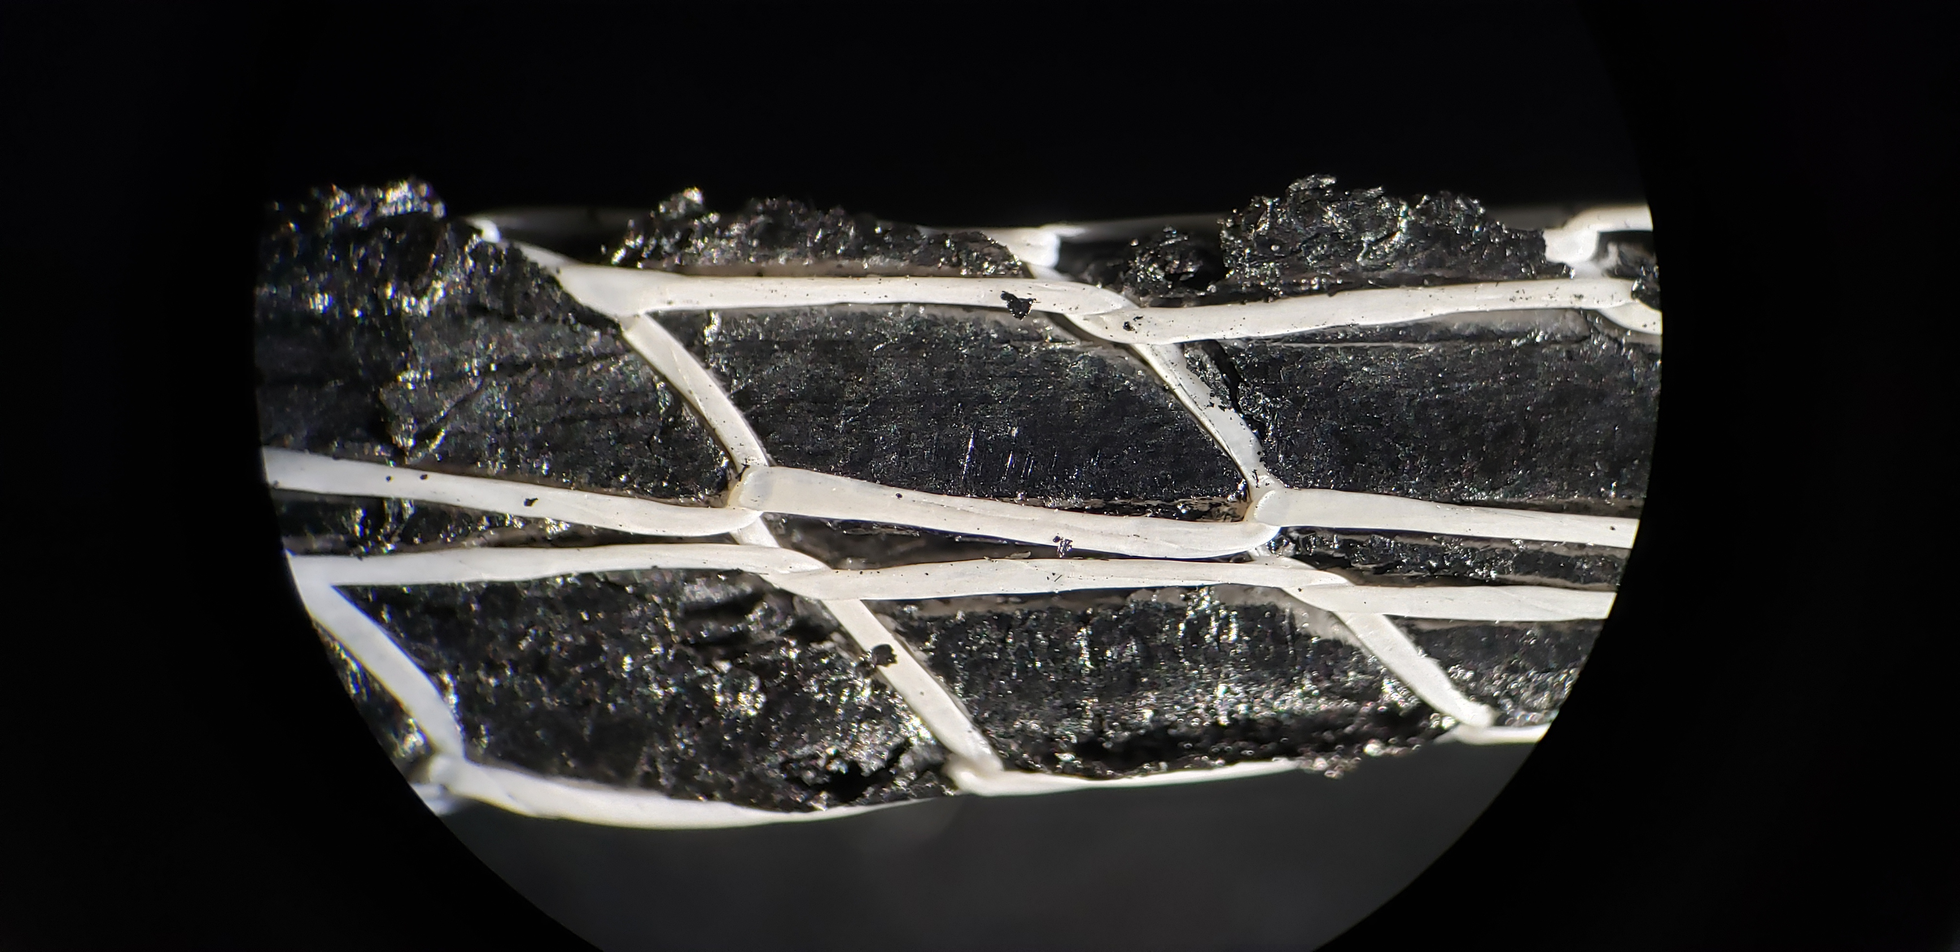
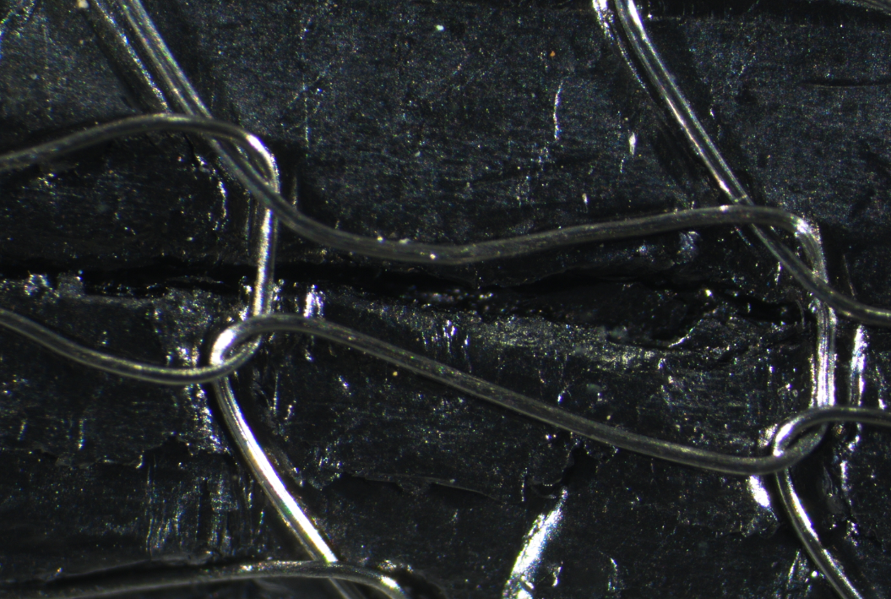
Fugitive Emissions Packings
Why is PTFE used in FE Packings?
ASTM¹, Shell² and API³ either limit PTFE content or have specific procedures for it.
  Is friction reduction significant?
  Is it necessary for FE service?
¹ASTM F2191 ²Shell SPE 85/204 ³API 622 3rd Ed

Slide 8
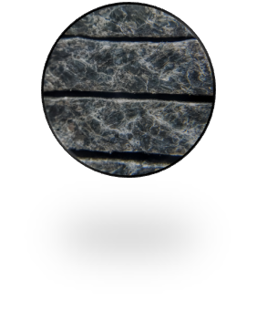
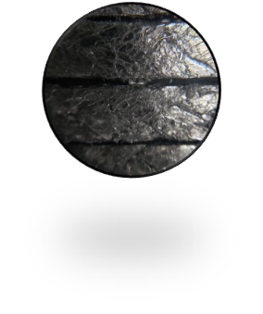
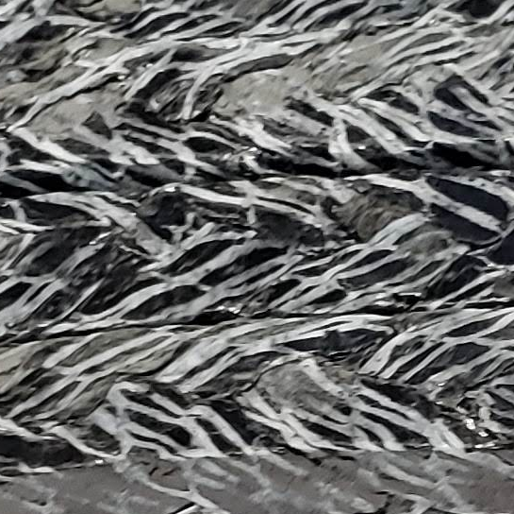
Fugitive Emissions Packings
Packings Description
STYLE | DESCRIPTION | TYPICAL APPLICATION
A | Flexible Graphite with a Nickel-Chrome wire reinforcement jacket. | Applications with higher temperatures, high pressure condensed steam
B | Flexible Graphite with a Nickel-Chrome wire reinforcement jacket, coated with PTFE Lubricant (less than 10%). | Premium packing for API622 requirements
C | Flexible Graphite with PTFE thread embedded with tracer particles reinforcement jacket. No additional coating | Premium packing for Control Valve Service

Slide 9
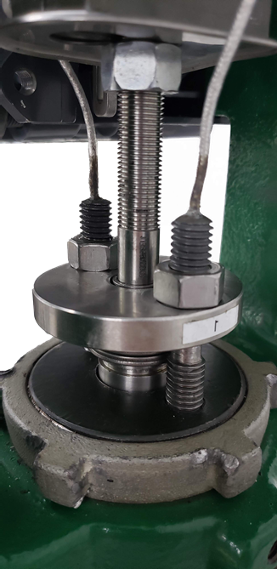
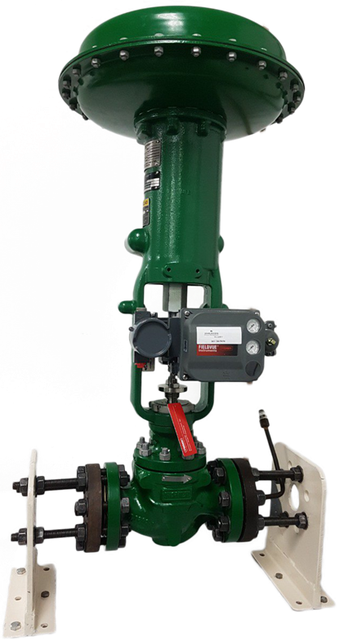
Control Valve Test Rig
Valve Size: 2’’ 300#
Packing Size: ¼’’ (6,4mm)
4
4
1
Thermocouple – Packing Gland
Thermocouple – Valve Body
Thermocouple – Valve Flange
Load Sensing Studs – 1 & 2
2
1
3
4
3
2

Slide 10
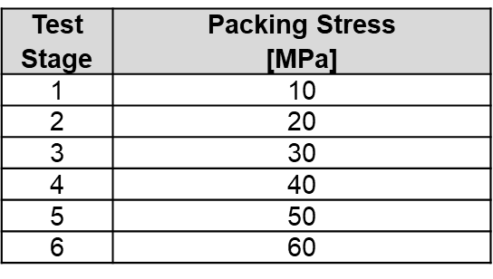
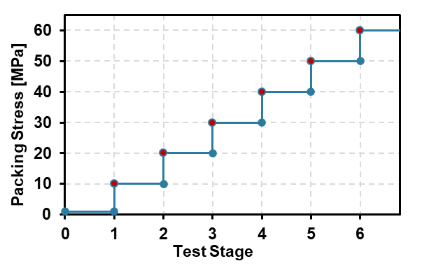
Friction Test Procedure
Pre-load (1 MPa) is applied individually to each ring to accommodate the packing;
A total of 5 rings are installed;
The desired test load is applied;
Packing is allowed to dwell for 3 minutes;
The desired test load is re-applied;
Valve performs one complete mechanical cycle;
Test evolves to next stress stage and steps 3-7 are executed again.

Slide 11
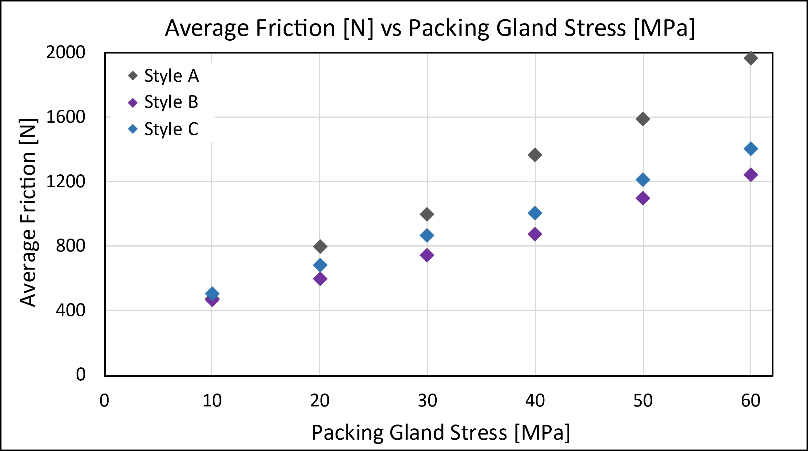
Friction Test Results
Room Temperature
Style A
No PTFE
Flex Grap.
Ni-Cr Mesh
Style B
<10% PTFE
Flex Grap.
Ni-Cr Mesh
Style C
Flex Grap.
PTFE Mesh

Slide 12
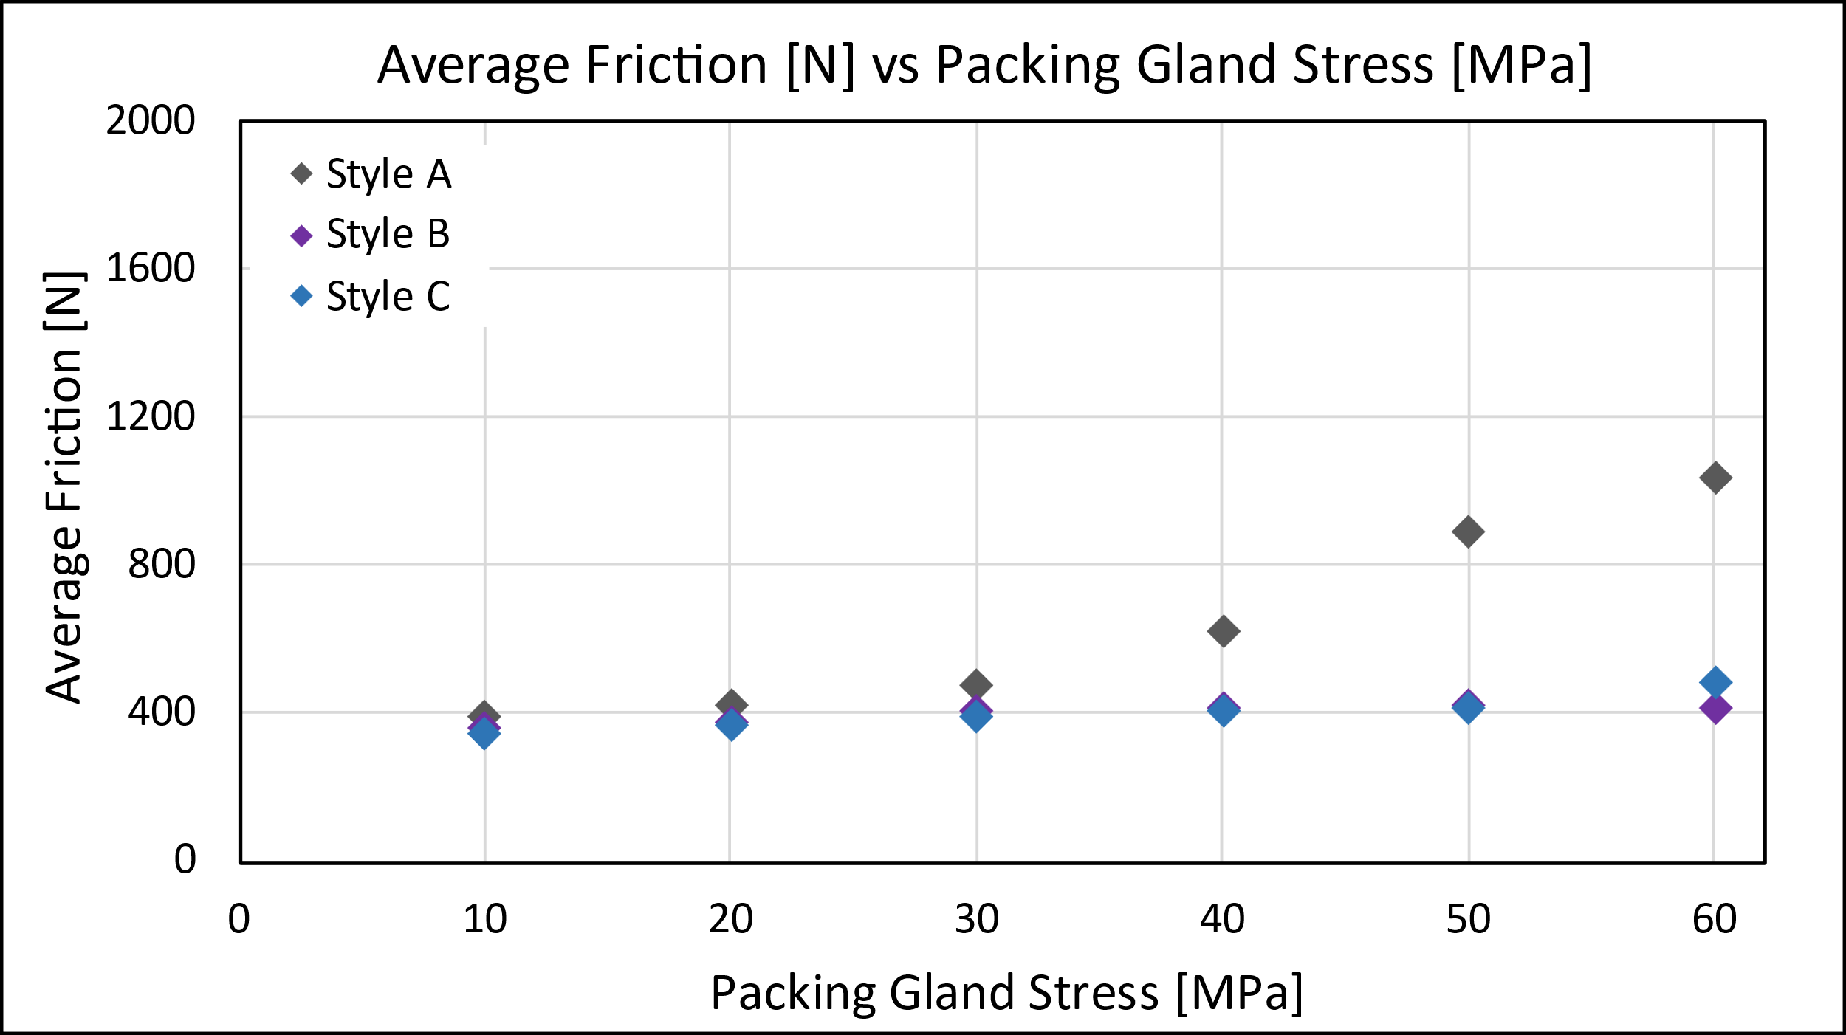
Friction Test Results
High Temperature (260°C)
Style A
No PTFE
Flex Grap.
Ni-Cr Mesh
Style B
<10% PTFE
Flex Grap.
Ni-Cr Mesh
Style C
Flex Grap.
PTFE Mesh

Slide 13
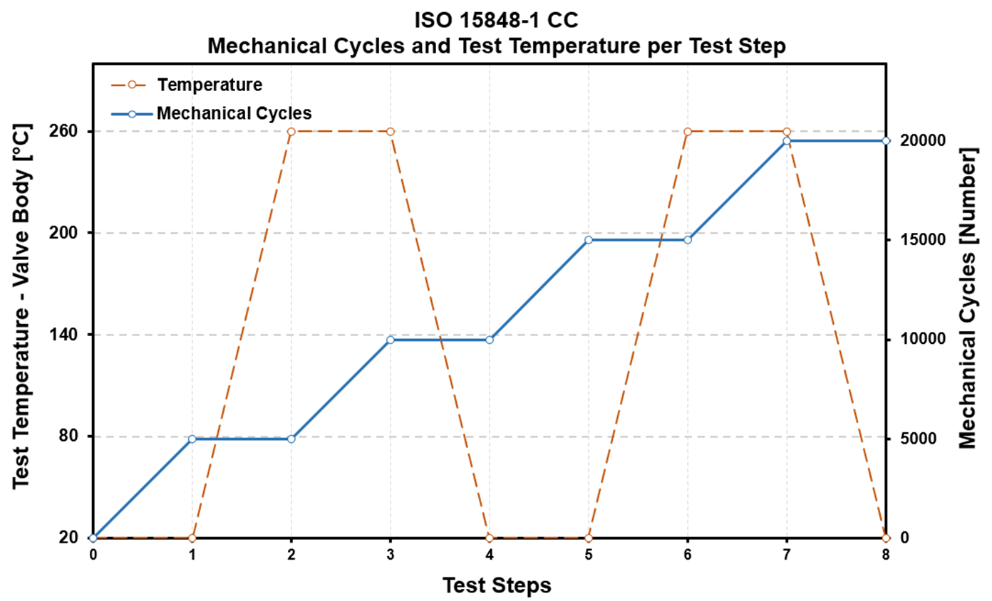
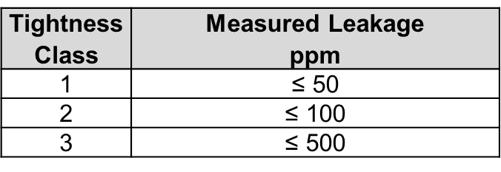
ISO 15848-1 FE Test
Test Procedure
2 thermal cycles (260°C)
20 000 mechanical cycles
  Stroke: 50% ± 10%
  Speed: 2 mm/sec
Media pressure: 40 bar (Methane)
Packing Stress: 60 MPa (5 rings)
Leakage measurements with sniffer

Slide 14
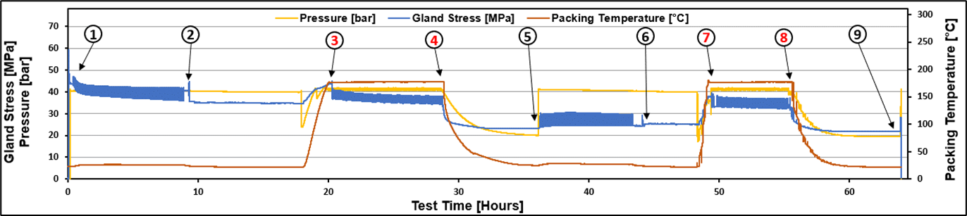
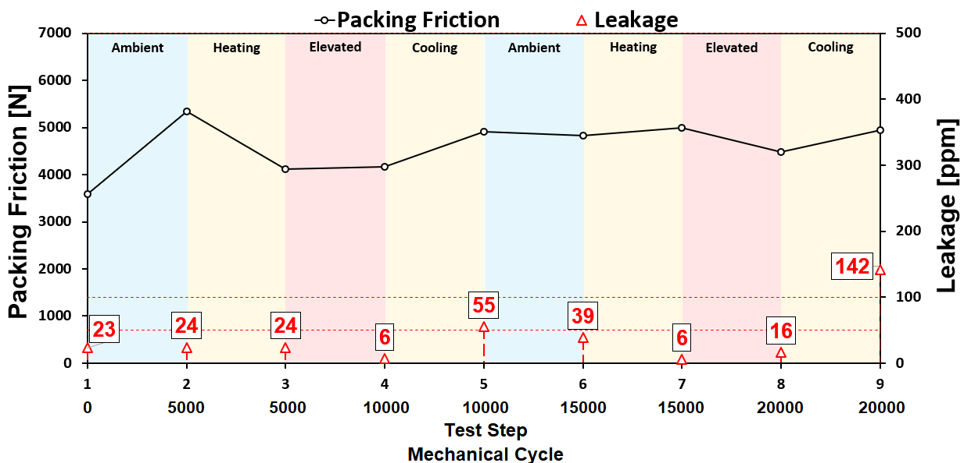
ISO 15848-1 FE Test
Test Results – Style A
Min. Packing Stress: 22 Mpa (S-9)
Max. Packing Stress: 60 Mpa (S-1)
Max. Leakage: 142 ppm (S-9)
Average Leakage: 38 ppm
ISO FE CM – CC1 – SSA 0 – t200°C
Style A
No PTFE
Flex Grap.
Ni-Cr Mesh

Slide 15
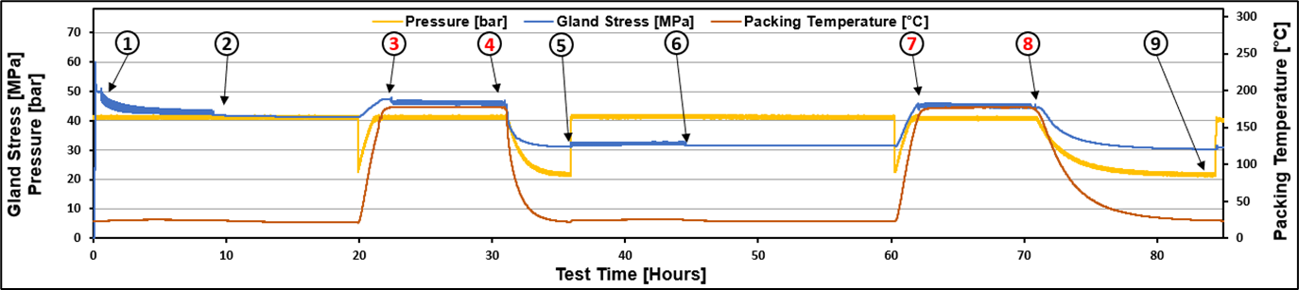
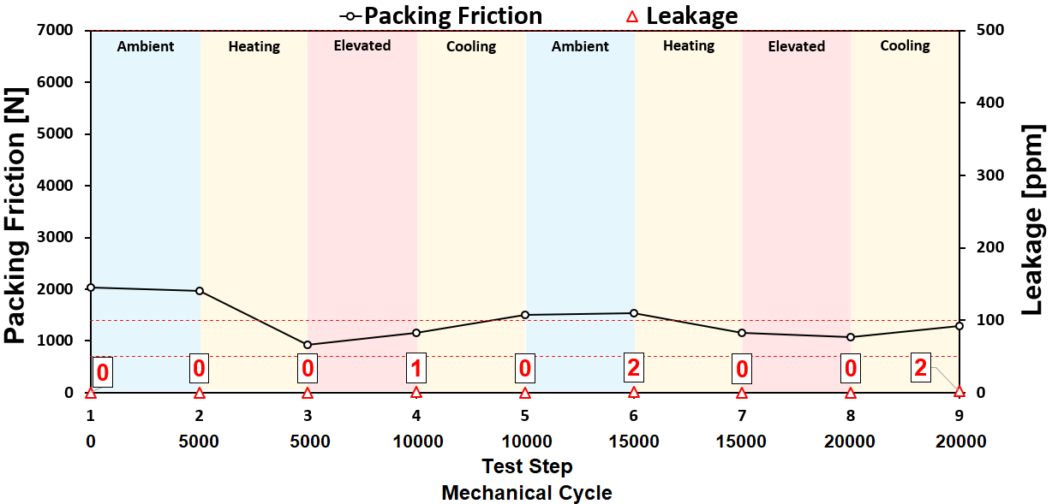
ISO 15848-1 FE Test
Test Results – Style B
Min. Packing Stress: 31 Mpa (S-9)
Max. Packing Stress: 60 Mpa (S-1)
Max. Leakage: 2 ppm (S-9)
Average Leakage: 0.62 ppm
ISO FE AM – CC1 – SSA 0 – t200°C
Style B
<10% PTFE
Flex Grap.
Ni-Cr Mesh

Slide 16
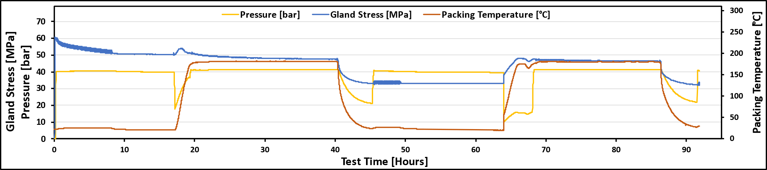
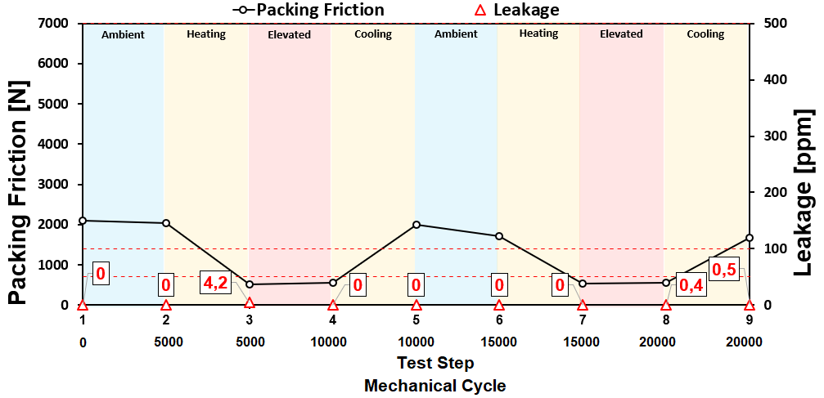
ISO 15848-1 FE Test
Test Results – Style C
1
2
3
4
5
6
7
8
9
Min. Packing Stress: 32 Mpa (S-9)
Max. Packing Stress: 60 Mpa (S-1)
Max. Leakage: 4.2 ppm (S-3)
Average Leakage: 0.56 ppm
ISO FE AM – CC1 – SSA 0 – t200°C
Style C
Flex Grap.
PTFE Mesh

Slide 17
How much can the right sealing solution reduce fugitive emissions?
How to calculate leakage losses???
ORGANIZERS
CONFERENCE ORGANIZERS

Slide 18
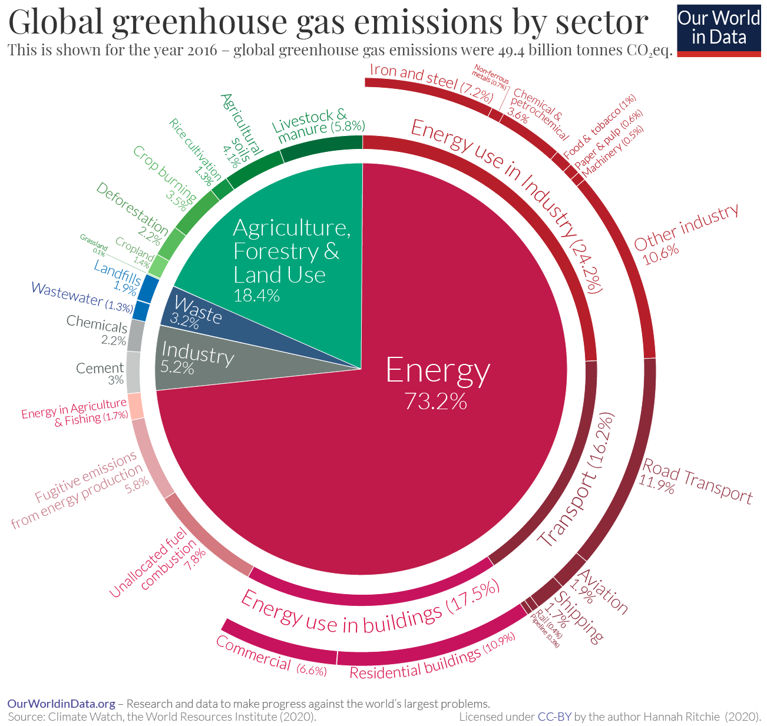
29% Industry
20% Agro
18% Building
16% Transportation
6% Fugitive Emission
3% Waste
8% Otthers

Slide 19
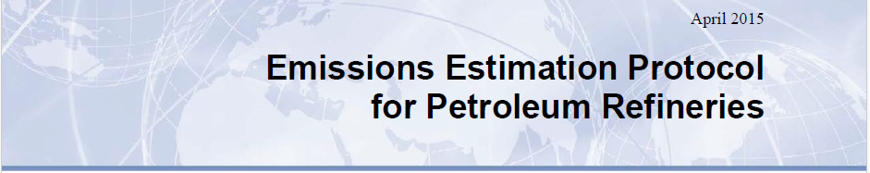
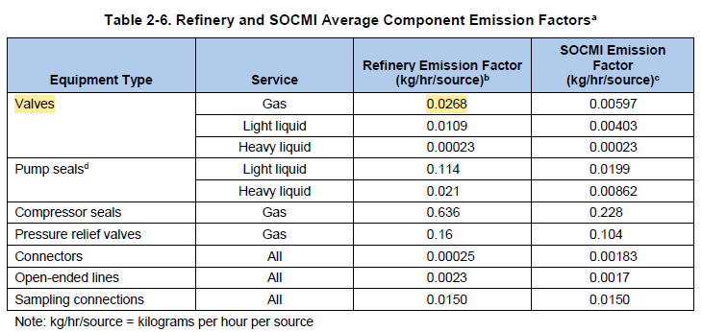
What dos EPA say?
If you do NOT measure...
Considering a small refinery
5,000 Valves
Leakage Estimation:
0.0268 x 24h x 365d x 5,000 =
= 1,173,840kg
Aprox. 1,200 Ton/yr

Slide 20
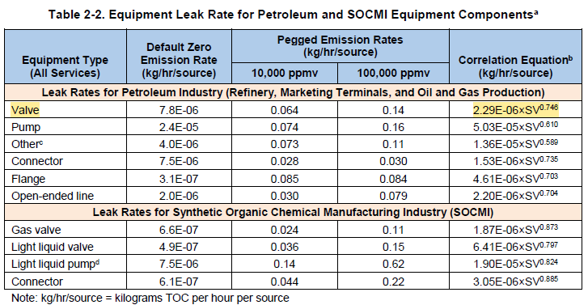
What dos EPA say?
If you DO measure... and use a premium product
Considering a small refinery
5,000 Valves
Leakage Estimation:
2.29*10⁻⁶ x (0.56ppm)^{0,746} x 24h x 365d x 5,000=
= 65kg
Less than 100 kg/yr

Slide 21
Final Remarks
Test show that PTFE improves fugitive emissions performance, specially in Control Valves. Adding a controlled, small amount of PTFE will:
  Lower stem friction;
  Reduce packing wear;
  Decreases packing relaxation.
Packing Stem Friction is heavily benefited from PTFE addition in packings:
  Up to 40% less friction at ambient temperature;
  This effect is increased with higher temperatures.
The selection of the RIGHT packings can have a considerable positive impact on the reduction of GHG
  Based on EPA correlation factors there is a reduction of up to 1,100 Ton/yr of emissions considering a small refinery

Slide 22
Carlos D. Girão | Technical Director at Teadit
carlos.girao@teadit.com
João H. Pontes | R&D Specialist at Teadit
joao.pontes@teadit.com

Slide 23
Thanks
ORGANIZING SECRETARIAT
Ph. +39 035 3230904
e-mail info@industrialvalvesummit.com
CONFERENCE ORGANIZERS
Ph. +39 3474908420
e-mail segreteria@valvecampus.com
www.industrialvalvesummit.com
www.valvecampus.com

