Slide 1
MASSIMILIANO GAMBA
ORGANIZERS
SCIENTIFIC COMMITTEE
Oil & Gas Professional
API 6D 25th Edition
Specification for valves, main changes
IVS 2022
Technical Conference

Slide 2
Biography
SPEAKER
Massimiliano Gamba is an Oil & Gas professional, certified NDE and welding inspector.
API Senior Auditor for API Q1, API Q2 API 18LCM, ISO 9001 and Monogram Program.
API University approved training provider
Roster of API Committees on Standardization of Oilfield Equipment and Materials (CSOEM):
SC20 – Supply Chain Management Task Groups 20A, 20B, 20C, 20D, 20G, 20J, 20M
SC06 – Valves & Wellhead Equipment
Member of ASTM Committees A01 (Steel, Stainless Steel and Related Alloy) and C01 (Cement).
More than 20 years experience on Oil & Gas Industry.
📞 +39 338 5264889
✉️ max@studiogamba.info
Copyright © 2022 Massimiliano Gamba

Slide 3
Speech agenda
API 25th edition publication and effectiveness
Brief history of API 6D specification
Main changes overview
Layout
Chapters
Annexes
Focus on main changes
By chapters
By annexes
Copyright © 2022 Massimiliano Gamba

Slide 4
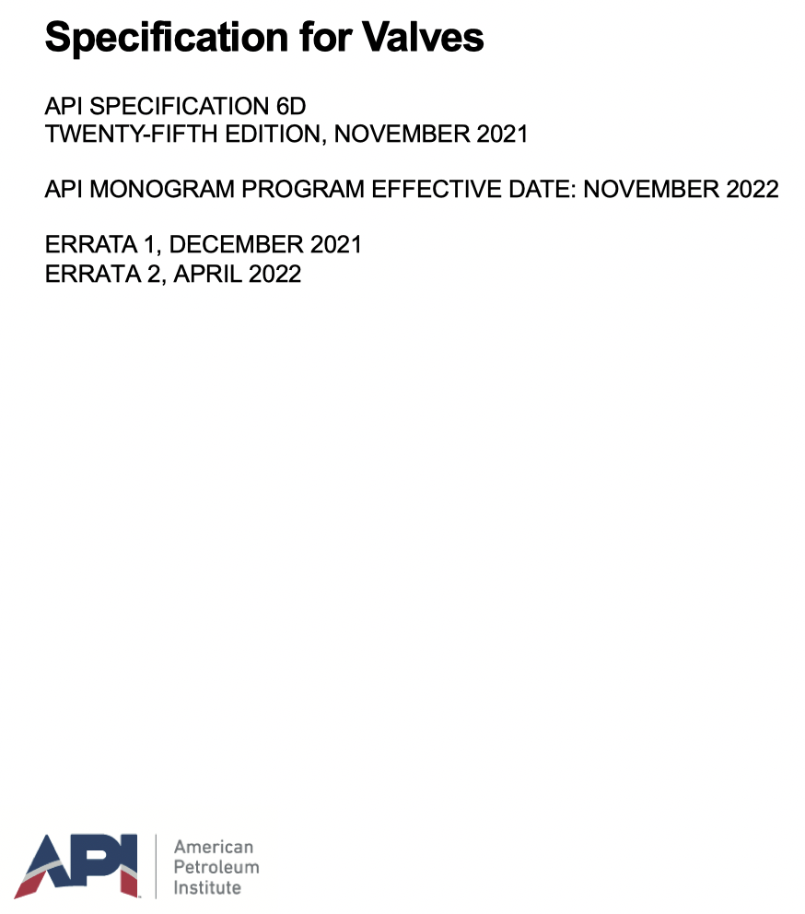
API 6D 25th edition
Publication Date: November 2021
Effective Date: November 2022
Errata 1, has been published in December 2021
Errata 2, has been published in April 2022
November 2021
Transition period
November 2022
Copyright © 2022 Massimiliano Gamba

Slide 5
API 6D brief history and continous evolution
API 6D (identified as API 5G1) was published in September 1936, went through 5 different revisions and was officially published in June 1947 as API 6D 5th edition
API 6D 22nd edition, published on January 2002 BECOME equivalent of ISO 14313.
API 6D 24th edition, published on August 2014 NOT LONGER equivalent of ISO 14313.
API 6D 24th revision process has been initiated in 2018 by API Subcommittee SC6.
REASON behind the new edition:
to accommodate the needs of industry
to address many interpretations and harmonize 10 Errata and 2 Addendum of 24th edition
to move the specification to a higher level of service to the petroleum and natural gas industry.
Copyright © 2022 Massimiliano Gamba
Notes:
SC6 - Subcommittee on Valves and Wellhead Equipment

Slide 6
API 6D 25th edition key changes overview
Specification TITLE and SCOPE
REORGANIZING the requirements in an order more aligned with the manufacturing process
Addition of AXIAL VALVES to the types of valves covered
Removal of CLASS ASME 400 as standard pressure class
Required conformance to API 6DX for valves supplied with actuators
Identifying allowable adjustment for SUBSIZE IMPACT SPECIMENS
Identifying MINIMUM HEAT TREATMENT requirements
Identifying MINIMUM BOLTING requirements
Revising MARKING requirements
Providing new DESIGN VALIDATION GUIDANCE
Addition of requirements for REPAIR AND REMANUFACTURE of valves from API 6DR in new Annex A
Collecting all PURCHASER-SPECIFIED REQUIREMENTS into Annexes (Annex K and Annex L)
Combining QSL requirements from Annexes N, J, H and G into one Annex I
Adding guidance throughout the DOCUMENT REFERENCE to API 20 series specifications
Copyright © 2022 Massimiliano Gamba
Notes:
Errata 2 - ANNEX N, J, H, G undergo into Annex I

Slide 7
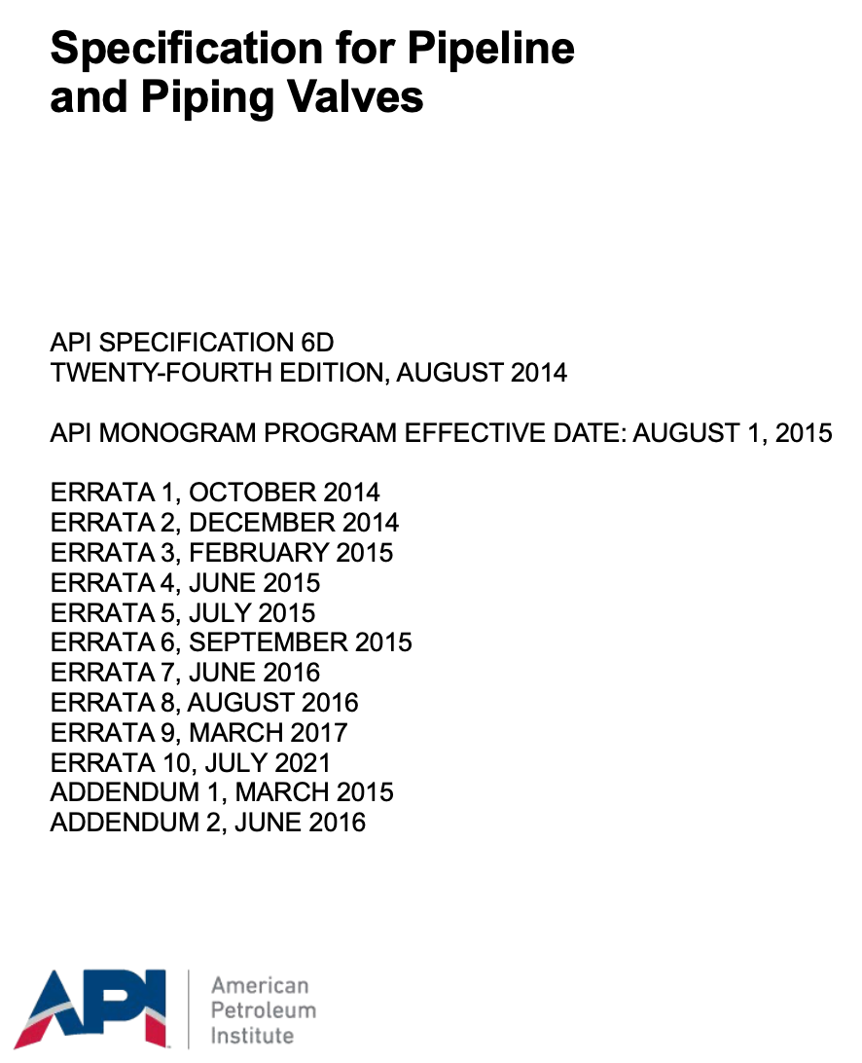
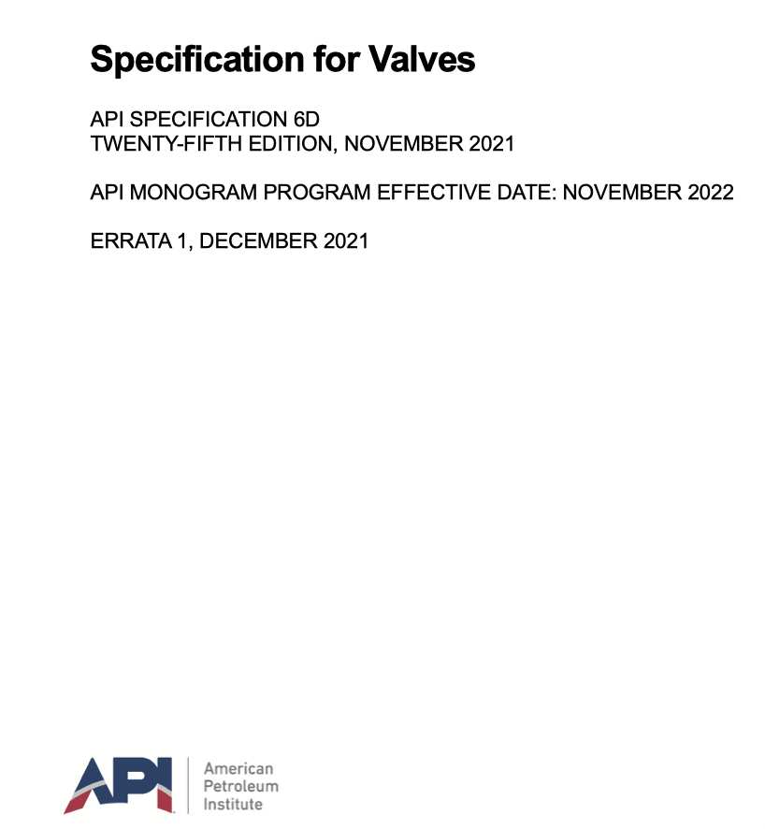
API 6D 25th Title and Scope
SCOPE §1
Defines the requirements for the design, manufacturing, materials, welding, quality control, assembly, testing, marking, documentation, and process controls of axial, ball, check, gate, and plug valves for application in the petroleum and natural gas industries.
Applies to ASME Classes 150, 300, 600, 900, 1500, and 2500.
Added welding, quality control, marking and process control
Added Axial valves
Delated ASME class 400
Become
Copyright © 2022 Massimiliano Gamba

Slide 8
API 6D 25th Structure
CONFIRMED LAYOUT in 14 sections
REORGANIZED sections
REDUCED Annexes (from 15 to 12, Annexes)
DELETED, ADDED, REORGANIZED/COMBINED Annexes
REORGANIZED and RENAMED Figures
REORGANIZED and RENAMED Tables
UPDATED Normative references
UPDATED Terms, definitions, acronyms, abbreviations and symbols
Copyright © 2022 Massimiliano Gamba

Slide 9
API 6D 25th layout comparison
API 6D 24th edition
1 Scope
2 Normative References
3 Terms, Definitions, Acronyms, Abbreviations, Symbols, and Units
4 Valve type and configuration
5 Design
6 Materials
7 Welding
8 Quality control
9 Pressure testing
10 Coating/Painting
11 Marking
12 Preparation for shipment
13 Documentation
14 Facility Requirements
API 6D 25th edition
1 Scope
2 Normative References
3 Terms, Definitions, Acronyms, Abbreviations, Symbols, and Units
4 Application, configuration and Performance
5 Design
6 Materials
7 Welding
8 Bolting
9 Quality control
10 Factory Acceptance Testing
11 Coating/Painting
12 Marking
13 Draining, protection and preparation for transport
14 Documentation
Copyright © 2022 Massimiliano Gamba
Notes:
CONFIRMED 14 SECTIONS with some changes thet we will gonna go to review in the next slide

Slide 10
API 6D 25th layout changes overview
SECTIONS RENUMBERED
Former §8 quality control become §9
Former §10 coating/painting become §11
Former §11 marking become §12
Former §13 documentation become §14
NEW SECTION ADDED §8 BOLTING, including extended requirements for bolting.
SECTION INTEGRATION/COMBINED - Former §14 FACILITY REQUIREMENTS and table 8, now integrated into §4.5 – MANUFACTURING PROCESSES and Table 2 (process control requirements)
RENUMBERING AND REWORDING
Former PRESSURE TESTING (§9) become FACTORY ACCEPTANCE TESTING into §10
Former PREPARATION FOR SHIPMENT (§12) become Draining, protection and preparation for transport into §13
Copyright © 2022 Massimiliano Gamba

Slide 11
API 6D Annexes comparison
API 6D 24th edition
Annex A (informative) API Monogram Program Use of the API Monogram by Licensees
Annex B (informative) Valve Configurations
Annex C (normative) Valve End-to-end and Face-to-face Dimensions
Annex D (informative) Guidance for Travel Stops by Valve Type
Annex E (informative) API 20 Series Supply Chain Management
Annex F (normative) Qualification of Heat-treating Equipment
Annex G (normative) Requirements for NDE
Annex H (normative) Supplementary Test Requirements
Annex I (informative) Requirements for Extended Hydrostatic Shell Test Duration and Records Retention for Valves in Jurisdictional Pipeline Systems
Annex J (normative) Quality Specification Level (QSL) for Pipeline Valves
Annex K (informative) Isolation Valve Features
Annex L (normative) External Coating for End Connections
Annex M (informative) Marking Example
Annex N (informative) Supplementary Documentation Requirements
Annex O (informative) Purchasing Guidelines
API 6D 25th edition
Annex A (informative) Repair or Remanufacture of Valves
Annex B (informative) Examples of Valve Configurations
Annex C (normative) Valve End-to-end and Face-to-face Dimensions
Annex D (informative) Guidance for Travel Stops by Valve Type
Annex E (informative) Isolation Valve Features
Annex F (informative) Design Validation
Annex G (normative) External Coating for End Connectors
Annex H (normative) Heat-treat Equipment Qualification
Annex I (normative) Quality Specification Level (QSL) and Supplemental Testing
Annex J (informative) Requirements for Extended Hydrostatic Shell Test Duration and Records Retention for Valves in Jurisdictional Pipeline Systems
Annex K (normative) Purchaser-specified Customization - Permissible Deviations to Specified Design and Manufacturing Requirements
Annex L (informative) Specified Customization - Supplemental Options to Specified Design and Manufacturing Requirements
Copyright © 2022 Massimiliano Gamba
Notes:
ANNESSI passano da 15 a 12
Da 6 normativi, sono diventati 5
VERDE – Confermati con stesso identificativo o con lettera differente
ROSSI – cancellati
VIOLA – nuovi
MARORNE – combinati (G, H, J, N – confluiti in Annex I «normativo)

Slide 12
API 6D 25th Annexes
DELETED
Annex A (informative) API Monogram Program Use of the API Monogram by Licensees
Annex E (informative) API 20 Series Supply Chain Management
Annex M (informative) Marking Example
Annex O (informative) Purchasing Guidelines
CONFIRMED (also with different letter, in some case)
Annex B (informative) Examples of Valve Configurations
Annex C (normative) Valve End-to-end and Face-to-face Dimensions
Annex D (informative) Guidance for Travel Stops by Valve Type
Annex E (informative) Isolation Valve Features
Annex G (normative) External Coating for End Connectors
Annex H (normative) Heat-treat Equipment Qualification
Annex J (informative) Requirements for Extended Hydrostatic Shell Test Duration and Records Retention for Valves in Jurisdictional Pipeline Systems
COMBINED (previous Annexes N, J, H and G)
Annex I (normative) Quality Specification Level (QSL) and Supplemental Testing)
NEW ADDED
Annex A (informative) Repair or Remanufacture of Valves
Annex F (informative) Design Validation
Annex K (normative) Purchaser-specified Customization - Permissible Deviations to Specified Design and Manufacturing Requirements
Annex L (informative) Specified Customization - Supplemental Options to Specified Design and Manufacturing Requirements
Copyright © 2022 Massimiliano Gamba
Notes:
ANNESSI passano da 15 a 12
Da 6 normativi, sono diventati 5
VERDE – Confermati con stesso identificativo o con lettera differente
B – B
C – C
D – D
K – E
L – G
F – H
I – J
ROSSI – cancellati
VIOLA – nuovi
MARORNE – combinati (G, H, J, N – confluiti in Annex I «normativo)

Slide 13
§2 - Normative references
Has been GROUPED BY SOURCE
AMPP (formerly NACE International)
Association for Materials Protection and Performance
API
American Petroleum Institute
ASME
American Society of Mechanical Engineers
ASNT
American Society for Nondestructive Testing
ASTM
American Society for Testing and Materials
ISO
International Organization for Standardization
MSS
Manufacturers Standardization Society of the Valve and Fittings Industry
SAE
Society of Automotive Engineers
UPDATED, DELATED and ADED normative references.
REMOVED ALL EDITIONS (excluding those relevant to API 20 series)
hence
Only latest editions are applicable
Copyright © 2022 Massimiliano Gamba

Slide 14
§3 - Terms and definitions
ADDED some definitions such as:
§3.1.13 - Design review and verification
§3.1.14 - Design validation
§3.1.21 – Manufacturer
§3.1.22 – Maximum allowable working pressure MAWP
§3.1.23 – Maximum allowable stem torque/thrust MAST
§3.1.37 - Purchaser
§3.1.38 – Remanufacturer
§3.1.39 – Repairer
§3.1.54 – Visible leakage
CHANGED some definitions such as:
§3.1.35 – Pressure-containing parts.
NOTE - do not include bolting (see Section 8).
§3.1.36 – Pressure controlling parts
§3.1.10 – Closure member
NOTE - Earlier editions of API 6D ref. to the closure member as an “obturator.”
ADDED various abbreviations, such as:
BSL (bolting specification level)
BTC (break‐to‐close) and BTO (break‐to‐open)
ETC (end‐to‐close) and ETO (end‐to‐open)
MDP (maximum pressure differential)
Copyright © 2022 Massimiliano Gamba

Slide 15
§4 - Application, Configuration, and Performance
New title, former “Valve Types and Configurations”
Deleted pressure class 400 for standard valves
Added NON-STANDARD VALVES (intermediate pressure and temperature rating)
Added AXIAL VALVES as new product together with existing (ball, check, gate and plug)
Axial valve nomenclature and configuration into Figure B.1
Axial valve end to end and face to face dimensions into Table C.1
Added table 2 – Process control formerly included into §14 and table 8
NO longer identified location (on-site, off-site, and/or outsourced) but “Performed by”
Modified process control activities and added requirements for processes outsourced
Modified process requiring validation formerly included into §1.4
Delated coating/component plating (previously by agreement),
Added visual examination
Copyright © 2022 Massimiliano Gamba
Notes:
NON Standard

Slide 16
§5 - Design
ADDED new requirements for bolted joint design
SPLITTED requirements for standard and non-standard face to face/end to end dimensions
Renumbered dimensions tables and some minor changes on dimensions and tolerances
New sizes added for check and axial valves
REMOVED references to “manufacturing method” to ensure flange alignment of flanged connectors
ADDED requirements for studded-end valve end connectors
MODIFIED requirements for weld end connectors and added requirements for mating pipes
DETAILED requirements for drive train torque/thrust based on different type of valves
ADDED requirements for drive train allowable stress in face of maximum allowable temperature
ADDED requirements for drive train bolting for Quarter-turn valves
ADDED requirements relevant to method of operation (manual gearbox and rotary motion)
ADDED requirements for valve operational data (upon request – Annex L – flow coefficient Cv or Kv)
Copyright © 2022 Massimiliano Gamba
Notes:
When verifying the bolt stress at the outer seal diameter, the bolting stress shall not exceed 0.83 of SMYS at test condition

Slide 17
§5 - Design
ADDITIONAL requirements for wrenches (longer than 24 in - 600 mm)
ADDED requirements for position indicators and position of closure members
ADDITIONAL requirements of travel stop into Annex D
Split ball valves into quarter turn valves and rising stem valves
Added expanding plug valves
ADDITIONAL requirements for operators
Actuators and mounting kits shall conform to API 6DX latest edition (formerly limited to sizing and ref. 6DX 1st)
Additional requirements provided for extended stem and shaft assembly
ADDITIONAL requirements for cavity pressure relief in face of service condition and temperature
CLARIFIED and ADDEDED details for vent, drains and injection points
PROVIDED details for other drain connection (if requested by customer)
Copyright © 2022 Massimiliano Gamba
Notes:
Formerly API 6DX 1st edition (as clarified by API 6D Errata 10 of July 2021)
The 24th edition simply said that the sizing of an actuator had to be in accordance with 6DX.
The 25th edition says that the entire actuator has to be in accordance with 6DX.

Slide 18
§5 - Design
ADDED requirements for lifting
Sketches and handling instructions for safe lifting
Safe working limit (SWL) requirements
ADDED requirements for design process
Conformity of design to documented procedure and applicable QMS
Design documentation requirements
Design review and verification requirements
Design validation requirements and procedure
ADDED ANNEX F (informative) provides on method for design validation
Provides combination of pressure, temperature and operating cycles
May be normative if required by the purchaser or if self invocated by the manufacturer
Can be used on prototype or production unit
Allows for scaling
Copyright © 2022 Massimiliano Gamba
Notes:
Sketches and handling instructions - limited to valves weighing more than 55 lbs (25 kg).

Slide 19
§6 - Materials
ADDED requirements for nonmetallic seals documented material specification
CLARIFIED items that shall be reported into metallic material test certificates
ADDED references API 20A, 20B and 20C for guidance qualification and production (casting and forging)
ADDED references API 20J for guidance on the use of outsourced distributors of metallic material
ADDED new section for casted parts
ADDED requirements for forged parts (forging ratio)
ADDED impact test requirements
Split V-notch impact requirements for Duplex and Super Duplex Stainless Steel and Others
Added adjustment factors for subsize specimens
Copyright © 2022 Massimiliano Gamba
Notes:
API 20B, and API 20C does not require that the materials be supplied from a facility that has been licensed to API 20A, API 20B, or API 20C.
Formerly (API 20A, B, C), included into Annex E (informative) «API 20 Series Supply Chain Management»
FORGING RATIO shall be:
At least 3:1
Documented into material certification

Slide 20
§6 - Materials
ADDED/MODIFIED/MOVED requirements for heat treatment and production heat treating equipment
Excluded application of requirements for surface coatings or localized PWHT processes
Identified requirements for record retention
Split requirements for each type of heat treatment and related new allowed tolerances
Moved requirements for calibration and accuracy from Annex F to chapter 6
Added requirements for multiple use furnaces
Thermal Uniformity Surveys requirements better defined into Annex H and into section 6 considering:
Heat treatment type
Furnace classes as per SAE AMS2750
Changed the thermocouple placement into figures from 2D to 3D
Better clarified number of required thermocouples (aligned to API 6A)
Copyright © 2022 Massimiliano Gamba
Notes:
TUS (previously included into ANNEX F

Slide 21
§7 - Welding
EXCLUDED application of the welding requirements for HVOF coating process.
ADDED reference to API 20G for guidance on the use of outsourced welding services
ADDED requirements of hardness survey
ADDED requirements of iron dilution for any CRA weld overlay (nickel-based alloy UNS N06625)
ADDED requirements for CRA weld overlay NDE in the final supplied conditions
ADDED requirements for NDE inspection of:
Weld to pressure containing parts
Weld pipe pups to valve ends
ADDED requirements for manufacturing repair welding and relevant inspections:
Casting
Forgings and plates
Copyright © 2022 Massimiliano Gamba
Notes:
High-Velocity Oxygen Fuel HVOF – considered a thermal spray coating process
class Fe 10: iron mass fraction 10.0 % maximum, unless the purchaser specifies otherwise (see K.10 which includes formerly option “When specified by the purchaser, an iron dilution Class Fe 5 iron mass fraction 5.0 % maximum shall be used”).

Slide 22
§8 - Bolting
Completely NEW section
Pressure boundary bolting shall
conform to API 20E, BSL-1 when using alloy and carbon steel bolting
conform to API 20F, BSL-2 when using corrosion-resistant bolting
requirements for bolting not listed into API 20E and API 20F
requirements for hardness limits and low temperature
Other bolting shall
confirm to accepted industry specifications or
conform to the manufacturer’s documented material specification
Copyright © 2022 Massimiliano Gamba
Notes:
does not require that the bolting be supplied from a facility that has been licensed to API 20E or API 20F
Bolting materials not listed in API 20E or API 20F shall conform to the manufacturer’s documented

Slide 23
§9 – Quality control
MODIFIED/ADDED requirements relevant to pressure measuring devices
pressure recording devices
calibration procedure
calibration interval (length and date of starting)
MODIFIED requirements for personnel qualification relevant to:
other personnel performing other quality control activities
NDE personnel
Welding inspectors
ADDED requirements for visual inspection for:
Castings
Forgings
Finished machined parts
Copyright © 2022 Massimiliano Gamba
Notes:
NEW - Changed 3 months calibration interval in 90 days (increment of 90 days up to 1 year)
NEW - The calibration interval shall start on the date of first use, not to exceed three months from the date of calibration. The date of first use shall be recorded. If the calibration interval is not started within three months of the date of calibration, the equipment shall be identified as out of calibration.

Slide 24
§9 – Quality control
ADDED requirements relevant to storage of nonmetallic seals
Manufacturer written requirements minimum content
Packaging and storage of elastomeric
ADDED requirements for valve assembly relevant to:
Documented procedure
Bolt tightening
Interface pressure controlling parts free of any sealant
Lubricant requirements
Welding inspectors
Copyright © 2022 Massimiliano Gamba

Slide 25
§10 – Factory Acceptance Testing
NEW section, previously §9 “Pressure testing”
Required documented procedure
Duration and acceptance criteria
Stabilization criteria
ADDED requirements for testing equipment external force
ADDED requirements for testing one piece body in non-assembled conditions
RE-ORGANIZED pressure tests based on valve type configuration
DELATED water temperature requirements
CHANGED testing media chloride contents requirements
Copyright © 2022 Massimiliano Gamba

Slide 26
§11 – Coating/Painting
CHANGED - Manufacturer’s standard BECOME manufacturer’s documented requirements.
ADDED 2 notes:
NOTE 1 - See Section 13 on corrosion protection for details.
NOTE 2 - See L.13 for requirements for coating of corrosion-resistant valves.
MOVED requirements external coatings for end connectors from Annex L to Annex G.
Copyright © 2022 Massimiliano Gamba

Slide 27
§12 – Marking
MOVED marking example (formerly in Annex M)
COMBINED marking requirements in one location with different tables:
Valve body marking
Additional marking
Valve marking on nameplate
ADDED some marking requirements for valves, nameplate and additional marking
ADDED allowance of laser engraved marking method
ADDED requirements for
DELATED QSL1 marking no longer required (only QSL 2 or greater needs to be marked)
ADDED - serial number and manufacturer’s name must be on both the body and the nameplate
Copyright © 2022 Massimiliano Gamba

Slide 28
§13 – Draining, Protection, and Preparation for Transport
ADDED requirements for documented procedure and its minimum contents, such as:
bare metallic machined surfaces
corrosion protection applied to exposed metallic surfaces of steels with less than 15 % chromium on flange faces, weld bevel ends, exposed stems, and all accessible internal surfaces of the equipment;
corrosion protection provided by a corrosion inhibitor having a runoff temperature of minimum 200 °F (93 °C)
Copyright © 2022 Massimiliano Gamba

Slide 29
§14 – Documentation
ADDED Minimum documentation requirements and retention, for instance:
retention of visual inspection records (§9.3)
retention of chloride content in the hydrostatic test water (§10.1.3)
ADDED requirements for Documentation provided with the valve
ADDED Documentation that shall be provided to the valve purchaser.
ADDED Additional requirements for Certificate of conformance
Additional requirements when specified by the manufacturer or purchaser in Annex F, Annex I, Annex J, Annex K, and Annex L;
Design code for pressure-containing parts and pressure-boundary bolting (see 5.1.1);
Code used for pressure-temperature rating (see 4.3).
Copyright © 2022 Massimiliano Gamba

Slide 30
Purchaser defined requirements – Annex K
Product customization requirements outlined into Annexes K (normative) and L (informative), against mandatory (“shall”) requirements included into API 6D body (from §4 to 14).
ANNEX K - Purchaser-specified customization. Permissible Design and Manufacturing Requirements.
Identifies permissible deviations to specified design and manufacturing requirements.
Requirements deviations must be specified by the purchaser (customer/end user/distributor)
The valve manufacture isn’t allowed to self invoked deviations of Annex K
Annex K includes list of permissible variation and addresses the requirements
The valve manufacture isn’t allowed to self invoked deviations of Annex K
Deviations must be traceable to the purchaser (purchase order)
Valves designed and manufactured with deviation of Annex K will be API 6D conforming
Copyright © 2022 Massimiliano Gamba

Slide 31
Purchaser defined requirements – Annex L
ANNEX L - Specified Customization. Supplemental Options to Specified Design and Manufacturing Requirements. Identifies supplemental requirements, which shall be performed by the manufacturer when specified by the purchaser.
Either upon purchaser’s request or self invoked by the valve manufacturer
No requirements for documentation of the selection of Annex L, unless otherwise specified or unless required by the purchaser.
Annex L includes list of options variation and addresses the requirements
Valves designed and manufactured with option of Annex L will be API 6D conforming
Copyright © 2022 Massimiliano Gamba

Slide 32
Purchaser defined requirements – Annex K and Annex L
Additional optons
Permissible deviations
L.2 - Reduced-opening Valves with Circular Openings
L.3 - Valve Operational Data
L.4 - Extended Stem and Shaft Assemblies
L.5 - Antistatic Testing
L.6 - Service Compatibility
L.7 - Bolting for Sour Service
L.8 - NDE of Weld End Connector
L.9 - Double Block and Bleed (DBB) Valves
L.10 - Double Isolation and Bleed DIB-1 (Both Seats Bidirectional)
L.11 - Double Isolation and Bleed DIB-2 (One Unidirectional and One Bidirectional Seat)
L.12 - Operations Testing—Valves Required for Double Isolation and Bleed (DIB-1 or DIB-2)
L.13 - External Coating or Painting of Corrosion-resistant Valves
L.14 - Drive Train Strength Test
L.15 - Drain, Vent, and Injection Lines
L.16 - Drain, Vent, and Injection Valves
L.17 - Corrosion-resistant Metallic Surfaces
L.18 - Hardness Testing - Production Parts for Sour Service
L.19 - Low-pressure Gas Seat Testing
L.20 - High-pressure Gas Testing
L.21 - Valve Orientation
L.22 - Disassembly/Maintenance Tools
L.23 - Pressure Balance Hole
L.24 - Fugitive Emissions
L.27 - Fire Testing
L.28 - Pressure Testing Valves with Hydrostatic End Load
L.29 - External Loads
K.2 - Intermediate Pressures and Temperature Ratings (see 4.3.1)
K.3 - Valve Bore (see 4.4.1)
K.4 - Non-standard Face-to face and End-to-end Dimensions (see 5.2.1)
K.5 - End Connectors (see 5.2.3.1.1, 5.2.3.2, 5.2.3)
K.6 - Flange Bolting for Studded-outlet End Connectors
K.7 - Other Drain Connectors (see 5.6.1)
K.8 - Lifting (see 5.9)
K.9 - Chemical Composition (see 6.3)
K.10 - Welding Overlay Iron Dilution (see 7.5.3.1)
K.11 - Weld Repair of Forgings and Plate Material (see 7.11.3)
K.12 - Pressure Boundary Bolting Hardness Testing (see 8.1)
K.13 - Use of Assembly Lubricant
K.14 - Hydrostatic Shell Testing of One-piece Bodies
K.15 - Alternate Seat Test (see 10.4 – I.8.3)
Copyright © 2022 Massimiliano Gamba

Slide 33
Quality Specification Levels – QSL (Annex I)
MERGED QSL and supplemental testing into Annex I (normative)
QSL can be:
Required by purchaser (customer/end user/distributor)
Self invoked by the valve manufacturer
REMOVED QSL1 considering QSL1 meeting the requirements of the main body (§4 to 14) of API 6D, hence
there's no need to call that out as a QSL1 (as well as to mark it)
QSL1 become the basic product as per API 6D requirements “no Quality Specification level”
ADDED QSL3G and QSL 4G to existing QSL2, QSL3 and QSL4
QSLs testing (table I.4) when test references back to FAT section the number of tests listed include those required into FAT (table make reference to section 10 – No extra tests are required)
Unlike to provisions of API 6A, QSL 3G and QSL 4G aren’t QSL 3 or QSL4 plus gas testing, hydro and gas testing are treated separately.
Copyright © 2022 Massimiliano Gamba

Slide 34
Quality Specification Levels – QSL (Annex I)
Annex I requirements and tables outlines specific requirements of QSL, relevant to:
NDE inspections
Table I.1 – Requirements for NDE considering parts, wrought and casts options
Table I.2 – NDE extent, methodologies and acceptance criteria for each type of NDE
Production material requirements
Table I.3 – QSL level, applicable references (PMR, API 20A/B/C/E/F) and relevant levels (PMR/CSL/FSL/BSL)
Testing requirements
Table I.4 – Pressure test for each QSL
Documentation requirements
Table I.6 – Documentation requirements for each QSL
QSL1, QSL2, QSL3, QSL4
QSL2, QSL3/3G, QSL4/4G
API 6D 24 edition
BECOME
API 6D 25 edition
Copyright © 2022 Massimiliano Gamba

Slide 35
Repair or Remanufacture of Valves – Annex A (informative)
NEW Annex (formerly API 6DR)
Requirements for repair or remanufacture of valves originally manufactured in accordance with API 6D, which shall be applied when specified by the manufacturer or purchaser
INCLUDES requirements for:
design,
materials,
quality control,
welding,
NDE,
pressure testing,
marking,
records
NOT APPLICABLE for:
valves damaged by fire;
field repair (with or without the replacement of parts) and modification of equipment;
surplus equipment intended for resale.
Copyright © 2022 Massimiliano Gamba

Slide 36
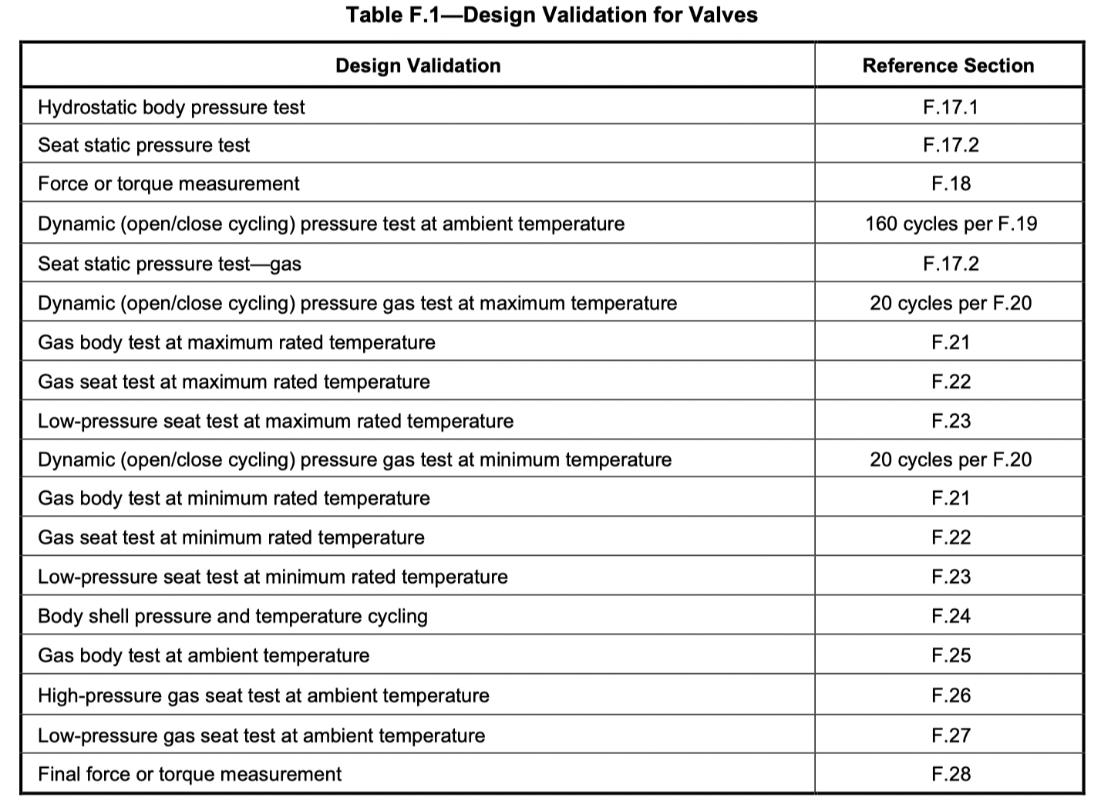
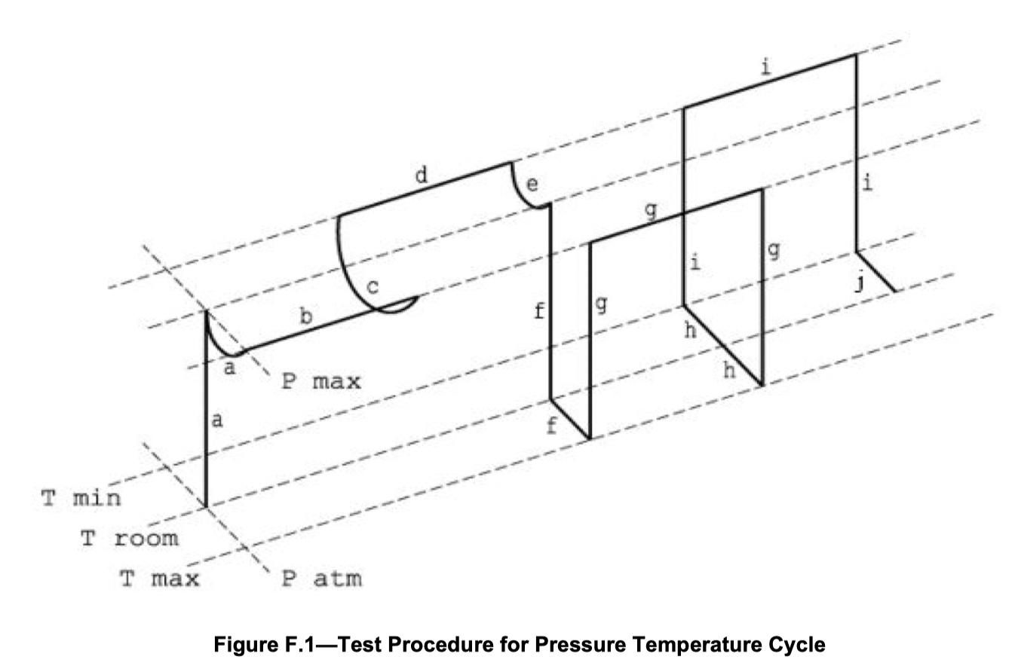
Design validation – Annex F (informative)
NEW Annex
Requirements which shall be applied when specified by the manufacturer or required by the purchaser
Design validation testing shall include:
Temperatures (high/low)
Pressures (high/low)
Dynamic cycles
Copyright © 2022 Massimiliano Gamba

Slide 37
Q & A SESSION
ORGANIZERS
SCIENTIFIC COMMITTEE
Thank you for your attention!
IVS 2022
Technical Conference

