Slide 1
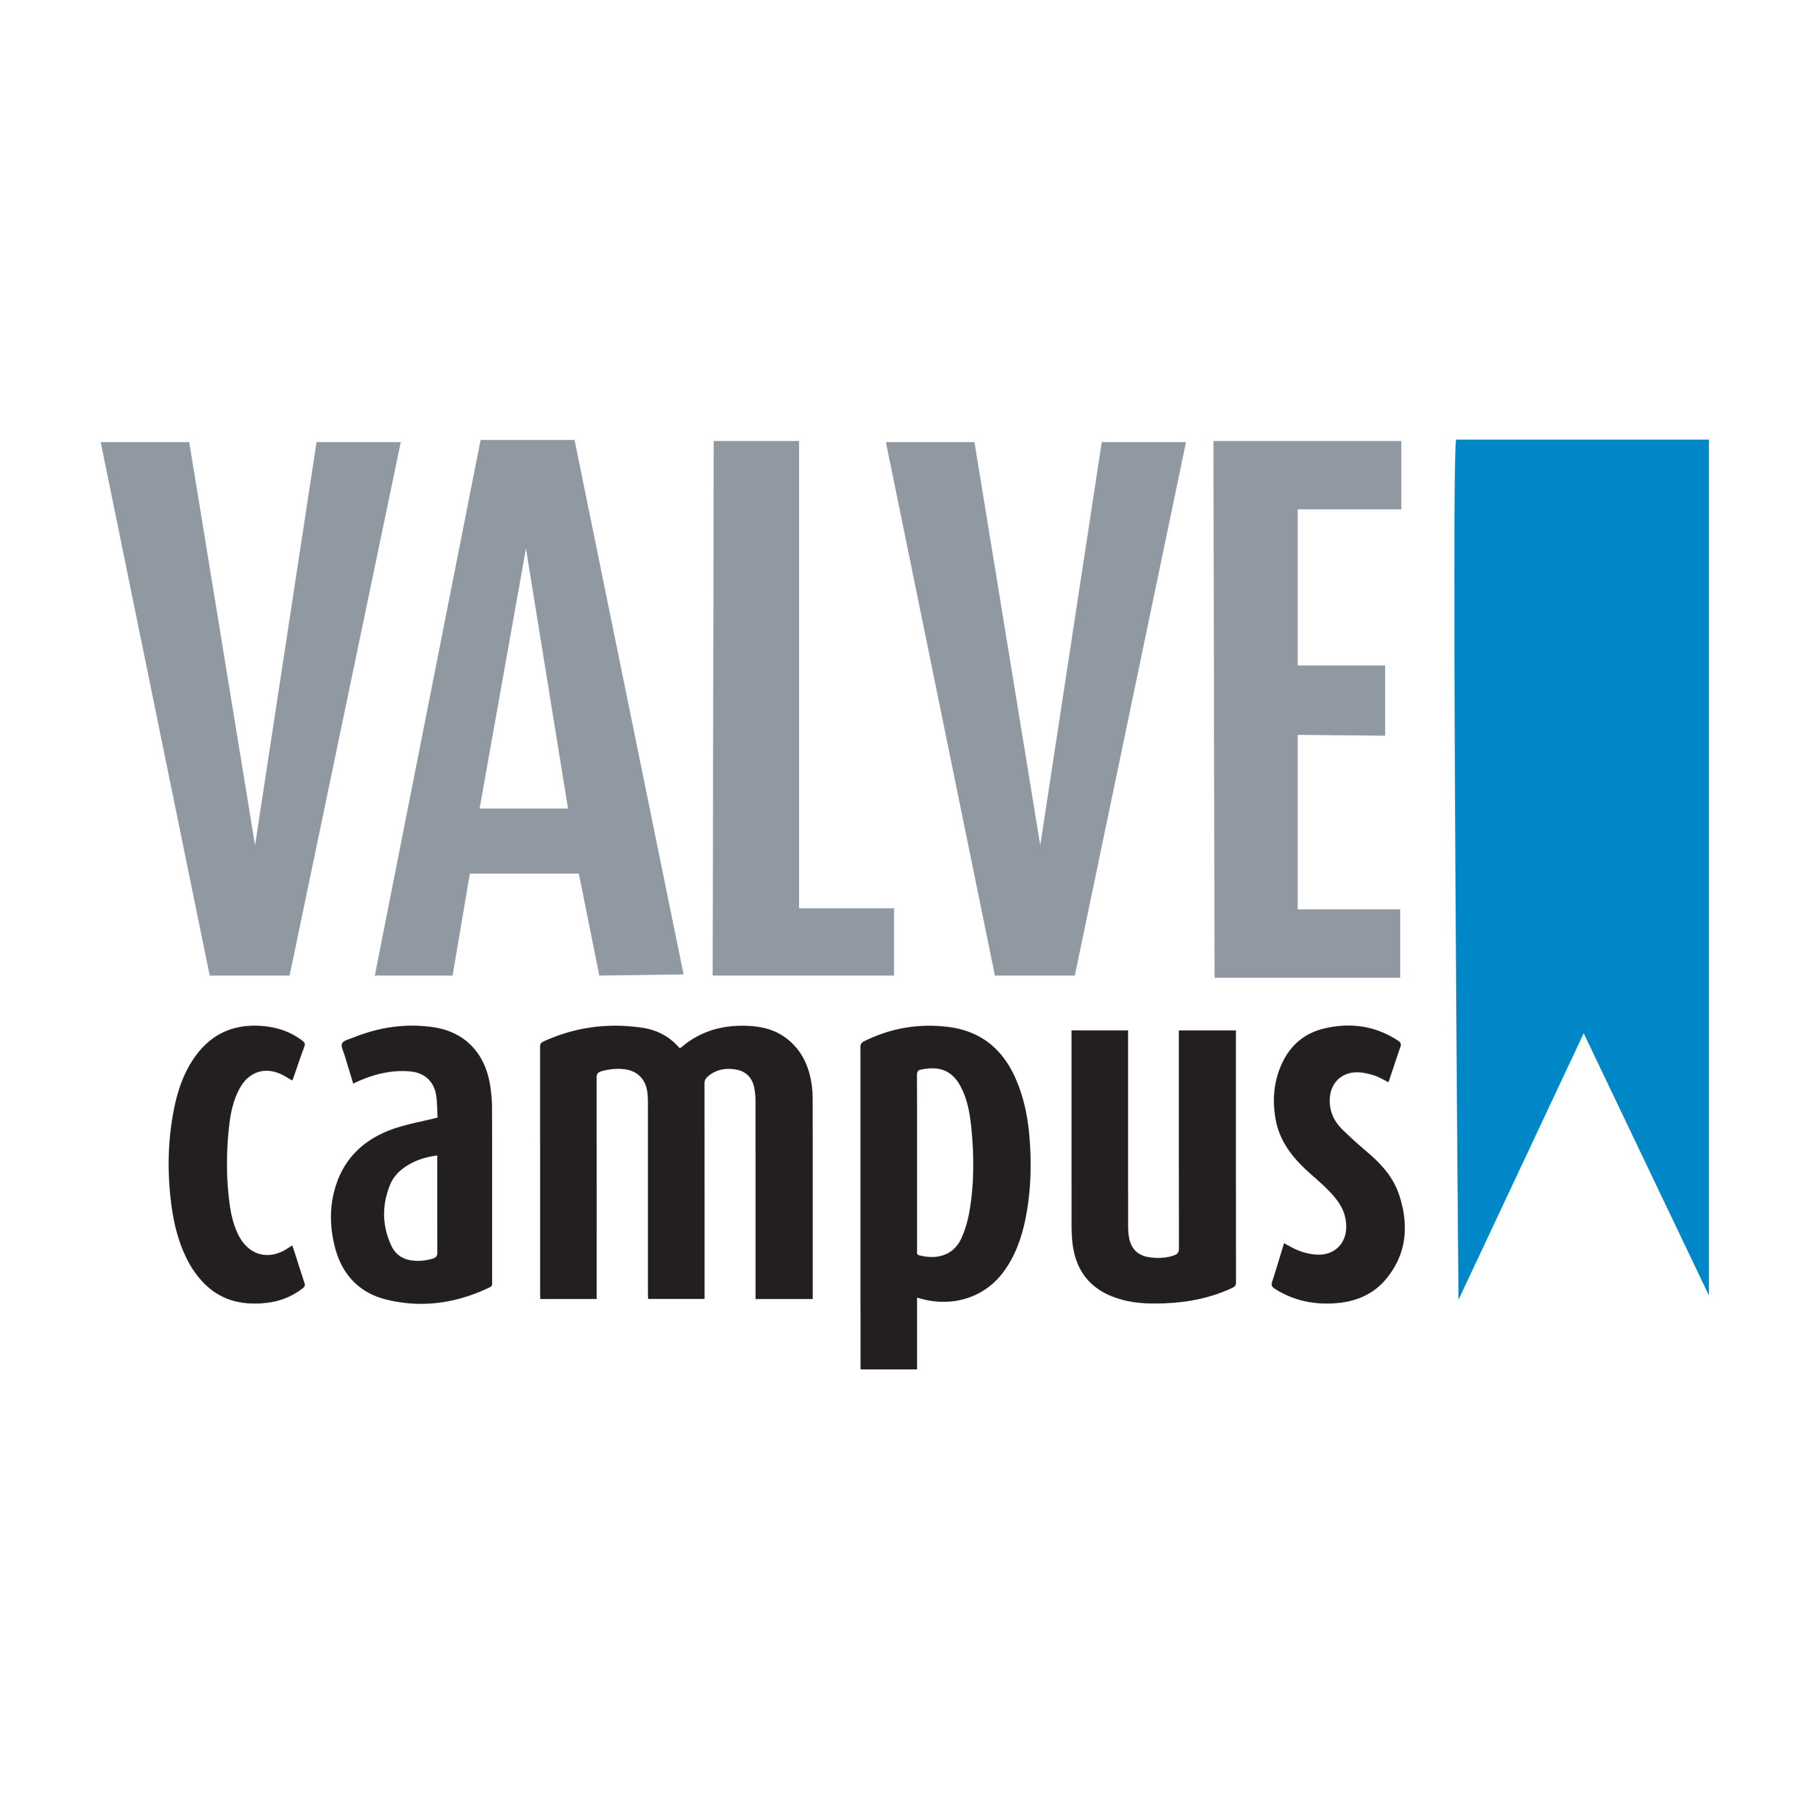
Giovanni Bettega
ORGANIZERS
SCIENTIFIC COMMITTEE
Simone Mandelli
Chief Technical Officer @ Solvo srl
General Manager @ Solvo srl
Advanced meshing techniques and their application on complex valve geometry components
IVS 2022
Technical Conference

Slide 2
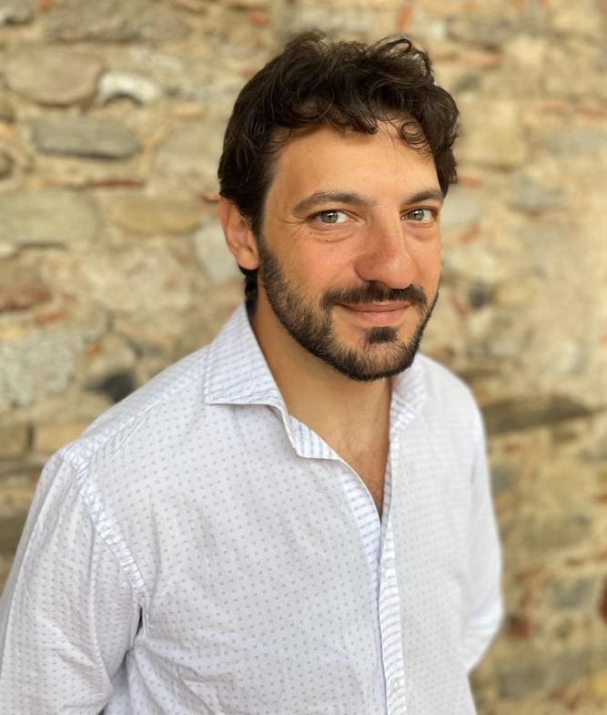
Biography
Eng. Giovanni Bettega
M.Sc. in Nuclear Engineering at Politecnico di Milano
PhD –Physics at Università degli Studi di Milano
More than 15 years of experience in FEA/CFD simulation, research project and technical consulting \
Eng. Simone Mandelli
M.Sc. in Engineering at Politecnico di Milano
PhD – Civil Engineering at Politecnico di Milano
More than 10 years of experience in FEA/CFD simulation, research project and technical consulting

Slide 3
Outline
Introduction
Solvo Srl – Company profile and mission
Numerical simulation
Grid generation
Grid generation techniques
Grid generation example
Q&A session

Slide 4
Introduction

Slide 5
About us: Company profile
Solvo Srl is an Italian start-up based in Milan, will provide an innovative software for Finite Element Analysis and all related supporting activities.
MISSION:
SOLVO aims to support partners providing an advanced simulation tool able to guarantee the highest technological level
WHAT WE DO:
The company is developing a software able to perform simulation using a set of Open-Source solvers. The software will be soon released to the market.
Customized software solution
Technical consultancy activities

Slide 6
Numerical Simulation, why?

Slide 7
Biography
Joachim Schoberl - “NETGEN An advancing front 2D/3D-mesh generator based on abstract rules” - Comput Visual Sci 1:41–52 (1997)
Hang Si “TetGen A Quality Tetrahedral Mesh Generator and a 3D Delaunay Triangulator” - https://wias-berlin.de/software/tetgen
Carlo Lombardi – Impianti Nucleari – Città Studi, 1993

Slide 8
Numerical simulations - why
- Searching for an approximate solution of a Partial Differential Equation (PDE)
- Aim: reproducing/predicting the behavior of a physical system, for analysis and verification purposes
Modern applications and large scale production of goods both require the use of numerical simulations:
- virtually no need of prototyping: expensive, time-comsuming test, are replaced by simulations
- no need to reproduce “extreme” operating conditions (pressure, temperature) in test areas
- investigation of the full range of failure modes
- [...]

Slide 9
Numerical simulations – which environment
Depending on the physics under investigation the PDE can be:
PARABOLIC: diffusion problems
- time dependent heat equation
- diffusion dominated Navier-Stokes
- ...
ELLIPTIC: equilibrium states, discontinuities have already been smoothed out
- steady state heat equation
- Poisson's equation for E
- irrotational flows
- ...
HYPERBOLIC: wave propagation
- EM waves
- advection dominated Navier-Stokes, ...
- …

Slide 10
Why use a computer for solving a PDE
Consider the following simple problem: a bar of metal with a square cross section of side l = 5 cm, whose ends are kept at T0 and T1, stands in air, exchanging heat by convection; compute the temperature profile along the solid, in steady state conditions

Slide 11
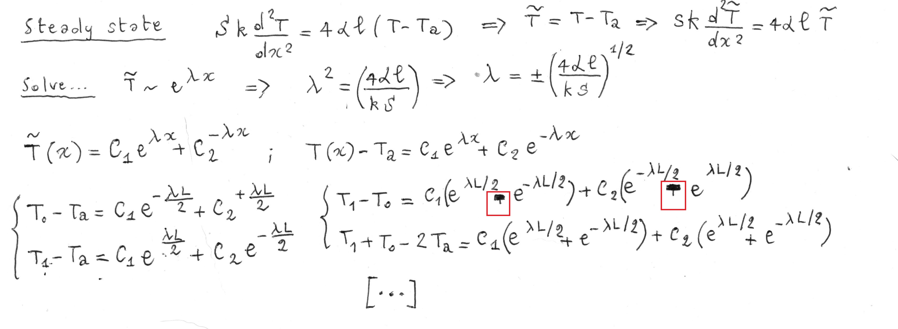
Why use a computer for solving a PDE
- From a 3D to 1D problem
- Possibility of “run time” errors...
- A lot of algebra

Slide 12
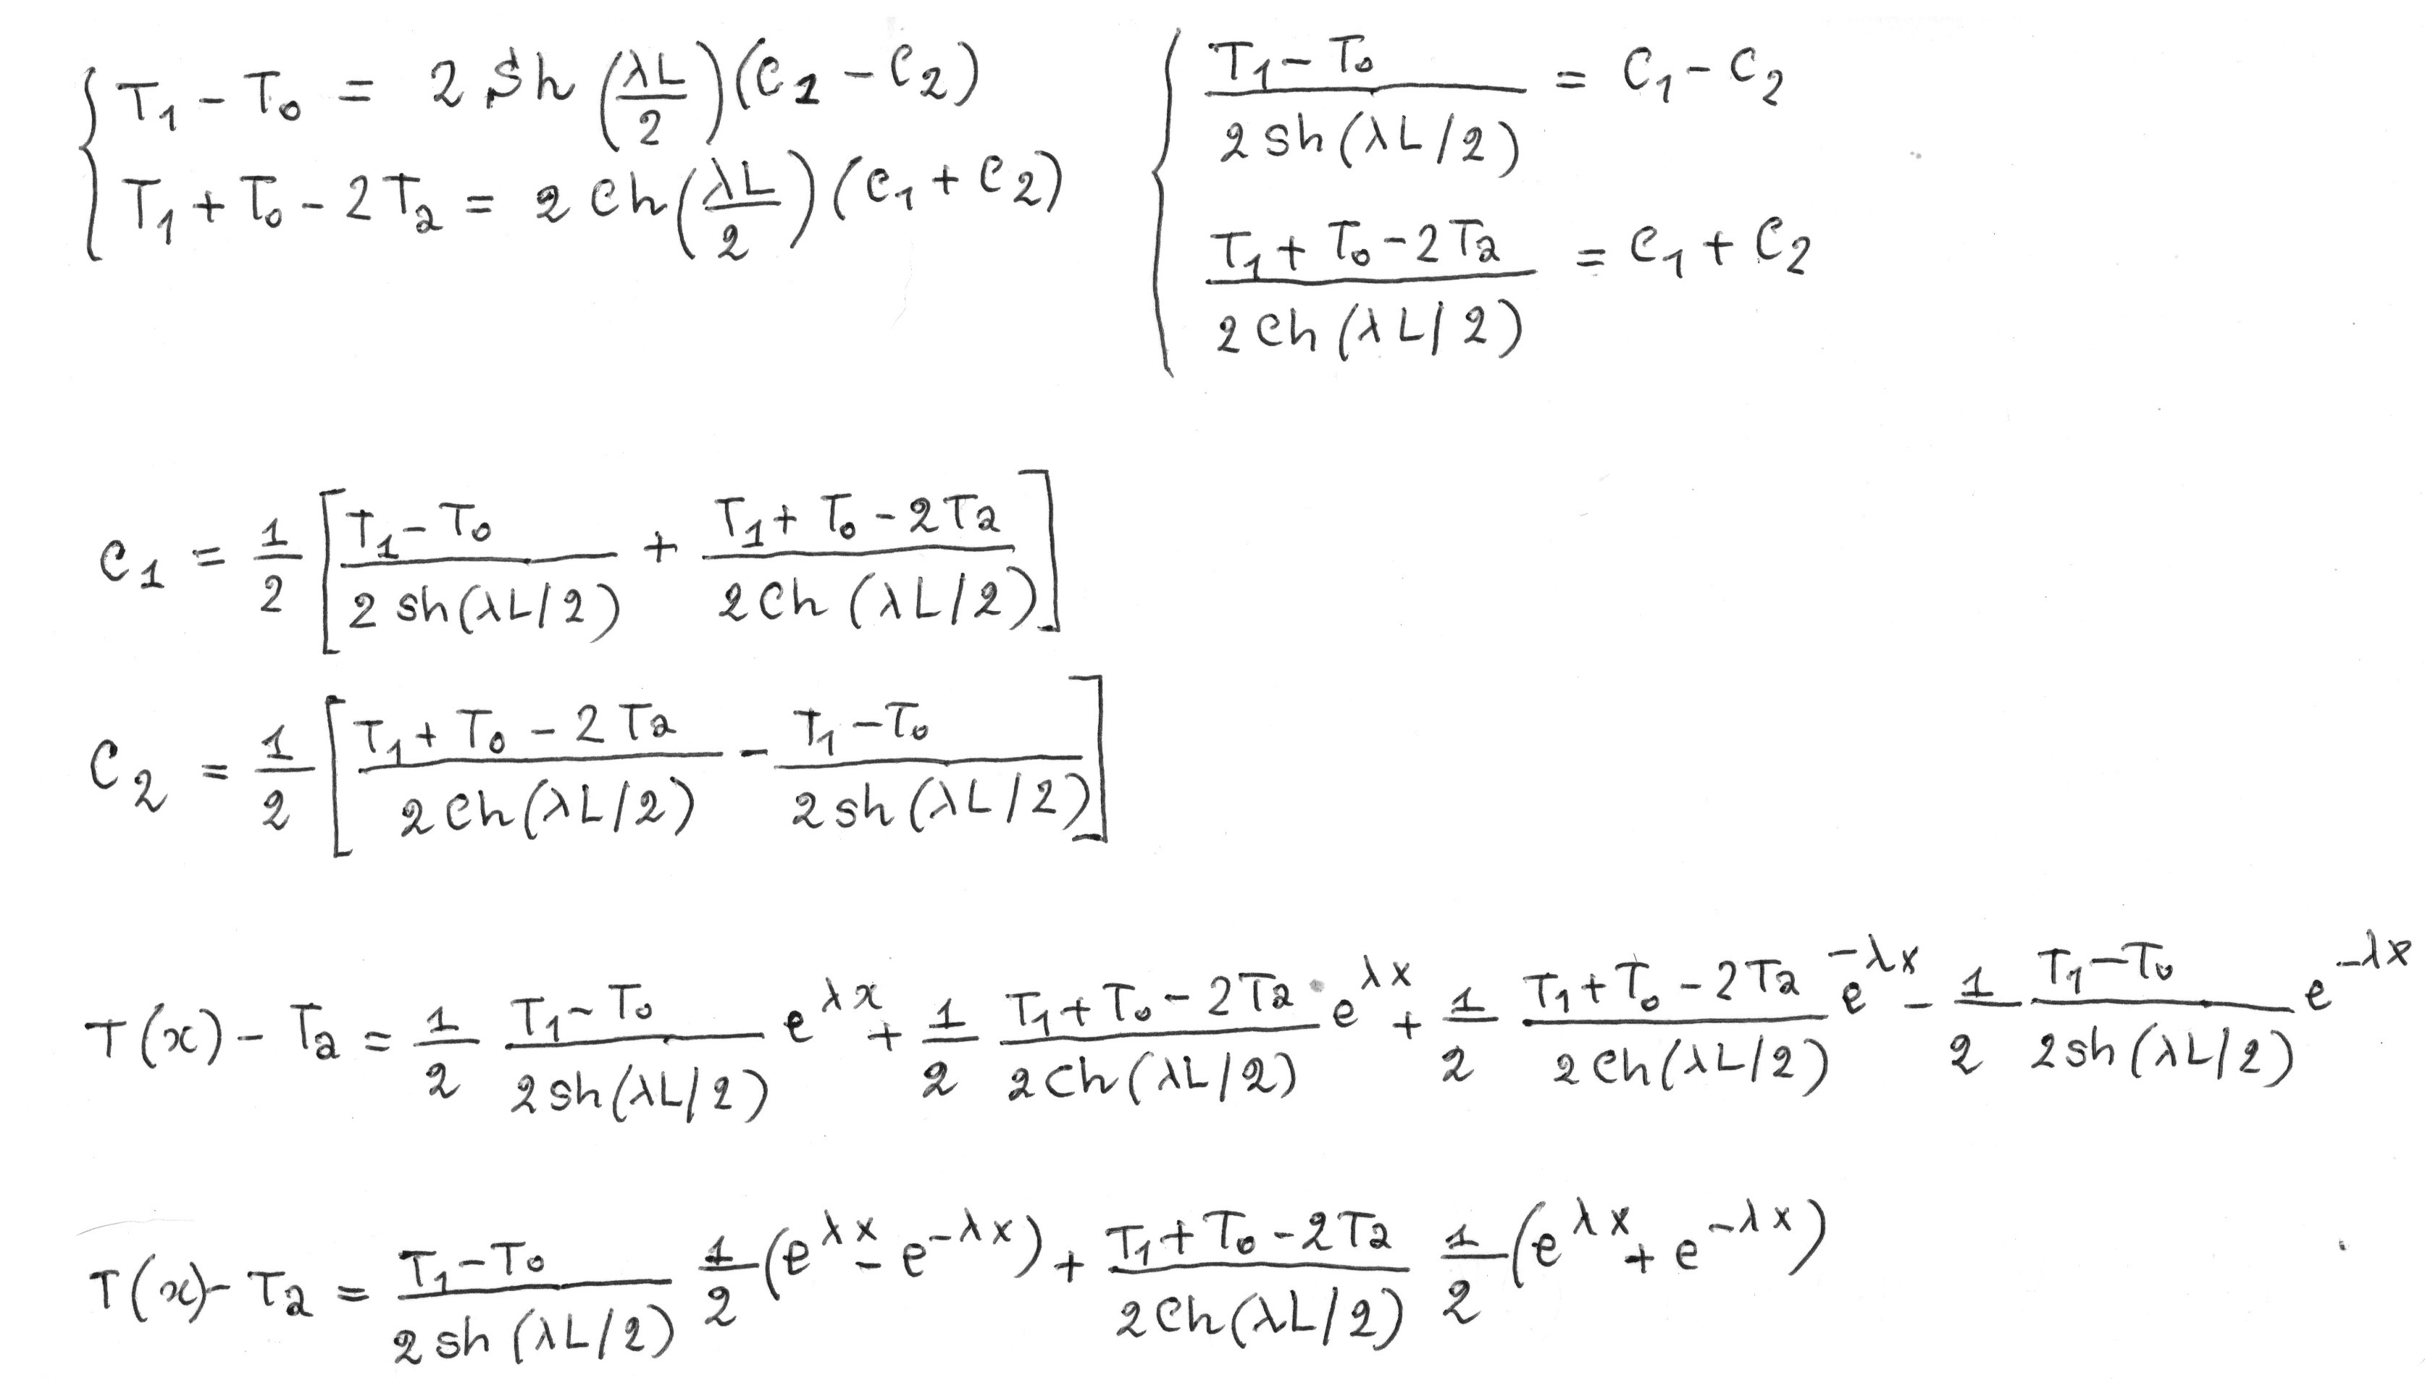
Why use a computer for solving a PDE
- From a 3D to 1D problem
- Possibility of “run time” errors...
- A lot of algebra

Slide 13
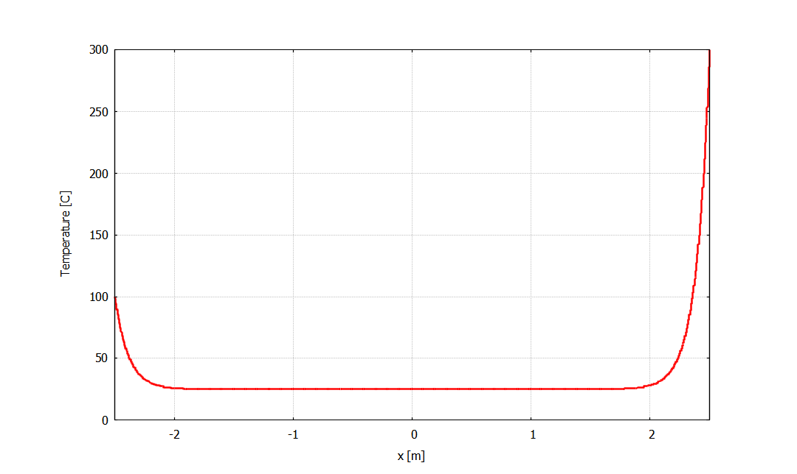
Why use a computer for solving a PDE
- From a 3D to 1D problem
- Possibility of “run time” errors...
- A lot of algebra
Special functions involved (hyperbolic,
Bessel functions, spherical harmonics, ...)
A “minor” modification in the geometry makes the problem impossible to be solved

Slide 14
PDEs are solved on a discrete computational grid
Finite Element Method - FEM, Finite Volume Method – FVM
the continuous domain is divided into a set of “elements” building a computational mesh.
FEM
the mathematical problem is reformulated => “weak” formulation of the PDE, allowing for discontinuos solutions
FVM
conservative form of the equations
Other strategies are possible, but always relying on a “valid”[*] computational mesh

Slide 15
Grid generation

Slide 16
Meshing of critical geometries
Meshing of valve subcomponents is more and more critical
Valves are more and more subjected to higher pressure or thermal stresses
Pressure up to 20000 psi – Cryogenic or high temperature – Vacuum
New production technics, like Additive manufacturing, are introducing more critical geometries and surfaces
Finite Element Analysis are used more and more to predict components behavior, prevent testing failures and prototype costs
Raw material costs are pushing valve manufacturers to guarantee excellent performances with lither valves meaning thinner subcomponents
Some example automatic meshing techniques and application

Slide 17
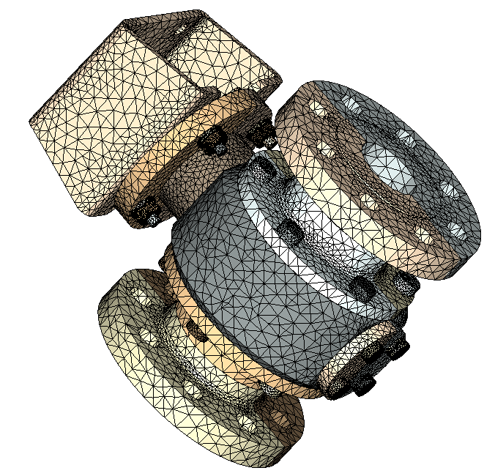
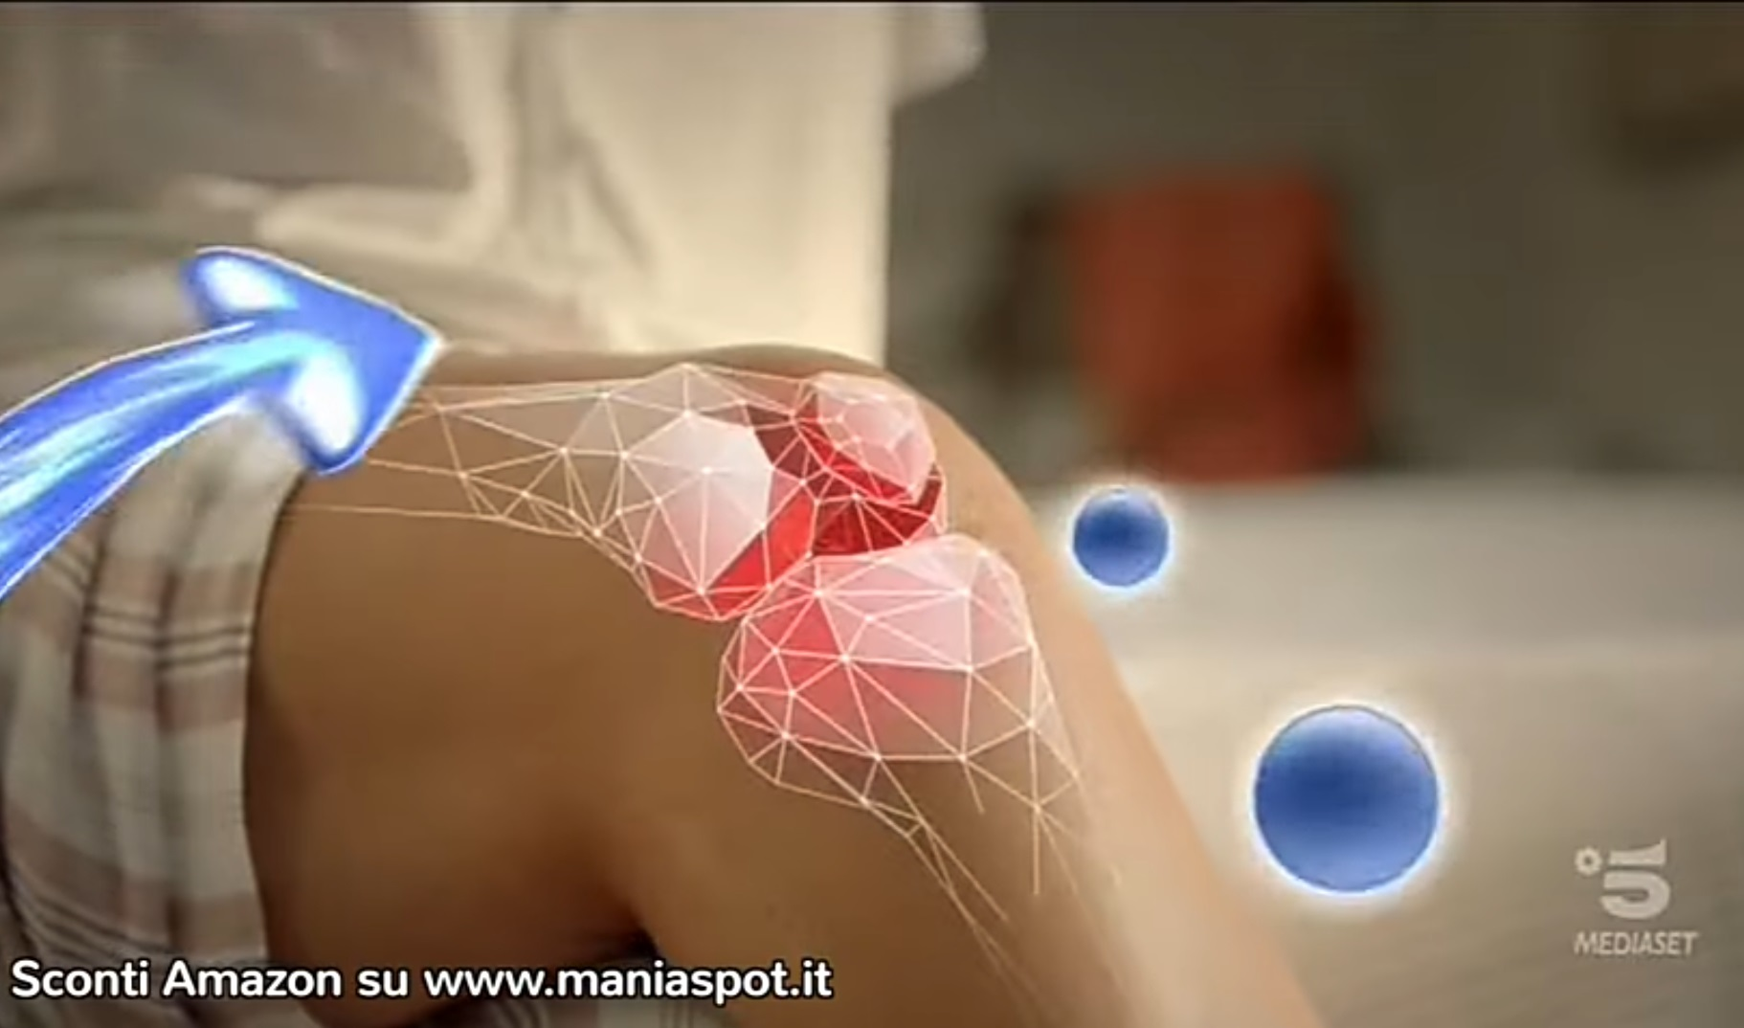
Grid generation
Manual
Automatic
https://www.novartis.it/
SOLVO mesh engine

Slide 18
Grid generation techniques – automatic methods
Cartesian, Delaunay triangulations – tetrahedralization, Advancing front, quad/octrees methods, ...
FEM
the mathematical problem is reformulated => “weak” formulation of the PDE, allowing for discontinuos solutions
FVM
conservative form of the equations
Other strategies are possible, but always relying on a “valid” computational mesh

Slide 19
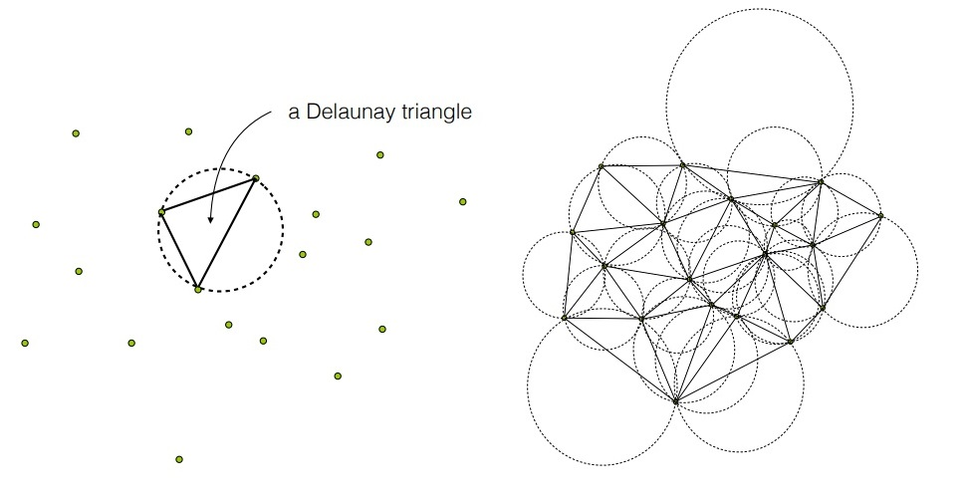
Grid generation techniques
Advancing front mesh generation: discretize edges (implicit curve following), discretize
model faces (implicit surface following), finally volume mesh
Delaunay based mesh generation: Delaunay property of a triangle/tetrahedron
Types of DT:
- set of points => convex hull
- constrained Delaunay
(preserve boundary)
- conforming Delaunay
(add points to boundary, all simplex are delaunay)

Slide 20
Grid generation techniques
Since mesh generation involve a lot of geometry queries for point placements, local measurements,
… the boundary domain must be well defined and free of errors
a volume defined using a tessellation (e.g. Piece-wise Linear Complex) requires a watertight
tessellation, absolutely free of error (self intersections, degenerancies, …)
a volume defined by an implicit CAD representation (BRep, STEP, Parasolid, …)
must be absolutely free of errors (no gaps, no self intersections of curves, …)
Tessellated geometries, and CAD models are errors prone and require healing/defeaturing

Slide 21
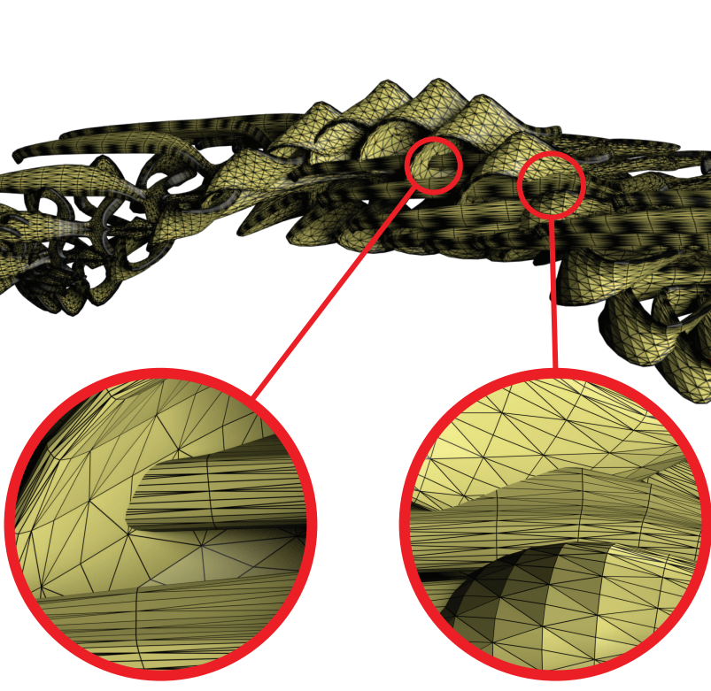
Handling CAD & tessellation errors
Complex 3D model with self intersecting
triangles
A pre-processing is mandatory
before trying to mesh.
This pre-processing is in
general time-consuming
In case of hundreds (or thousands) of
errors automatic healing by the available
tools (commercial) or not is really not
applicable

Slide 22
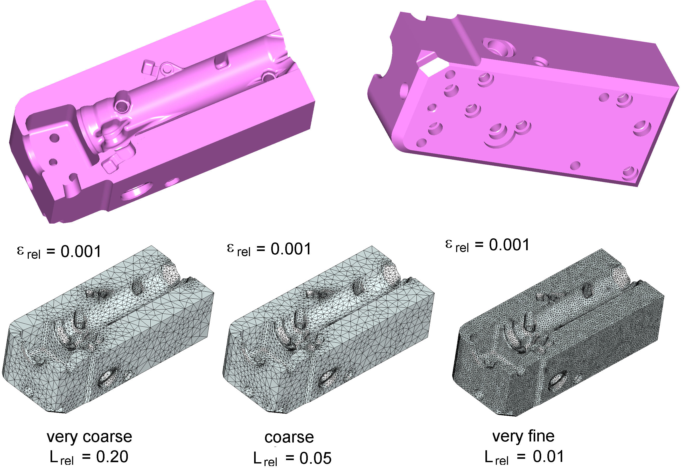
Medium complexity – smooth, error free CAD

Slide 23
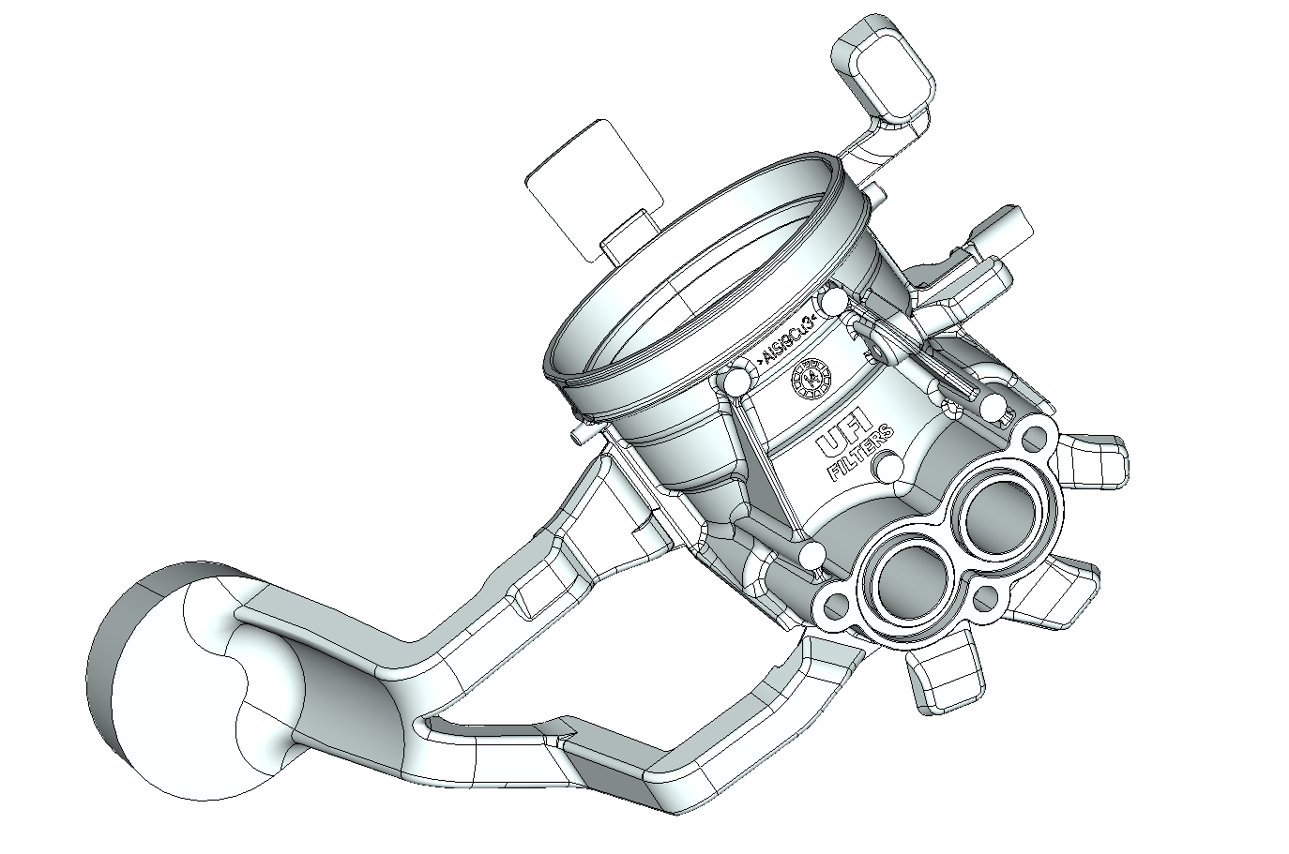
Complex shapes, corrupted CAD models

Slide 24
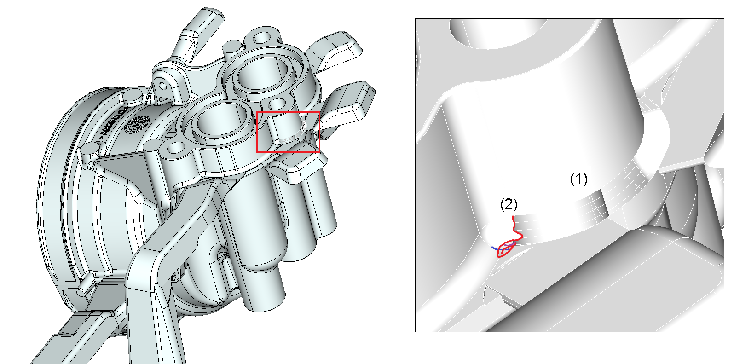
Complex shapes, corrupted CAD model

Slide 25
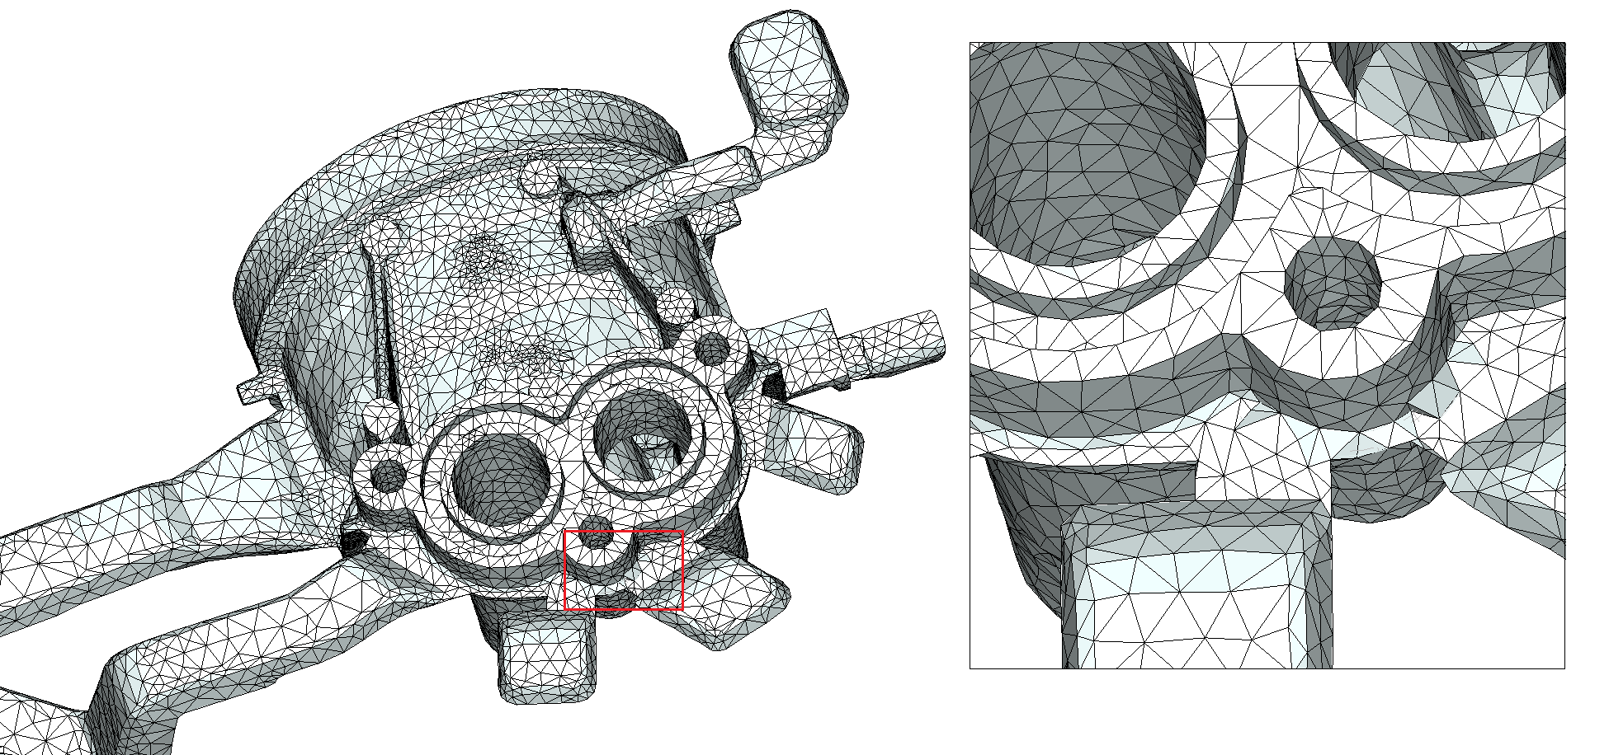
Complex shapes, corrupted CAD model

Slide 26
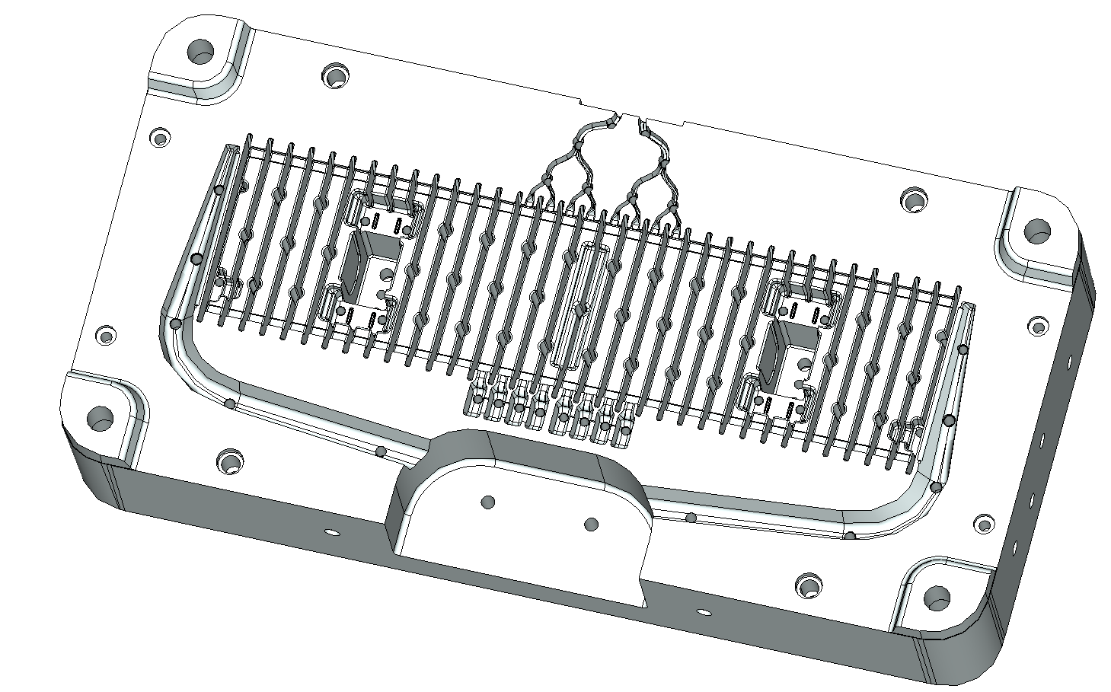
Complex shapes

Slide 27
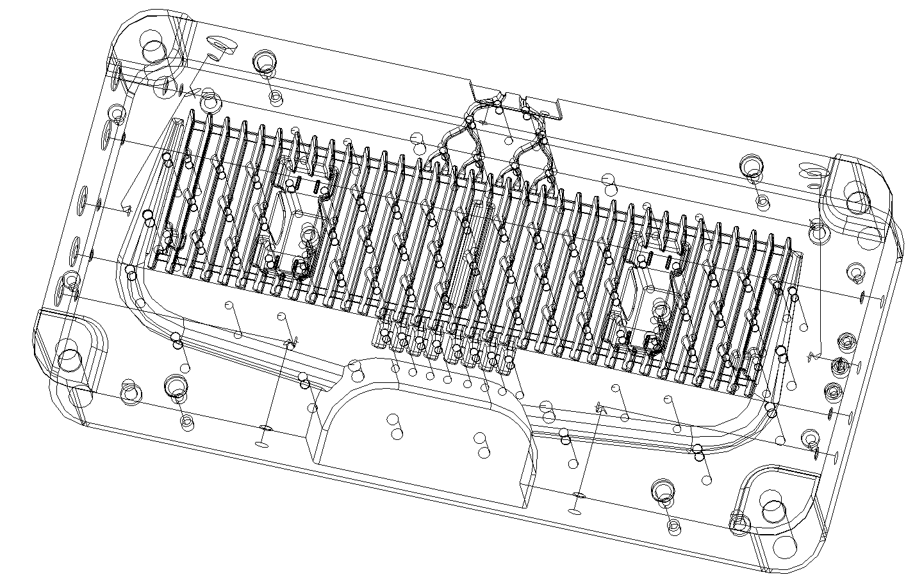
Complex shapes

Slide 28
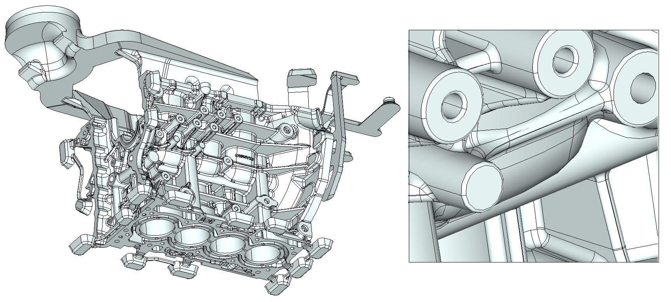
Impossible with patch conforming – more than 200 CAD errors

Slide 29
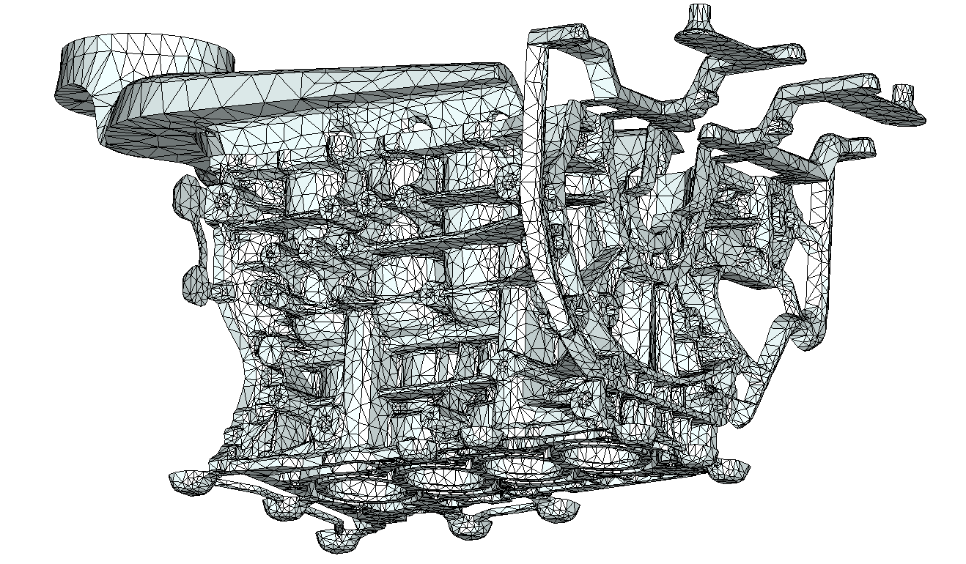
Impossible with patch conforming – more than 200 CAD errors

Slide 30
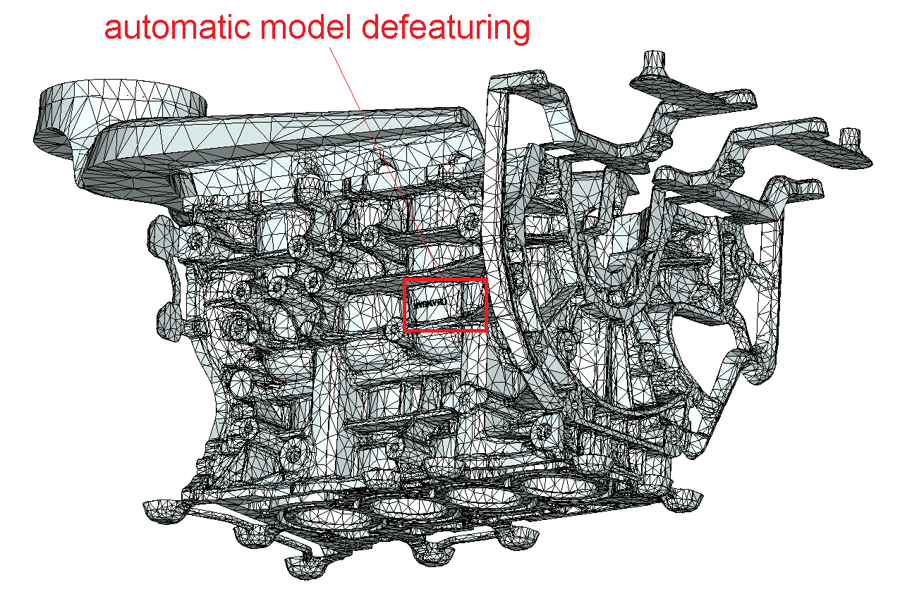

Slide 31
Q & A SESSION
ORGANIZERS
SCIENTIFIC COMMITTEE
Thank you for your attention!
IVS 2022
Technical Conference

