Slide 1
MICHELE CEVENINI
ORGANIZERS
SCIENTIFIC COMMITTEE
Managing Director - NDT ITALIANA SRL
BIO WATER BASED LIQUID PENETRANTS FOR NON DESTRUCTIVE TESTING OF VALVES’ QUALITY
IVS 2022
Technical Conference

Slide 2
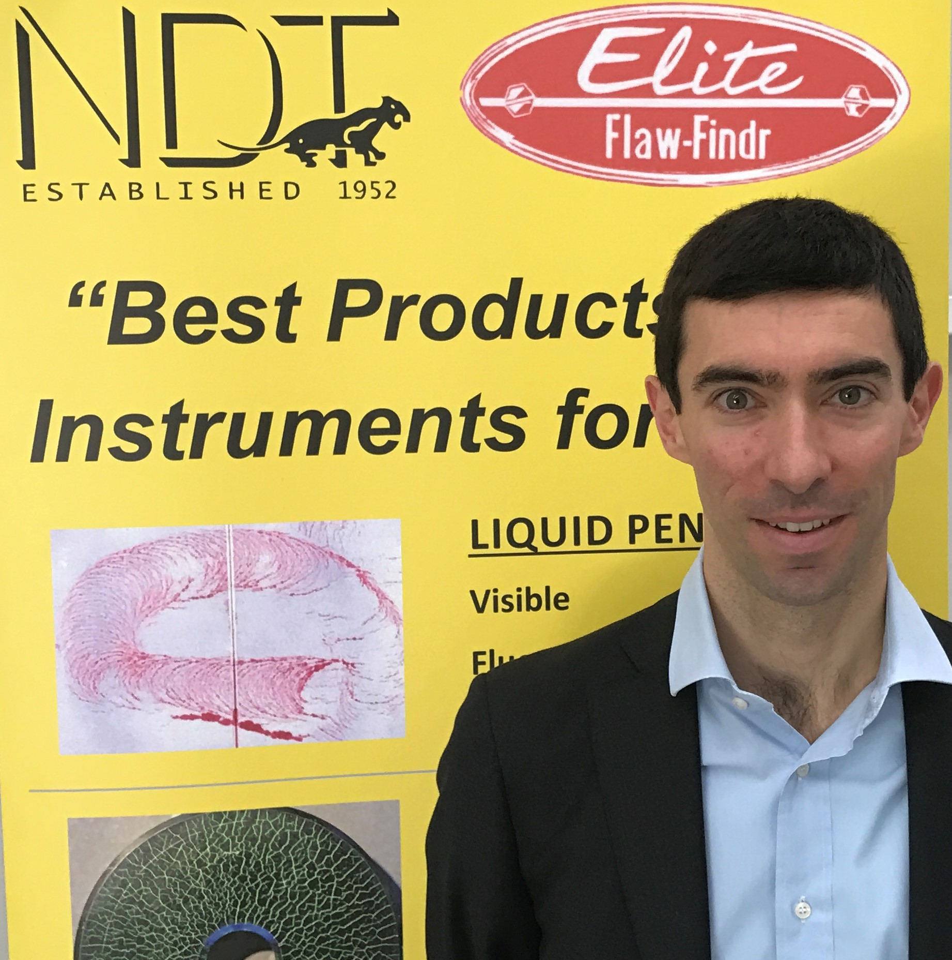
Biography
Michele Cevenini is the managing director of NDT Italiana, one of the world’s most famous non-destructive testing quality inspection companies.
Michele joined the Company in 2005, after a cum laude degree in economics and work experiences in London and New York.
NDT Italiana has a very long experience manufacturing liquid penetrants, magnetic particles, ultrasonic couplants and UV lamps, and is focused on safety and productivity of quality control in the valve industry.
Company
NDT ITALIANA
Via Del Lavoro 28
Concorezzo (MB) ITALY
+39 039 64 75 90
INFO@NDT.IT

Slide 3
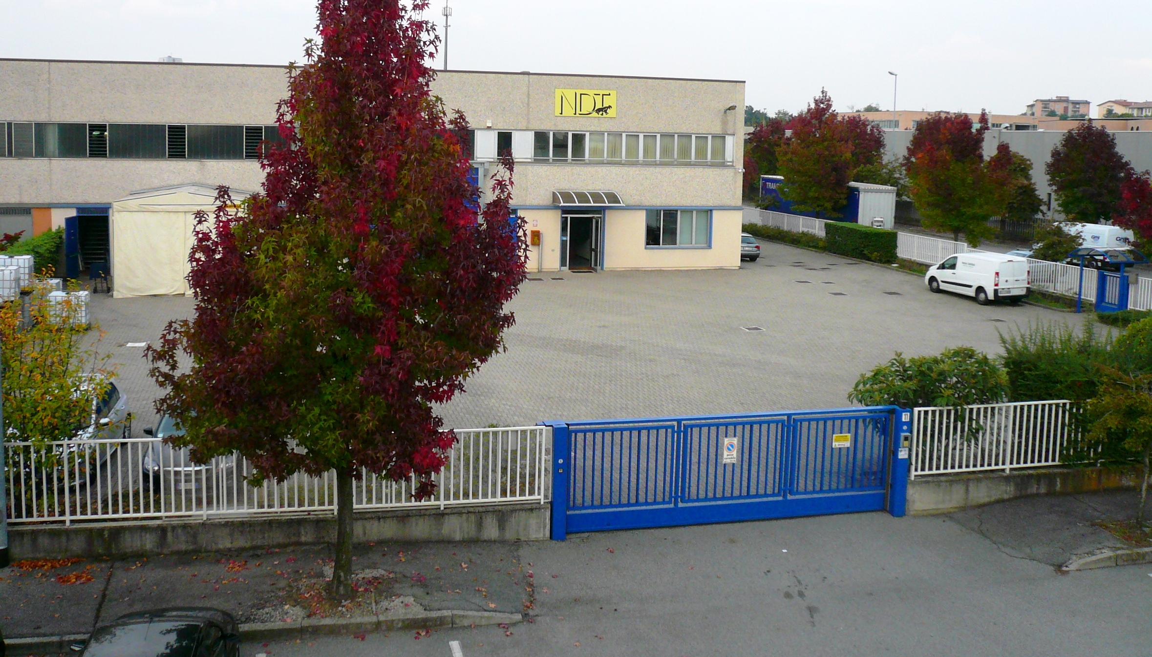
About us – Quality Pioneers
NDT ITALIANA works since 1952 in the field of NON-DESTRUCTIVE TESTING.
The headquarters are in Italy near Milan. A large area is devoted to production and goods stocking, to guarantee quick supply to customers worldwide
NDT Italiana is certified UNI EN ISO 9001 and approved NATO AQAP-120, and is equipped with internal Chemical and Electronic Laboratories, Technical Service, Specialised Consulting at the service of our customers
NDT founder, Mrs. Angela in 1952
NDT factory in Italy, near Milan

Slide 4
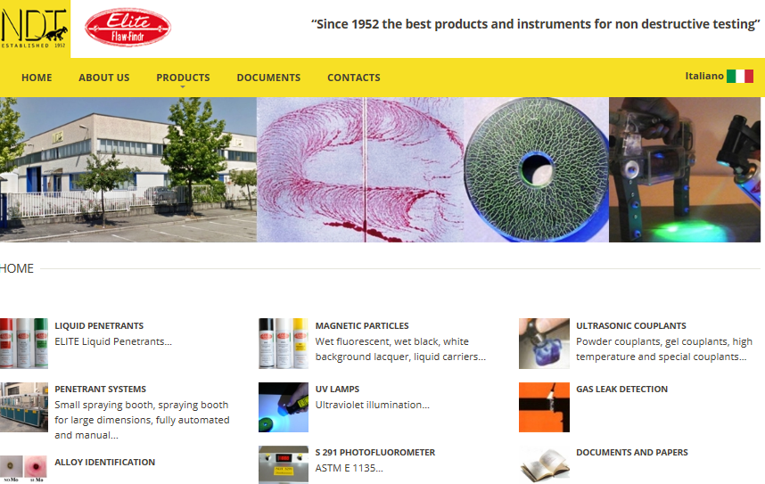
About us
NDT Italiana manufactures:
LIQUID PENETRANTS:
FLUORESCENT WATER BASED
RED WATER BASED AND TRADITIONAL OIL-BASED
MAGNETIC PARTICLES:
FLUORESCENT AND DUAL COLORED, BLACK
ULTRASONIC COUPLANTS
UV LED LIGHTS

Slide 5
About us
NDT ITALIANA with its products and instruments meets the requirements of many key industrial sectors with turn-key solutions
NDT Italiana’s Products are sold in over 100 countries:
Albania, Algeria, Angola, Argentina, Australia, Austria, Azerbaijan, Bahrain, Bangladesh, Belgium, Bolivia, Bosnia Herzegovina, Brazil, Bulgaria, Canada, Chile, China, Colombia, Congo, Croatia, Cyprus, Czech Republic, Denmark, Ecuador, Egypt, Equatorial Guinea, Estonia, Ethiopia, Finland, France, Germany, Great Britain, Greece, Holland, Hong Kong, Hungary, Iceland, India, Indonesia, Iraq, Ireland, Israel, Italy, Ivory Coast, Japan, Jordan, Kazakhstan, Kenya, Kosovo, Kuwait, Latvia, Lebanon, Libya, Lithuania, Luxembourg, Malaysia, Mali, Malta, Morocco, Mexico, Nepal, New Zealand, Nigeria, Norway, Oman, Pakistan, Panama, Peru, Philippines, Poland, Portugal, Qatar, Romania, Saudi Arabia, Serbia, Singapore, Slovakia, Slovenia, South Africa, South Korea, Spain, Sudan, Sweden, Switzerland, Taiwan, Thailand, Trinidad, Tunisia, Turkey, Ukraine, United Arab Emirates, United States, Venezuela, Vietnam, Zimbabwe…

Slide 6
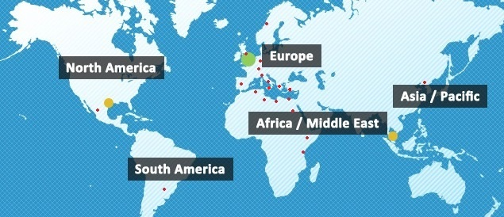
About us
NDT ITALIANA is geographically located to exploit non destructive testing opportunities worldwide
NDT ITALIANA is selling directly and through a network of distributors covering all industries, and is focused on the Industrial Valve Industry

Slide 7
International Standards: ISO 3452; ASME V Art. 6; API 20D, AMS 2644…
“Penetrant systems are to be classified as follows […]:
Method A(W) Water washable – water containing (≥ 20% water by volume)
AMS 2644
“Penetrant testing products shall be classified by type method and form […] Form c: Water Suspendable”
EN ISO 3452
“PT shall be performed using either Type 1 (fluorescent) or Type 2 (visible) penetrant […]:
Method A: Water Washable
Form c: Water suspendable”
API 20D

Slide 8
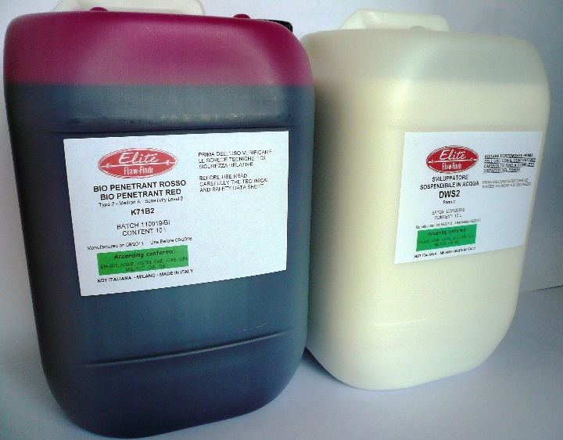
Bio Liquid Penetrants: Advantages for the operators and the environment
Safety Advantages:
No flammability risk, not irritant for the eyes or the skin of the operator (water-based)
0% Volatile Organic Compounds (VOC), no expensive air treatment with active carbon filtration needed, safe for the environment
Cost Advantages:
No costs of cabins with active carbon filtration for solvents (being water-based)
Economical: free of oil and other volatile solvents
Same sensitivity and process parameters compared to traditional oil- based penetrants and solvent-based developers
K71B2 BIO red penetrant+
Elite DWS2 developer

Slide 9
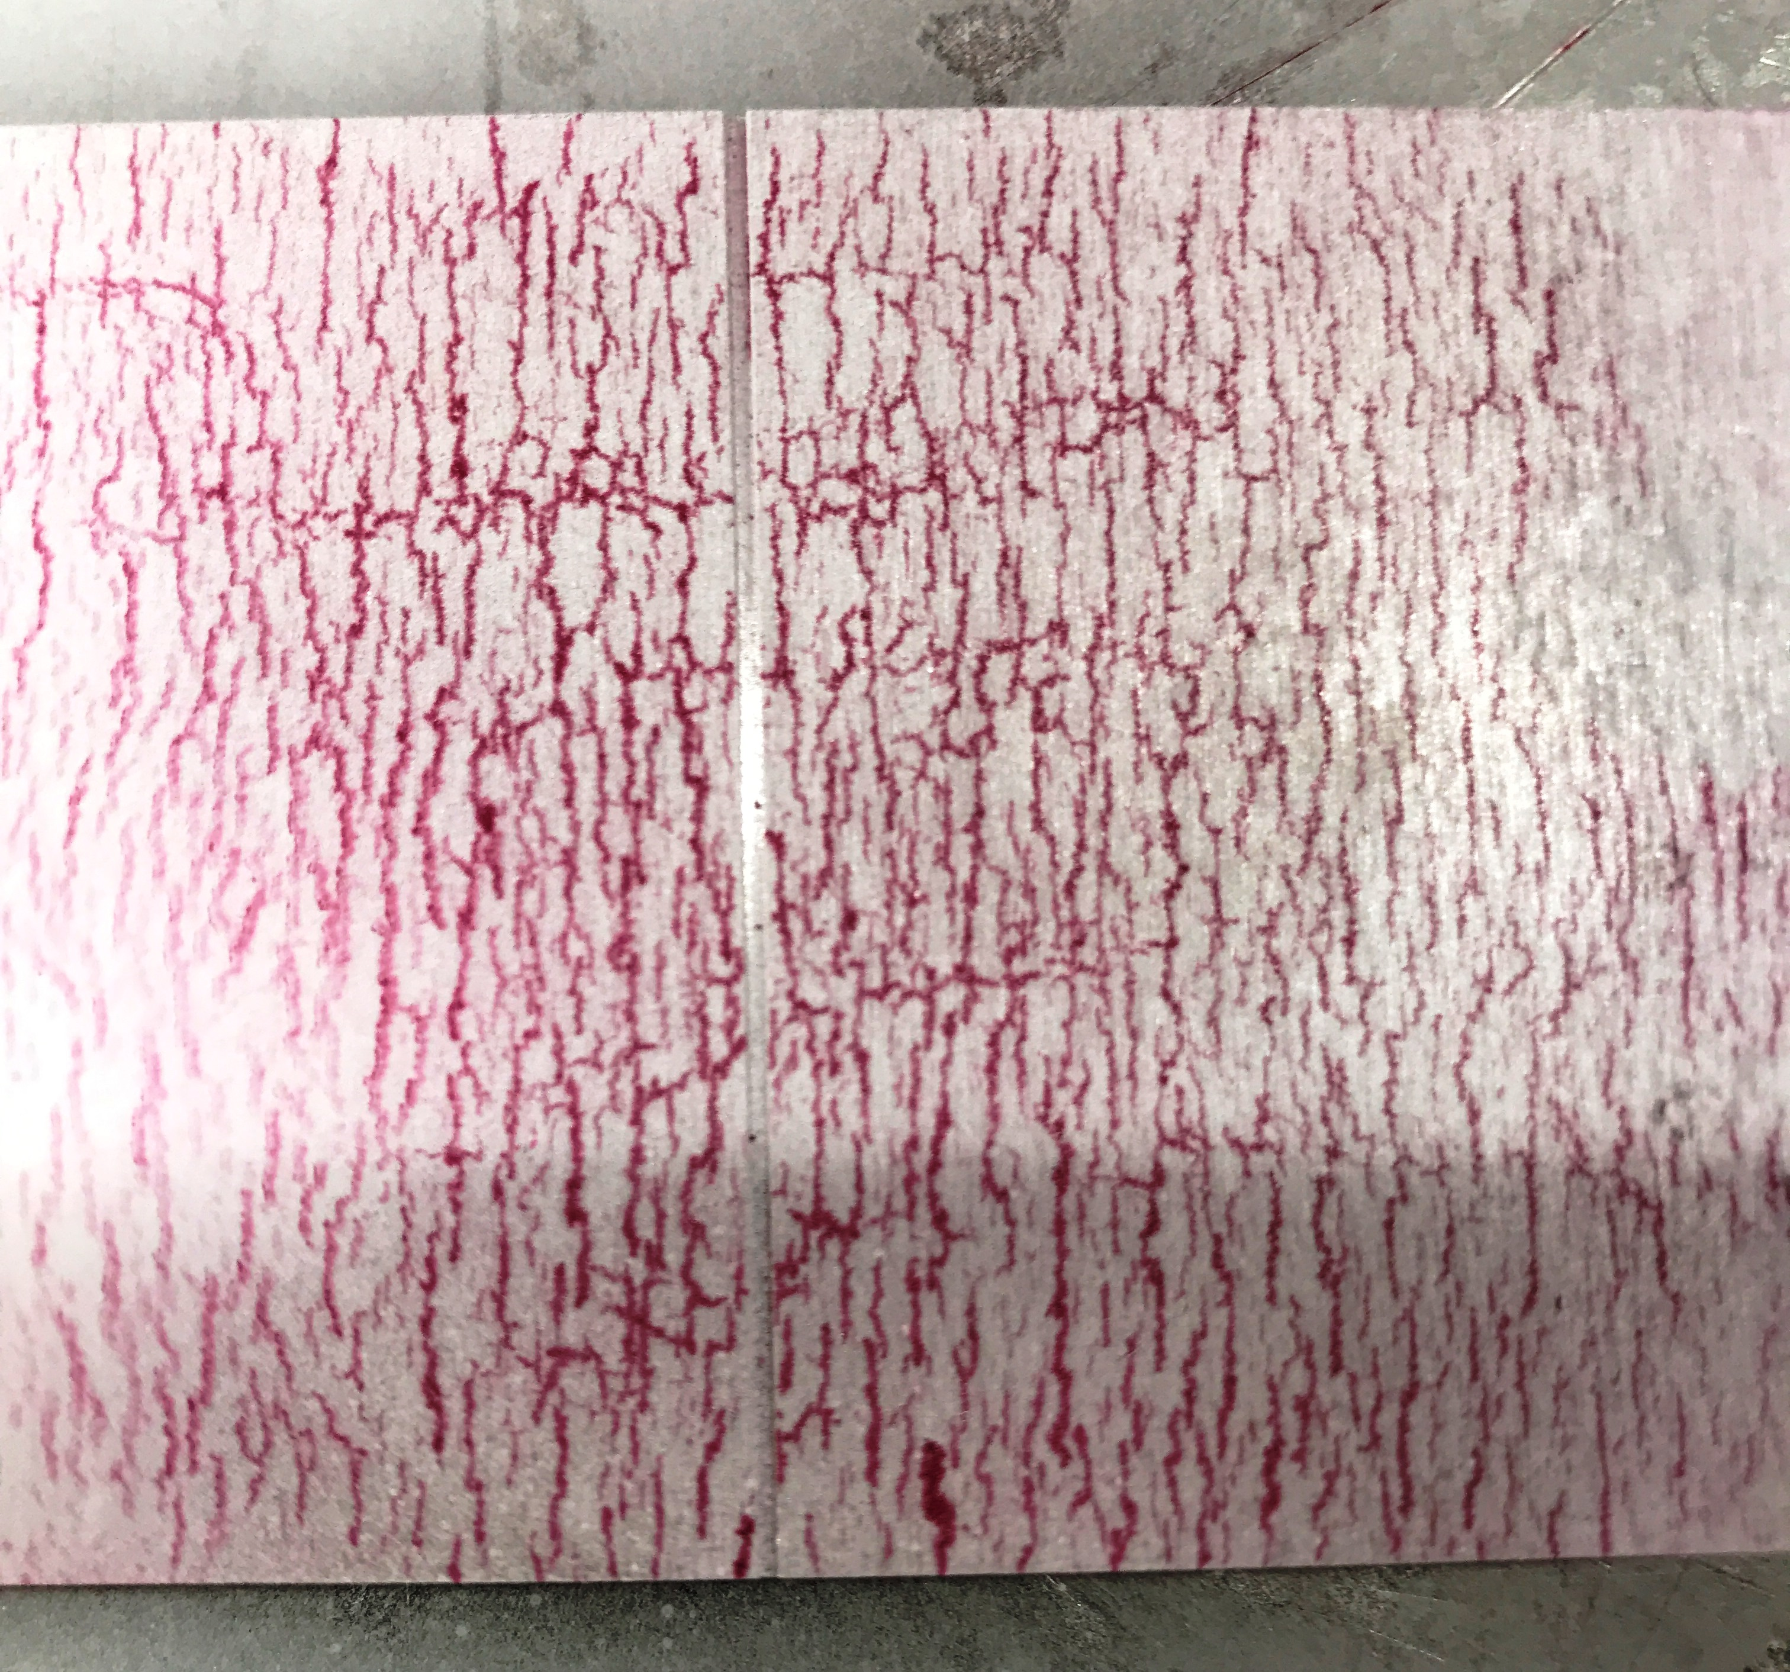
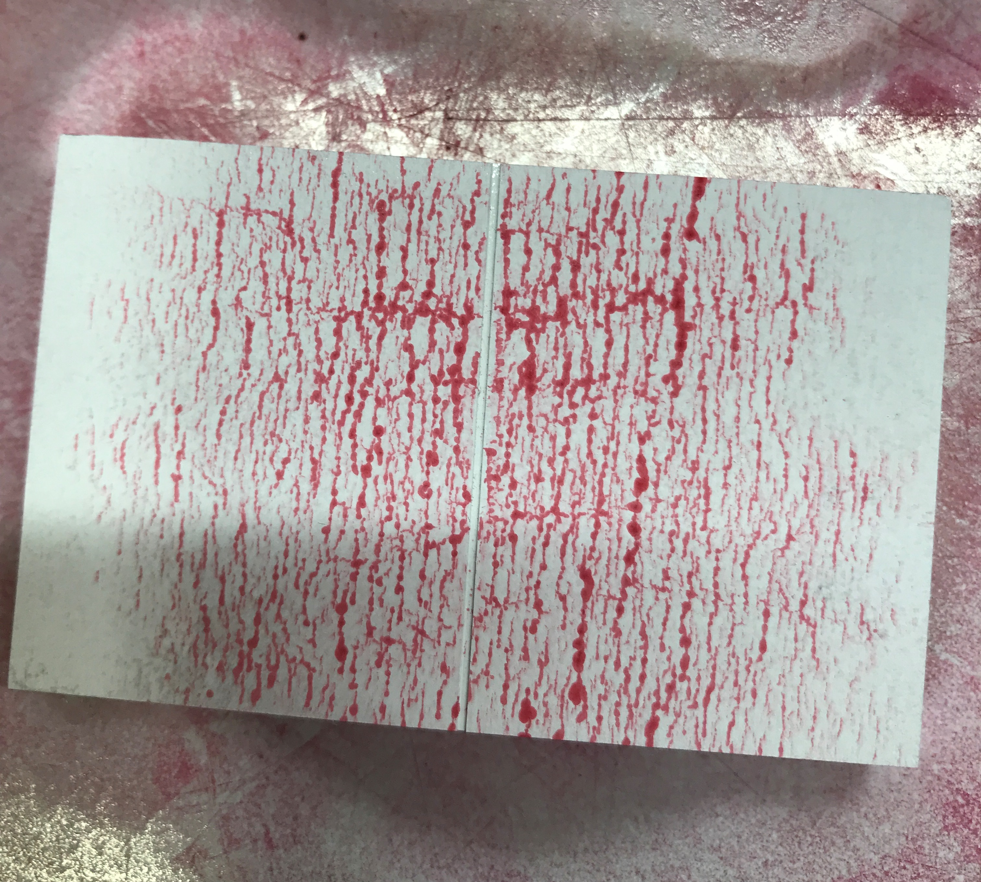
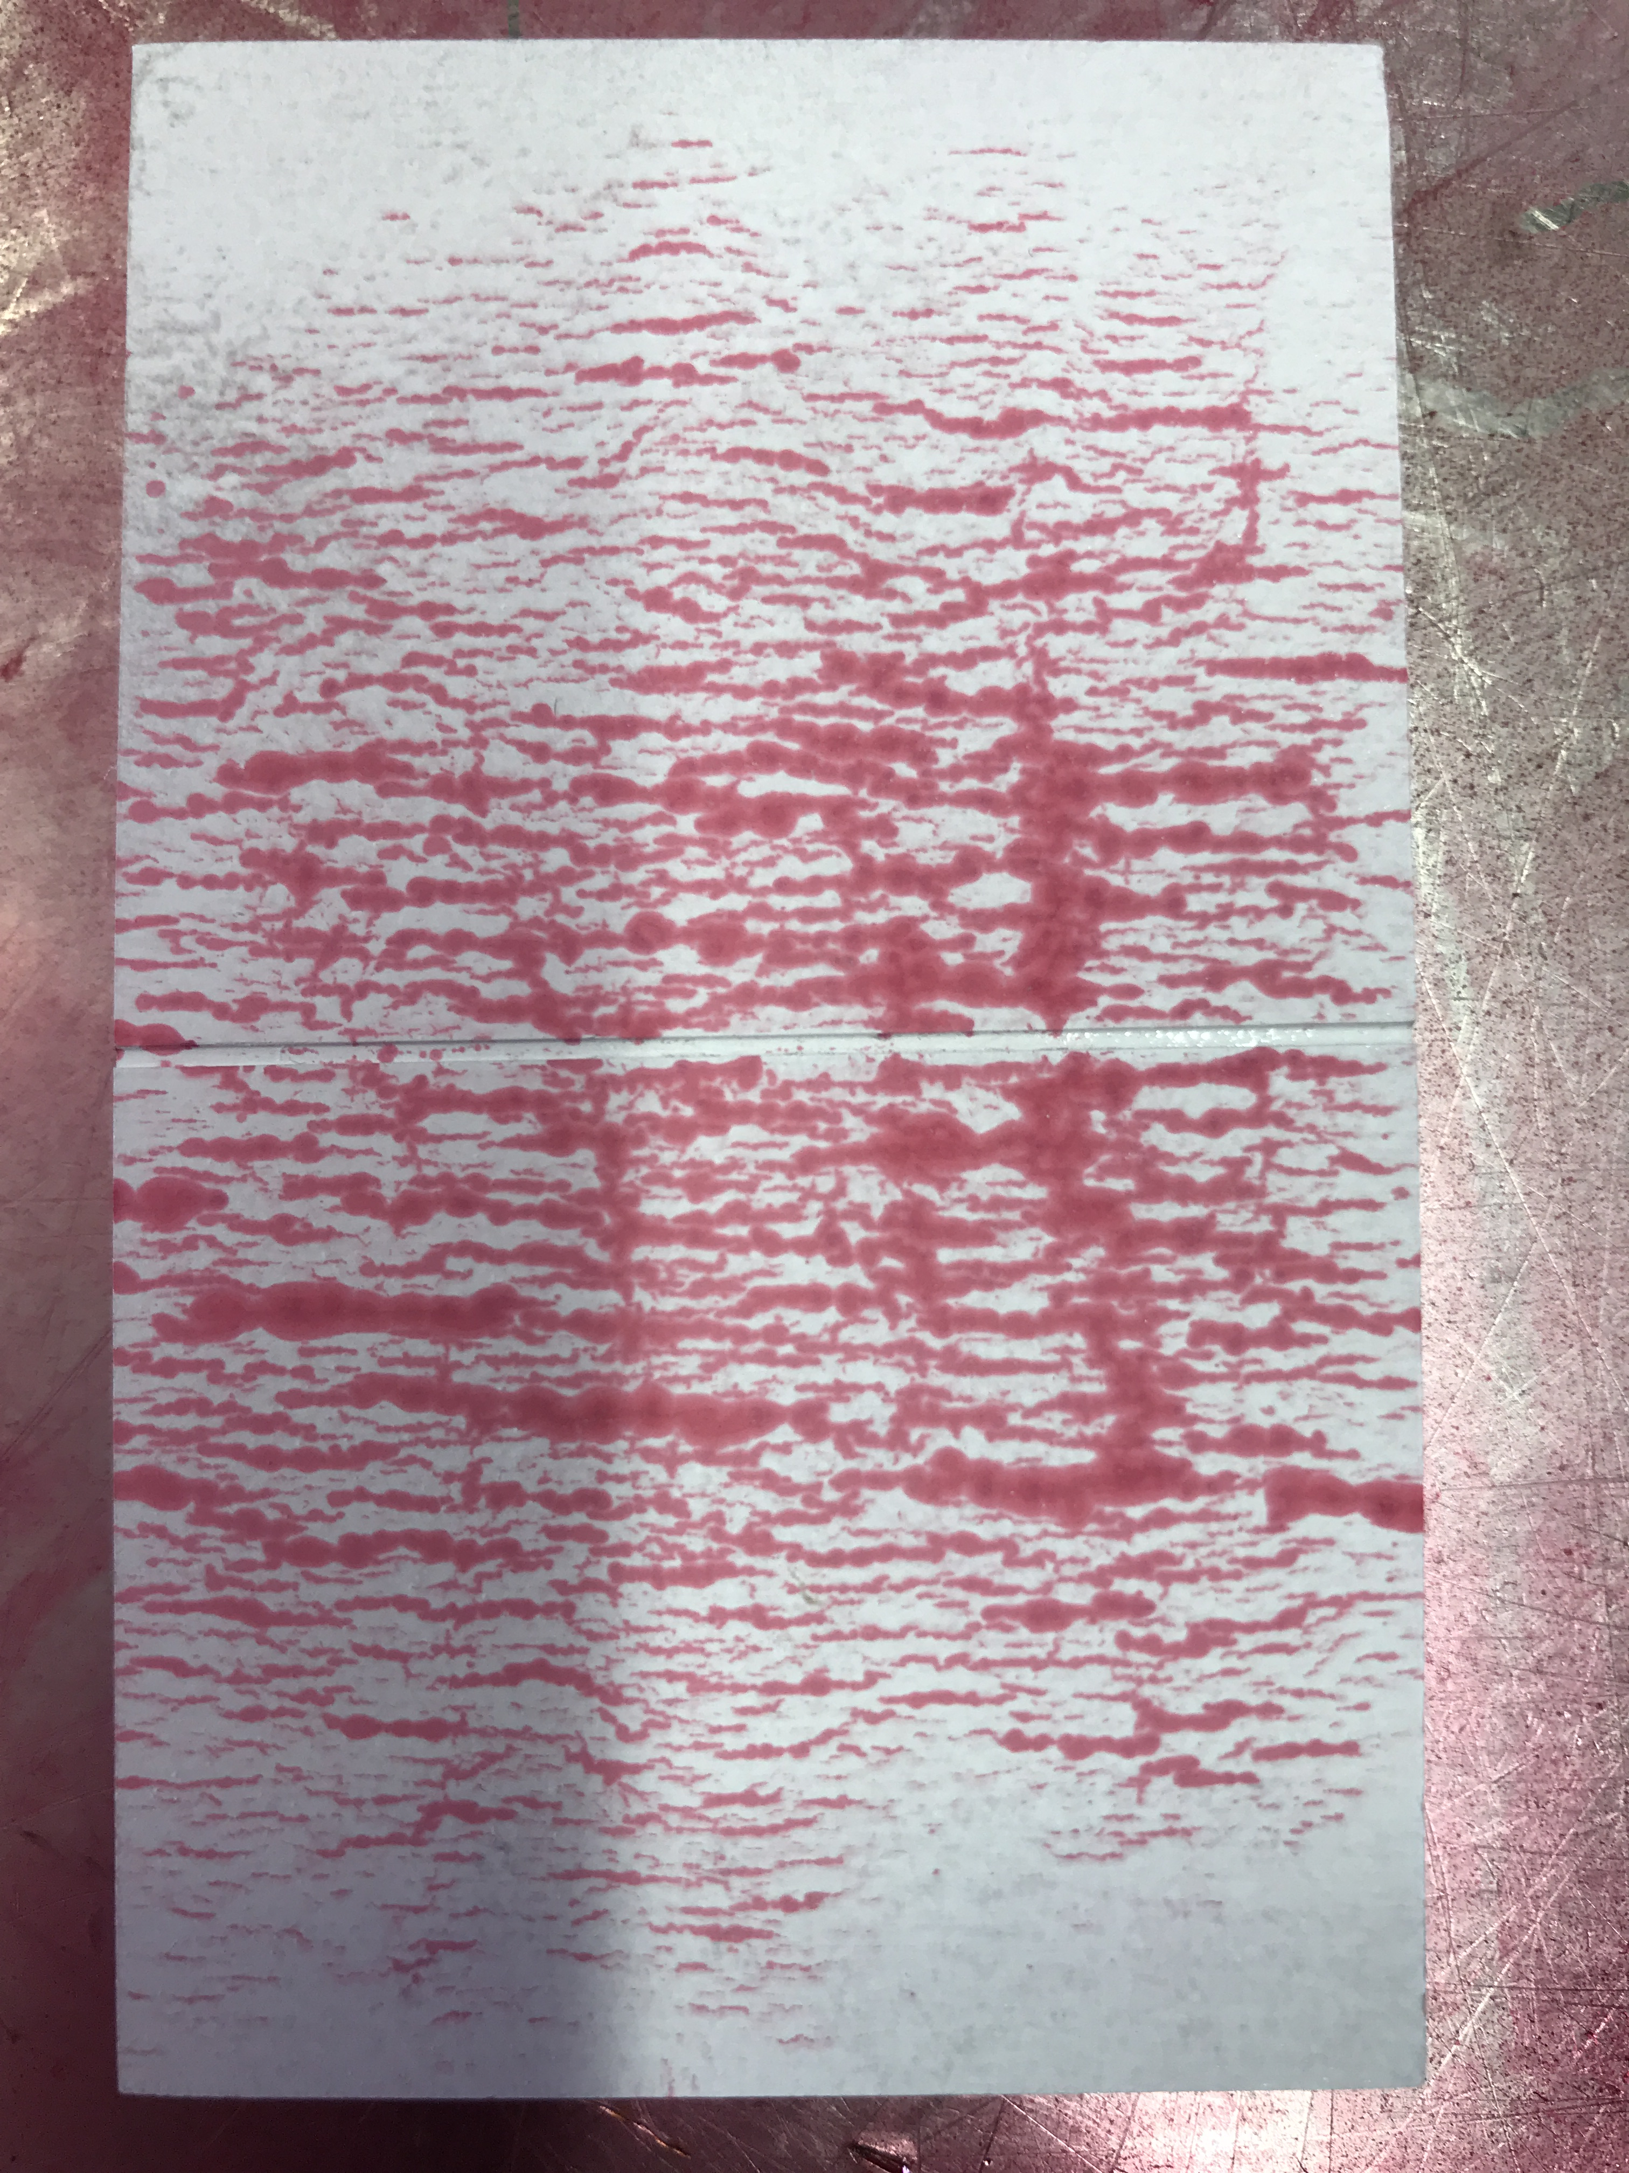
Red Bio Liquid Penetrant indications on test block
Stable and reliable indications’ sizing over time
Penetrant Elite K71B2 BIO red penetrant+ Elite DWS2 developer
Left: 30 s after developement
Right: 5 min after developement
Sensitivity level 2 (same of traditional oil-based penetrants)
Competitor equivalent «B»
Left: 30 s after application
Right: 5 min after application
Competitor’s Fluorescent
particles
Elite Dual-colored
particles
Too much bleed out = generation of false cracks + missing small ones

Slide 10
Safer Products – the BIO line
Elite Bio NDT Products Standard NDT Competitor Products
X
Penetrant and Magnetic Bio products are not flammable, not harmful, not even irritant for the eyes or the skin, not polluting for the environment
GHS02
Flammable
X
GHS07
Xi Irritant
Xn Harmful
X
Environmental Hazard

Slide 11
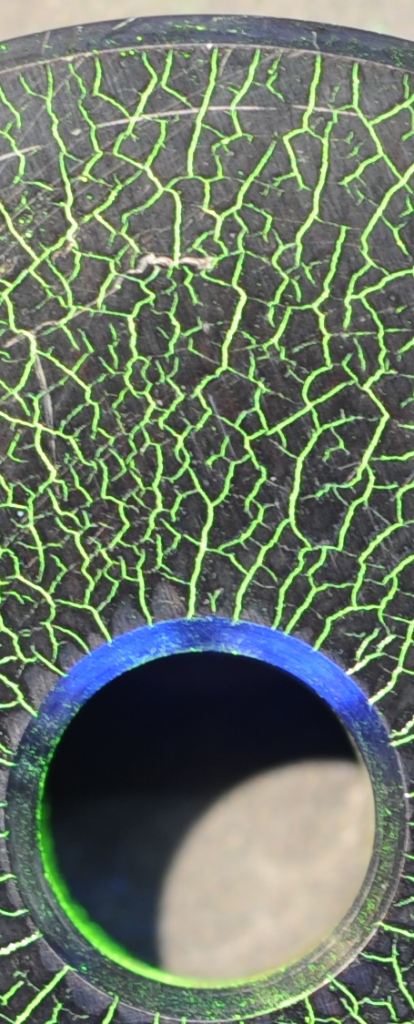
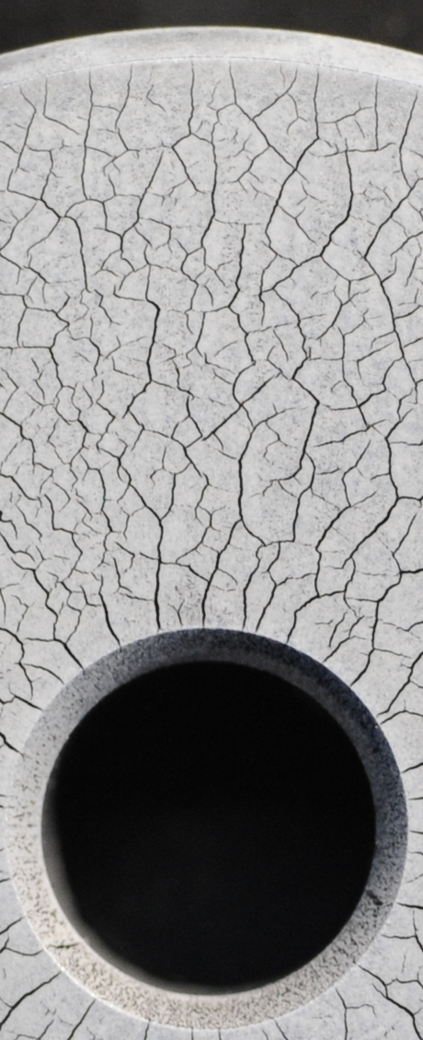
Magnetic testing with our line of Bio Magnetics
Also for magnetic inspection today is available the possibility to use a safer Fluorescent Bio Magnetic product
Cracks with Elite FW1AC Bio
Water Based Fluorescent Magnetic:
No need to apply and remove white contrast paint!
Same Cracks with standard white contrast paint + black magnetic:
Need to apply and remove white contrast paint!

Slide 12
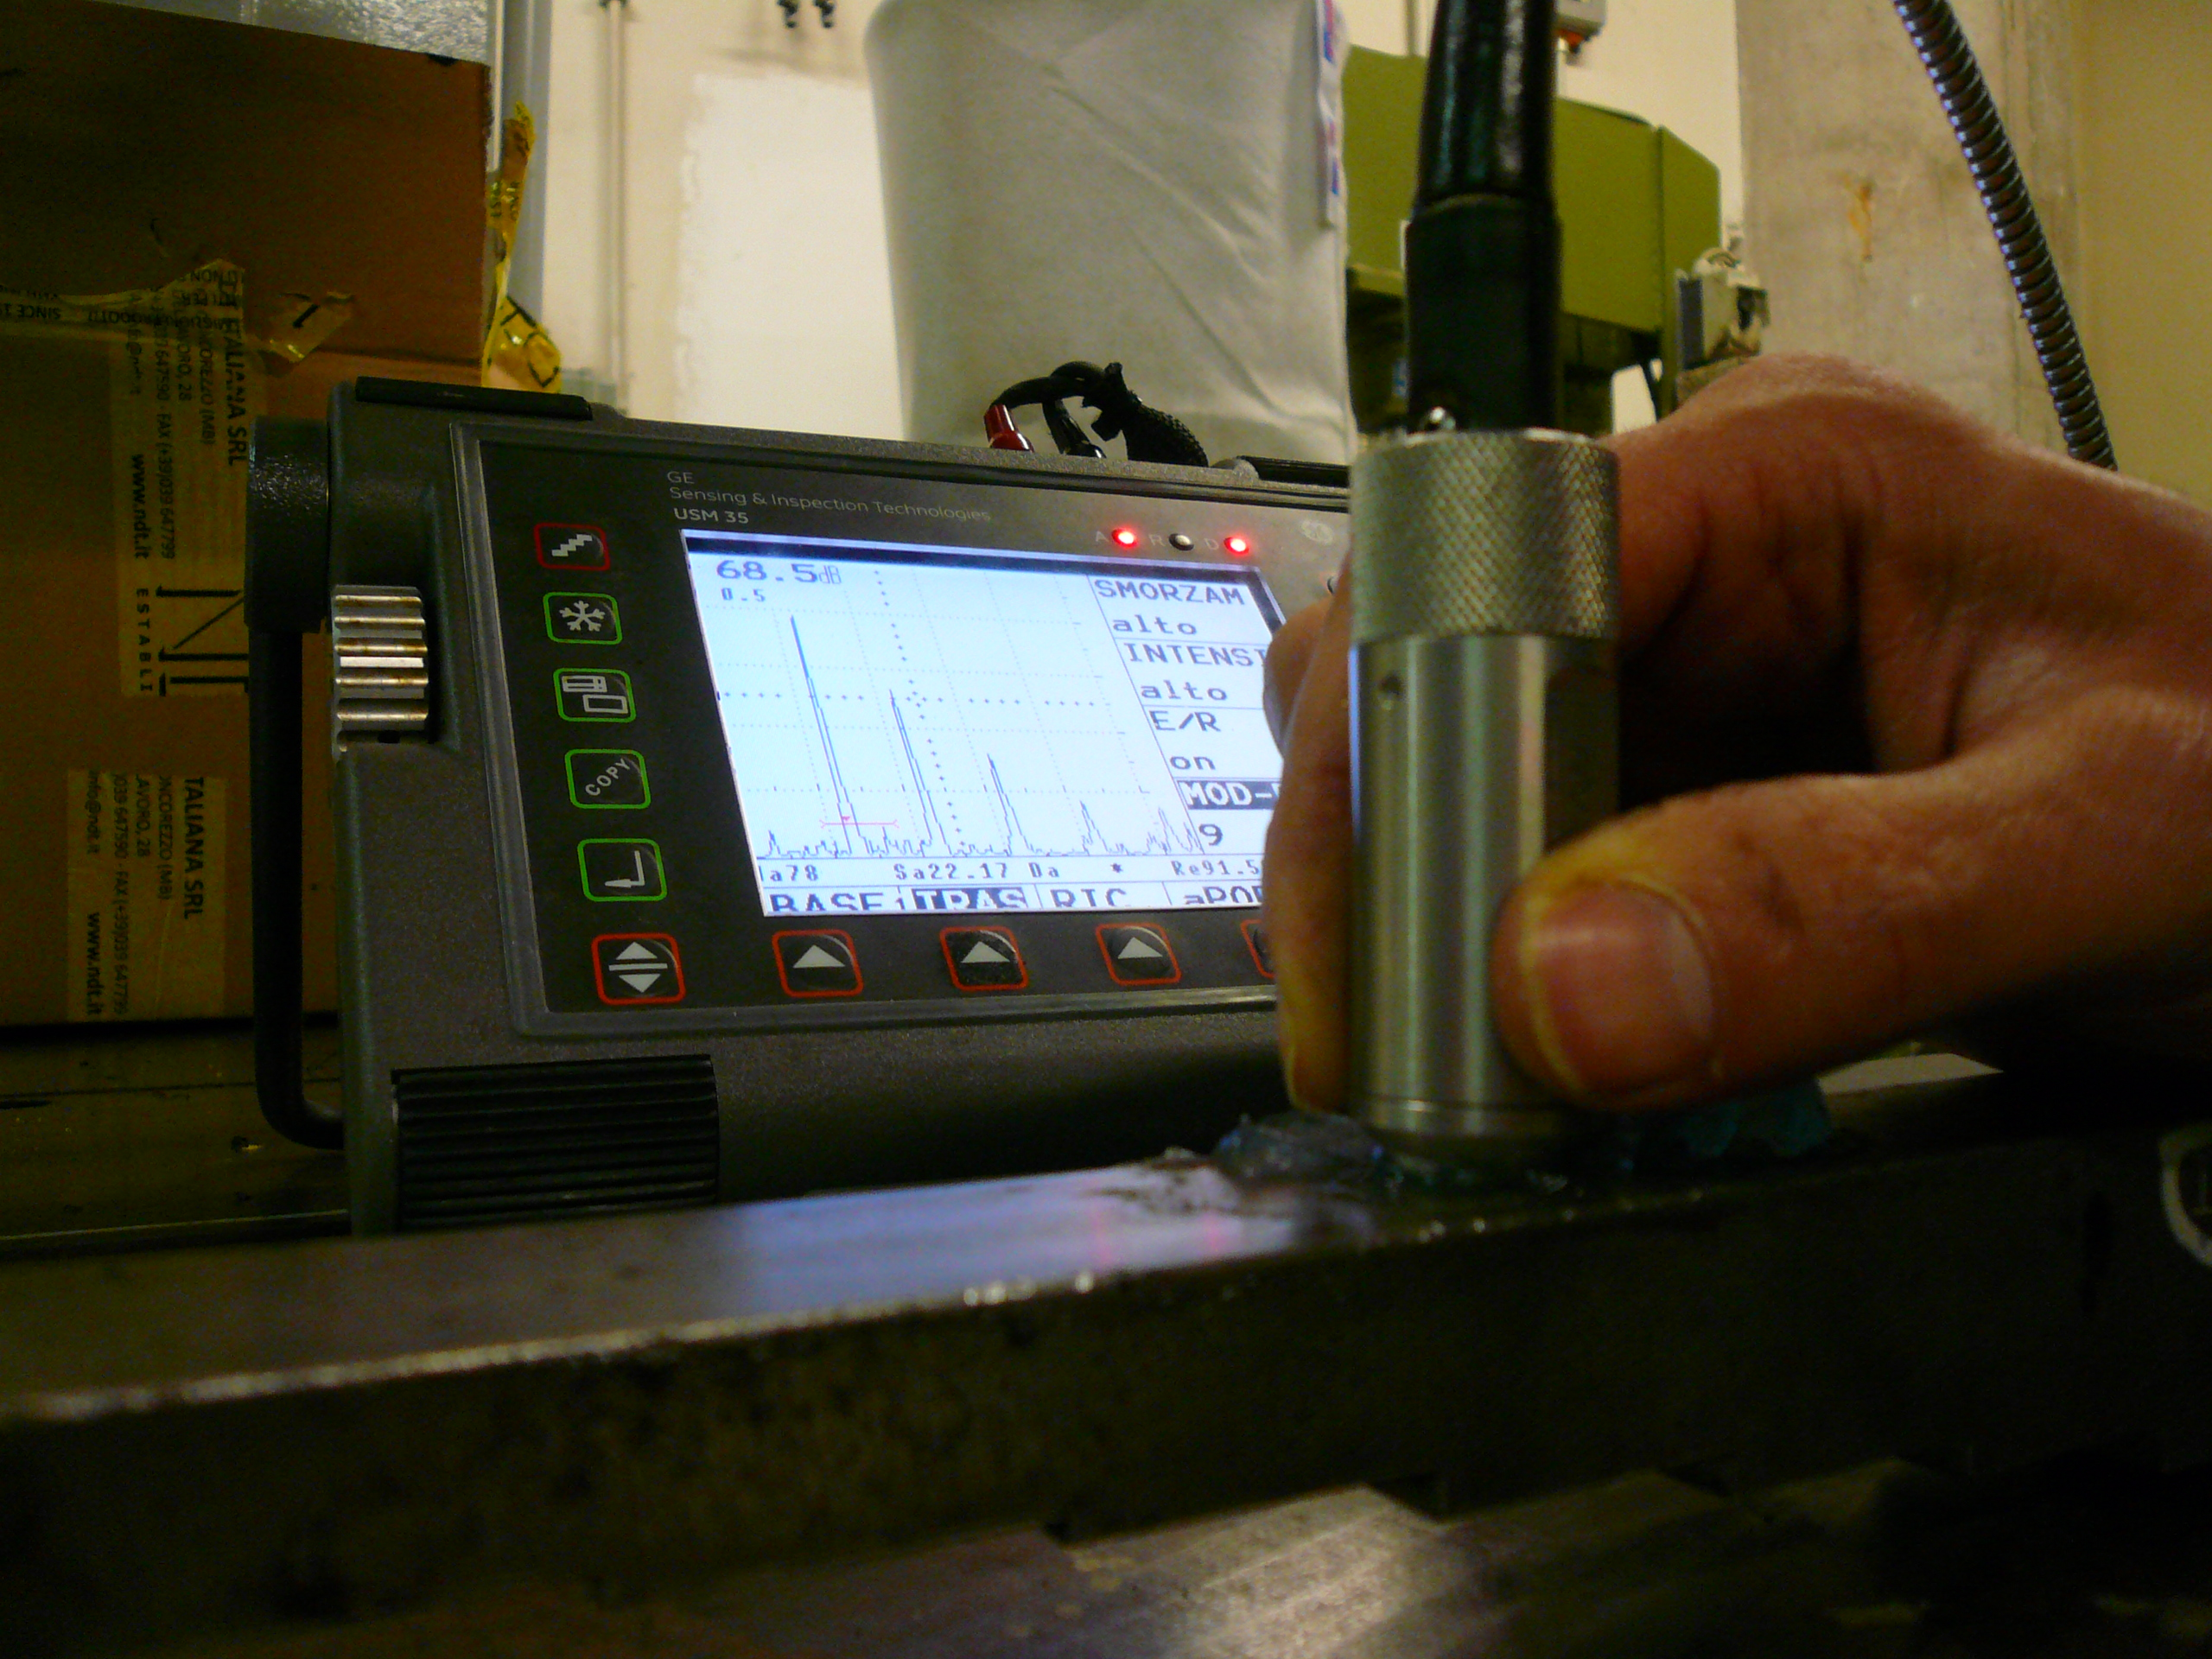
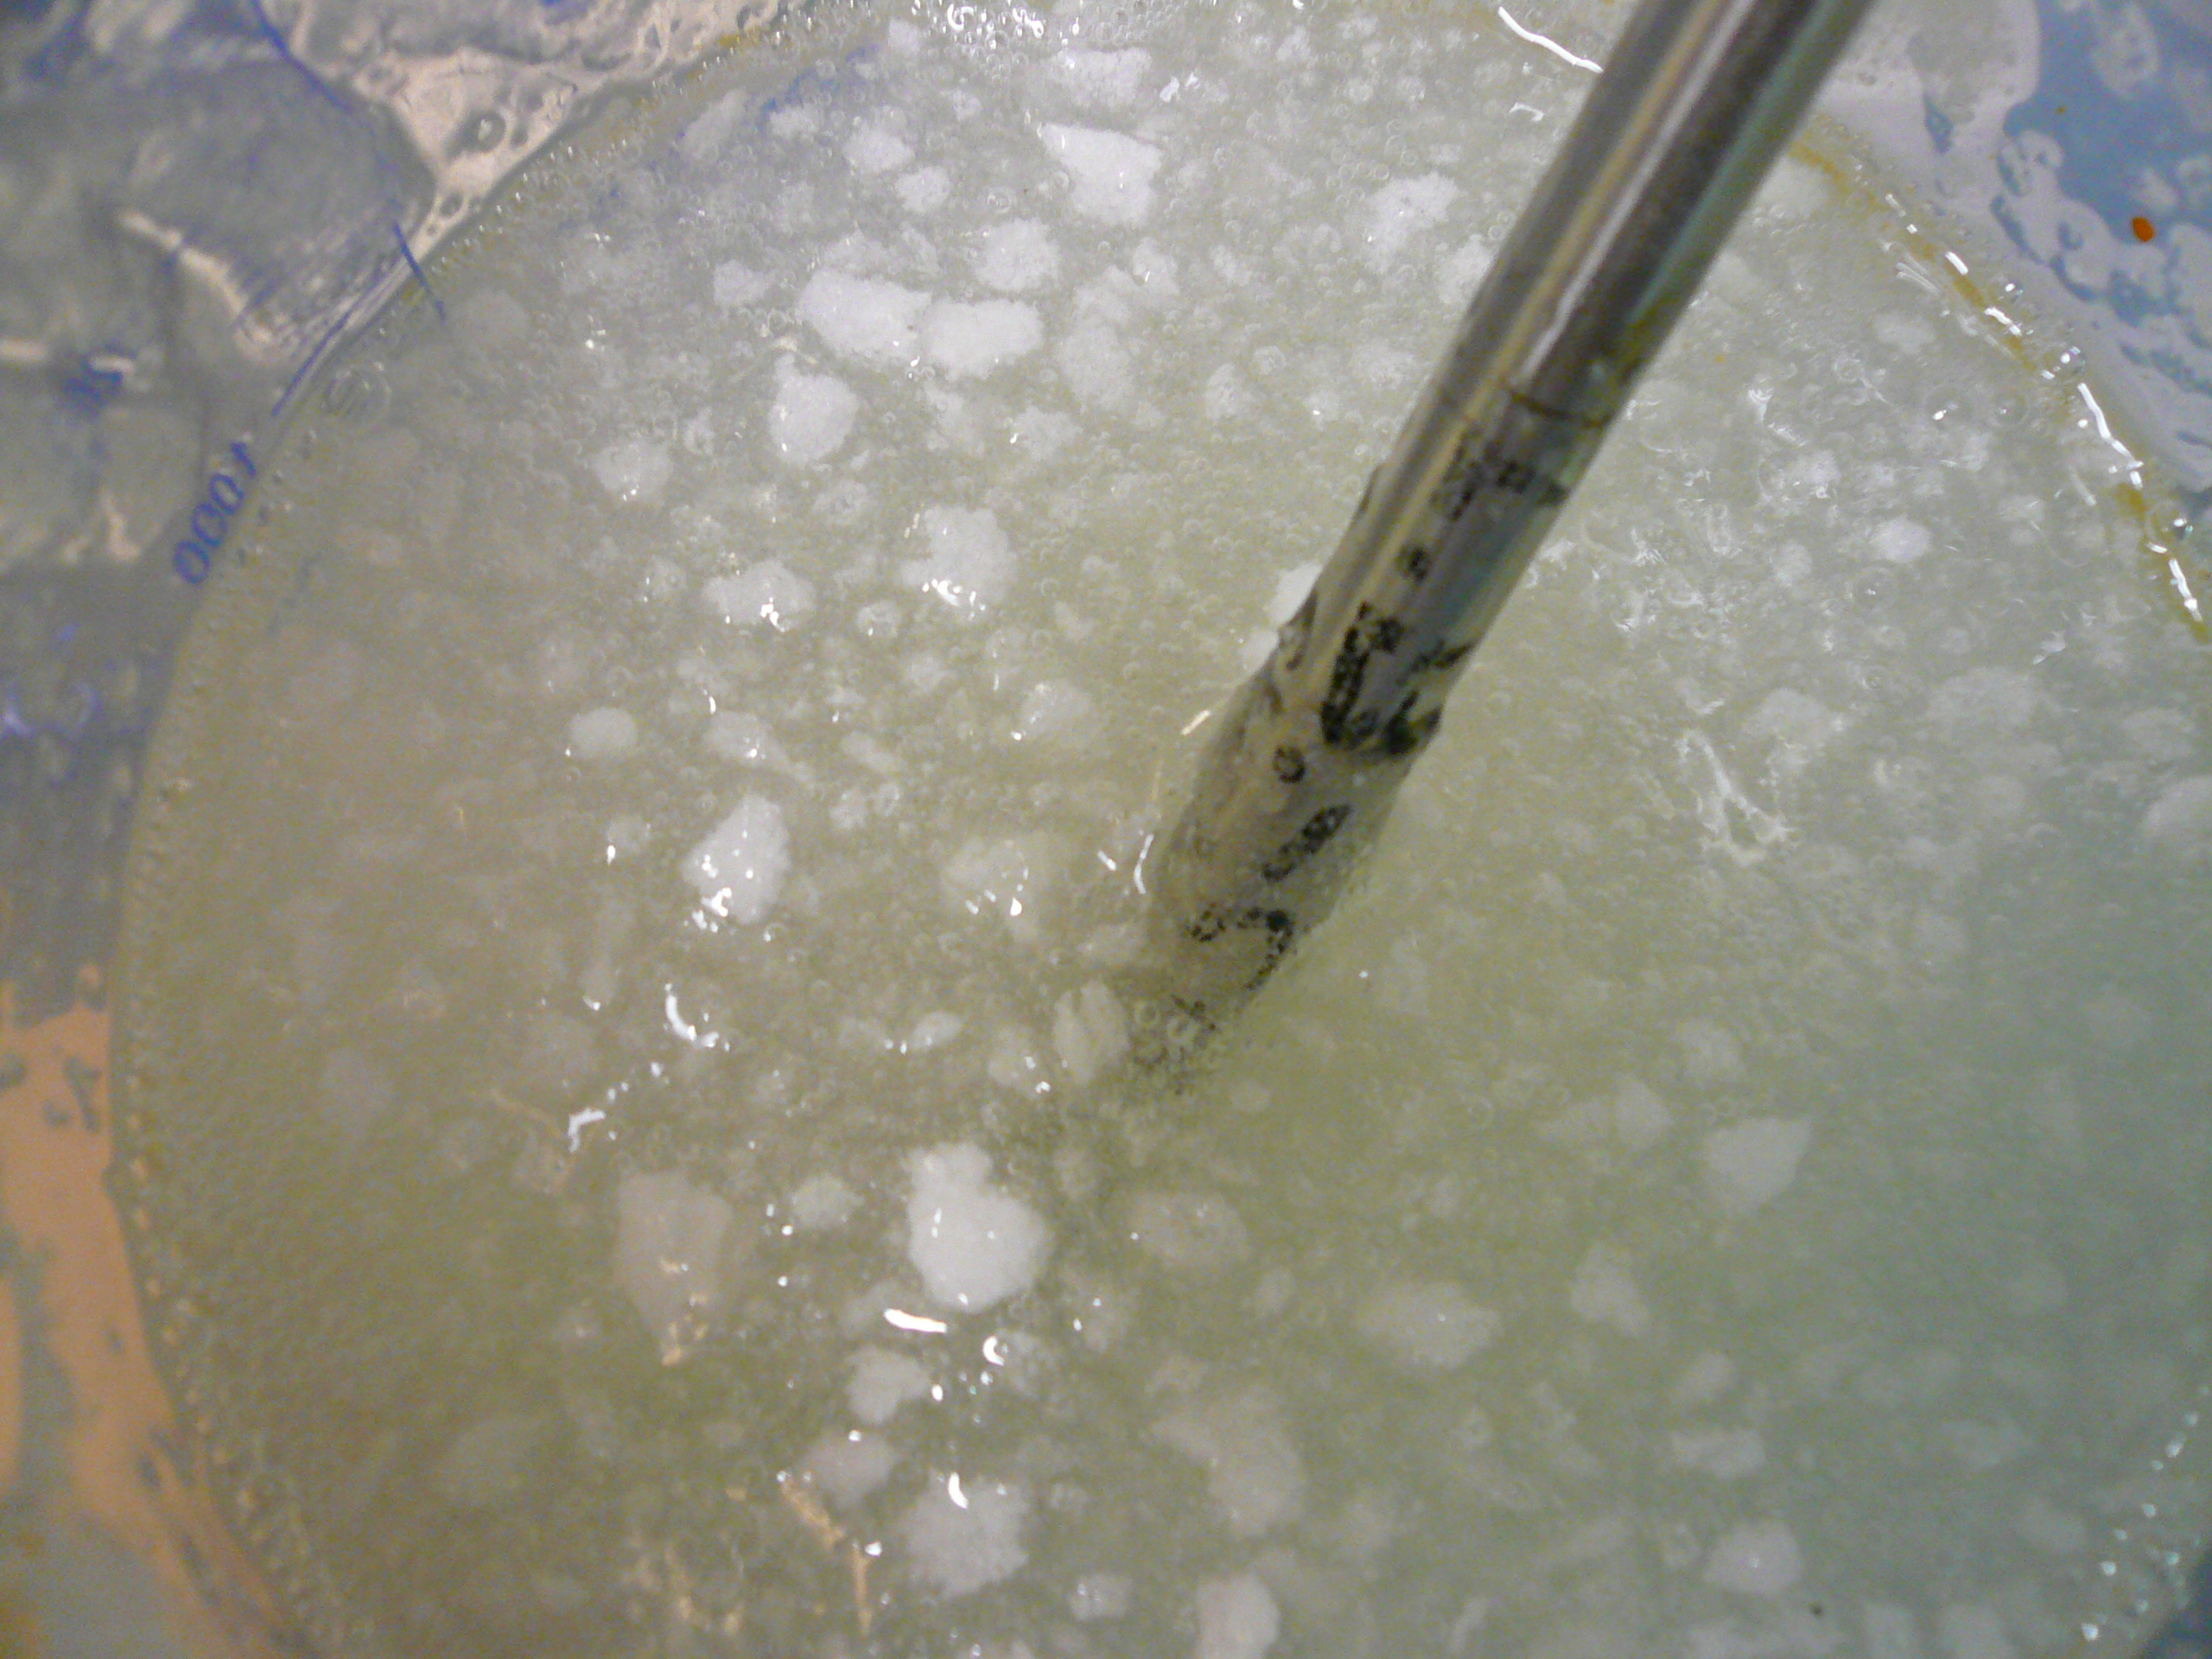
Ultrasonic testing with our line of Bio Couplants
Couplant specific for Ultrasonic Testing
Safe for operator and environment
Fast to apply and remove
Anti-rust protection
Higher quality of the signal (lower background noise): up to +30%
Couplant not specific for Ultrasonic Testing (example: glue, grease, oil…)
No Safety Data Sheet or Certificate of Analysis
Difficult to prepare (see above) and remove
Probe and piece not protected
Lower quality of the signal force the operator to increase the gain with higher background noise

Slide 13
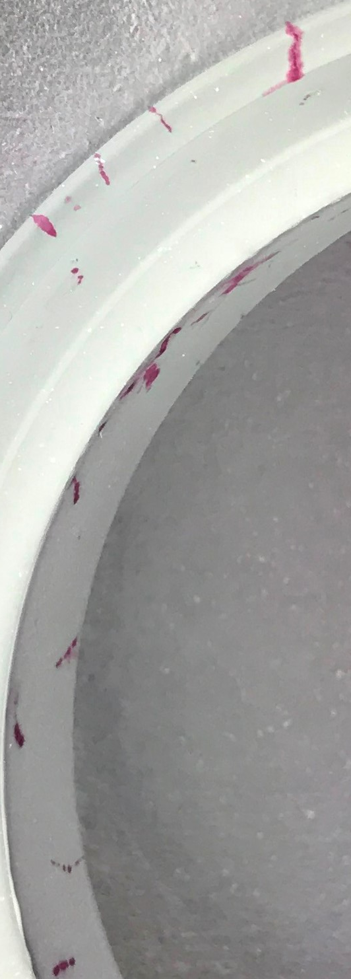
Company case studies in the valve industry
Liquid Penetrant Inspection with Bio penetrants
Large Valve producer for the Oil&Gas Industry
Target: eliminate any risk for the operators and dangerous emissions (VOC volatile organic compounds) during quality inspection of Valves with liquid penetrants and magnetics
Solution: Elite red Bio Penetrant K71B2 and white developer water suspendible Elite DWS2
Easy to apply and economical, uses a compressed air spraying gun (no empty spray cans to dispose of)

Slide 14
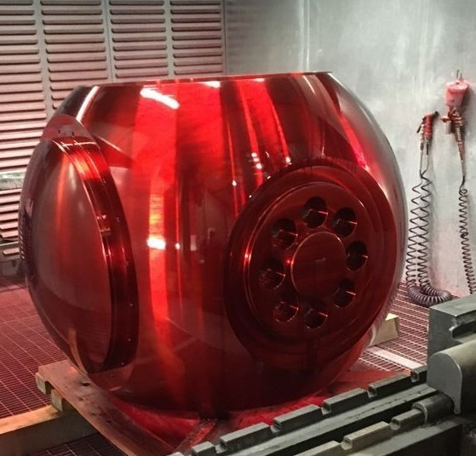
Company case studies in the valve industry
Liquid Penetrant Inspection with Bio penetrants
Large Valve producer for the Oil&Gas Industry
Target: large pieces to be inspected with max operator’s safety and environment care
Solution: water based penetrant Elite K71B2 bio

Slide 15
Company case studies in the valve industry
Liquid Penetrant Inspection with Bio penetrants
Large producer for the Oil&Gas Industry
Target: use only water based risk free products to improve to sustainability profile of the Company
Solution: water based penetrant Elite K71B2 bio and Elite DWS2 white developer
Application tutorial

Slide 16
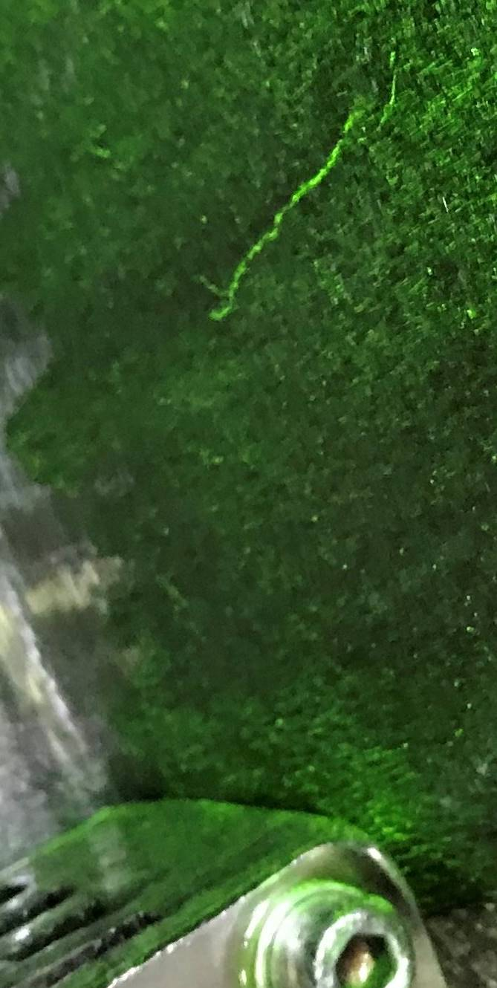
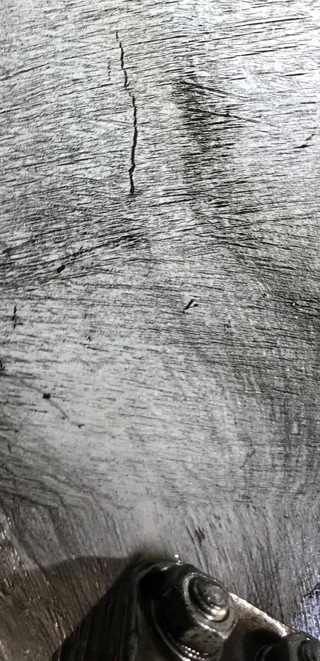
Company case studies in the valve industry
Magnetic Particles Inspection with Bio magnetics
Large Valve producer for the Oil&Gas Industry
Target: eliminate any risk for the operators and dangerous emissions (VOC volatile organic compounds) during quality inspection of Valves with liquid penetrants and magnetics
Solution: Elite Bio Fluorescent Dual Magnetic particles FW1AC
No risk for the operator or the environment, economical and fast: no need to apply and then remove the white contrast paint!

Slide 17
Q & A SESSION
ORGANIZERS
SCIENTIFIC COMMITTEE
Thank you for your attention!
IVS 2022
Technical Conference

