Slide 1
Giovanni Bettega
ORGANIZERS
SCIENTIFIC COMMITTEE
Simone Mandelli
Chief Technical Officer @ Solvo srl
General Manager @ Solvo srl
Advanced meshing techniques and their application on complex valve geometry components - Case study on Valves Subcomponents
IVS 2022
Technical Conference

Slide 2
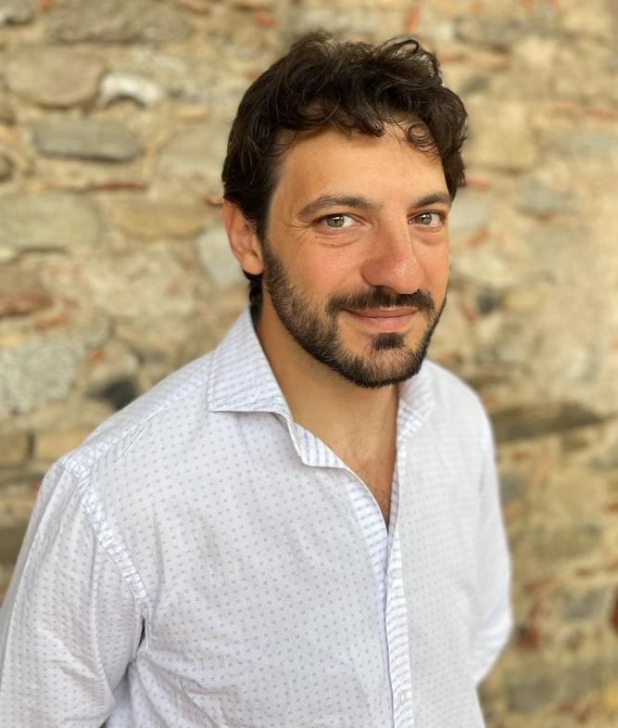
Biography
Eng. Giovanni Bettega
M.Sc. in Nuclear Engineering at Politecnico di Milano
PhD –Physics at Università degli Studi di Milano
More than 15 years of experience in FEA/CFD simulation, research project and technical consulting \
Eng. Simone Mandelli
M.Sc. in Engineering at Politecnico di Milano
PhD – Civil Engineering at Politecnico di Milano
More than 10 years of experience in FEA/CFD simulation, research project and technical consulting

Slide 3
Outline
Introduction
Solvo Srl – Company profile and mission
Criticalities of complex geometry meshing
Why meshing of valve subcomponents is more and more critical
Case study on Valves Subcomponents
Q&A session

Slide 4
Introduction

Slide 5
About us: Company profile
Solvo Srl is an Italian start-up based in Milan, will provide an innovative software for Finite Element Analysis and all related supporting activities.
MISSION:
SOLVO aims to support partners providing an advanced simulation tool able to guarantee the highest technological level
WHAT WE DO:
The company is developing a software able to perform simulation using a set of Open-Source solvers. The software will be soon released to the market.
Customized software solution
Technical consultancy activities

Slide 6
Criticalities of complex
geometry meshing

Slide 7
Meshing of critical geometries
Why meshing of valve subcomponents is more and more critical
Valves are more and more subjected to higher pressure or thermal stresses
Pressure up to 20000 psi – Cryogenic or high temperature – Vacuum
New production technics, like Additive manufacturing, are introducing more critical geometries and surfaces
Finite Element Analysis are used more and more to prevent testing failures
Raw material costs are pushing valve manufacturers to guarantee excellent performances with lither valves meaning thinner subcomponents
Some example of critical mashing and boundary layer application

Slide 8
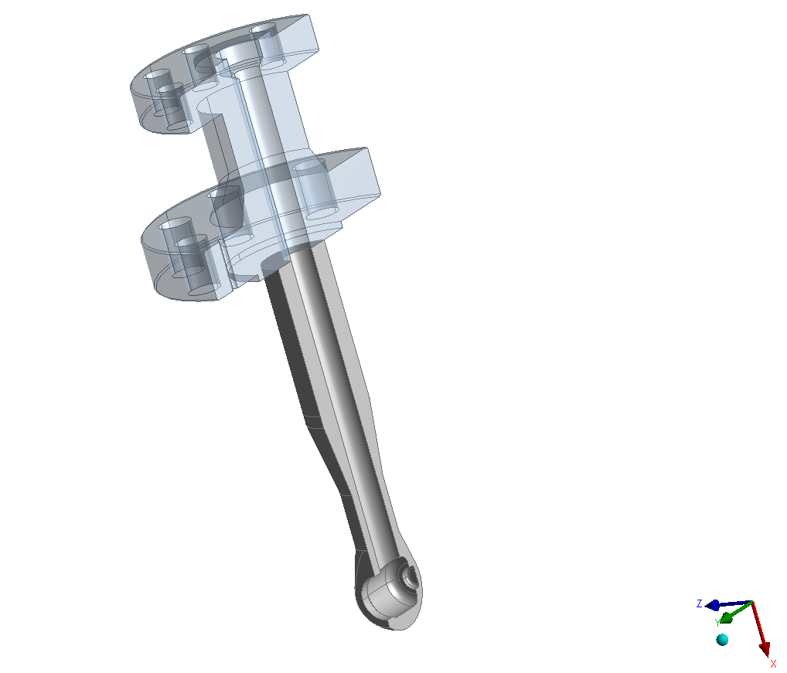
Application and Example
Thermo-mechanical fatigue / high thermal gradient
Coating
Use meshing to properly capture
Physical phenomena, in these example by means of
Boundary layer

Slide 9
Boundary Layer application – Example 1
Thermal Shock on desuperheater – Fatigue analysis
Asses the fatigue behavior along the service life according to ASME VIII Div.2
Thermal shock is considered – no gradual transition
Loading cycle on DSH
Description | Time | Steam |  | Water
 | t [min] | T [°C] | Q [kg/s] | T [°C] | Q [kg/s]
Initial condition | 0 | 524.2 | N/A | N/A | N/A
Loading cycle | 1 | 524.2 | 58.48 | 123.8 | 1.27
 | 10 | 524.2 | 58.48 | 123.8 | 1.27
 | 30 | 524.2 | 58.48 | 123.8 | 1.27

Slide 10
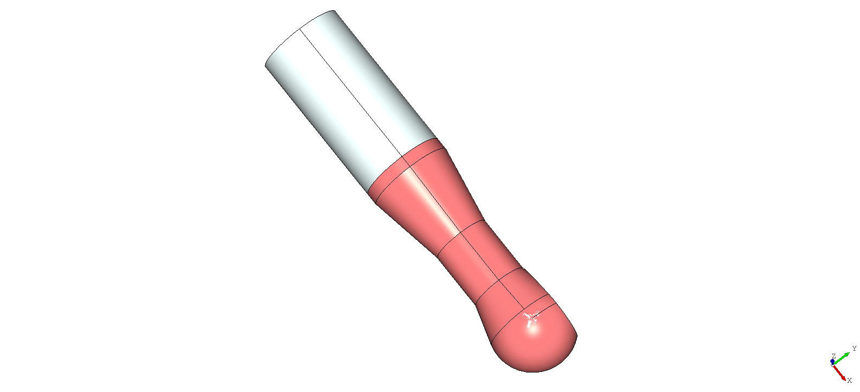
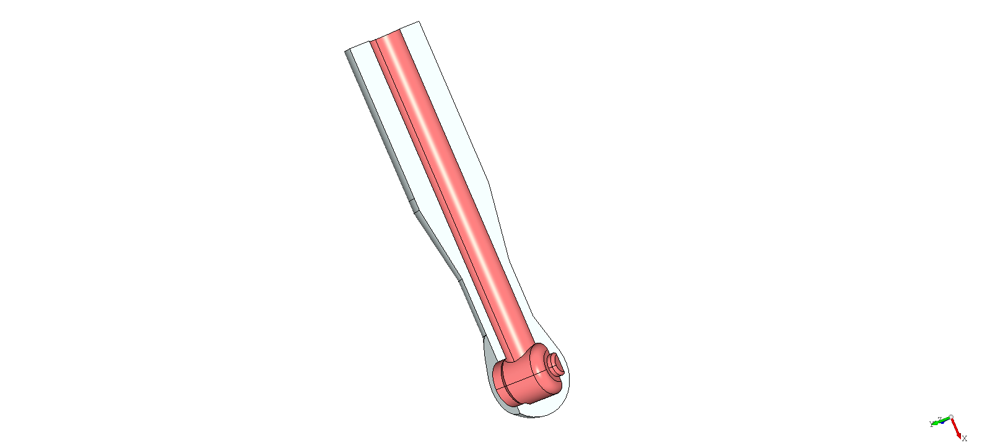
Boundary Layer application – Example 1
Thermal Shock on desuperheater – Main boundary conditions
Forced convection with hot steam
Water flow inside DSH – Convection with cold water

Slide 11
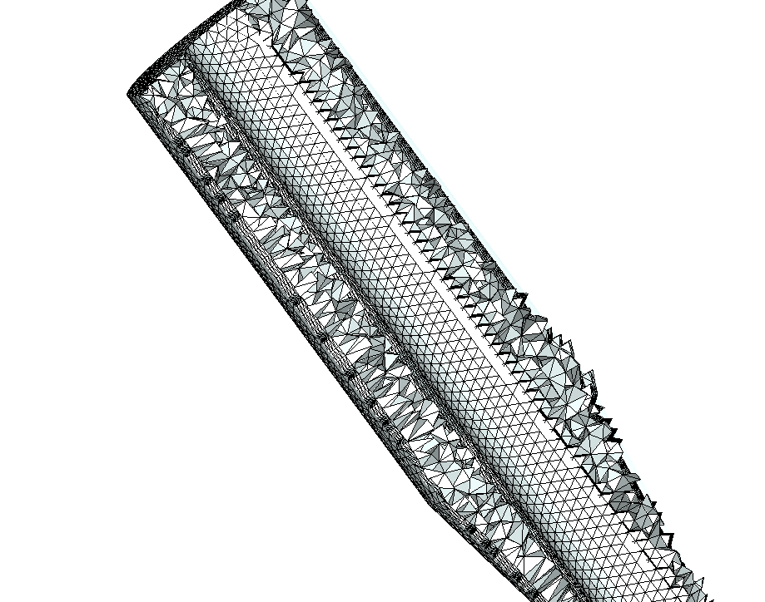
Boundary Layer application – Example 1
Mesh
Boundary layer used to capture thermal gradient
Prismatic boundary layer with tethadreal mesh (pre-algo with netgen)
4 prismatic layer of 0.5mm
35000 nodes and 188571 elements
Section view – internal mesh

Slide 12
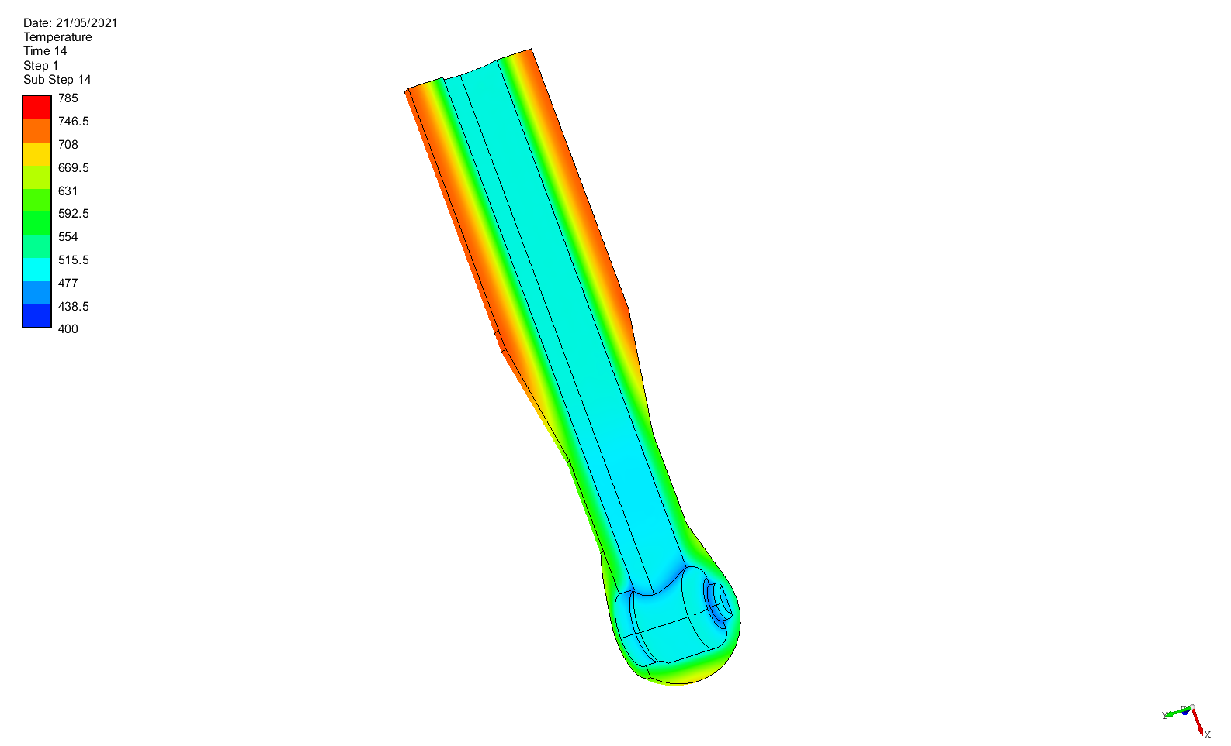
Boundary Layer application – Example 1
Thermal gradient
- Calculation of thermal history until steady state condition is reached
Section view – Temperature

Slide 13
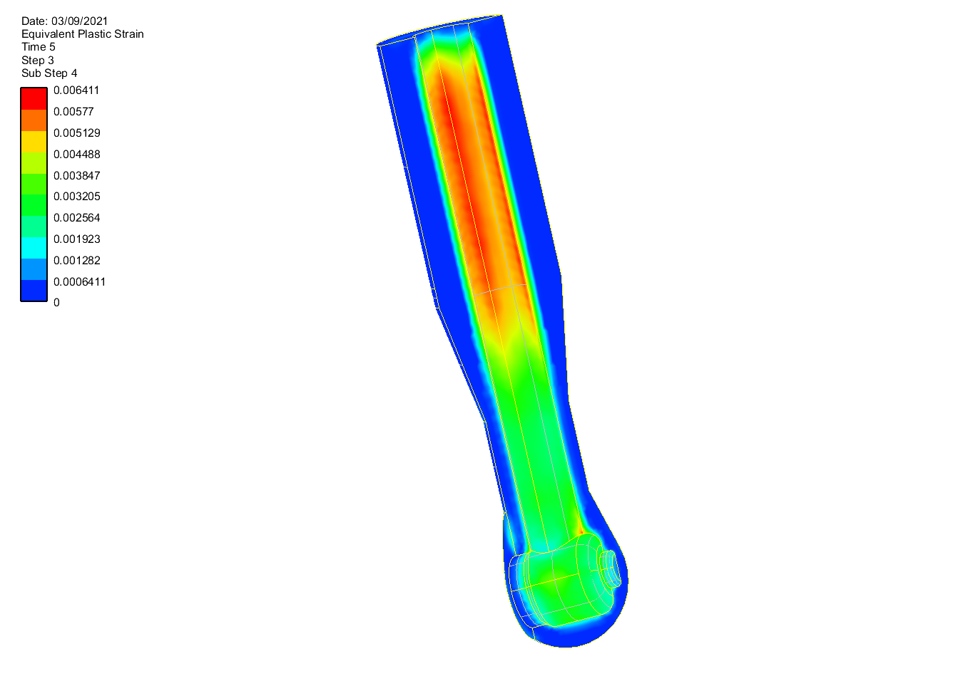
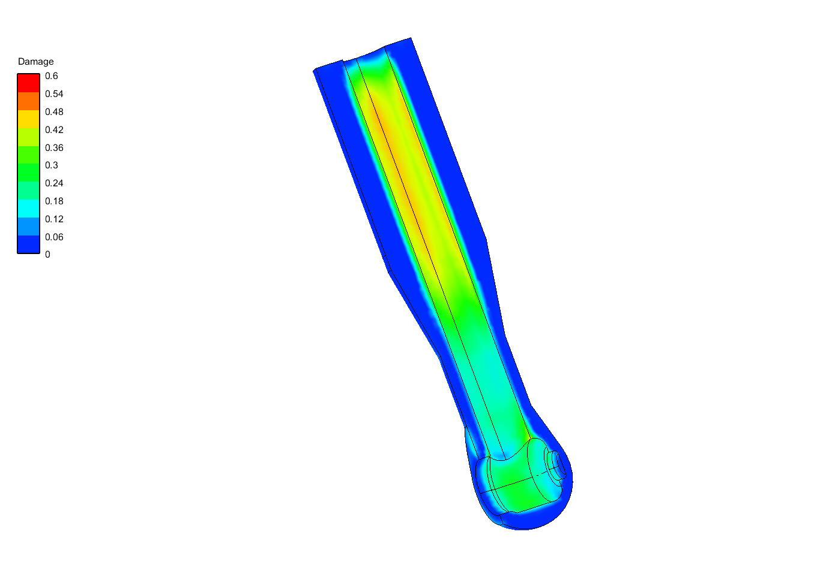
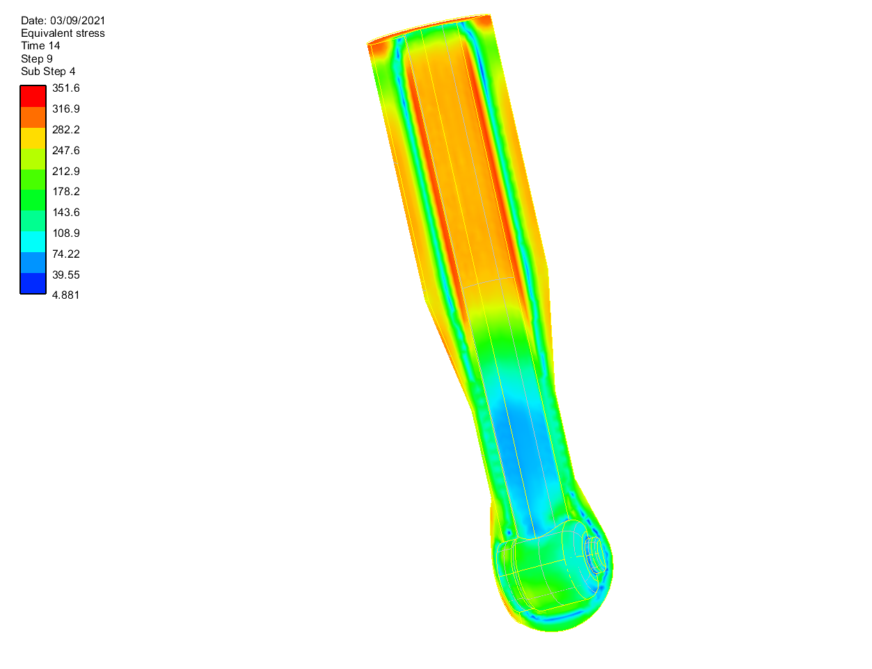
Boundary Layer application – Example 2
Damage calculation
Stress-strain history analysis for fatigue calculation
Damage index computation through Twice Yield Method
Section view – Von Mises Stress , Plastic Strain , Damage index

Slide 14
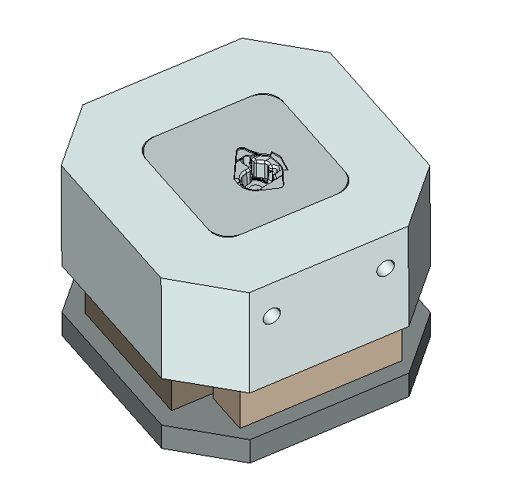
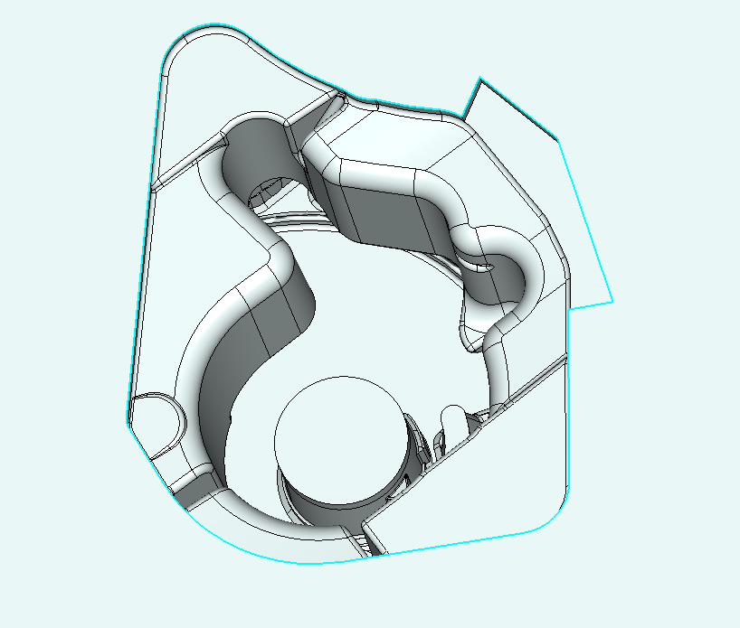
Boundary Layer application – Example 2
Thermo-mechanical fatigue on casting die
Need to catch high thermal and stress gradient within a small thickness
Boundary layer strategy for obtain a good balance between mesh nodes and computational effort
Very corrupted geometry – no geometric defeaturing used

Slide 15
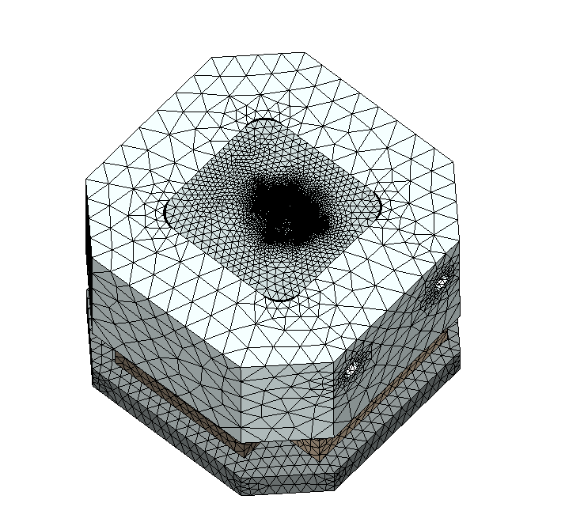
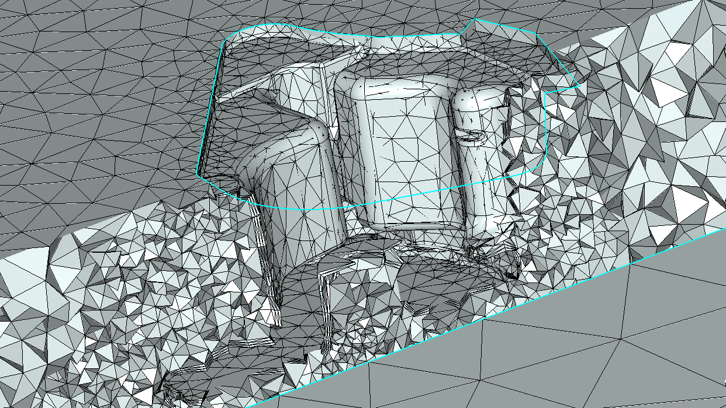
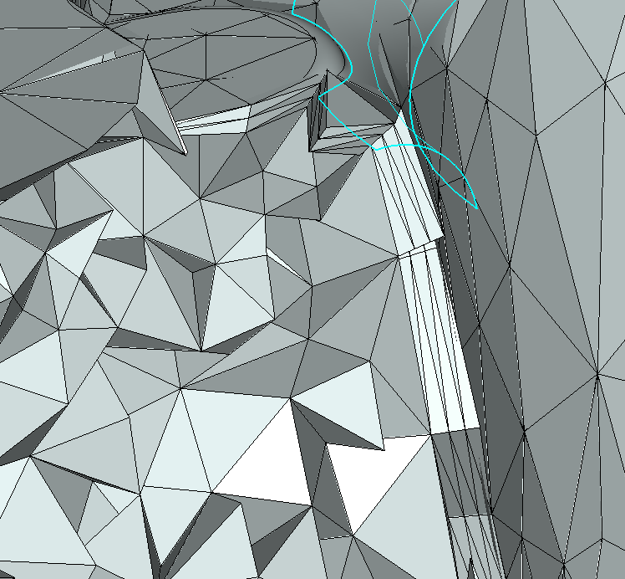
Boundary Layer application – Example 2
Mesh
Boundary layer used to capture thermal gradient
Tetrahedral boundary layer with tetrahedral mesh (Post algo with Tetwild)
Mesh – 240444 nodes

Slide 16
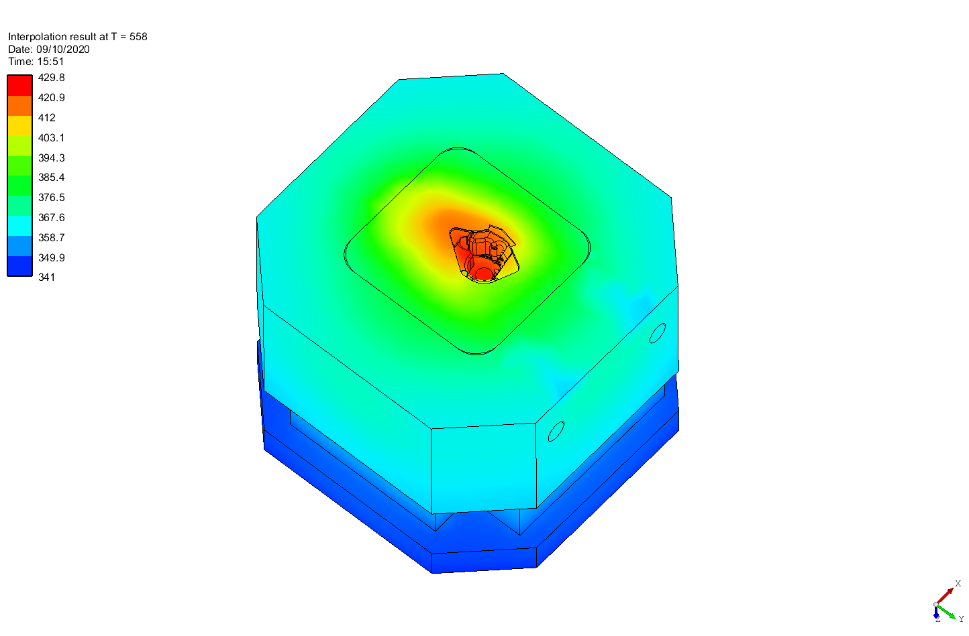
Boundary Layer application – Example 2
Thermal analysis
Fatigue calculation:
Thermal cyclic loading
Inner pressure
Temperature

Slide 17
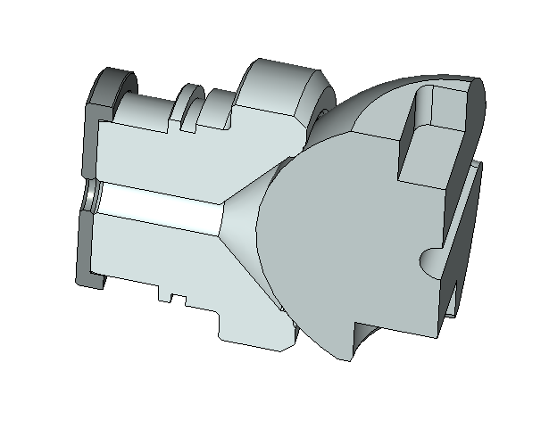
Boundary Layer application – Example 3
Seat-Ball contact analysis
Insert coating material on seat and ball
Coating is modeled by a prismatic mesh layer
No need of geometric pre-processing

Slide 18
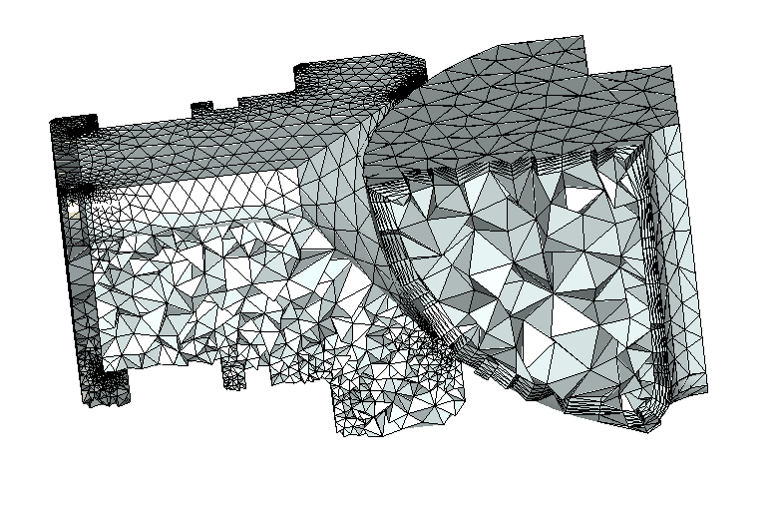
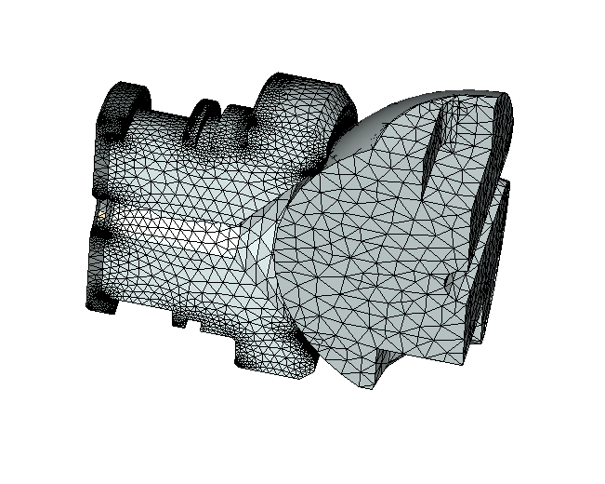
Boundary Layer application – Example 3
Coating
Define coating thickness and automatic generation

Slide 19
Q & A SESSION
ORGANIZERS
SCIENTIFIC COMMITTEE
Thank you for your attention!
IVS 2022
Technical Conference

