Slide 1
Alberto Morini, Simone Volpi
ORGANIZERS
SCIENTIFIC COMMITTEE
Fondinox S.p.A.
Castings Production of SDSS with high wall thicknesses
IVS 2022
Technical Conference

Slide 2
Biography
 | Alberto Morini | General Manager – Fondinox S.p.A.
 | Bio | He was born in Milano in 1950, where he lives today.
 | Previous | Researcher at Politecnico di Milano from 1975 to 1990
 | Education | Politecnico di Milano – PhD Politecnico di Milano – Nuclear Engineering
 | Experience | Has held the role of General Manager in the family owned and operated company since 1990.
 | Simone Volpi | Metallurgist– Fondinox S.p.A.
 | Bio | He was born in Lodi in 1994, where he lives today.
 | Education | Politecnico di Milano – Bachelor Degree in Materials Engineering
 | Experience | Works as a production engineer and metallurgist in Fondinox since 2018.

Slide 3
Summary
Introduction – Aim of the work
Case History 1 (Globe Valve)
Case history 2 (Ball Valve)
Conclusions

Slide 4
Introduction
Authors: M. Bosatra, S. Morini, A. Polonini, S. Volpi – Fondinox S.p.A.
The production of superduplex castings with high wall thicknesses (>200mm) has always been considered with some skepticism by the market, especially in the valve industry.
In this presentation, two examples of SDSS valves with thicknesses up to 270mm are examined. It is possible to reach more than satisfactory values of physical and mechanical properties, without loosing the real advantage of a product coming from a wooden pattern: the possibility to reduce costs thanks to free geometrical shape and consequent weight minimization, which in a moment of very high raw material costs, assumes a remarkable importance.
This is basically achieved through four concomitant factors:
- Deep metallurgical knowledge of SDSS
- Adequate production equipment
- Strict adherence to operating procedures, which describe the process
- Possibility of having a staff highly trained by the continuous production of these particular items.

Slide 5
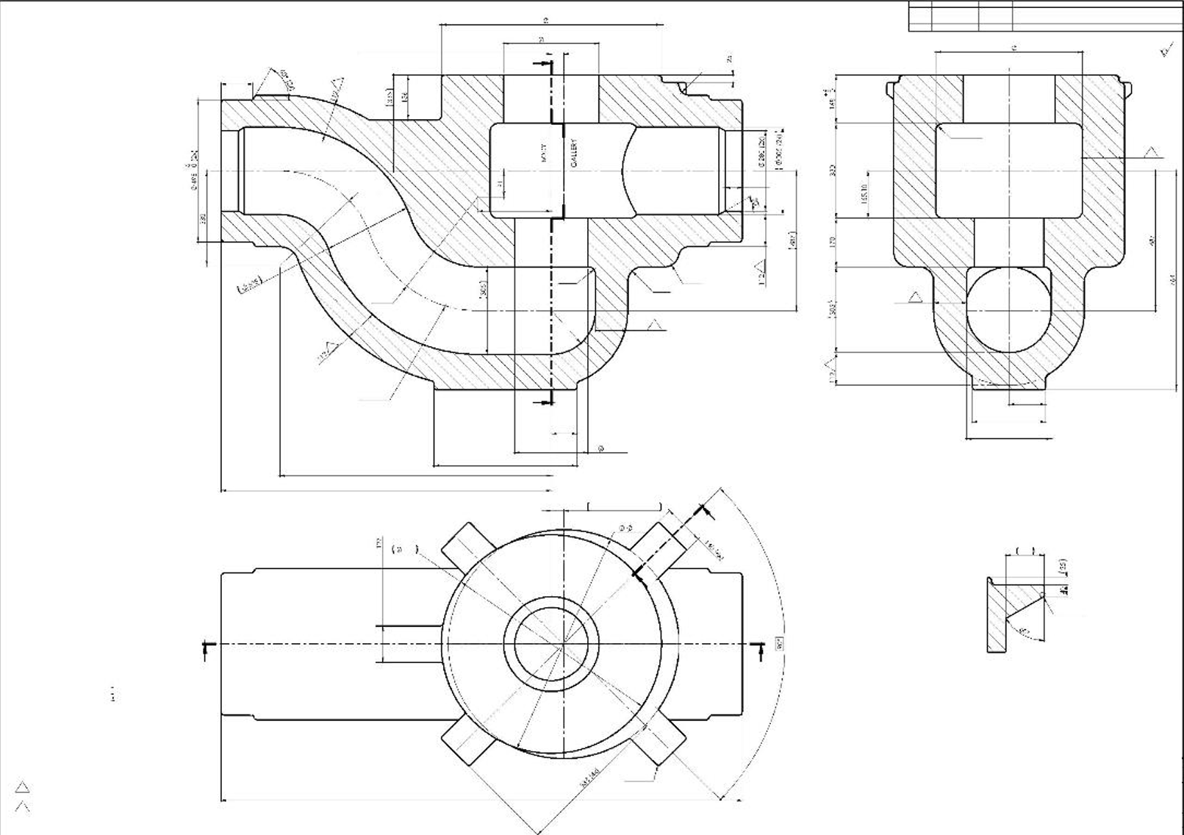
CONTROL VALVE BODY 14”X14 ” ASME 2500
No. 2 globe valve bodies
Material: ASTM A995 GR 6A
Net Weight: 3850 Kg
Thickness: 250 mm in seats area

Slide 6
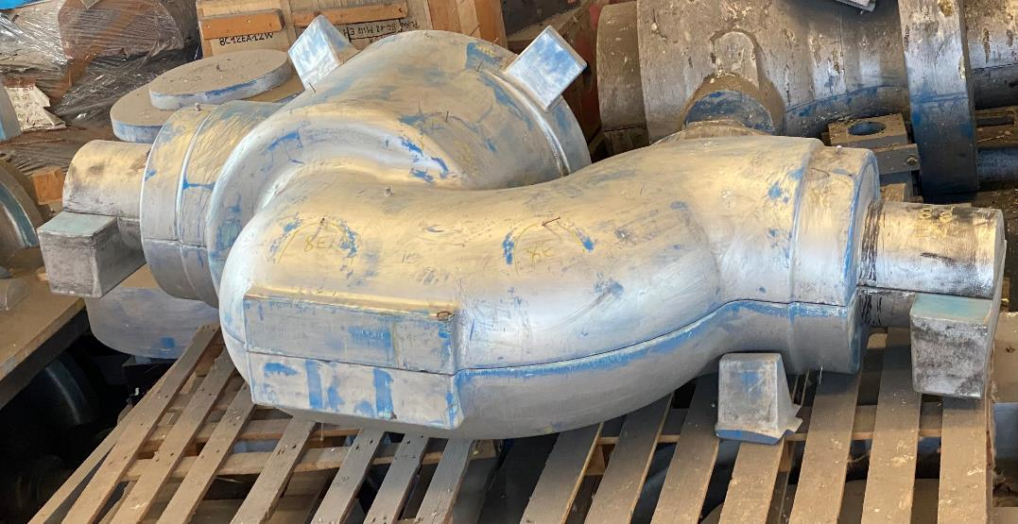
Pattern
Produced in strict accordance with ISO8062-3 for what regards dimensional tolerances and machining allowances.
General shrinkage coefficient 2.5% variable in some critical areas.

Slide 7
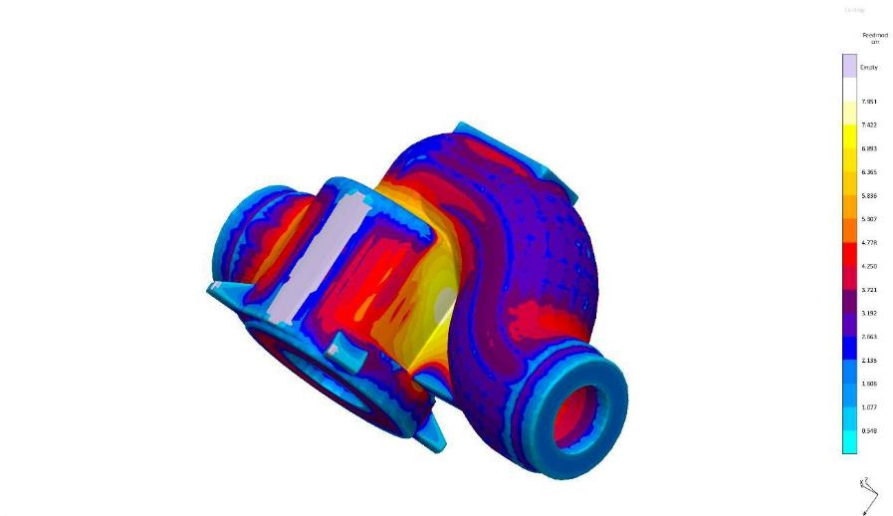
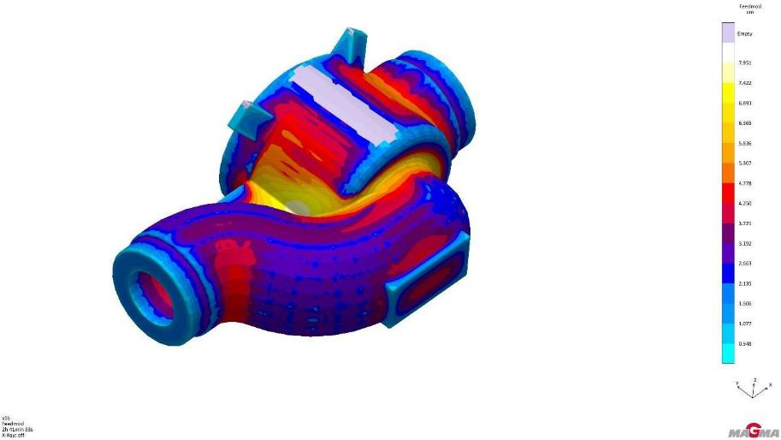
Simulation of solidification using MAGMASOFT
A simulation without any casting device has been carried out, and the “Feedmod” feature has been observed, in order to have an accurate map of thermal module of part.

Slide 8
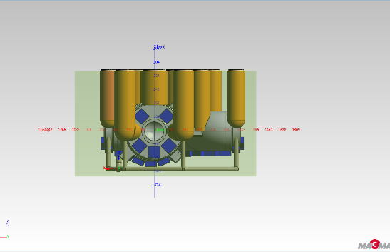
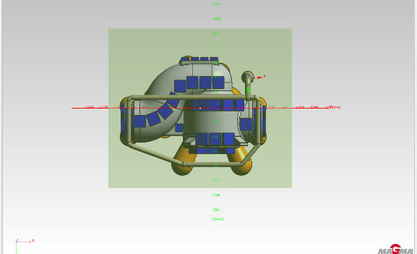
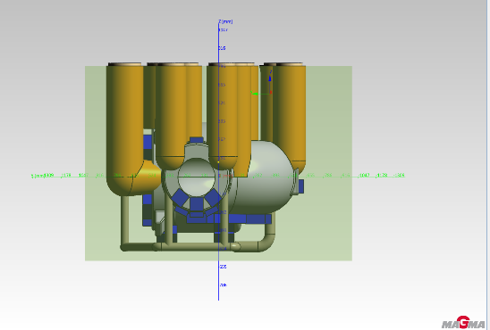
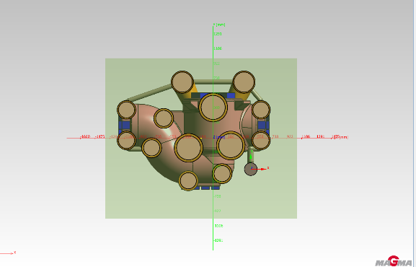
Simulation of solidification using MAGMASOFT
Simulation results parameters that have been considered are “Niyama criteria”, “soundness” feature, and “microporosity”, which are, according to our experience on stainless steels, the more reliable tools to forecast presence of casting defects.
The simulation of the valve body produced according to this scenario shows no relevant defects.
The simulation will be then validated by RT, PT and VT examination.

Slide 9
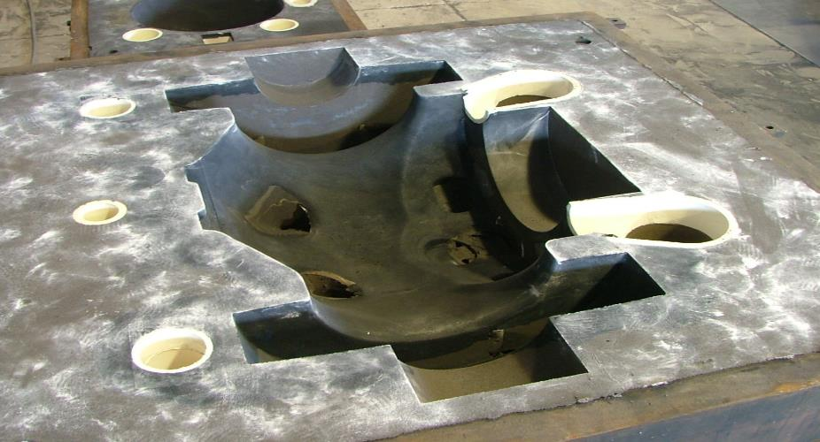
Moulding
It is made by silica and chromite sands with Pentex-type binders. It requires additions of oxidizing compounds in mixture, to prevent during solidification in mold a process of partial carburization of the surface. The presence of oxidizing atmosphere is essential to prevent chemical reactions between the pyrolysis gases of the binder and the molten metal.
Chromite sand and silica sand are placed on different zones, in order to contribute to create a thermal gradient and so an accurate directional solidification.

Slide 10
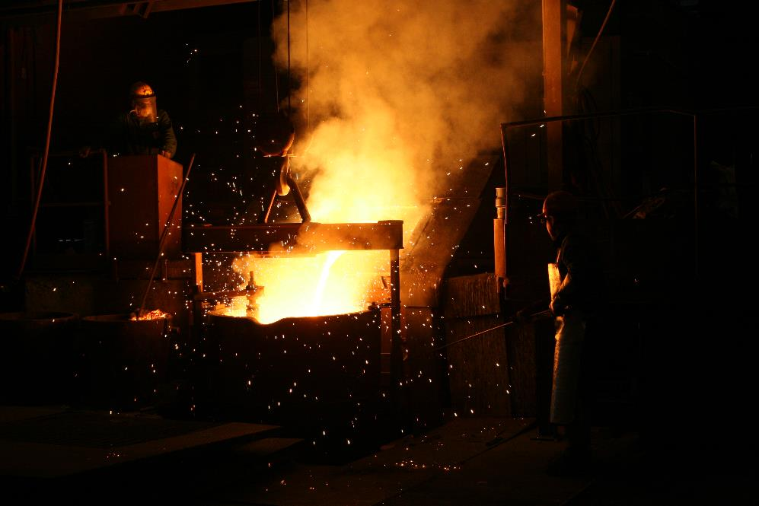
Melting and pouring
Material has been produced by remelting AOD master ingots in induction furnaces or directly melt in vacuum. The latter process produces a cleaner material, although it is necessary to blow Ar and N to restore the N content in the analysis, which the vacuum process would tend to remove.
Later, the steel is poured into a ladle at a temperature considered optimal based on years of experience and which for these castings is around 1550°C.

Slide 11
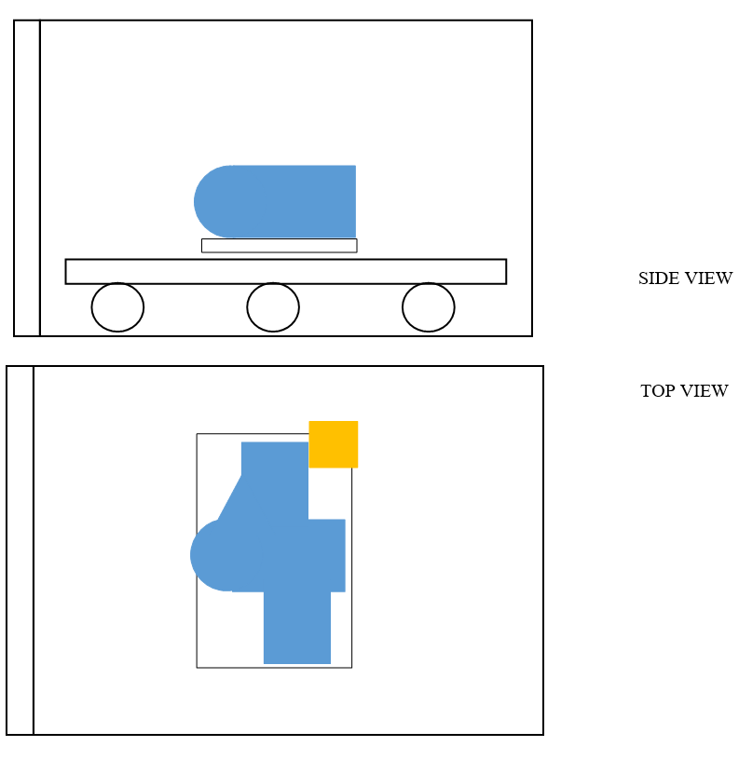
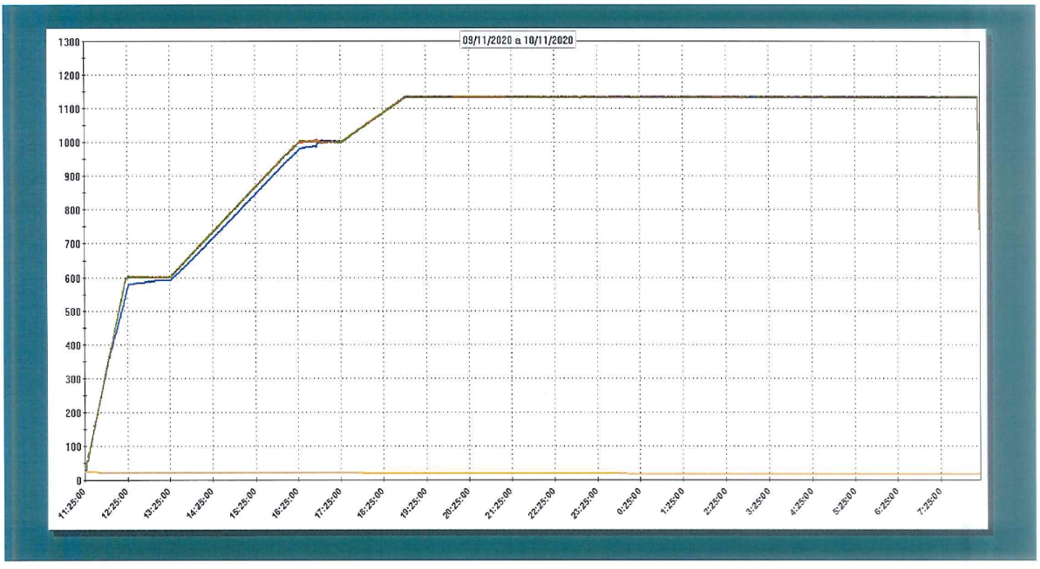
Solution heat treatment

Slide 12
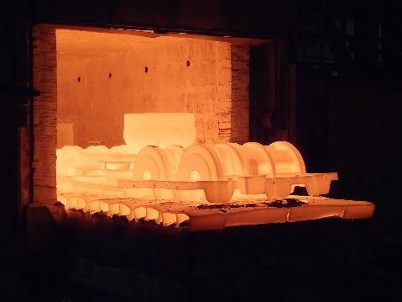
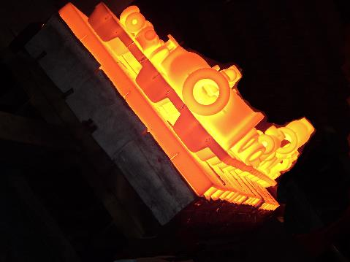
Solution heat treatment
First solution heat treatment to separate the feeding system from the casting.
Second solution heat treatment performed after visual inspection, defect repairs, fettling and first liquid penetrant test to carry out surface repairs.
Treatment furnaces
Capable of reaching very high soaking temperatures.
Carefully calibrated to ensure absolute temperature uniformity.
Burners in perfect operating status.
Highly accurate temperature measurement using a sufficient number of thermocouples calibrated quarterly.
Very short furnace opening and water quenching times of the piece.
Quenching tank with high heat capacity.

Slide 13
Results
Chemical composition:
Heat | C | Cr | Ni | Mo | Mn | Si | P | S | Cu | N | W | PREn
A995 GR 6A | <0.030 | 24÷26 | 6.5÷8.5 | 3÷4 | <1 | <1 | <0.030 | <0.025 | 0.5÷1 | 0.2÷0.3 | 0.5÷1 | >40
HEAT 1 | 0.021 | 24.59 | 7.69 | 3.62 | 0.75 | 0.57 | 0.023 | 0.003 | 0.53 | 0.238 | 0.55 | 40.36
HEAT 2 | 0.021 | 24.63 | 7.53 | 3.59 | 0.72 | 0.57 | 0.024 | 0.003 | 0.59 | 0.235 | 0.61 | 40.24
Mechanical and corrosion properties:
Property | ASTM A995 or ref. MDS | HEAT 1 | HEAT 2
Location |  | ¼ thickness | ¼ thickness
UTS (N/mm²) | 700 N/mm² | 782 N/mm² | 780 N/mm²
Y.S. 0.2% (N/mm²) | 450 N/mm² | 542 N/mm² | 511 N/mm²
A (%) | 25% min | 30.2 % | 28.6%
Z (%) | - | 55.95 % | 57.73%
KV (J) -46°C | 45 J avg. | 109.7 J avg. | 130.3 J avg
HB | INFO | 226.5 | 228.3
G48 method A (50°C) | 4g/m² max | 0.90 g/m² | <0.15g/m²
Delta ferrite by manual point counting (E562) | 35/55% | 50.9% | 47.3%
Micro | No precipitates | No precipitates | No precipitates

Slide 14
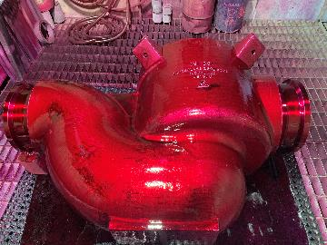
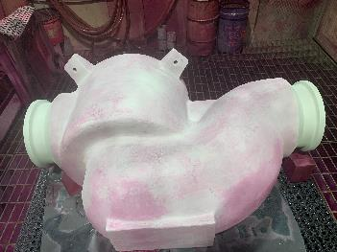
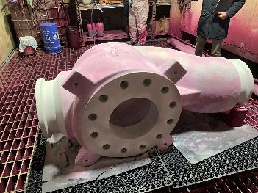
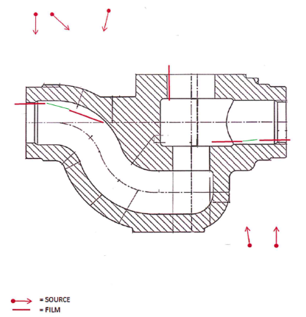
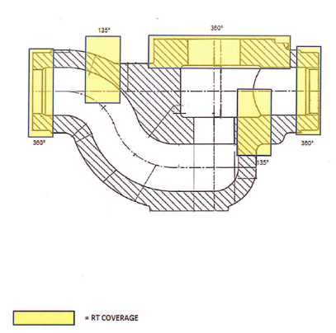
Non-destructive testing
PT: dye penetrant test has been performed according to ASME VIII Div.1 App.7 and to ASME VIII Div.1 App.8 on machined surfaces.
Dimensional inspection: a complete dimensional inspection has been performed on the pieces. All dimensions according to the applicable drawing.
RT:
castings have been x-rayed in critical areas according to the attached sketch. Produced No. 48 films per piece. Acceptance criteria as per ASME VIII Div.1 App.7
HEAT 1: all films free from defects. Films with minimum indications according to ASTM E186 and E280: no. 3 films with gas porosity A1, no. 2 films with inclusions B1 and no. 1 film with shrinkage CB1.
HEAT 2: No. 5 films with gas porosity A1, no. 2 films with shrinkage CC1, no. 1 film with inclusion B1.

Slide 15
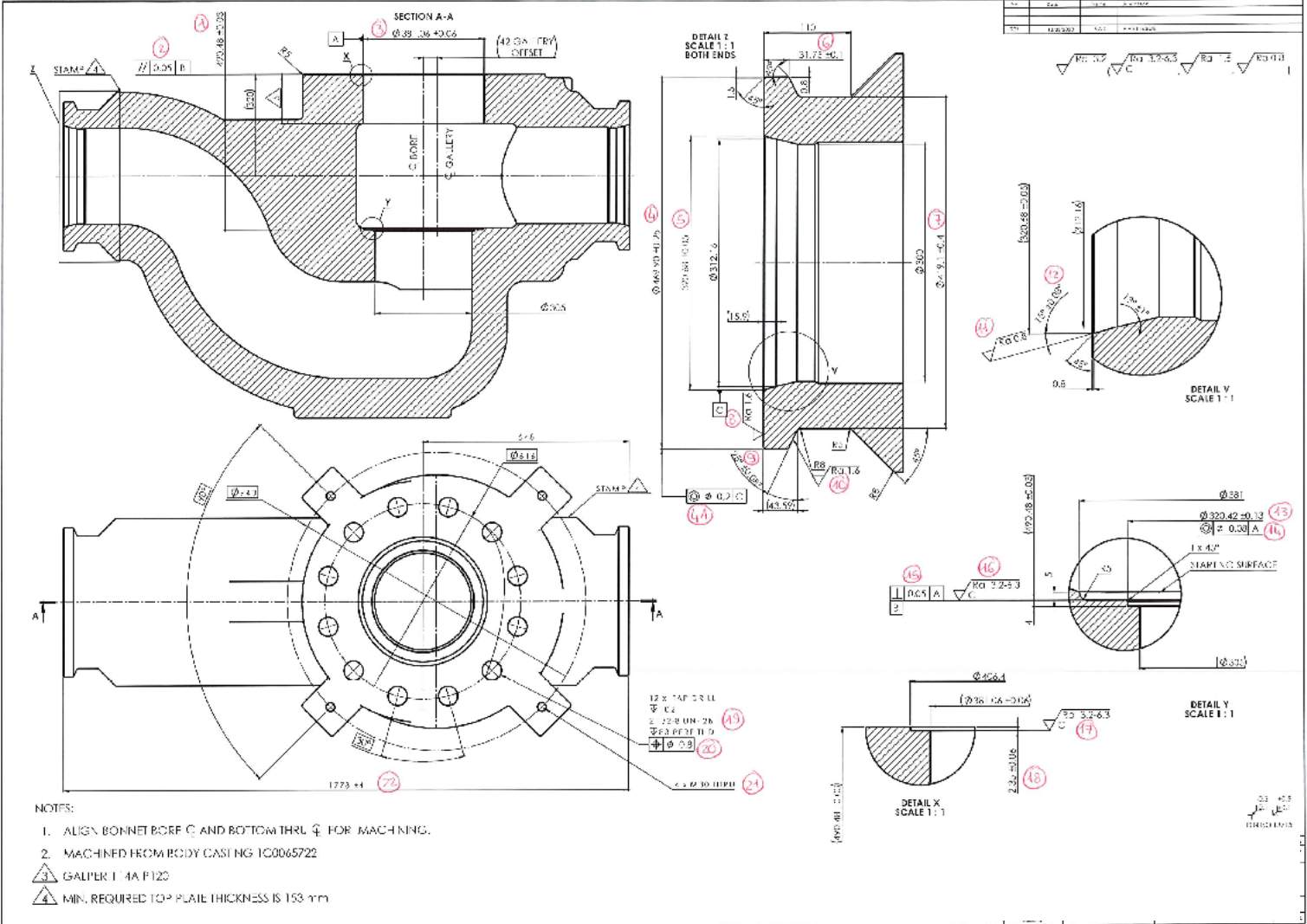
Machining
The two castings have been final machined.

Slide 16
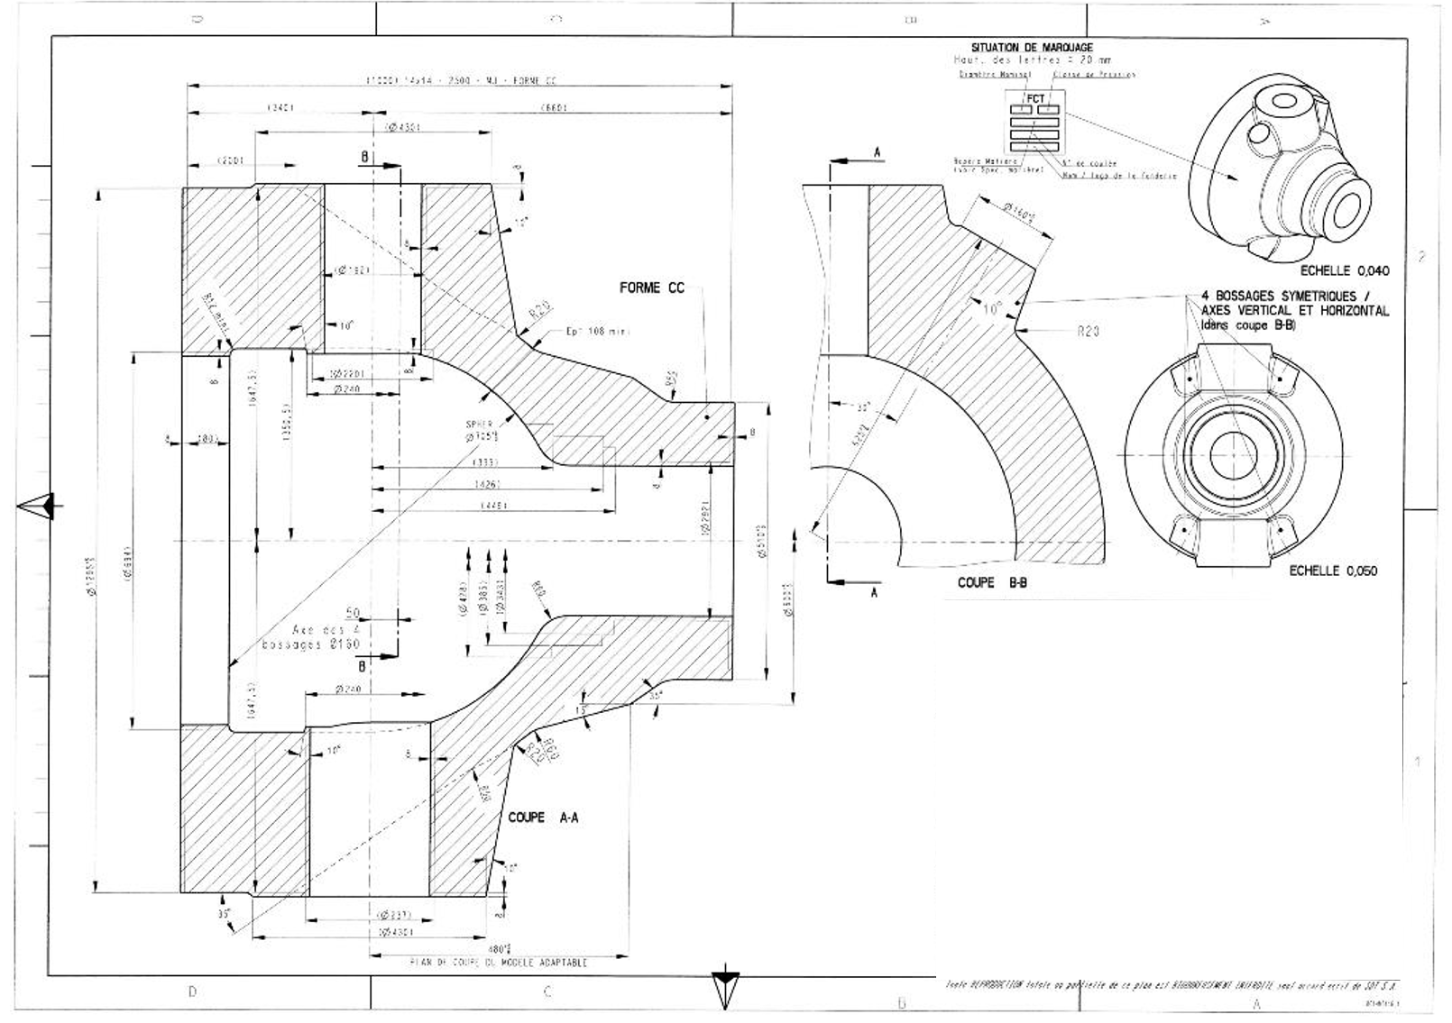
BALL VALVE BODY 14”X14 ” ASME 2500
No. 2 ball valve bodies
Material: ASTM A995 GR 5A
Net Weight: 4300 Kg
Thickness: 270 mm in upper flange area
For R&D reasons has also been poured a test block of 300 mm thickness

Slide 17
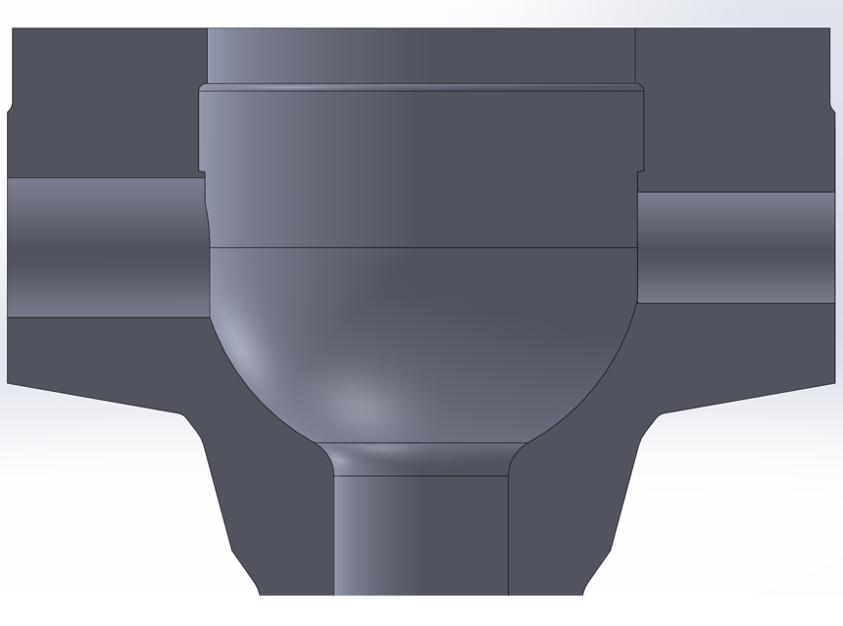
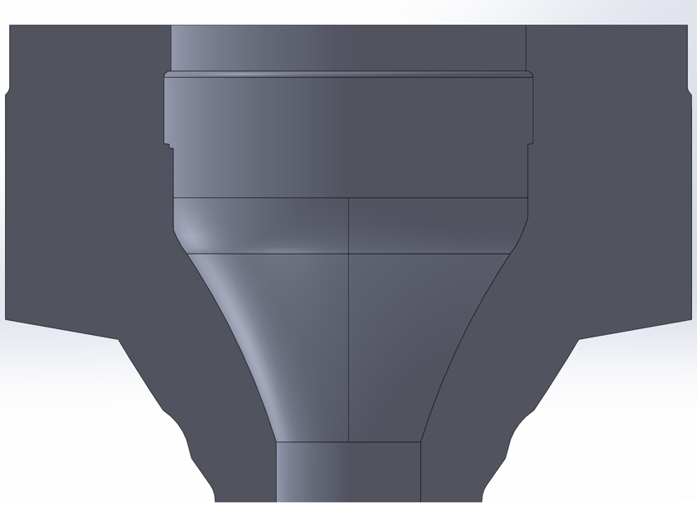
BALL VALVE BODY 14”X14 ” ASME 2500
The very compact shape of the profile suggests to pour the casting in vertical position.
Redesign of the casting in order to ensure better directional solidification.

Slide 18
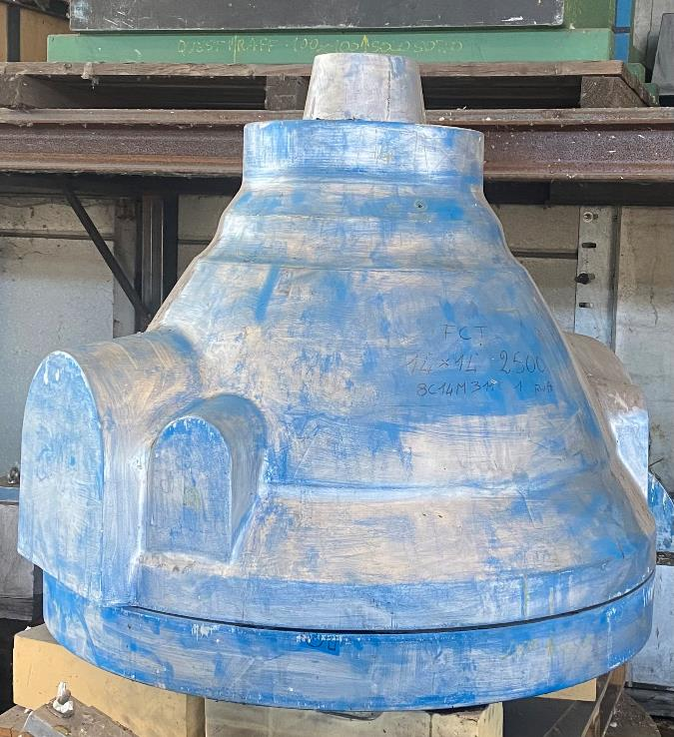
Pattern
The wooden pattern has been realized with the same criteria of the previous castings.

Slide 19
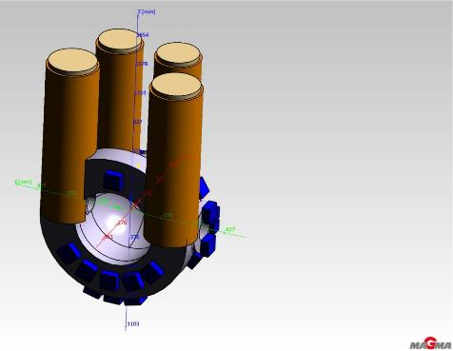
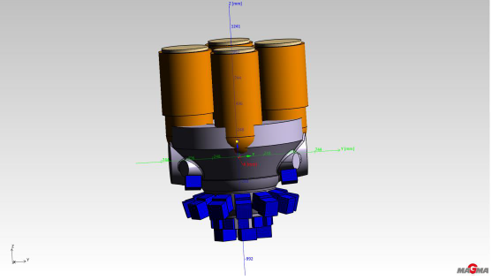
MAGMASOFT
Horizontal orientation:
+ Easier feeding of whole part
(flange / seat / BW)
Larger feeders on coupling flange (metallurgical issues)
Heat concentration between risers
Vertical orientation:
+ Smaller feeders and higher heat losses
- Piece shape doesn’t allow a simple feeding system
(thickness variation along vertical axis)

Slide 20
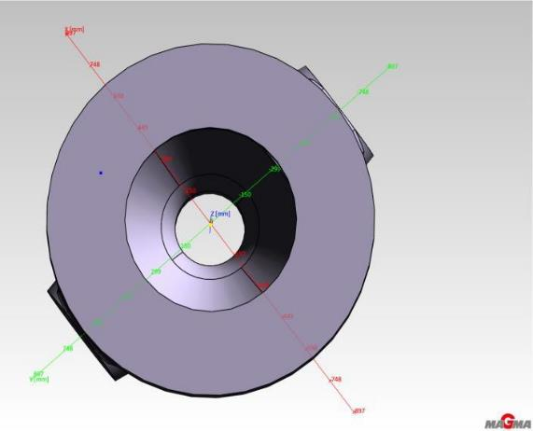
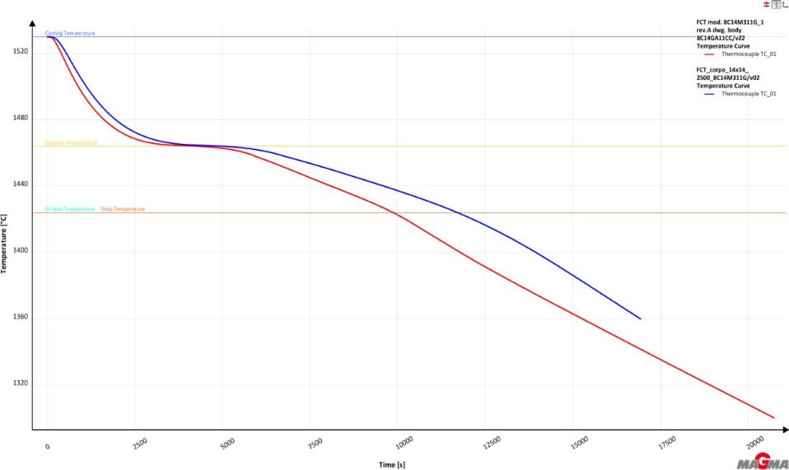
MAGMASOFT
Transition time between TL and TS at flange mid thickness: horizontal (blu line) versus vertical version (red line).
For horizontal version estimated time is 40% higher respect to vertical version.

Slide 21
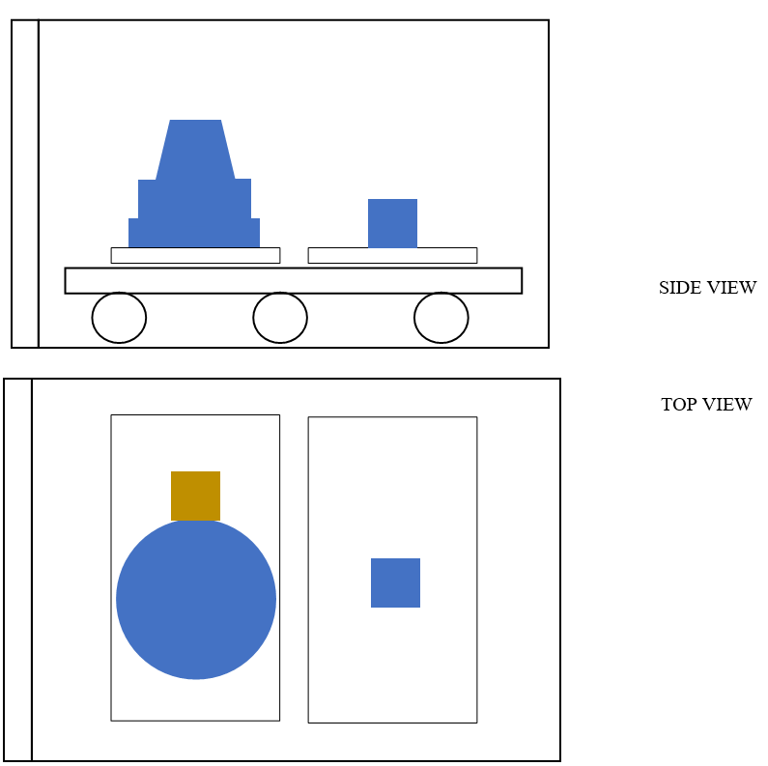
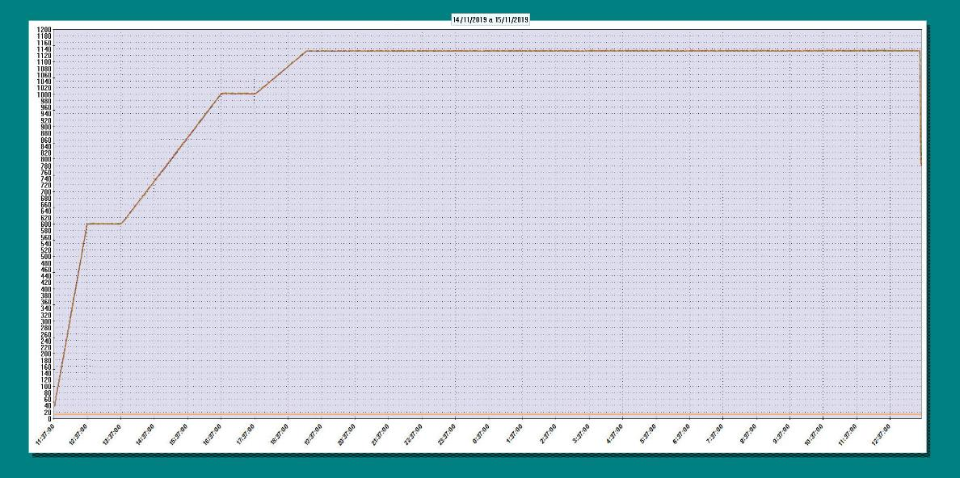
Solution heat treatment

Slide 22
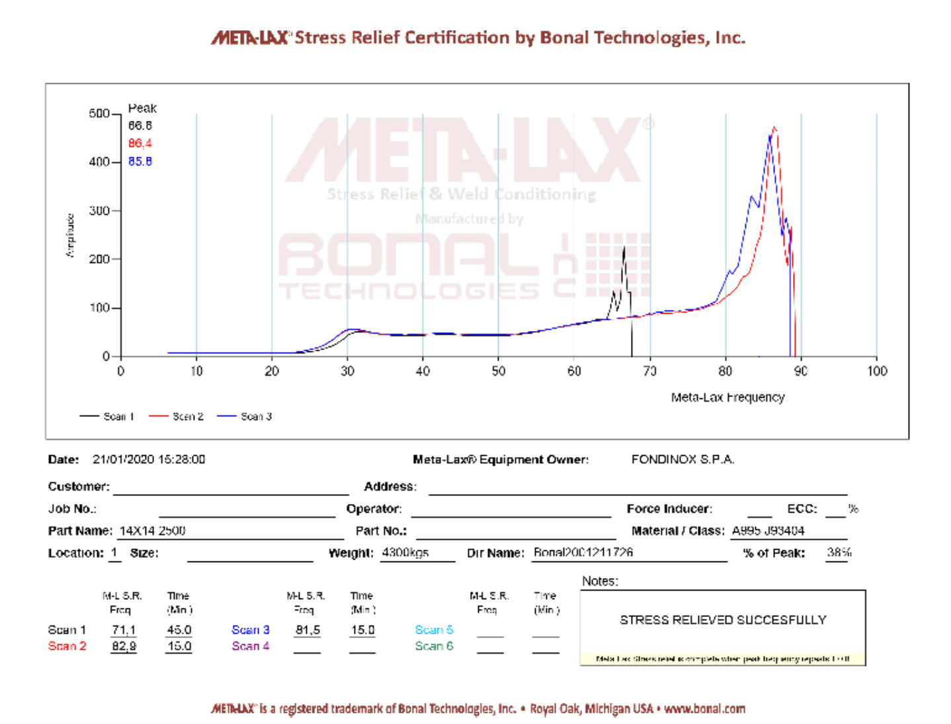
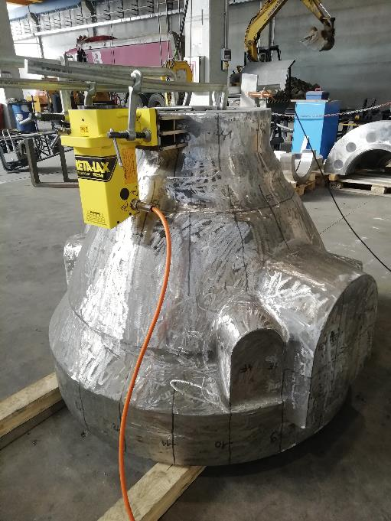
Vibration stress relief
Addition of a stress relieving after heat treatment and eventually after rough machining.

Slide 23
Results
Chemical composition:
Heat | C | Cr | Ni | Mo | Mn | Si | P | S | N | PREn
A995 GR 5A | <0.030 | 24÷26 | 6÷8 | 4÷5 | <1.5 | <1 | <0.040 | <0.025 | 0.2÷0.3 | >40
HEAT TB (300 mm) | 0.022 | 24.57 | 7.16 | 4.15 | 0.80 | 0.61 | 0.026 | 0.004 | 0.214 | 41.69
HEAT 1 | 0.015 | 24.48 | 7.40 | 4.13 | 0.81 | 0.49 | 0.025 | 0.004 | 0.250 | 42.11
HEAT 2 | 0.019 | 24.34 | 7.50 | 4.11 | 0.82 | 0.54 | 0.022 | 0.003 | 0.256 | 42.00
Mechanical and corrosion properties:
Property | A995 or ref. MDS | HEAT TB (TB 300mm) | HEAT 1 | HEAT 2
Location |  | ½ thickness | ¼ thickness | ¼ thickness
UTS (N/mm²) | 700 N/mm² | 718 N/mm² | 737 N/mm² | 724 N/mm²
Y.S. 0.2% (N/mm²) | 515 N/mm² | 538 N/mm² | 535 N/mm² | 522 N/mm²
A (%) | 18% min | 27.0 % | 25.0% | 26.0%
KV (J) -46°C | 45J avg. | 76 J avg. | 86 J avg | 79 J avg.
HB | INFO | 263.0 | 262.0 | 255.0
G48 method A (50°C) | 4g/m² max | 0.82 g/m² | 0.75 g/m² | 0.50 g/m²
Delta ferrite by manual point counting (E562) | 35/55% | 50.4 % | 51.0 % | 48.7%
Micro | No precipitates | No precipitates | No precipitates | No precipitates

Slide 24
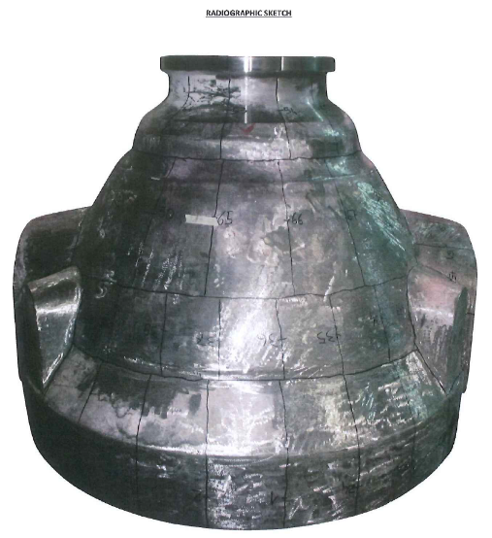
Non-destructive testing
PT: castings have been PT tested repeatedly during production cycle, resulting in agreement with requirements of ASME VIII Div.1 App.7 plus no indication on sealing areas.
Dimensional inspection: a complete dimensional inspection has been performed on the pieces along with the Customer, resulting in full compliance with the applicable drawing.
RT:
Due to the criticality of the piece, the valves have been x-rayed at 100% of the volume. Produced No. 60 films. Acceptance criteria as per ASME VIII Div.1 App.7.
HEAT 1: No. 1 film A1, no.2 films B1, no. 1 film CB1, no. 6 films CC1
HEAT 2: No. 3 films A1, no. 1 film B1, no. 4 films CC1

Slide 25
Conclusion
These results are basically achieved through four simultaneous factors:
- Deep metallurgical knowledge of SDSS
- Adequate production equipment
- Strict adherence to operating procedures, which describe the process
- Possibility of having a staff highly trained by the continuous production of these particular items.
The present work does not allow to evaluate what is the upper limit of thickness, which can be reached with acceptable values for physical and mechanical properties. In all cases it shows, that sand cast parts with thicknesses of 300mm can be safely produced, using the right cautions.

Slide 26
Q & A SESSION
ORGANIZERS
SCIENTIFIC COMMITTEE
Thank you for your attention!
IVS 2022
Technical Conference

