Slide 1
Luisa Elena Mondora
ORGANIZERS
SCIENTIFIC COMMITTEE
General Manager, Valland & CEO, f3nice
Circular Economy in the O&G Industry for Additive Manufacturing of
Metal Parts
IVS 2022
Technical Conference

Slide 2
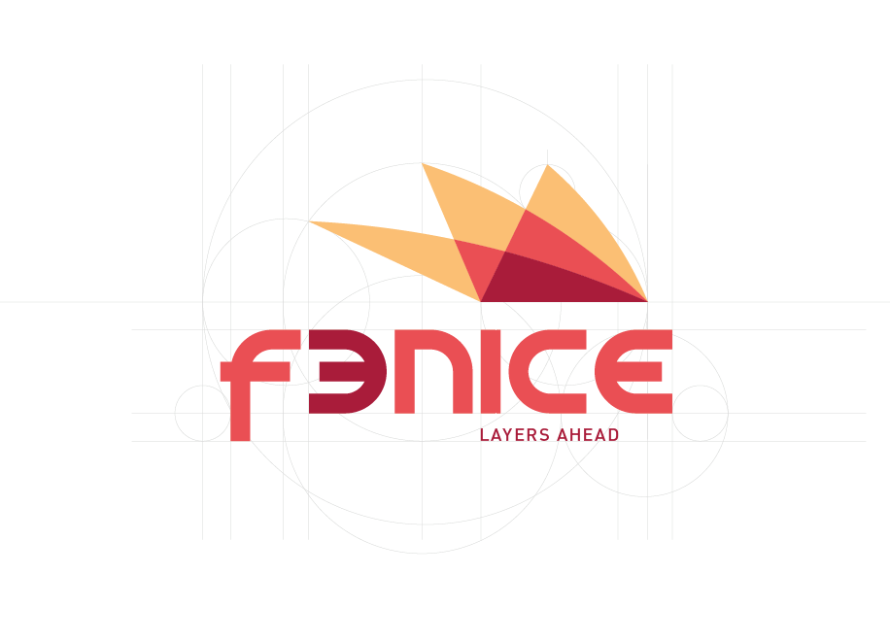
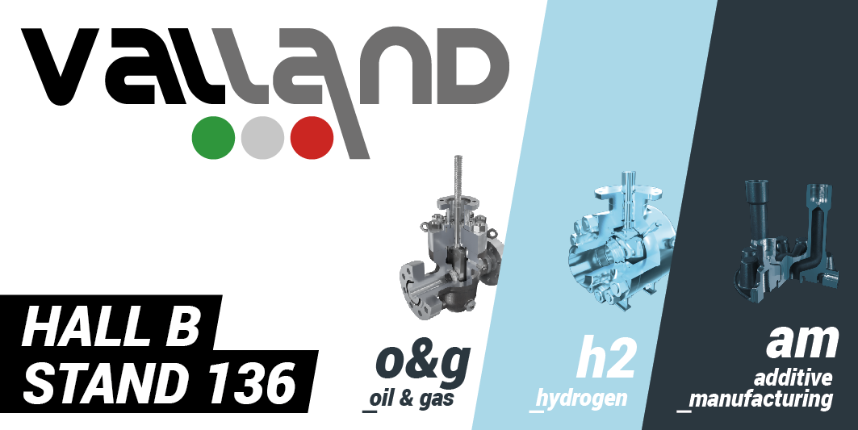
Biography
Luisa Elena Mondora is General Manager at Valland since 2015; since 2016 she has started exploring Additive Manufacturing Technologies for Oil&Gas applications and this has led her, among other ventures, to fund f3nice in 2020.
F3nice is an innovative start up that upcycles Oil&Gas metal waste to produce metal powder for 3D printing.

Slide 3
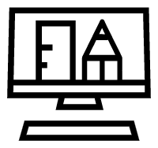
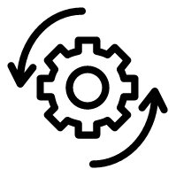
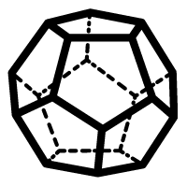
AM Advantages
Freedom of design
Small complex geometries
Prototyping
Efficient material
usage
Waste reduction
Low-volume production
Material properties
Just-in-Time
Digital Inventory
On-Site production
Notes:
Freedom of design
Material properties
Small complex part

Slide 4
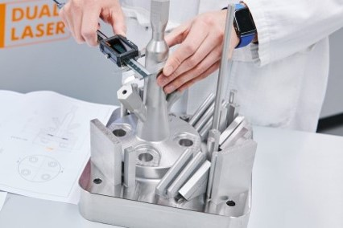
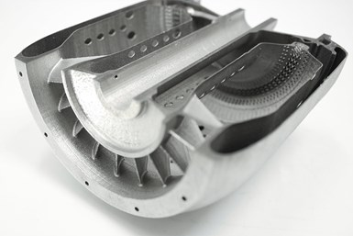
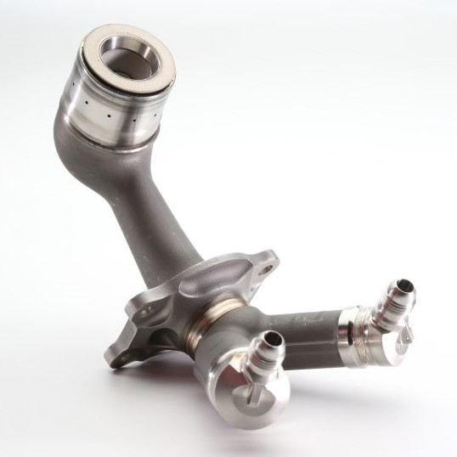
Metal 3D printing in Oil&Gas
GE prints LEAP’s engine fuel nozzles through AM technology. The parts rely on a complex internal geometry that 3D printing is the only practical way to mass-produce them.
Sierra Turbines’ engine combustor; with traditional manufacturing, this part would have required the assembly of 61 discrete components.
Shell’s 3D printed pressure vessel in accordance with the European Pressure Equipment Directive (PED).
Notes:
Case studies
Shell, Equinor, etc
Aidro?

Slide 5
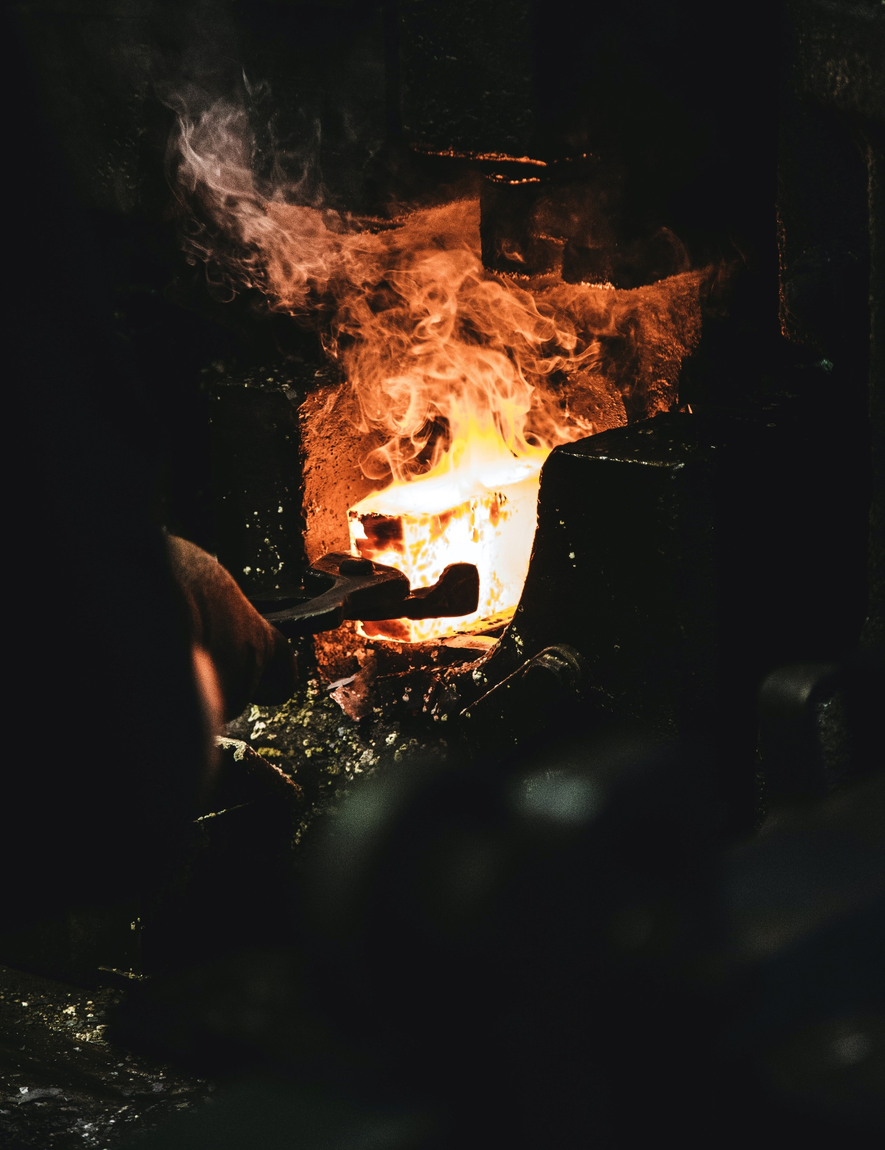
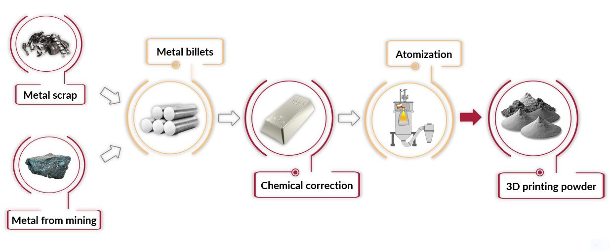
Economic and Environmental Issues
Conventional process
1 kg of metal
1 : 25+
25+ kg of CO₂
Notes:
Feedstock -> how is it made

Slide 6
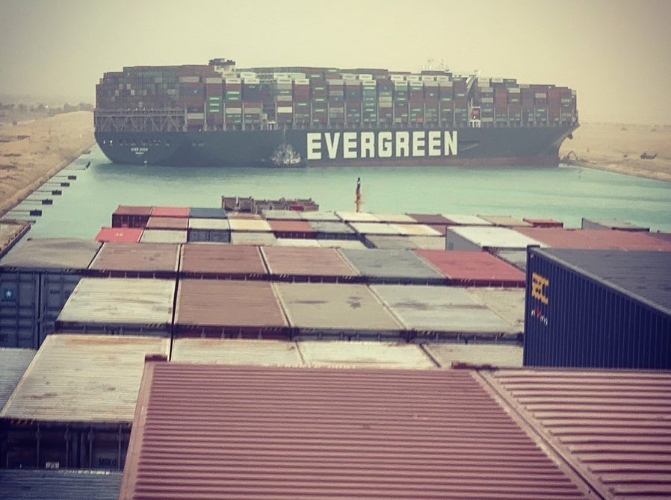
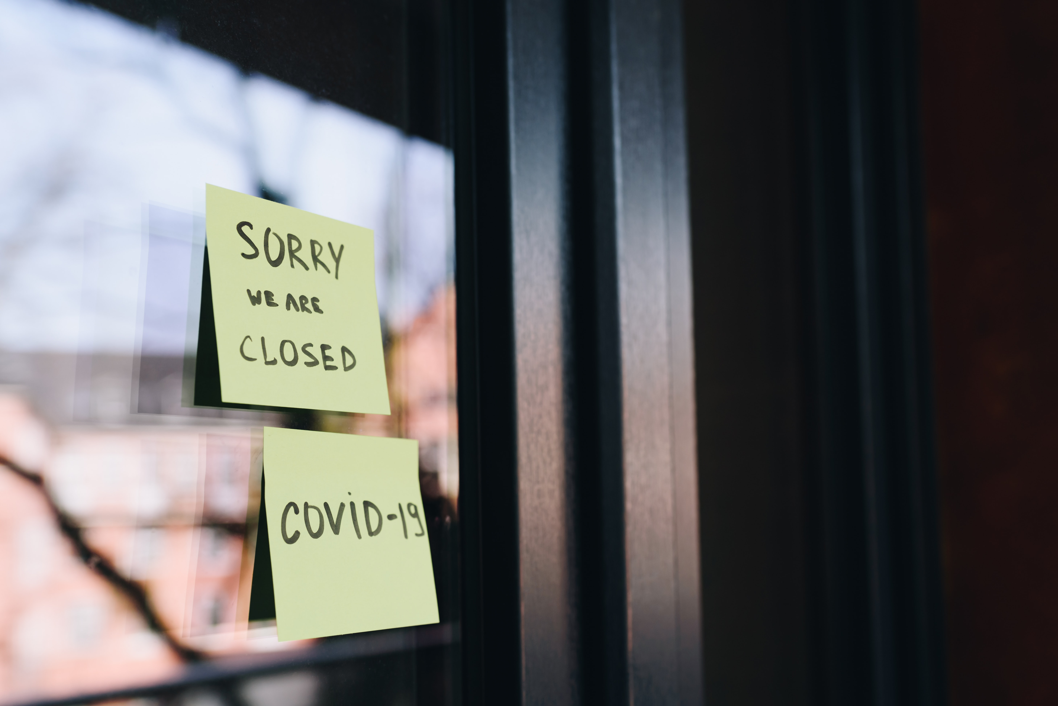
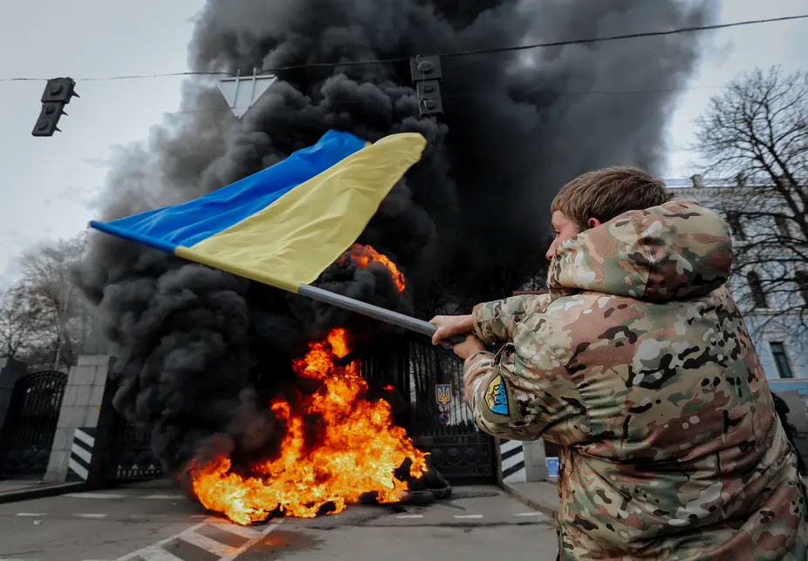
Supply Chain Issues
Need of a more resilient supply chain
Notes:
Covid + war -> need of a more resilient supply chain

Slide 7
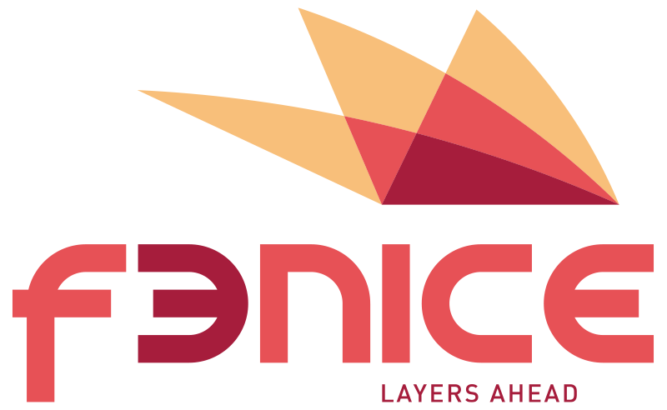
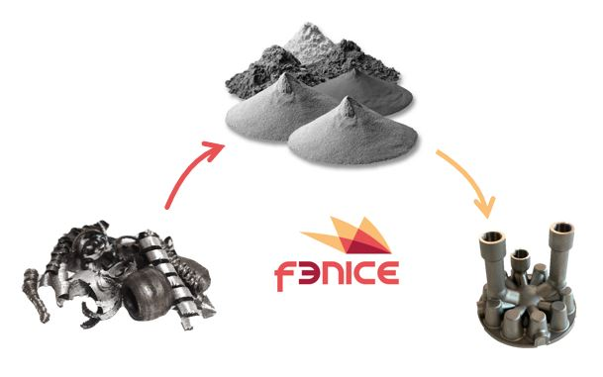
f3nice’s Solution
Sustainable AM feedstock for 3D printing
Decommissioned Oil & Gas components
Printed parts
Metal scrap from the supply chain
Reduced ecological footprint
Notes:
Making feedstock from decommissioned O&G components + metal scrap from the supply chain

Slide 8
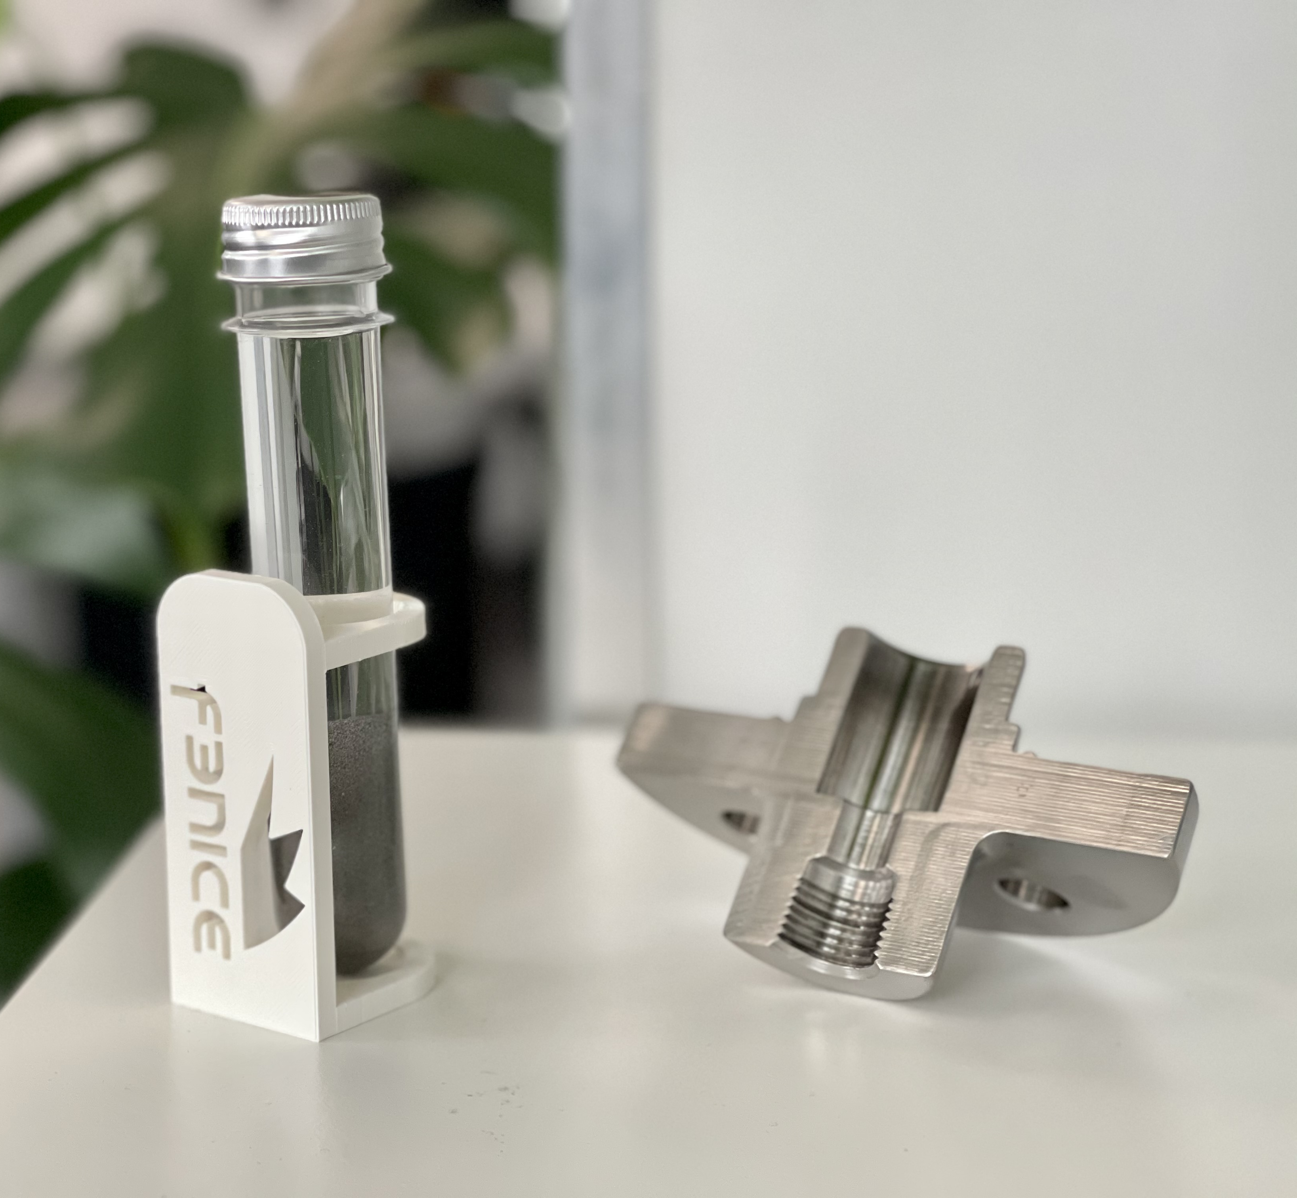
Energy and CO2 Savings
To proof our impact we develop LCA analyses on our powder production process.

Slide 9
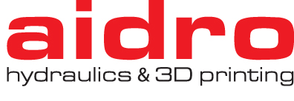
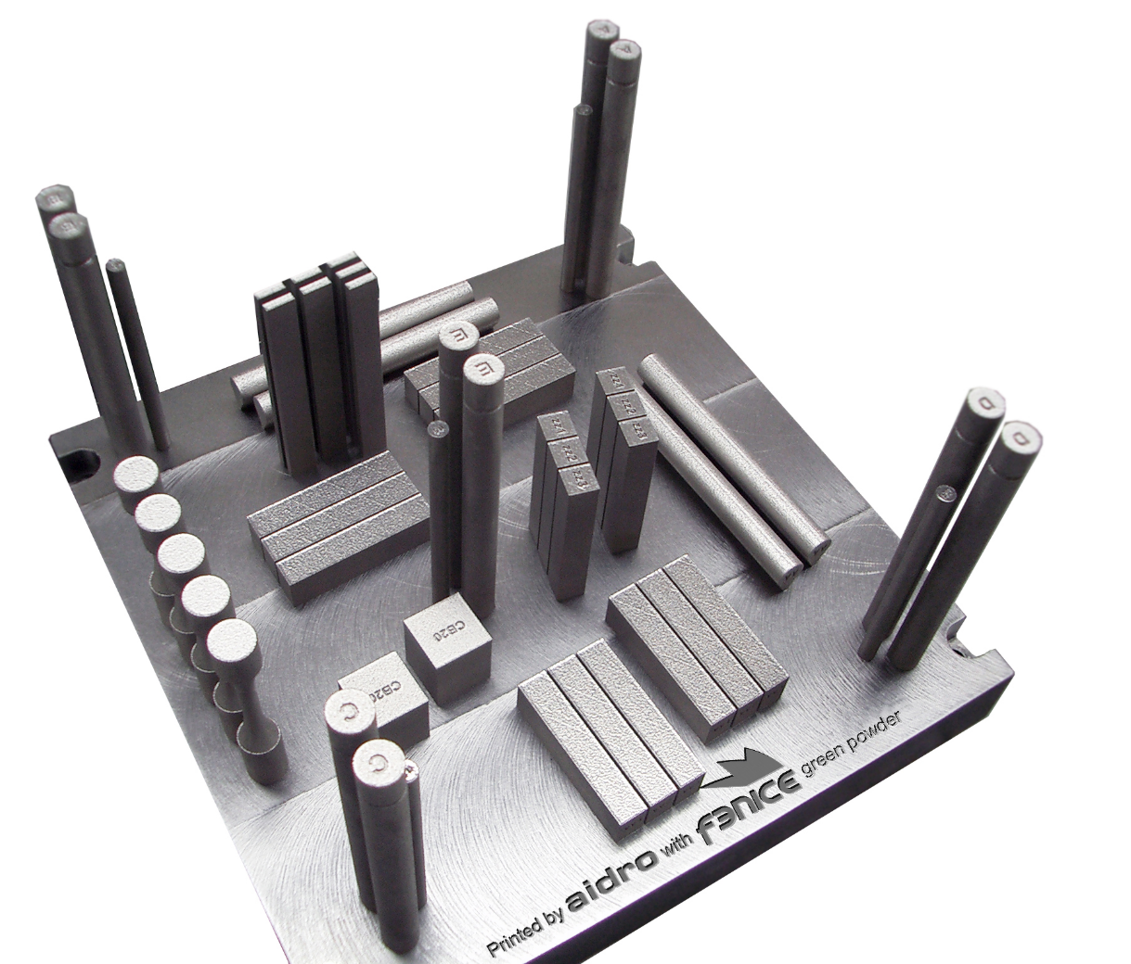
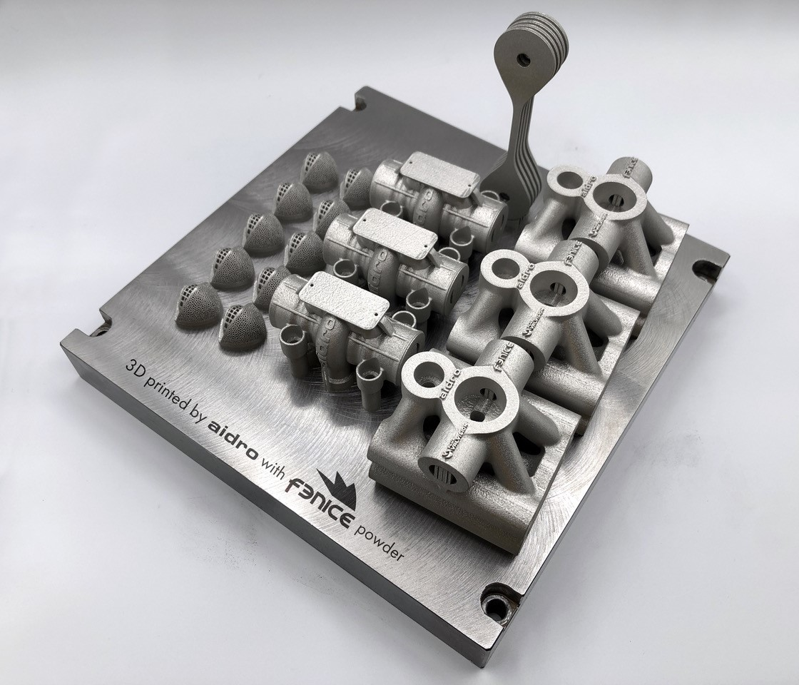
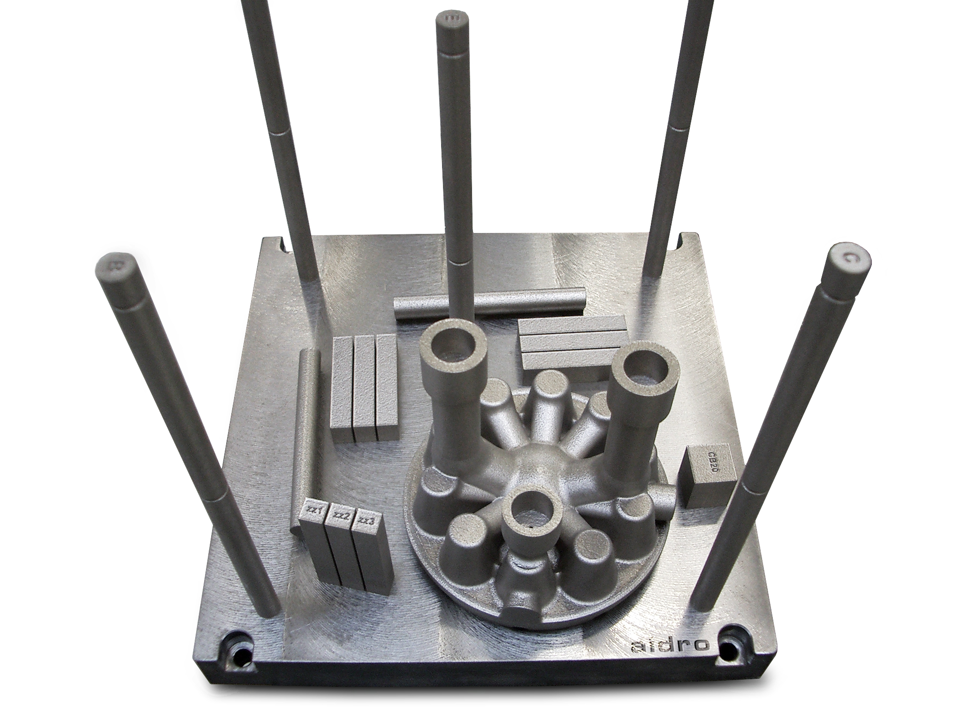
Examples
3D printed components realized in partnership with Aidro
Notes:
Caratterizzazione dei materiali, Aidro, UIS, etc

Slide 10
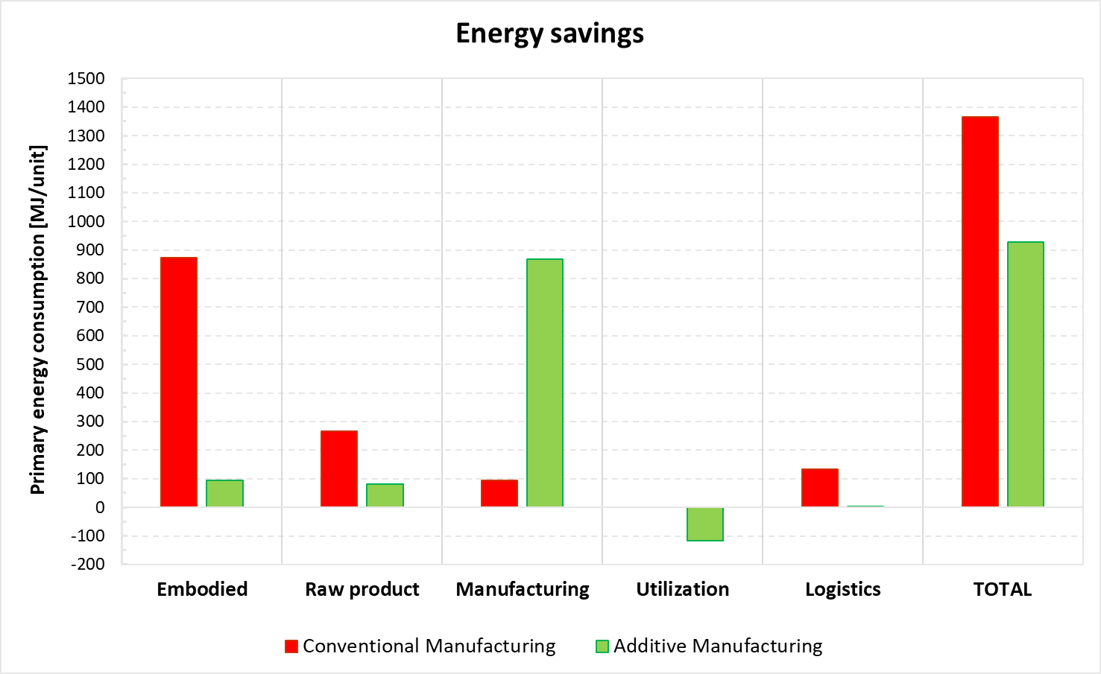
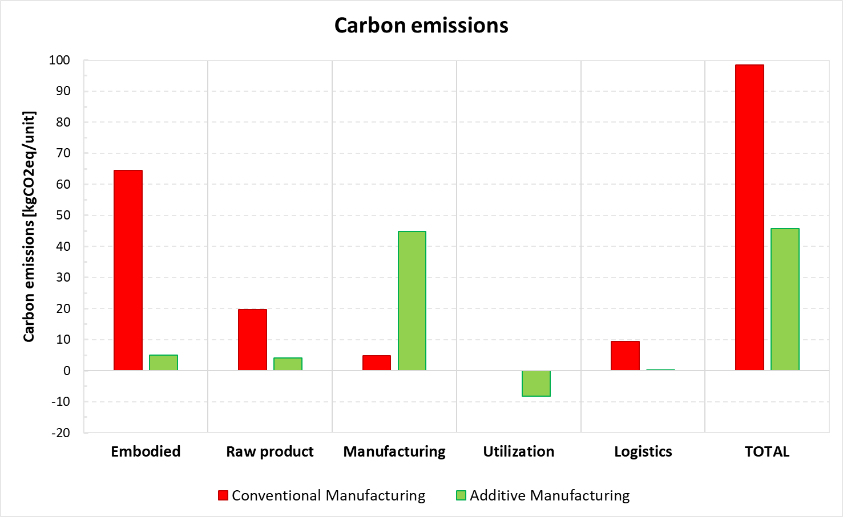
Combining f3nice’s feedstock + design to achieve top results
3D printed floating ball valve developed in partnership
with Wilhelmsen & thyssenkrupp.

Slide 11
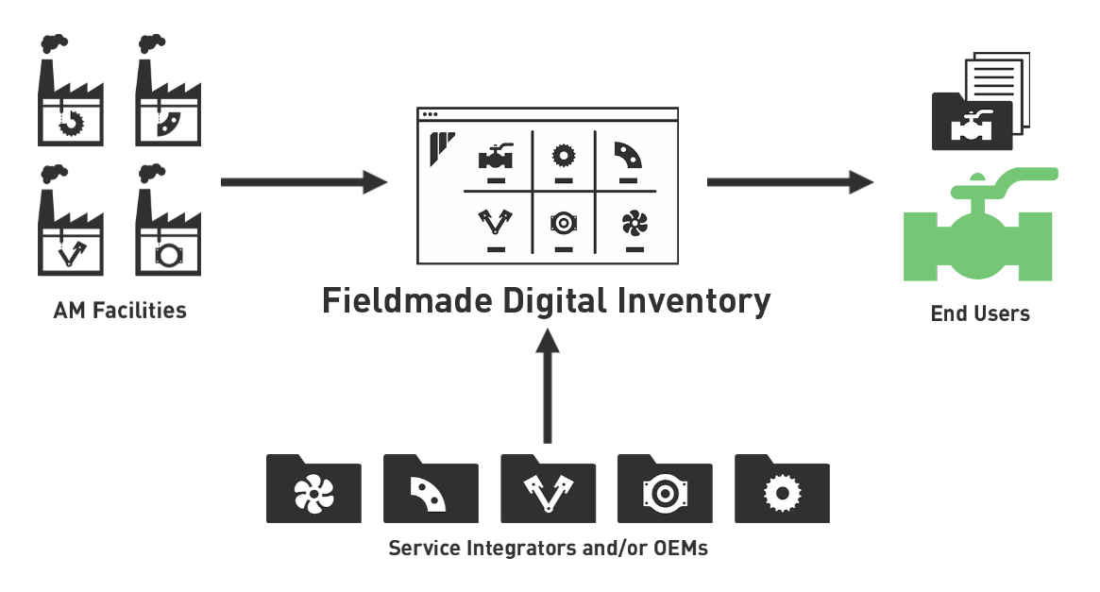
A True Circular Economy Ecosystem
Combining feedstocks production with components printing for the Digital Inventory initiatives:

Slide 12
Call To Action
The future of metal AM is bright, is green, and is now!
We want to revolutionize the sector with our Circular Economy Ecosystem.
Collaborate with us!
luisa.mondora@f3nice.com
+39 3663795186
f3nice.com
We value your metal scrap
Use our powder for your metal 3d printing needs
f3nice - Sustainable AM Feedstock
Notes:
Contact us!
Give us your scrap
Use our powder for your metal 3d printing needs

Slide 13
Q & A SESSION
ORGANIZERS
SCIENTIFIC COMMITTEE
Thank you for your attention!
IVS 2022
Technical Conference

