Slide 1





LOÏC DENEUVILLE
ORGANIZERS
SCIENTIFIC COMMITTEE
Static Equipment Specialist – Valve SME TOTALENERGIES
Comparative study between IOGP and ISO valve fugitive emissions requirements
In collaboration with
E. Sauger and J. Leray CETIM France
IVS 2022
Technical Conference

Slide 2
Aim of study
- Reducing VOC (Volatile Organic Compound) emissions is one of the identified key levers to achieve carbon neutrality
- In 2019, IOGP published a series of supplementary specifications from API 6D and API 600/603 parent valve standards. The IOGP specifications included fugitive emission testing requirements based on ISO 15848-1 but with some modifications. - In order to further assess the differences between the two documents, a study sponsored by TotalEnergies was launched by Cetim.
- Using an API 6D ball valve, a series of tests have been conducted to compare both procedures.
- Results of this study can be utilized in order to implement the most suitable strategy for valves fugitive emissions qualifications for Oil&Gas assets.

Slide 3
Analysis of procedures
A comparative analysis between IOGP S-562 and ISO 15848-1 has highlighted three main differences :
  Difference 1 - fugitive emission measurement techniques:
    IOGP S-562 recommends sniffing
    ISO 15848-1 requires the vacuum and accumulation method for class BH (or only the vacuum method for AH).
  What is the influence of the measurement method on the valve qualification for fugitive emissions?

Slide 4
Analysis of procedures
  Difference 2 - Measurement fluids :
    ISO 15848-1 mandates 97% Helium minimum.
    IOGP S-562, either:
      97 % Helium,
      Mixture of 10% Helium and 90% Nitrogen as an alternative for valves above DN300 (NPS12).
  What is the influence of the nature of the fluid on the qualification valve for fugitive emissions?

Slide 5
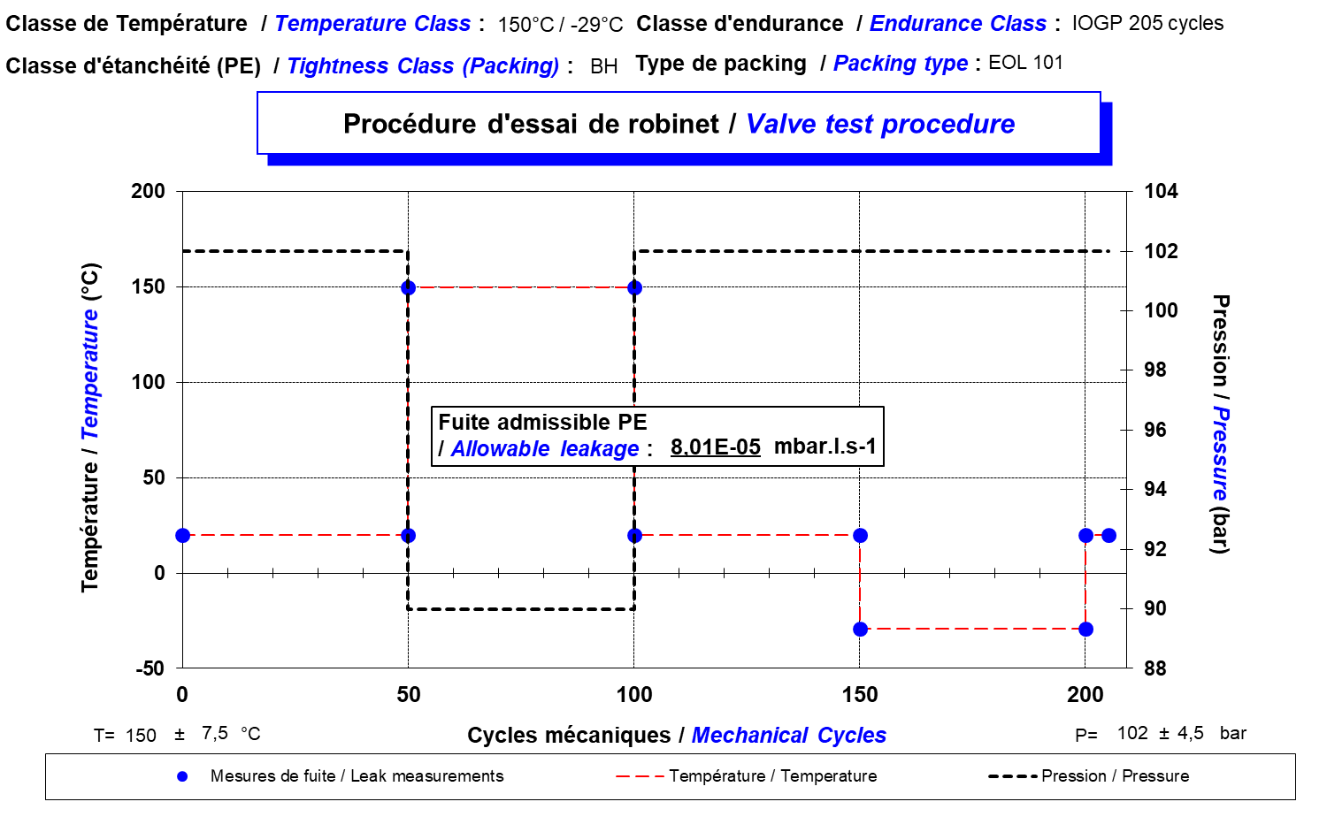
Analysis of procedures
  Difference 3 - Thermal cycles:
    IOGP S-562: 205 cycles during a test, including 50 cycles at the lowest temperature and 50 cycles at the highest temperature

Slide 6
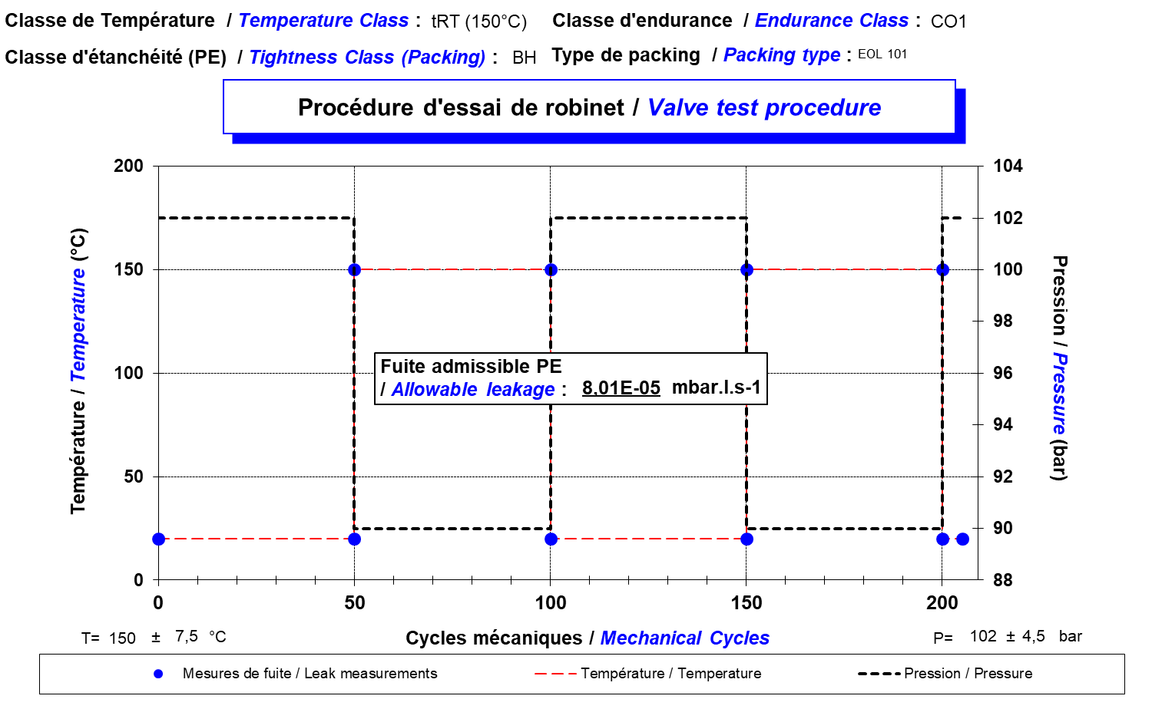
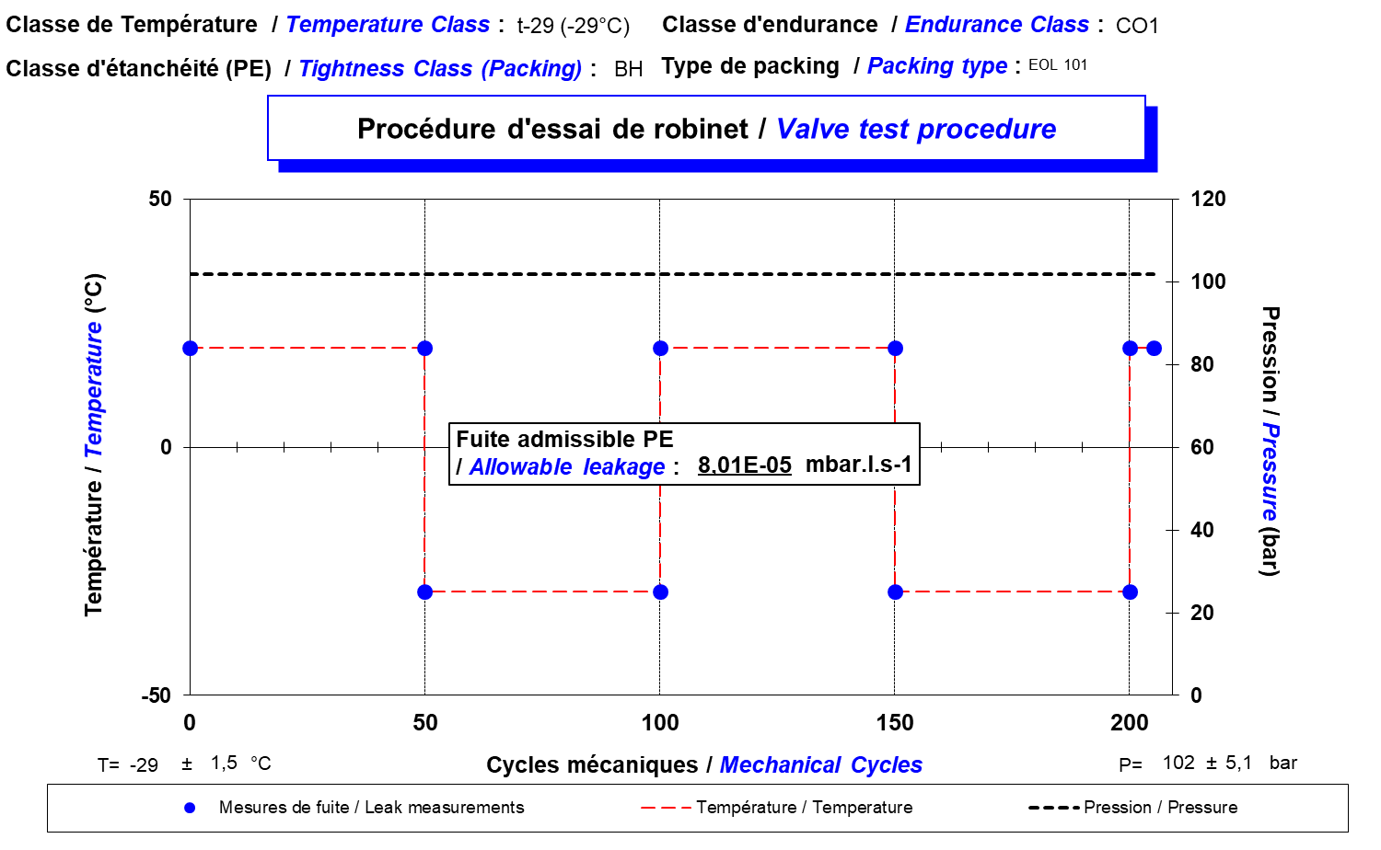
Analysis of procedures
  Difference 3 - Thermal cycles :
    ISO 15848-1: 205 mechanical cycles per temperature. But mandates two separate tests at lowest and highest temperature,
  100 cycles carried out at test temperature (either below and above room temperature)
at 150°C
at -29°C

Slide 7
Test program
 | IOGP S-562 |  | ISO 15848-1 – CO1
 | 97% hélium | 10% He + 90% N2 | 150°C | -29°C | 10% He + 90% N2
Factor 1 | X |  | X
Factor 2 |  | X |  |  | X
Factor 3 |  |  |  | X
Factor 1: influence of leak rate measurement method
Factor 2: influence of test fluid
Factor 3: influence of thermal and mechanical cycles

Slide 8

Test conditions
  Test valve
Instrumentation adaptation for vacuum method measurement
TM Ball Valve DN150 CL600
Stem seal:2 RGD O-rings + graphite ring
Sealing system changed after each test
Automated with electrical motor

Slide 9
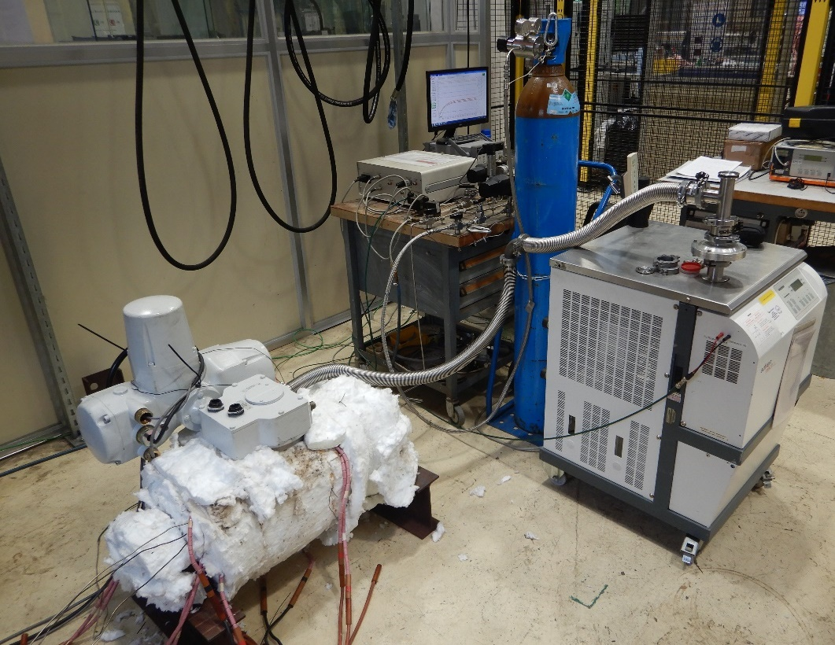
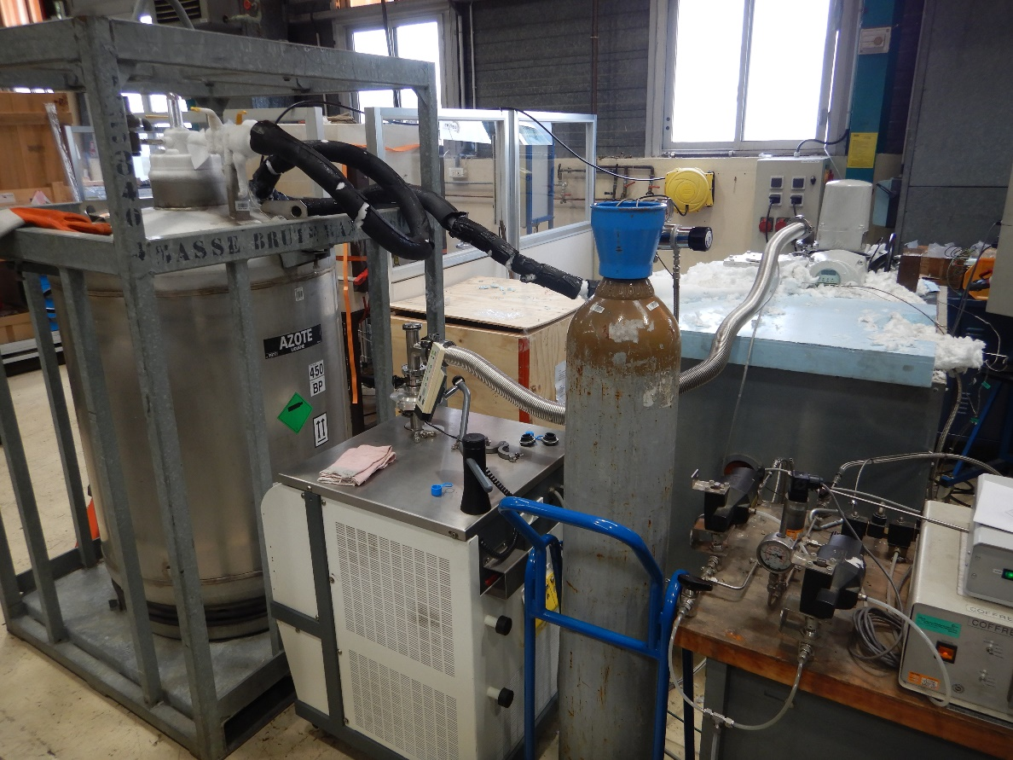
Test conditions
  Test set-up (CETIM Laboratory / Nantes)
Pressure control
Data acquisition
Test valve
Liquid Nitrogen Tank
Test valve
Helium mass spectrometer
Helium mass spectrometer
Pressure control
At 150°C
At -29°C

Slide 10
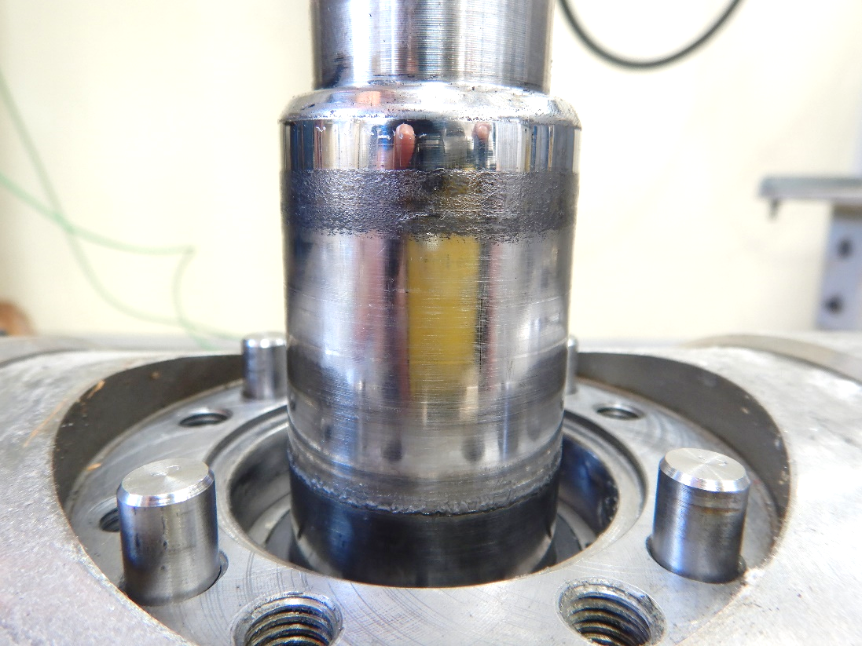
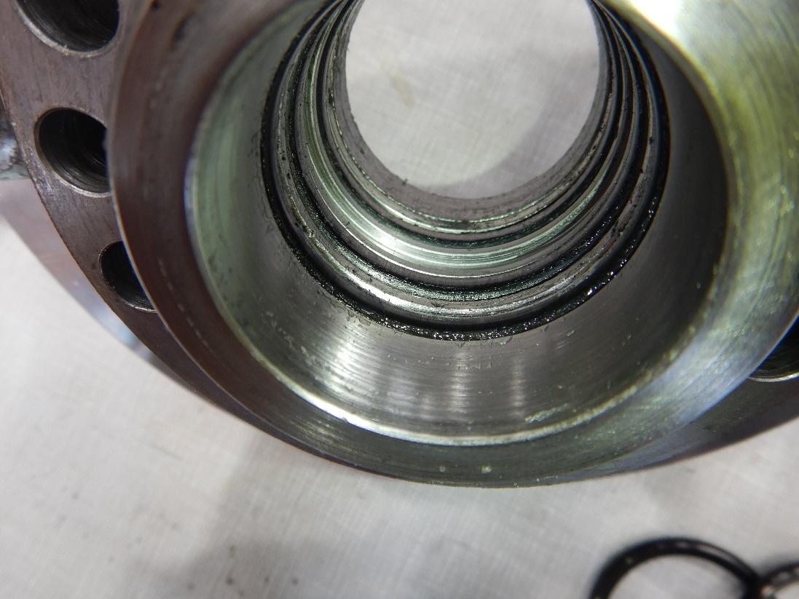
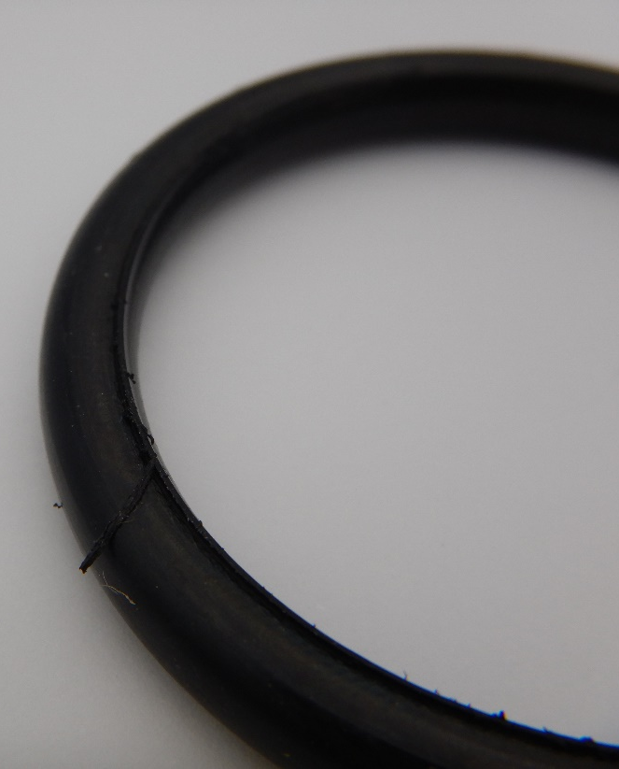
Test results
  Visual observations after each test
Graphite particles sticked on stem
Stem sealing housing
O-ring after test

Slide 11
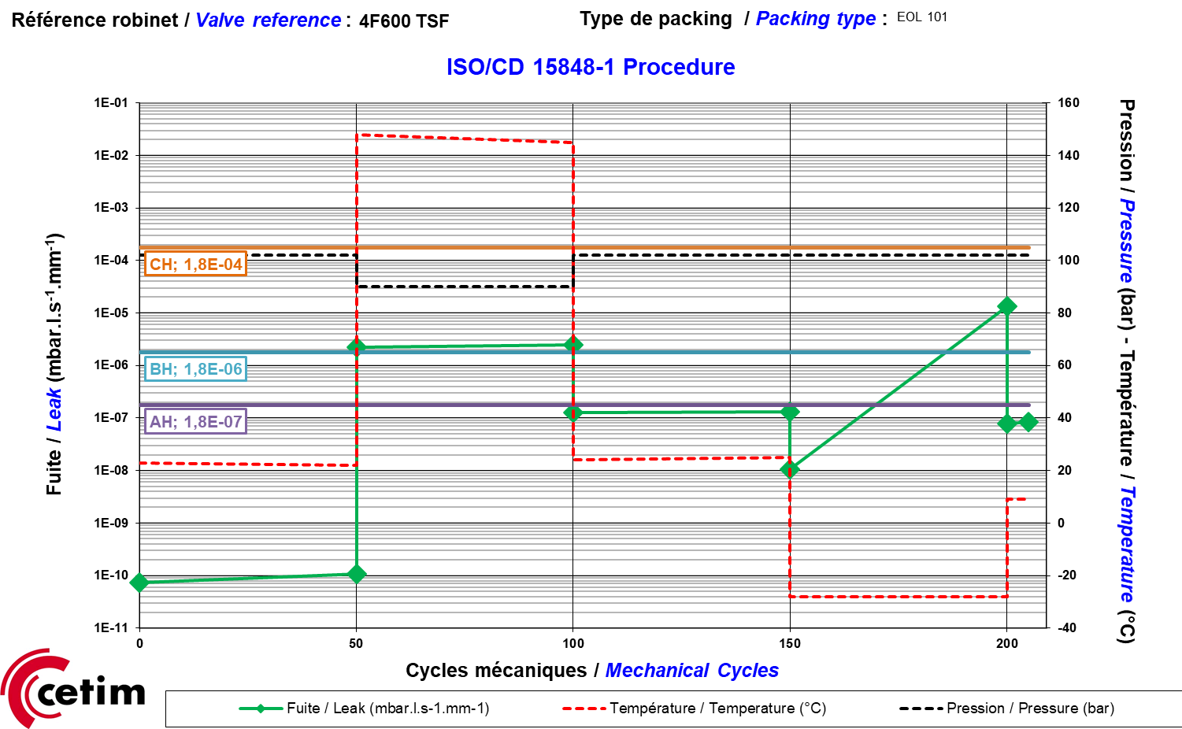
Test results
  Tightness measurements:IOGP S-562 (97% Helium + vacuum measurements)
Sniffing method initially implemented but
found difficult to implement (only large leakage variations measured, takes more time to reach stabilisation)
⇒ measurements with vacuum method
Just above BH Class at 150°C
⇒ increase of leak rates due to
elastomer permeability variation
CH at -29°C
⇒ CH over the whole test due to test
Temperature below Tg (-9°C for material
compound used)
IOGP S-562 Procedure

Slide 12
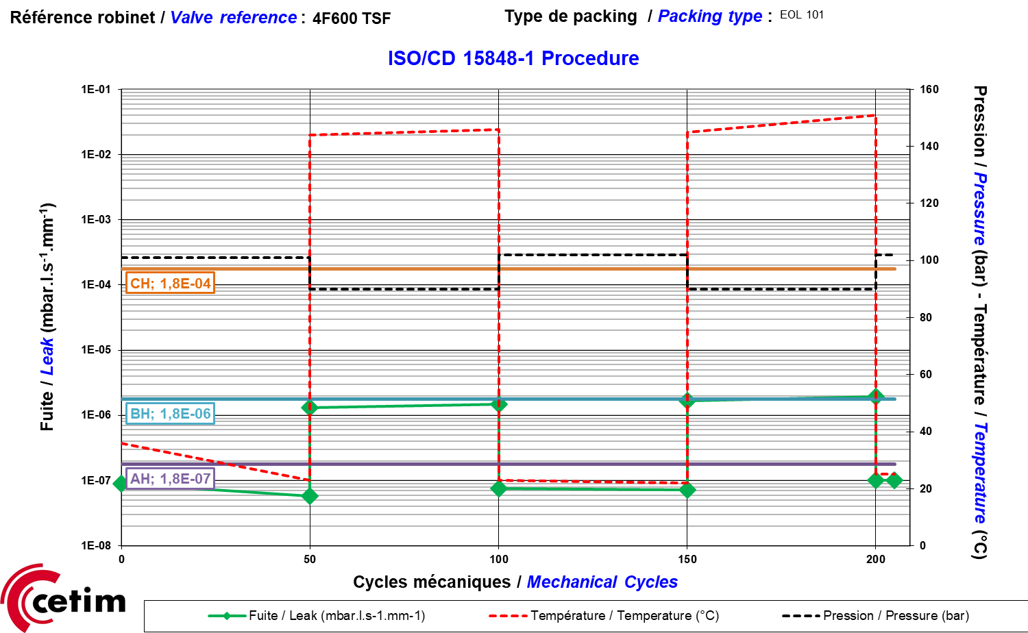
Test results
  Tightness measurements:ISO15848-1/IOGP S-562 at 150°C (97% He)
IOGP S-562 Procedure
Both just above BH Class at 150°C
Good reproducibility of measurements due to vacuum measurements
More significant variations of Leak rates with ISO 15848-1

Slide 13
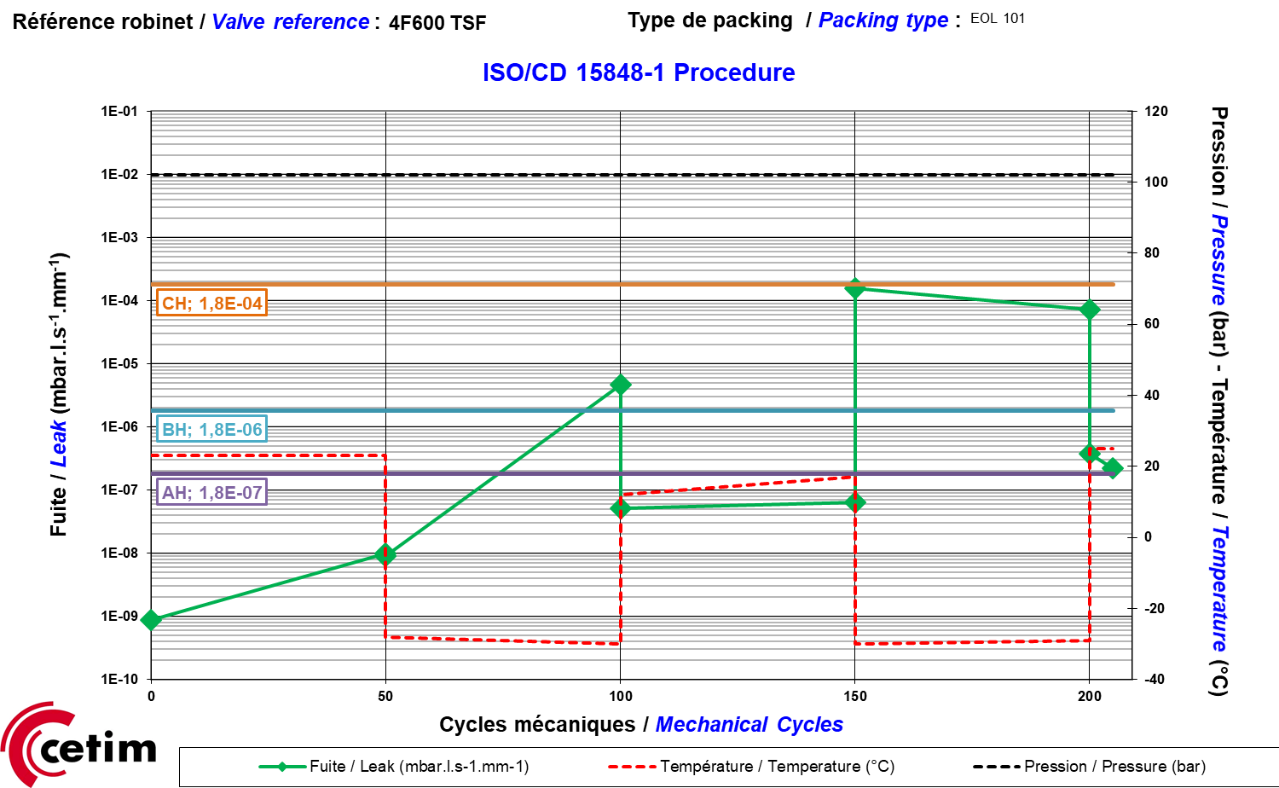
Test results
  Tightness measurements:ISO15848-1/IOGP S-562 at -29°C (97% He)
IOGP S-562 Procedure
Both CH Class at -29°C
Good reproducibility of measurements due to vacuum measurements
Leak rates are higher when stem seal temperature < Tg of elastomer material

Slide 14
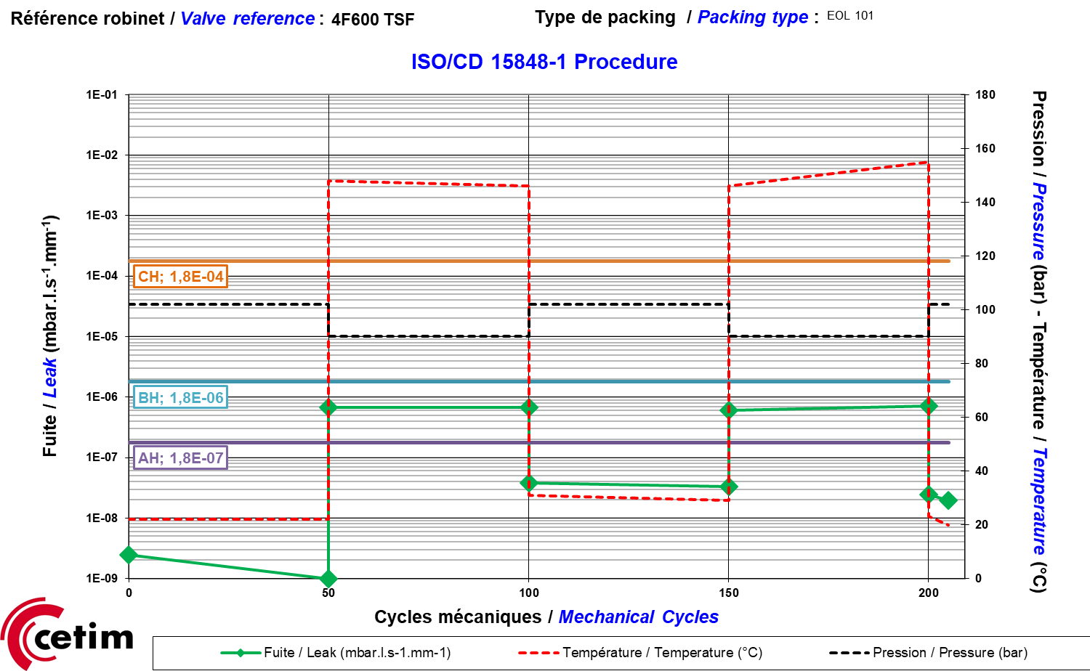
Test results
  Tightness measurements:ISO15848 10%He vesus 97%He at 150°C
Both BH Class
Same type of leak rate variations with lower amplitudes when using lower Helium content.

Slide 15
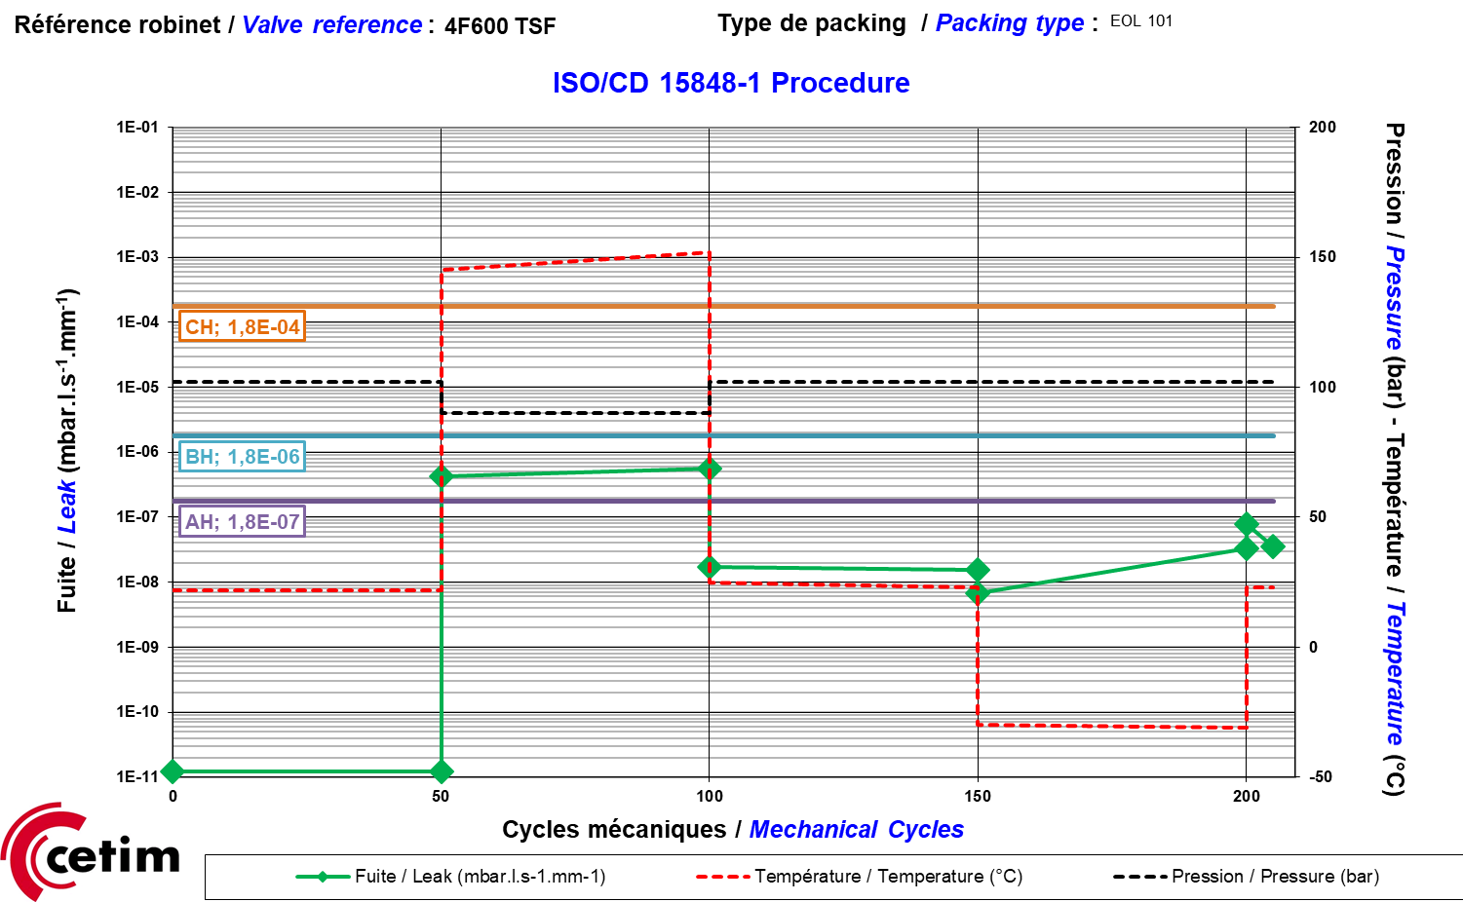
Test results
  Tightness measurements:IOGP S-562 10%Helium
BH Class at 150°C
AH Class at -29°C
Helium content is not high enough
to clearly show loss of tightness at
-29°C

Slide 16
Conclusions
  Comparison of IOGP S-562 and ISO15848-1, 3 main differences are highlighted:
    Different fugitive emission measurement techniques: sniffing (IOGP) and vacuum (ISO)
    Measurement fluids can be different: 10%Helium (IOGP), 97%Helium (ISO)
    Different thermal and mechanical cycles
  To compare IOGP S-562 and ISO15848-1, test program is developed and undertaken on an instrumented ball valve (DN150 Cl600) with elastomer O-ring as stem seals
  Influence of measurement : vacuum method allow more significant and reproducible leak rate measurement variations. Sniffing method is found to be not compatible with test duration.

Slide 17
Conclusions
  Influence of fluid:
  with 10% Helium, leak rate variations are less significant. When using IOGP S-562, a ratio between 6 to 9 was found, compared to factor 10 indicated in standard.
  with 10% Helium, loss of tightness at -29°C is not observed.
  Different thermal and mechanical cycles
  ISO15848-1: 2 thermal cycles of same type (high or low temperature) + 205 mechanical cycles
  IOGP S-562: 1 thermal cycle at the highest and lowest temperatures + 205 mechanical cycles
  ⇒ ISO procedure allows more significant and reproducible leak rate variations.
  ⇒ IOGP gives leak rate variation tendency with only one test.
  ⇒ With both methods, elevated temperature (150°C) leak rates increase due to elastomer permeability
  ⇒ At lowest test temperature (-29°C), loss of tightness is observed when T<Tg

Slide 18

Q & A SESSION
ORGANIZERS
SCIENTIFIC COMMITTEE
Special Thanks to Cetim and OMS Saleri
for their collaboration on this project.
Thank you for your attention!
IVS 2022
Technical Conference

