Slide 1
Dave Anderson
ORGANIZERS
SCIENTIFIC COMMITTEE
Director in Score Group
Emissions Elimination;
Why “Reduce” Emissions when you can “Eliminate” them?
IVS 2022
Technical Conference

Slide 2
Biography
DAVID M. ANDERSON is a Director in the Score Group and is responsible for the global deployment and development of the company’s valve condition and performance monitoring products and services, which are focused on delivering emissions reduction operating cost reduction, risk minimization and efficiency maximization for its customers.
With 38 years of experience of working directly in the valve industry, David has worked in many roles. He is in his 28th year of employment in the Score Group and has been involved in valve diagnostics and condition monitoring for over 20 years.
David is a Fellow of the Institute of Directors, a Chartered Quality Professional, a Member of the Chartered Quality Institute and a Member of the Institute of Asset Management. He is a time served Mechanical Engineering Technician and has a wide array of Engineering and Business qualifications and is passionate about sharing his knowledge and coaching / mentoring others.

Slide 3
Emissions Elimination; Why “Reduce” Emissions when you can “Eliminate” them?
Whilst most organisations have already started their journey towards lower emissions, we believe it is possible - and now is the time - to accelerate market-wide progress, to achieve maximum possible emissions reductions in the fastest possible timescale.
Based on our global experiences (a series of case studies, which shall be presented), we shall highlight real life emissions sources, the root causes of these, how we found and quantified them using the correctly selected tooling and survey technologies and then focused on achieving the delivered outcomes and benefits in each scenario.
This is an approach which can be replicated across all fluid / process industries and the paper shall conclude that by taking a planned, systematic and holistic approach to emissions elimination we can take immediate steps to achieve major progress towards a zero emissions target.

Slide 4
Low Cost AE Survey Delivers High Impact
$2.5m
Capex Planned
62off
Valves Targeted “JICM”
Low Cost
AE Survey
Delivers
High Impact
$20k
Monitoring Survey
615T
Emissions / Annum
8off
Leaking Valves Repaired
54off
54off
Valve Repairs Avoided
Valve Repairs Avoided
$343k
£278k
Annual Gas Recovery
Annual Gas Recovery
$3m
£2.29m
Net Gain in Year 1
Net Gain in Year 1

Slide 5
Greenhouse Gas Reduction Strategies
1
2
3
4
Reduce | Being efficient in operations, reducing energy demand and process emissions
Replace | Replacing fossil fuels with renewable energy and green fuels; using EV’s in place of conventional
Remove | Enhancing natural capital to sequester carbon and deliver biodiversity net gain
Offset | Generating and exporting renewable energy to reduce national reliance on fossil fuels

Slide 6
Market Forces and Initiatives
Energy Transition needs (Market Drivers and Opportunities)
Compliance Requirements & New Legislation (Push)
Seeking Solutions and Innovation - Cost savings / advantages (Pull)
ESG – Purpose Environmental, Social and Governance (Leadership)

Slide 7
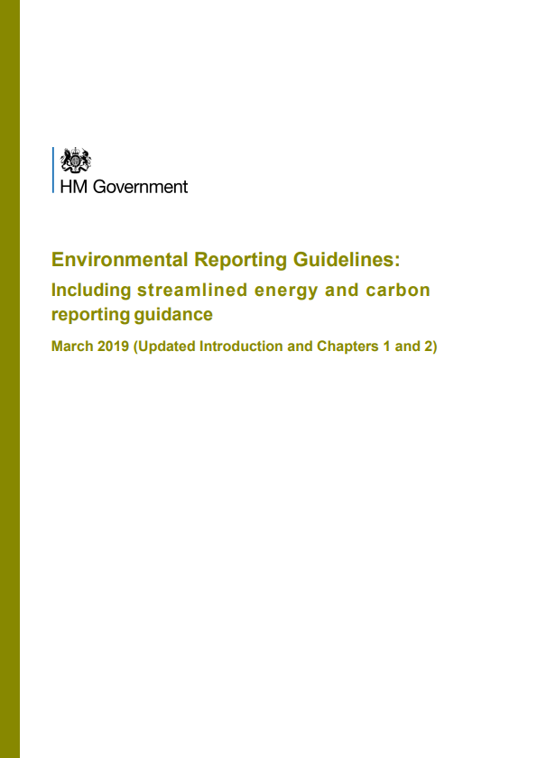
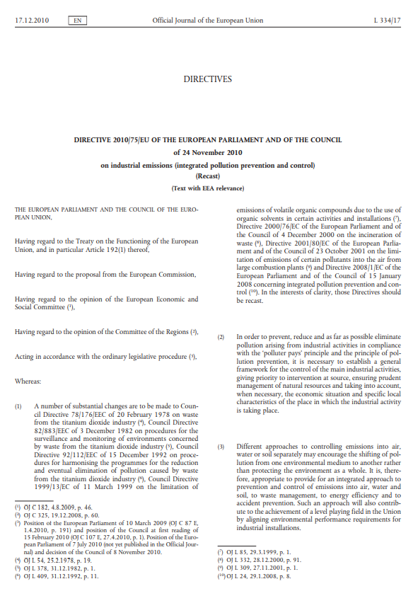
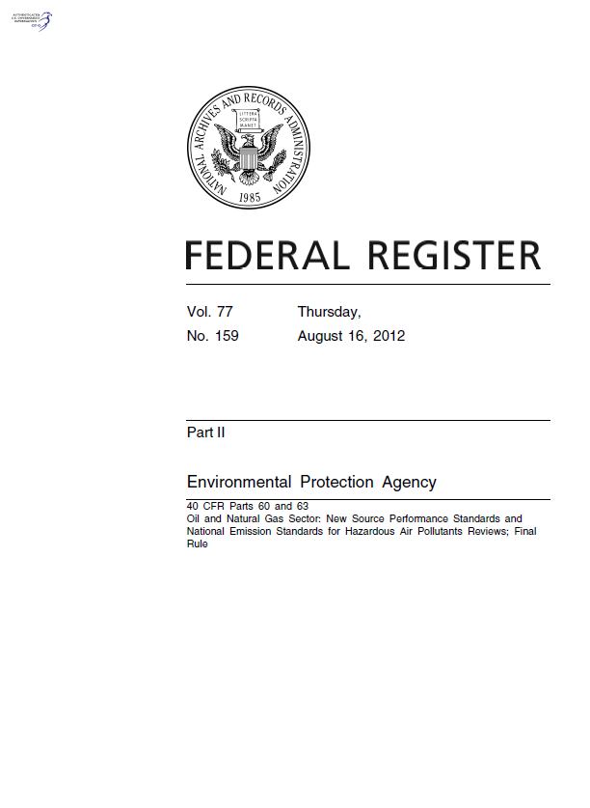
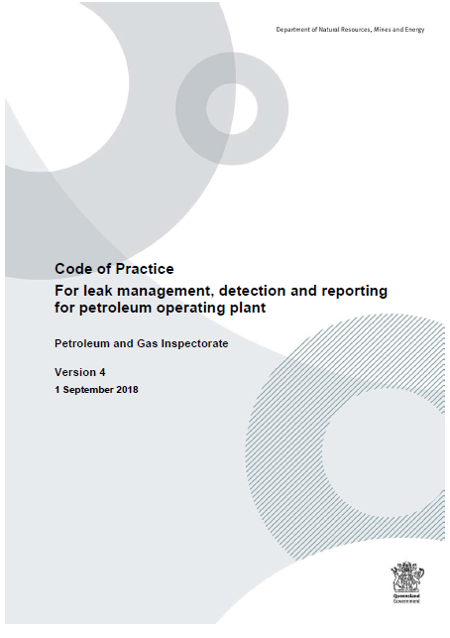
Compliance Requirements v’s Company Performance Standards
UK | Europe | USA | Rest of World
UK Government Environmental Reporting Guidelines | Directive 2010/75/EU of the European Parliament and the Council on industrial emissions (the Industrial Emissions Directive or IED) is the main EU instrument regulating pollutant emissions from industrial installations. | Environmental Protection Agency 40 CFR Parts 60 and 63 Oil and Natural Gas Sector: New Source Performance Standards and National Emission Standards for Hazardous Air Pollutants Reviews; Final Rule | Local Rules… Paris Accord (195 Countries) COP 26, Glasgow

Slide 8
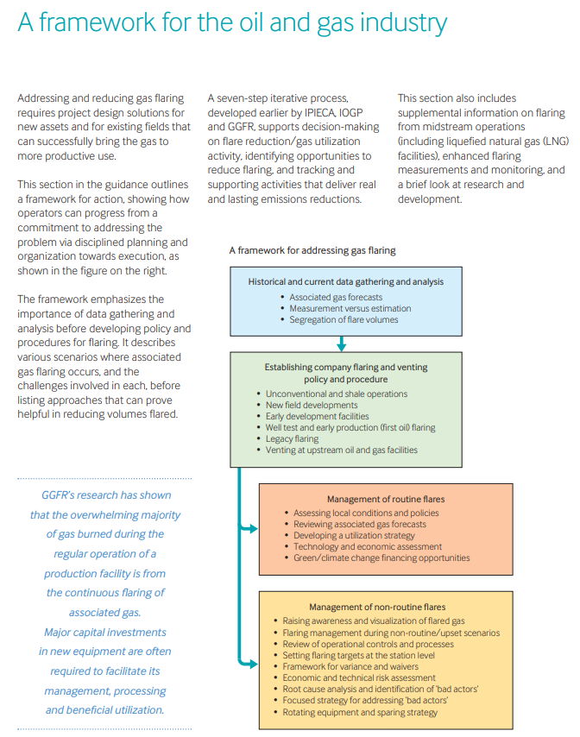
EU Regulations on Flaring & Venting
Key Points :-
Research shows that the overwhelming majority of gas burned during the regular operation of a production facility is from the continuous flaring of associated gas.
Applies to New and Existing Production Assets
Moving from “commitment” to “planning and execution”
Emphasis on Data Gathering and Analysis
Seven step iterative process developed by IPIECA, IOGP and GGFR to support decision-making
Targeting real and lasting emissions reductions

Slide 9
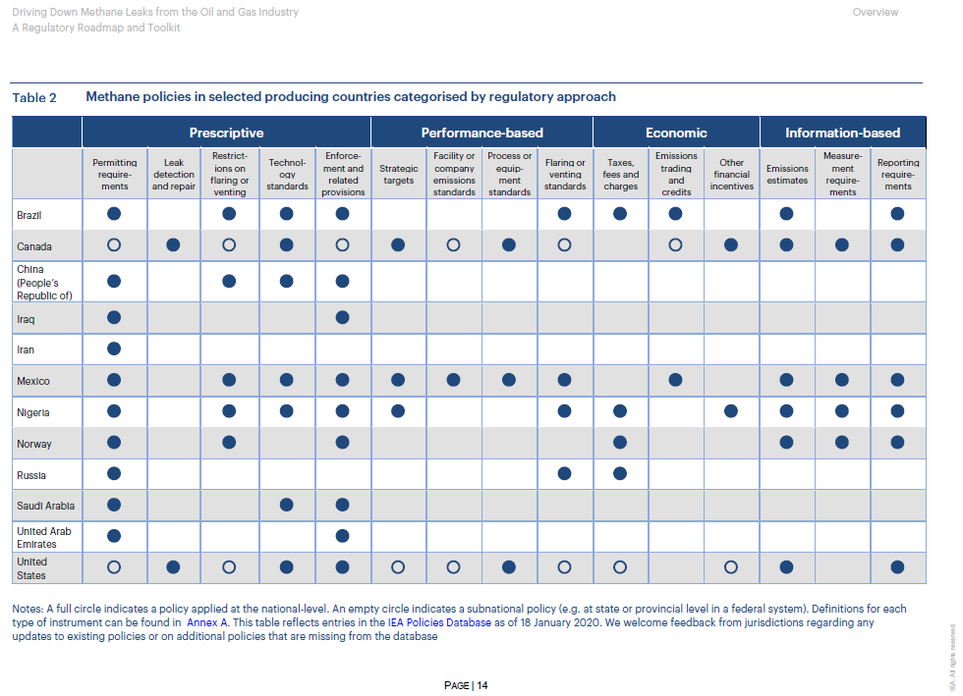
IEA (International Energy Agency)
IEA (International Energy Agency)
Driving Down Methane Leaks from the
Oil and Gas Industry
A regulatory roadmap and toolkit

Slide 10
Green House Gas Protocol of 2001
These Scopes form the basis for mandatory GHG reporting in the UK
Scope 1
(DIRECT)
Scope 2
(INDIRECT)
Scope 3
(Everything Else)
These are the Green House Gas (GHG) emissions that a company makes directly from operating - for example during “production”, while running its plant and vehicles.
These are the emissions it generates indirectly – for example, emissions produced in the generation of electricity or energy the company buys for production, heating and cooling buildings, etc.
These are all the emissions the organisation is indirectly responsible for, up and down its value chain. For example, from buying products and services from its suppliers, and also from its products when customers use them.

Slide 11
Five things you need to know about Scope 1, 2 and 3:
Scope 1 and 2 are most within an organisation’s control.
Companies will normally have the source data needed to convert direct purchases of gas and electricity into a value in tonnes of GHGs. This information may sit with procurement, finance, estates management, or in a sustainability function.
In some cases, the solutions exist to deliver net zero for Scope 1 and 2 emissions.
For example, an organisation can source renewable electricity, renewable gas, or electrify its heat demand, or transition to electric vehicles.
Scope 3 is often where the impact is.
For many businesses, Scope 3 emissions account for more than 70 percent of their carbon footprint. For example, for an organisation that manufactures products, there will often be significant carbon emissions from the extraction, manufacture and processing of the raw materials.
Businesses also have less control on how Scope 3 emissions are addressed.
You can offer to collaborate on solutions to reduce emissions with current suppliers, or consider changes to your supply chain. However, in most areas, suppliers will have considerable influence on how emissions are reduced through their own purchasing decisions, and product design.
Committing to reach net zero will involve tackling your Scope 3 emissions.
Definitions for what constitutes net zero ambition can be slippery - but businesses looking to adopt best practice will commit to tackling Scope 3 emissions as part of their plans. Mapping your emissions footprint by scale, and how much control you have over the source will be a good way to start addressing them. As well as making the emissions hotspots within easy reach your first ports of call.

Slide 12
Score Group Timeline to “Net Zero”
SHORT TERM (< 1YEAR )
Compliance & Beyond
4-step GHG Emissions Elimination Program (EEP)
Prioritisation – Surveys – Analysis – Quantification – Rectification – Continuous improvement
MEDIUM TERM (Year 1-3)
Enhanced Emissions Elimination
Improved accuracy and cost-effective methods
Support services to generate and deliver Net Present Value (NPV) positive solutions to reduce (eliminate) flaring/venting/fugitive emissions
Broader approach to reduce environmental losses
LONG-TERM (Year 3+) Optimised Emissions Elimination
Macro solutions for flaring and emissions
Permanently installed sensors/systems enhancing remote monitoring capabilities, no survey requirement
Continuous improvement of plant assets and systems, valve performance etc.
Thinking beyond - supporting the transition journey to green energy
Valve recycling
Engineering support
Materials engineering – Hydrogen/CCUS

Slide 13
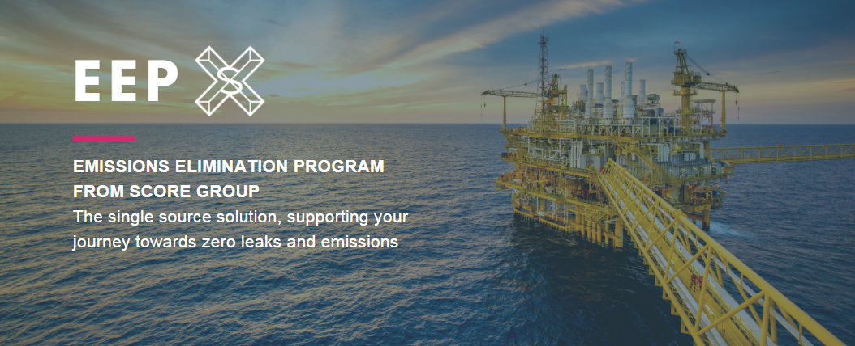
EEP

Slide 14
WHY ZERO EMISSIONS IS OUR GOAL
HEALTH AND SAFETY
Target zero accidents, incidents and near-misses
Eliminate exposure to any/all process fluid releases
ENVIRONMENT
Drive towards net zero
Environmental stewardship and sustainability
Compliance with legislation
FINANCIAL COST
Avoid unplanned outages
Maximise return on investment in maintenance
Recovered product/sales
Avoidance of penalties/fines
PRODUCTION
Optimised production and operating efficiencies
Increased availability and reliability
Reduced outages/downtime
REPUTATION
Image & brand accountability and enhancement
Positive Public Relations
Leadership positioning in marketplace

Slide 15
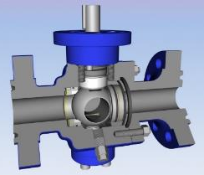
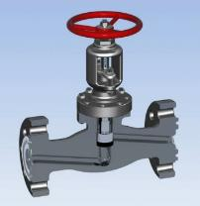
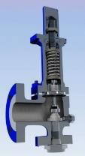
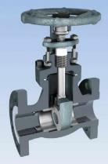
Why are valves a primary focus for “Net Zero” discussions?
Fugitive Emission Sources by Percentage
Stem Seal Failure
Flange Bolting
Through Seat
Flange Facings
Body to Bonnet and Trunnion Bolting
Source – Monitoring and containment of Fugitive Emissions from Valve Stems, University of British Columbia, Vancouver
Plug and Vent Fittings
Leak Paths on Ball, Globe, Relief and Gate Valves

Slide 16
Target Leaks and Emissions Sources - A holistic approach
LEAKS TO ATMOSPHERE​
From plant & equipment
LOSSES TO FLARE AND VENTING​
ISOLATING VALVES POINTING TO FLARE
Global Greenhouse Gas Emissions by Gas
Plus all other 'non-Greenhouse Gas' process leaks and emissions.
11%
LOSSES TO VENTS/DRAINS​
ISOLATING VALVES POINTING TO FLARE
Carbon Dioxide
(Forestry and other
land use)
Methane 16%
16%
6%
SYSTEM INEFFICIENCIES​
GENERATING CO2 AS A BI-PRODUCT
Nitrous Oxide 6%
F-gases 2%
2%
Carbon Dioxide 65%
(Fossil fuel and industrial processes)
65%
NON-FUGITIVE EMISSIONS​
CORROSION CRACKS IN PIPEWORK ETC.

Slide 17
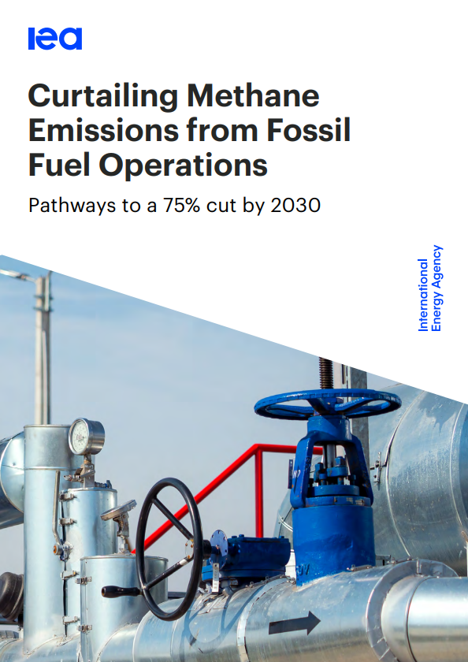
Methane Abatement
Tried and tested approaches exist for lowering methane emissions from oil and gas, and efforts to improve data quality are ongoing. A set of well established policy tools have already been deployed in multiple jurisdictions to drive down emissions.
These include leak detection and repair requirements, technology standards and bans on non-emergency flaring and venting. Still further reductions can be achieved with the help of more accurate and reliable data on emissions and abatement opportunities – but this will require robust measurement and reporting mechanisms.
If all countries that have already committed to reducing methane emissions were to adopt these policies, we estimate methane emissions from global fossil fuel operations could be cut by nearly 15%.

Slide 18
Shortcut to Net Zero : Emissions & Leaks Management
Operator Needs
LDAR
Score Focus
Find
Scale
Predict
Detection
Quantification
Trending
Q
LD AR

Slide 20
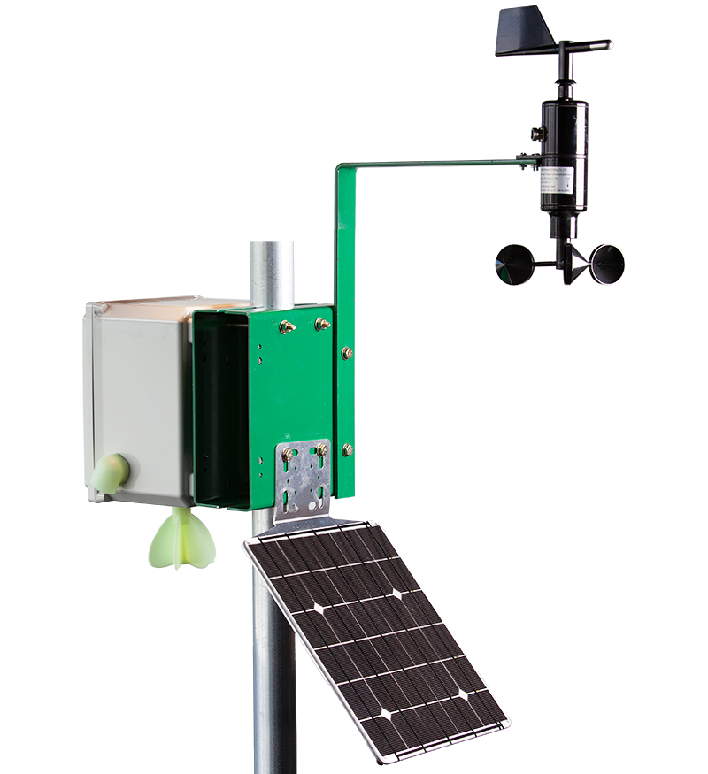
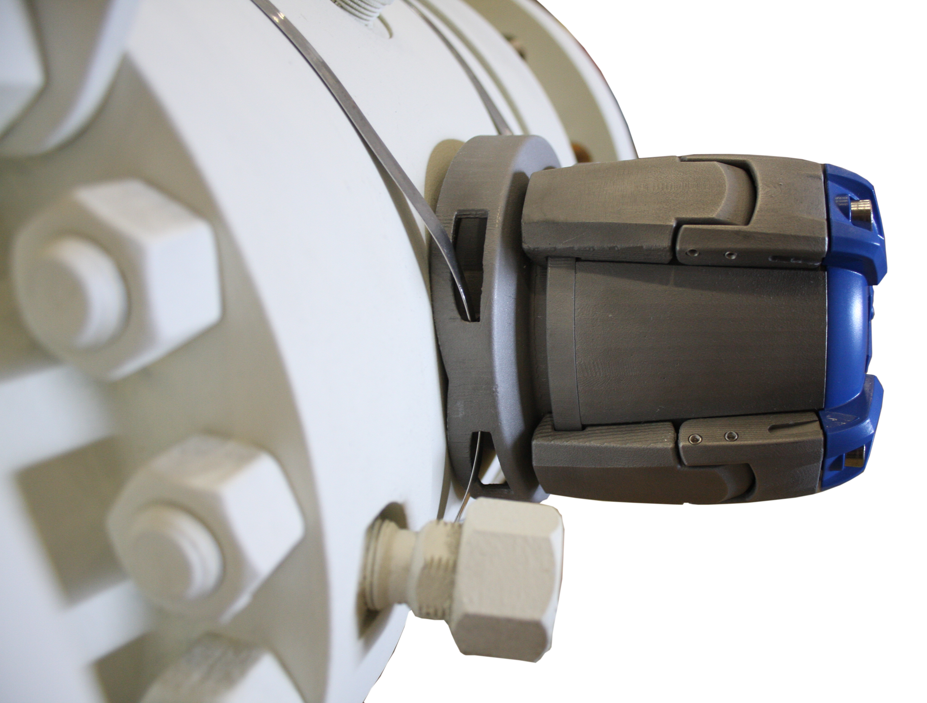
Route to Net Zero : “Whole Environment” Approach
Monitoring Systems and Devices :-
Satellites
UAVs
AVs
Drones
Perimeter Devices
Local Fixed Sensors
Hand-Held, Portable Devices
Macro
Micro

Slide 21
EMISSIONS ELIMINATION PROGRAM
TOOLS AND TECHNIQUES
PROVIDING CROSS
INDUSTRY SUPPORT TO ACHIEVE ZERO EMISSIONS
MIDAS Meter®, MIDAS® Sensor, V-MAP ®
Optical gas imaging
Thermal imaging
VOC/FID Sniffers
Ultrasound (airborne/structural)
Non-Destructive Testing
Complementary condition monitoring tooling
Quantification tooling and software
Software solutions (digital survey tablet)
A single source solution, supporting your journey towards zero leaks and emissions.
SOURCES OF
LEAKS
&
EMISSIONS
Leakages to
atmosphere
Losses to flare
Losses to vents/drains
System inefficiencies
Non-fugitive
emissions

Slide 22
SOURCES OF LEAKS AND EMISSIONS

Slide 23
Portable Tools - For Scope 1 & 2 leak detection, quantification and trending
Survey Tablet
Acoustic Emissions
Sniffer Devices
Airborne Ultrasound
Optical Gas Imaging
Thermal Imaging

Slide 24
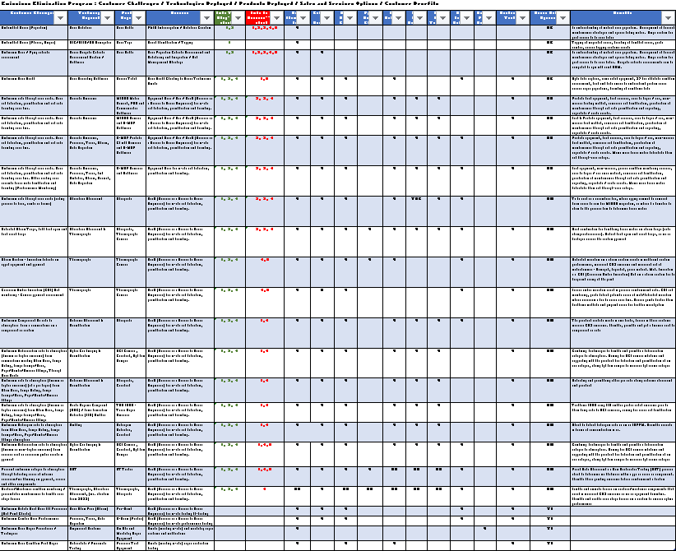
Shortcut to Net Zero : Unlocking ROI
Ready Reckoner
Customer Challenges
Technology Deployed
Product/Tooling
Services
EEP Links
Leak Sources
Capabilities Profile
Benefits of Use

Slide 25
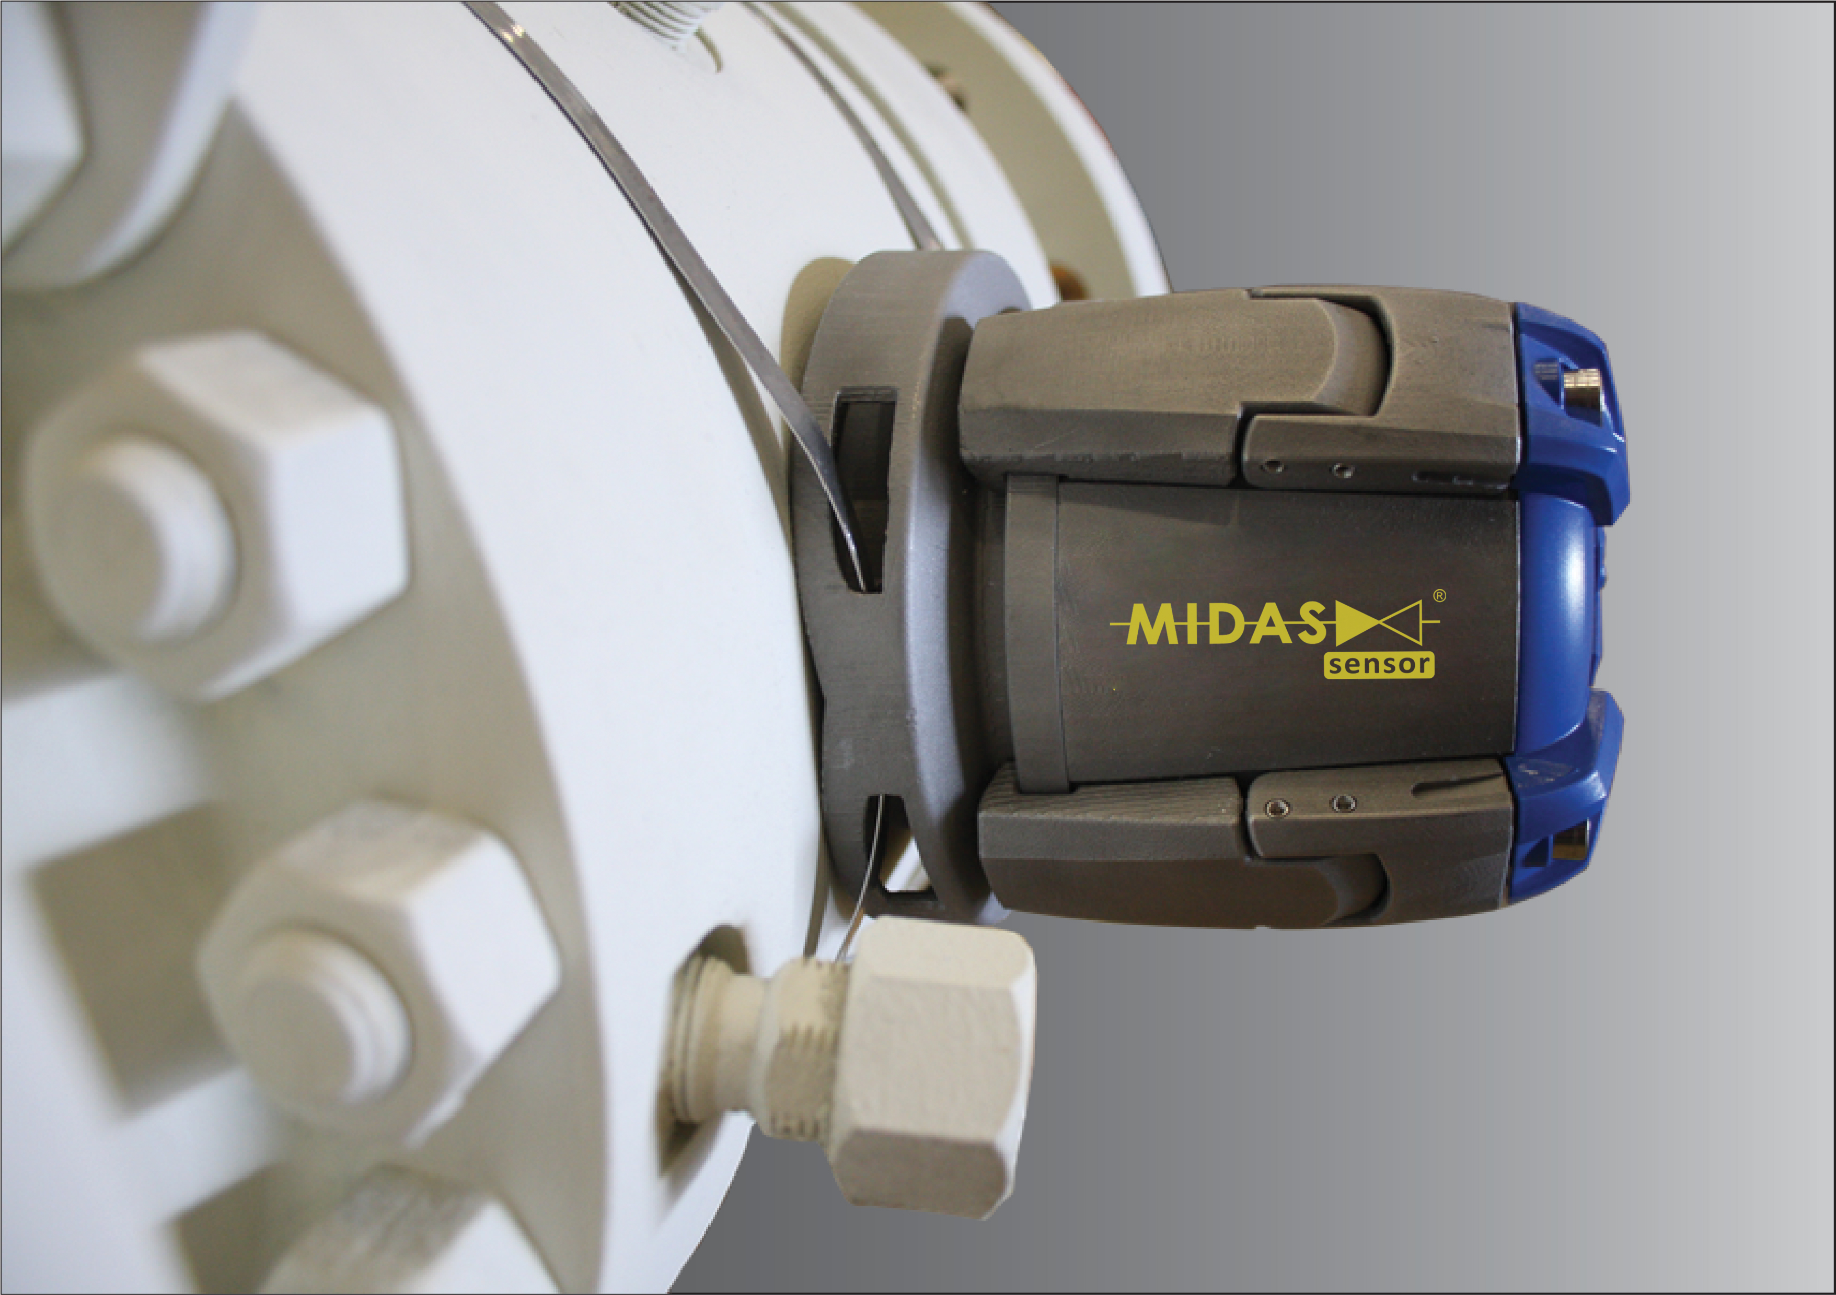
MIDAS® VALVE DIAGNOSTICS RANGE
KEY QUANTIFICATION TOOLS FOR ONLINE MONITORING AND EVALUATING
Score’s proprietary suite of monitoring equipment and systems include:-
Permanently deployed MIDAS® Sensor / V-MAP®
System for continuous, non-invasive valve condition and performance
monitoring of critical valves and the process/systems in which they are
operating. With almost 20 years of successful operation
Hand-held MIDAS Meter®
Non-Invasive Through-Seat Leak Testing tool. Delivers a proven valve monitoring
technology. With a track record of more than 10 years.
Used globally by companies in the oil and gas, petrochemical, utility, energy and
wider process industries

Slide 26
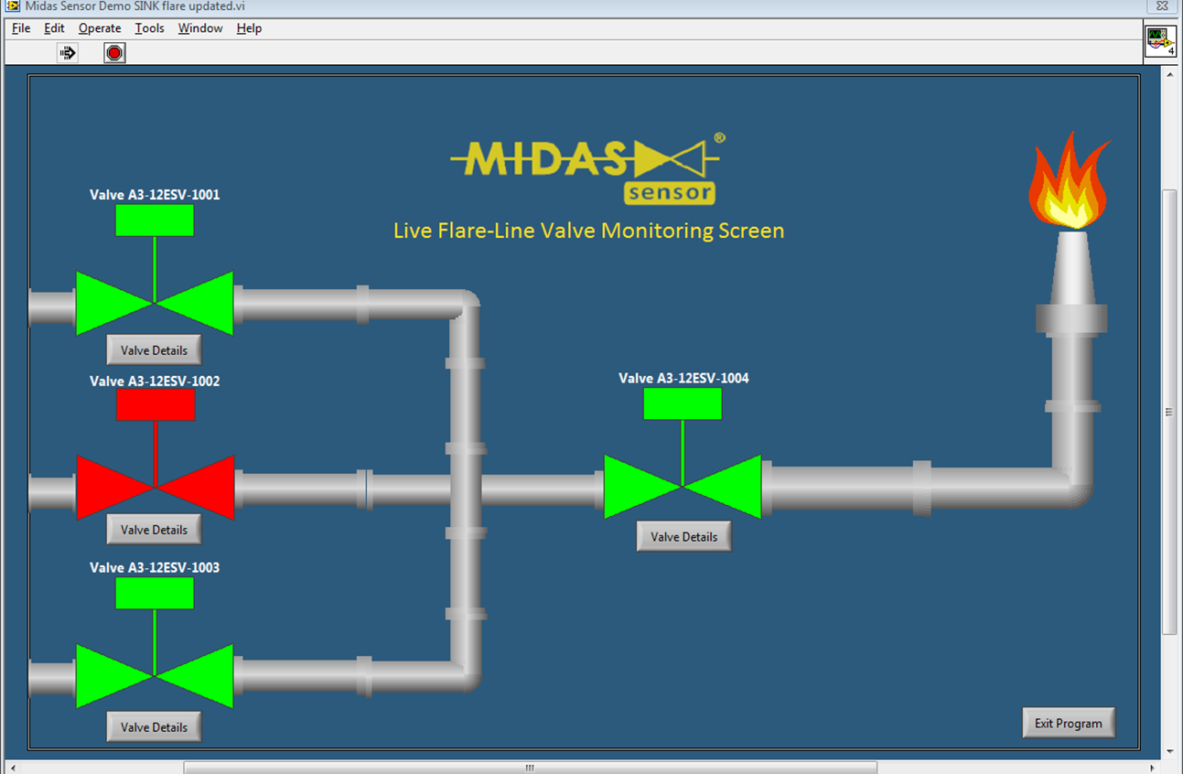
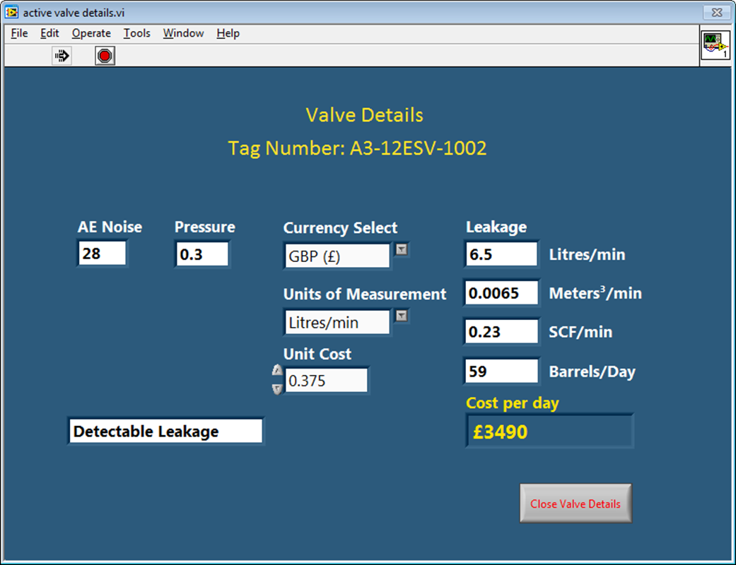
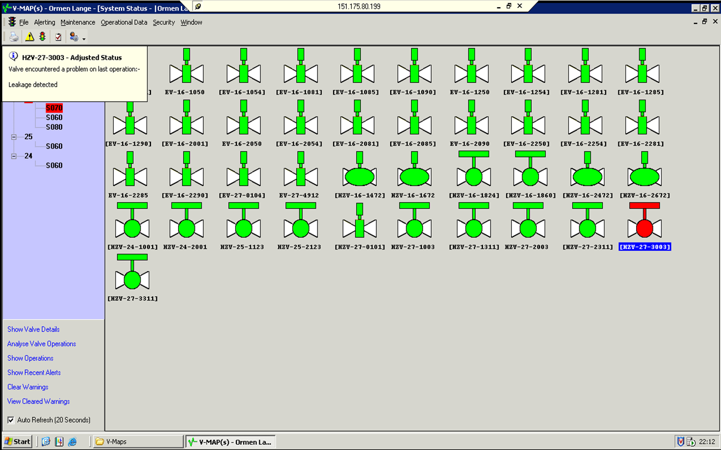
MIDAS® Sensor / V-MAP® - For continuous and automated leak detection, quantification and trending
BENEFITS
Remote monitoring of all valve operations
Margins monitoring supports predictive approach to maintenance
Evidence to drive proactive and predictive maintenance activities
Performance standards for all Safety Critical Elements
Condition and performance reporting on every valve stroke
Trending of valve, actuator and drive train over product life cycles
Manages risk and reduces exposure to failures for personnel
Detect
FEATURES
Quantify
Issues warning of any performance deterioration
Remote access to data and analysis functions
Provides trending, benchmark comparison, reports and audit records
All ESV operations are recorded
Monitors the actuator supply pressure and strain between valve operations
Seamlessly integrates with customers’ Site Automation Systems (SAS)
APPLICATIONS
Asset Integrity Management (AIM)
Risk Based Inspection (RBI) programmes
Pre-shutdown planning activities to maximise ROI
Trouble shooting to avoid shutdowns
Reliability data for confirmation of Safety Integrity Levels (SILs)
Trend

Slide 27
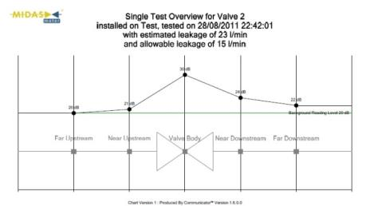
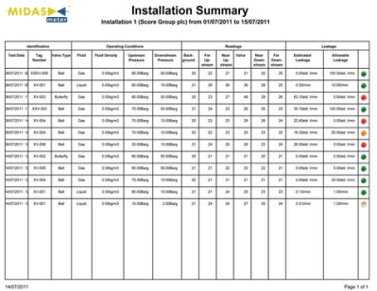
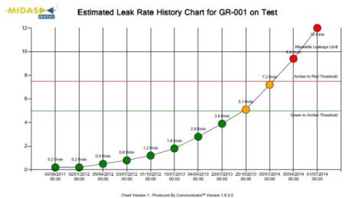
MIDAS Meter® - For hand-held leak detection, quantification and trending
BENEFITS
Reduced operating costs
Maximised profitability
Minimised losses
Optimised process efficiency
Optimised reliability and uptime
Minimised safety and environmental risks
Detect
FEATURES
Completely portable and easy-to-use
Non-intrusive and safe for use in hydrocarbon environments
Integral display for use stand alone
Rechargeable battery
Bluetooth from sensor to PDA for data logging/quantification analysis
Data download and export capabilities
Quantify
APPLICATIONS
Asset Integrity Management (AIM)
Risk Based Inspection (RBI) programmes
Pre-shutdown planning activities to maximise ROI
Trouble shooting to avoid shutdowns
Trend

Slide 28
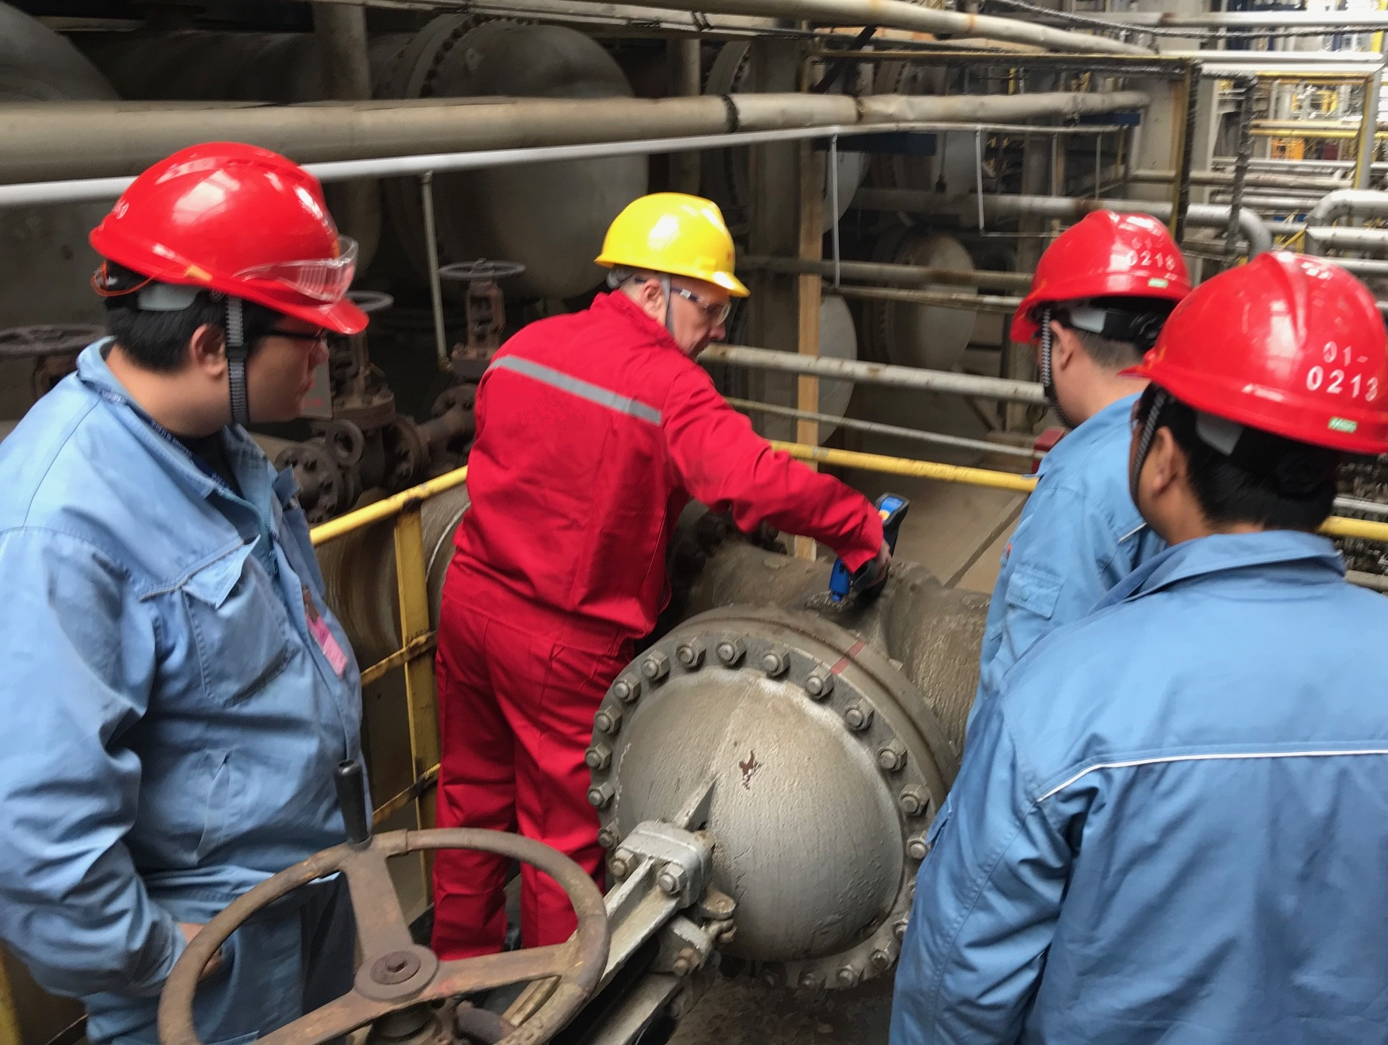
Taking a
“Find and Fix” Approach

Slide 29
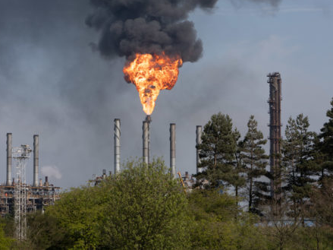
Taking a
“Find and Fix” Approach

Slide 30
Journey to zero leaks and emissions
Planned Outage
Intrusive Maintenance to rectify remaining leaks and emissions
Zero Leaks & Emissions
Starting Point
Identify leaks/emissions sources
Quantify losses/prioritize
Determine failure modes
Engineering review
Develop maintenance plans
Non-Intrusive and Temporary Repairs
Reduce losses, leaks and emissions quickly, with no disruption to normal plant operations
Minimal carbon emissions
No associated downtime
No associated financial loss
Optimised system
Maximum investment

Slide 31
MAINTENANCE SOLUTIONS
NON-INTRUSIVE
Valve Integrity clamps (stem, gland & plug)
Pipe & flange integrity clamps
Isolation barrier sealant injection
Leak sealing solutions
Gland packing adjustment
Controlled bolting
Composite techno-wrap
PLANNED
New valve & actuator supply
Joint integrity management
Valve & Actuator overhaul & repair
PSV inline testing & recertification
Lagging inspection & repair
Instrumentation/control systems inspection, repair, assembly & supply
Hose manufacture & supply
On-site machining & fabrication

Slide 32
Proven Benefits of Reducing Process Emissions
With Valve Diagnostics Equipment / Systems
and Targeted, Fast and Effective Repairs.

Slide 33
Case Study: Campaign undertaken at Processing Plant
01:
Capture
01
02
03
04
Site Survey
Identified losses of 540 tonnes per annum
Data Analysis
Maintenance strategy developed
Mitigation
Mobilised to undertake non-intrusive maintenance
Improvement
Mobilised to undertake intrusive maintenance
Identified & Repaired
178 On-line leaks repaired – valve glands, screwed fittings, instrument tubing and bolted joints
8 Isolation valves identified with through bore leakage – injected with isolation barrier solutions
700+ Valves overhauled
1086 Flanged joints assembled
221+ Flange faces re-machined to spec
142 New valves supplied
60% reduction achieved
84% reduction achieved on total emissions

Slide 34
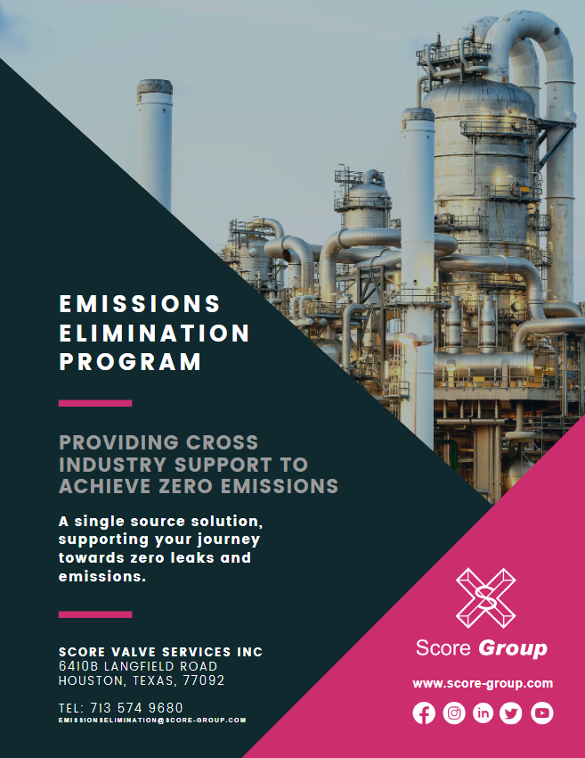
Case Study
Case Study 1
Surveyed 62 safety relief valves to detect & quantify any leakages. Repaired 8 valves confirmed to be leaking process to flare. Realised annual product loss savings of $342k USD. Avoided maintenance on 54 valves confirmed not leaking. Cost of survey over 4 day period $30k USD.
Case Study 2
19 fugitive emissions identified from recent survey (losses 9.2 Kg/Hr). Fast, non-intrusive temporary maintenance undertaken on 13 leaking valves. Remaining 6 leaking valves monitored & repaired during planned outage. Temporary maintenance alone reduced emissions to 1.1 Kg/hr. Temporary maintenance completed within 10 days of initial survey. All emissions eliminated as a result of further planned maintenance activities.
Case Study 3
Ball valve confirmed leaking 2.6 Kg/hr process gas to atmosphere. Injected a temporary isolation barrier to eliminate leakage. Planned to undertake permanent maintenance during next outage. 436.8 Kg of gas emissions per week prevented prior to planned outage. Personnel safety was maintained at site prior to valve being repaired.
Case Study 4
89 Blowdown valves scheduled for removal & maintenance during planned outage. Survey valves to detect & quantify any leakages prior to removal from line. Undertake maintenance on 28 valves confirmed as leaking process to flare. $430k savings delivered by repairing the process leaks to flare. Maintenance on remaining 61 valves avoided through condition monitoring. Return on investment from survey: ROI : $21.50 returned, for every $1 spent.
Case Study 5
Suspected valve leakage in one or two 12” 2500# gate valve on the flank gate to VFS and VFN (PIG Launchers). The leaking valve was positively identified, investigated and the outcome was wrong end-stop settings on the actuator. End-stop positions were checked and adjustments made. Process shutdown was avoided and major cost savings made, since new valves were not required / procured. Additionally, MIDAS® Meter saved the customer money in the identification of the leakage, when compared to traditional tests methods.

Slide 35
Key Takeaways
Strategy :-
Why are we doing this?
WIN~WIN
Our Joint Targets
ESG
Sustainability
Compliance
Digital Transformation
Optimization
Reliability
What will deliver Net Zero?
Collaboration
Urgency
Measured Data
Prioritized Action
Continuous Improvement
Investment

Slide 36
Key Takeaways
It takes ALL of us!
To achieve long term sustainability

Slide 37
Emissions Elimination – Path to Net Zero
BENEFITS OF PARTNERING WITH SCORE
Safe, efficient and sustainable solutions
Access, without complexity and compromise on quality
40 years of service in the UKCS
Specific Emissions Elimination Program (EEP) to reach net zero targets
A significant contribution to Environmental, Social and Governance objectives and enhance overall business performance

Slide 38
Relationships/Collaborations/Knowledge Share/Influence
Standards Bodies we are working with/have representation on;
British Valve and Actuator Association (BVAA) – Principally on the valve working group which covers/monitors valve related standards
Also represented on TEGs (Technical Expert Groups) which provide BVAA’s response/input to BSI for input into international standards.
TEGs represented on include Hydrogen and Fugitive Emissions
BSI – We are represented on PSE 18 (Industrial valves, steam traps, actuators and safety devices against excessive pressure)
UNI – Italian equivalent of BSI. Also representation on ISO and CEN committees via UNI.
CEN – European standards:
Functional Safety of Safety Related Valves and Actuators – CEN TC69 WG1 AHG3
A working Group looking into valve standards for hydrogen transition – part of CEN TC234 (Gas infrastructure), but under TC69
ISO – Input to working groups working on standards focussed on:
ISO 5640 Mounting Kits
ISO 10497 Fire Testing
ISO 5115 Part-turn Valve Actuation
ISO 23632 Type Testing of Valves
API – Following the development of API valve standards – API 6D
IOGP JIP33 – Significant input to valve and actuator related specifications in the last 4 years.
ISA – Voting Member of the ISA TR 96 Committee, currently focused on TR 96.05.02 - In-Situ Testing of Valves and TR 96.05.01 - Partial Stroke Testing of Valves, also engaged in all other TR 96 committees’ work on valve automation
PLUG – Guidance on failure modes and diagnostic analysis

Slide 39
Working together and implementing our innovative technologies and proven program will help you eliminate emissions.
For consultation or further details, please visit us on stand 6
You may also contact us by email directly, at : EEP@score-group.com
Please visit our website for further information, www.score-group.com

Slide 40
Q & A SESSION
ORGANIZERS
SCIENTIFIC COMMITTEE
Thank you for your attention!
IVS 2022
Technical Conference

