Slide 1





Dave Anderson
ORGANIZERS
SCIENTIFIC COMMITTEE
Director in Score Group
The Convergance of IIoT, Data Analytics and Asset Integrity Management / Reliability in the Valve Industry
IVS 2022
Technical Conference

Slide 2
Biography
DAVID M. ANDERSON is a Director in the Score Group and is responsible for the global deployment and development of the company’s valve condition and performance monitoring products and services, which are focused on delivering emissions reduction operating cost reduction, risk minimization and efficiency maximization for its customers.
With 38 years of experience of working directly in the valve industry, David has worked in many roles. He is in his 28th year of employment in the Score Group and has been involved in valve diagnostics and condition monitoring for over 20 years.
David is a Fellow of the Institute of Directors, a Chartered Quality Professional, a Member of the Chartered Quality Institute and a Member of the Institute of Asset Management. He is a time served Mechanical Engineering Technician and has a wide array of Engineering and Business qualifications and is passionate about sharing his knowledge and coaching / mentoring others.

Slide 3
The Convergance of IIoT, Data Analytics and Asset Integrity
Management / Reliability in the Valve Industry
Describing the multi-layered visions and opportunities that the IIoT promises – what are these today and how could they change moving forward? Have we clearly and correctly identified the connection between the developing technologies and the true value they can deliver?
What are the drivers and key factors to consider in moving from “novel” inventions to global adoption? Is technology development driving compliance, or compliance driving innovation? Are there barriers stopping the wider and faster adoption of innovative technologies?
What are the relationships between failure modes and performance data, collection, communication, security, interconnectivity, compatibility, centralization, interpretation, analytics, insights and VALUE?
Who are the main players, what are the potential benefits, who will reap the rewards? Where do we go next – what will our future target focus be?
We will look at a model for improving process valve reliability through Intelligent Valve Management and a case study on performance data analytics versus failure modes in valve assemblies.

Slide 4
IIoT Environment & Condition Monitoring :-
Key Elements Driving Reliability and Added Value
Introduction
There are more new technologies and “smarter” ways of working than ever before.
Digitalisation opportunities in exciting new areas such as IIoT : Industry 4.0 : Cloud Computing : Big Data : Machine Learning : Remote Monitoring / Global and Centralised Control Rooms : Edge Devices : Artificial Intelligence : Digital Twins : Augmented Reality : etc, etc. are changing the way we are working.
What are our next carefully planned steps in this evolution? What does this really mean for us in the Valve Community? Can we really leverage digitalisation advances to deliver enhanced valves’ reliability moving forward?

Slide 5
Harmony and Alignment… Or competing interests?
Operators Needs
Valve Manufacturers
Operating Hardware
Operating Software
Plug & Play Operators
v
v
v
v
v
Supplier Needs
Integrators
Monitoring Hardware
Monitoring Software
Plug & Play Sensors
Can one succeed without the other?
Pandemic – Accelerated adoption of technologies?

Slide 6
Unlocking Value & Sustainability With IIoT – The Benefits and Rewards

Slide 7
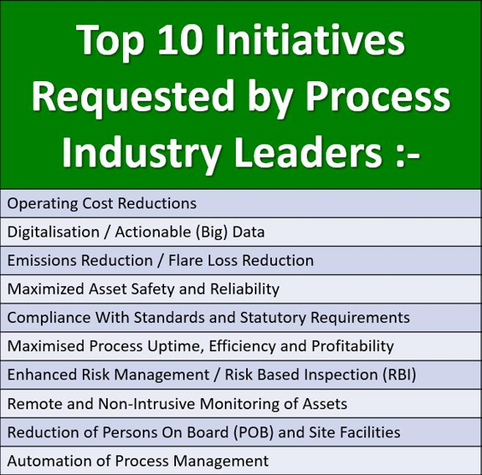
Aligning with Operating Company Initiatives

Slide 8
Who can deliver the required outcomes?
It takes ALL of us!

Slide 9
Key points to consider :-
What decisions are process operators currently taking about valves / operators?
What data or evidence supports, informs, or drives these decisions?
What could improve this decision making?

Slide 10
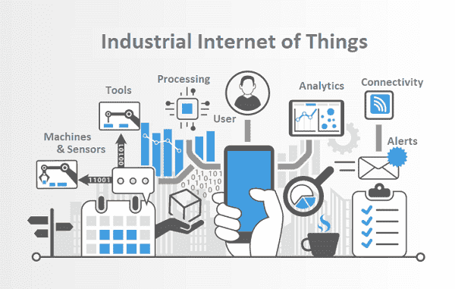
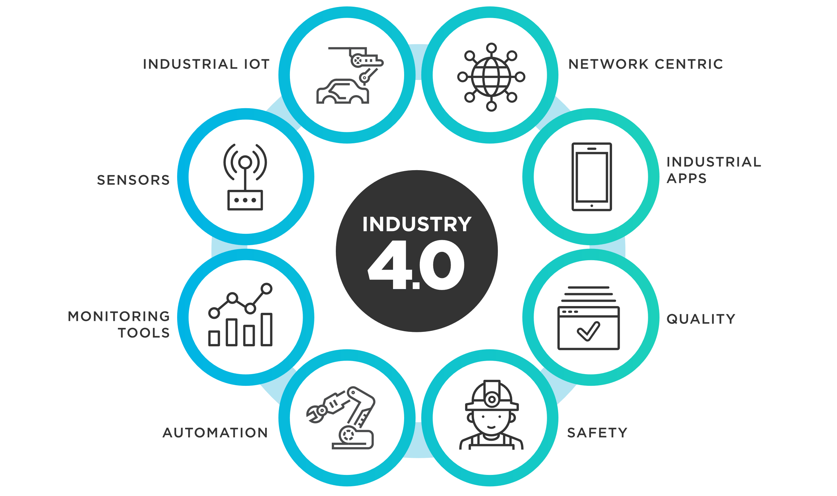
An Optimisation Initative
The Industrial Internet of Things is primarily about connecting machines in industrial settings to gain insights not previously visible or known.
Source : Optiware
Source : Tibco

Slide 11
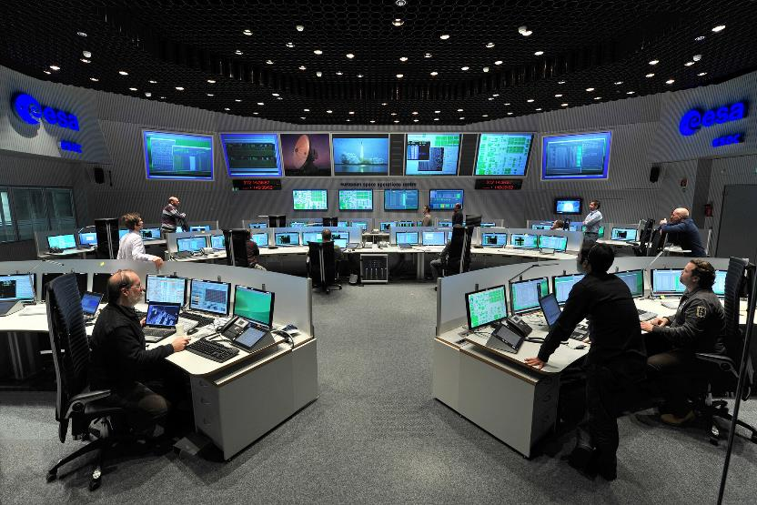
Automated Instrumented Systems & Digital Twins
Centralised Control
Remote Operation
Full / Partial Automation
Interconnected Assets
Interconnected Sensors
Interconnected Systems
Interconnected Processes
Raw Data
Levers
Triangulation
Inter-relationships
Insights
Modelling
Source : ESA

Slide 12
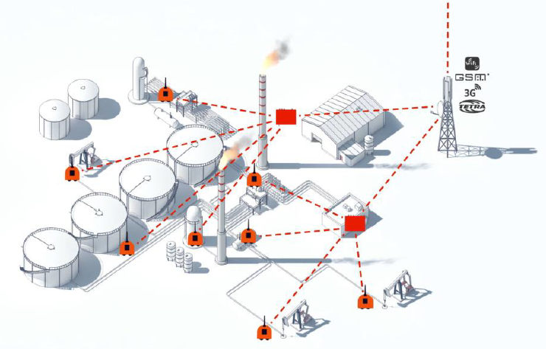
Assets Monitored in the Digital Environment
Motors
Pumps
Bearings
Compressors
Pressure Gauges
Flow Meters
Tanks
Flares
Valves
Actuators
Pipework
Heat Exchangers
Steam Traps
Etc.
Asset Tracking
Asset Status
Asset Performance
Asset Degradation

Slide 13

IIoT Environment & Condition Monitoring :-
Key Elements Driving Reliability and Added Value
Specialised
Sensors
(Data Gathering)
IIoT
Open, Reliable & Secure Communications
(Data Transfer)
Valve Insights™
(Data Understanding)
STANDARDIZATION

Slide 14
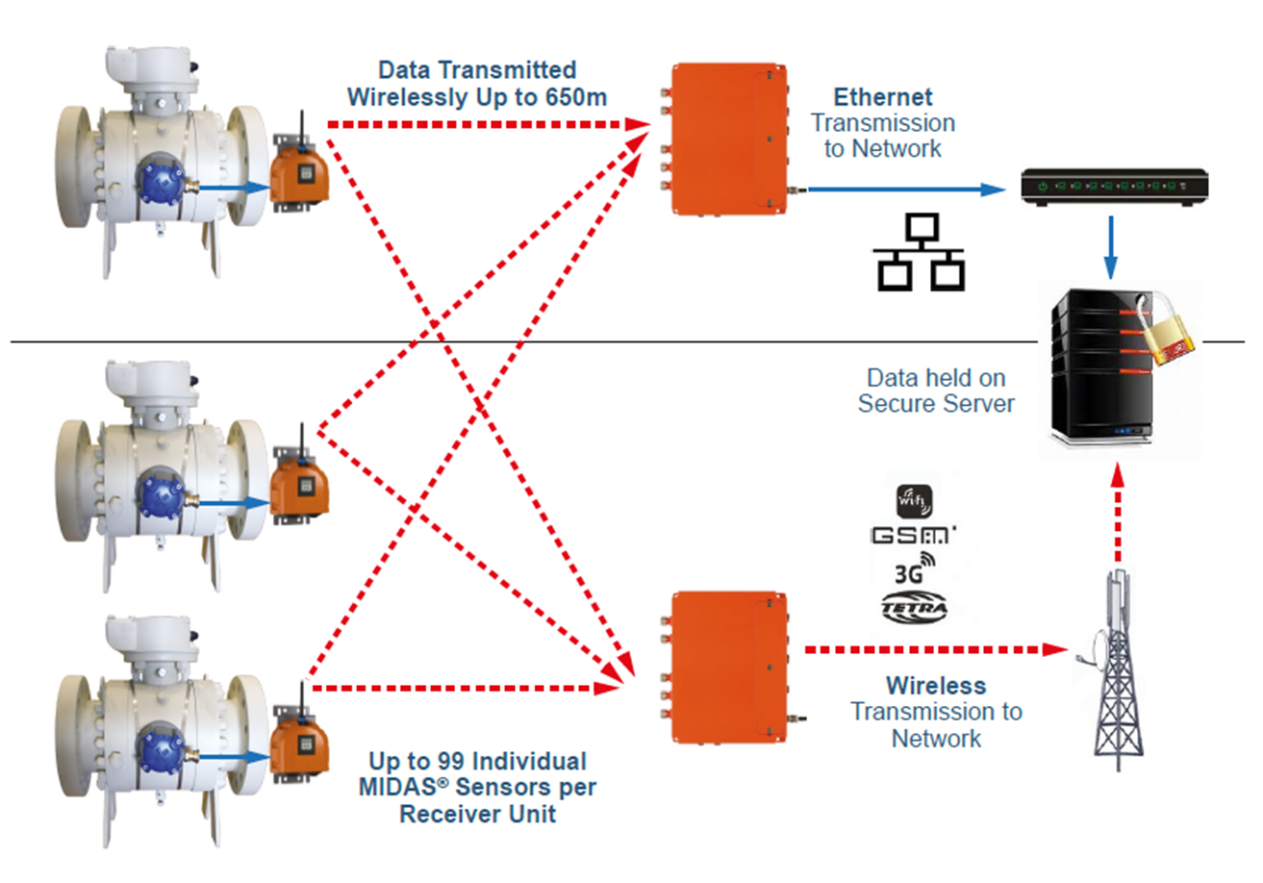
Asset Management and Monitoring Eco-Systems
Edge Devices and Centralised Analysis of Performance

Slide 15

Awareness / Opportunity / Global and Local Compliance
Requirements are Changing : Existing, New and Revised Standards
Existing, New and Revised Standards
Pipeline Safety Regulations (1996) PSR Regulation 19 : ESDV Maintenance
PAS55 / ISO 55,000 : Asset Integrity Management
ISO 9001:2015 : Risk Based thinking
ISO 33,000 : Risk Management
ISO 23632: Design Validation Testing
ISO 15848, EPA 21, TA-Luft : Fugitive Emissions
ISO / IEC 61508 / 61511 : Safety Integrated Systems
ANSI/ISA-TR96.05.01-2017 : Partial Stroke Testing of Automated Block Valves
ANSI/ISA-TR96.05.02 : In Situ Testing of Automated Valves (Draft 03)

Slide 16

Awareness / Opportunity / Global and Local Compliance
Requirements are Changing : Existing, New and Revised Standards
Existing, New and Revised Standards
BSEE - 30 CFR § 250.880 - Production Safety System Testing (Monthly ESD Valve Testing)
EPA - Emissions Reductions Targets : 250ppm Limit (From 20,000!)
Kyoto Protocols / Paris Agreement (22/04/16) : International Greenhouse Gas Emissions mitigation, adaption and control (COP 26 – Glasgow)
Integrated Pollution Prevention Regulations (IPPR) : Local v National Targets
Hydrocarbon Release Reduction (HCRR) : Local Targets
UK HSE’s “KP4” Audits : Ageing & Life Extension of Assets

Slide 17
Optimisation / Sustainability / The Prizes
Safety Performance Assurance
Operating Cost Reductions
Asset Integrity Management
Continuous Improvement
IIoT and
Digitalisation
Reliability Centred Maintenance
Maximum Compliance
Production Uptime Maximisation
Minimum Exposure to Risk
Maximised Operating Profits

Slide 18
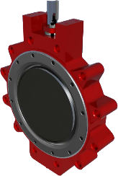
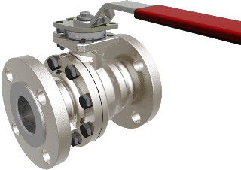
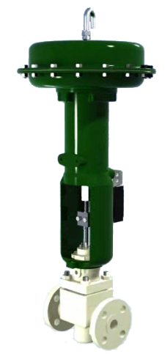
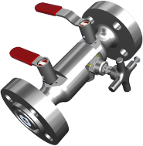
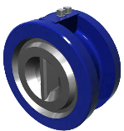
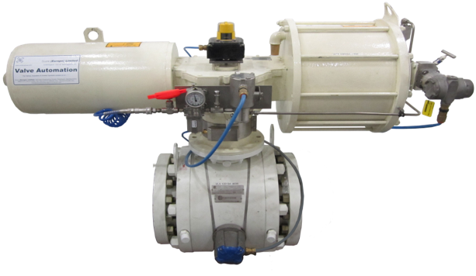
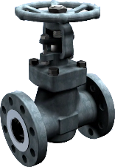
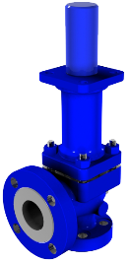
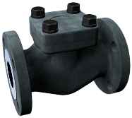
The critical roles valves play in managing
fluids in process plants v’s other assets?
Fluid Containment
Fluid Isolation
Fluid Flow Regulation
Fluid Pressure Relief
Fluid Reverse Flow Protection
Fluid Diversion
Fluid Mixing
Etc…

Slide 19
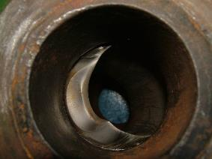
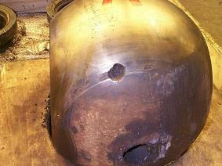
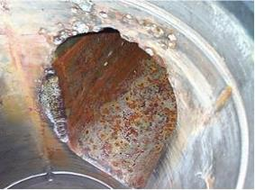
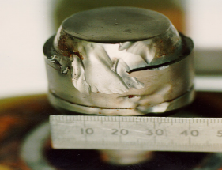
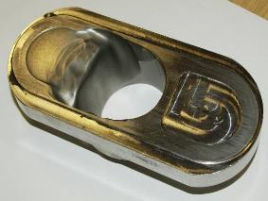
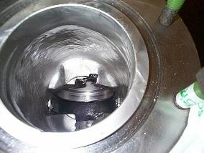
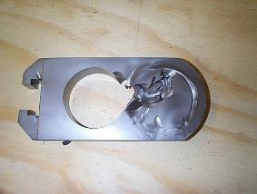
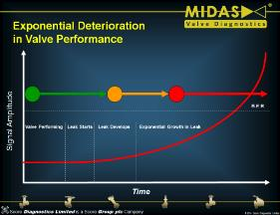
Enhanced Management of Valves / Operators
Wear, Aging, Mechanical Damage, Mechanical Failure, etc
Acronyms : FTO, FTC, FTR, RTOF, RTCF, OSF, ELS, HSF, PSF, …etc!
FMEDA – Data Connection to Root Causes (& Learning Opportunity!)
Inference : Identify to “address”
Performance Standards & Pre-Failure Indicators

Slide 20

Collaboration to Deliver Valve Reliability Improvements
(The Virtuous Cycle of Continuous Improvement)
Trend for Reliability
Score Group Intelligent Valve Management™
1 Engineer
2 Supply & Install
3 Monitor
4 Maintain
5 Learn
Modify for Reliability
Design for Reliability
Maintain for Reliability
Verify for Reliability
Trend Performance for Reliability

Slide 21
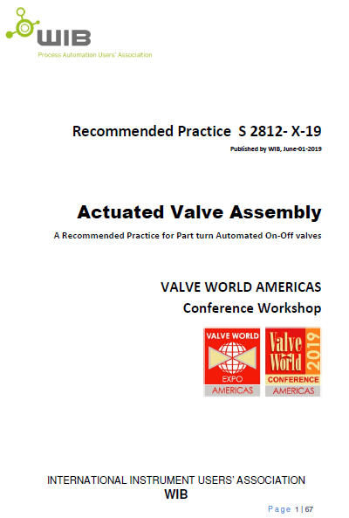
AVARP
WIB RP S 2812-X-19
Actuated Valve Assembly
A Recommended Practice for Part Turn Automated On-Off Valves

Slide 22
Actuated Valve Assembly Performance
Torque Vs. Angle of Rotation
New Actuator
Buyer Beware :-
Design v’s As Manufactured
Flow v’s No Flow Conditions
+FoS/FM
Torque Output / Requirement
New Valve
0°
45°
90°
Rotation Angle°

Slide 23
Actuated Valve Assembly Performance
Torque Vs. Angle of Rotation
Deteriorating Actuator
Valve Insights™
Detectable Deterioration
Predictive Maintenance
-FoS/FM
Torque Output / Requirement
Deteriorating Valve
No Movement!
0°
45°
Rotation Angle°
90°

Slide 24
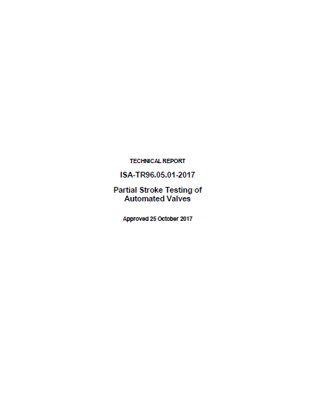

ISA (International Society for Automation)
TR96.05.01-2017
Partial Stroke Testing of Automated Valves
(Replaced 2008 Version)

Slide 25
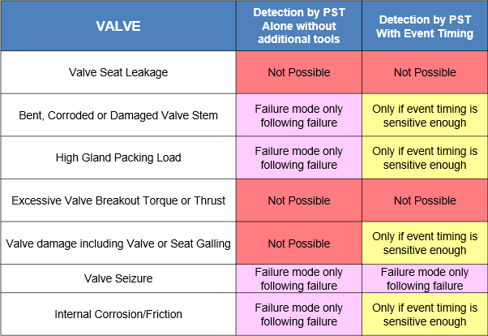
Valve Monitoring Solutions Selection…
Diagnostic Capabilities Comparison

Slide 26
ISA TR96.05.01
% of Diagnostic Coverage (Driving Visibility / Confidence)
Coverage Level | With PST | PST System Elements Description
I | 15 | PST without Instrumentation
II | 40 | PST with Event Timing
III | 60 | PST with actuator based instrumentation
IV | 80 | PST with external CBM system

Slide 27
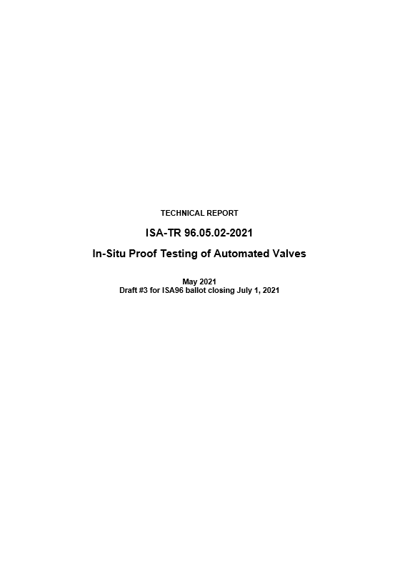
ISA (International Society for Automation)
TR96.05.02-2021
In Situ Proof Testing of Automated Valves
Draft 03 Approved

Slide 28
Valve Monitoring Solutions Selection…
Diagnostic Capabilities Comparison
VALVE | Detection by PST Alone without additional tools | Detection by PST With Event Timing | Detection by On line Monitoring and Signature Analysis
Valve Seat Leakage | Not Possible | Not Possible | At initial onset and monitored for effects on margin
Bent, Corroded or Damaged Valve Stem | Failure mode only following failure | Only if event timing is sensitive enough | At initial onset and monitored for effects on margin
High Gland Packing Load | Failure mode only following failure | Only if event timing is sensitive enough | At initial onset and monitored for effects on margin
Excessive Valve Breakout Torque or Thrust | Not Possible | Not Possible | At initial onset and monitored for effects on margin
Valve damage including Valve or Seat Galling | Not Possible | Only if event timing is sensitive enough | At initial onset and monitored for effects on margin
Valve Seizure | Failure mode only following failure | Failure mode only following failure | Predictable based on analysis & trending
Internal Corrosion/Friction | Failure mode only following failure | Only if event timing is sensitive enough | At initial onset and monitored for effects on margin

Slide 29
ISA TR96.05.02
% of Diagnostic Coverage (Driving Visibility / Confidence)
Coverage Level | With PST | Full Cycle No Flow | Full Cycle Op Conditions
I | 15 | 15 | 15
II | 40 | 46 | 81
III | 60 | 65 | 83
IV | 80 | 83 | 96

Slide 30
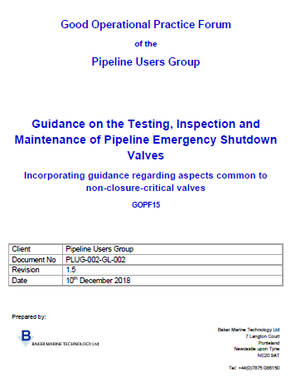
PLUG
PLUG-002-GL-002 Rev 1.5
Guidance on the Testing, Inspection and Maintenance of Pipeline Emergency Shutdown Valves

Slide 31
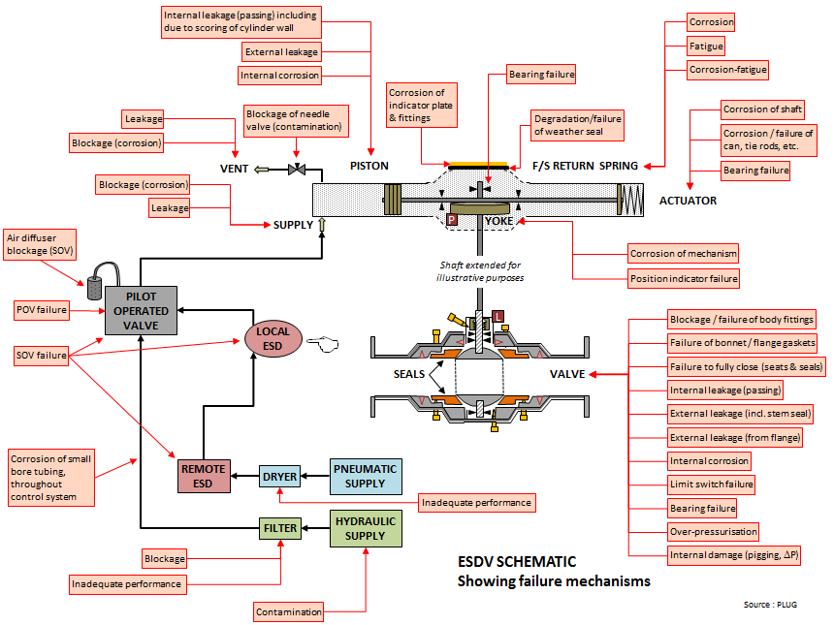
PLUG : Common Failure Modes in Valve Assemblies

Slide 32
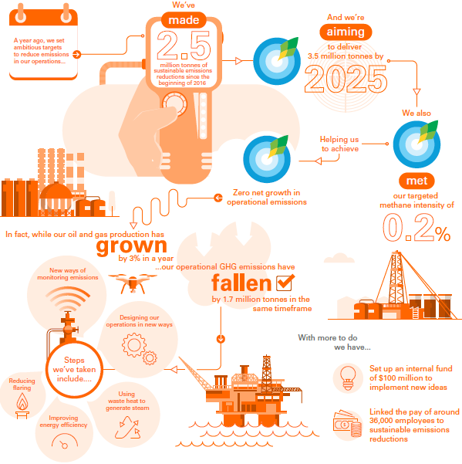
Operating Companies : Goals Setting
Valve Condition Based Monitoring System
“ToR” Development
Recognition of changes
ST / IIoT / ML / AI
$100M Funding to implement new ideas

Slide 33
Collaboration to Deliver Valve Reliability Improvements
(The Virtuous Cycle of Continuous Improvement)
Trend for Reliability
Modify for Reliability
Score Group Intelligent Valve Management™
1 Engineer
2 Supply & Install
3 Monitor
4 Maintain
5 Learn
Design for Reliability
Operating Companies
Manufacturers
Service Companies
AVARP
Manufacturers
Operating Companies
Service Companies
Verify for Reliability
Maintain for Reliability
AVARP
ISA
PLUG
Manufacturers
Operating Companies
Service Companies
Operating Companies
PLUG
Manufacturers
Service Companies
ISA
PLUG
Operating Companies
Service Companies
Trend Performance for Reliability

Slide 34
It takes ALL of us!

Slide 35
Further Reading on Critical Valve Reliability
Valve World Magazine Special Feature Article
Pdf version can be forwarded, on request

Slide 36
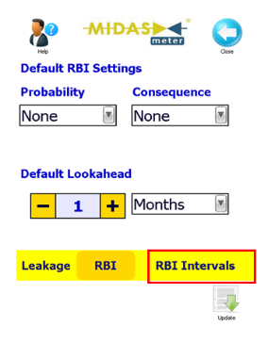
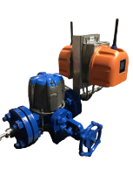
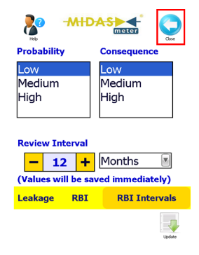

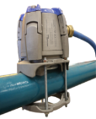
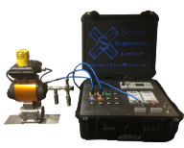
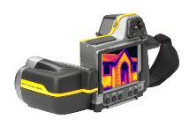

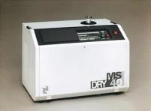
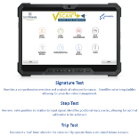
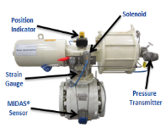
Failure Modes, Sensors Selection
and Risk Management
Risk Assessment / Management : Probability / Consequences
Risk Based Approach :-
Increasing risk due to “Probability of Failure”
Increasing risk due to “Consequences of Failure “
Types of Data Known v’s Unknown Contributors to Failure
Focus on what we already know about or disruption?
Historical - Recognized and Learned
Risk and Prioritisation
Infrequent
Manual
Surveys
More frequent
Manual or
Automated
Surveys
Continuous
Automated
Monitoring
Low
Risk
High
Risk
Increasing Diagnostic Coverage, to Manage Risk
Hand-Held
Inspection Tools
Permanent (or Semi) Installed Continuous
Monitoring Equipment
Permanently Installed
(IIoT) Continuous
Monitoring Systems
Big Data
Bigger Data
Biggest Data

Slide 37
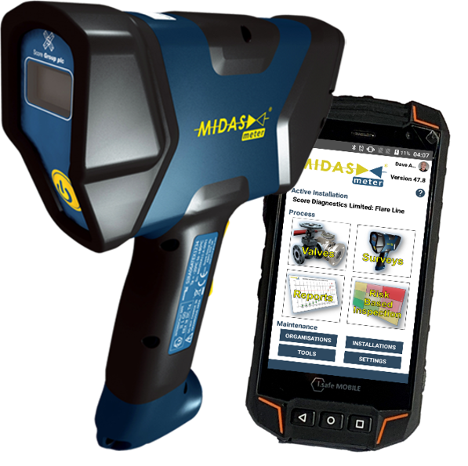
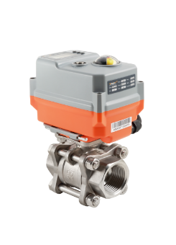
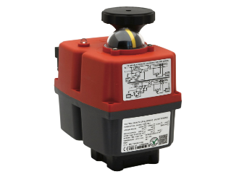
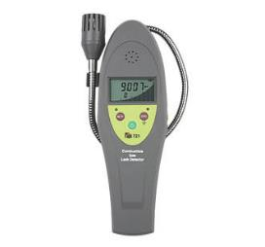
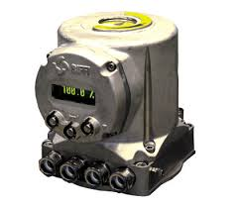
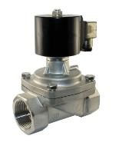
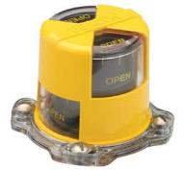
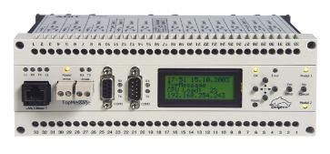
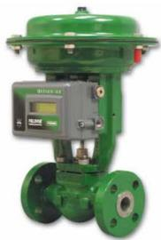
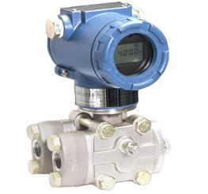
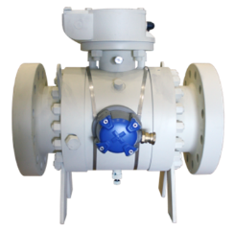


Valve Monitoring Sensors and
Tools in the Marketplace
SMART(ER) Sensors and Inspection Tools and Operating Systems / Devices
Thermal Imaging Cameras,
Sniffer Devices,
Ultrasonic Devices,
Vibration Sensors,
Temperature Sensors,
Pressure Sensors,
Acoustic Emissions Sensors,
Smart Actuators and Positioner / Indicators with Full and Partial Stroke Operating Capabilities.

Slide 38

Valve Monitoring Sensors
- Making Valve Condition & Performance Visible
DIAGNOSTIC COVERAGE is the key to SELECTION, but…
Not just the sensors, but the integration (software, hardware, interfaces, signal transfer, security, etc)
Devices, Systems, Automation, Connectivity, Integration
SIS / PST / FST / PI / LS: Active v’s Passive / Intrusive v Non-Intrusive
Data Portability - Wired / Wireless / Standardisation etc
Agnostic - Independent of manufacturers (Valve & Operator)
Wide coverage (not limited to any one manufacturer)
Data Polling / Data Resolution / Data Quality / Local / Remote
New / Advancing Sensor technologies
Continuing Investment in R&D Required
Opportunities
Limitations

Slide 39




Critical Valve Condition Monitoring Solutions
MONITORING UNPLANNED OPERATIONS
TO
LO
AUTOMATIC DETERIORATION ALERTS
VALVE PERFORMANCE TRENDING
TO
LO
M
ACTUATOR PERFORMACE TRENDING
LEAK QUANTIFICATION & TRENDING
MONITORING CONTROL SYSTEM
IMPORTANCE
MONITORING VALVE TORQUE
15%
96%
ONLINE ACCESS & TROUBLESHOOTING
THOUSAND SAMPLING POINTS PER SEC
MONITORING VALVE POSITION
MONITORING PIPELINE PRESS/TEMP
MONITORING PLANNED OPERATIONS
2
4
11
19
VALUE ADD & COST
Key Deliverable Diagnostic Functions
TO – Timed Only
LO – Leak Rate Only
M – Manual Deployment
Generic Time and
Travel Sensors
Continuous, Automated Leak Sensors
Manual Timing, Travel, Leak and Strain Sensors
Continuous, Automated, Timing, Travel, Leak and Strain Sensors

Slide 40
Understanding and Handling Compromises and Limitations:-
Managing Expectation and Risk Simultaneously
 | High | Low
Sampling Rate | Good resolution of data catches all planned and unplanned events | Poor resolution of data may miss some events
Data Value | Small volume of high value Actionable Insights | Large volumes of “normal” data with low or no value
Power Consumption | Hard-Wired Power Recommended | Battery Operated Option Available
A “missed” event represents an operational risk at worst,
or an incomplete dataset / unreliable analysis at best.

Slide 41

Sensor Data Value
What data do we have and what is it telling us?
Trying to find something we already recognize has value?
Trying to identify something we don’t yet know about?
Find… and fix?
Reactive → Data, Driving
Proactive → Decisions &
Preventive → Behaviours
Predictive→
Understanding Data and Enhancing Outcomes
Insights / Dashboards
Analytics / Data Science / Data Aggregation / Pattern Recognition
Performance Standards
Action Limits / Actionable Data
Human Interpretation v’s Machine Learning

Slide 42
Valve (& Plant) Life Cycle (Reliability Curve)
Sealing Performance / Capability
Maintenance Activities
Corrective Maintenance
Preventive Maintenance
Predictive Maintenance
No Maintenance
Critical
Failure
Leak Rate
Valve Performing
Leak Starts
Leak Develops
Exponential Growth in Leak
Time

Slide 43
Valve Monitoring Sensors Data & Diagnostic Coverage
100% Recording of Performance Data
NO Missed Events
BIG DATA
Huge Volumes
Expensive to store
De-Focused
Difficult to analyse
Time consuming to interpret
ACTIONABLE EVIDENCE
Data Reduction
Storage Cost Savings
Focused Data
Automated Failure Indication
Immediate Interpretation
Data
Continuous Data Monitoring
Selective Data Storage
Time

Slide 44
What will we do operationally with our new “Actionable Evidence”?
“Knowing”
is not enough

Slide 45

Performance Data Storage, Security and References
Historians / Data Lakes / Clouds
Security / Ownership
Operator Databases
Industry Databases
OREDA Database
Exida Database

Slide 46

Analytics : Trending / Predictive Strategies

Slide 47


Analytics / Data Presentation : Dashboards
Actionable Insights / Action Limits
Automated Communications : Alarms / Alerts
Predictive Analytics / Trending / Learning
Known / Unknown (Hidden) Failure Modes

Slide 48
Who Benefits from IIoT / Analytics?
Summary of Valve Monitoring Benefits by Engineering Discipline
 | Identify Poorly Performing Valves | Quantify Performance Degradation in Valves | Trend Degradation in Performance Over Time
Maintenance Engineers | Easy Inspection / Failure Modes Detection | Prioritised / Targeted Resources Deployment | No Unplanned Shutdowns or In-Service Failures
Reliability Engineers | Early Identification of Degradation / Failures | Optimized Shutdown Planning | Minimized Downtime / Maximized Uptime
Asset Integrity Management Engineers | Risk Based Inspections / Visibility of Degradation | Proactive and Preventive Maintenance | Predictive Modelling of Failure Modes
Control Room Operators | Enhanced Monitoring and Troubleshooting | Loss Prevention and Reduction | Operating Profit Maximization
HSEQ Team | Risk Management and Compliance | In-Service Failures and Emissions Reduction | Optimized Operational Performance
Site Management Team | Risk Management and Compliance | Loss Reduction | Optimized Operating Profits
Moving from reactive response to optimized asset management, informed by quantitative evidence.

Slide 49
Who can deliver these required outcomes?
It takes ALL of us!
To achieve long term sustainability

Slide 50

Collaboration
Between
ALL Stakeholders
is KEY

Slide 51
Our call to action…
Will you join us
on the Journey to Reliability and ultimately, Sustainability with other Operating Majors?

Slide 52

Thank You
To discuss this subject further, please come and see us on exhibition stand #6
Or, you may contact us at e-mail:
midas.enquiries@score-group.com
Please visit our website page
“Reliability, Integrity & Diagnostics”
on the Score Group website
(www.score-group.com) for more information
Score Group

Slide 53

Q & A SESSION
ORGANIZERS
SCIENTIFIC COMMITTEE
Thank you for your attention!
IVS 2022
Technical Conference

