Slide 1
DR. JÖRG ISENBERG
ORGANIZERS
SCIENTIFIC COMMITTEE
AUMA Riester GmbH & Co. KG
Mechanical components for functional safety applications (SIL): Standardization urgently needed!
IVS 2022
Technical Conference

Slide 2
Biography
Dr. Jörg Isenberg, AUMA Riester
Product Specialist for Functional Safety Product Management Department
Primary working areas:
Responsible for AUMA’s Functional Safety products
Related topics like Fail-Safe actuators
Explosion proof actuators
Other Functional Safety involvements:
Co-worker in German & European standardization committees
Co-Organizer of conferences and workshops on functional safety

Slide 3
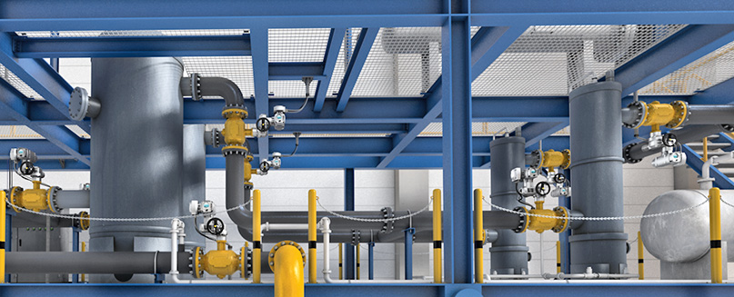
Assessment of mechanical components
Observation:
Sometimes certificates on comparable valves and actuators differ by a factor of ≥ 100 ( ⇔ up to 2 SIL-levels) !
Why is this?
Main difference: failure rate data for mechanical components
Some people even question the assessment of mechanical components in general: “Is it really necessary to include mechanical components in the SIL assessment?”

Slide 4
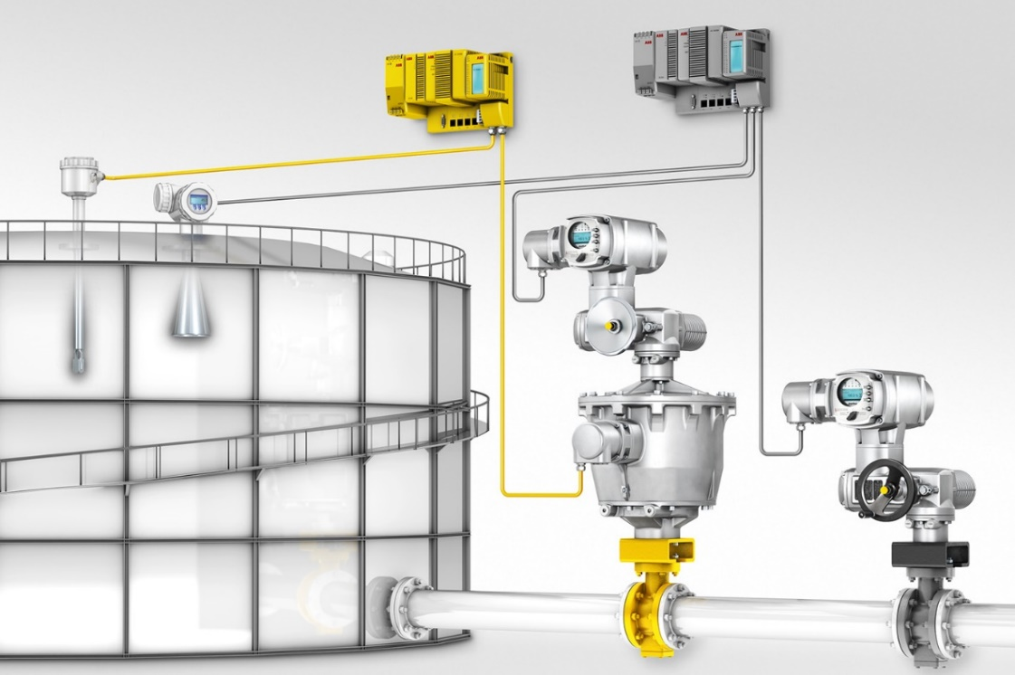
Assessment of mechanical components
Necessary?
Yes!
… if mechanical components are part of the safety chain
Assessment implies both: systematic and random capability (not just failure rates / PFD)!!

Slide 5
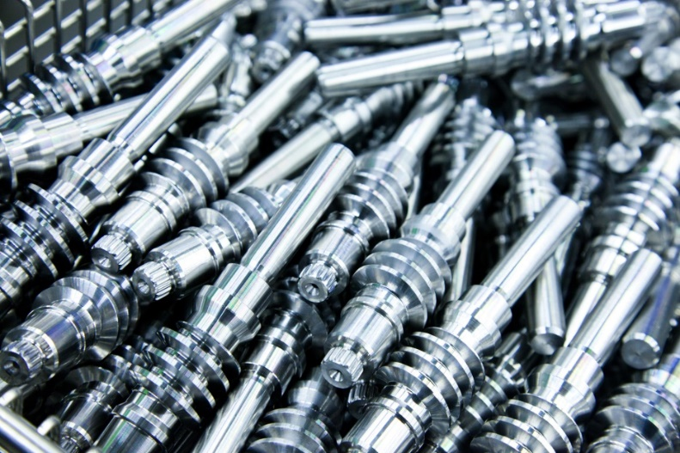
Assessment of mechanical components – How?
IEC 61508 “Functional Safety of electrical / electronic / programmable electronic safety-related systems”
Applicable to mechanical components?
IEC 61508-1: „… Therefore, while this International Standard is concerned with E/E/PE safety-related systems, it may also provide a framework within which safety-related systems based on other technologies may be considered.”
But: How?

Slide 6
Assessment of mechanical components – How?
Standard procedure for electrical / electronic components (hardware):
Functional Safety Management (FSM) / Systematic capability
Type testing
“fit for purpose”/”intended use” (≈ systematic capability)
Redundancy (part of system architecture)?
Identify all safety-relevant components
Obtain component failure rates and failure modes from literature (e.g., SN 29500)
Conduct an FMEDA (Failure Modes Effects & Diagnostic Analysis)
⇒ λ_{S}, λ_{DD}, λ_{DU}, SFF, …

Slide 7
Assessment of mechanical components – How?
Why is this not straight-forward for mechanical components?
Functional Safety Management / Systematic Capability
Same for mechanical components
OK & absolutely necessary
BUT: No guidline / “checklist” available
For electronics e.g. IEC 61508-2 A.15-17 & B.1-5
Type test ⇒ OK
Redundancy / HFT ⇒ OK

Slide 8
Assessment of mechanical components – How?
Why is this not straight-forward for mechanical components?
FMEDA ⇒ OK BUT: How to obtain failure rates and failure modes? There is no “SN 29500” for mechanical components

Slide 9
Avoidance of systematic failures
General suitability for the intended application (“fit for purpose”):
Environmental conditions (pressure, temperature, humidity, expected contamination, …)
Influence of process media (corrosivity, particles, …)
Mechan. requirements (torque, closing time, vibrations, …)
Functionality (safety function(s) & priority, seating, …)
Guidance on lifecycle failure avoidance for mechanical components?
Currently no official ones available
IEC 61508-2 tables A.15-17, B.1-5 only partially applicable
Future: EN xxxxx:202x
Hints can be found in e.g.
My presentations on actuator specification
ISO/DIS 5115 (under preparation)
…

Slide 10
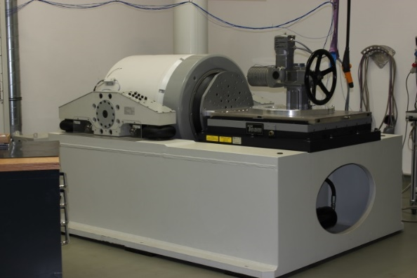
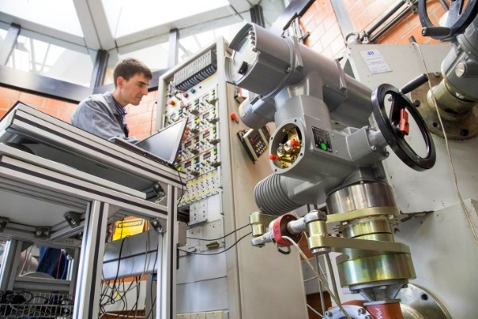
Failure rates of mech. components – how?
In principle 3 possibilities:
Laboratory tests
Handbook data
Field data / proven in use
Laboratory tests:
Excellent to prove suitability of component in principle ⇒ Indispensable as type test
Critical influences may be specifically simulated (if known)
Accelerated tests necessary & possible
Accelerated tests (e.g. B10/B10_{D}) do only include wear, no aging! ⇒ Misleading for the determination of λ for low demand / low utilization rate!

Slide 11
Failure rates of mech. components – how?
In principle 3 possibilities:
Laboratory tests
Handbook data
Field data / proven in use
Handbook data:
Collection of data from field experience Examples: SINTEF/OREDA, exida handbook, …
Handbooks need to group products & application conditions
Less specific
Failure rates estimated “on the safe side” ⇒ Usually, product is rated considerably poorer than it is
Often include systematic failures as well ⇒ Not generally accepted

Slide 12
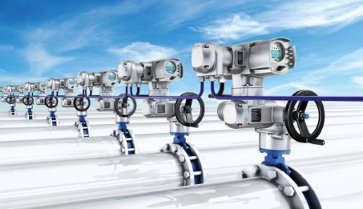
Failure rates of mech. components – how?
In principle 3 possibilities:
Laboratory tests
Handbook data
Field data / proven in use
Field data / proven in use
Often most realistic data for mechanical components
Accelerated testing impossible ⇒ It typically takes many years after product launch to obtain data
Is enough field data available? 90% confidence level required by IEC 61508-2, 7.4.4.3.3 route 2_{H} ⇒ Typically, in the order of 10s or 100s of Mio. operation hours needed

Slide 13
Failure rates of mech. components – how?
In principle 3 possibilities:
Laboratory tests
Handbook data
Field data / proven in use
Field data / proven in use
Danger: How realistic is the data?
Were all field failures reported?
Are operation / environmental conditions comparable?
Were all relevant parts of the hardware (software) tested (=used) evenly?
…

Slide 14
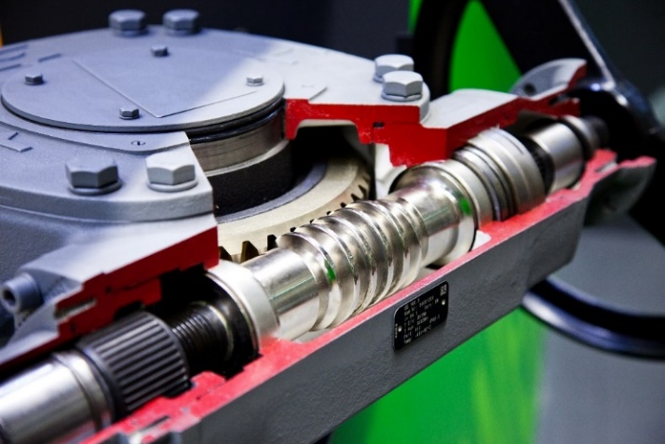
Mech. components – recommendations
Always:
Functional Safety Management
Implement procedures to avoid systematic failures
Type test for general suitability
FME(D)A
Newly developed products:
Handbook data for calculation of failure rates / modes
Components with long & well documented operation history:
Field data used for calculation of failure rates
Handbooks can be used for failure modes and distribution
Method of choice depends strongly on quality of available data!

Slide 15
Warnings and typical pitfall – demand mode & B10/B10_{D}
Demand mode and failure rates:
SIL-certificate of a valve + fail-safe unit (from 2015, meanwhile withdrawn):
Information in certificate: “The named values are the result of extensive laboratory test.”
What has happened here?
Most likely explanation:
Failure rates were calculated for high demand mode from laboratory tests
Failure rates for low demand mode were calculated under the assumption that the failure rate per demand is the same as for high demand
Demand mode | Assumed demands | λ_{DU} [FIT] | λ_{DD} [FIT] | λ_{SU} [FIT] | λ_{SD} [FIT]
High demand | 2000/y | 145 | 0 | 7093 | 0
Low demand | 1/y | 0,07 | 0 | 3,55 | 0
Is this OK?
factor
2000

Slide 16
Warnings and typical pitfall – demand mode & B10/B10_{D}
Demand mode and failure rates:
SIL-certificate of a valve + fail-safe unit (from 2015, meanwhile withdrawn):
Only wear taken into account
Aging was obviously neglected (for both low&high demand mode)
Typical pitfall if components are tested in laboratory for high demand mode!
Demand mode | Assumed demands | λ_{DU} [FIT] | λ_{DD} [FIT] | λ_{SU} [FIT] | λ_{SD} [FIT]
High demand | 2000/y | 145 | 0 | 7093 | 0
Low demand | 1/y | 0,07 | 0 | 3,55 | 0
factor
2000
Aging is main failure mode for low demand mode
⇒ No easy way to calculate low demand failure rates from high demand failure rates

Slide 17
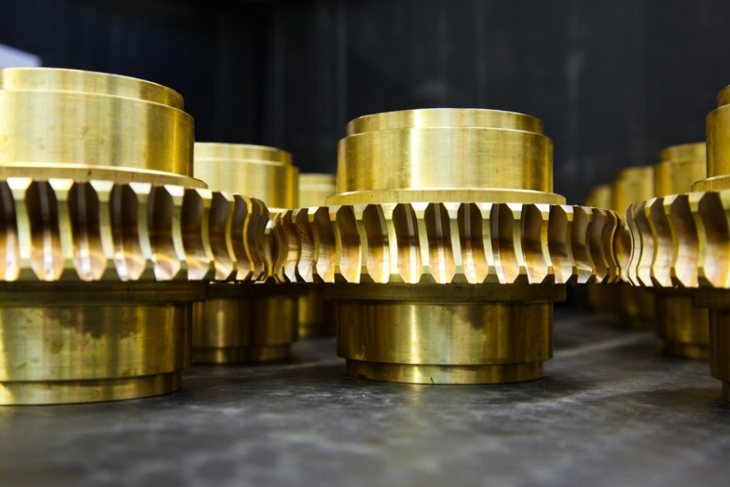
Warnings and typical pitfall – FMEDA & fault exclusion
Fault exclusion (in FMEDA procedure):
Assumption: Certain failure modes are so extremely improbable that they don’t need to be taken account for.
Example: Rupture of significantly oversized drive shaft
Advantage:
Reduces λ_{DU}
Increases $SFF= \frac{{\text{}}_{S}+{\text{}}_{DD}}{{\text{}}_{S}+{\text{}}_{DD}+{\text{}}_{DU}}$
Decreases PFD
Is this OK?

Slide 18
Warnings and typical pitfall – FMEDA & fault exclusion
IEC 61508-2 7.4.4.1.1 may easily be misunderstood:
“With respect to the hardware fault tolerance requirements […] c) when determining the hardware fault tolerance achieved, certain faults may be excluded, provided that the likelihood of them occurring is very low in relation to the safety integrity requirements of the subsystem. Any such fault exclusions shall be justified and documented (see Note 2). […] Note 3 Certain faults may be excluded because if an element clearly has a very low probability of failure by virtue of properties inherent to its design and construction (for example, a mechanical actuator linkage), then it would not normally be considered necessary to constrain (on the basis of hardware fault tolerance) the safety integrity of any safety function that uses the element.”
IEC 61508 does explicitly allow fault exclusion for HFT (redundancy) requirements only!

Slide 19
Warnings and typical pitfall – FMEDA & fault exclusion
If fault exclusion is used for FMEDA / failure rate calculation purposes:
Check with your assessor if acceptable
Failure not yet observed ≠ sufficient evidence for fault exclusion!
For individual failure modes only, never for a complete part/component!
Every single fault exclusion has to be …
… technically justified
… well documented!
Use fault exclusion only for rare, well justified exceptions (better: don‘t use it at all)!

Slide 20
Conclusion
Systematic capability / avoidance of failures is basis of a robust, reliable safety system
SIL rating of comparable mechanical components sometimes varies by up to 2 SIL levels
systematic capability requirements vaguer than for E/E/PE components
no normative specification of failure rate determination ⇒ no uniform approach/result
In general, 3 methods to obtain failure rates
Laboratory tests
Handbook data
Field data
All have their individual weaknesses and pitfalls
CEN is currently preparing a European standard to harmonize assessment of mechanical components for functional safety

Slide 21
Q & A SESSION
ORGANIZERS
SCIENTIFIC COMMITTEE
Thank you for your attention!
IVS 2022
Technical Conference

