Slide 1
ORGANIZERS
SCIENTIFIC COMMITTEE
PIERPAOLO MANDOLESI
GIAMBATTISTA DE GHETTO
Professor at Polytechnic of Milan
Process Engineer at Valvitalia SpA
A new equation for flow through surface choke valve in digital field calculations
IVS 2022
Technical Conference

Slide 2
Biography
Mandolesi Pierpaolo is a Process Engineer. He works at Valvitalia S.p.A., an oil and gas company located in Ancona (AN). He graduated in Earth Resource Engineering – Curriculum Offshore at University of Bologna in 2019. During his studies Pierpaolo did an internship at Eni S.p.A. (DICS Ravenna – Production Unit) where he studied practical cases of critical and subcritical multiphase flow performance through wellhead choke.
Mandolesi Pierpaolo – Valvitalia S.p.A.

Slide 3
TABLE OF CONTENTS
CHOKE VALVE FLOW DESCRIPTION
EXISTING MULTIPHASE CHOKE MODELS
THE IMPORTANCE OF FIELD DIGITALIZATION
NEW EQUATION FOR FLOW THROUGH CHOKE IN DIGITAL FIELD CALCULATIONS
METHODOLOGY OF WORK
QUANTITATIVE EVALUATION AND RESULTS
CONCLUSIONS

Slide 4
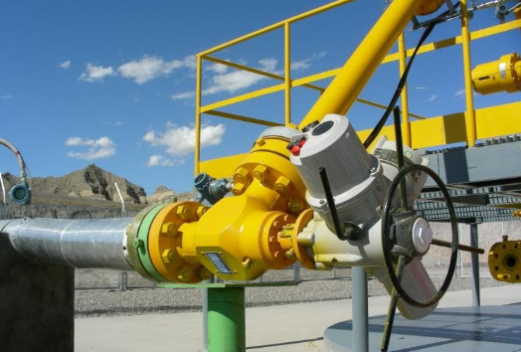
CHOKE VALVE FLOW DESCRIPTION
Wellhead choke valve is the most important valve to regulate the hydrocarbon produced by the wells.
CHOKE REGULATION ALLOWS TO:
Give the optimal oil/gas flowrate
Prevent water arrival
Prevent water arrival
Choke valve in an onshore field application

Slide 5
EXISTING MULTIPHASE CHOKE MODELS
Sachdeva et al. model (1984)
THEORETICAL MODELS
Perkins model (1993)
LITERATURE ANALYSIS
EMPIRICAL CORRELATIONS
Gilbert equation (1954)
Valid only for critical flow : velocity of fluid > sound velocity

Slide 6
THE IMPORTANCE OF FIELD DIGITALIZATION
ACCESSIBILITY TO INFORMATION
REDUCES OPERATING COSTS
FIELD DIGITALIZATION
Advantages
IMPROVE DECISION SUPPORT
INCREASE PRODUCTIVITY (eliminating manual oilfield processes)
Million of input data can be gathered real-time in digital oilfield
Data from choke are vital !

Slide 7
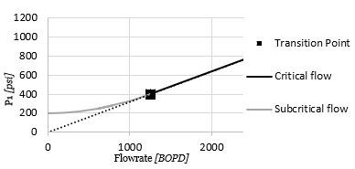
NEW EQUATION FOR FLOW THROUGH CHOKE IN DIGITAL FIELD CALCULATIONS
Assuming Gilbert equation valid for critical flow.
Starting from an equation that describe the subritical flow derived from field experience
The two lines (critical and subcritical flow) have one point in common (transition point).
In this point the two curves have the same derivative.
Assuming, in line with the field experience, transition point between critical and subcritical flow r=P1/P2=2
ASSUMPTIONS:
STARTING EQUATION :
Where:
P1= Pressure upstream
P2= Pressure downstream
B and n = numerical coefficients

Slide 8
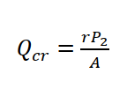
NEW EQUATION FOR FLOW THROUGH CHOKE IN DIGITAL FIELD CALCULATIONS (2)
STARTING EQUATION E0) :
GILBERT EQUATION (valid only for critical flow):
PROCEDURE
1) Call Qcr the rate in correspondence to the transition point r critical/subcritical. Qcr can be easily obtained using Gilbert and considering P1=r·P2 at the transition point, as shown below:
E1)
Where:
2) At this point the two equation are equalized.
3) Equilizing the derivatives at this point:
E2)
E3)

Slide 9
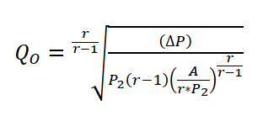
NEW EQUATION FOR FLOW THROUGH CHOKE IN DIGITAL FIELD CALCULATIONS (3)
PROCEDURE
4) The equation E2) and E3) can be put in a system of two equations with two unknowns: B and n. Equation E3) can be rearranged and Q_{cr}^{n} can be substituted with equation E2), obtaining:
E1)
5) We can extract B from equation E2), and considering A from Gilbert generate:
E0)
6) The initial form of new equation can be easily obtained as follows

Slide 10
NEW EQUATION FOR FLOW THROUGH CHOKE IN DIGITAL FIELD CALCULATIONS (4)
PROCEDURE
7) Assume, in line with the field experience, that the boundary between critical/subcritical (transition point) are equal to 2.
6) The initial form of new equation for subcritical flow through choke
FINAL NEW EQUATION
Where:
ΔP= differential pressure across the choke (psia)
P2= Pressure downstream (psia)
D = choke diameter (64 ^{th}/inch)
GOR = gas oil ratio (Scf/bbl)

Slide 11
NEW EQUATION FOR FLOW THROUGH CHOKE IN DIGITAL FIELD CALCULATIONS (5)
 | Upstream choke |  |  |  | Downstream choke |  |  | Fluid properties
 | Pressure | Specific volume gas | Temperature | Liquid density | Pressure | Specific volume gas | Mixture density | API gravity | Gas gravity | Compressibility factor | Heat capacity ratio | Gas oil ratio (GOR) | Choke diameter | Discharge coefficient | Gas mass fraction | Oil mass fraction | Water mass fraction
Sachdeva | √ | √ | √ | √ | √ | √ | √ | √ | √ | √ | √ | √ | √ | √
Perkins | √ |  | √ | √ | √ |  |  | √ | √ | √ | √ | √ | √ | √ | √ | √ | √
New equation | √ |  |  |  | √ |  |  |  |  |  |  | √ | √

Slide 12
METHODOLOGY OF WORK
The qualitative and quantitative analysis of new equation and existing models was possible by the creation of a FIELD DATA BASE composed by more than 800 subcritical and 120 critical field flow data. The field flow data was gathered at ENI S.p.A. and are mainly from: Nigeria, Angola, Italy, Norway.

Slide 13
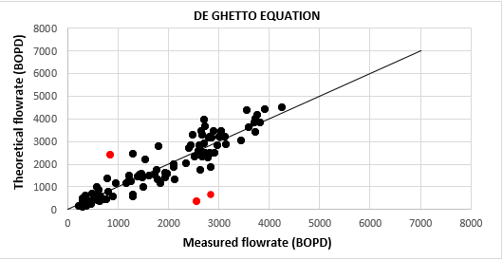
QUANTITATIVE EVALUATION AND RESULTS
EVALUATION CRITERIA :
AVG. ABSOLUTE ERROR (%)
AVG. RELATIVE ERROR (%)
AVG. STANDARD DEVIATION (%)
Example of subcritical flow data results of new equation for Nigeria fields data.

Slide 14
QUANTITATIVE EVALUATION AND RESULTS (2)
 | FINAL RESULTS
 | SACHDEVA | PERKINS | NEW EQUATION
Avg. Relative error (%) | -9,9 | -8,8 | -1,2
Avg. Absolute error (%) | 17,2 | 27,0 | 17,5
Avg. Standard deviation (%) | 16,8 | 26,5 | 16,4
AVG. ERRORS OF MODELS AND NEW EQUATION VS. SUBCRITICAL FIELD DATA BASE
(MORE THAN 800 SUBCRITICAL FIELD FLOW TESTS ANALYZED)

Slide 15
CONCLUSIONS
NEW EQUATION
ADVANTAGES | LIMITATIONS
Simple correlation valid for subcritical flow Few parameters required Unique fluid characteristics required is GOR (gas oil ratio) Practical and very useful for digital field application Easy to understand and apply Good accuracy and precision (results comparable with the best model present in the literature – Sachdeva et al.) Numerical coefficients of the equation don’t come from regression analysis of our field data set (they have general validity) | The equation doesn’t work with small choke diameter Dchoke< 8/64th inch. However, this type of Dchoke is rarely used in field in O&G industry. For simplicity, the equation assumes that the boundary critical/subcritical flow corresponds to a ratio of Pupstream/Pdownstream=2. This is a rule of thumb well known in field.

Slide 16
Q & A SESSION
ORGANIZERS
SCIENTIFIC COMMITTEE
Thank you for your attention!
IVS 2022
Technical Conference

