Slide 1





MASSIMO SANSO’
ORGANIZERS
SCIENTIFIC COMMITTEE
Project Quality Specialist - ENI SPA
Managing Supply Chain Risks
IVS 2022
Technical Conference

Slide 2
Biography
Massimo Sansò has fourteen years’ experience in project quality management in onshore and offshore O&G developments. He spent fourteen years working as quality specialist for Eni SPA within pre-execution project teams, and as quality reviewer in multidisciplinary assurance teams during project execution. Massimo is also a member of the ISO TC 67 WG2 and of IOGP JIP33 and has been involved in several working groups for the drafting of ISO standards.

Slide 3
Agenda
Quality Moment – Valve Case Study
Realizing value through collaboration
Introducing ISO 29001:2020
Complementary standards
Implementation case study
Certification Schemes
Innovation
Summary Q&A

Slide 4
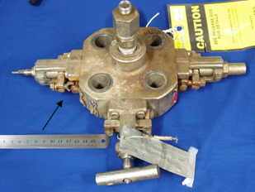
Quality Moment– Valve Failure Case Study
Monoblock Isolation Valve Failure
Incident Description
Gland Packing Retention Bolt Failure
High Pressure Gas Release (300 Bar)
Potential for injury/secondary escalation
What Went Wrong
Incorrect Material used by manufacturer
Hydrogen embrittlement in humid
marine environment
Failure after 16 months

Slide 5
Quality Moment– Valve Failure Case Study
Monoblock Isolation Valve Failure
Actions Taken
Inspection of identical valves revealed further bolt failures
Investigate cause – Supplier error
250 valves to be replaced $$$$$
Lessons Learnt
Ensure suppliers have effective material control processes for critical equipment.
Establish effective source/receiving inspection and verification of material grade.

Slide 6
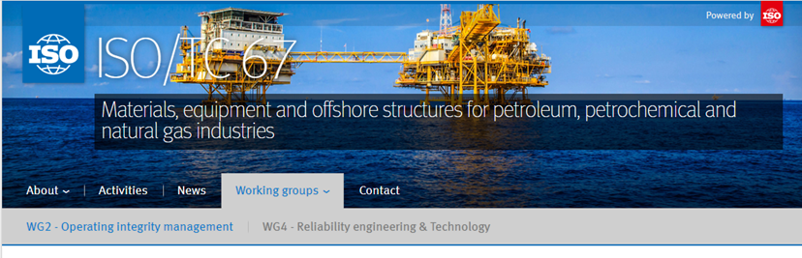
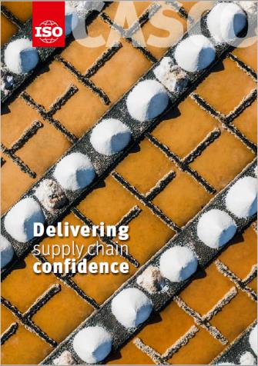


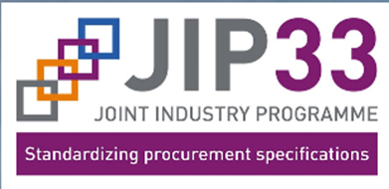

Realizing & protecting value through collaboration

Slide 7
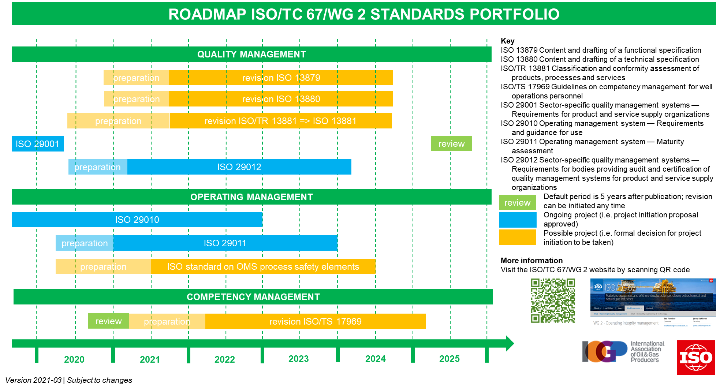
ISO/TC67/WG2 – Operating Integrity Management

Slide 8
ISO 29001 a Short History
Initially issued in 2003 as a technical specification
Updated in 2010 to reflected the changes within ISO 9001:2008.
From 2010 became much more widely accepted to be applied across:
  facilities design and construction;
  specialized engineered equipment and services;
  general suppliers of products and services
Up until 2013 was cobranded with API Q1.
ISO 9001:2015 introduced a step change to the way that Quality Management Systems are to be implemented across all industries
ISO 29001:2020 published with national adoptions progressing
Complementary conformity assessment standard (ISO 29012) under development

Slide 9
Matrix” structure of ISO Management System Standards
Core Harmonized Structure, format and text (“Annex SL”)
+
Discipline-specific standards
Quality (ISO 9001)
Environmental (ISO 14001)
HSMS (ISO 45001)
etc
+
Increasing specificity
Sector-specific standards
Oil & Gas
ISO 29001
Aerospace
AS 9100
Telecomm
TL 9000
Automotive
IATF 16949
etc
+
+
Company-specific standards
IOGP – JIP33 Harmonised Quality Requirements

Slide 10

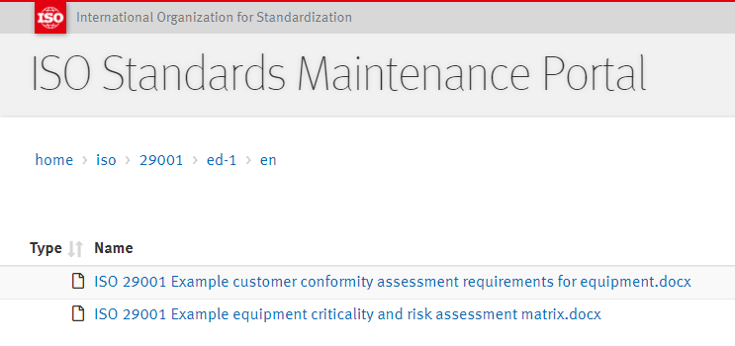
ISO 29001:2020 Development Rationale
Focus on risks associated with the energy sector
Supplement ISO9001, where justified on the basis of the sector’s context and risks
Align requirements with complementary quality standards such as API Spec Q1 and Q2
Provide standardized tools to support implementation
ISO 29001
ISO 9001
Supporting documents ISO 29001
Correlation matrices ISO 29001
Guidance for use of ISO 29001
Rationale ISO 29001 supplements
Guidance/tools on risk assessment processes are available in electronic format via:
https://standards.iso.org/iso/29001/ed-1/en

Slide 11
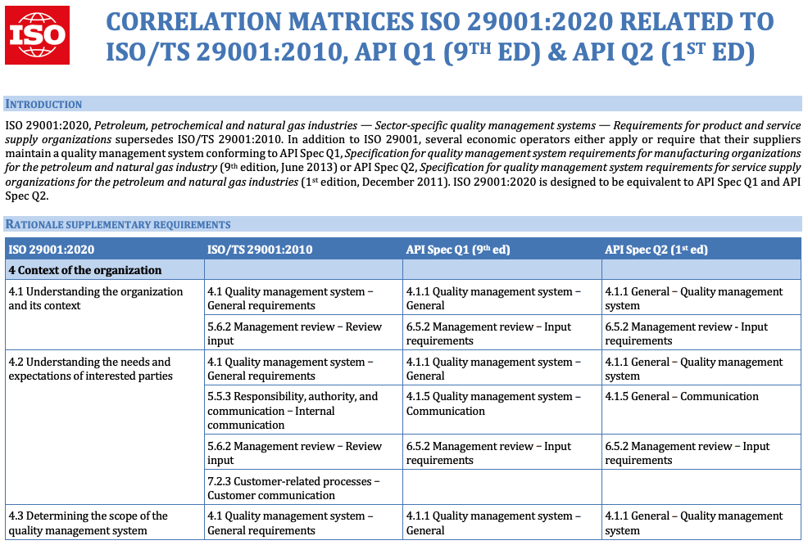
Interface with complementary quality management standards

Slide 12
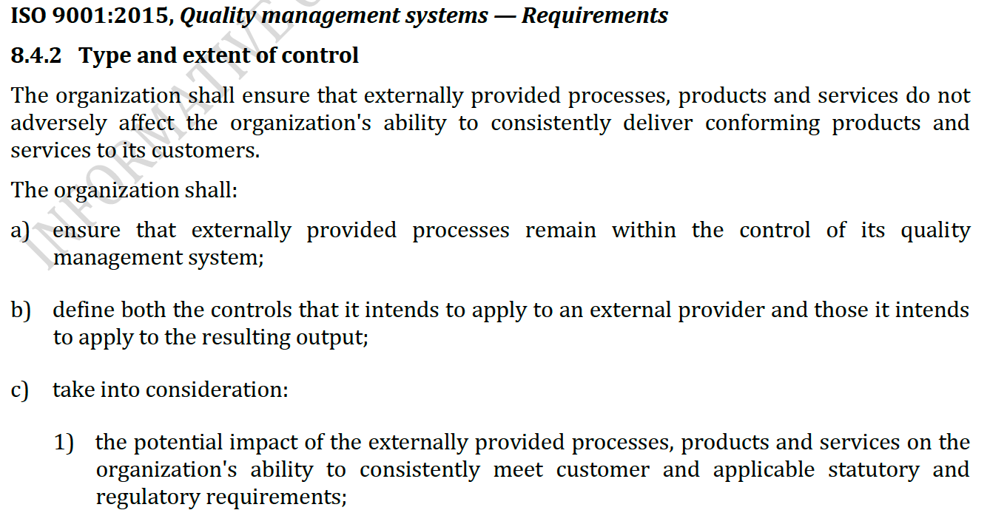
ISO 29001 8.4 Control of externally provided processes,
products and services

Slide 13
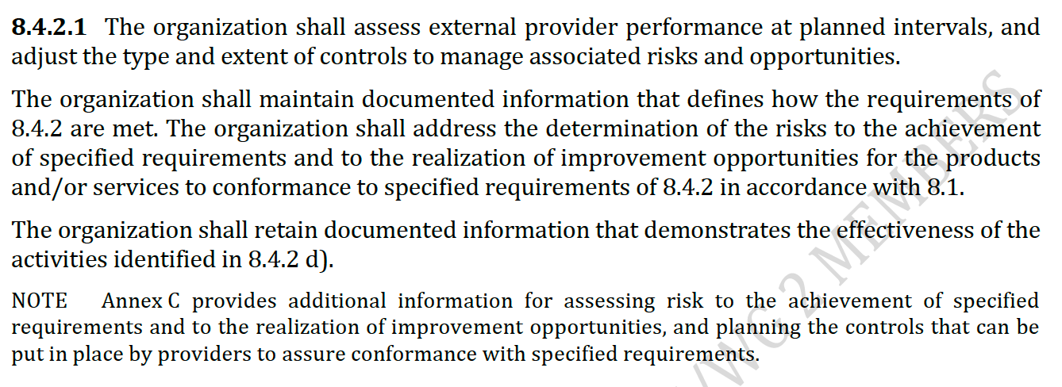
ISO 29001 8.4 Control of externally provided processes,
products and services

Slide 14
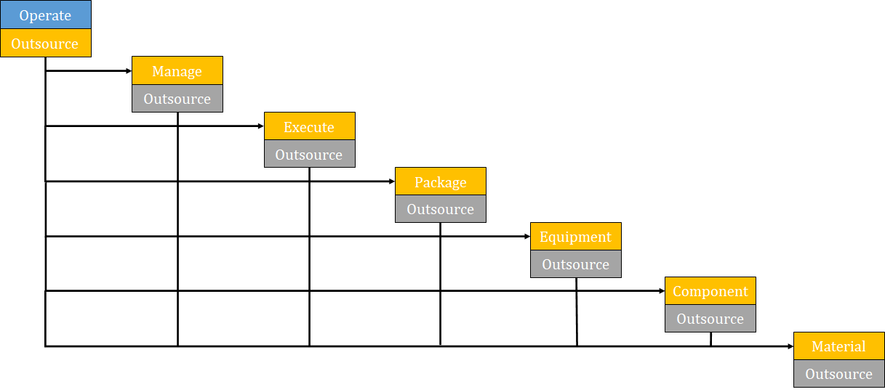
ISO 29001 Annex C – The Value Proposition
Any organization in the supply chain (orange boxes) can provide the contracted process, product or service themselves or decide to (partly) outsource these activities.
“Trust but verify”

Slide 15
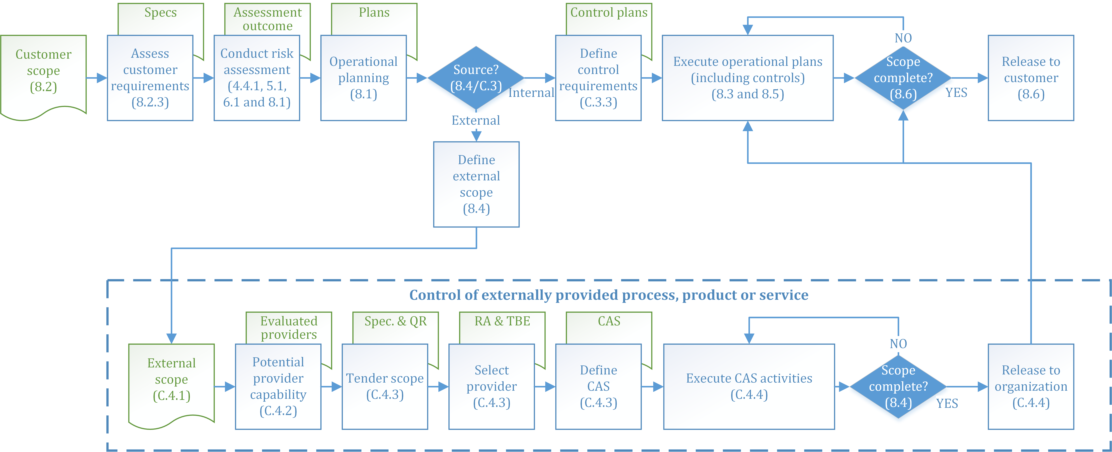
ISO 29001 Annex C – The Value Proposition

Slide 16
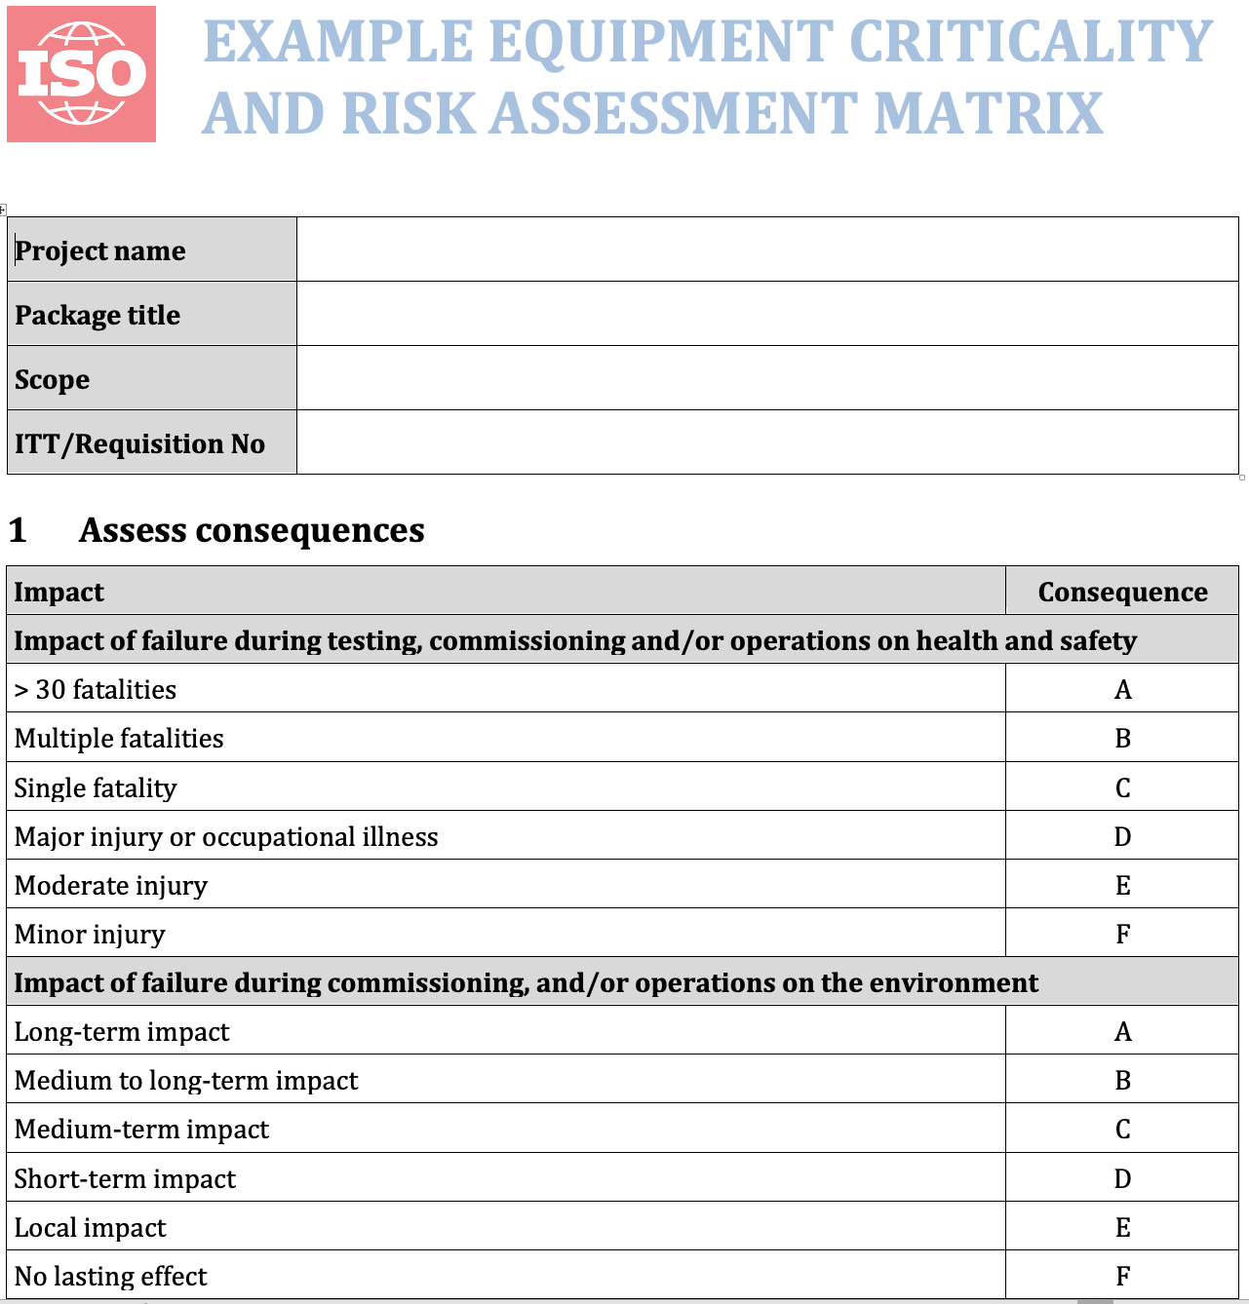
ISO 29001 Annex C – Risk and Criticality Assessment
Methodology extends traditional criticality assessment process employed by the sector through:
Adoption of risk consequence and likelihood ranging model
Establishing consequence based on service risk
Considering generic likelihood based on complexity and maturity
Moderating likelihood based on supplier capability to inform the level of purchaser intervention or Conformity Assessment System (CAS)

Slide 17
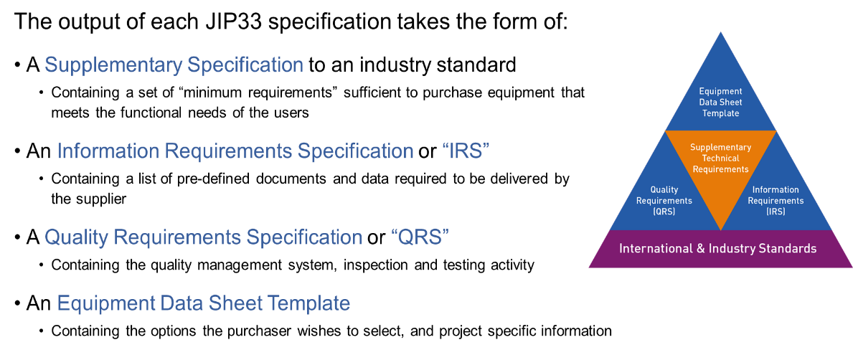
ISO 29001 Annex C – JIP 33 Case Study

Slide 18
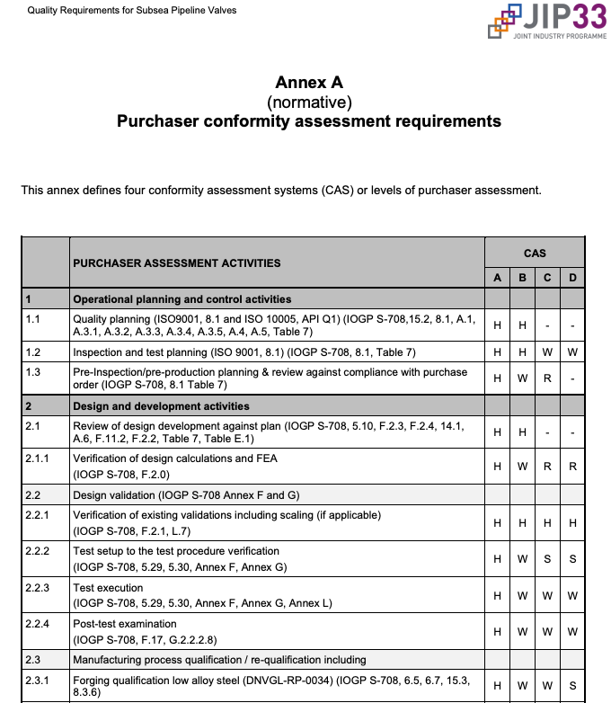
ISO 29001 Annex C – Risk Based Conformity Assessment
Risk and criticality assessment informs the level of purchaser intervention or controls
Four generic CAS levels are developed for each user case (e.g. IOGP-JIP33 Subsea Pipeline Valves)
New supplier novel or complex design
Existing supplier novel or complex design
Existing supplier proven design for critical or safety applications
Existing supplier, standard design non-critical applications
Optimize intervention and maximise use of innovative virtual assessment technologies

Slide 19
JIP33 Package Procurement Workflow QRS > ITP
SUPPLIER CONTROLS QUALITY
OPERATOR
QRS
EPC
QRS
Quality Requirements Specification
Quality Requirements Specification
JIP33 ITT Package
JIP33 ITT Package
OPERATOR issues Procurement Package to EPC with or without CAS Level defined in Datasheet
EPC uses QRS as delivered OR determines a CAS Level and adds to Datasheet (if not provided by Operator)
Supplier:
reviews technical requirements
plans quality control activities (ITP)
adds purchaser (EPC) intervention points based on QRS CAS level
issues ITP to EPC for approval
Implements ITP activities including facilitating purchaser assessments
ITP
For Information
EPC
Inspection & Test Plan
OPERATOR
For Approval
EPC checks ITP against QRS and Designated CAS Level, approves ITP and implements assessments to the approved ITP

Slide 20
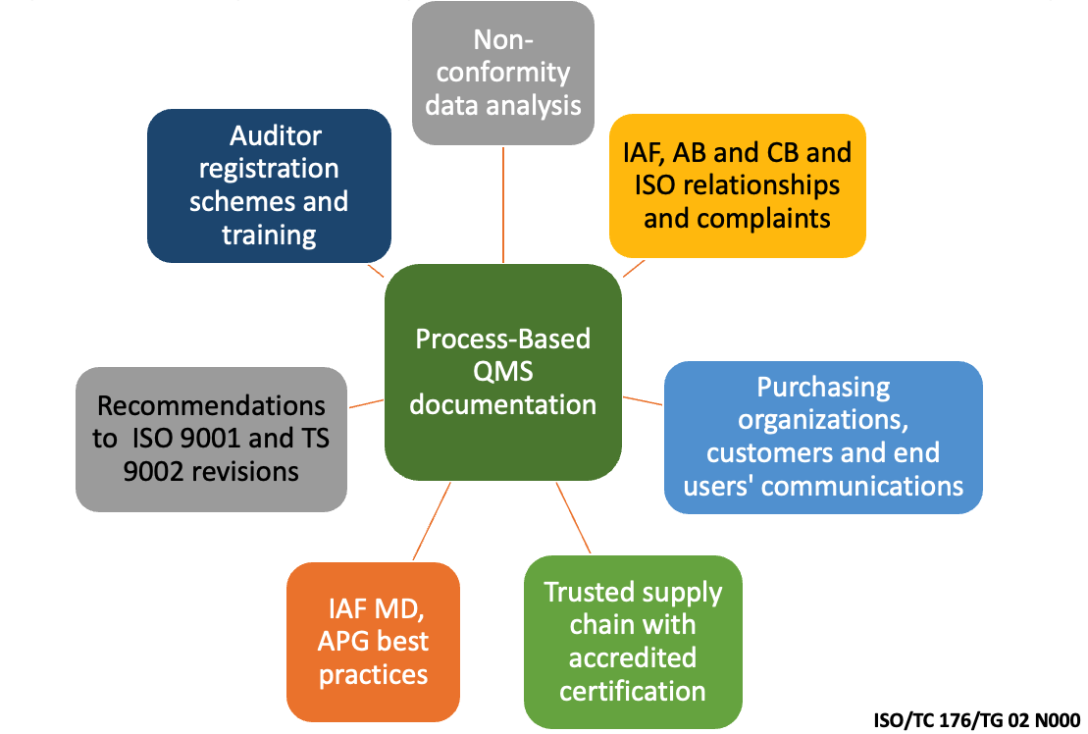
ISO 29012 - Sector-specific Scheme for Supplier Quality
Management System
Sector recognizes certification “brand integrity” concerns can limit value of certification to suppliers and purchasers
New standard to supplement ISO/IEC 17021-1 to define sector specific audit protocol and competency requirements
Supporting implementation strategy led by operators and leveraging key stakeholders (IAF. NAB, key sector CB’s and contractors),
Closing the loop to improve ISO 9001 Brand Integrity

Slide 21
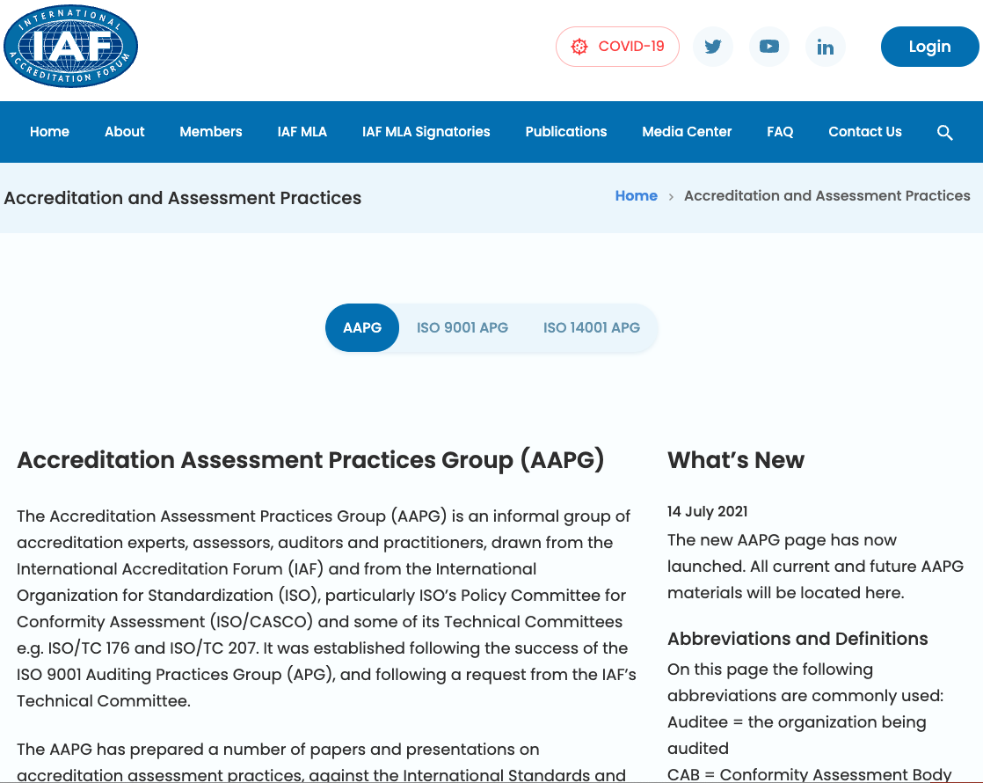
ISO 29012 - Sector-specific Scheme for Supplier Quality
Management System
To provide a credible 3rd party certification scheme which informs operator/contractor supplier capability assessment the sector will influence and leverage the existing IAF/NAB/CB model:
Oil & Gas sector will develop the “rules” (ISO 29012)
Include protocols for use of virtual technologies
IAF mandate CB accreditation to ISO 29012 requirements (Scheme) by NABs
CB’s develop schemes to a standard template addressing the ISO 29012 requirements
Only certification by accredited CB’s recognised
IAF CertSearch registration mandated
Oil & Gas sector oversight of scheme

Slide 22
Concluding Remarks
Alignment with ISO 9001:2015 and best practice – supplements to manage risks !
ISO harmonised structure for management systems facilitates system integration
Applicable to Oil and Gas, complementary and emerging low carbon industries
Driving improvement to create and protect value in the industry
Facilitates adoption of innovative assessment (virtual) technologies
Certification to ISO 29001:2020 encompasses ISO9001:2015
Continuing collaboration with IOGP, API and complementary organisations
Companion conformity assessment standard (ISO 29012) under development

Slide 23

Q & A SESSION
ORGANIZERS
SCIENTIFIC COMMITTEE
Please visit:
ISO/TC67/WG2
LinkedIn
Operating integrity management for oil and gas sector | Groups | LinkedIn
Thank you for your attention!
IVS 2022
Technical Conference

