Slide 1
ORGANIZERS
SCIENTIFIC COMMITTEE
MARTIN DYTRYCH
President, Industrial Data Labs
Applying Artificial Intelligencie in the valve sourcing/selling process within Industrial Valve Market
IVS 2022
Technical Conference
Notes:
Add note to this slide

Slide 2
ORGANIZERS
SCIENTIFIC COMMITTEE
Biography
Marty Dytrych is a co-founder of Industrial Data Labs, specializes in deep knowledge technology centered around sourcing within the industrial pipe, valve, flange, and fitting industry.
Before founding Industrial Data Labs, Marty worked with several startups in the healthcare and oil and gas industries to find product/market fit, develop new products, and accelerate growth by leading their sales and marketing teams and strategies.
Marty holds a B.S. in Business Administration from the University of Notre Dame is passionate about extracting value and developing new products at the intersection of information and decision making.
IVS 2022 | Technical Conference
2
Notes:
Add note to this slide

Slide 3
ORGANIZERS
SCIENTIFIC COMMITTEE
Fax?
IVS 2022 | Technical Conference
3
Notes:
Add note to this slide

Slide 4
ORGANIZERS
SCIENTIFIC COMMITTEE
"The complete labour content to manufacture a ¾ 800 class gate valve is 2.5 minutes. Robotics & automation introduced at manufacturers in the ’80s cut labour time from 45’ to 2.5’.
The sales process in the last 50 years remained the same.
Okay, it went from telex to fax to mail, but it still takes 10 to 15 min to prepare a 1 item quote. If you are lucky & have the product on the shelf, and if you know what you are doing.
If not, add 30 to 45 min labour time for sourcing & let your customer wait days."
- Simone Brevi, GMD, OMB Valves
IVS 2022 | Technical Conference
4
Notes:
Add note to this slide

Slide 5
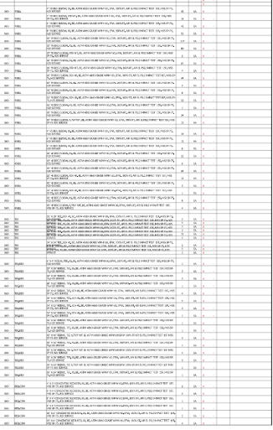
ORGANIZERS
SCIENTIFIC COMMITTEE
RFQ Process
IVS 2022 | Technical Conference
5
Notes:
Add note to this slide

Slide 6
ORGANIZERS
SCIENTIFIC COMMITTEE
Timeline Comparison
IVS 2022 | Technical Conference
6
Notes:
Add note to this slide

Slide 7
ORGANIZERS
SCIENTIFIC COMMITTEE
Manufacturer Example
IVS 2022 | Technical Conference
7
Notes:
Add note to this slide

Slide 8
ORGANIZERS
SCIENTIFIC COMMITTEE
Manufacturer Example
IVS 2022 | Technical Conference
8
Notes:
Add note to this slide

Slide 9
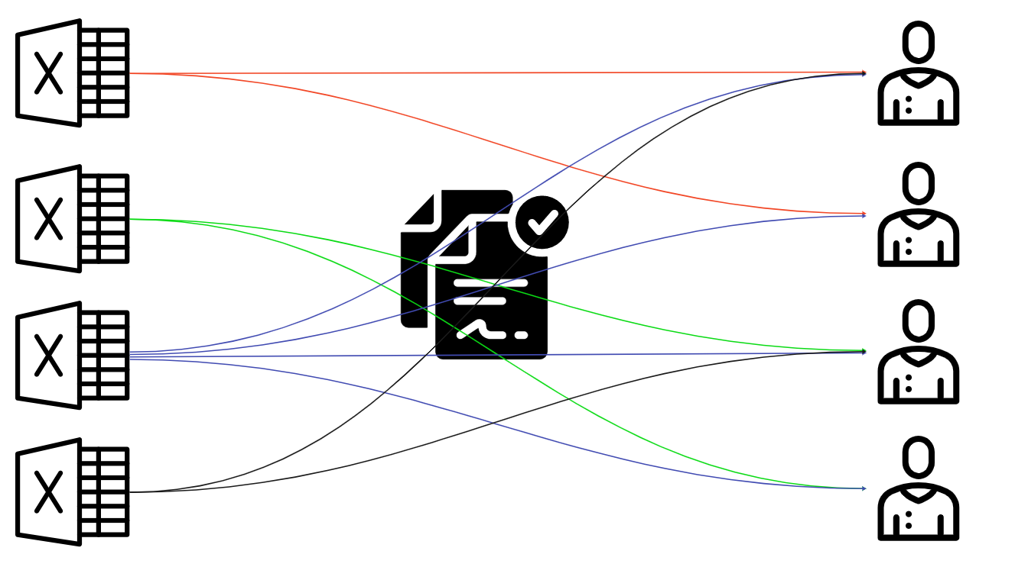
ORGANIZERS
SCIENTIFIC COMMITTEE
EPC Example
IVS 2022 | Technical Conference
9
Notes:
Add note to this slide

Slide 10
ORGANIZERS
SCIENTIFIC COMMITTEE
EPC Example with Technology
Fundamentally understands equipment and the requests to acquire that equipment
Knows historical data and alternative offerings
Communicates with partnerships within customized parameters (AML & Pricing)
IVS 2022 | Technical Conference
10
Notes:
Add note to this slide

Slide 11
ORGANIZERS
SCIENTIFIC COMMITTEE
Technology is Here
Invoices
Predict European Court of Justice Rulings
Healthcare
IVS 2022 | Technical Conference
11
Notes:
Add note to this slide

Slide 12
ORGANIZERS
SCIENTIFIC COMMITTEE
Build Together to Advance Intelligence
IVS 2022 | Technical Conference
12
Notes:
Add note to this slide

Slide 13
ORGANIZERS
SCIENTIFIC COMMITTEE
Q & A SESSION
Thank you for your attention!
IVS 2022
Technical Conference
Notes:
Add note to this slide

