Slide 1





LAURENT GUIMET
ORGANIZERS
SCIENTIFIC COMMITTEE
Product engineering manager – Technetics Group
SEMI-DYNAMIC METAL SEALING
Base theory and examples of valve applications
IVS 2022
Technical Conference

Slide 2
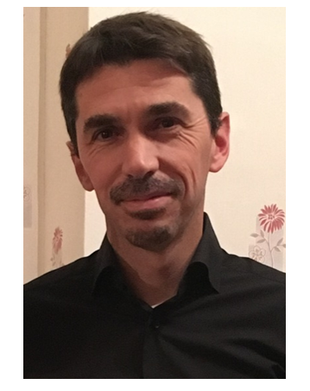
Biography
Laurent Guimet, graduated from the ENSIAME engineering school (Valenciennes, France), has been working with Technetics Group for 16 years.
After 12 years in charge of special engineering projects (most of them on valve seals and mechanical seals for pump), Laurent is now sharing his time between management of the product engineering team, expert’s tasks related to sealing challenges in demanding environments and seal developments project with CEA-maestral lab.

Slide 3
Agenda
Common use of metal seals in the industry
Semi-dynamic sealing applications
  Definition
  Specificities on the assembly design
2 examples:
  Quarter-turn metal stem sealing
  Shut-off sealing for Triple Offset Butterfly Valves

Slide 4
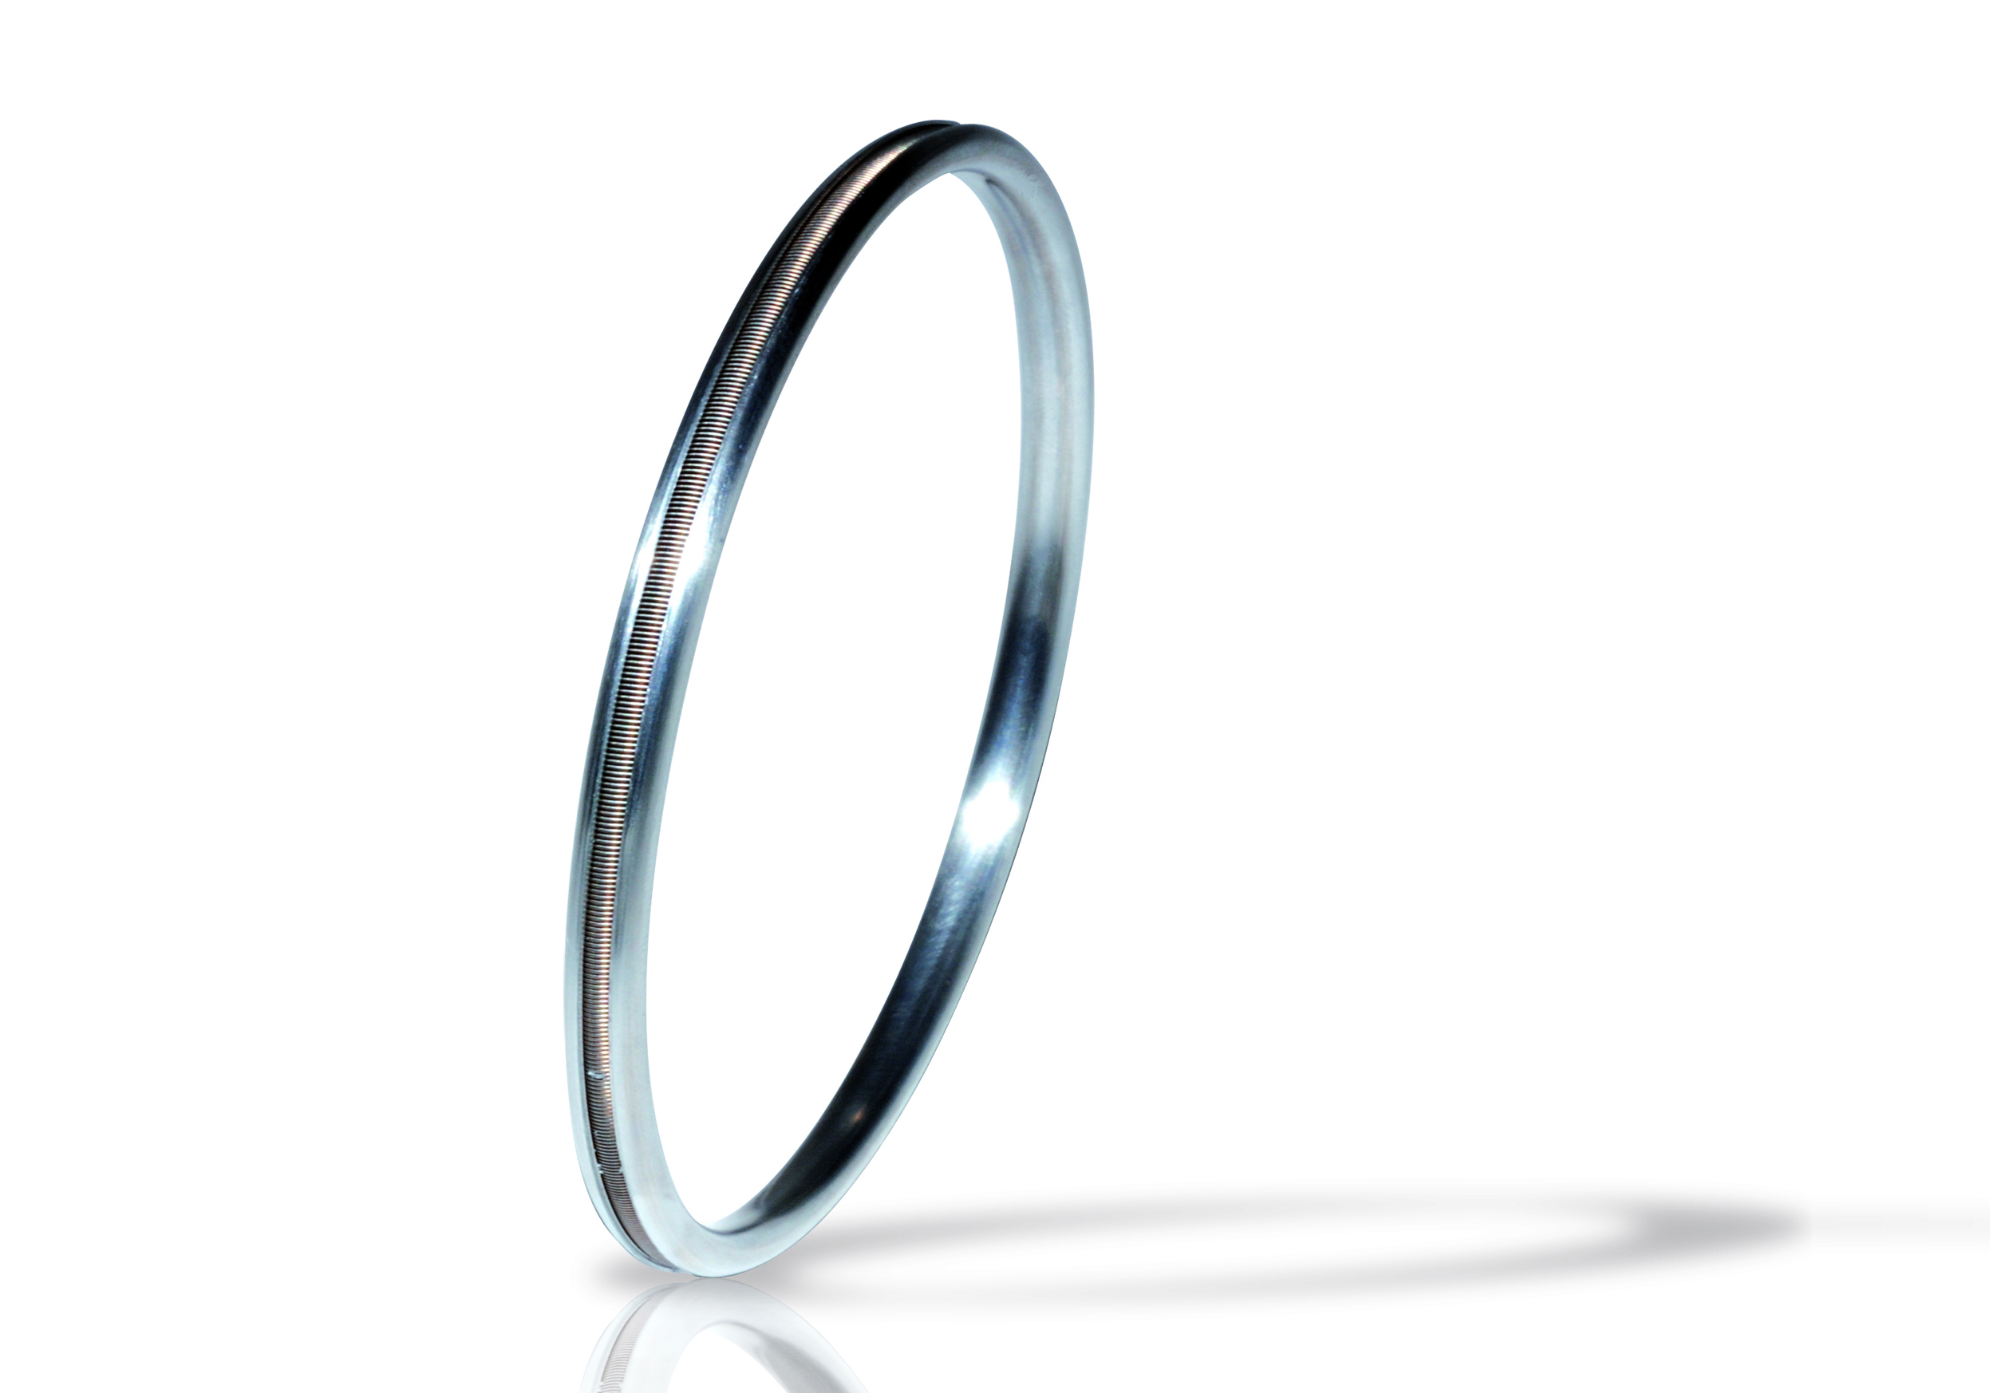
Common use of metal seals / design philosophy

Slide 5
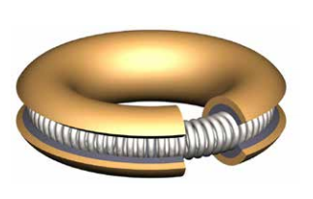
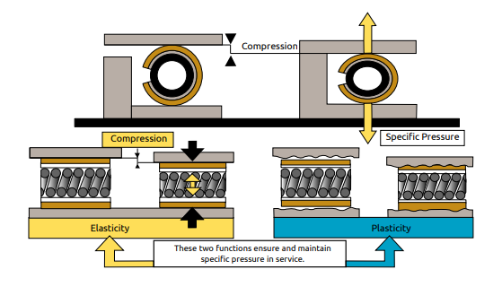
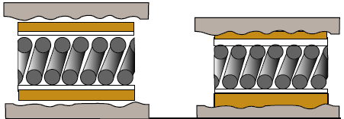
Working principle
Metal seal: hardness of the seal sealing not so obvious
Sealing possible using plasticity of the sealing layer
Sealing layer
Intermediate layer
Coil spring
Example of spring energized metal seal
Plastified sealing layer penetrating the flanges roughness

Slide 6
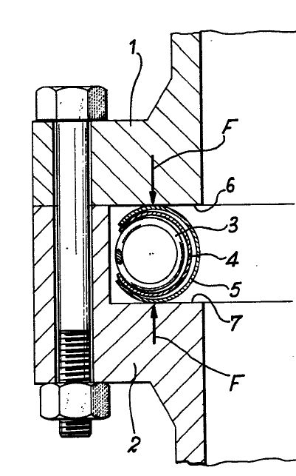
Standard performances / knowledge / limitations
Accurate definition and suitable surface finish Helium tightness easily reachable with static metal seals
Spring energized metal seal: first patent in 1969. Growing knowledge for 50 years :
  Physical behavior
  Design
  Performance
  Life-time
  Applications specificities
  …
Preconceived idea: limitation of the concept to static sealing
Flange motion ⬄ destruction of the sealing layer / loss of performance

Slide 7
Semi-dynamic sealing applications
Semi-dynamic contact profile 1​
Semi-dynamic contact profile 2​

Slide 8
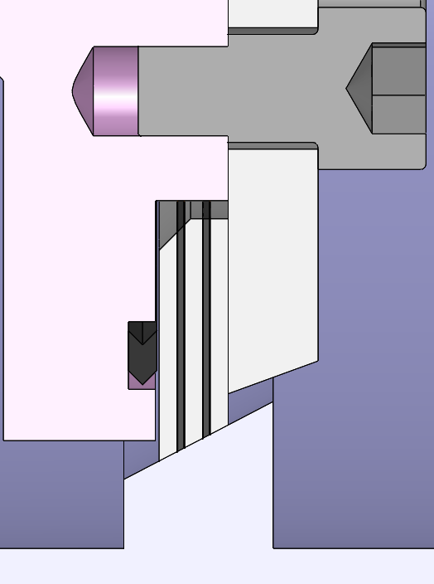
Definition: semi-dynamic sealing
Dynamic sealing: motion of the contact surface(s) or flange(s)
Semi-dynamic sealing: can be considered as dynamic sealing with certain specificities:
  motion is “slow”
  motion is not continuous
  energy provided by the friction of the seal negligible
Semi-dynamic sealing: used also about static seals submitted to regular cycles “compression / decompression with loss of contact”.
Valve stem sealing with graphite packing
Lamellar seal

Slide 9
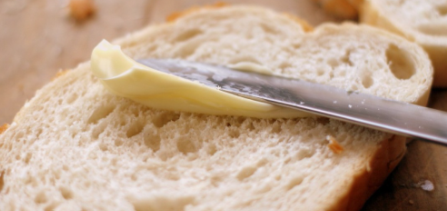
Metal-seal for semi-dynamic applications: contact mechanisms
Example of metal seal for semi dynamic application: very high temperature valves
Usual approach with soft seal (elastomer):
  Live-adaptation of the seal to the surface
  Static contact profile always applicable
With metal seal, 2 possible contact mechanisms:
  Profile 1: contact of 2 polished surfaces with a relatively high hardness
    quality of both surfaces: key of the performance
  Profile 2: contact of soft metal seal with a harder flange with very low roughness;
    some soft material migrates in the counter surface.
    during the motions, final contact: “soft vs. soft”
static contact profile
Semi-dynamic contact
hard polished surfaces (1)
Semi-dynamic contact migration of soft material in hard material (“buttering”) (2)

Slide 10
Metal seal contact mechanisms: expectable performances (profile 1)
Quality of the roughness crucial for the performance
Performance limited as no “gap-filling” at the interface
Bubble-tightness achievable by working on the interface quality
Optimization over time by “self-lapping” between the surfaces
    Difficult to master though due to the slow motions
Main advantage: durability over the cycles
Main applications: opening/closing
  Valve shut-off sealing
Semi-dynamic contact
hard polished surfaces

Slide 11
Metal seal contact mechanisms: expectable performances (profile 2)
Superior performance achievable (Helium tightness), as gap filling of the surfaces
Performance limited in case of loss of contact
  risk of scratching the seal overtime
Shorter lifetime : flowing of the buttering, cycles after cycles
Main applications: arrangements without loss of contact (with “sealing track”)
  Quarter turn stem sealing
  Linear stem sealing (replacement of bellows)
Semi-dynamic contact profile 2
migration of soft material in hard material (“buttering”)

Slide 12
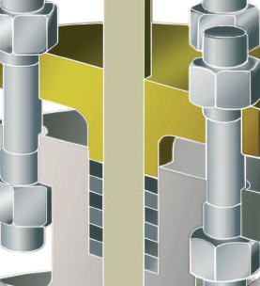
1st example: quarter-turn metal stem-sealing

Slide 13
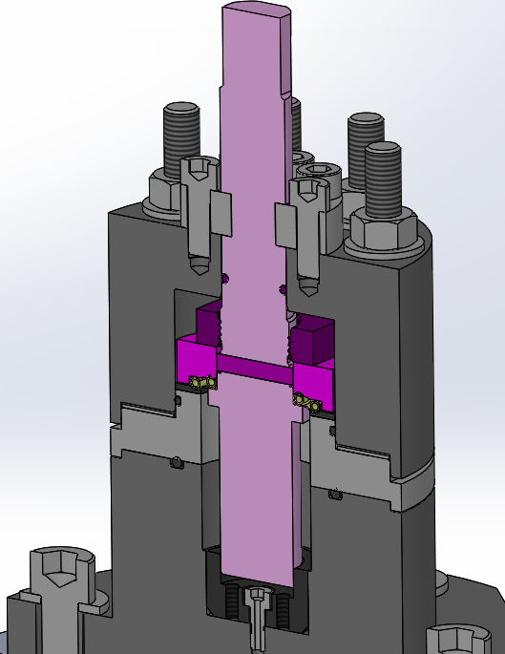
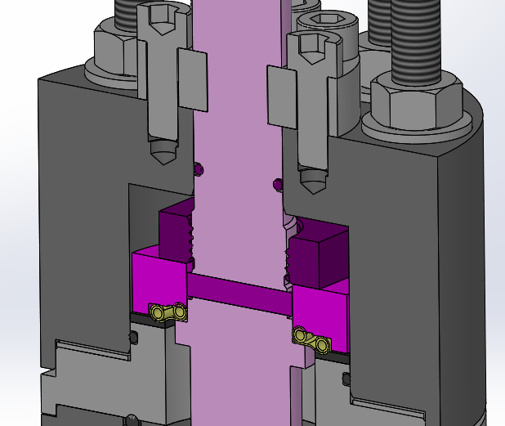
Concept of metal seal for stem seal
Sealing solution:
  Axial sealing with a spring energized metal seal
  Sliding on a super polished surface (low roughness and flatness)
  Spring used to balance the last imperfections on all ¼ turn travel
Design: double torus spring energized metal seal
Initial purpose: high performance sealing under 10 bar / 100 actuations
Results: 10⁻⁸ mbar.l.s⁻¹
Design with gold coating sliding on a super-polished Stellite face
PATENT PENDING
PATENT PENDING

Slide 14
Concept details
Rotor parts (pink nuance)
Stator parts (grey nuance)
Double torus metal seal (yellow part)
Stem Ø: 16mm – 5/8’’
Bolts for compressing external torus
2 half bearings
Nut for compressing internal torus
PATENT PENDING
Internal torus (static sealing)
Contact sliding point: external torus / lapped stellite counterface
Pressure area

Slide 15
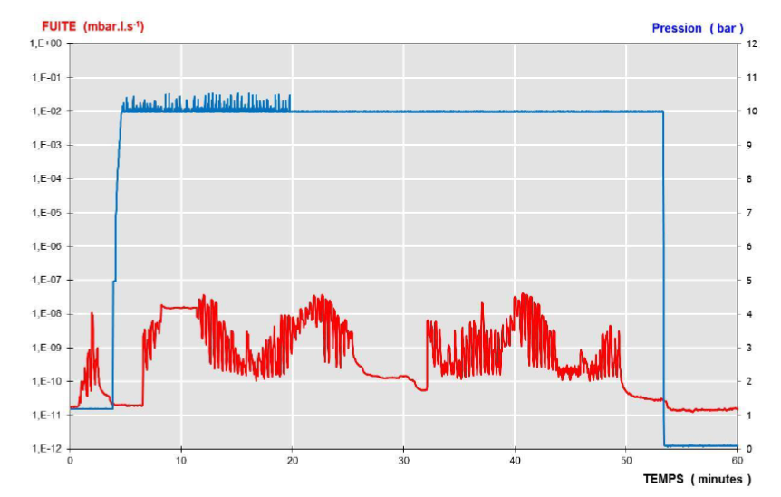
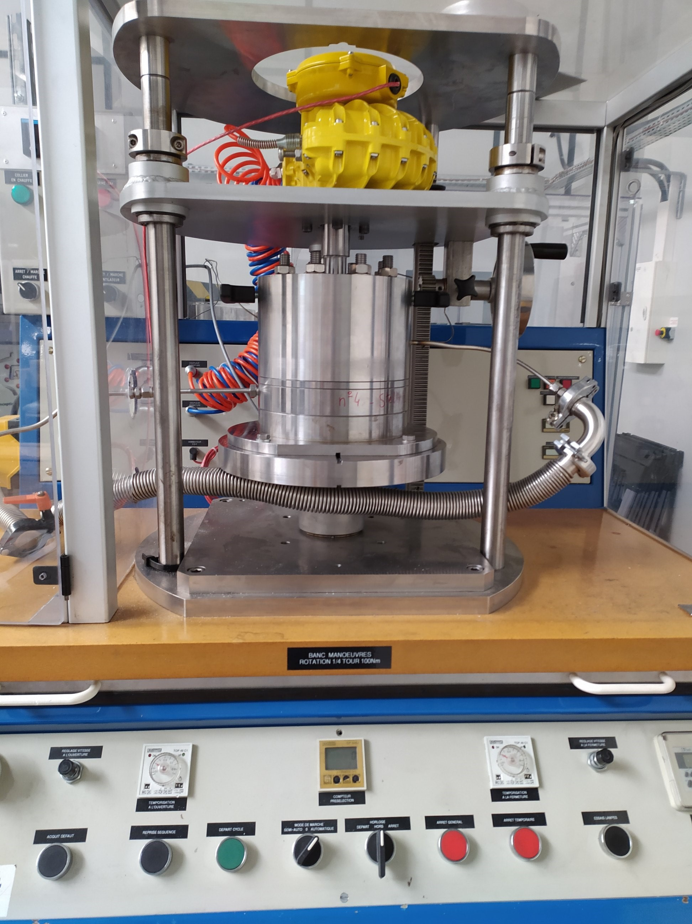
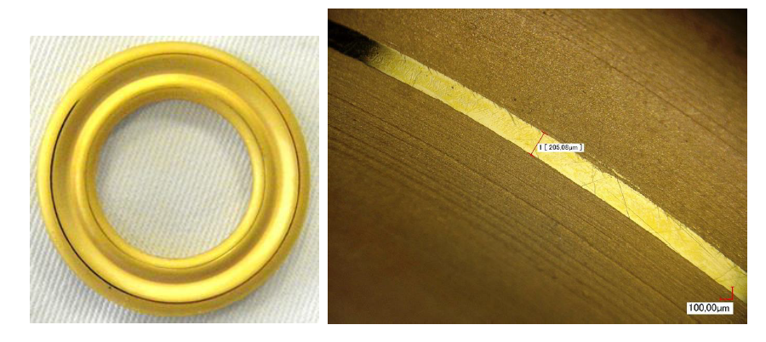
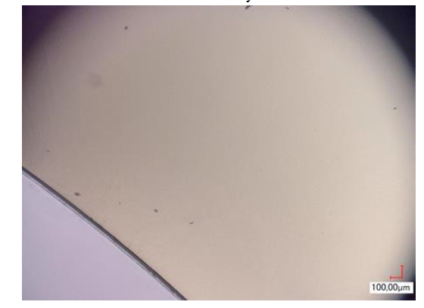
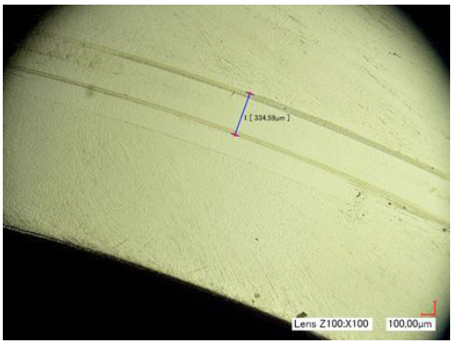
Test results on 110 operations
Superior sealing properties @ 10 bar/150 PSI
  leak rate < 10⁻⁸ mbar.l.s⁻¹ in static position
  with small peaks < 10⁻⁷ mbar.l.s⁻¹ while moving)
Performance < 10⁻⁷ mbar.l.s⁻¹ @ 50 bar/750 PSI He pressure
Moderate buttering due to the extremely low initial roughness of the counterface
Leakage (mbar.l.s-1)
Pressure (bar)
Time (minutes)
Counter-face
before the test
after the test
Test bench
Sealing track on the seal after test

Slide 16
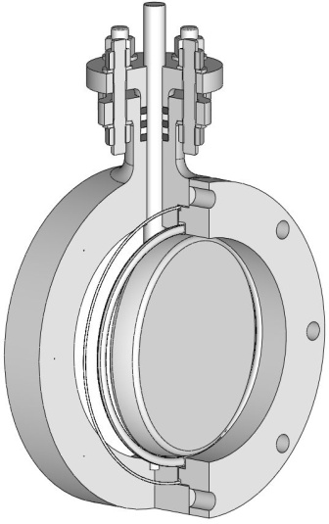
2nd example: Spring-energized metal seal design for TOBV

Slide 17
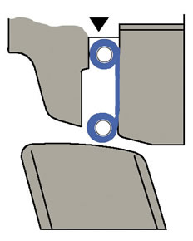
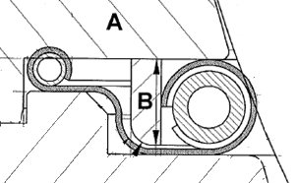
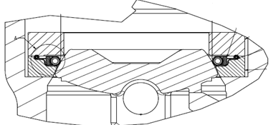
Valves shut-off sealing: current know-how
Strong know-how on metal seat-sealing for DOBV (Double Offset Butterfly Valve)
Typical application using “profile 1”
  Full-metal solution
  Cryogenics, liquid natural gas, nuclear
  Leak tightness until class B ISO 5208
  High resistance over time
Current developments:
  Expand concept to TOBV sealing
  Improve the performance (target class A ISO 5208)

Slide 18
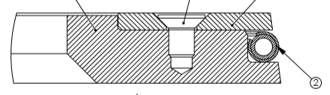
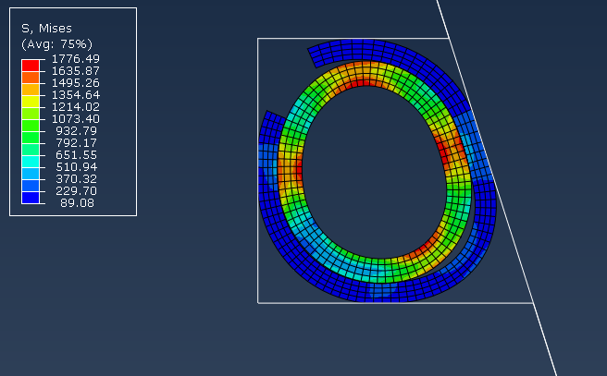
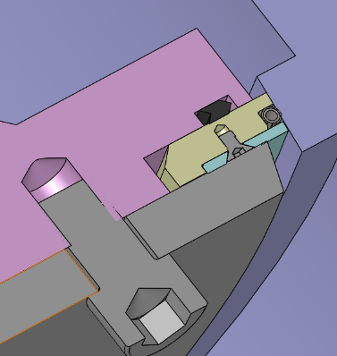
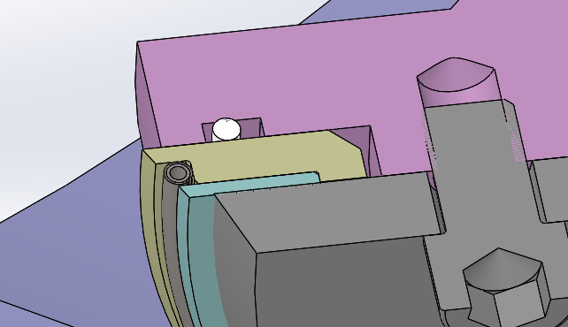
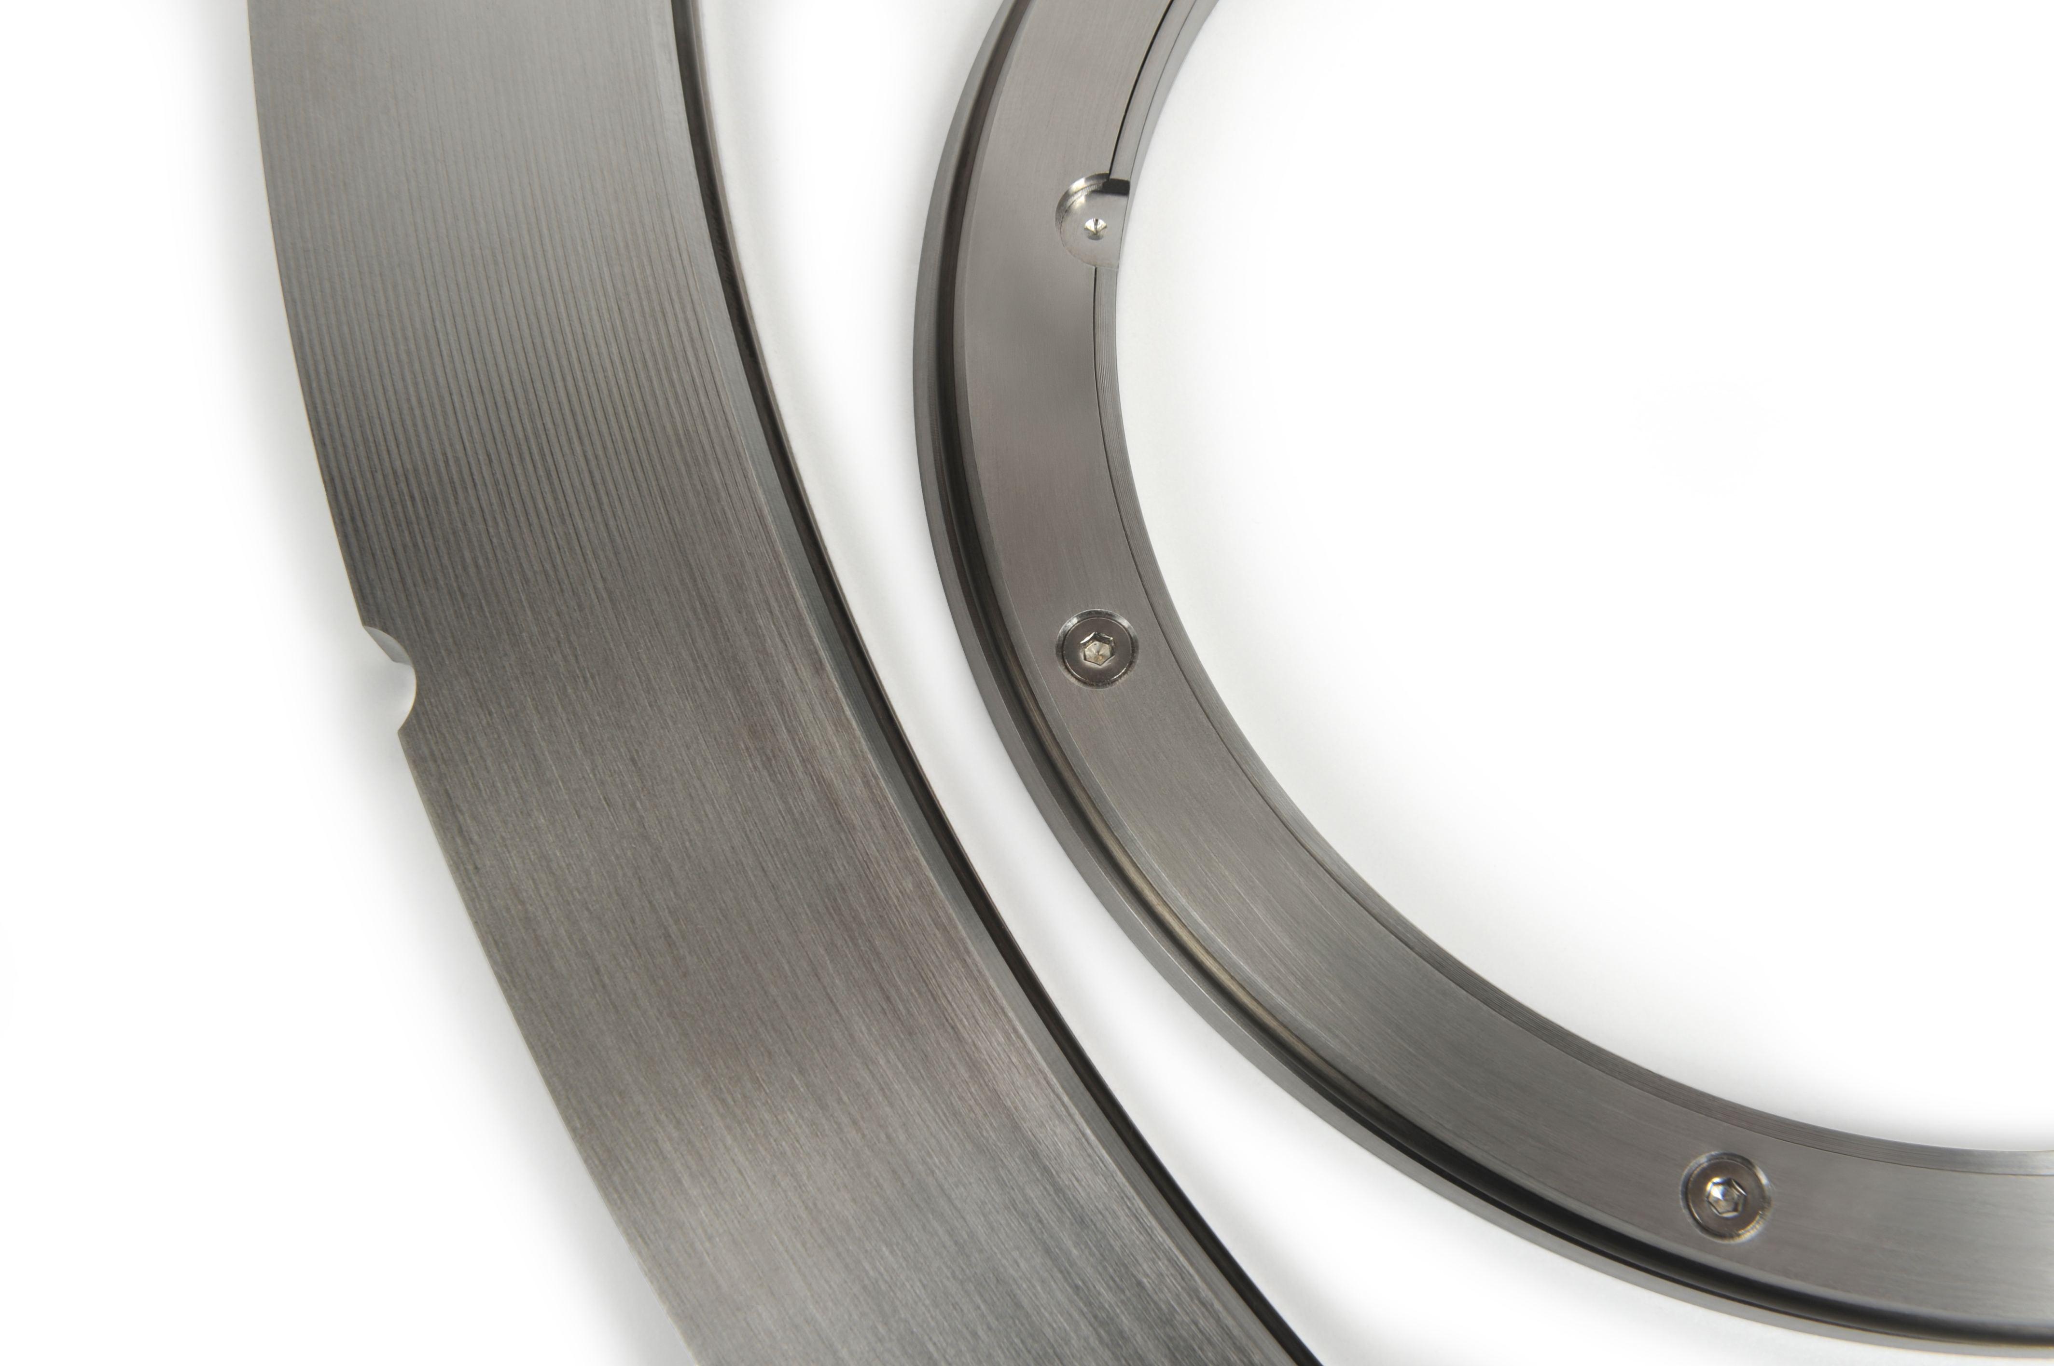
Concept for using spring-energized metal seals on TOBV
Concept of “radial” spring-energized metal seal tested, in a special custom-designed “box”
The box (beige part)
  maintains the seal
  acts as a limiter in the movement of the butterfly
Elliptic surfaces designed into the box to ensure uniform compression of the elliptic metal seal all around the periphery
PATENT PENDING
PATENT PENDING
Sealing tracks
PATENT PENDING

Slide 19
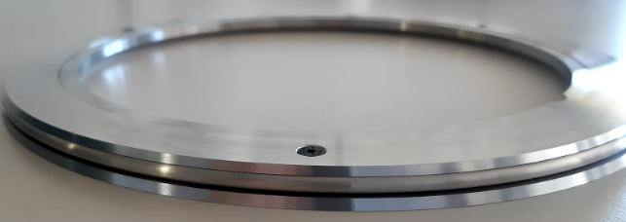
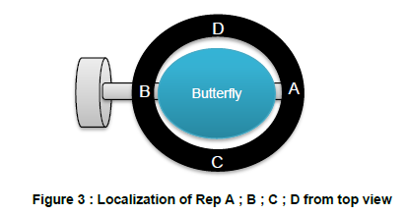
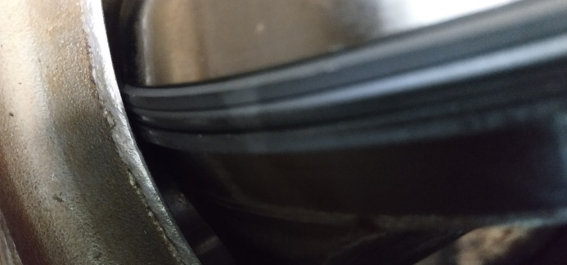
Ongoing tests
Tests are currently were run with different designs of HELICOFLEX® seals (different sealing layers to optimize the wear behavior)
Tests on ND250 PN 100 valve, in our lab in Pierrelatte (France), at room temperature / valve design reverse-engineered by Technetics
One current “standard” design in INCONEL®600 + wear-treatment
See He sealing performances below
Cycle # | 10 bar | 30 bar | 50 bar | 75 bar | 100 bar
1 | 0 | µ-bubble
5 | 0 | µ-bubble
25 | 0 | 0
100 | 0 | 0 | 0
200 |  |  | 0
300 | few bubbles (close to the axis) | µ-bubble (A) | 0
500 | 60 bubbles / min | 30 bubbles / min | 10 bubbles / min
 | 33 mm3/s | 17 mm3/s | 5.6 mm3/s
750 |  |  | 6 bubbles / min | 12 bubbles / min | 20 bubbles / min
 |  |  | 3.35 mm3/s | 6.7 mm3/s | 11.17 mm3/s
ISO 5208 Class A
ISO 5208 "very good" class AA
ISO 5208 class AA
Class AA criteria
45mm3/s max
Reverse pressure:
ISO 5208 class A on a customer new prototype valve 6’’, pressure 20 bar

Slide 20
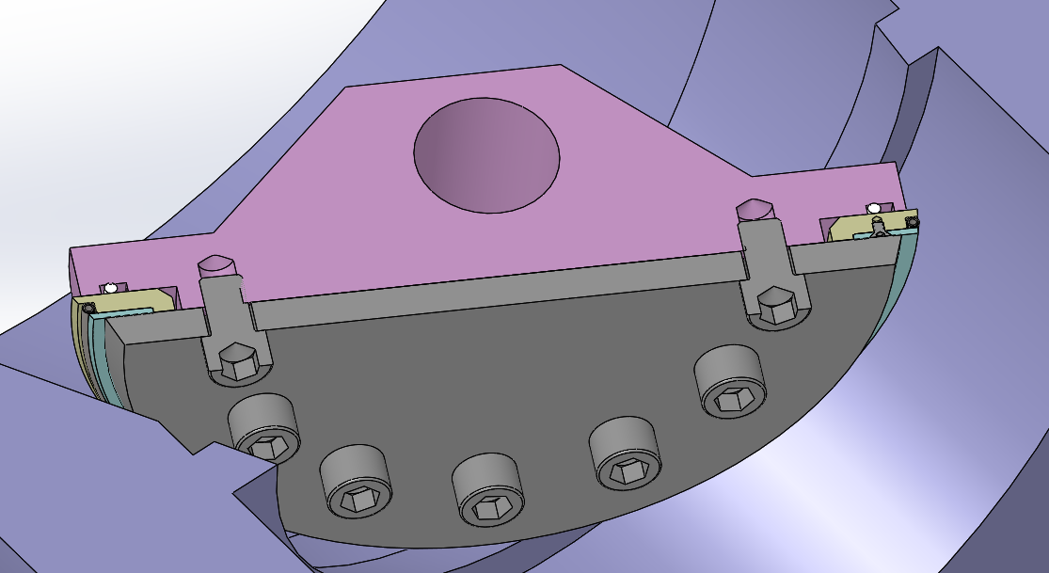
Performance overview of metal seals on DOBV / TOBV
Best performance observed with a “hard” polished seal
  Buttering does not work (too many shearing on soft material at each closure)
  Class A ISO 5208 over a big amount of seals is reachable on a custom design seal
  Trend on the market to improve the shut-off sealing (class A was before targeted for only soft polymer seals)
  New targets achievable through a clever seal/seat combination
PATENT PENDING
Semi-dynamic contact
hard polished surfaces (1)

Slide 21
Conclusion
Semi-dynamic metal sealing solution:
  Key for valve optimization
  Actual and future extreme applications
Different contact mechanisms and seal designs can be used depending on the performance expectations
Best performance achievable with:
  Good surface engineering (crucial)
  Strong collaboration between valve manufacturer & seal supplier

Slide 22

Q & A SESSION
ORGANIZERS
SCIENTIFIC COMMITTEE
Thank you for your attention!
IVS 2022
Technical Conference

