Slide 1





NICOLAI TASCA
ORGANIZERS
SCIENTIFIC COMMITTEE
Ved-Coemi – Italy
The impact of valves on the environment
IVS 2022
Technical Conference

Slide 2




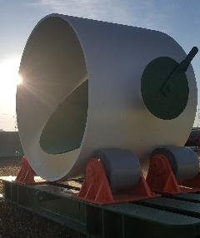
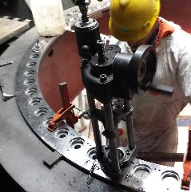
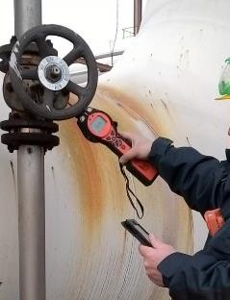
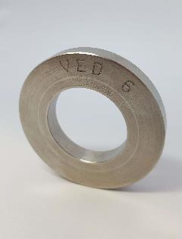


VED DIVISIONs PRODUCTS & SERVICES
Our Services
All our activities are based on a long experience and certifications and standards we have as core elements to offer to our customers as high level quality system.
Over 50 years thanks with gained experience a specific technical area was born to offer time by time a kind of service as a key chain one.
Engineering support
certification
Know how
Each department has is own engineering and technical office
ISO 9001:2015 | IS0 14001:2015
Gained experience during 50 years working in Oil&Gas Energy area
Team skill
Meet your requests
Technical support
Engineers | Specialized Technician
Chemists | Software Programmers
Multi Area Customer Care Services
Our R&D Office works as problem solving solution services
GPE
REFERENCES
CMA
TMS
GFE
Gasket Production
Composite Material
Technical Maintenance
Emission Control
Engineering and production of an high range of gasket typologies for any request
Pipe and fittings production and Steel Recovery system against corrosion act
Flange facing machining , leak sealing services, bolting service, valve maintenance
L . D . A . R .
Leak Detection And Repair, with special program

Slide 3
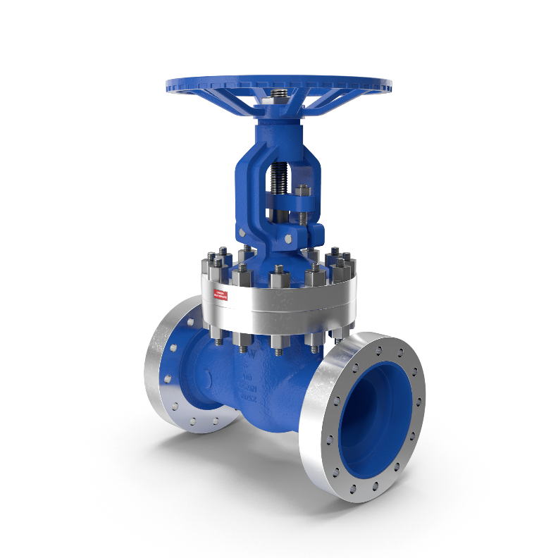

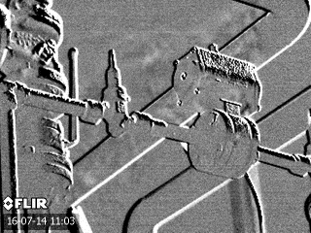
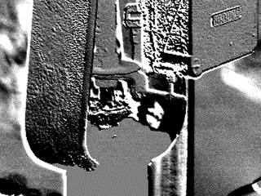
Fugitive Emission
Emission into the atmosphere, caused by the aging and wear of valve components and also bad maintenance management
Optical Gas Imaging leak monitoring
Valve glands
Flaged Joints
Notes:
Industrial plant valves play a critical role in environmental impact. Valves can emit two main types of emissions.
The first one is fugitive emission to the atmosphere caused by the aging and wear of valve components and also bad maintenance management.
Leakage from valve glades is by far the most common emission. They account for more than 99% of overall valve emission.
Emission by flanged joints is also possible, although less likely.

Slide 4


Valves are the main components that influence the overall plant fugitive emission
A typical refinery or chemical plant can emit 600 -700 tons per year of VOCs from leaking equipment, such as valves, connectors, pumps, sampling connections, compressors, pressure-relief devices, and open-ended lines.
EPA studies have estimated that valves and connectors account for more than 90% of fugitive emissions from leaking equipment with valves being the most significant source.
Figure shows fugitive emission distribution
Table shows fugitive emission contribution from valves.
Facilities | Overall source count | Valve count | Relative count | Overall Emission [ton/year] | Valve Emission [ton/year] | Relative emission
Refinery | 99.000 | 28.000 | 28% | 180 | 133 | 74%
Refinery | 224.000 | 66.000 | 29% | 539 | 300 | 56%
Chemical plant | 79.000 | 21.400 | 27% | 872 | 548 | 63%
Chemical plant | 11.200 | 2.000 | 18% | 88 | 55 | 63%
Thermoelec. power plant | 1.800 | 522 | 29% | 1,4 | 0,86 | 61%
Thermoelec. power plant | 2.400 | 677 | 28% | 1,77 | 1,39 | 79%
TOT | 417.400 | 118.599 | 28% | 1.682 | 1.038 | 62%
Data was collected from monitoring surveys during LDAR program implementation
VALVES ACCOUNT FOR 30% OF EMISSION SOURCES AND FOR MORE THAN 60% OF EMISSION
Notes:
Data collected from monitoring surveys during the LDAR program in ITALY show the same results.
A medium sized refinery plant, shown in the first line of the table, accounts for about one hundred thousand emission sources, more than seventy percent of emissions came from valves. This value reduces to just over sixty percent for chemical plants and rises to almost eighty percent for thermoelectric power plants. Among all the leaking equipment, valves are definitely the largest source of emissions of volatile organic compounds (VOCs) and volatile hazardous air pollutants (VHAPs) from petroleum refineries and chemical manufacturing facilities.

Slide 5
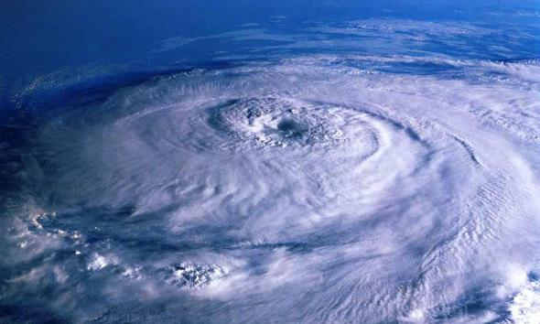
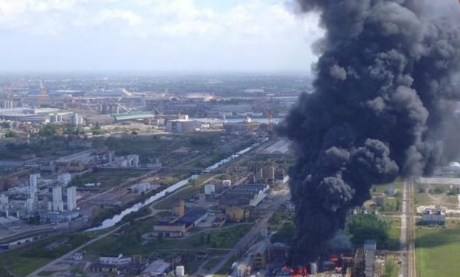


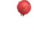

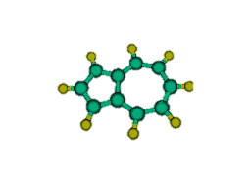

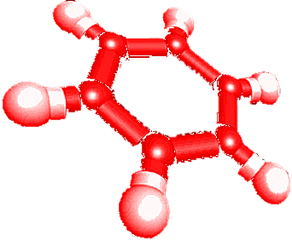
Fugitive emission impact on the environment
Fugitive emission of VOCs (volatile organic compound) contribute to the formation of ground-level ozone. Ozone is a major component of smog, and causes or aggravates respiratory disease, particularly in children, asthmatics, and healthy adults who participate in moderate exercise.
Some species of VOCs are also classified as VHAPs (volatile hazardous air pollutants). Some known or suspected effects of exposure to VHAPs include cancer, reproductive effects, and birth defects. The highest concentrations of VHAPs tend to be closest to the emission source, where the highest public exposure levels are also often detected.
Some common VHAPs emitted from refineries and chemical plants include acetaldehyde, benzene, formaldehyde, methylene chloride, naphthalene, toluene, and xylene.
The Greenhouse Gas Protocol (Scope 1) indicates fugitive emission as Direct GHG emissions.
VOCs are flammable increasing fire and explosion risk

Slide 6




Reducing fugitive emission by Leak Detection And Repair implementation
When the LDAR requirements were developed, EPA estimated that petroleum refineries could reduce emissions from equipment leaks by 63% by implementing a facility LDAR program. Additionally, EPA estimated that chemical facilities could reduce VOC emissions by 56% by implementing such a program.
Figure shows fugitive emission reduction by LDAR implementation in an Italian refinery
Benefits of an LDAR Program
Emissions reductions from implementing an LDAR program:
increase safety for workers and operators
reduce product losses
reduce emissions fees,
decrease exposure of the surrounding community,
help facilities avoid enforcement actions
Reduction of 77,2 % = 433 tons of VOC saved

Slide 7



Elements of an Leak Detection And Repair program
Identifying Components
Physically tag each regulated equipment component with a unique ID number. Institute an electronic data management system for LDAR data and records. Periodically perform a field audit to ensure lists and diagrams accurately represent equipment installed in the plant.
Monitoring Components
Leak Definition
Use an electronic data logger to save time, improve accuracy, and provide an audit record. Audit the LDAR program to help ensure that Method 21 procedures are being followed properly, and the required records are being kept.
Utilize a leak definition lower than what the regulation requires. Simplify the program by using the lowest leak definition when multiple leak definitions exist. Make the lowest leak definition conservative to provide a margin of safety when monitoring components.
Recordkeeping
Repairing Components
Perform internal and third-party audits of LDAR records on a regular basis to ensure compliance. Electronically monitor and store LDAR data. Perform regular records maintenance. Continually search for and update regulatory requirements. Properly record and report first attempts at repair. Keep the proper records for components on Delay
of Repair lists.
Develop a plan and timetable for repairing components.
Make a first attempt at repair as soon as possible after a leak is detected. Monitor components to ensure a leak has been successfully repaired.
Replace problem components with “leakless” or other technologies

Slide 8
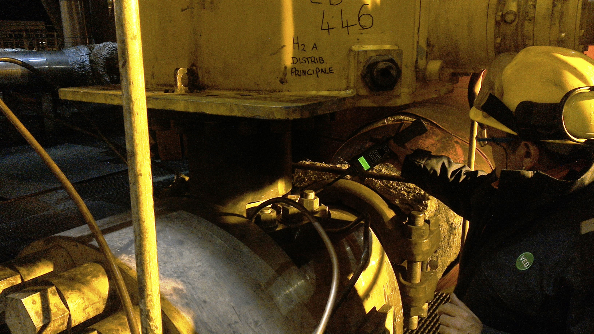
Leak Detection
EPA 21 Method- accessible sources
Non-accessible sources
Flame ionization detector
Optical Gas Imaging
Photo ionization detector
Ultrasound camera
Thermal conductivity detector
Infrared detector
Low power semiconductor detector
Catalytic oxidation

Slide 9
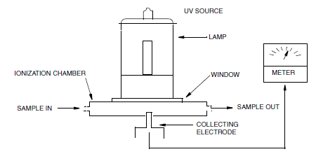


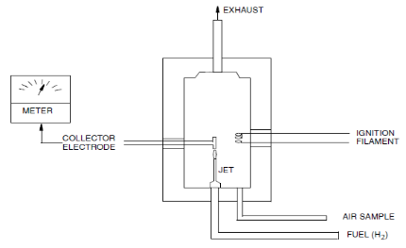

Leak Detection – CHOOSING THE RIGHT VOC MONITORING DEVICE (EPA21)
Instrumental monitoring of VOC (Volatile Organic Compounds) can be carried out with two main devices: the Flame Ionization Detector, (FID), and the Photoionization detector (PID).
A Photoionization detector (PID) uses an ultraviolet (UV) light source to ionize chemicals to positive and negative ions that can be easily counted with a detector. Ionization occurs when a molecule absorbs the light energy and when molecules ionizzation potenzial is lower than light energy.
U.V. Lamp
C₆H₆⁽⁺⁾
+
e⁽⁻⁾
C₆H₆
A Flame detector (FID) uses a hydrogen flame to ionize chemicals to positive and negative ions that can be easily ions counted with a detector.
R-C-H → R-C· + H· R-C· + O· → R-C-O⁽⁺⁾ + e⁽⁻⁾
Notes:
PID’s can be adversely affected in dirty and humid conditions or where other non-responsive gases are present. Humidity can cause leakage currents or refract the UV light resulting in lower sensitivity. When there are other gases present that are not detected by the PID, they work to reduce sensitivity (quenching) as the UV lights energy is absorbed in collision with the molecules other than those of the target gas (if UV photons collide with a gas, they can’t ionize. Then that photon’s energy is lost reducing the amount of UV photons available).

Slide 10

Leak Detection – CHOOSING THE RIGHT VOC MONITORING DEVICE (EPA21)
FID and PID are both mentioned in the EPA 21 method for VOC fugitive emissions monitoring, but our field experience showed substantially different results using FID and PID. Tests carried out simultaneously, on real samples and in real LDAR monitoring conditions, showed that FID is the best technology for VOC fugitive emissions monitoring. Its flame ionization technology is less affected by interferences; FID can detect VOC presence with a higher precision compared to PID.
U.V. Lamp
Target
gas
Barrier gas
PID’s use ultra-violet light to ionize the sample gas stream. Some gases, like methane, are not ionized, where other gases can react photochemically and form compounds that can coat the lamp surface. Those gases cause a barrier effect giving a decreased device efficiency and sensitivity.
Humidity can introduce leakage currents or refract the UV light, resulting in lower sensitivity. As a consequence, PID can be successfully used for single chemical compounds measurement in low concentration conditions, with a higher sensitivity than FID. PID can be less effective in high concentration conditions.
PID’s can be adversely affected in dirty and humid applications or where other non-responsive gases are present

Slide 11

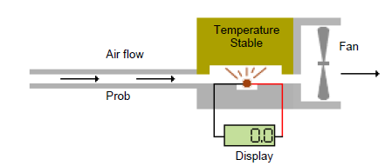
Leak Detection – CHOOSING THE RIGHT MONITORING DEVICE FOR INORGANIC COMPOUNDS
Hydrogen
Thermal Conductivity
All gases conduct heat but by varying amounts, if an object is heated and then the source of heat is removed, the object will eventually cool down to match ambient air temperature. Detectors contain a heated thermistor bead that transmits heat to a block of material that remains at a constant temperature. When gases with different thermal qualities pass through the chamber the amount of heat being transmitted to the Temperature Stable block changes. These changes are measured, calculated and displayed as leak rates or gas concentrations.
TCD is less sensitive than FID, but it is responsive to all gases, so it is used for inorganic gas leak monitoring

Slide 12
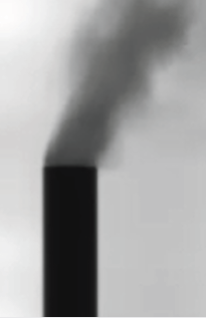
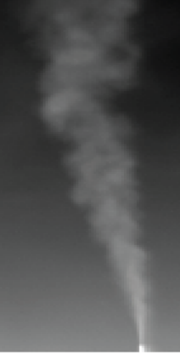
Leak Detection – Optical Gas Imaging
Using an infrared OGI camera you can visualize gas plumes
Absorptive plume (Black smoke)*
Emissive plume (White smoke)*
* Presumes polarity of white = hot

Slide 13
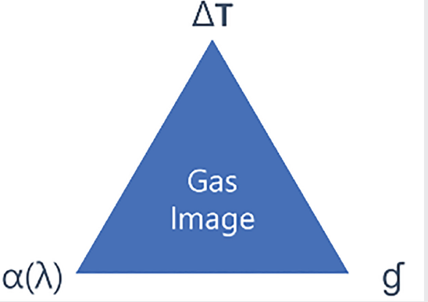
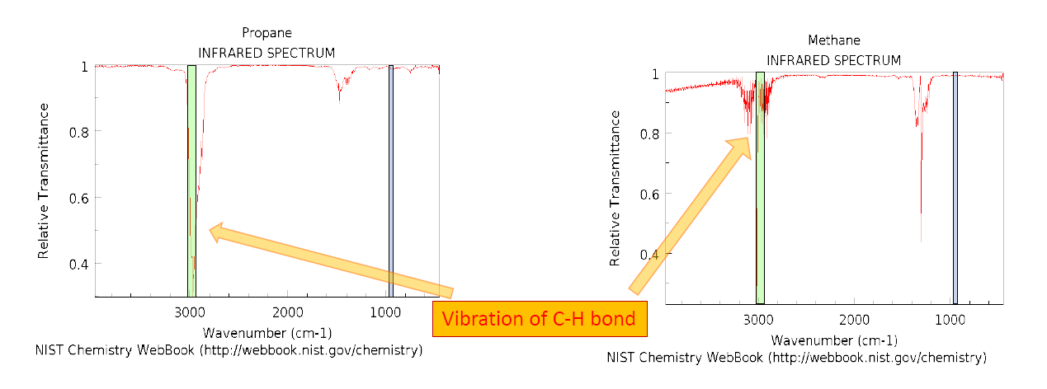
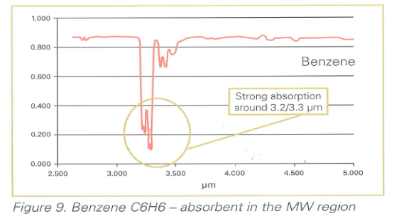
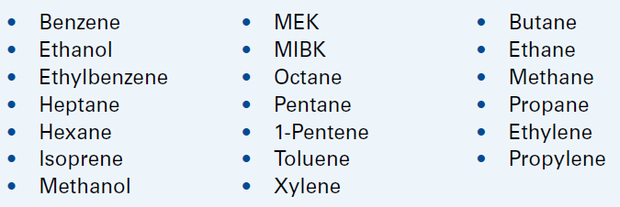
Leak Detection – Optical Gas Imaging
You need three things to image a gas with an infrared camera
1. α(λ): The gas has IR absorption peak that overlaps with the spectral window of the OGI camera (usually between 3,2 and 3,4 micron)
Detectable gas list

Slide 14
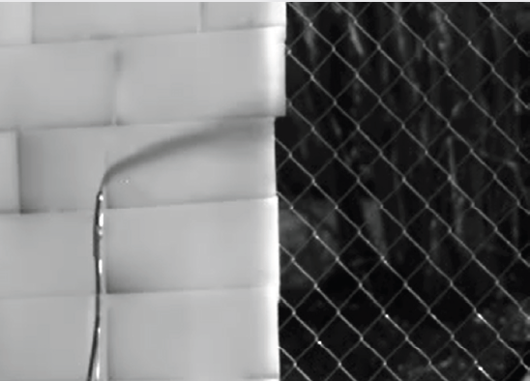
Leak Detection – Optical Gas Imaging
You need three things to image a gas with an infrared camera
2. ΔT: There is sufficient temperature difference between the gas plume and the background (2-3 °C is recommended)
GOOD ΔT
POOR ΔT
Sufficient temperature difference must exist between the gas plume and the background. A higher ΔT will lead to more visible plume in the OGI camera’s display.
Detectable gas list
Image of a gas leak showing the effects of Delta T as the gas moves from a hot background (the wall) to a background that is ambient temperature (the fence)

Slide 15
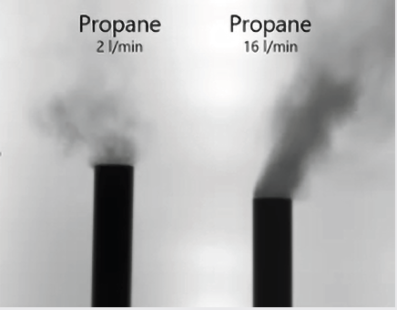
Leak Detection – Optical Gas Imaging
You need three things to image a gas with an infrared camera
3. CL: There is sufficient concentration path-length. This is the path integrated Concentration Length of the gas, measured by gas concentration multiplied with gas plume length, e.g. [ppm x m]
There must be gas present in the image that is greater than the minimum detection limit of the system
Detectable gas list
Examples of propane with varying concentration path-lengths

Slide 16
Leak Detection – Sniffing versus Optical gas imaging
Category | Sniffing | Gas Imaging
Applicability | piping systems are easily accessible. very small leaks must be detected. | many potential leak points are covered by insulation or are not easily accessible.
Detection limit | very low concentrations | 1 to 10 g/h for aliphatic hydrocarbons and benzene.
Reliability | false positives (tiny leak with high ppmv) false negatives (large leak with low ppmv). | all leaks above the detection threshold will be consistently detected.
Limitations | Many limitation for accessibility. | No limitation for accessibility (Leaks under insulation are normally detected).
Survey manpower | Up to 1,000 components per days, very labour-intensive. | Up to 2,000 components per day
Emission quantification | Correlations between ppmv measured and kg/h leak rate | Leak/no-leak factors applied to all potential leak points;

Slide 17
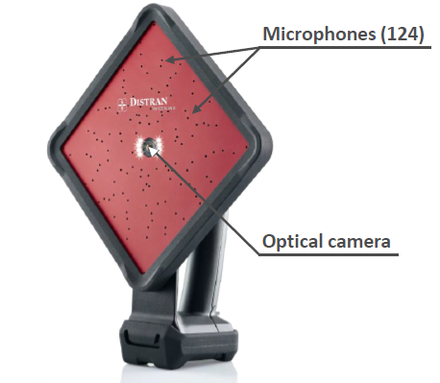
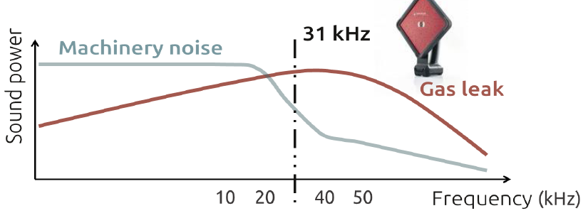
Leak Detection – Passive ultrasonic imaging for leak detection
How does it work?
An ultrasound camera is composed of:
  an array of microphones sensitive to ultrasounds
  an optical camera
  31 - 60 kHz is the default monitoring frequency range

Slide 18
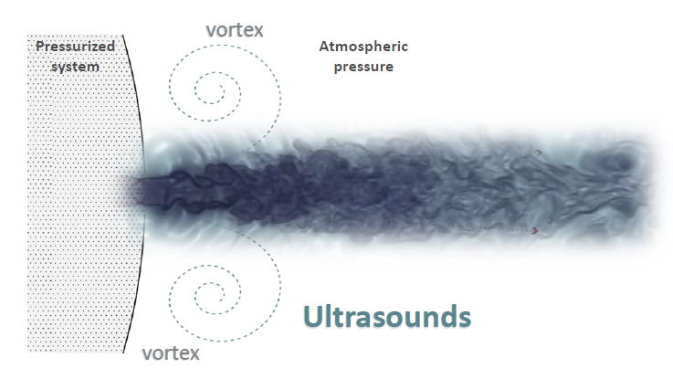
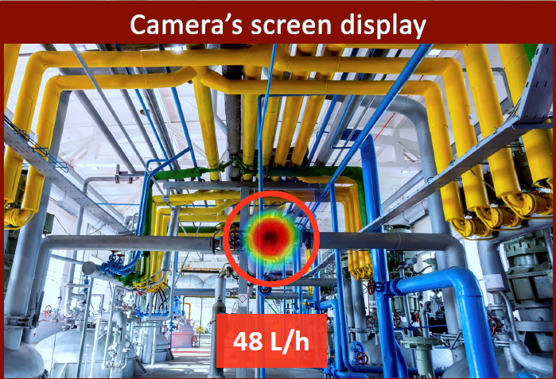
Leak Detection – Passive ultrasonic imaging for leak detection
How does it work?
Gas leaks emit ultrasounds, picked up by ultrasound cameras’ microphones.
Ultrasound waves reach each individual microphone at a different time. From these time differences, the camera algorithms reconstruct and display the ultrasound source location

Slide 19


Leak Detection – Passive ultrasonic imaging for leak detection
Advantages and limitations of using Ultrasound Imaging
Inspect areas 10 times faster than with other methods
Perform inspection in normal operation without scaffoldings
Not sensitive to the gas type and concentration, finding leaks of any gas type
Gas leak must create ultrasounds
  Minimum pressure difference required
there must be a direct path between leak and camera
  cannot detect leaks under insulation.
  Sound reflections (echoes) can be detected by the camera
The camera also detects flow noise, vibration, ventilation and partial discharge interfering with leak localization

Slide 20

Leak Detection – comparative table
FEATURE | FID | PID | TCD | OGI | Ultrasound
Price | €€ | € | € | €€€€€ | €€€
Lower threshold limit | 1 ppmv | 1 ppbv | 50 ppmv | ND | ND
Leak quantification | YES | YES | YES | YES, but with expensive and not speditive method | Limited to few gases and under significant restriction
Inaccessible sources monitoring | NO | NO | NO | YES | YES
Insulated sources monitoring | NO | NO | NO | YES | NO
Meets EPA 21 method requirement | YES | YES | YES | NO | NO
Device weight | 5 kg | 0,7 kg | 0,5 kg | 2,5 kg | 1,5 kg
Needs auxiliary gases | YES | NO | NO | NO | NO
Adverselya affected by humidity, dust, complex composition | NO | YES | NO | NO | NO
Gas type response | almost all VOC | Depends on gas ionization potential (not sensitive to CH4, C2H6, C3H8..) | No limitations | Limited VOC types | No limitations

Slide 21

Q & A SESSION
ORGANIZERS
SCIENTIFIC COMMITTEE
Thank you for your attention!
IVS 2022
Technical Conference

