Slide 1
ORGANIZERS
SCIENTIFIC COMMITTEE
ANDREA GIRONI
PAUL TURNER
IMTEX CONTROLS - CEO
LGM ENGINEERING - Marketing Manager
THE INTEGRATED VALVE INFORMATION DEVICE FOR EMERGENCY SHUTDOWN VALVE
IVS 2022
Technical Conference

Slide 2
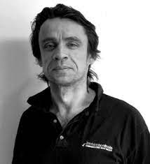
Biography
Paul Turner
Engineering Director
Imtex controls
Engineering Degree
Paul is a graduate in engineering (Durham University) and joined Imtex in 1995. Paul is the Engineering Director at Imtex, with particular focus on product development and certification at the Company. During his time at Imtex, Paul has managed the development of several new products, some with patented technology and gaining approximately 30 third party product certificates. He has a wide knowledge of the applications that the Company’s products are utilised in and enjoys interacting with clients to develop products and solutions to meet the challenges they face.

Slide 3
Biography
Andrea Gironi
Marketing Manager
LGM Engineering
Andrea is graduated in Economics (Bocconi University) and joined LGM ENGINEERING in 2018. Andrea started its working experience into a Italian business angel associations, as marketing support in support of startups. Than, he moved to Techogym, operating in the marketing and commercial area. From 3 years, Andrea is formally operating as Marketing Manager in LGM Engineering with particular focus on product marketing and converying to the market innovations and politic to help LGM in expanding is business.

Slide 4
ORGANIZERS
SCIENTIFIC COMMITTEE
WHO WE ARE
1

Slide 5
ORGANIZERS
SCIENTIFIC COMMITTEE
LGM ENGINEERING
2

Slide 6
ORGANIZERS
SCIENTIFIC COMMITTEE
IMTEX CONTROLS
3

Slide 7
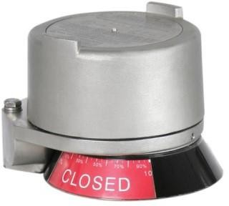
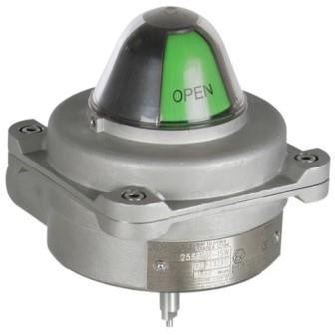
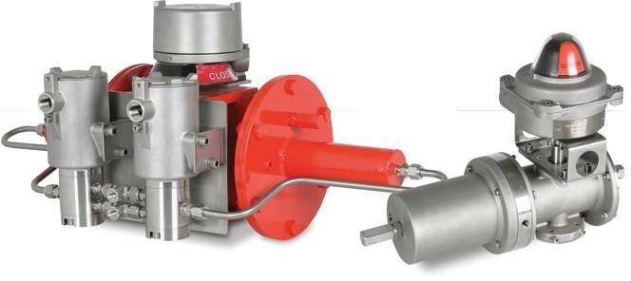
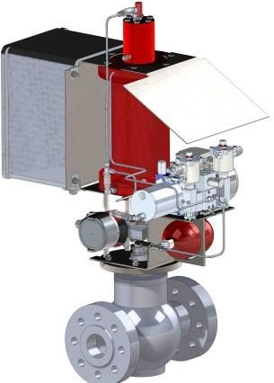
ORGANIZERS
SCIENTIFIC COMMITTEE
IMTEX VALVE COMMUNICATION & ACTUATORS
IMTEX VALVE COMMUNICATION
Valve Communication & Control Systems
Valve Monitoring
4 to 20mA Position Transmitters
Bus Communication Systems
Valve Diagnostic and Test Systems
CAMTORC ACTUATORS
Pneumatic, Hydraulic and Electro-Hydraulic Actuators
Quarter-Turn and Linear Actuators
Steel, Stainless Steel, Aluminium and Epoxy Construction*
MATIC ACTUATOR SYSTEMS
Valve Automation Service
Site Services
4

Slide 8
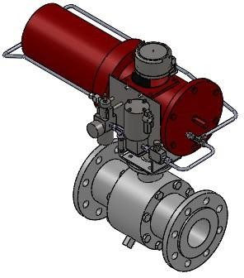
ORGANIZERS
SCIENTIFIC COMMITTEE
OPERATING REQUIREMENTS
Two Position - Open or Closed
Must be Automated to Ensure Automatic Response to Emergency Event
Located to Ensure Plant Safety during Potentially Hazardous Events
Inactive for Majority of Operational Life to Maximise Process 'Up' Time
Must 'Fail Safe' on Demand
Integral Part of 'Safety Instrumented System' (SIS) - Final Element
5

Slide 9
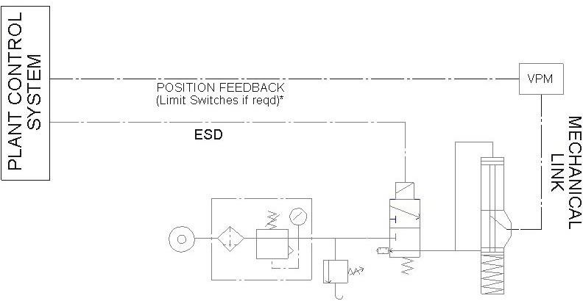
ORGANIZERS
SCIENTIFIC COMMITTEE
SHUT DOWN VALVE – TYPICAL SCHEMATIC
6

Slide 10
ORGANIZERS
SCIENTIFIC COMMITTEE
TYPICAL PROBLEMS
Valve becomes stuck or blocked
Deterioration in Actuator Performance
Solenoid fails to release or sticks
THESE PROBLEMS WILL ONLY BE REVEALED WHEN THE SYSTEM IS EXERCISED!
7

Slide 11
ORGANIZERS
SCIENTIFIC COMMITTEE
SDV ISSUES – IDENTIFICATION METHODS
SHUT DOWN EVENT (ESD)
Real-World information
Not desirable to discover a major problem at this time!
FULL STROKE TESTING (FST)
Tests to entire SD system
Usually requires a Plant Shutdown
MUST be performed periodically to comply with FS requirements
PARTIAL STROKE TESTING (PST)
Tests the SD Valve over a specified range
Can be implements without Plant Shutdown
Allows for the interval of FST to be extended
WHEN TESTING, THE GOAL SHOULD BE TO TEST THE VALVE SYSTEM IN A WAY THAT REFLECTS AS CLOSELY AS POSSIBLE THE WAY THE SYSTEM ACTS DURING AN ESD EVENT.
8

Slide 12
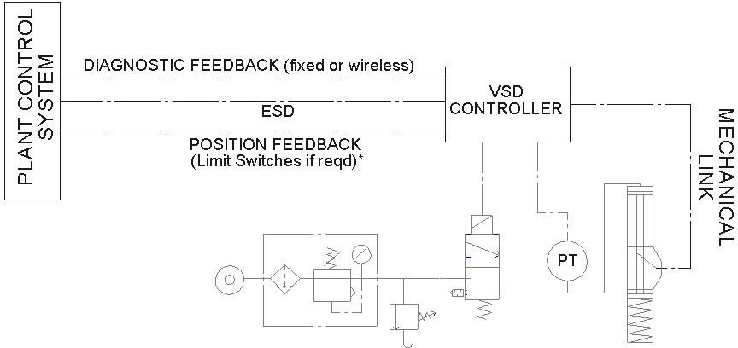
ORGANIZERS
SCIENTIFIC COMMITTEE
GOAL: INTRODUCE TESTING THAT MIMICS ACTUAL ESD TRIP AS CLOSELY AS POSSIBLE
SHUT DOWN VALVE – TYPICAL INSTALLATION
SHUT DOWN VALVE – WITH TESTING DIAGNOSTICS
DIAGNOSTIC
CONTROLLER
6

Slide 13
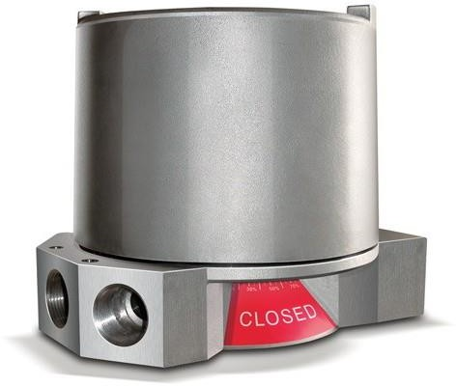
ORGANIZERS
SCIENTIFIC COMMITTEE
VALVESCAN TYPE V SMART CONTROLLER
PRINCIPLE OF OPERATION
Integrate Valve Test Capability into Valve Position Monitor Device that uses the components of the ESD Valve Assembly to deliver the test.
MAJOR BENEFITS
Uses the Solenoid that is part of the ESD Valve Assembly or a Second Solenoid to deliver testing functionality
Works with ANY Solenoid Valve so suits both Hydraulic and Pneumatic Systems
Full Valve Testing (FST/PST/SOT) with Independent Position Monitoring as well as Signatur Capture during Valve Operation
Test Valve, Actuator AND Solenoid
Can work with 1 or 2 Solenoids
Easy to Use for Local, Semi-Local or Remote Control
Easy to Calibrate
Full Diagnostics Available as Standard
Ideal for both New Build AND Retrofit

Slide 14
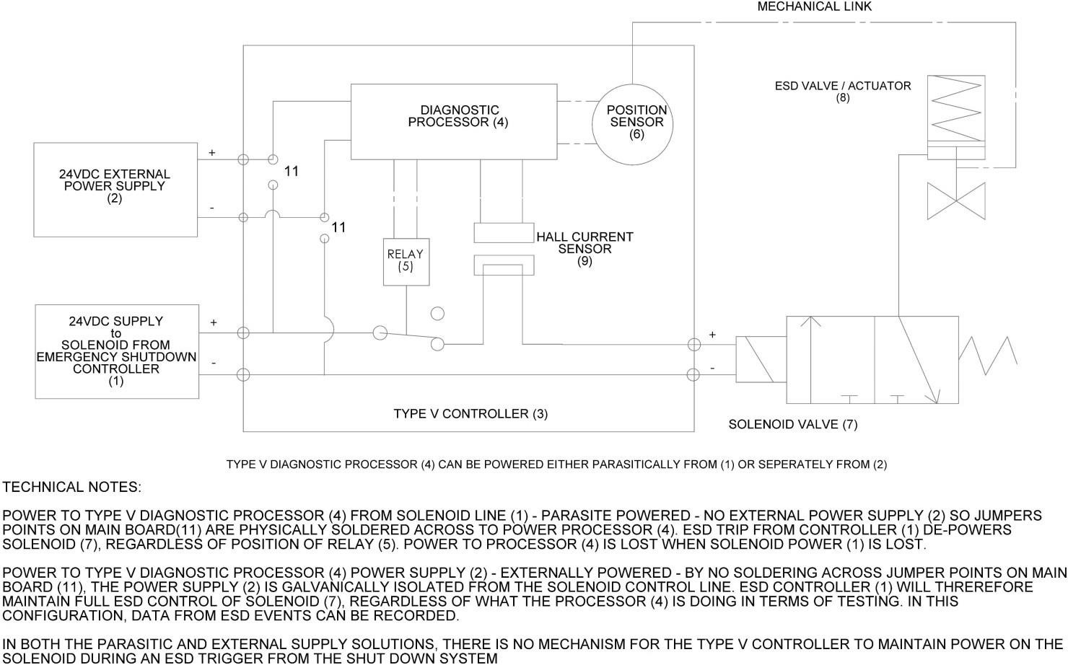
ORGANIZERS
SCIENTIFIC COMMITTEE
TYPE V CONTROLLER – OPERATIONAL OVERVIEW

Slide 15
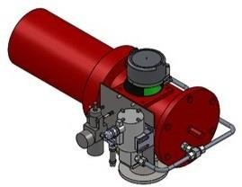
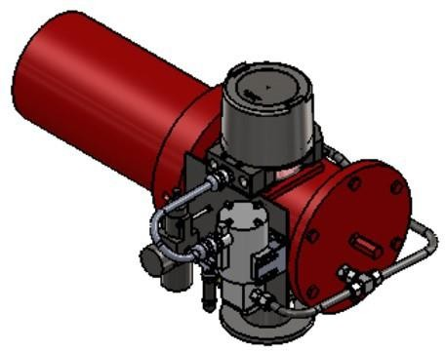
ORGANIZERS
SCIENTIFIC COMMITTEE
VALVESCAN TYPE V SMART CONTROLLER
Fits anywhere a conventional S/Box can be installed
No special Piping required
Utilises any make of Solenoid
Easy to retrofit - downtime 20 minutes

Slide 16
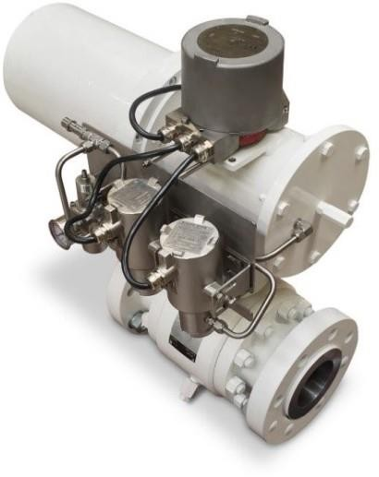
ORGANIZERS
SCIENTIFIC COMMITTEE
FEATURES
Full Valve Testing (FST/PST/SOT) and ESD Datalogging with up to 4 x Independent Position Monitoring Switches or 2 x Independent 4-20mA Transmitters
IP67 316SS Enclosure with 6 Conduit Entries for flexibility
Integrated Solid State Position Monitor
Communication via HART (VA & VI). Alternative options for Bluetooth and Modbus. (VS only)
Up to 5 x Digital Inputs and 4 x Digital Outputs (typically for Local Control Panel connection)
Up to 2 x Active Analogue Inputs, 1 x Passive Analogue Input and 2 x Analogue Outputs (version dependent)
Solenoid Current Monitoring (VA and VI variants only)
Position and Pressure Monitoring
Onboard Diagnostic Analysis
Optional ‘Automatic’ test feature – device can self initiate tests at regular intervals (in line with IEC 61508 standard recommendation
Multiple Power Options including Loop Powered
Exd (ia) and Ex ib Certified

Slide 17
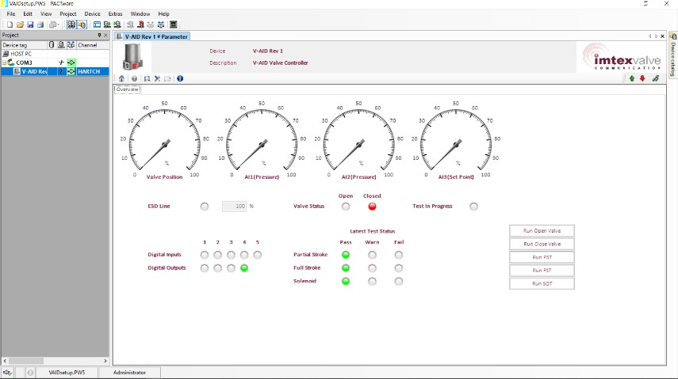
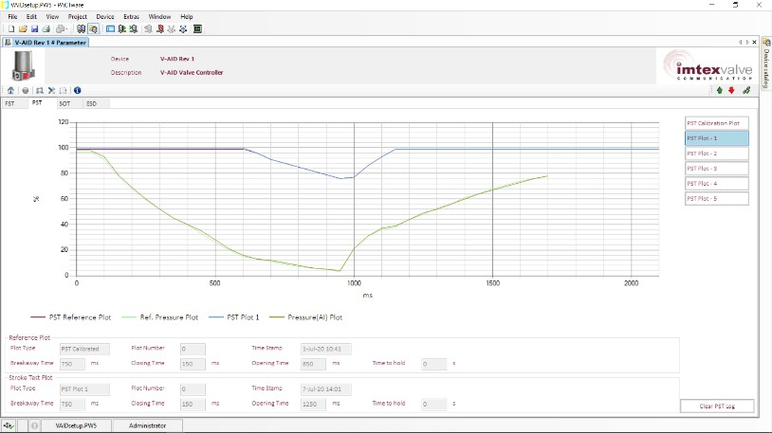
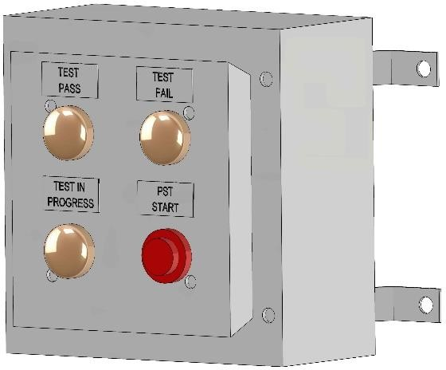
ORGANIZERS
SCIENTIFIC COMMITTEE
TYPE V CONTROLLER – OPERATION & DIAGNOSTICS
REMOTE OPERATION
Valve Signature
Partial Stroke Testing
Solenoid Testing
Full Stroke Testing
Valve/Actuator Characteristics – Comparative Analysis
Targeted Fault Finding
Cloud Upload Option (with VDMS)
LOCAL
Local Push Button Initiation
Local Pass/Fail Indicators
Automatic Test Option

Slide 18
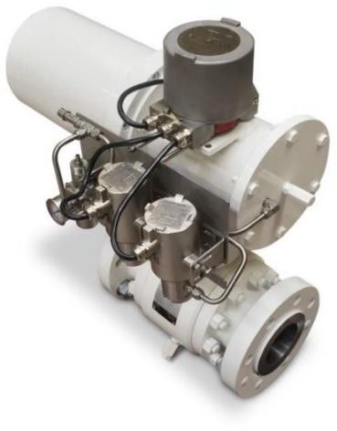
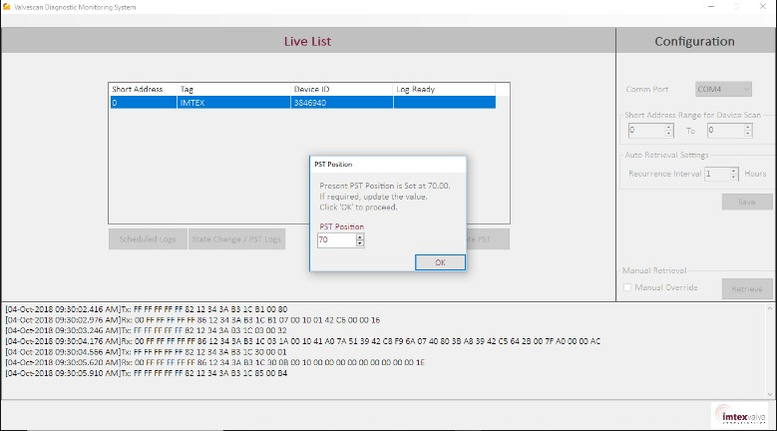
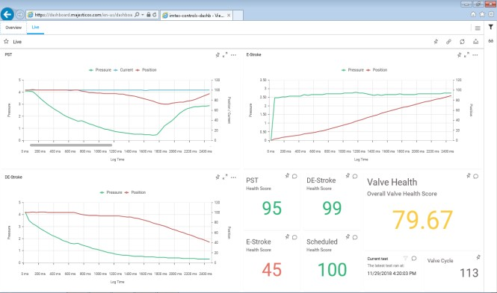
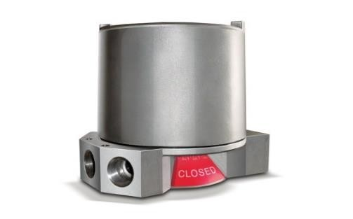
ORGANIZERS
SCIENTIFIC COMMITTEE
TYPE V CONTROLLER – SIMPLY DATALOGGING FOR ON-OFF VALVES
WHAT IF YOU DON’T WANT / NEED TO PERFORM TESTING?
BECAUSE:
Valves are not as critical (Process Control Valves)
Valves operate relatively frequently
Operational Constraints
SOLUTION – TYPE V and VDMS
V-ID Data Logging Solution –Smart Transmitter
Loop Powered Transmitter with Position, Pressure and Solenoid Current Monitoring
Simplified Set-up and Configuration via HART
Simplified data retrieval options including the revolutionary VDMS solution for End-to-End Diagnostics and Monitoring
Local and Cellular Wireless Monitoring with Cloud Analyse

Slide 19
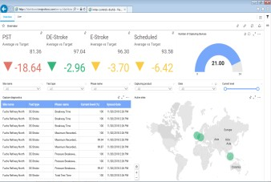
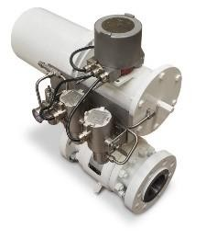
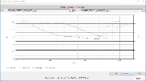
ORGANIZERS
SCIENTIFIC COMMITTEE
TYPE V / VDMS IMPLEMENTATION – CONTINUOUS IN-SERVICE VALVE MONITORING
Cellular Mast
4. Valve performance raw data harvested directly to Cloud via a Cellular network connection
3. Plant Safety System and/or Process Control System – No Additional Infrastructure Required at Plant Level as data is shared directly to the cellular network
5. ValveHealth Application to analyse field data and provide real-time information and feedback to key Plant personnel on the health of each automated valve
2. Automated Valve Assembly (Valve, Actuator & Solenoid) equipped with VFMD incl Cellular SIM is put into service and feeds information to Cloud regularly. Benchmarking can be done at this stage (no requirement for the VDMS Plant Master Application)
VALVE INTO SERVICE
1. VDMS Plant Master Application allows valve ‘As New’ operation data to be logged at FAT and/or First Commission. Shared to ValveHealth Cloud
TEMPORARY HART MODEM CONNECTION

Slide 20
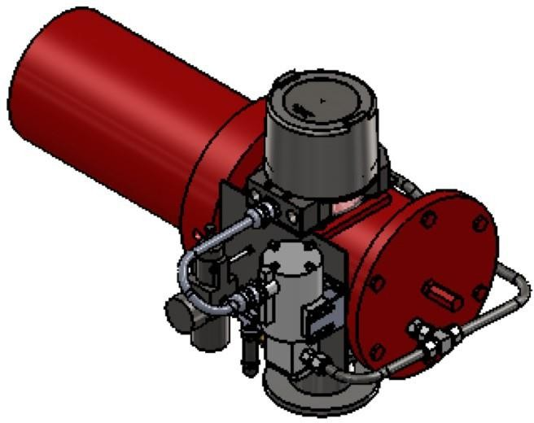
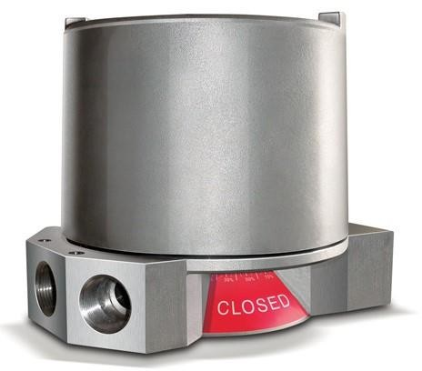
ORGANIZERS
SCIENTIFIC COMMITTEE
PARTIAL STROKE TESTING AND VALVE DIAGNOSTICS TAKEAWAYS
Retrofit without the need for significant plant modifications
Fully scaleable – Local operation through to full automated condition monitoring solutions
No negative impact on Functional Safety – only the benefit gained from PST implementation
VDMS End-to-End Solution for Datalogging every valve operation WITHOUT affecting Plant Operational Control
SAFETY AND DIAGNOSTIC SOLUTIONS WITHOUT COMPROMISE!!

Slide 21
Q & A SESSION
Thank you for your attention!
ORGANIZERS
SCIENTIFIC COMMITTEE
IVS 2022
Technical Conference

