Slide 1
ALEX GIORGINI
ORGANIZERS
SCIENTIFIC COMMITTEE
Hydrogen Specialist – Valland SpA
Materials selection for valves in H₂ environment
IVS 2022
Technical Conference

Slide 2
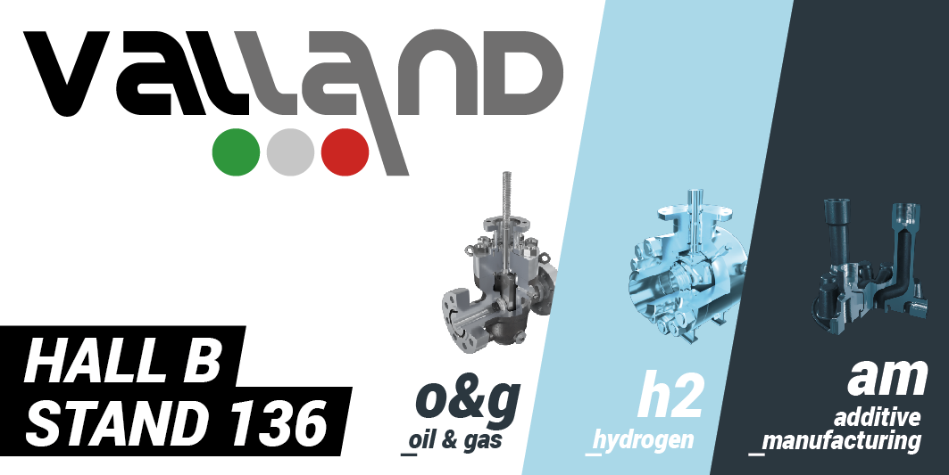
Biography
M.Sc. in Energy Engineering at Politecnico di Milano
Hydrogen Specialist – R&D Department at Valland SpA
Expertise in material science for energy applications
Come visit us and join the hydrogen revolution!

Slide 3
Outline
Introduction
About Valland
Hydrogen economy and current status of deployment
Compatibility issues: H₂ in materials
Hydrogen degradation mechanisms in metals and soft materials
Innovative solutions for H₂ applications
3D printing as enabling technology for the hydrogen economy
Q&A session

Slide 4
Introduction

Slide 5
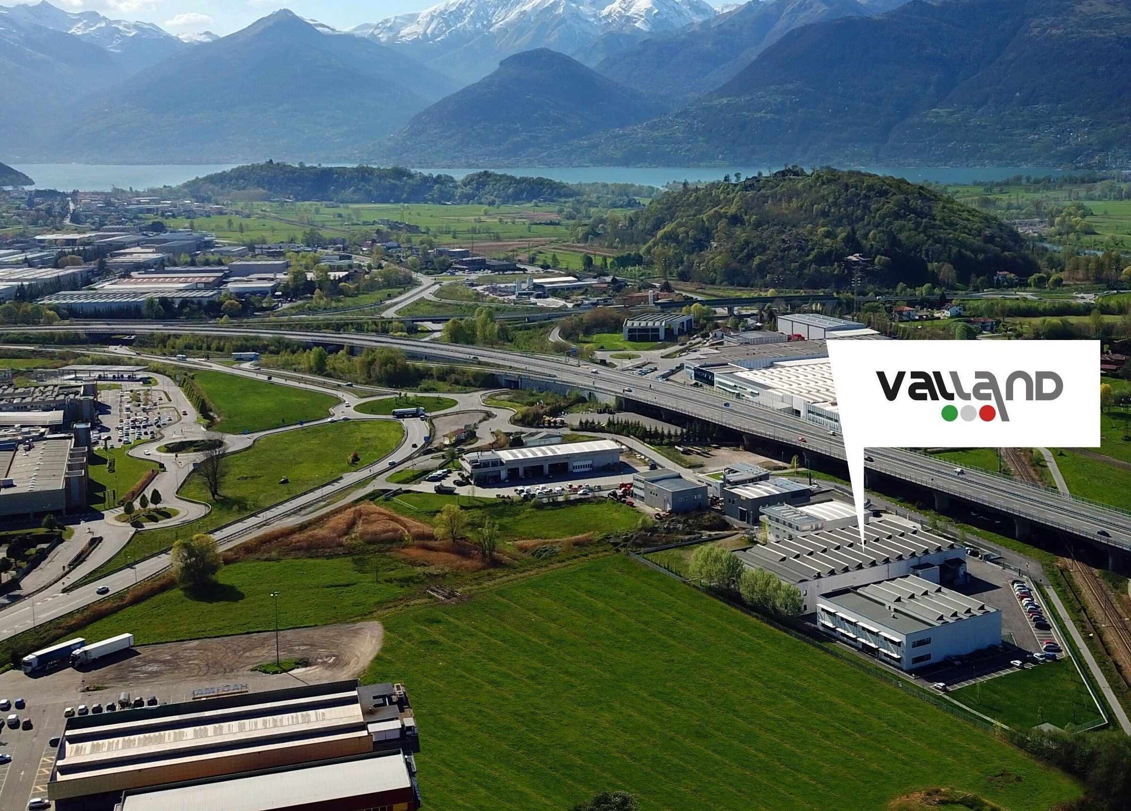
About us: Company profile
What we do
High-quality and tailor-made valves
Reference market is Oil & Gas Exploration and Production sectors and other special industrial services
Innovation pillars
Energy transition
Additve Manufacturing
We strongly believe in Innovation as the main enabling factor to configure a Sustainable Future for our planet, society and economy.

Slide 6
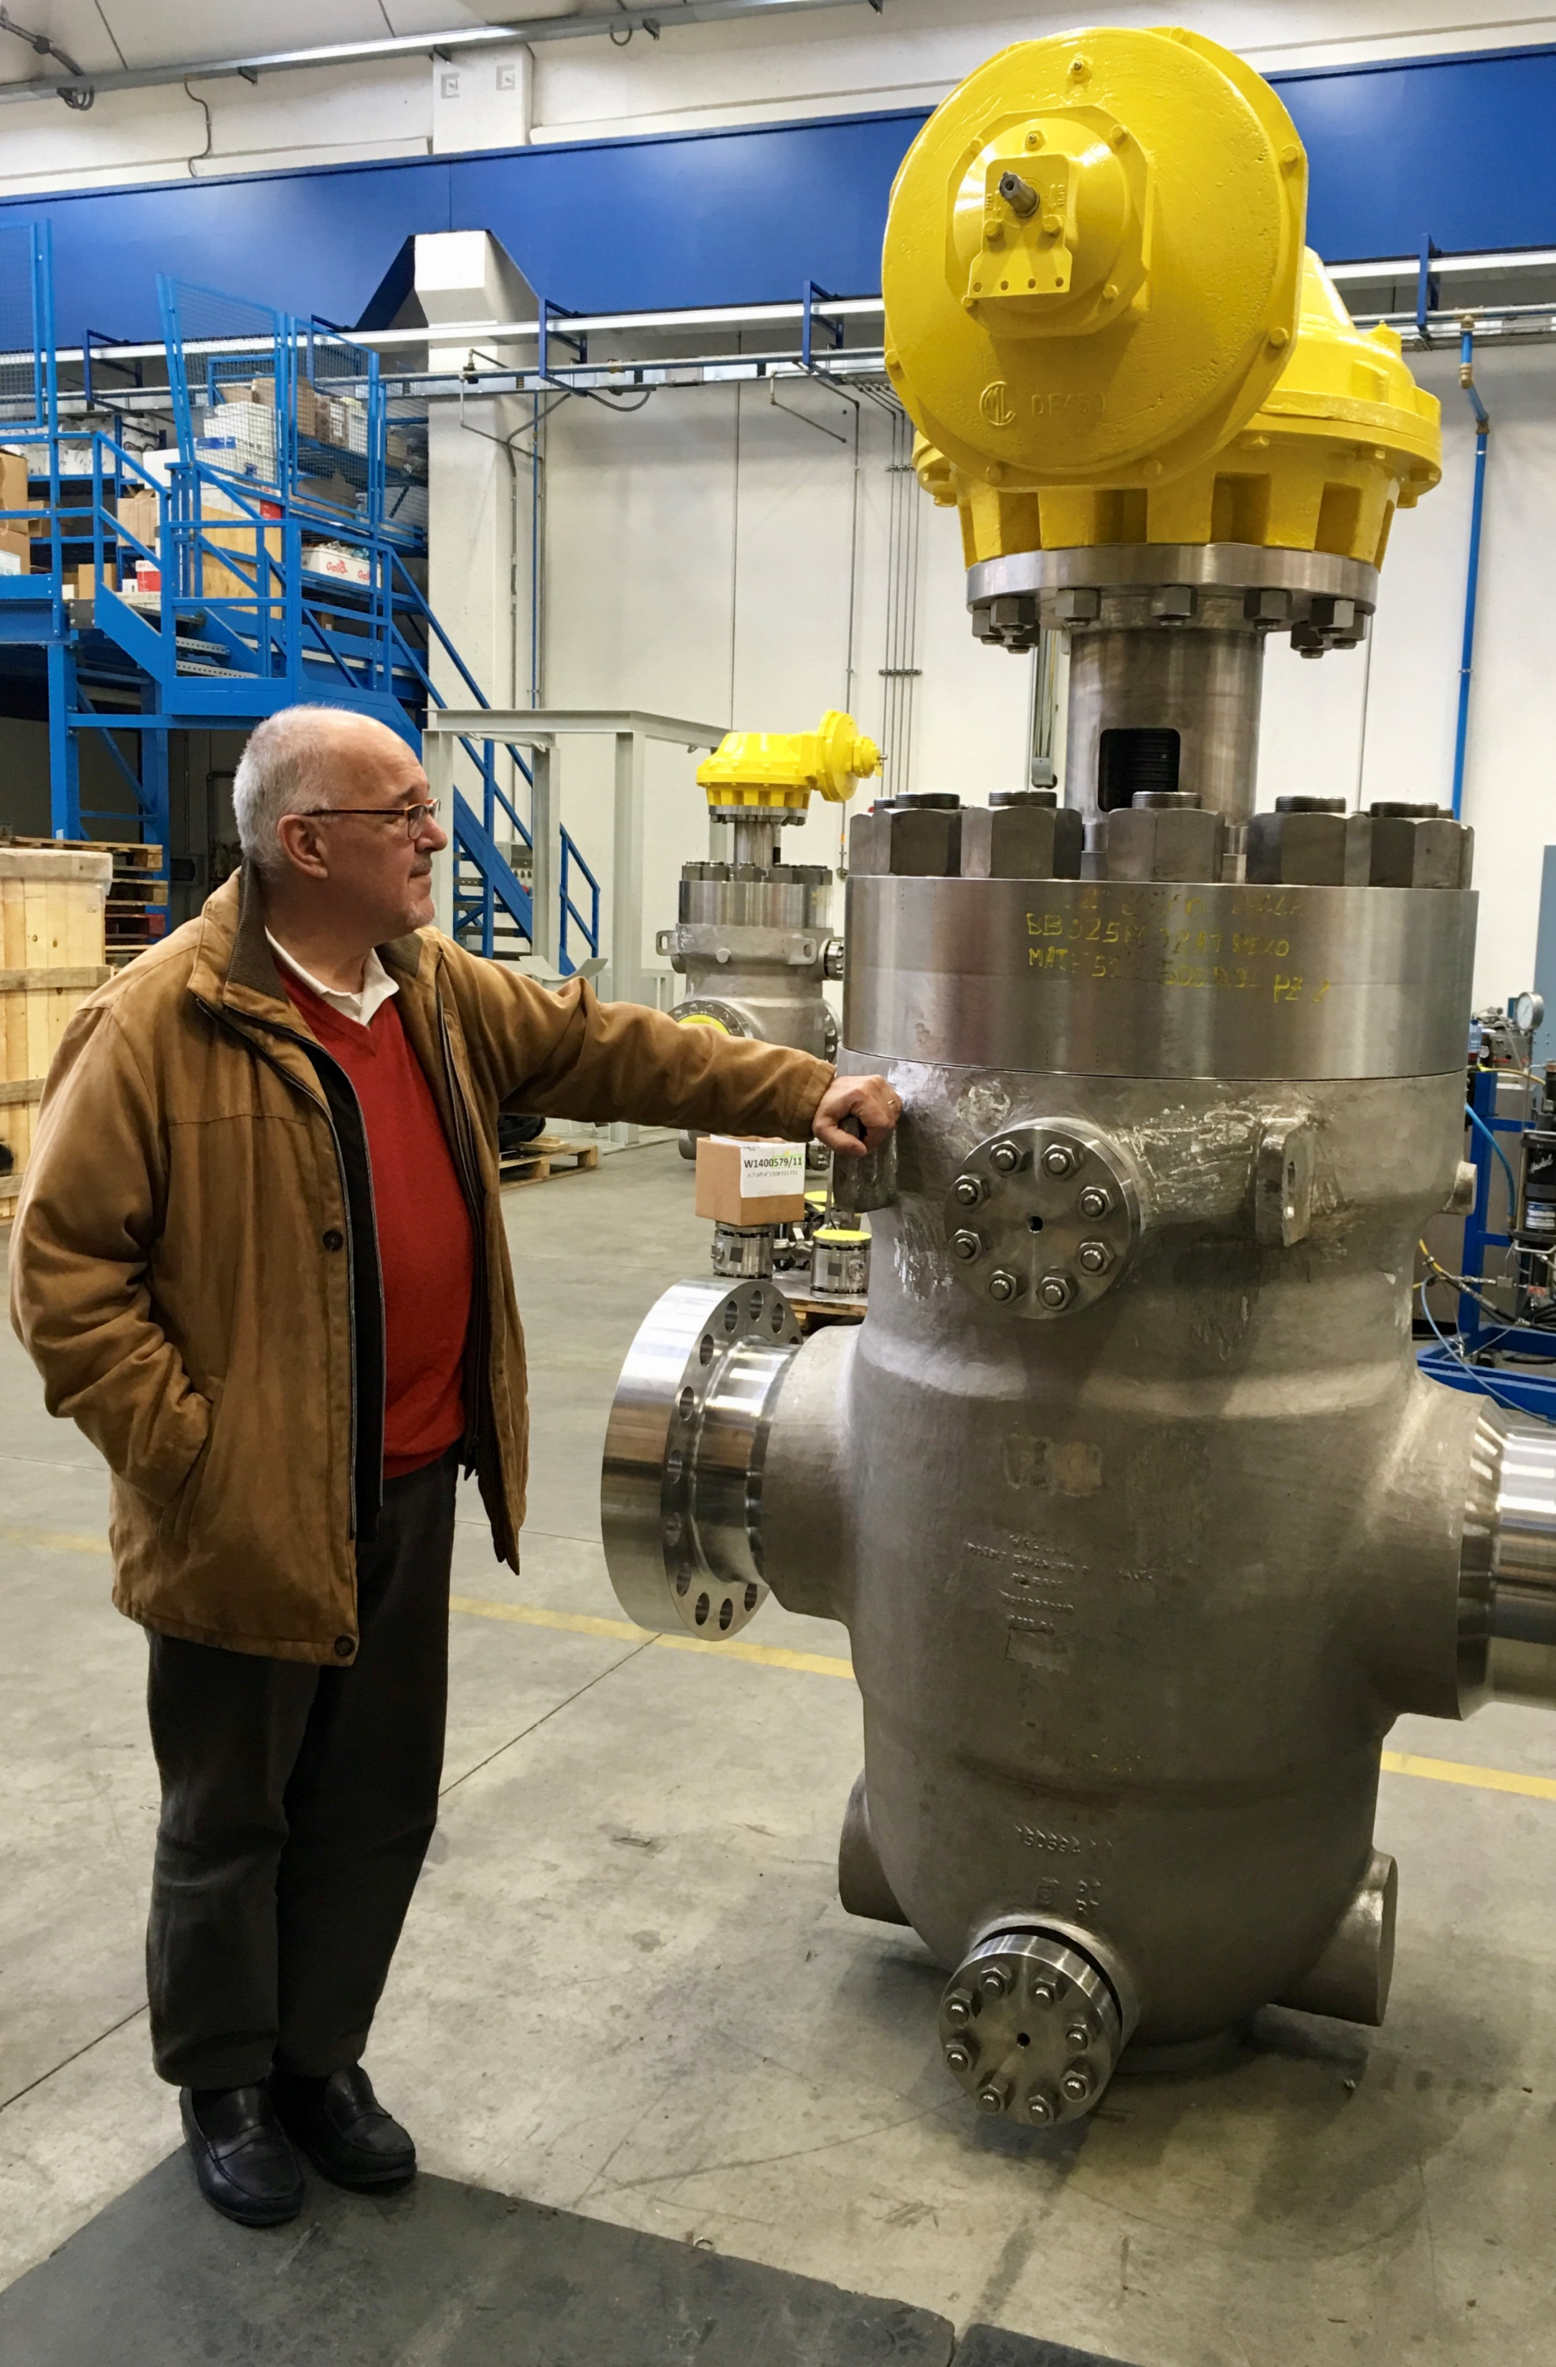
About us: Vision, Mission and Values
The Valland standard is to provide valves designed to withstand any working condition, delivering the most reliable product in the shortest lead time.
Vision
Mission
Values
Continuous improvement
Value creation
Trustable and
Sustainable cooperation with Stakeholders
Realization of Client’s vision
Trust and respect throughout the supply chain
Enrich enviornment and society
Caring
Flexibility
Innovation
Sustainability

Slide 7
About us: Sustainability strategy
Innovation First
Friendly Workplace
Preserve Natural Resources
Road to Carbon Neutrality

Slide 8
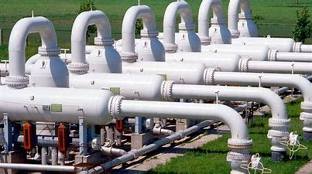
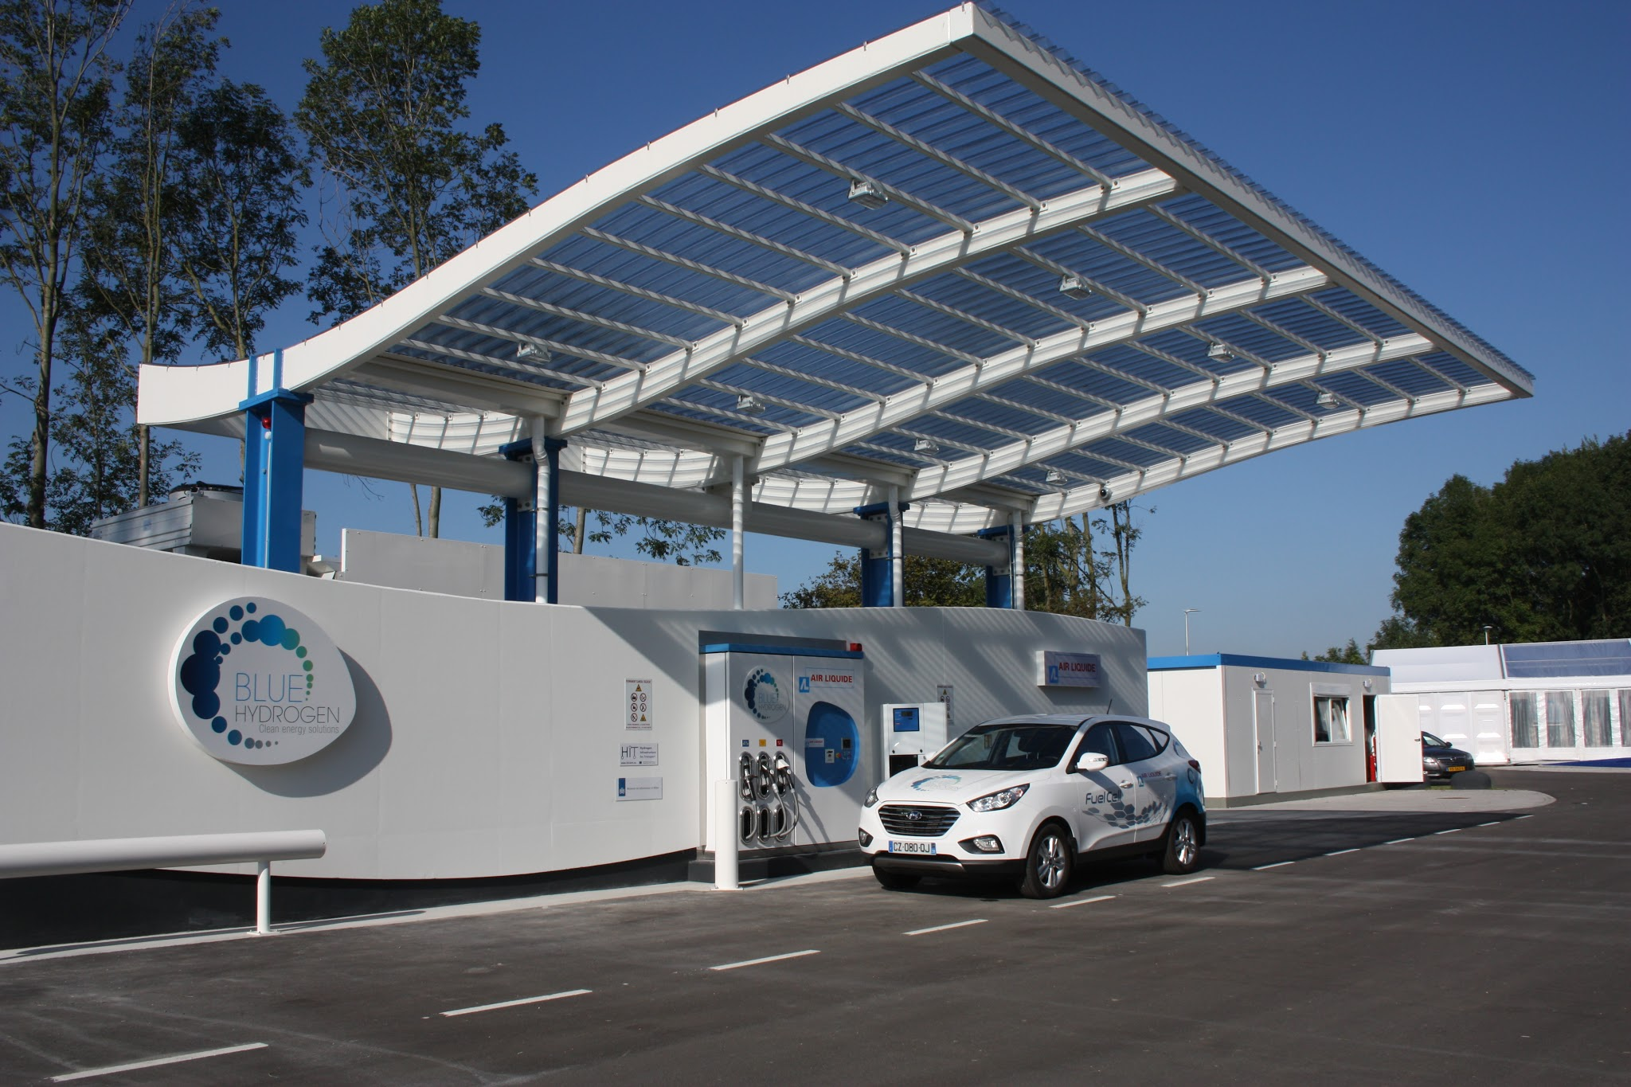
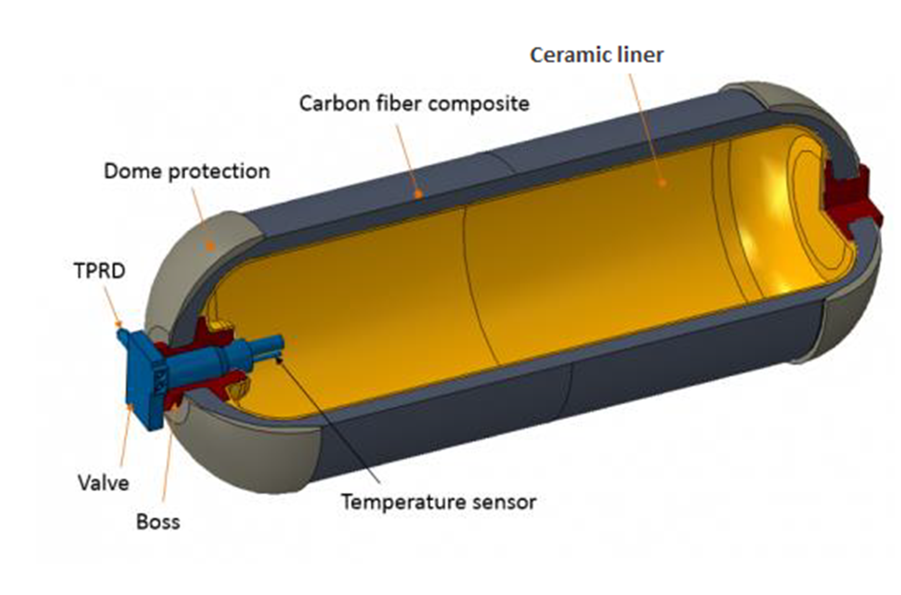
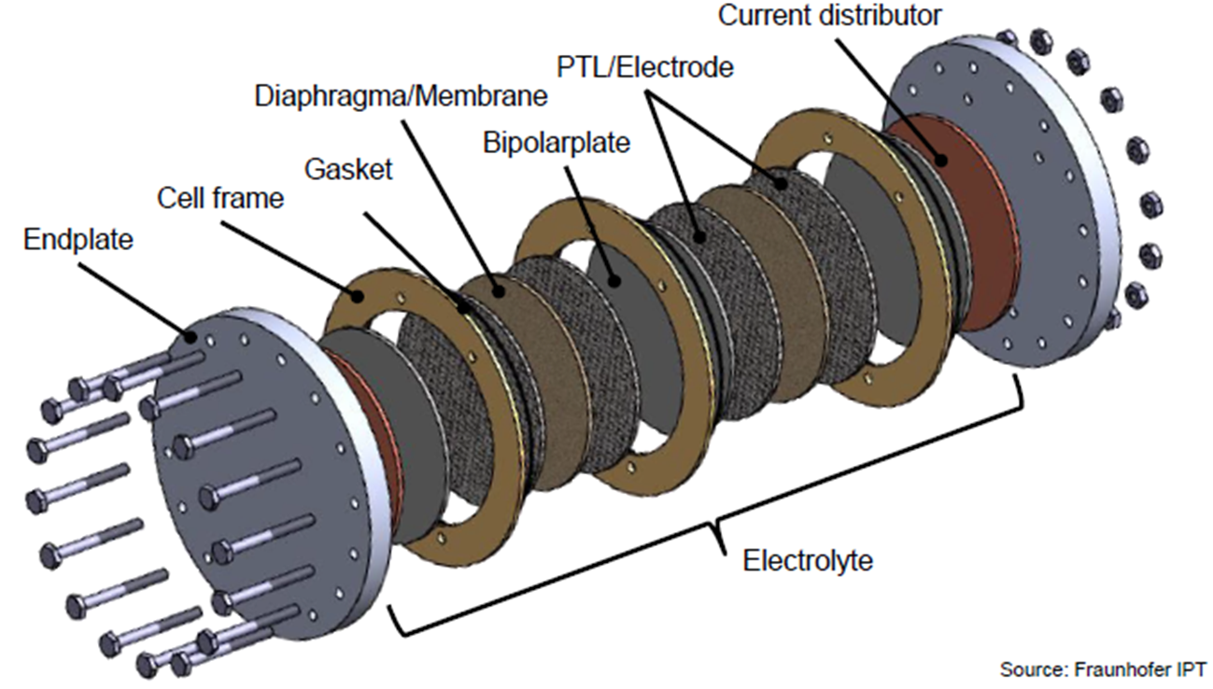
Hydrogen economy and current status of deployment
Valves are required almost everywhere along the hydrogen value chain!

Slide 9
Compatibility issues:
H₂ in materials

Slide 10
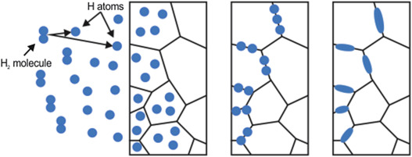
Hydrogen degradation mechanisms in metals
Hydrogen Embrittlement (HE) or hydrogen embrittlement cracking
HE occurs at any operating conditions, worsening at high hydrogen pressure
H2 dissociation (i.e., atomic form) and adsorption
Diffusion, reverse transformation (atomic -> molecular form) and accumulation
Blistering and/or crack initiation
HE depends on the microstructure of metals and on their mechanical behavior

Slide 11
Hydrogen degradation mechanisms in metals
Hydrogen Embrittlement (HE) or hydrogen embrittlement cracking
HE occurs at any operating conditions, worsening at high hydrogen pressure
H2 dissociation (i.e., atomic form) and adsorption
Diffusion, reverse transformation (atomic -> molecular form) and accumulation
Blistering and/or crack initiation
HE depends on the microstructure of metals and on their mechanical behavior
[M. Koyama et al., ACTA MATERIALIA, 2013]

Slide 12
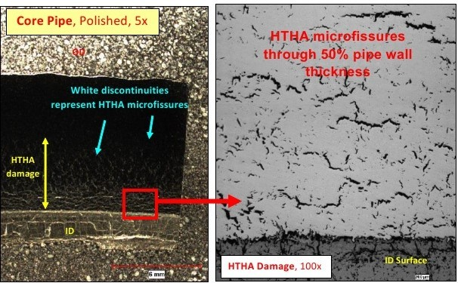
Hydrogen degradation mechanisms in metals
High Temperature Hydrogen Attack (HTHA)
HA occurs mainly at high temperatures (above 200 °C)
Atomic hydrogen chemically reacts with elements inside the metal matrix
Gas (CH4), Water (H2O) or brittle phases (hydrides) are produced
[“High Temperature Hydrogen Attack (HTHA) of Welds”, 2019]

Slide 13
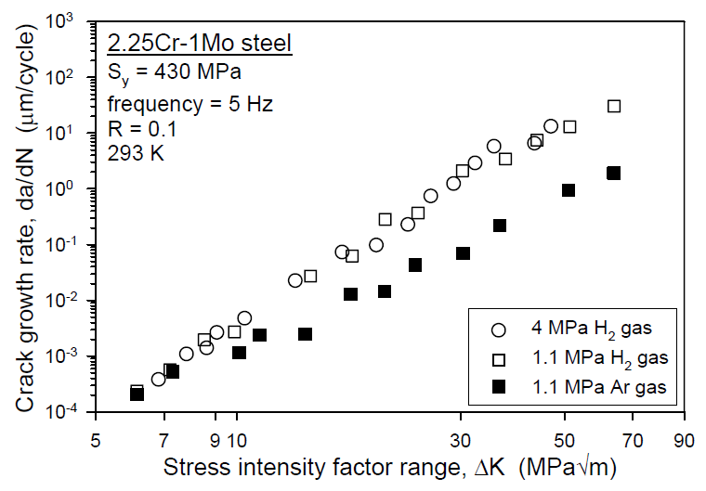
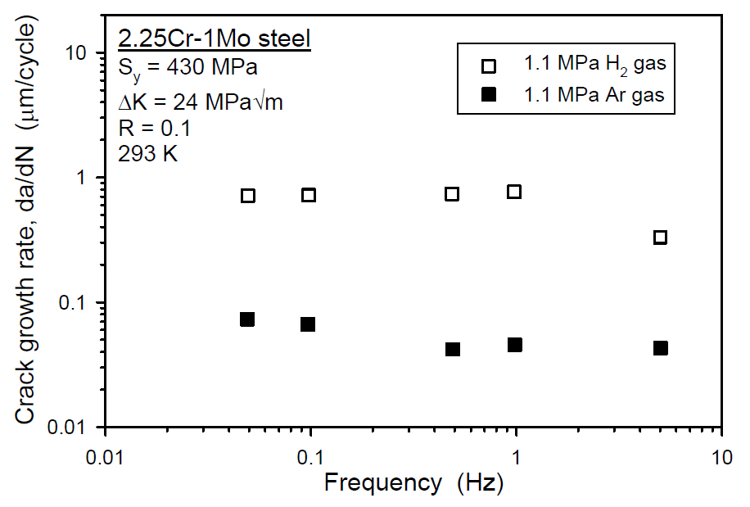
Hydrogen in carbon and low-alloyed steels
Poor compatibility of carbon and low-alloyed steels in H₂ environment
Decrease in tensile ductility particularly in the presence of stress concentration
Reduction in fracture toughness and cracks propagation resistance
Utilization in H2 environment shall be limited to very specific applications
[“Technical reference for hydrogen compatibility of materials”, 2012]

Slide 14
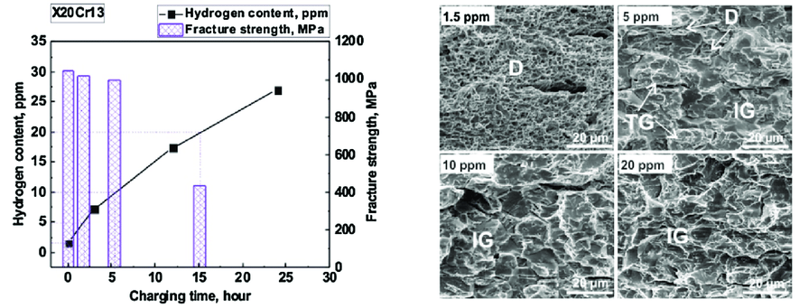
Hydrogen in ferritic and martensitic steels
Poor compatibility of ferritic/martensitic steels in H2 environment
Significant reduction in ductility (i.e., elongation and reduction of area) and stress-to-rupture
Martensitic steels worse than ferritic because of the high strength
Solution-annealed materials present less issues compared to precipitation hardened
[M. Djukic et al., ENGINEERING FRACTURE MECHANICS, 2019]

Slide 15
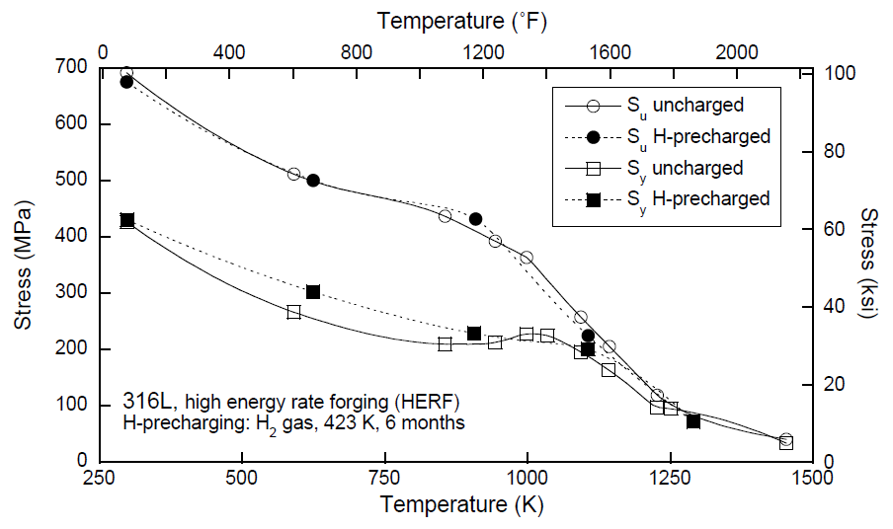
Hydrogen in austenitic and super-austenitic steels
Good compatibility of austenitic steels in H2 environment
Austenitic steels (e.g., 316, 321 and 347) presents high resistance to HE and/or HA
316(L) seems the best candidate because of Ni% and Mo% contents
Limited promising studies about super-austenitic steels (6Mo or F44) in H2 yet
[“Technical reference for hydrogen compatibility of materials”, 2012]

Slide 16
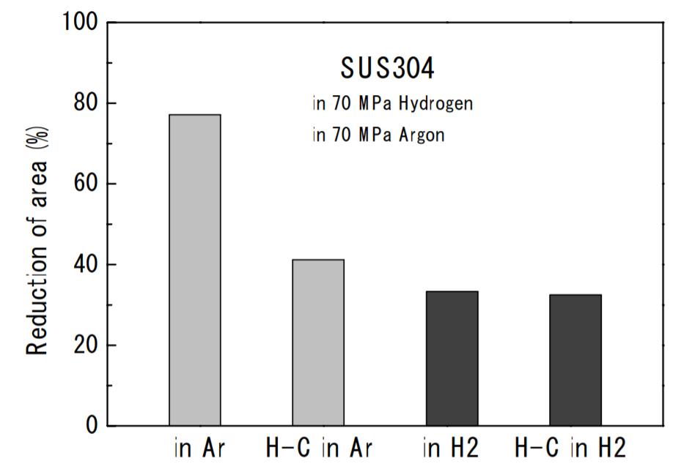
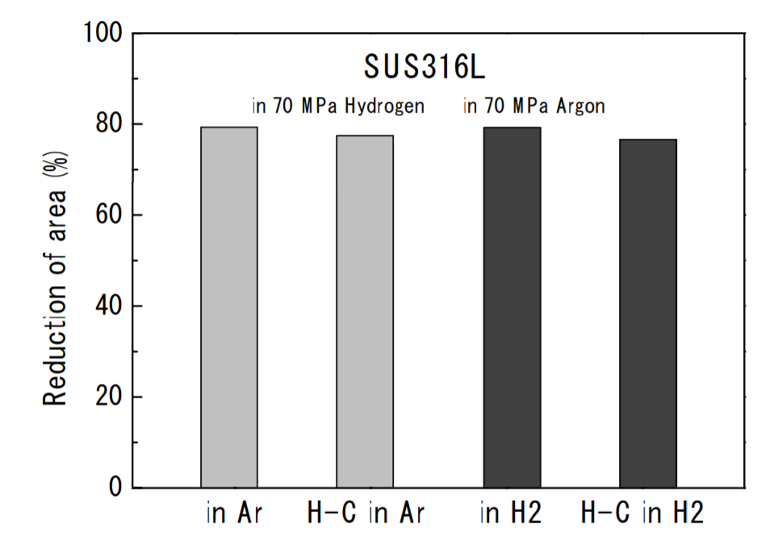
Hydrogen in austenitic and super-austenitic steels
Good compatibility of austenitic steels in H2 environment
Austenitic steels (e.g., 316, 321 and 347) presents high resistance to HE and/or HA
316(L) seems the best candidate because of Ni% and Mo% contents
Limited promising studies about super-austenitic steels (6Mo or F44) in H2 yet
[“Hydrogen Environment Embrittlement of Steels and Alloys”, 2007]

Slide 17
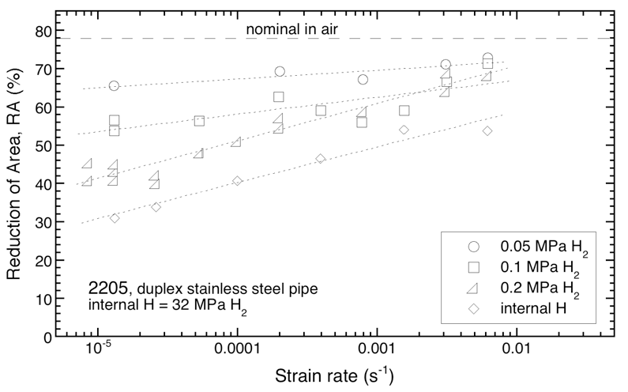
Hydrogen in duplex and super-duplex steels
Limited compatibility of duplex steels in H2 environment
Mixed response between ferritic (CONs) and austenitic (PROs) features
H2 compatibility increases with austenite-stabilizing elements content
Duplex steels are less prone to recovery because of the complex micro-structure
[“Technical reference for hydrogen compatibility of materials”, 2012]

Slide 18
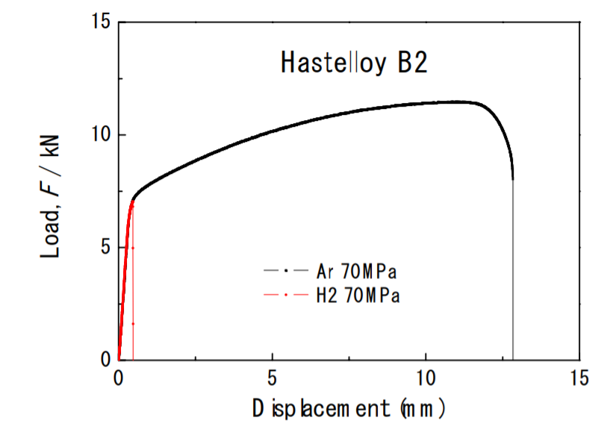
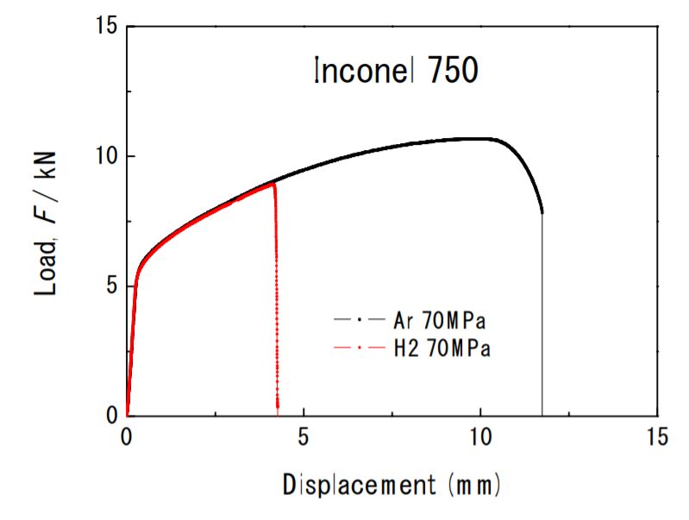
Ni-based alloys (Inconel and Hastelloy)
Extremely poor compatibility of Ni-based alloys in H₂ environment
Dramatic reduction in ductility and strength at any temperature level
Lesser degradation in solution-annealed materials (e.g., Inconel 625)
Unacceptable response in precipitation-hardened alloys (e.g., Inconel 718 or 725)
[“Hydrogen Environment Embrittlement of Steels and Alloys”, 2007]

Slide 19
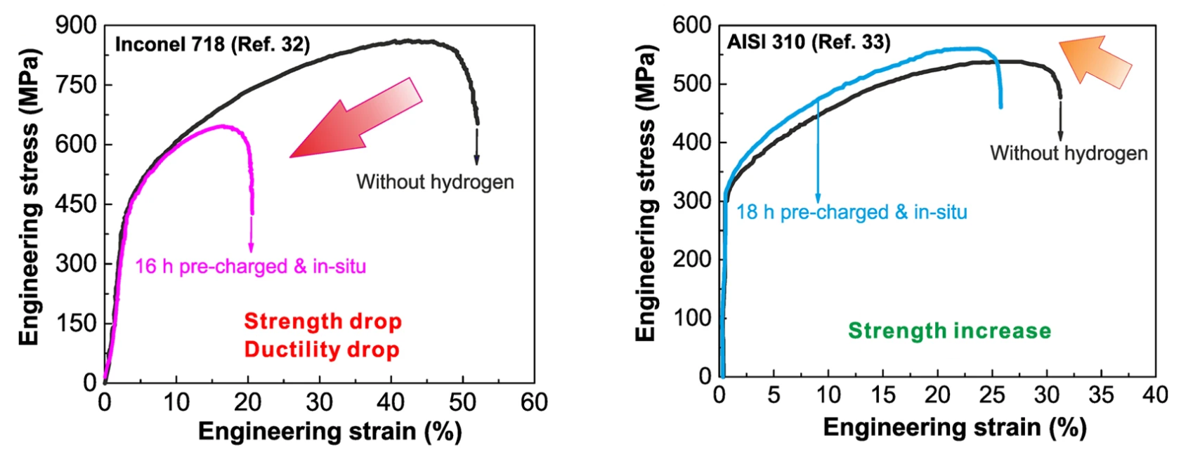
Ni-based alloys (Inconel and Hastelloy)
Extremely poor compatibility of Ni-based alloys in H₂ environment
Dramatic reduction in ductility and strength at any temperature level
Lesser degradation in solution-annealed materials (e.g., Inconel 625)
Unacceptable response in precipitation-hardened alloys (e.g., Inconel 718 or 725)
[H. Luo et al., SCIENTIFIC REPORTS, 2017]

Slide 20
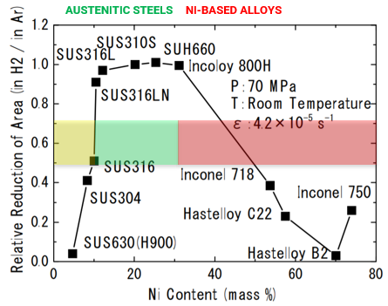
Ni-based alloys (Inconel and Hastelloy)
Extremely poor compatibility of Ni-based alloys in H₂ environment
Dramatic reduction in ductility and strength at any temperature level
Lesser degradation in solution-annealed materials (e.g., Inconel 625)
Unacceptable response in precipitation-hardened alloys (e.g., Inconel 718 or 725)
[“Hydrogen Environment Embrittlement of Steels and Alloys”, 2007]

Slide 21
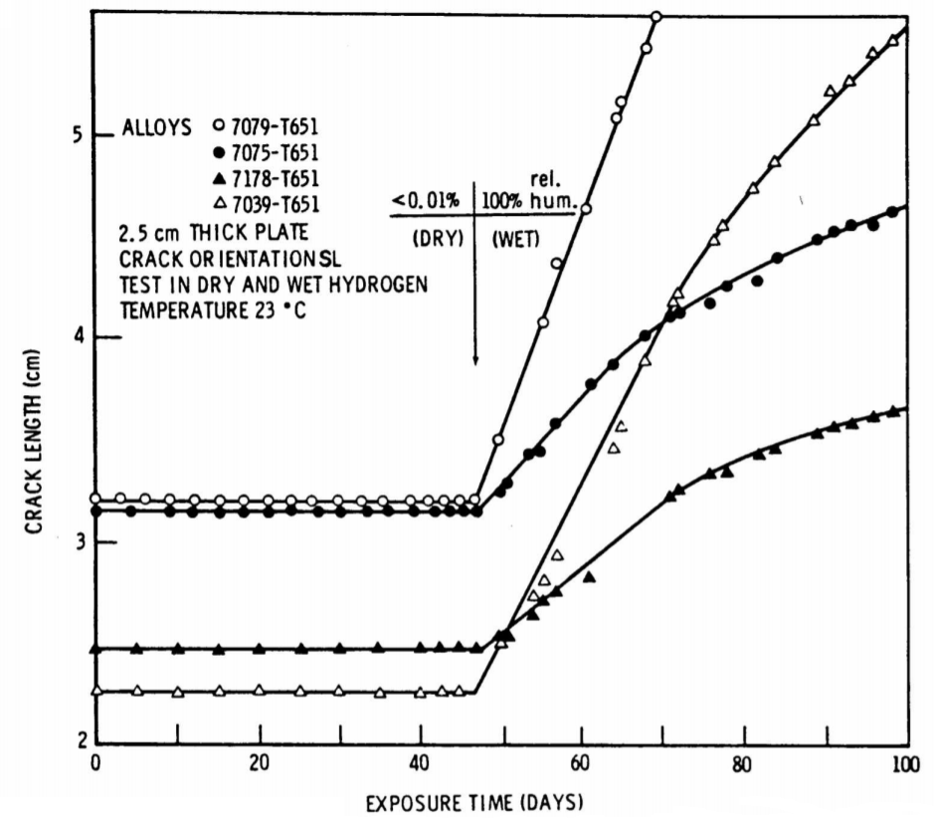
Other alloys (Al- and Cu-based materials)
Limited compatibility of Al- and Cu-based alloys in H2 environment
Al- and Cu-alloys are employed outside from the O&G
These alloys present good resistance versus pure H2 (no hydrogen embrittlement)
High sensitivity to contamination (degradation in presence of oxygen/water)
[“Hydrogen Embrittlement and Stress Corrosion Cracking”, 1984]

Slide 22
H₂ in polymeric elastomers
Critical compatibility of elastomers in H2 environment
Elastomers have high degree of “free volume” in their micro-structure
H2 uptake can be detrimental for elasticity and deformability in elastomers
Highly dense elastomers (HNBR, Viton, etc.) shall be preferred to avoid RGD
[Courtesy of Sandia National Laboratories, 2017]

Slide 23
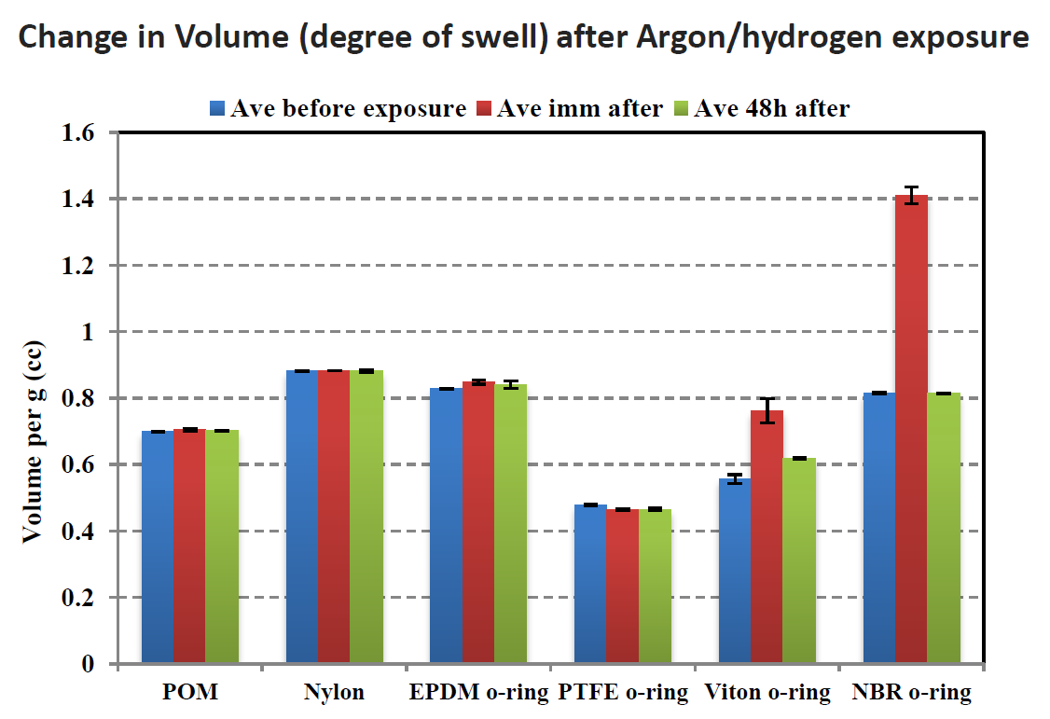
H₂ in polymeric thermo-plastics
Good compatibility of thermo-plastics in H₂ environment
Thermo-plastics present a denser and more rigid structure compared to elastomers
Inferior hydrogen uptake and limited gas swelling
PTFE- and PEEK-based polymers are extensively used for H₂ applications
[Courtesy of Sandia National Laboratories, 2017]

Slide 24
Innovative solutions
for H₂ applications

Slide 25
3D printing: an enabling technology for H₂
Superior compatibility of 3D printed 316L steel in H2 environment
316L by Selective Laser Melting (SLM) presents superior mechanical properties
The peculiar micro-structure of 3D printed 316L enhances its H2 resistance
An enabling material for the entire hydrogen value chain, from valves to electrochemical devices
​ | ASTM A182 316L​ | ASTM A182 F55​ | AM 316L MDS​ | Tested in Valland
Yield Strength [MPa]​ | ≥ 170​ | ≥ 550​ | 500 ± 30​ | 508 ± 33​
Ultimate Strength [MPa]​ | ≥ 485​ | ≥ 750​ | 590 ± 50​ | 594 ± 45​
Elongation [%]​ | ≥ 30​ | ≥ 25​ | 47 ± 7​ | 44,3 ± 7,8​
Area Reduction [%]​ | ≥ 50​ | ≥ 45​ | N/A​ | 70,4 ± 2,5​

Slide 26
3D printing: an enabling technology for H₂
Superior compatibility of 3D printed 316L steel in H2 environment
316L by Selective Laser Melting (SLM) presents superior mechanical properties
The peculiar micro-structure of 3D printed 316L enhances its H2 resistance
An enabling material for the entire hydrogen value chain, from valves to electrochemical devices

Slide 27
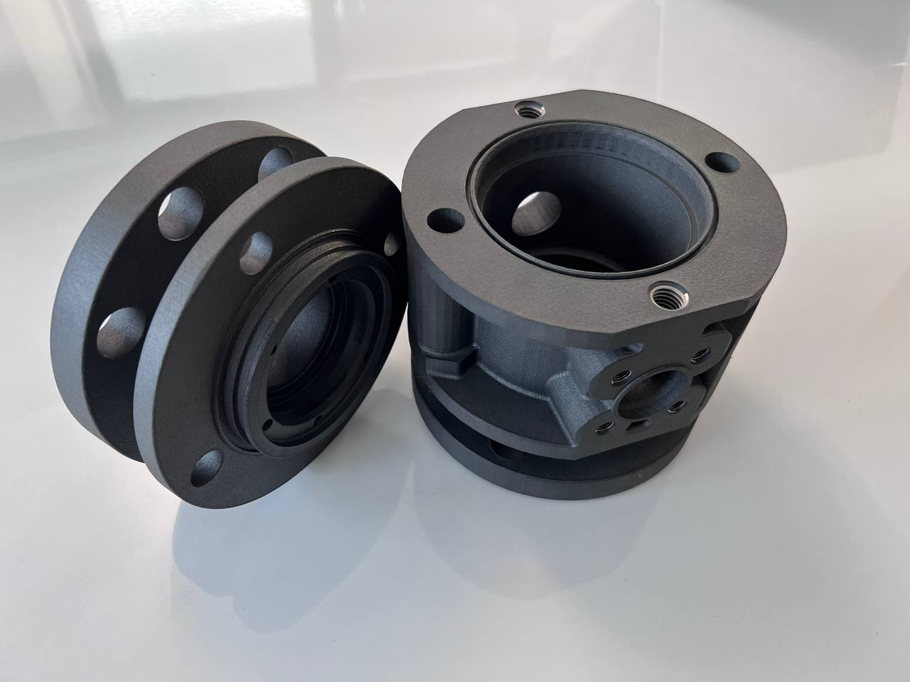
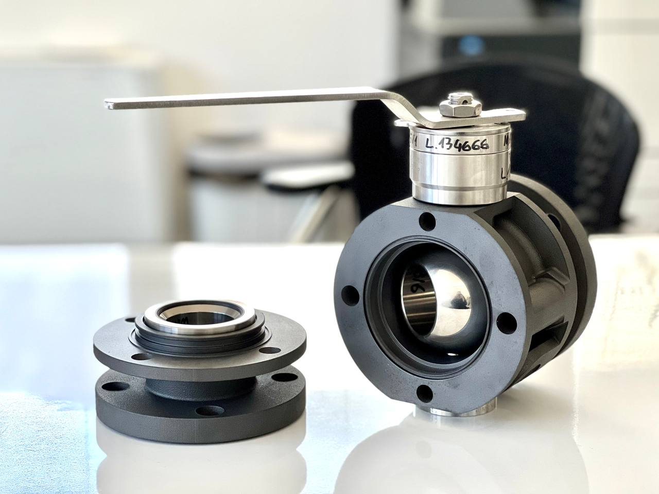
3D printing: an enabling technology for H₂
And when the operating conditions are not so severe… 3D printed plastic ball valve!
Technologically-relevant polymers for body and closure parts
Operating pressure up to 20 – 30 bar (above ASME B16.34 Class 150#)
Operating temperature from -19 °C to 60 °C

Slide 28
Q & A SESSION
ORGANIZERS
SCIENTIFIC COMMITTEE
Thank you for your attention!
IVS 2022
Technical Conference

