Slide 1





Philippe Burlot
ORGANIZERS
SCIENTIFIC COMMITTEE
R&D Engineer
A systematic approach for pre-validation of polymer spring-energised seals for critical valve applications
IVS 2022
Technical Conference

Slide 2
About
After a Ph.D on fracture mechanics on pipeline steel, Philippe joined Saing-Gobain Omniseal Solution in 2015 as an R&D Engineer.
He participated to the design evolutions and internal testing of seals for cryogenic applications, mostly for the energy sector.
He is currently the R&D expert on cryogenic and hydrogen applications at Saint-Gobain.

Slide 3
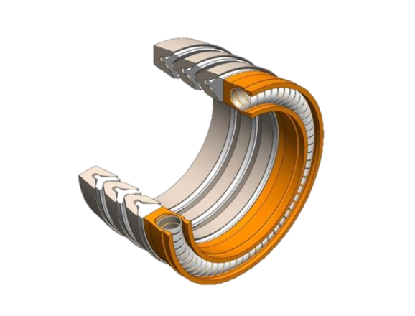
Spring energised seals in general
Simplified hardware design
Self-energised solution, no need to be compressed axially
Reduced length
No need for a secondary sealing arrangement
Low operating torques
Long life time

Slide 4
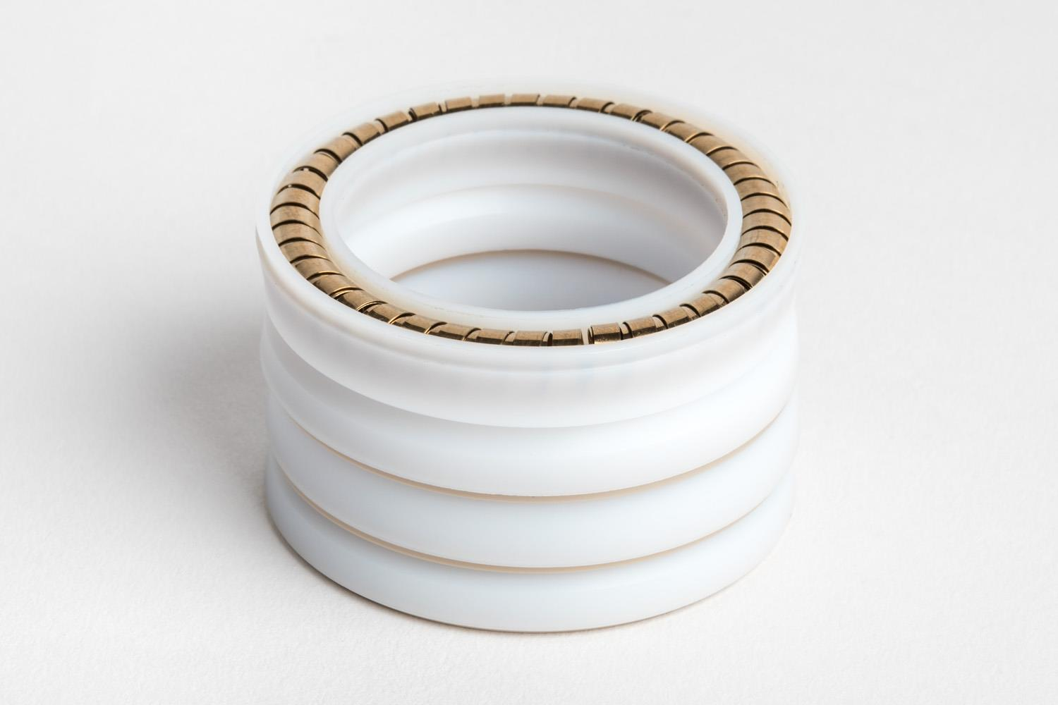
Compliance with ISO-15848-1 (2015) class AH – C01 from -50°C / +160°C (-58°F / +320°F)
Low-emission stem sealing solutions;
Project Scope:
  Temp: -50°C / +160°C (-50°F / +320°F)
  Pressure: up to #2500 (6000psi)
  Quarter-turn motion
  Endurance class ISO15848-1 CO1 (205 cycles) / SHELL MESC SPE 77-300
  Focus on Low Temperature tightness
There is a need for fundamental understanding of material behaviors and further design optimizations.
  Simulation (FEA)
  Internal mockup testing
  Basic understanding
  Qualification on real valve
Class BH stem sealing solution developed for quarter-turn valves (2014). There is an increasing demand for a Class AH solution.

Slide 5
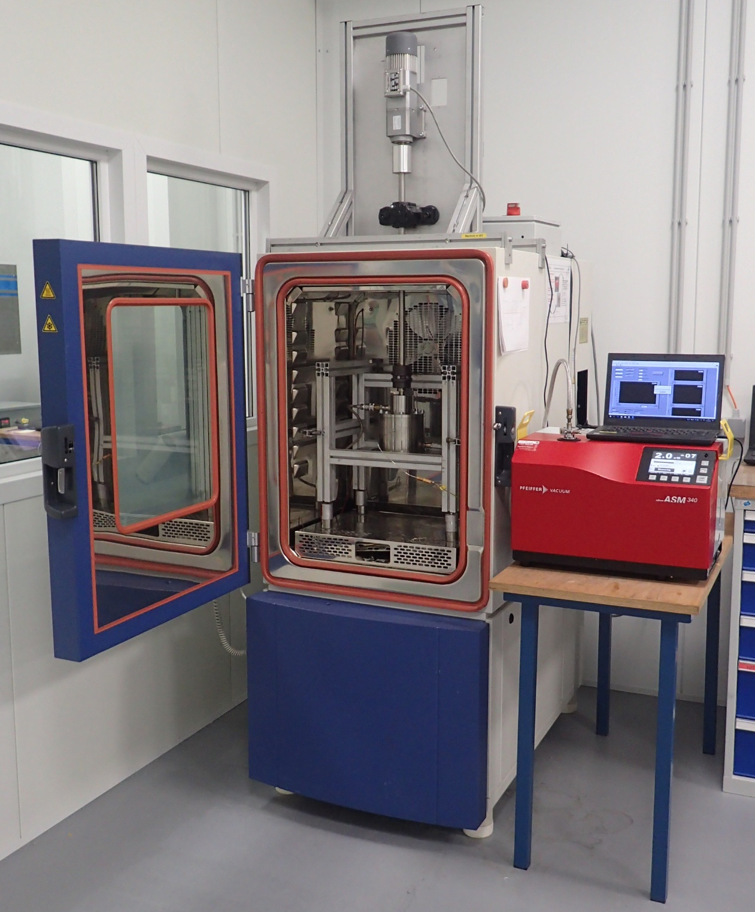
Internal testing capabilities ISO 15848-1 compliant:
Data acquisition:
  Leakage rate (full vacuum + mass spectrometer)
  Pressure
  Temperature
  Torque
Test parameters:
  Pressure: up to 100 bar (1500PSI) Helium
  Temperature: -50 °C (-58 °F) to +160 °C (320 °F)
  205 up to 2500 ¼ turn cycles
  Gland ID 34.8 mm (1.37”) x OD 46.0mm (1.81”)

Slide 6
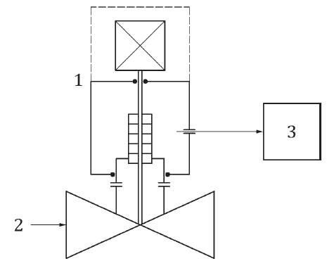
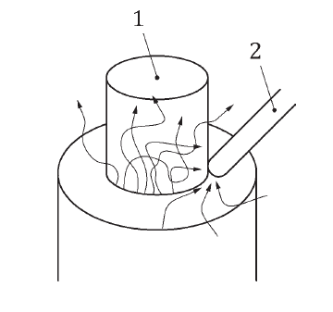
Class AH Measurement techniques used in ISO and SHELL spec
Leakage measurement of Helium:
  Helium is the 2nd smallest molecule to be sealed
  Accuracy of the measurement will depend on the measurement technique
  Two main methods to measure Helium leakage for class AH
Testing methods used to qualify valves for Fugitive Emissions
Vacuum method (ISO15848) | Sniffing Method (Shell MESC 77-300)

Slide 7

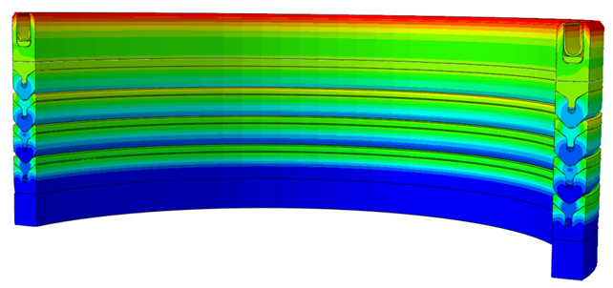

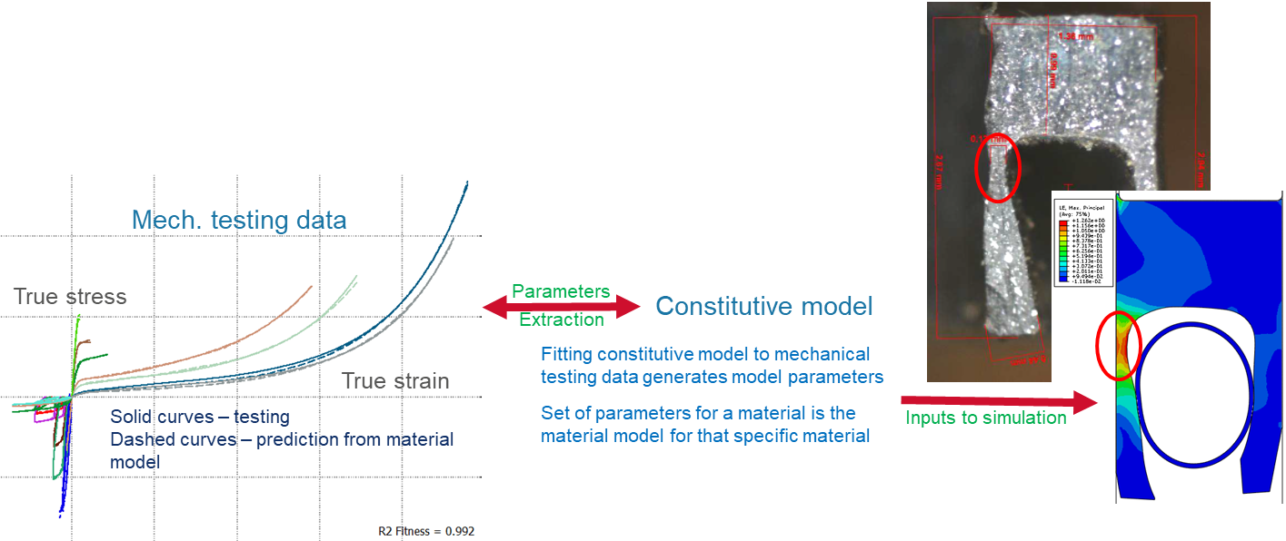
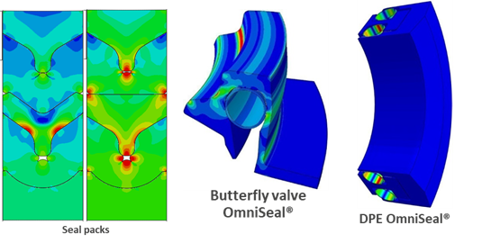
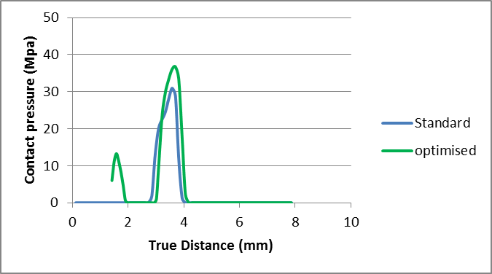
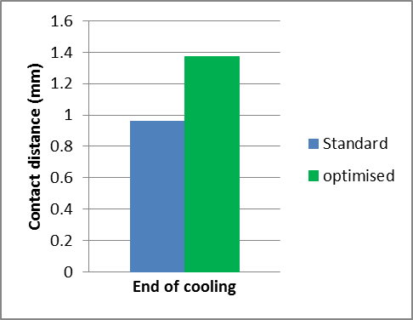
Solution development supported by Design Assessment Simulation
Simulation platform:
Advanced material constitutive models developed by Saint-Gobain:
  Viscoelastic
  Plastic
  Creep
  Relaxation
  Large deformation
FEA design optimization:
  Optimization of contact length and load distribution as a function of pressure and temperature

Slide 8
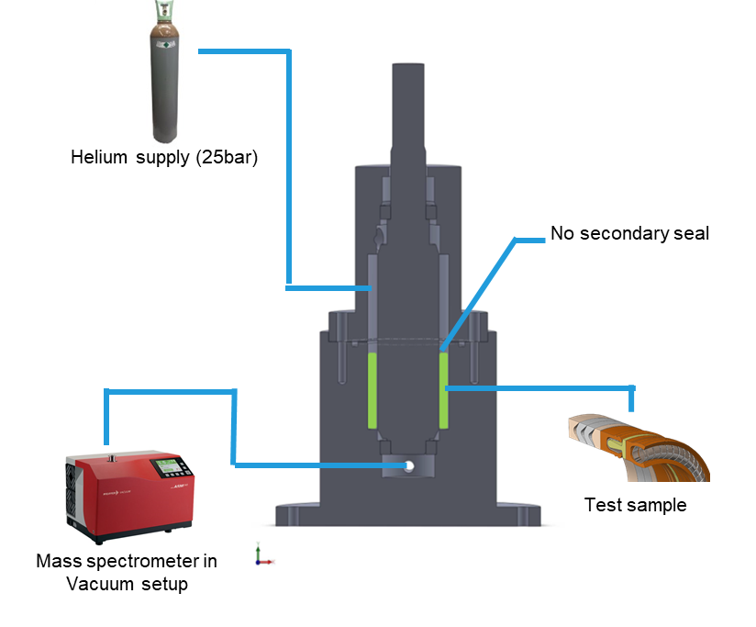
ISO 15848-1 class AH stem sealing solution tested on mock-up
CO1/160°C/25bar He
  Gland ID 34.8 mm (1.37”) x OD 46.0mm (1.81”)
  Stem and gland roughness +- 0.2µRa

Slide 9
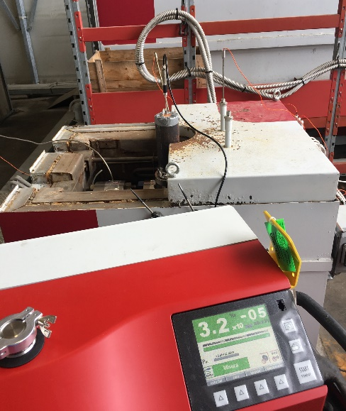
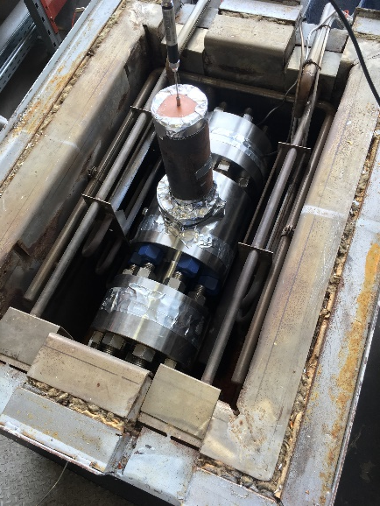
Third-party testing on TMBV 10 #1500 to SHELL MESC SPE 77-300
Test sequence | Conditions | Pressure | Measured leakage rate (mbar.l/s) | Acceptance criteria for FE stem seal SPE 77-300 Table C.7 & C.9 Stem dia = 81.80 mm | Performance level
1 | RT Static | 250 bar | 2.00 E-06 | Class A ≤ 1.46 E-05 mbar.l/sec.mm Tightness classes for helium expressed in atm.cm3/s are equivalent to 1.013 mbar.l/s per mm of stem external diameter | CLASS A
2 | RT Dynamic 17 cycles | 250bar | 2.00 E-06 |  | CLASS A
3 | - 196°C Static | 250 bar | 5.45 E-06 |  | CLASS A
4 | - 196°C Dynamic 17 cycles | 250 bar | 6.87 E-06 |  | CLASS A
5 | - 80°C Static | 250 bar | 2.00 E-06 |  | CLASS A
6 | - 80°C Dynamic 17 cycles | 250 bar | 2.48 E-06 |  | CLASS A
7 | RT Static | 250 bar | 2.00 E-06 |  | CLASS A
8 | RT Dynamic 17 cycles | 250 bar | 2.61 E-06 |  | CLASS A

Slide 10
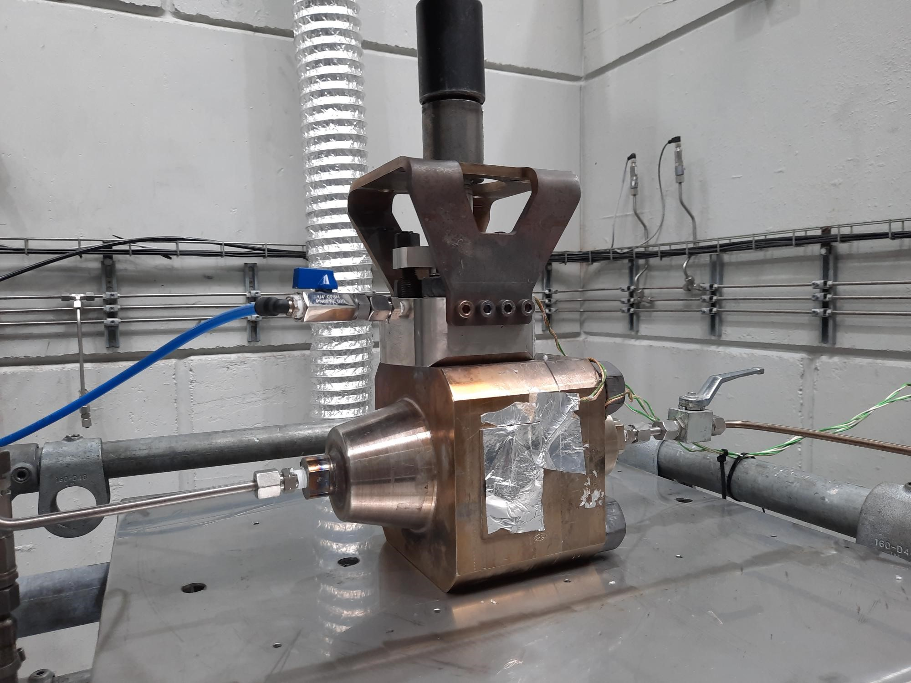
Third-party testing on TMBV 2” #1500 to ISO15848-1
Descrition | Test Conditions | Scope | Status
Stem diameter | 30mm | 15mm up to 60mm | -
Stem motion | Quarter turn | Quarter turn | -
Pressure class | #1500 | #1500 or below | -
Endurance class | CO1 | CO1 | -
T° class | t-46°C | -46°C up to +40°C | Successful Certification completed
 | t+200°C | +40°C up to +200°C | Work in progress this time
Tightness class | AH | AH or less stringent
Fig. 7 ISO15848-1 Qualification Certificate issued by ITIS B.V.

Slide 11
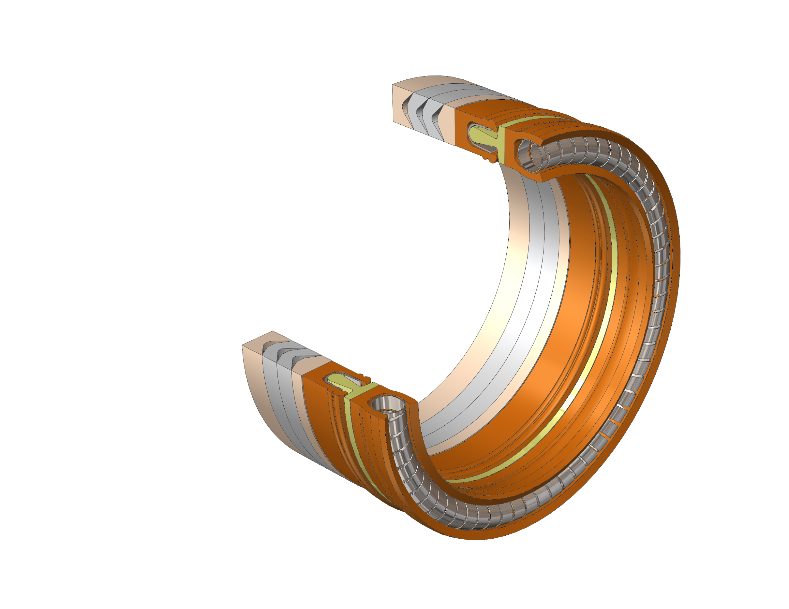
OmniSeal® compliant with ISO 15848-1 class AH leakage requirement
Backup element
T-spacer
Backup element
Secondary Jacket
Primary Jacket
Multiple Sealing elements

Slide 12
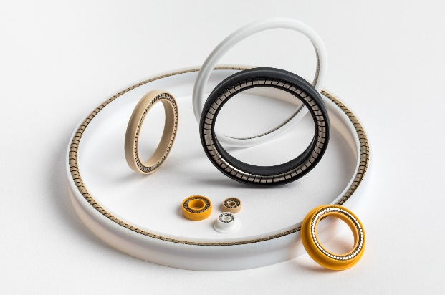
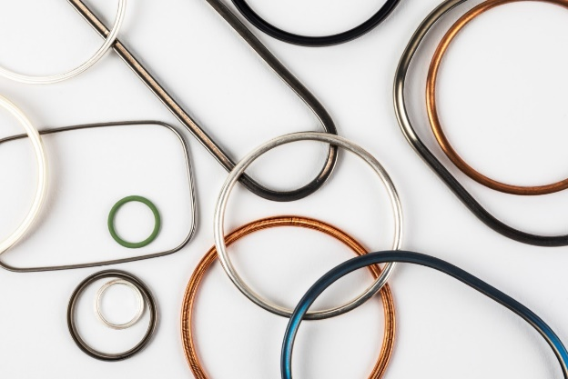

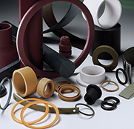
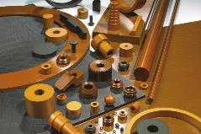
Our Sealing & Material solutions for Hydrogen Piping & Valves
OMNISEAL® POLYMER SEALS
OMNISEAL® METAL SEALS
150 MPa
90 MPa
Not affected by RGD
Controlled friction
Low heat generation
Wide P/T range from Cryo up to +100MPa
Not affected by RGD
Extreme low leakage
Chemical inertness
Wide P/T range from Cryo up to +100MPa
RULON® FLUOROPOLYMERS
MELDIN® THERMOPLASTICS
0 MPa
LH2
-253°C
-423°F
-40°C
-40°F
H2
+140°C
284°F
Dimensional stability
Creep resistance
Low heat generation
Chemical resistance to KOH solutions
Excellent tribologic performance in H2/LH2
Low hear generation
Able to cope with extreme pressure
Precision Sealing & Material Solutions
11

Slide 13
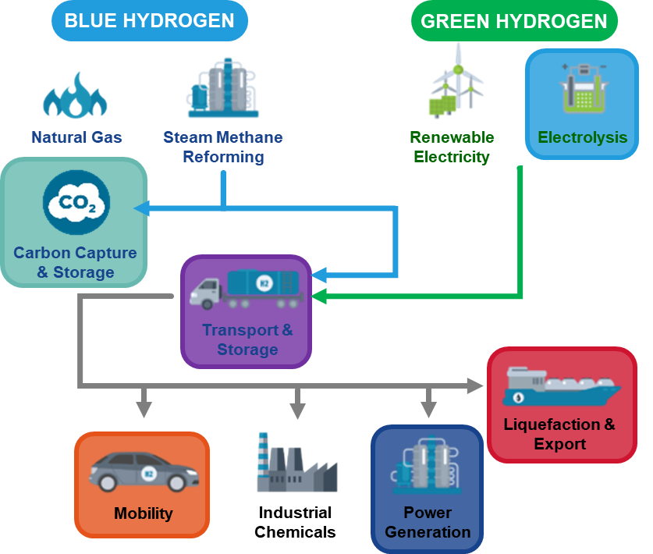


Our H2/LH2 material test campain
H2/LH2 extensive material test campaign aiming at generate data and gain knowledge about our polymer materials
Our Metal & Polymer Sealing Solutions for the whole H2 value Chain
2021
2022
Tribology H2 / LH2
H2 permeation & RGD up to 70MPa
Tensile tests & CTE down to 4°K
EN13555 Creep relaxation tests
H2 diffusion, volume change up to 90MPa
We participate to several strategic standardization initiatives
Passive member of Hydrogen Europe and registered in 7 WGs to kick-off in 2022
Active member of CEN/TC 69/WG 19 - Valves for hydrogen applications and networks

Slide 14
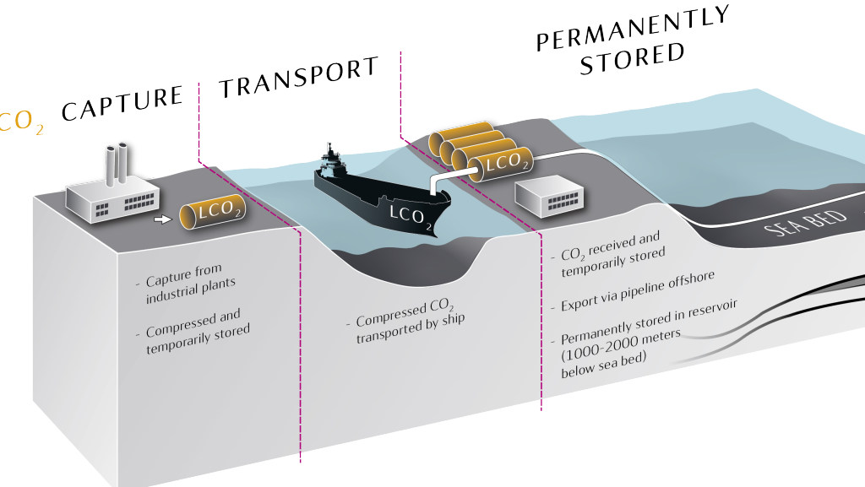
Our 100% CO₂ I3P certification of proprietary Fluorpolymers
In partnership with an Energy major, we completed 100% CO₂ certification that consisted of a bespoke immersion testing in compliance with the pass/fail criteria of Norsok M-710 Ed.3
Test conditions :
  100% CO₂ (liquid & super-critical)
  345 bar
  -46 / RT / 97°C / 127°C
All materials passed successfully :
  Proprietary Custom PTFE Fluoroloy® A02, A10, A16, A19 , A21
  Proprietary Custom FEP Fluoroloy® A20
  Proprietary Ekonol-filled PTFE Fluoroloy® A08
  Proprietary Custom UHMW-PE Fluoroloy® A09
  Proprietary Custom PEEK Meldin® 5301
Required for Carbon Capture & Storage projects
Image courtesy from Equinor
Valves & Wellheads
100% CO₂ / up to 350 bar / from -30°C to 130°C
Liquid CO₂ loading & unloading
100% CO₂ / 15 bar & -30°C (design 48 bar / -46°C)

Slide 15

Q & A SESSION
ORGANIZERS
SCIENTIFIC COMMITTEE
Thank you for your attention!
IVS 2022
Technical Conference

