Slide 1
David Greeson
ORGANIZERS
SCIENTIFIC COMMITTEE
President, Proven Project Development Group
Carbon Capture Utilization
and Storage:
a practical guideline to CCUS
IVS 2022
Technical Conference

Slide 2
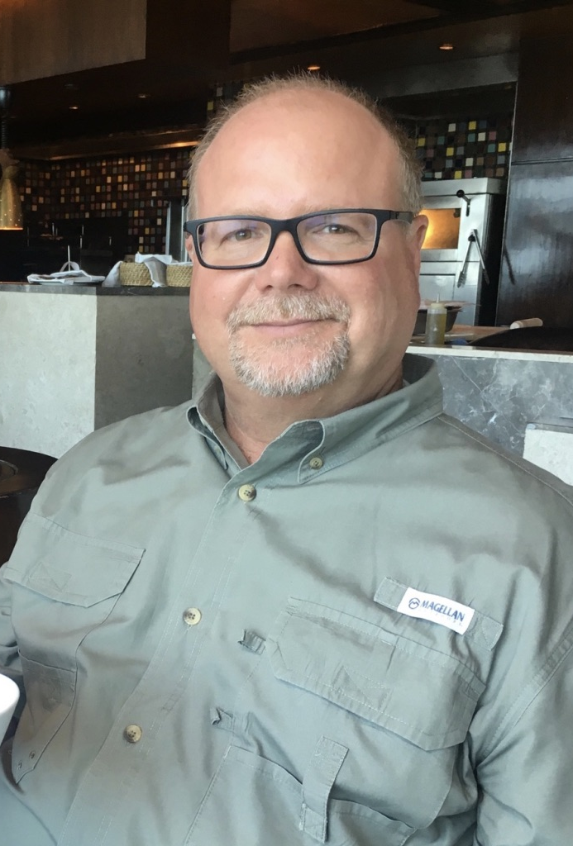
Biography
David Greeson
Advising process industries and electric utilities in developing CCUS projects to decarbonize fossil fuels.
Developed developed the Petra Nova Carbon Capture project from inception through commissioning.
Over 40 years experience with electric utilities and independent power companies. Developed 4 major power stations in the USA.
David@davidgreeson.com
+1 281 220 7623

Slide 3
We need CCUS
Fossil fuels are not the problem - carbon dioxide is the issue. We use technology to solve problems in medicine, manufacturing, agriculture, etc. and technology is the solution for managing the cabon doxide from fossil fuels. It is morally wrong to deny the billions of people on this plant who do not have acces to the affordable, reliable, and life-saving energy that can be produced from fossil fuels. It is incumbent on the industrialized nations of the world to develop and improve the technologies that provide a pathway out of energy poverty for these people.

Slide 4
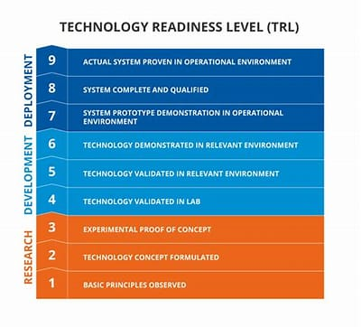
Industrial carbon capture technologies
Stages of technical readiness (Technology Readiness Level, AKA “TRL”)
Many technologies – few are at TRL 9
Caution when talking about “Carbon Utilization”
Volume is the challenge
Caution when relying on TRL
TRL makes no judgement on ability to actually reduce CO2 emissions
Life Cycle Analysis (”LCA”) perspective not considered
See also:
Technology Readiness and Costs of CCS by Kearns, Liu, and Consoli
https://www.globalccsinstitute.com/wp-content/uploads/2021/03/Technology-Readiness-and-Costs-for-CCS-2021-1.pdf

Slide 5
Technology providers are making progress
Commercially ready – in cost optimization phase:
Liquid amine
Cryogenic
Near ready – addressing with real world conditions at scale:
Solid adsorbents
Membranes
Direct Air Capture
Utilization - working on scale and costs in commodity markets:
mineralization – cement products
conversion – catalytic-based for fuels and petrochemicals
photosynthesis – algae to food protein or plastics

Slide 6
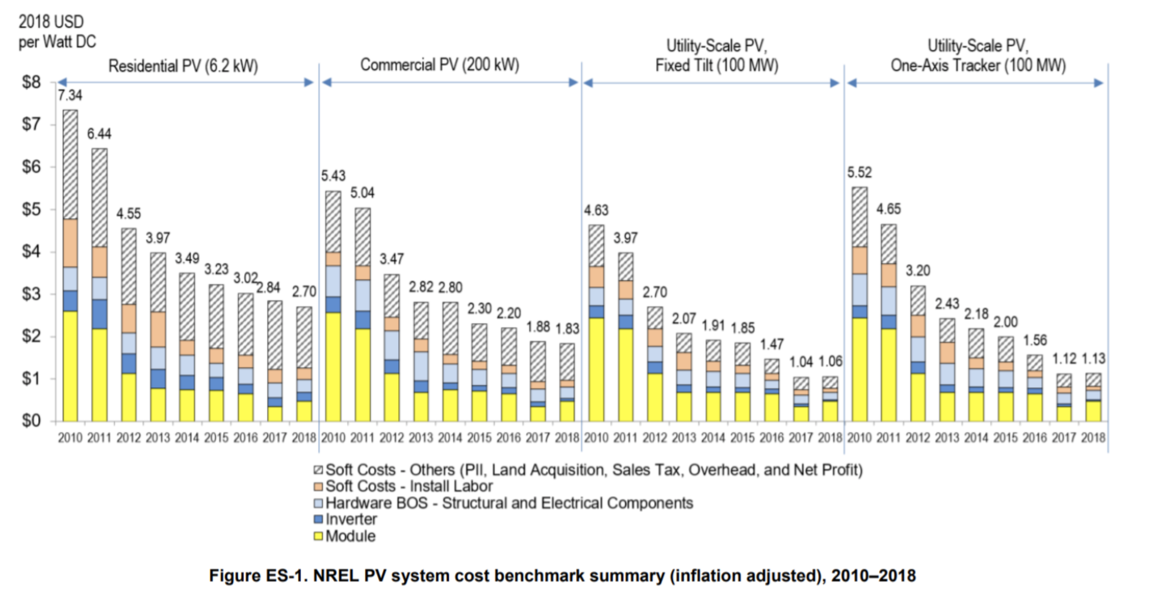
CCS cost should come down
Solar technology was not even close to economic just 10 years ago
Today, costs are close to the value of intermittent power
Source: Solar Energy Cost Trends Over Time by Ryan Austin
https://earthtechling.com/solar-energy-costs-trends/

Slide 7
What are the Economics of Carbon Capture?
Capital (“CapEx”) – what does it cost to build a capture system?
Operations Costs (“OpEx”) – what does it cost to capture a metric ton (“tonne”) of CO₂?

Slide 8
CapEx is a Function of CO₂ Concentration
Cost per tonne of of flue gas processed per day is ~ $9,000 in all cases

Slide 9
Operating Costs driven by physics
Liquid amine is Temperature Swing Absorption (“TSA”) process
Absorption at low temp (requires cooling)
De-sorption at high temp (requires heating)
Circulation from low temp to high temp areas (requires pumping)
Liquefaction and dehydration for shipping (requires compression)
Ratios are independent of volume
Steam per tonne
Power per tonne
Solvent consumption per tonne
process water per tonne
etc. per tonne

Slide 10
Geologic storage – large-scale, permanent
Saline formation – at or near TRL-9
demonstrated secure
good candidates on all continents
massive volumes for significant impact
Enhanced oil recovery (“EOR”) – TRL-9 for over 40 years
demonstrated secure
good candidates in many locations (on-shore oil fields)
massive volumes for significant impact
economic value and displaces oil produced without CO₂ storage
Storing CO₂ in sandstone is like injecting water into a sponge

Slide 11
Petra Nova successful demonstration
First three years of operations typical of a
first of a kind (“FOAK”)
scale-up

Slide 12
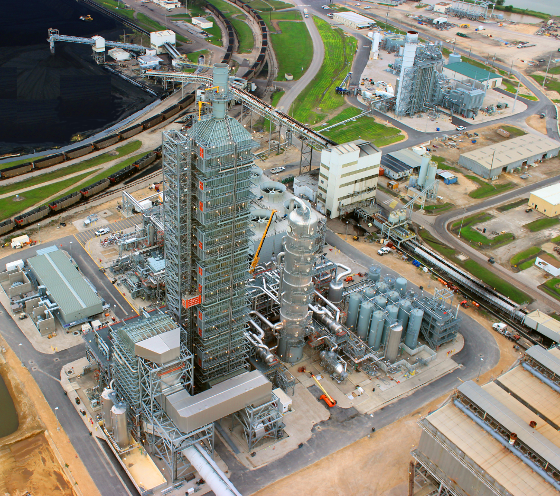
Regenerator
Petra Nova site photo
Cogeneration
(steam & power)
Absorber
CO₂ Pipeline
Petra Nova
Carbon Capture
Site
Compressor
Quencher
Flue Duct

Slide 13
Petra Nova Current Status
Project to demonstrate CCS at industrial scale was very successful
Constructed on-time in 30 months
Completed under budget
Performance exceeded guarantees
The enhanced oil recovery (“EOR”) project was not a profitable as expected
Production was 50% of expected
Oil price was less than half of forward projection
After the 3-year demonstration period – commercial decision to suspend
New low-carbon programs in the USA have owners working on re-start

Slide 14
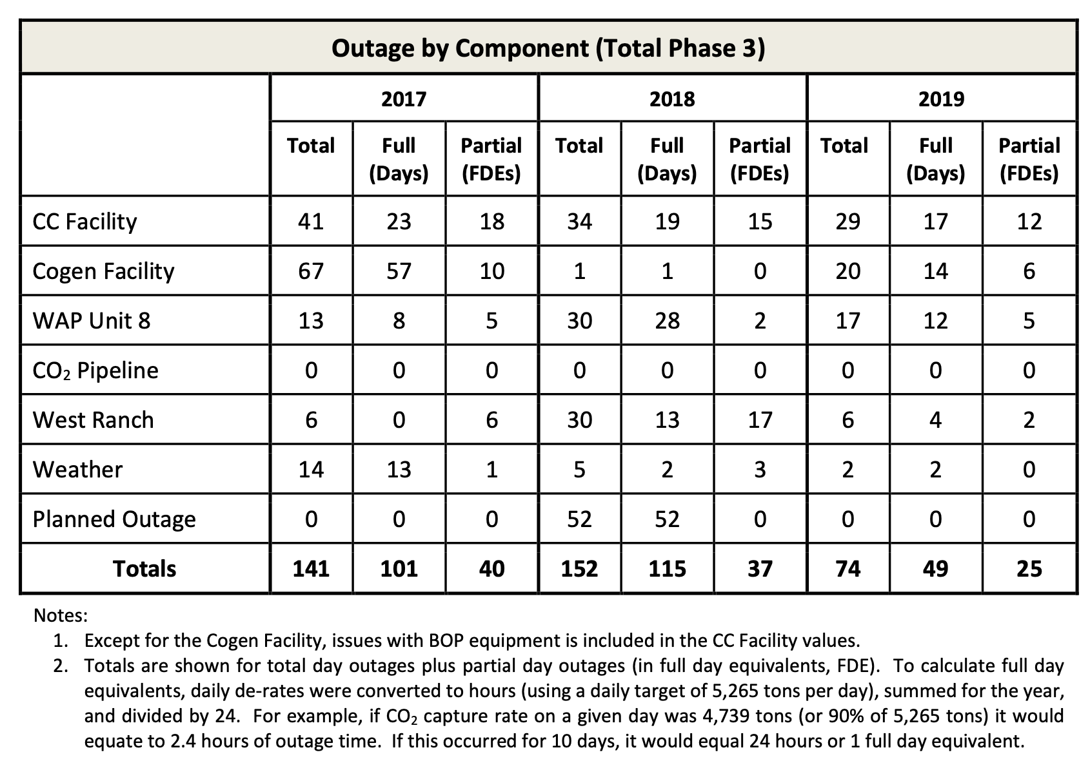
Petra Nova Operating Record
By the 3rd year
Carbon Capture achieved
90+% online factor
Source:
W.A. Parish Post-Combustion CO2 Capture and Sequestration Demonstration Project
DOE Award Number DE-FE0003311
Final Scientific/Technical Report
March 31, 2020

Slide 15
CCS Cost Differ
Tundra costs are close to $50/tonne
Ethanol has lower costs
and
higher revenue opportunity
Sources:
Costs from National Petroleum Council report “Meeting the Dual Challenge” 2019
LCFS amount from California Air Resources Board Weekly LCFS Credit Transfer Activity Report 12th April 2021 – 18th April 2021

Slide 16
Q & A SESSION
ORGANIZERS
SCIENTIFIC COMMITTEE
Thank you for your attention!
IVS 2022
Technical Conference

