Slide 1
NICK GRAY
ORGANIZERS
SCIENTIFIC COMMITTEE
Head of Engineering and Quality at Shipham Valves
Selection and Application of Nickel Aluminium Bronze Isolation Valves
IVS 2022
Technical Conference

Slide 2
Biography
Nick Gray is Head of Engineering and Quality at Shipham Valves and helps EPC’s, End-users and other valve users with the specification and customisation of valves to suit even the most bespoke of applications.
Before becoming Head of Engineering and Quality, Nick spent over 10 years working in various roles for a number of Valve manufacturers. During this time he gained a Master’s Degree in the field of ball valve seat development and design. His expertise primarily lies within the design of valves and their application to specific situations through the selection of materials and features.
Nick is available for supporing any quieries with regards to product selection. Nick can be reached at Nick.Gray@shiphamvalves.com

Slide 3
Selection and Application of Nickel Aluminium Bronze Isolation Valves
Nickel Aluminium Bronze typically finds use in applications where seawater or brine is present; providing a long service life far exceeding that of rubber-lined or ferrous based steel valves used on the same service.
The whole-life cost of using a Nickel Aluminium Bronze valve in seawater applications is economically superior to other solutions, when considering additional inspection, maintenance and service costs and that of whole valve replacement, typically required when other solutions are adopted.
Nickel Aluminium Bronze may not enjoy the notoriety of other materials; this presentation contains information which can assist in the correct selection and application of valves manufactured from Nickel Aluminium Bronze.

Slide 4
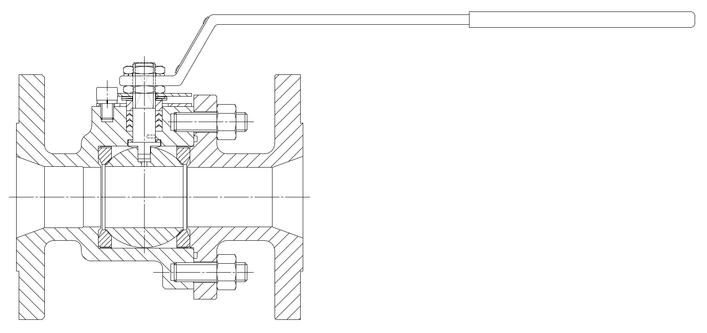
Valve Size
Valve and pipe / system sizing must consider a maximum fluid velocity of 4.3m.s⁻¹.
Above the limit of 4.3m.s⁻¹ there is a danger of on-setting erosion of the self-repairing protective surface film (oxide layer) on the material surface.
The velocity limit is applicable to both full and reduced bore valves; the increase in velocity in the reduced bore section of the valve is also limited to 4.3m.s⁻¹

Slide 5
Temperature Limits
-196°C is possible without impact testing – ASME B31.3 Process Piping, Table 323.2.2.
Temperature Range across which ASTM B148 C95800 may be used.
-196°C
Temperature Range
+325°C

Slide 6
Corrosion Resistance and Chemical Compatibility
High resistance to ammonia stress corrosion and immune to Chloride stress cracking;
Resists biofouling (accumulations of barnacles and algae);
Heat-treated – better corrosion resistance;
Most suitable for use with:
● Acetic Acid | ● Nitric Acid
● Alkalis | ● Phosphoric Acid
● Calcium Hypochlorite | ● Seawater
● Hydrochloric Acid | ● Sodium Hypochlorite
● Hydrofluoric Acid

Slide 7
Valve Type
Isolation Valves |  | Check Valves |  | Flow Control
Valve Type | Design Std. | Valve Type | Design Std. | Valve Type | Design Std.
Ball | BS 5351, ISO 17292 & API 6D | Swing-Check | BS 1868, BS 5154 & API 6D | Butterfly | API 609
Butterfly | API 609 | Dual-Plate Check | API 594 | Globe | API 623, ASME B16.24 & BS 5154
Gate | API 600, ASME B16.24, BS 5154, EN 12288 & MSS SP-80 | Lift-Check | BS 5154, MSS SP-80 | - | -
Globe | API 623, ASME B16.24 & BS 5154 | SDNR Globe | ASME B16.24 & BS 5154 | - | -

Slide 8
Pressure Class Determination
Nickel Aluminium Bronze typically used at ASME Class 150, Class 300 & Class 600 pressure ratings;
ASME B16.24 & ASME B16.34 methods P-T determination methods used.
B148 C95800 against A216 'WCB'
800
700
600
500
Working Pressure / psig
400
300
200
100
0
0
50
100
150
200
250
300
350
400
450
500
Temperature /
°
F
Class 150
Class 300
'WCB' Class 150
'WCB' Class 300

Slide 9
Trim Material Selection
Nickel Aluminium Bronze Trim
Monel® Trim
Valve Type | Obturator Material | Shaft / Stem Material
Ball Valve | Ball: ASTM B148 C95800¹ | Shaft: ASTM B150 C63200
Butterfly Valve | Disc: ASTM B148 C95800 | Shaft: ASTM B150 C63200
Gate Valve | Wedge: ASTM B148 C95800 | Stem: ASTM B150 C63200
Globe Valve | Disc: ASTM B148 C95800 | Stem ASTM B150 C63200
Check Valve | Disc: ASTM B148 C95800 | Pin: ASTM B150 C63200
Notes: ¹Valves NPS 4 and below typically have a ball manufactured from equivalent bar material
Valve Type | Obturator Material | Shaft / Stem Material
Ball Valve | Ball: ASTM A494 M 35-1¹ | Shaft: ASTM B865 N05500
Butterfly Valve | Disc: ASTM B148 C95800 | Shaft: ASTM B865 N05500
Gate Valve | Wedge: ASTM A494 M 35-1 | Stem: ASTM B865 N05500
Globe Valve | Disc: ASTM A494 M 35-1 | Stem ASTM B865 N05500
Check Valve | Disc: ASTM A494 M 35-1 | Pin: ASTM B865 N05500
Notes: ¹Valves NPS 4 and below typically have a ball manufactured from equivalent bar material

Slide 10
Packing / Gasket Selection
Selection of these materials should be consistent i.e. packing and gaskets should be the same material(s)
2 Main material options:
PTFE
Chemically inert
Available as flat gaskets and braided packing rings
Wide operating Temperature range
Available as WRAS approved
Graphite
Chemically inert
Available as flat gaskets and braided packing rings
Extremely wide operating temperature range
Suitable for Firesafe products
Additives used to remove galvanic corrosion potential

Slide 11
Bolting Selection
Recommendation is to use Nickel Aluminium Bolting (ASTM B150 C63000 HR50) as per ASME B16.24.
Suitable for Saline Environments
Same base material as valve (no differential thermal expansion or material strength)
More costly than Steel bolting but expected lifetime is 25-30+ years in service
Where Ferrous bolting is specified ASTM A193 B7 / ASTM A194 2H shall be used.
Bolting must be coated – coating life dependant on damage
Strength ratio to Nickel Aluminium Bronze threaded holes acceptable
Not suitable for Saline Environments

Slide 12
Q & A SESSION
ORGANIZERS
SCIENTIFIC COMMITTEE
Thank you for your attention!
IVS 2022
Technical Conference

